Slide 1
Faith, Science, and the Genesis Creation
Notes:
It was a warm summer evening. Two people were walking along the beach listening to the gentle lapping of the waves and looking at the star-studded sky. They both spotted a light flashing out at sea. One of them was a professor of physics, the kind of scientist who thought of nothing but his work. Science was his life. He rushed to his car where, being the sort of person he was, he kept all kinds of scientific equipment. He got out a stopwatch and timed the flashes. He got out a photometer and measured the brightness of the flashes. He set up a spectrometer and recorded their spectrum. He noted the position of the light against the background stars. As he drove home along the coast road he stopped a couple of times and noted its position again as it appeared to move against the background stars, and did some triangulation calculations on his laptop. When he got home his wife said, ‘You look excited dear, did you see something interesting tonight?’ ‘Yes,’ he said, ‘I saw what I deduced was a heated tungsten filament, enclosed in a silica envelope, emitting a regular pattern of flashes of visible radiation at an intensity of 2,500 lumens from a distance of about 850 metres offshore.’
The other person on the beach that night was a teenager going home from Sea Scouts. When she got home her mother said, ‘You look excited dear, did you see something interesting tonight?’ ‘Yes,’ she said, ‘I saw a boat signaling SOS. I phoned the Coastguard, and they sent out the lifeboat.’
This ‘parable’ illustrates the fact that the same event may have more than one level of explanation. Science, by the very methods which it uses, is restricted to the study of material things - matter and energy - and so its explanations are always expressed in materialistic terms. As a result it explains the mechanisms of nature - in the parable, how the flashing light was produced. It cannot answer questions about meaning and purpose - in the parable, why someone was shining the light and the message it carried. The how and the why. The scientific explanation could only go as far back as the tungsten lamp (the secondary cause). It couldn’t get back behind it to the mind of the person using it (the primary cause).
Lucas, E (2004, May 13). Science and the Bible: Are they incompatible?. Lecture presented at The Faraday Institute for Science and Religion, St. Edmund’s College, Cambridge.

Slide 2
“Let science dig, and dredge, and work her laboratories. She is searching for God’s truth. If her teachers are atheistic, accept still the truth that is well established; but to the atheism give no quarter, for it is to Man the annihilation of hope and of all the higher joys of his being.”
James Dana (1813-1895) - American Geologist, Mineralist, Zoologist, Yale Professor, and Christian Minister
Notes:
I want to start with this quote from a well-respected 19th century Christian scientist who lived during the origin of the current science/faith controversy. A large portion of this presentation considers this time period and the impact it had on emerging science and Christianity. Hopefully through contemplating this impact we may gain insight into how to equip ourselves to deal with modern struggles between science and our faith.
The above quote sums up well how I view science, how I plan to present this series of talks, and how I hope all of you begin to view science (if you don’t already) as you move through some very trying years of life. You all are in the middle of a transition within our community, whether or not you are aware of it just yet. It is no longer intellectual honest to engage science – and especially evolution – as our community has in the past 40 years or so. There has been far too much advancement… especially with the rise of genetics, the mapping of the human genome, and the discoveries within paleoarchaelogy and anthropology, for us to resort to the poor arguments against science that we all too often hear from our platforms and read in our publications.
If that sounds a bit ominous, I also want to share with you the refreshing ways our pioneering brethren engaged the relevant science of their day, with the goal of showing that historic Christadelphia viewed science favorably, treated it with the utmost respect, and actually adjusted their interpretations of some key scriptural passages because of what the science of the day was showing them. So, what I’m presenting here isn’t some fringe position… it has solid historical significance within our community.

Slide 3
Pew Research Center (2009):
More than half of the public (55%) says that science and religion are “often in conflict.” Close to four-in-ten (38%) take the opposite view that science and religion are “mostly compatible.”
Yet the balance is reversed when people are asked about science’s compatibility with their own religious beliefs. Only 36% say science sometimes conflicts with their own religious beliefs and six-in-ten (61%) say it does not.
Notes:
Although the idea that science and religion are in “conflict” is widely considered true, the conflict itself is not so easy to nail down. David Livingstone, a noted historian of science, summarizes it as a perceived “death-struggle between science and religion” which “has captured the popular mind”,<1> yet is based upon misconceptions of the actual history.
A Gallup poll in 2010 (which I didn’t include in this presentation) reveals that perhaps 25-30% of the US population is resolutely opposed to evolution based on conservative Biblical interpretation. (Evo Edu Outreach, 2010).
Are you?
If so, why?
Can you give specifics to support your position?
Or, do you immediately draw battle lines without engaging the argument? Or, perhaps dismiss it with a wave of the hand? Is this the historic Christadelphian response to such issues? Are we maintaining that same spirit of truth-seeking that our community was founded upon?
References:
<1> Livingstone (1984). Darwin’s Forgotten Defenders, p.1

Slide 4
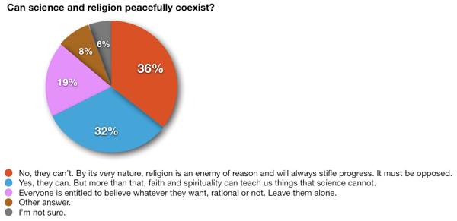
Institute of Ethics and Emerging Technologies, 2010
Notes:
‘Religion – by its very nature - is an ENEMY of reason and WILL ALWAYS STIFLE PROGRESS. It MUST BE OPPOSED.’
Strong language to use. Yet, when religion is seen as anti-science, and therefore anti-progress, it will not find much support among those who regard religion as no longer useful… →

Slide 5
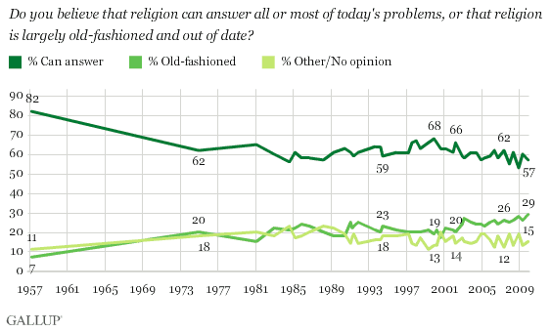
A leading reason?
Religion’s perceived anti-science stance.
Notes:
What’s important to note is the dwindling opinion that religion has relevance …. by 25% over the last 50 years. Likewise, religion as ‘old-fashioned’ (read ‘archaic’, ‘outdated’) has increased by 22% over the same period. A leading reason? Religion is seen as anti-science by more and more of society.
http://friendlyatheist.com/2009/12/27/gallup-poll-americans-are-becoming-less-religious/

Slide 6
In this perceived conflict between science and religion (specifically Christianity), what are some of the main areas of disagreement?
Climate change
Stem cell research
Homosexuality
Age of earth
Flood geology
Evolution
Notes:
Christianity’s precepts are considered to be opposed to ration, logic and reason by a growing segment of the US population. Some of the better known Christian beliefs that are under scrutiny are:
1. Denial that climate change is occurring (dismissal of environmental stewardship)
2. Objection of medical advancements (embryonic stem cells challenge views on the immortal soul)
3. Homosexuality as anything more than a ‘conscious choice’.
4. A very young earth (under 10,000 years old, contrary to scientific evidence).
5. A global flood (contrary to scientific evidence).
6. Denial of evolution (specifically common descent).
Skeptics take an even harder line, equating religion with blind faith that serves no useful purpose in a modern, enlightened society.

Slide 7
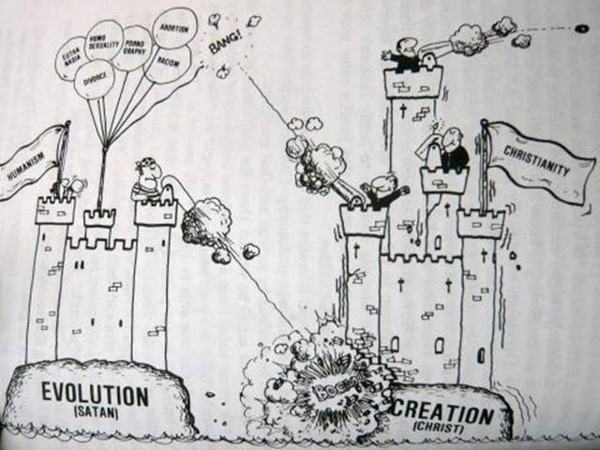
Notes:
Does this reflect our community’s heritage?
Have we, as a community, effectively circled the wagons… becoming largely insular?
We need to directly engage perceived threats to our faith… not dismiss them in a bout of cognitive dissonance or with intellectual dishonesty. Science - to include evolution – is not going away. In fact the case for it grows stronger and stronger and won’t be ignored.

Slide 8
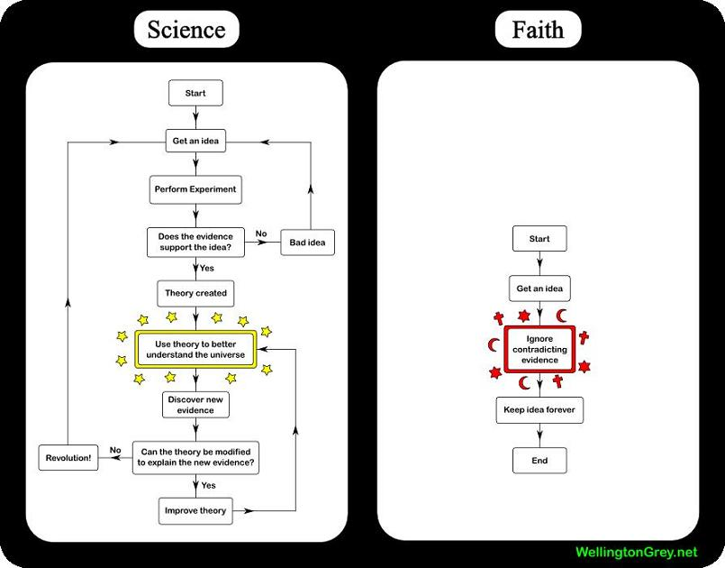
Notes:
This is how Christianity (and on a larger scale, religion) is viewed by the New Atheism movement and many self-proclaimed skeptic groups today. And, unfortunately, for a vast percentage of American Christians, they aren’t wrong.
Here’s are two quotes from atheists that sum this up well… →

Slide 9
“Faith is also used to refer to belief without supporting evidence or proof.”
Infidels.org (1997). An Introduction to Atheism
“If any religion had a record of being right and useful, then I’d trust it too. But they simply don’t. Science does, so I’m going to be sticking with it.”
Anonymous blog post, 2006
Notes:
By no means am I suggesting that either of these quotes carry any ‘official’ recognition among atheist or skeptic groups. I refer to them only as representative of the growing view among those questioning the relevance of religion today, especially the younger generation who are more educated and have more access to the world than any previous generation.
Basically, the view is that religion is not right, is not useful, and therefore not worth one’s trust. Christians are seen as not needing any evidence in order to believe the Bible – with it’s many inconsistencies – to be true, that the god of the bible demands obedience on fear of eternal damnation, etc. In other words, that Christianity is archaic, superstitious, unfair…. and worthless.
Yet, this isn’t actually what the Bible demands of its adherents…

Slide 10
Glenn Miller, Christian apologist , owner of The Christian-Thinktank.com:
“The Judeo-Christian faith is surprisingly ruthless in its insistence on proof (broadly considered), evidence, truth, examination, 'cordial skepticism'...and correspondingly disdainful of those who believe nonsense.”
Consider briefly the following passages in the Bible:
Notes:
The Bible shows that God freely gave evidence of His promises and His works, and required His people to seek for evidence in order to believe…

Slide 11
Gen 15 - When Abraham asked God "how will I KNOW that this future will happen?", God did not rebuke him, but made a legal covenant with him.
Exodus 33 - Moses argued with God that God should not destroy Israel, so that there would be evidence of His work in history
Number 16 - Moses argued with the Israelites over the leadership issue, and appealed to evidence.
Deut 29 - Moses appeals to their MEMORIES as a basis for decision...historical events.

Slide 12
Deut 18 - God is VERY explicit-if a prophet EVER misses a prediction, this proves he is not a prophet of YHWH. The test was evidential--pure and simple.
Is 43 - The prophet draws a picture of a courtroom scene. The prophets are to bring forth their evidence that they are indeed speakers of truth. The only admissible evidence is a proven track-record of future prediction!
Ezek. 13:2 "Son of man, prophesy against the prophets of Israel who are now prophesying. Say to those who prophesy out of their own imagination: 'Hear the word of the LORD!'" --Accuracy and legitimacy is of critical moment!

Slide 13
Act 17 - Paul referred to the historical resurrection as "God's proof" that people will have to answer for their innermost attitudes toward God.
2 Cor 13 - the Corinthians demanded proof of Paul's authority. He submitted historical evidence and lifestyle as data.
Luke 1 - Luke investigated the sources and wrote the account for his reader, SO THAT he could know for CERTAIN.
Notes:
The Bible does not teach or demand faith without evidence. What it does demand is that a godly life include critical thinking, logic, rationale and reason. However, what we see in the larger Christian world does not seem to reflect this, and that is what a growing number of skeptics are seeing as Christianity. We know better as Christadelphians.
So, is this attitude part of our community’s view of faith? From brother Thomas…

Slide 14
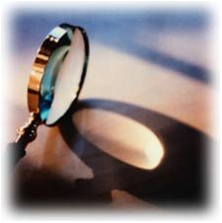
"Investigate everything you believe - if it is the truth it cannot be injured thereby; if error, the sooner it is correct the better. Never be afraid of results to which you may be driven by your investigations, as this will inevitably bias your mind and disqualify you to arrive at ultimate truth.“
Dr. John Thomas
Notes:
Our community was founded on applying logic, rational, critical analysis, and reason to our studies… this HAS TO include everything that our faith touches; and that INCLUDES science. And, for the pioneers it did. More on that later… let’s get back to the conflict.

Slide 15
“In the last century, the most persistent and sharpest clash between religion and science in the United States has centered on the issue of evolution. Indeed, while virtually all scientists agree that life on Earth has evolved over billions of years, public opinion polling over the last few decades has shown that between 40% and 50% of Americans consistently reject the very idea of natural evolution, largely on the grounds that it conflicts with biblical accounts of creation.”
Source: Pew Research (2007)
Notes:
Removing everything not underlined, we can give a little clarity to the quote →

Slide 16
“…the most persistent and sharpest clash between religion and science…has centered on…evolution…largely on the grounds that it conflicts with biblical accounts of creation.”
Where do you think this conflict’s ‘ground zero’ is?
Educational institutions
Notes:
So, the science/faith conflict finds its root in the apparent disagreement between evolution and the Biblical Creation. However, a closer examination will show that in reality it is evolution versus a particular interpretation of the Biblical Creation, but more on that later.
So, where is ground zero? Our nation’s educational institutions.

Slide 17
More from the Gallup Poll…
“There is a strong relationship between education and belief in Darwin's theory, as might be expected, ranging from 21% of those with high-school educations or less to 74% of those with postgraduate degrees.”
The Gallup Poll (2009)
Notes:
Is this poll saying that the American education system, while actively promoting evolution, rejects God? Would that be how we read this?
Does American secular education actively deny God’s existence by promoting evolution? In other words, are the two mutually exclusive?
Is this a fair assessment?

Slide 18
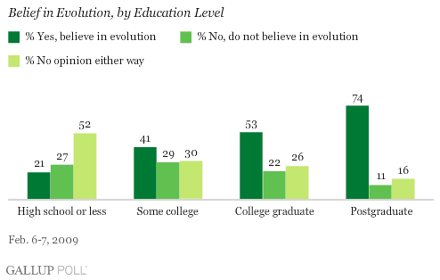
Notes:
So, we do see that higher education goes hand-in-hand with acceptance of evolution. The only question is why? Some may conclude that is a kind of conspiracy theory by the education system in an effort to eliminate God. Is it because the schools are actively promoting this conflict? Or, is it that as people learn to think logically, employ critical analysis, and think through an issue with more rationality they learn to form more objective opinions on the available data and rely less on what knowledge they’ve been handed down from parents, friends, churches…from the platform?

Slide 19
“On the eve of the 200th anniversary of Charles Darwin's birth, a new Gallup Poll shows that only 39% of Americans say they "believe in the theory of evolution," while a quarter say they do not believe in the theory, and another 36% don't have an opinion either way. These attitudes are strongly related to education and, to an even greater degree, religiosity.”
The Gallup Poll (2009)
Notes:
Overall results of the Gallup poll. The conclusion from the polling data suggests a strong correlation between evolution and education, while a conflict exists between evolution and religion.
http://www.asa3.org/ASA/topics/Evolution/index.html

Slide 20
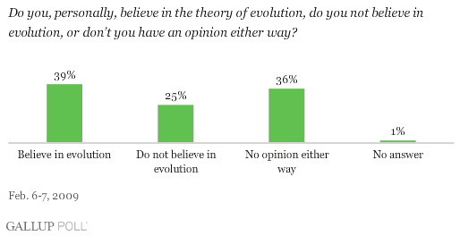

Slide 21
The Conflict Examined
The result? In America, public opinion believes:
the Bible teaches ideas contrary to observable, falsifiable science
religion and education are at odds
However, what is not widely known is that this supposed conflict between science and religion is barely 150 years old or that it originated in 19th century Victorian England… it is not a conflict as old as Christianity OR the Bible.
Notes:
Popular opinion has the Bible and science at odds.
However, what many may not know is that the origin of this ‘conflict’ has its roots in mid-nineteenth century Victorian England.

Slide 22
What is the Purpose of this Presentation?
Examine the history of the science/faith conflict
Provide early Christadelphian commentary on science
Outline leading views of the Genesis Creation narrative
Where does our community to go from here?
Notes:
This presentation is concerned with the historic background of the current science/faith conflict that is confronting our community. The primary objective, as stated at the beginning of this presentation, is to show our community has a solid history of engaging science and harmonizing it with our faith. This I hope to establish in the following slides.
The end result is to hopefully show that we, as a robust community of faith, are strong enough to absorb emerging scientific advancements into a better understanding of our God, who we firmly believe is the Creator of everything we see, feel, touch and experience each and every day.

Slide 23
The Conflict Examined
“The so-called ‘war’ between faith and learning,
specifically between orthodox Christian theology
and science, was manufactured during the second
half of the nineteenth century. It is a construct that
was created for polemical purposes.”
“The main architects of the notion of a “war” between theology and science were scientists and advocates of secular education.”
Larsen (2008). War is Over, if You Want it;
Beyond the Conflict between Faith and Science, p.148
Notes:
Polemic – an aggressive attack (argument) against the opinions or principles of another. In this case, this “war” or “conflict” was waged by scientists and those opposing religious educational institutions against Christianity. In other words →

Slide 24
The Conflict Examined
Larsen’s observations provide key points to consider:
The primary instigators were ‘men of science’ and those advocating a secular-based education.
The focus of the instigation was to drive a wedge between theology and education (specifically, science education in this case).
Why?
Notes:
So, the conflict then was between ideologies, not scientific observations.

Slide 25
The Conflict Examined
Early 19th century England had two universities, Oxford and Cambridge
Curriculum focused on the Classics.
Faculty positions only for Anglican priests.
As you may imagine, this meant that those who desired a career in education and university-supported research had to toe the line as an Anglican clergyman (Sir Isaac Newton, anyone?).
Notes:
The educational ‘culture’ of the time provided the perfect backdrop for a ‘war’ between science and faith.

Slide 26
The Conflict Examined
“Indeed, being a priest in the Church of England was widely seen as the most sensible way to make a living for someone who wished to pursue scholarly interests. It was a learned profession that allowed one considerable time to invest in intellectual pursuits of one’s own choosing.”
Larsen, p. 150
Notes:
For the one who desired a life in academics and research, the best option in 19th century Victorian England was ordination into the Anglican priesthood. This allowed them to apply for faculty positions at the universities and so spend their life in academic pursuits.

Slide 27
The Conflict Examined
“Huxley and others who aspired to turn scientific pursuits into a profession, therefore, ‘needed’ a war between science and religion. The purpose of the war was to discredit clergymen as suitable figures to undertake scientific work in order that the new breed of professionals would have an opportunity to fill in the gap for such work created by eliminating the current men of science. It was thus tendentiously asserted that the religious convictions of clergymen disqualified them from pursuing their scientific inquiries objectively.”
Larsen, p.150
Notes:
To upset the educational structure of 19th century England, it was imperative that the credibility of the existing faculty to conduct truly objective scientific research. To do this, the proponents of this ‘war’ suggested that religious beliefs clouded the clergy-scientists perceptions of the natural world.
Some examples include…→

Slide 28
The Conflict Examined
Some false claims by this group:
A flat earth doctrine
Anesthetics, a newly discovered drug used during childbirth, was declared heretical by the church because it eased a woman’s necessary suffering during labor.
Study of human anatomy through autopsies and dissections prohibited by the church during the Middle Ages and the Renaissance.
Notes:
Some of the better known false claims from this time.

Slide 29
The Conflict Examined
A flat earth:
8th Century Christian apologist Bede stated unequivocally that the earth was shaped like a “ball”. Thomas Aquinas (and Christian apologists from the high medieval period on) also believed this.
Clerics critical of Columbus believed him wrong about the size of the earth (he thought it smaller than they), not its shape. THE CLERICS WERE CORRECT.
Notes:
High medieval period – 11th thru 13th centuries.

Slide 30
The Conflict Examined
A flat earth:
From Stephen Gould, a noted agnostic evolutionary biologist and historian of science:
“[T]he nineteenth-century invention of the flat earth … occurred to support another dubious and harmful separation … the supposed warfare between science and religion.”
Larsen, 149
Notes:
Even agnostic scientist Stephen Gould acknowledged the deliberate smear campaign waged on Christian scientists by their opponents in the 19th century.

Slide 31
The Conflict Examined
Prohibited use of anesthetics in childbirth:
Still believed even today --
Deborah Blum, a Pulitzer prize winning science writer and a professor at the University of Wisconsin-Madison, wrote in the New York Times (Aug 1, 1996):
“When 19th-century doctors began using chloroform to alleviate the pain of childbirth, the Scottish Calvinist church declared it a ‘Satanic invention’ intended to frustrate the Lord’s design.”
Notes:
Whether intentional or not, this is shoddy work from a trained historian and university professor →

Slide 32
The Conflict Examined
Prohibited use of anesthetics in childbirth:
But, this is not historically accurate:
“In reality, however, no such claim was ever made. In fact, ministers applauded the drug while medical professionals denounced it on “scientific reasons”.
Larsen, p.149

Slide 33
The Conflict Examined
Prohibited study of human anatomy:
“…[T]he Papal medical school, San Viansa, now University of Rome, was for years, for decades, even centuries during the early modern period (ca. 16th – 19th centuries), pioneering work in anatomy and physiology.”
Ronald Numbers, Lecture on “Myths and Truths in Science and Religion: A historical perspective”, 2006
Notes:
Again, Christianity lead the way in scientific endeavors, contrary to the fabricated claims of those wishing to upset the structure of England’s educational institiutions.

Slide 34
The Conflict Examined
While the deliberate effort to create a conflict between science and faith has largely been successful on many levels, the consensus of historians of science today tells the real story:
“It is surely not without significance that Christian botanists, geologists, and biologists - that is to say, those best placed to see with clarity the substance of what Darwin had proposed believed the evidence supported an evolutionary natural history.”
David N Livingstone "Darwin's Forgotten Defenders" (Eerdmans 1984) p xi-xii
Notes:
However, historians of science tell us a much different story.
This is something that is not widely known… Christians who studied in the relevant fields that touched evolutionary concepts accepted Darwin’s proposals.

Slide 35
The Conflict Examined
“Although popular images of controversy continue to exemplify the supposed hostility of Christianity to new scientific theories, studies have shown that Christianity has often nurtured and encouraged scientific endeavour, while at other times the two have co-existed without either tension or attempts at harmonization. If Galileo and the Scopes trial come to mind as examples of conflict, they were the exceptions rather than the rule.”
Gary Ferngren, Science & Religion
Notes:
Acceptance and/or peaceful co-existence, not disharmony, were what defined the relationship between science and Christianity.

Slide 36
The Conflict Examined
“The story of the nineteenth century is actually one in which orthodox Christian ministers, theologians, churches, and denominations accepted dramatic scientific developments with remarkably little fuss. Christians quickly accepted the new findings of geology, for example, and an earth that is millions of years old was the normative view among clergymen even well before Charles Darwin’s On the Origin of Species (1859).”
Larsen, p. 152
Notes:
Christians were able to find a solution between new scientific findings and their interpretations of the Bible with “remarkably little fuss”.

Slide 37
The Conflict Examined
“[T]he introduction of Darwinism into Victorian thought is not a story of denominations making official pronouncements against it or clergymen lining up to attack it, but rather of widespread acceptance and even championing of it by ministers and theologians.”
Larsen, p. 152
Notes:
It might surprise some to know Darwin had many proponents from the Christian world.

Slide 38
The Conflict Examined
“In the late Victorian period it was common to write about the ‘warfare between science and religion’ and to presume that the two bodies of culture must always have been in conflict.
However, it is a very long time since these attitudes have been held by historians of science.”
Steven Shapin, Professor of Sociology
quoted in ‘The Mythical Conflict between Science and Religion’, James Hannaman, 2003-2005
However, it is a very long time since these attitudes have been held by historians of science.”
Notes:
So, while those who study the supposed conflict have determined that it was a farce, popular opinion has accepted this farce and holds it up as truth to this day.

Slide 39
The Conflict Examined
Summarizing the conflict –
Origins of current conflict not based on religious objections to science
19th century theologians largely embraced evolutionary naturalistic history – they saw no theological inconsistencies between what was observed in nature (evidence of God’s handiwork) and the Bible (God’s revealed word). It was a matter of interpreting both harmoniously.
History shows Christians have been at forefront of emerging science since late antiquity, finding harmony in the record of the “two books.”

