Slide 1
Ways to Build a Stronger Spiritual Life
Victor M. Parachin

Slide 2
Be a River, Not a Swamp
John 7: 38

Slide 3
Go to Bed Early
& Get Up Early
Psalm 5: 3

Slide 4
Identify Blessings
James 1:17

Slide 5
Speak Words of Blessings
Numbers: 6:24-26

Slide 6
Nurture a Prayer Life
Philippians 4:6

Slide 7
Take a Step of Faith
Hebrews 11:1

Slide 8
Restore Someone’s Faith
Luke 8: 43 -44

Slide 9
Be a Grateful Person
Romans 1:8

Slide 10
Share the Journey
John 1: 6

Slide 11
Serve
John 13: 5

Slide 12
Solitude
Matthew 6:6

Slide 13
Fast and Pray
Matthew 17: 21

Slide 14
Turn Your Worries Over To God
Psalm 55:22

Slide 15
Spread Love Wherever You Go
John 13: 34

Slide 16
Strive for Excellence
Ecclesiastes 9:10

Slide 17
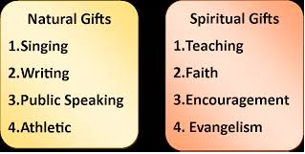
Use It or Lose It
Matthew 25:21

Slide 18
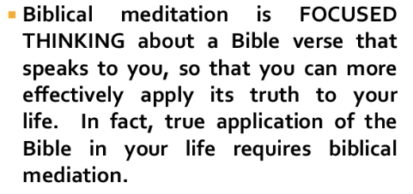
Meditate on Scripture
Psalm 4:4

Slide 19
Be Reliable
Proverbs 11:13

Slide 20
Ask God to Make You a Blessing Today
Luke 12:48

Slide 21
Spend Time in Nature
Genesis 1:10

Slide 22
Choose to Be Happy
Psalm 144:15

Slide 23
Share Your Testimony With others
Luke 8: 39

Slide 24
Keep Your Priorities Straight
Exodus 20: 3

Slide 25
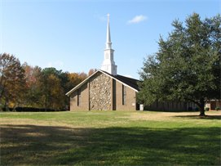
Bring Someone to Church

Slide 26
Make A Plan & Follow It!

