Slide 1
Stages of Labour
Understanding the stages of labour
Notes:
The stages of labour are commonly broken down into three main phases. This is misleading, however, in that the first stage is comprised of three sub-phases and is what most people identify as labour. Stage I consists of early labour, active labour and transition. Stage II is the pushing stage and Stage III is the birth of the placenta.
1

Slide 2
Stage 1
It is common practice to define the phases of Stage I by the degree of cervix dilation and length of each labour contraction. However, these are truly poor indicators of how a labour will progress. This is because dilation doesn't usually occur in a completely linear fashion.
Notes:
In other words, your cervix may go from 1 to 4 cm dilated, skipping all the degrees in between. Your contractions may resemble those seen in transition while you are only 3 cm dilated and you could be holding that baby only minutes later. Always remember that the focus should be on you as a person, the mother as a whole, and not just your cervix. It's the same principle that applies when a nurse or doctor relies too heavily on machines when one glance at a mother's ashen skin and ragged breathing should tell them that something is seriously wrong. Only after she or the baby goes into distress do they realize that the machines were malfunctioning.
2

Slide 3
In the case of a home birth, most mothers do not submit to cervical checks since they provide little useful information and are poor predictors of labour progression. In these cases, the care provider more accurately relies on powers of observation to judge progress through the stages of labour.
Notes:
Some mothers will even push their babies out never having known their degree of cervical dilation. Instead, they wait for an uncontrollable urge to push to tell them its time rather than an arbitrary cervical check.
3

Slide 4
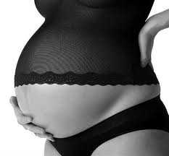
Early Labour
Early labour takes up the majority of the birthing experience. It is characterized by contractions that are regular but may not be very close together or last very long. The contractions may be 10 minutes apart and last only 30-45 seconds. This is the most comfortable of the stages of labour, easing the body into the process. In this phase, dilation is to a maximum of 4 cm.
Stage 1

Slide 5
Active Labour
Active labour is more intense with longer, stronger, more intense contractions that may be 3-5 minutes apart and last up to 60 seconds.
This is the beginning of the serious phase, where relaxation comes into play and the birth companion's role becomes more prominent. Dilation is usually from 5-7 cm.

Slide 6
Transition
Transition is by far the most challenging, although the shortest, phase of birthing. This can cause overwhelming sensations which might falter your focus. This is the phase usually depicted in mainstream media. These contractions are stronger and longer and finish dilating the cervix.

Slide 7
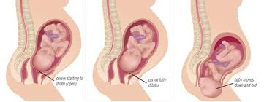
They usually last 90-120 seconds with breaks of about a minute or two in between. Generally this phase only last for 30 minutes to 2 hours. A time distortion may also be experienced in this phase that makes it seem to pass more quickly and may make this period difficult to remember clearly after the birth.
Experiencing grogginess or a mental fog are also common. Nausea can also set in as well as involuntary painless shaking from the intensity.
Notes:
Women are especially vulnerable to suggestion at this time, which can be used to enhance or to hinder the birth.
7

Slide 9
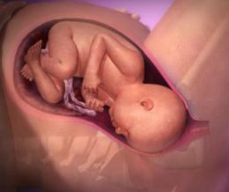
Stage 2 Pushing
The pushing stage, the second phase of labour, begins once 10 cm has been reached. This will end with the much-anticipated birth of the baby. This stage can last a few minutes or several hours.
Notes:
In a natural birth, the pushing phase is typically much shorter than in a medicated one. Women commonly report this as the most empowering part of the birth experience and as the most motivating and comfortable.
9

Slide 10
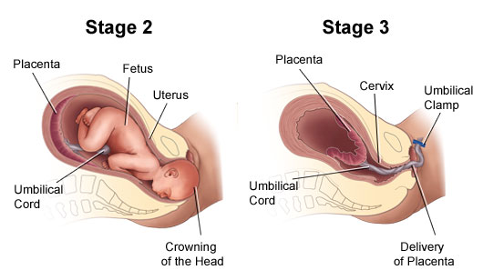

Slide 11
Pushing Stage..
Pushing is usually much more manageable than transition. The pushing contractions are of a different variety than those previously experienced. The body will push independently of intentional effort. This is the purpose of the uterine contraction, to first fully dilate and efface the cervix, and then to expel the baby from the uterus. True "pushing" is rarely required.
Notes:
The most effective course of action is to let your body guide your efforts by not pushing until an overwhelming urge is felt. Reaching 10 cm dilation alone does not necessarily mean the body is ready to push. The baby may not yet be in the best position or the tissues may not yet have had enough time to gently stretch on their own.
11

Slide 12
Negatives
Pushing too soon wastes energy and can lead to complications such as fetal distress, malpositioning, pulled ligaments, perineal tearing and forceps or vacuum extraction. If a lull in contractions is experienced, simply letting the baby drift down on its own is advisable. This preserves energy for you and the baby. It also makes for a slow, controlled delivery with less chance of tearing and can eliminate the sometimes-reported "ring of fire" when perineal tissues stretch rapidly to accommodate the baby's head as it crowns.

Slide 13
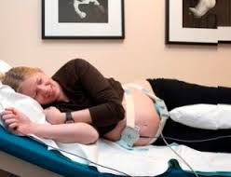
Stage 3
THE PLACENTA DELIVERY
When the baby reaches your arms, the final of the stages of labour, the placenta delivery, often receives little attention. It begins with the birth of the baby and ends with the arrival of the placenta. On average, it takes roughly 20 minutes for the placenta to detach from the uterine wall, although it can safely be longer.
Notes:
The placenta will detach from the uterine wall and then be expelled through the birth canal. The care provider will determine when the placenta is ready to detach by a small gush of blood or a lengthening of the cord.
13

Slide 15
Summary
It is not enough to just recognize the stages of labour: mothers must know exactly how to handle each stage as it comes. By becoming familiar with the unique qualities of each stage, anxiety about giving birth can be eliminated so that when labour begins, you will be fully prepared to face each step along the way to holding your newborn baby.

