Slide 1
Welcome to Trinity
Order for Worship
January 8, 2023

Slide 2
Prelude by Roxanne Groff
Office of the Acolyte
Ringing of the Bell
Scripture Focus:
Matthew 3:1-17
Notes:
Image: Preparing yeast dough. Copyright © tomasworks/iStock/Thinkstock. Used by permission.

Slide 3
CONFESSION AND FORGIVENESS
All may make the sign of the cross, the sign marked at baptism…
P: We confess our sins before God and one another.
Pause for silence and reflection.
P: Merciful Lord,
Notes:
Image: Five Loaves by Caroline Coolidge Brown. Copyright © Caroline Coolidge Brown. All rights reserved. Used by permission of the artist.

Slide 4
CONFESSION AND FORGIVENESS
C: Christ came into the world and showed us how to live, but we have failed to live by what he taught. We have not loved you with all our heart, soul, mind and strength, we have not done to others as we would have done to ourselves. Shine a light on our hearts, that we might turn from the shadows of our sin and walk in your ways.
Notes:
Image: Five Loaves by Caroline Coolidge Brown. Copyright © Caroline Coolidge Brown. All rights reserved. Used by permission of the artist.

Slide 5
CONFESSION AND FORGIVENESS
L: Jesus came not to condemn the world, but that the world might be saved through him. By his abundant love, all your sins are forgiven, that you might walk in the light of Christ.
C: Amen.
☩
Notes:
Image: Five Loaves by Caroline Coolidge Brown. Copyright © Caroline Coolidge Brown. All rights reserved. Used by permission of the artist.

Slide 6
Hymn of Praise
“Spirit of God, Descend Upon My heart”
LBW 486
Notes:
Image: Five Loaves by Caroline Coolidge Brown. Copyright © Caroline Coolidge Brown. All rights reserved. Used by permission of the artist.

Slide 7
Spirit of God, Descend Upon My Heart LBW 486
1 Spirit of God, descend upon my heart;
wean it from earth, through all its pulses move;
stoop to my weakness, strength to me impart,
and make me love you as I ought to love.
Notes:
Image: Five Loaves by Caroline Coolidge Brown. Copyright © Caroline Coolidge Brown. All rights reserved. Used by permission of the artist.

Slide 8
Spirit of God, Descend Upon My Heart LBW 486
2 I ask no dream, no prophet ecstasies,
no sudden rending of the veil of clay,
no angel visitant, no op'ning skies;
but take the dimness of my soul away.
Notes:
Image: Five Loaves by Caroline Coolidge Brown. Copyright © Caroline Coolidge Brown. All rights reserved. Used by permission of the artist.

Slide 9
Spirit of God, Descend Upon My Heart LBW 486
3 Have you not bid me love you, God and King;
all, all your own, soul, heart, and strength, and mind?
I see your cross; there teach my heart to cling.
Oh, let me seek you and, oh, let me find!
Notes:
Image: Five Loaves by Caroline Coolidge Brown. Copyright © Caroline Coolidge Brown. All rights reserved. Used by permission of the artist.

Slide 10
Spirit of God, Descend Upon My Heart LBW 486
4 Teach me to love you as your angels love,
one holy passion filling all my frame:
the baptism of the heav'n-descended dove,
my heart an altar, and your love the flame.
Notes:
Image: Five Loaves by Caroline Coolidge Brown. Copyright © Caroline Coolidge Brown. All rights reserved. Used by permission of the artist.

Slide 11
APOSTOLIC GREETING
P: The grace of our Lord Jesus Christ, the love of God, and the communion of the Holy Spirit be with you all.
C: And also with you.
Notes:
Image: Five Loaves by Caroline Coolidge Brown. Copyright © Caroline Coolidge Brown. All rights reserved. Used by permission of the artist.

Slide 12
PRAYER OF THE DAY
P: Let us pray… Holy Spirit, in the waters of the Jordan you claimed Jesus as your beloved son and launched him into his earthly ministry. Fill us with your Holy Spirit that we might live as your children and care for all that you have made.
C: Amen.
Notes:
Image: Five Loaves by Caroline Coolidge Brown. Copyright © Caroline Coolidge Brown. All rights reserved. Used by permission of the artist.

Slide 13
Notes:
Image: Preparing yeast dough. Copyright © tomasworks/iStock/Thinkstock. Used by permission.

Slide 14
Scripture Reading
R: The Scripture reading is from the Gospel according to saint Matthew, Chapter 3.
C: Glory to you O’ Lord! (Spoken)
Notes:
Image: Five Loaves by Caroline Coolidge Brown. Copyright © Caroline Coolidge Brown. All rights reserved. Used by permission of the artist.

Slide 15
Matthew 3:1-17
In those days John the Baptist appeared in the wilderness of Judea, proclaiming, ²“Repent, for the kingdom of heaven has come near.” ³This is the one of whom the prophet Isaiah spoke when he said, “The voice of one crying out in the wilderness: ‘Prepare the way of the Lord, make his paths straight.’” ⁴Now John wore clothing of camel’s hair with a leather belt around his
Notes:
Image: Five Loaves by Caroline Coolidge Brown. Copyright © Caroline Coolidge Brown. All rights reserved. Used by permission of the artist.

Slide 16
Matthew 3:1-17
waist, and his food was locusts and wild honey. ⁵Then the people of Jerusalem and all Judea were going out to him, and all the region along the Jordan, ⁶and they were baptized by him in the river Jordan, confessing their sins.
⁷But when he saw many Pharisees and Sadducees coming for baptism, he said to them, “You brood of vipers! Who
Notes:
Image: Five Loaves by Caroline Coolidge Brown. Copyright © Caroline Coolidge Brown. All rights reserved. Used by permission of the artist.

Slide 17
Matthew 3:1-17
warned you to flee from the wrath to come? ⁸Bear fruit worthy of repentance. ⁹Do not presume to say to yourselves, ‘We have Abraham as our ancestor’; for I tell you, God is able from these stones to raise up children to Abraham. ¹⁰Even now the ax is lying at the root of the trees; every tree therefore that does not bear good fruit is cut down and thrown into the fire. ¹¹“I
Notes:
Image: Five Loaves by Caroline Coolidge Brown. Copyright © Caroline Coolidge Brown. All rights reserved. Used by permission of the artist.

Slide 18
Matthew 3:1-17
baptize you with water for repentance, but one who is more powerful than I is coming after me; I am not worthy to carry his sandals. He will baptize you with the Holy Spirit and fire. ¹²His winnowing fork is in his hand, and he will clear his threshing floor and will gather his wheat into the granary; but the chaff he will burn with unquenchable fire.”
Notes:
Image: Five Loaves by Caroline Coolidge Brown. Copyright © Caroline Coolidge Brown. All rights reserved. Used by permission of the artist.

Slide 19
Matthew 3:1-17
¹³Then Jesus came from Galilee to John at the Jordan, to be baptized by him. ¹⁴John would have prevented him, saying, “I need to be baptized by you, and do you come to me?” ¹⁵But Jesus answered him, “Let it be so now; for it is proper for us in this way to fulfill all righteousness.” Then he consented. ¹⁶And when Jesus had been baptized, just as he came up from the water,
Notes:
Image: Five Loaves by Caroline Coolidge Brown. Copyright © Caroline Coolidge Brown. All rights reserved. Used by permission of the artist.

Slide 20
Matthew 3:1-17
suddenly the heavens were opened to him and he saw the Spirit of God descending like a dove and alighting on him. ¹⁷And a voice from heaven said, “This is my Son, the Beloved, with whom I am well pleased.”
Notes:
Image: Five Loaves by Caroline Coolidge Brown. Copyright © Caroline Coolidge Brown. All rights reserved. Used by permission of the artist.

Slide 21
Matthew 3:1-17
P: This is the Word of the Lord.
C: Praise to You, O Christ (Spoken)
Notes:
Image: Five Loaves by Caroline Coolidge Brown. Copyright © Caroline Coolidge Brown. All rights reserved. Used by permission of the artist.

Slide 22
Sermon
Notes:
Image: Five Loaves by Caroline Coolidge Brown. Copyright © Caroline Coolidge Brown. All rights reserved. Used by permission of the artist.

Slide 23
Sermon
Notes:
Image: Five Loaves by Caroline Coolidge Brown. Copyright © Caroline Coolidge Brown. All rights reserved. Used by permission of the artist.

Slide 24
Sermon
Notes:
Image: Five Loaves by Caroline Coolidge Brown. Copyright © Caroline Coolidge Brown. All rights reserved. Used by permission of the artist.

Slide 25
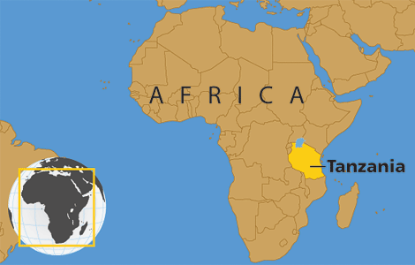
Sermon
Notes:
Image: Five Loaves by Caroline Coolidge Brown. Copyright © Caroline Coolidge Brown. All rights reserved. Used by permission of the artist.

Slide 26
Sermon
Notes:
Image: Five Loaves by Caroline Coolidge Brown. Copyright © Caroline Coolidge Brown. All rights reserved. Used by permission of the artist.

Slide 27
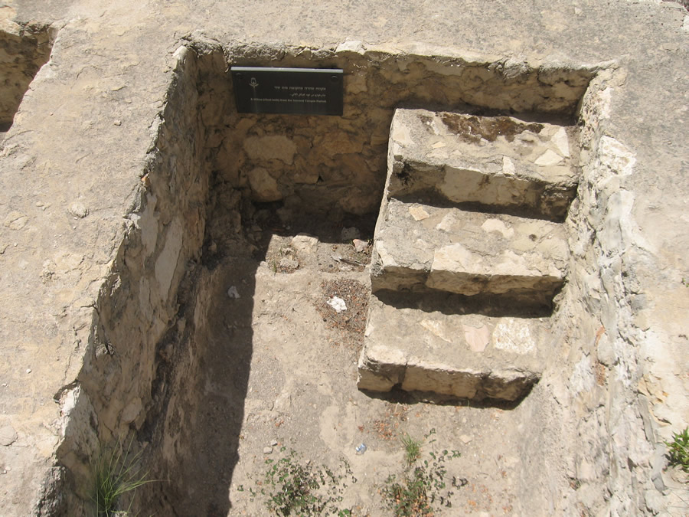
Sermon
Notes:
Image: Five Loaves by Caroline Coolidge Brown. Copyright © Caroline Coolidge Brown. All rights reserved. Used by permission of the artist.

Slide 28
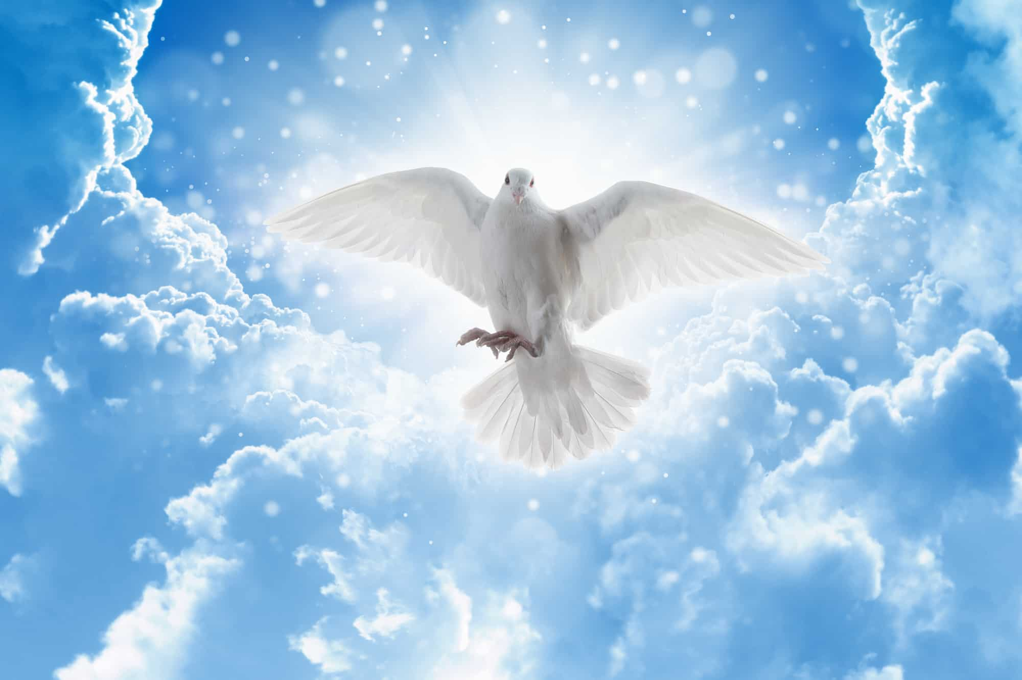
Sermon
Notes:
Image: Five Loaves by Caroline Coolidge Brown. Copyright © Caroline Coolidge Brown. All rights reserved. Used by permission of the artist.

Slide 29
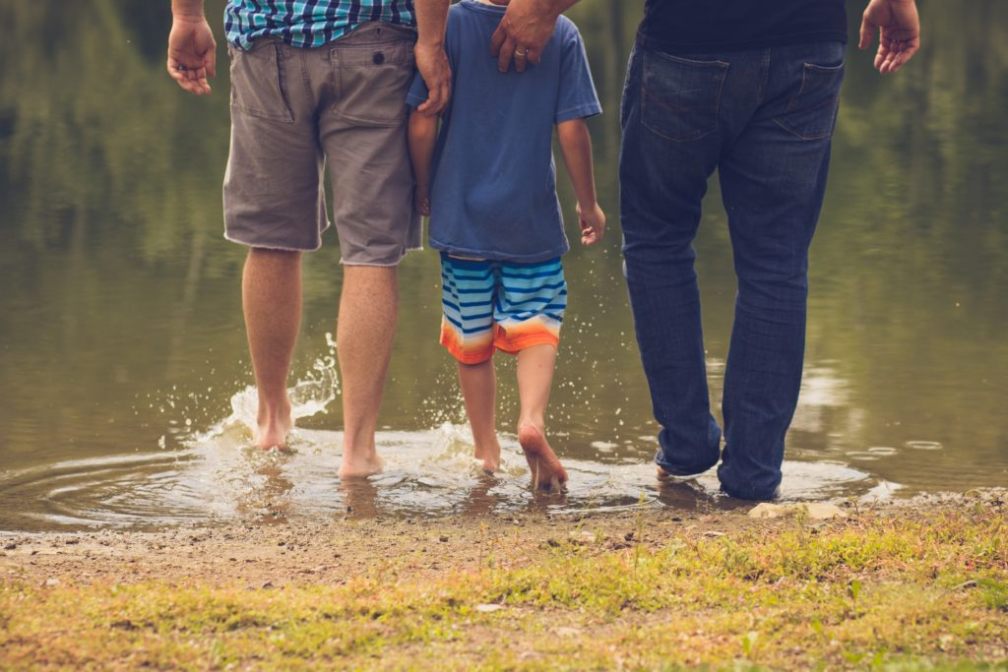
Sermon
Notes:
Image: Five Loaves by Caroline Coolidge Brown. Copyright © Caroline Coolidge Brown. All rights reserved. Used by permission of the artist.

Slide 30
Special Music
Larry Harter
“Welcome To Our World”
Notes:
Image: Five Loaves by Caroline Coolidge Brown. Copyright © Caroline Coolidge Brown. All rights reserved. Used by permission of the artist.

Slide 31
APOSTLE’S CREED
C: I believe in God, the Father almighty, creator of heaven and earth.

Slide 32
APOSTLE’S CREED
C: I believe in Jesus Christ, his only Son, our Lord. He was conceived by the power of the Holy Spirit and born of the virgin Mary. He suffered under Pontius Pilate, was crucified, died, and was buried.

Slide 33
APOSTLE’S CREED
C: He descended into hell. On the third day he rose again. He ascended into heaven, and is seated at the right hand of the Father. He will come again to judge the living and the dead.

Slide 34
APOSTLE’S CREED
C: I believe in the Holy Spirit, the holy catholic Church, the communion of saints, the forgiveness of sins, the resurrection of the body, and the life everlasting. Amen.

Slide 35
NICENE CREED
C: We believe in one God, the Father, the Almighty, maker of heaven and earth, of all that is, seen and unseen.

Slide 36
NICENE CREED
C: We believe in one Lord, Jesus Christ, the only Son of God, eternally begotten of the Father, God from God, Light from Light, true God from true God, begotten, not made, of one Being with the Father.

Slide 37
NICENE CREED
C: Through him all things were made. For us and for our salvation he came down from heaven; by the power of the Holy Spirit he became incarnate from the virgin Mary, and was made man. For our sake he was crucified under Pontius Pilate;

Slide 38
NICENE CREED
C: he suffered death and was buried. On the third day he rose again in accordance with the Scriptures; he ascended into heaven and is seated at the right hand of the Father. He will come again in glory to judge the living and the dead, and his kingdom will have no end.

Slide 39
NICENE CREED
C: We believe in the Holy Spirit, the Lord, the giver of life, who proceeds from the Father and the Son. With the Father and the Son he is worshiped and glorified. He has spoken through the prophets. We believe in one holy catholic and apostolic Church.

Slide 40
NICENE CREED
C: We acknowledge one Baptism for the forgiveness of sins. We look for the resurrection of the dead, and the life of the world to come. Amen.

Slide 41
Installation of Church Council
P: The following persons have been elected by the congregation…
(As your name is read, please stand.)

Slide 42
Installation of Church Council
P: In Holy Baptism…
P: On behalf of your sisters and brothers in Christ, I ask you: Are you ready to accept and to faithfully carry out the duties of the offices to which you have been elected?
Council Members: Yes, by the help of God.

Slide 43
Installation of Church Council
P: People of God, I ask you: Will you support these, your elected leaders, and will you share in the mutual ministry that Christ has given to all who are baptized?
C: Yes, by the help of God.
P: I now declare you installed as officers, council members, and delegates of this congregation. God bless you with his Holy Spirit, that you may prove faithful servants of Christ.
C: Amen!

Slide 44
PRAYERS OF INTERCESSION
Each petition will end with the words,
A: Merciful God,
The congregation will respond with:
C: You hear our prayer.

Slide 45
PRAYERS OF INTERCESSION
The prayer concludes…
P: Receive our prayers and hold all for whom we pray in your loving arms, in the name of your son, Jesus Christ.
C: Amen.

Slide 46
SHARING OF THE Peace
The Sharing of the Peace that began when the congregation arrived is now shared with the Pastor at this time...
P: The peace of the Lord be with you always.
C: And also with you.

Slide 47
Offering
Notes:
Image: Five Loaves by Caroline Coolidge Brown. Copyright © Caroline Coolidge Brown. All rights reserved. Used by permission of the artist.

Slide 48
Offering Prayer
Notes:
Image: Five Loaves by Caroline Coolidge Brown. Copyright © Caroline Coolidge Brown. All rights reserved. Used by permission of the artist.

Slide 49
THE LORD’S PRAYER
P: Jesus is the “tie that Binds us together”, let us pray as Jesus taught…
C: Our Father, who art in heaven, hallowed be thy name, thy kingdom come, thy will be done, on earth as it is in heaven. Give us this day our daily bread; and forgive us our trespasses,

Slide 50
THE LORD’S PRAYER
C: as we forgive those who trespass against us; and lead us not into temptation, but deliver us from evil. For thine is the kingdom, and the power, and the glory, forever and ever. Amen.

Slide 51
Announcements
Notes:
Image: Five Loaves by Caroline Coolidge Brown. Copyright © Caroline Coolidge Brown. All rights reserved. Used by permission of the artist.

Slide 52
SENDING BLESSING
P: The God who faithfully brings forth justice and breaks the oppressor’s rod bless, strengthen, and uphold you, today and always.
C: Amen.
☩

Slide 53
Sending Song
On Jordan’s Banks the Baptist’s Cry
LBW 36
Notes:
Image: Five Loaves by Caroline Coolidge Brown. Copyright © Caroline Coolidge Brown. All rights reserved. Used by permission of the artist.

Slide 54
On Jordan’s Banks the Baptist’s Cry LBW 36
1 On Jordan’s banks the Baptist’s cry
announces that the Lord is nigh;
awake and hearken, for he brings
glad tidings of the King of kings!
2 Then cleansed be ev’ry life from sin;
make straight the way for God within,
and let us all our hearts prepare
for Christ to come and enter there.
Notes:
Image: Five Loaves by Caroline Coolidge Brown. Copyright © Caroline Coolidge Brown. All rights reserved. Used by permission of the artist.

Slide 55
On Jordan’s Banks the Baptist’s Cry LBW 36
3 We hail you as our Savior, Lord,
our refuge and our great reward;
without your grace we waste away
like flow’rs that wither and decay.
4 Stretch forth your hand, our health restore,
and make us rise to fall no more;
oh, let your face upon us shine
and fill the world with love divine.
Notes:
Image: Five Loaves by Caroline Coolidge Brown. Copyright © Caroline Coolidge Brown. All rights reserved. Used by permission of the artist.

Slide 56
On Jordan’s Banks the Baptist’s Cry LBW 36
5 All praise to you, eternal Son,
whose advent has our freedom won,
whom with the Father we adore,
and Holy Spirit, evermore.
Notes:
Image: Five Loaves by Caroline Coolidge Brown. Copyright © Caroline Coolidge Brown. All rights reserved. Used by permission of the artist.

Slide 57
DISMISSAL
P: Until we gather again as God’s people to offer our worship and praise, depart in Christ’s Love,
C: Seeking, welcoming, and serving all. Amen!
Postlude by Roxanne Groff
Copyright © 2022 Augsburg Fortress. All rights reserved. Reprinted by permission under Augsburg Fortress Liturgies Annual License #SAS023830. New Revised Standard Version Bible, Copyright © 1989, Division of Christian Education of the National Council of the Churches of Christ in the United States of America. Used by permission. All rights reserved. Revised Common Lectionary, Copyright © 1992 Consultation on Common Texts, admin Augsburg Fortress. Used by permission.

