Slide 1
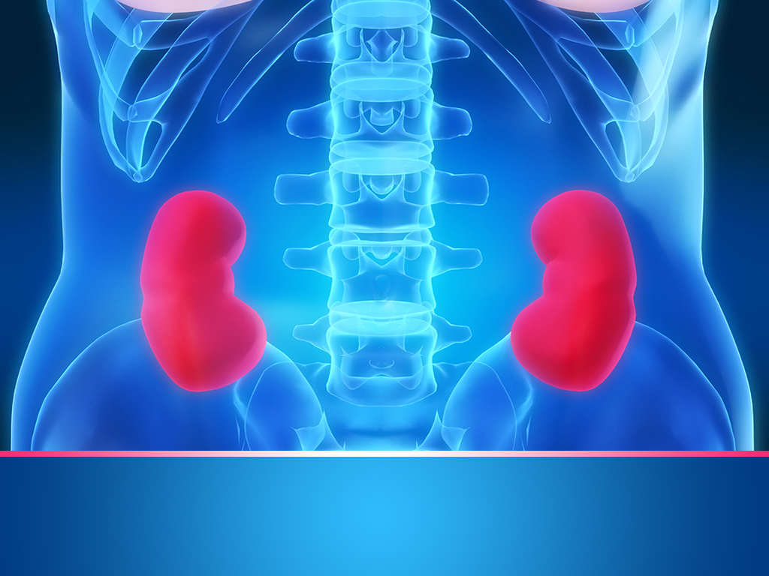
Pathophysiology of renal disorders
Professor Dragan Ljutić, M.D., PhD

Slide 2
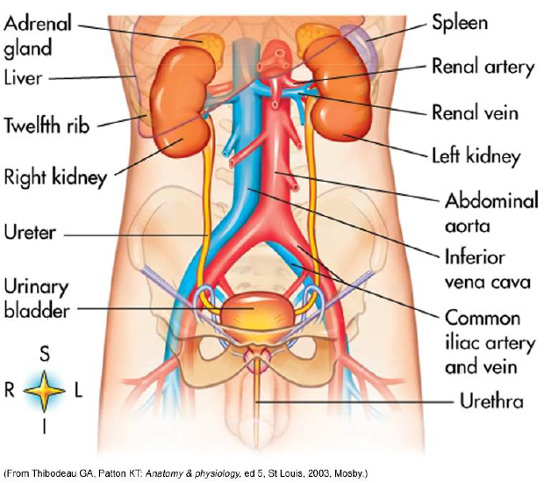

Slide 3
Etiopathogenesis:
Nephropathies – kidney diseases
Primary → etiological factor primarily affects kidney
Secondary → kidney disorder results as disorder of other organ systems
Uropathy – disorder of urinary tract
Inflammatory, tumorous, neurogenic, urololithic mechanisms and anomalies in the fetal developement

Slide 4
Urinary Tract Infections
Urethritis; Cystitis; Pyelonephritis
Etiology
Ascending infection ----- women > men
Prostate hypertrophy with urinary retention
Incomplete emptying of bladder with urinary stasis
Pregnancy associated with stasis
Cystitis vs. pyelonephritis

Slide 5
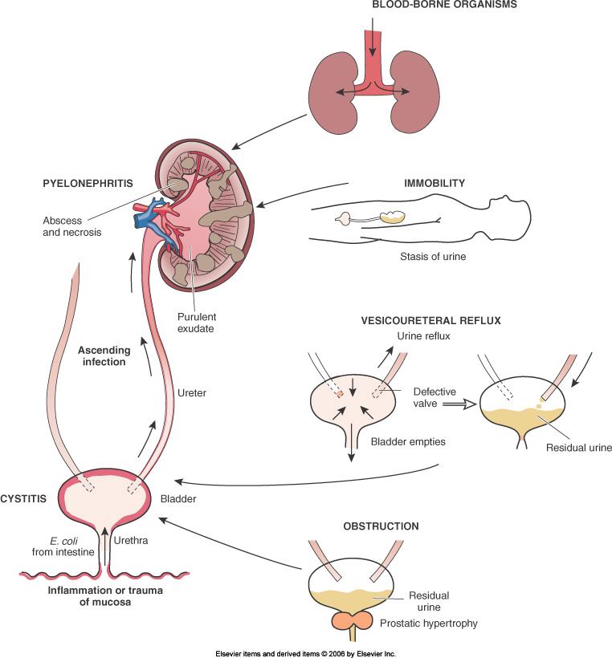
Etiologies:
Inflammation of mucosa
Trauma of mucosa
Obstruction
Vesicoureteral reflux
Immobility

Slide 6
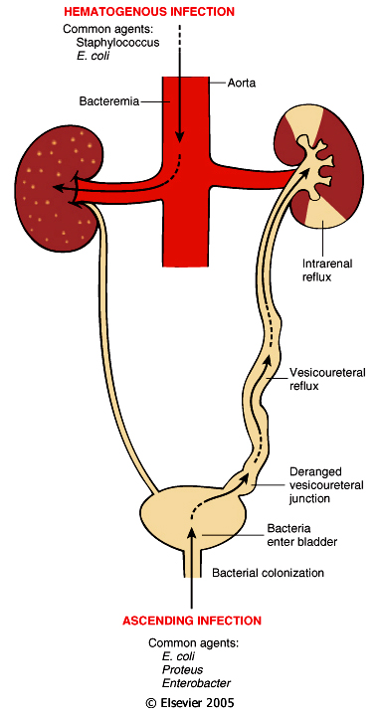
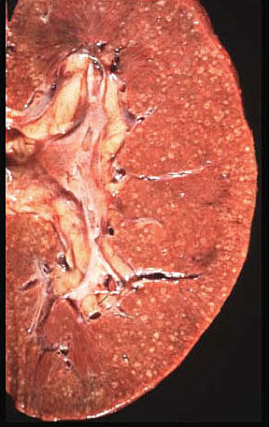
Acute Pyelonephritis
Causes:
ascending infection - vesicoureteral reflux into the renal pelvis and papillae; E. coli, Proteus, Enterobacter.
hematogenous seeding - due to septicemia or endocarditis; Staphlococcus and E. coli.
Patchy process, pinpoint microabscesses on cortical surface.

Slide 7
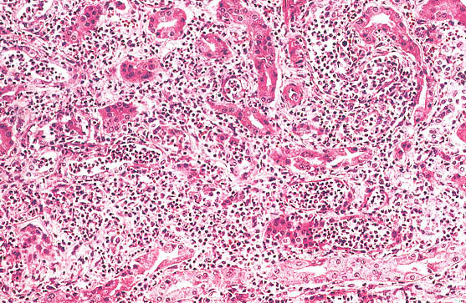
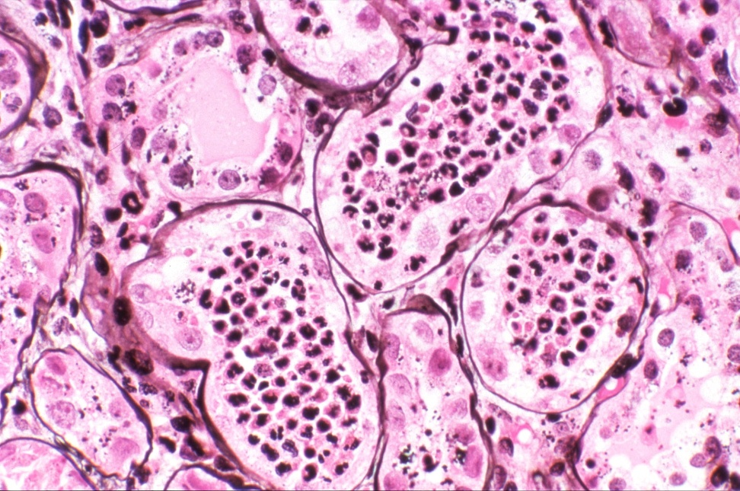
Acute Pyelonephritis
Common in patients with:
incompetent ureteral valves.
diabetes.
immunocompromise.
Patchy suppurative inflammation, tubular necrosis, neutrophilic casts.
Abscesses and papillitis more common in diabetics.
Flank pain, fever, dysuria, pyuria and bacteriuria.

Slide 8
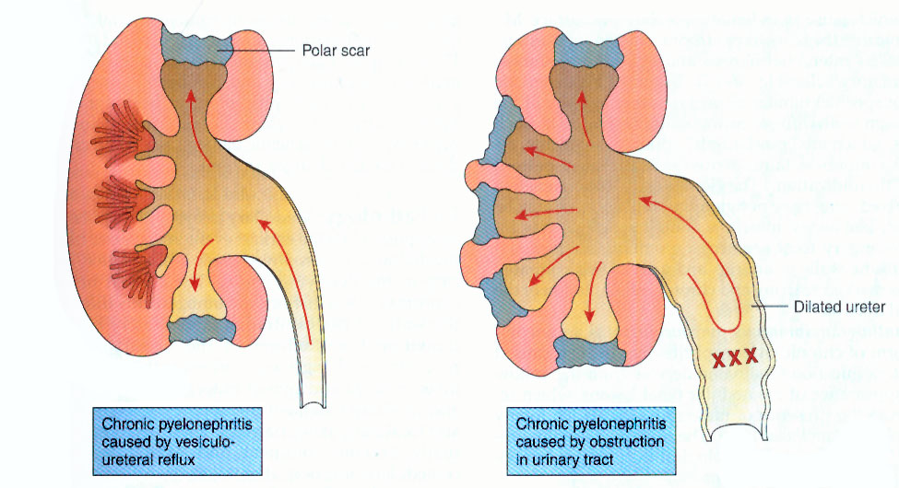
Chronic Pyelonephritis
Chronic tubulointerstitial inflammation with renal scarring.
Important cause of end-stage renal disease.
Two forms:
reflux-associated: common, congenital vesicourtehral reflux or intrarenal reflux.
obstructive: posterior urethral valves, ureteral calculi abnormalities.

Slide 9
(1) glomerulonephritis (nephritic sy.) vs. (2) nephrotic syndrome
Glomerulonephritis
Symptoms = proteinuria, edema, oliguria, hematuria, hypertension
Different causes
Can lead to irreversible kidney damage

Slide 11
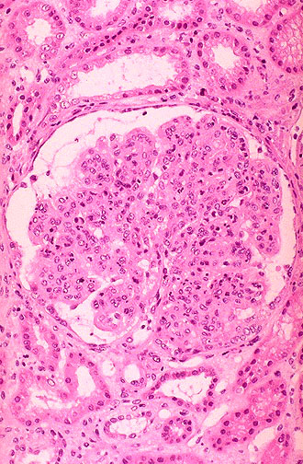
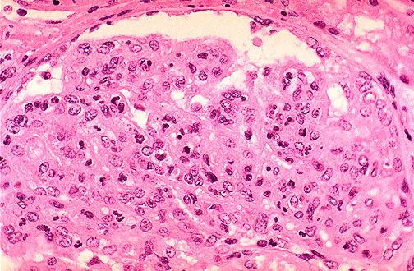
Acute Diffuse Proliferative Glomerulonephritis
Acute post-streptococcal glomerulonephritis is the most common cause of this reaction pattern.
This produces the nephritic syndrome in children two weeks following a respiratory or skin infection with a "nephritogenic strain" of group A, beta-hemolytic streptococci.
The cause is deposition of circulating immune complexes which fix complement and attract PMN's.

Slide 12
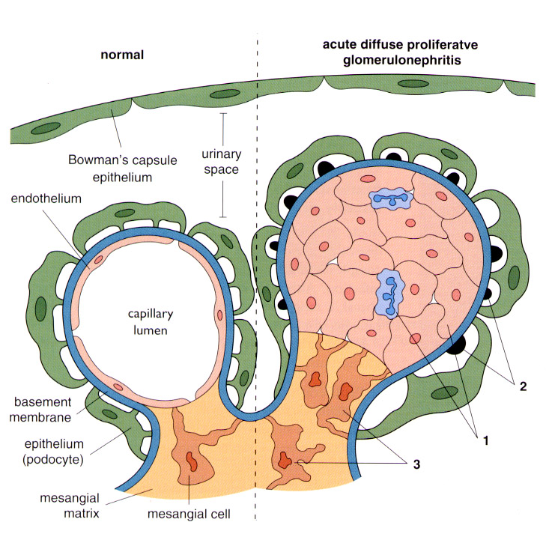
Acute Diffuse Proliferative Glomerulonephritis
There is swelling and proliferation of glomerular endothelial cells.
This explains the oliguria, edema, and hypertension.
Deposits of circulating immune complexes fix complement and attract neutrophils.

Slide 13
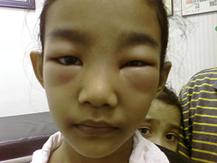
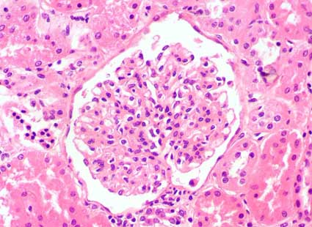
Nephrotic Syndrome
Glomerular disorder – incresed protein loss (albumin)
Symptoms:
edema
Proteinuria (>3,5 g/day)
hypoalbuminemia
hyperlipoproteinemia
hypercoagulable state
Etiology:
amyloidosis
diabetic glomerular disease
minimal change glomerulopathy
...

Slide 14
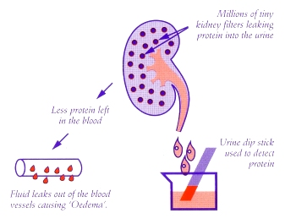
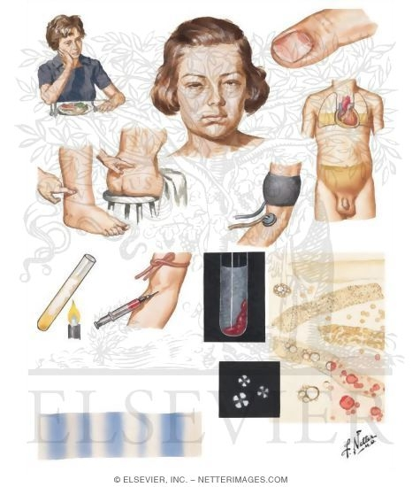

Slide 16
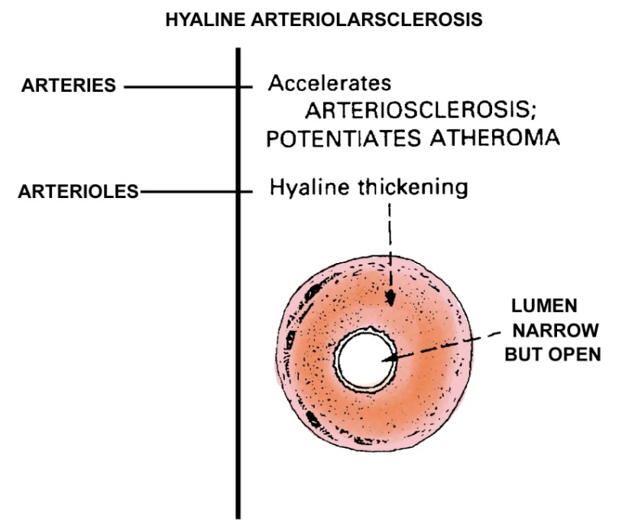
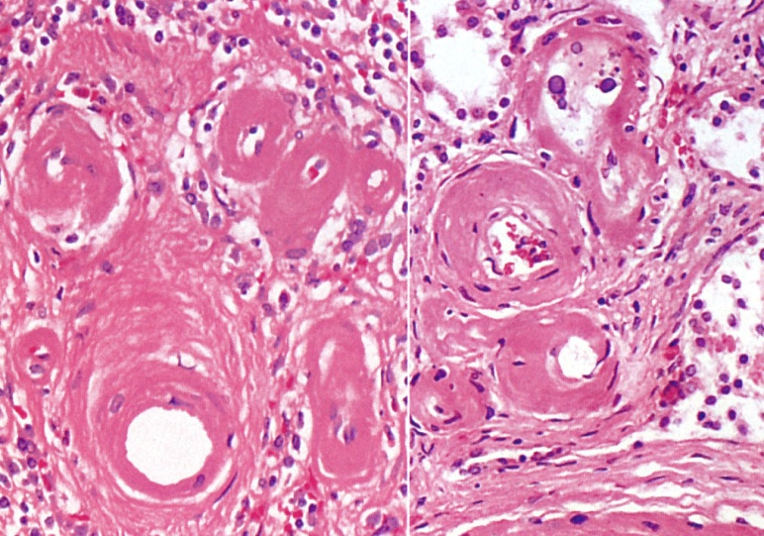
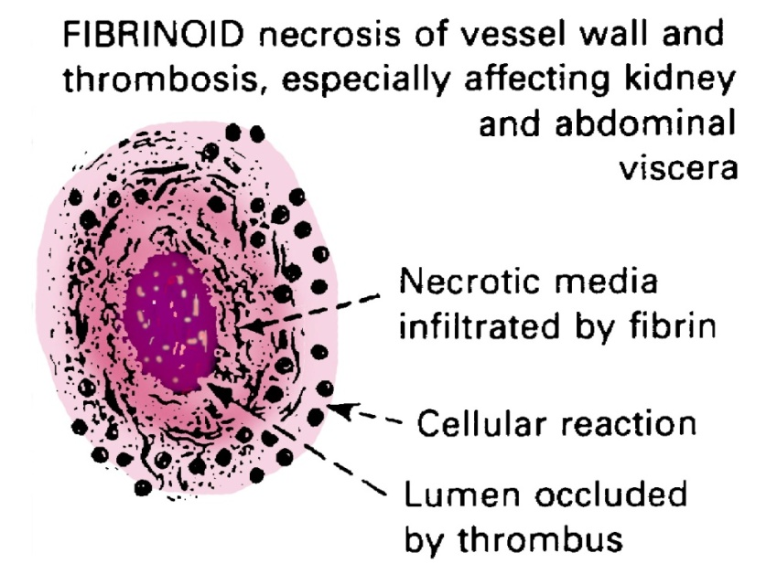
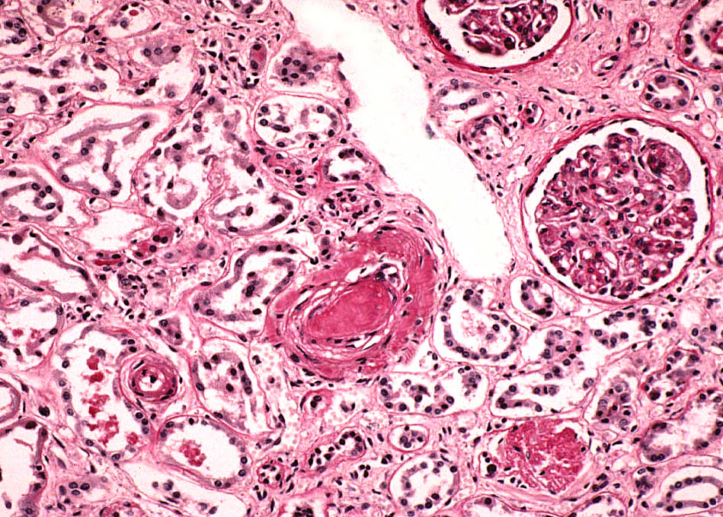
Benign vs. Malignant Nephrosclerosis

Slide 17
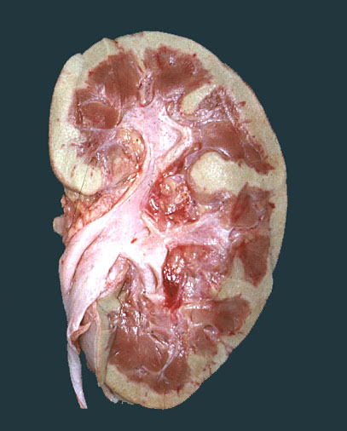
Acute Tubular Necrosis
Acute renal failure associated with dysfunction and necrosis of tubular epithelial cells.
Classification:
ischemic: shock, sepsis, burns, transfusion, other.
toxic: drugs, metals, poisons, solvents, other.
Pathology: variable, focal to extensive epithelial necrosis.
Pathogenesis:
vasoconstriction, obstruction, tubular leakage of filtrate.
Ischemic ATN: characterized by swollen kidneys with a pale cortex and congested medulla.

Slide 18
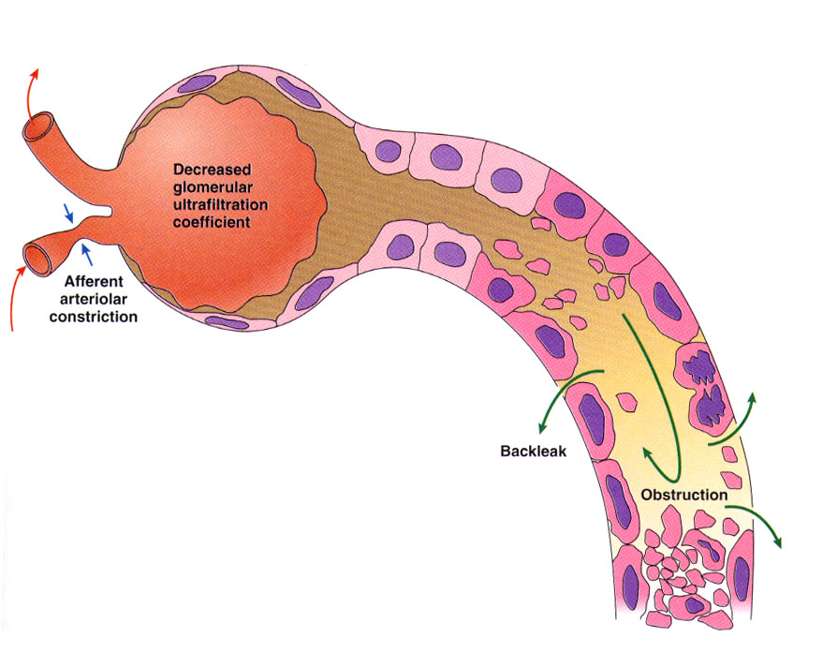
Acute Tubular Necrosis
Pathogenesis: sloughing and necrosis of epithelial cells results in cast formation. The presence of casts leads to obstruction and increased intraluminal pressure, which reduces glomerular filtration. Afferent arteriolar vasoconstriction, caused in part by tubuloglomerular feedback, results in decreased glomerular capillary filtration pressure. Tubular injury and increased intraluminal pressure cause fluid backleak from the lumen into the interstitium.

Slide 19
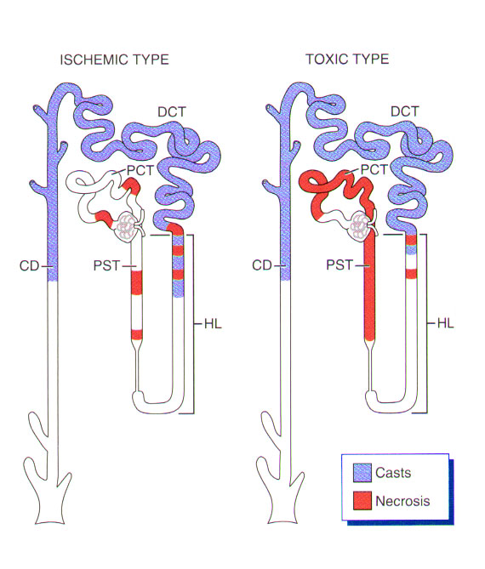
Acute Tubular Necrosis
Patterns of damage:
Ischemic:
necrosis is patchy.
relatively short lengths of tubules are affected.
straight segments of the proximal tubules and ascending limbs of Henle’s loop are most vulnerable.
Toxic:
necrosis of proximal tubule segments with many toxins.
necrosis of distal tubule may also occur.
In both types, the lumens of the distal convoluted tubules and collecting ducts contain casts.

Slide 20
Acute Drug-Induced Interstitial Nephritis
A well-recognized adverse reaction to a constantly increasing number of drugs.
Most frequently occurs with synthetic penicillins (methicillin, ampicillin), other synthetic antibiotics (rifampin), diuretics (thiazides), NSAIDs, and miscellaneous drugs (allopurinol, cimetidine).
2 weeks after exposure - characterized by fever, eosinophilia, and rash in about 25% of patients, and renal abnormalities (hematuria, mild proteinuria, and leukocyturia often including eosinophils).
A rising serum creatinine level or acute renal failure with oliguria develops in about 50% of cases, particularly in older patients.

Slide 21
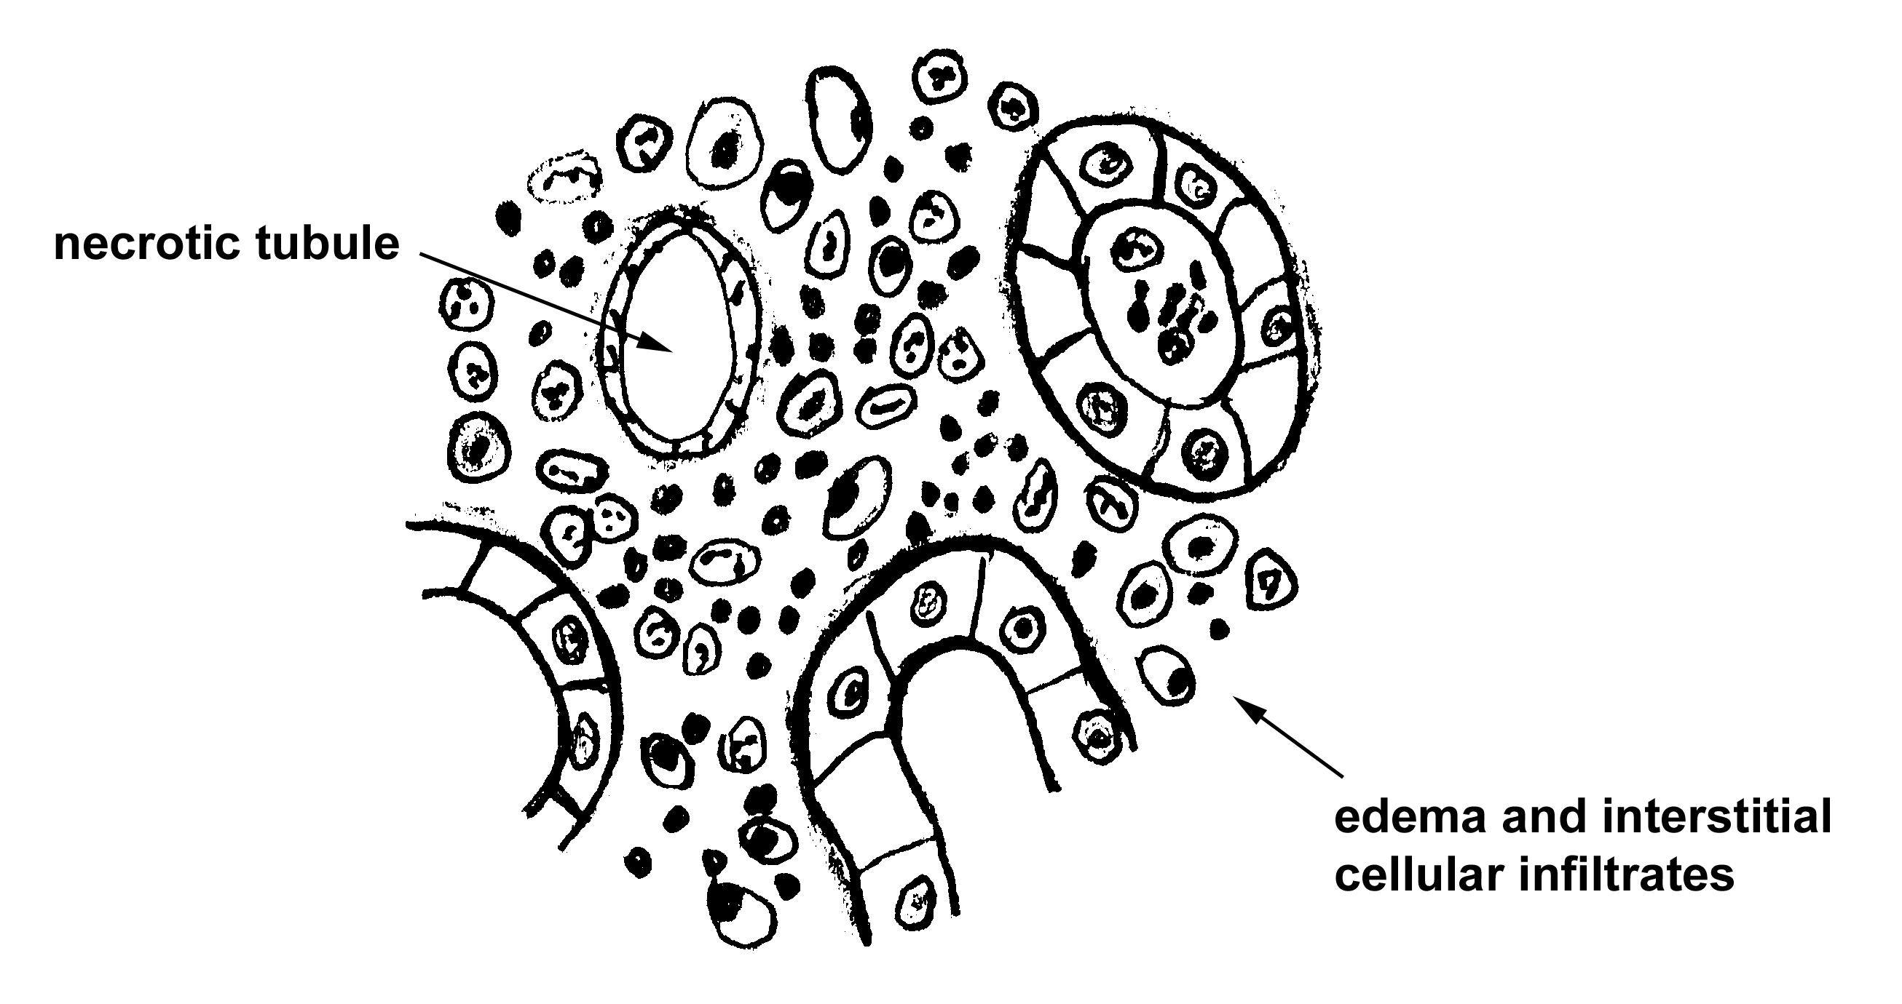
Acute Drug-Induced Interstitial Nephritis
Interstitium is affected: edema and infiltration by mononuclear cells, principally lymphocytes and macrophages.
Eosinophils and neutrophils may be present.
With some drugs (e.g., methicillin, thiazides), interstitial granulomas with giant cells may be seen.

Slide 22
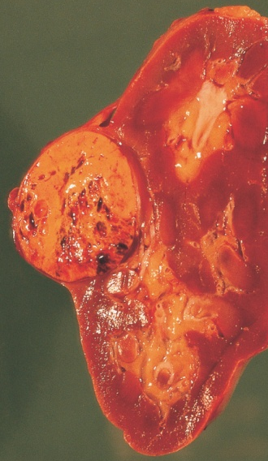
Obstructive Disorders
Renal Calculi
Etiology: Calcium, Uric acid, Urine crystals
Symptoms: renal colic, chills, fever
Risk factors: prolong dehydration, prolong immobilization, infection
Treatment: surgery, lithotripsy
Anomalies
Strictures
Pelvic kidney
Tumors
Note that primary symptom = hematuria (painless)
Renal Cell Ca = most common, unilateral, adeno Ca from tubular epithelium
See picture
Bladder Ca = usually from transitional epithelium

Slide 23
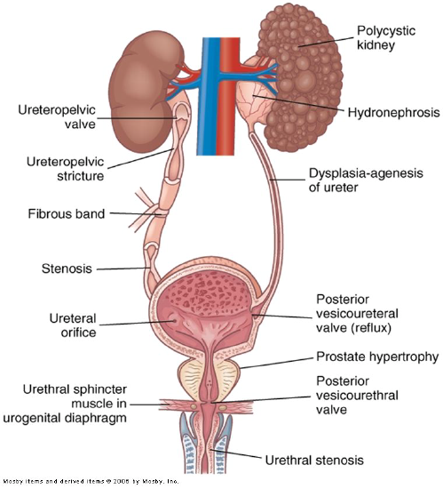
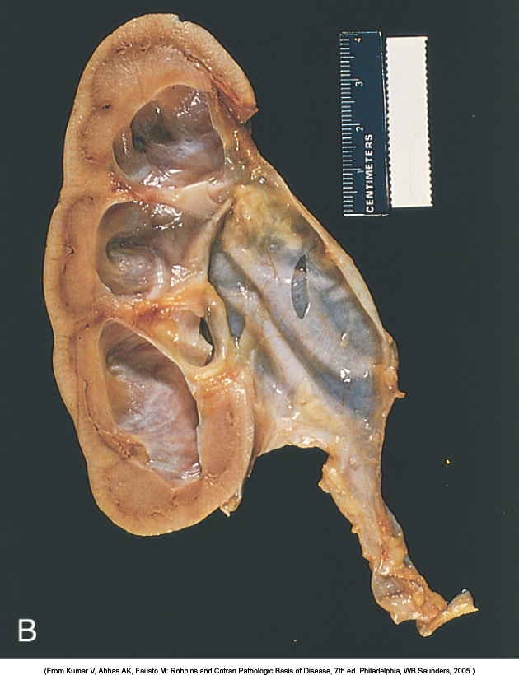
These result in:
Hydronephrosis
Hydroureter
Major sites of urinary tract obstruction

Slide 24
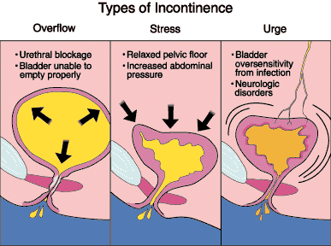
Incontinence, retention
Urinary Incontinence
Loss of voluntary control of bladder
Frequently called “neurogenic bladder”
Many causes
Enuresis = involuntary control after age 4 or 5
Types:
Stress
Urge
Overflow

