Slide 1
Procedures with amputated parts and preparing for replantation (reimplantation, revascularisation)
Plastic, Reconstructive and Aesthetic Surgery and Burns
Surgery 2015/2016
Primarius, Ass. prof. Zdravko Roje, M.D.

Slide 2
Definition:
… replantation is operating procedure that is carried out after amputation injury and with it establishes the circulation and reconstruct all anatomical structures for a function more important amputated part

Slide 3
History of the replantation
First replantation of the upper extremity in the level of the elbow:
1962-12.y. children: Malt i McLehman, Boston
1962.- First revascularization of the finger in human: Klainerth i Kasdan, Kentacky, USA
1963.- First replantation cases in China - Chen and Co.
1965.- First replantation in Japan - Komatsu and Tamai
1968.- First reconstruction of thumb of the hand – Toe to thumb transfer- Cobett, USA
MARKO replant, Godina, 1981.
Book: History of the replantation: Kleinerth and Co, 1991.

Slide 4
Indications for replantation
Microsurgical center and good microsurgical team
Decision always be individualized
Technique for micro replantation
Technique for micro replantation
Type of the amputation injury
Condition of the amputated stump
Condition of the amputated part
Alo-transplantation
Time of worm ischemia
Year of age, profession, motivation, and all.
Expected result, i. e. functional recovery, and all.
Morbidity, rehabilitation, return to work and life (QL)

Slide 5
Amputations
Definition:
Macroamputation
Hand – RC articulation
Lower leg – TC articulation
Microamputation
Hand and the lower extremity
Multilevel amputations
A. total amputation: division of all anatomical structures
B. subtotal amputation: preserved the bridge of skin, blood vessel, or other tissue
> Muscle masse & < time for ishemic tolerance
Re-vascularisation
Procedures in case of the subtotal amputation

Slide 6
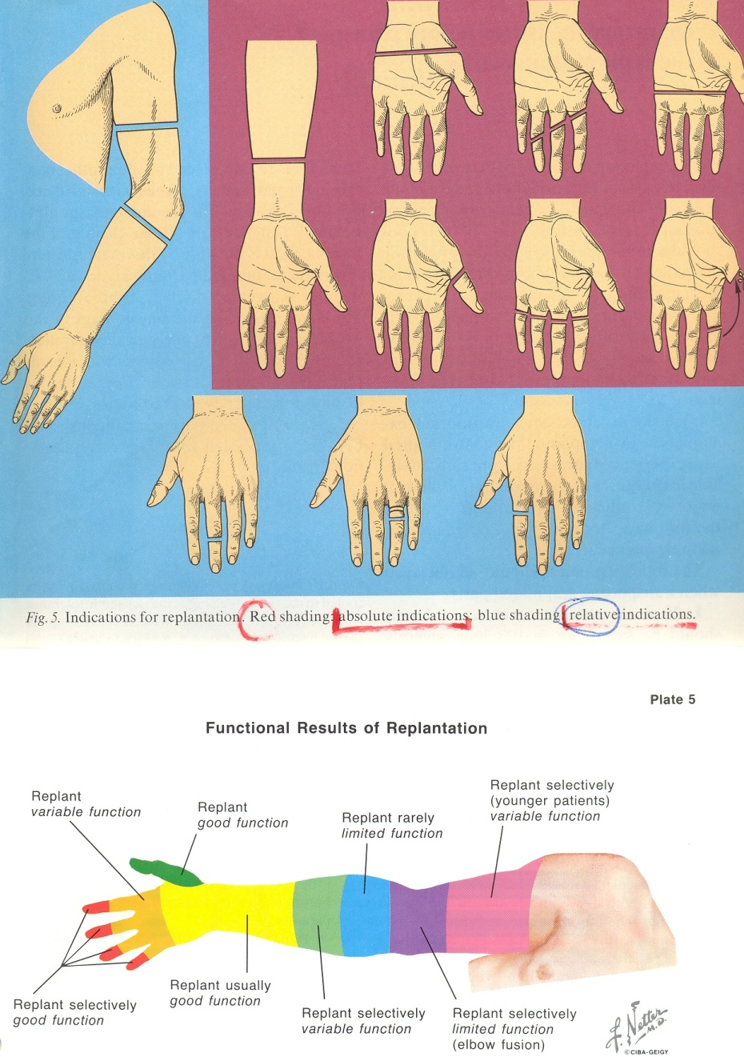
Shema of the amputations
Macro and micro amputations

Slide 7
Replantation
Time for replantation.....
The time elapsed since injury (Time of the worm ischemia)
Time of the worm ischemia for micro-replantation
( < muscle masse)
Time of the worm ischemia for macro-replantation
( > muscle masse)
Amputated part (Replant)
Smooth cutting injury
Conquasation
Avulsion injury
Conditions of the soft tissue, bone, tendon, blood vessels , nerves, joints at all.

Slide 8
Replantation
Amputated stamp :
- Stop bleeding; Torniguet
- No use of the vascular cleme or peans
- Aseptic debridement of the amputated stump
- Treatment of general conditions and traumatic shock
- Preparation for transport and replantation
Amputated parts (Replant):
- Aseptic debridement of the amputated part
- Plastic bag with ice (Ice prolonged ischemic time of the amputated part)
- Transport packaging: termos suitcase or portable refrigerator (+4⁰C)

Slide 9
Procedure with amputated part or replant
Obrada amputata:
skraćenje amputata: posebno koža, mišićna masa, tetivni dio, koštani skelet, zglob, NVS i dr. tkiva

Slide 10
Replantation
Absolute indication for replantation:
Amputation injury in childhood
Thumb amputation
Amputation of the multilevel
Trans-metacarpal amputation and radio-carpal amputation

Slide 11
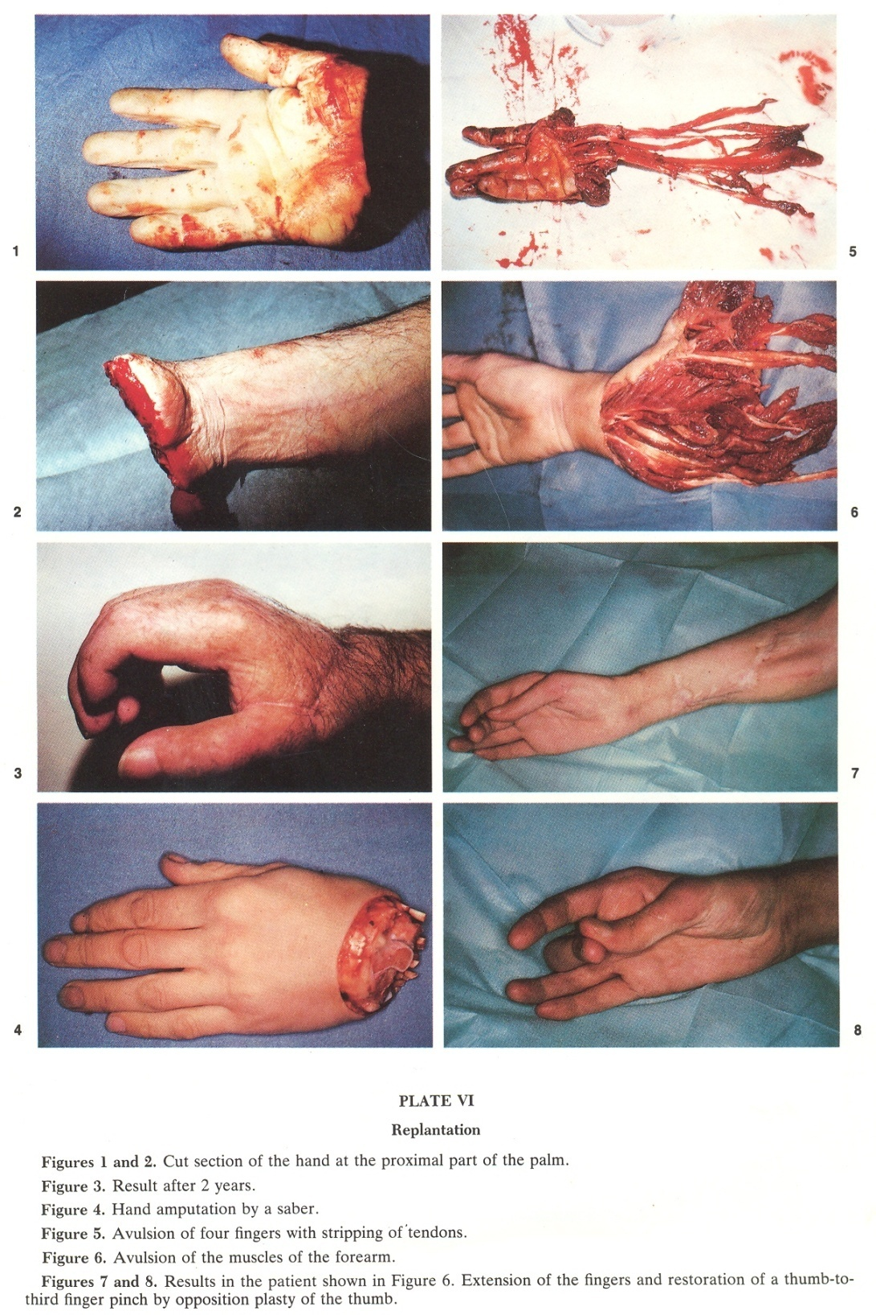

Slide 12
Replantation
Contraindications:
Absolute contraindications:
heavy general condition
extensive conquasation, avulsion injury et all.
Relative contraindications:
patient age, bed general condition, multilevel amputation,
singe digital amputation, expected for the thumb
huge, dirty wound of amputated part

Slide 13
Replantation
Surgical technique:
Type of the anesthesia
Stabilzation of the general conditions and vital sings
Preoperative examination of the replant and amputated stamp
General roles:
Reconstruction of all functional structures during the first operation
Principles of treatment of each particular structures
(Bone, soft tissue, blood vessels at all.)
Blood coagulation and vazospasam
Tissue incompatibility & Immune supression
(i.e. Alo-transplantation)

Slide 14
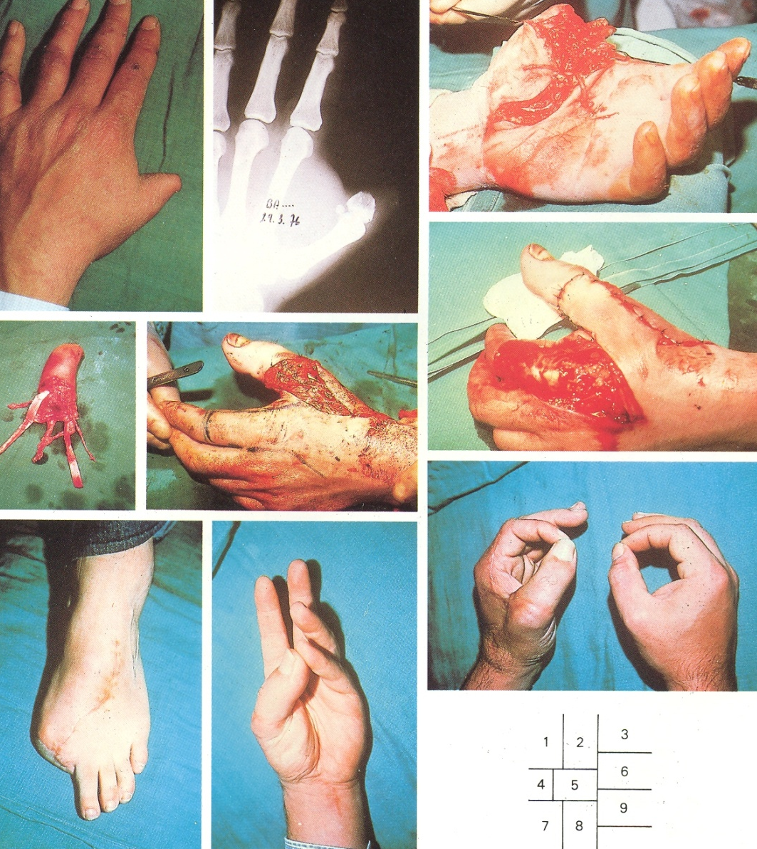

Slide 15
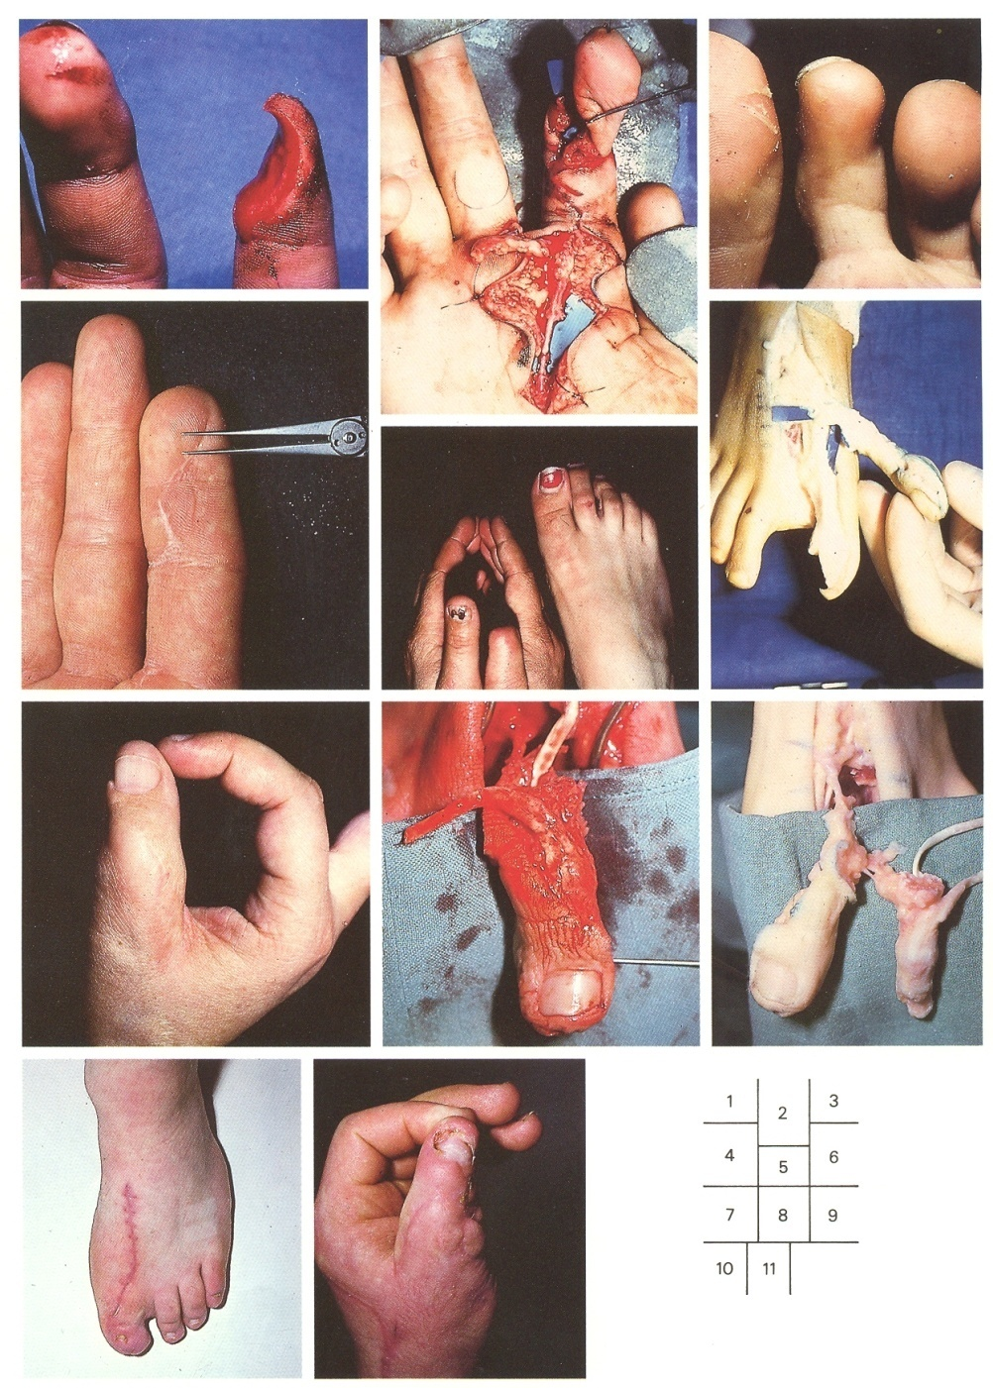

Slide 16
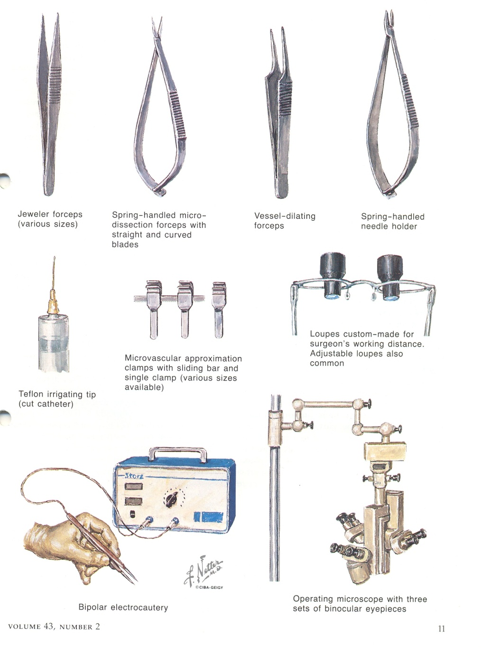
Microsurgical instruments and devices

Slide 17
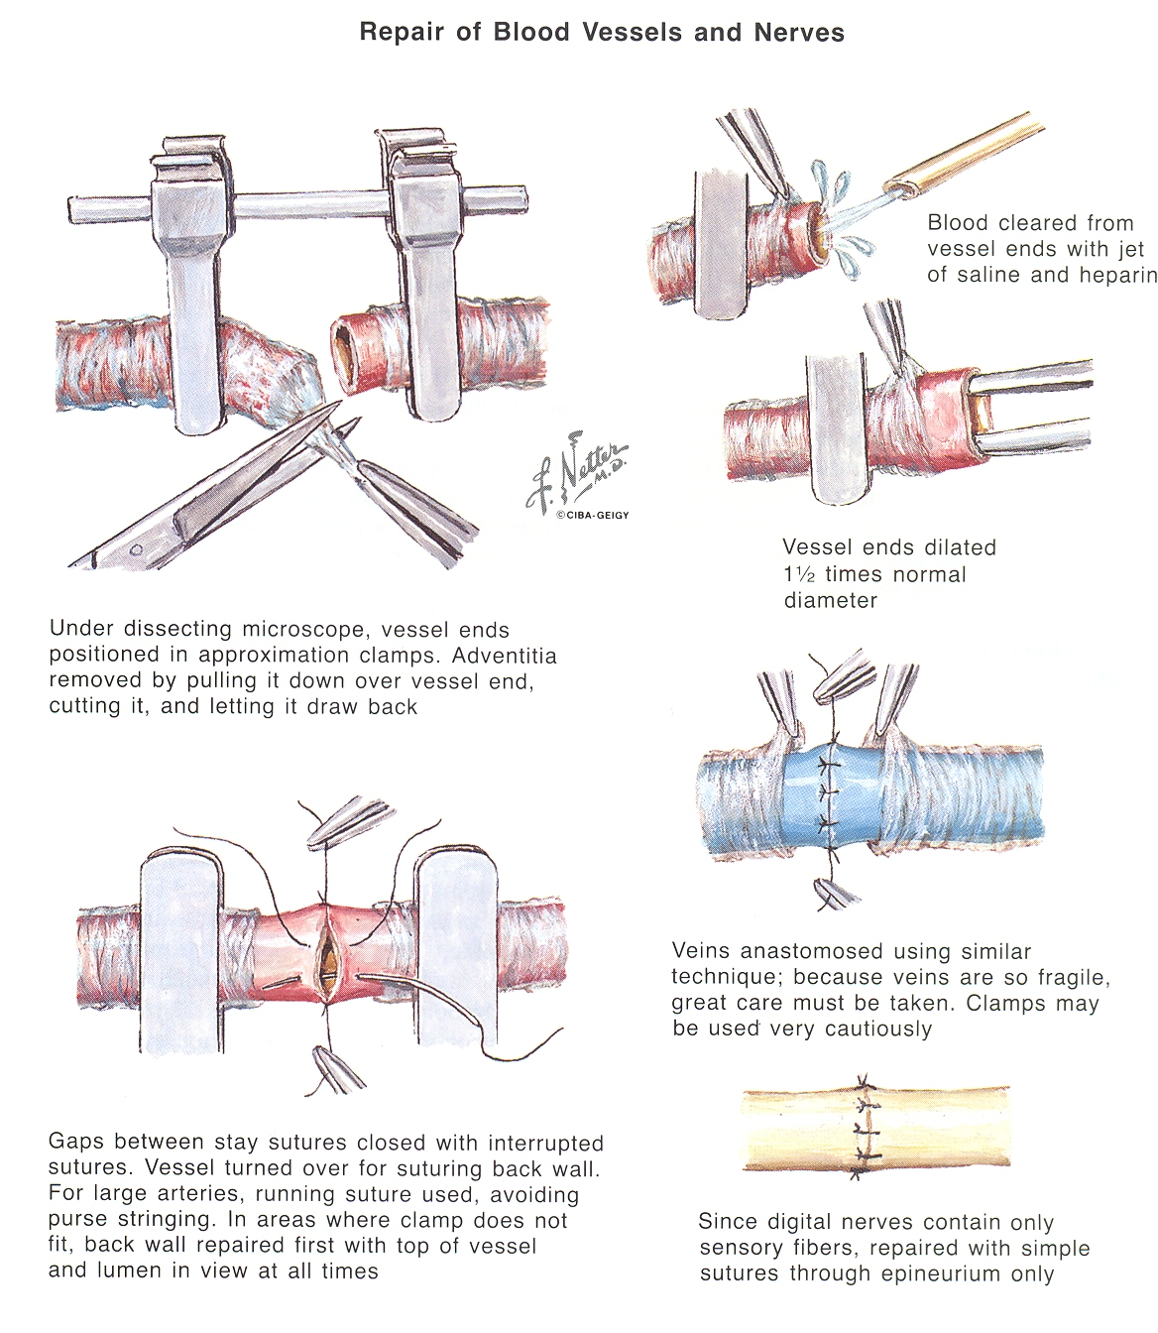
Micro-anastomosis of blood vessels

Slide 18
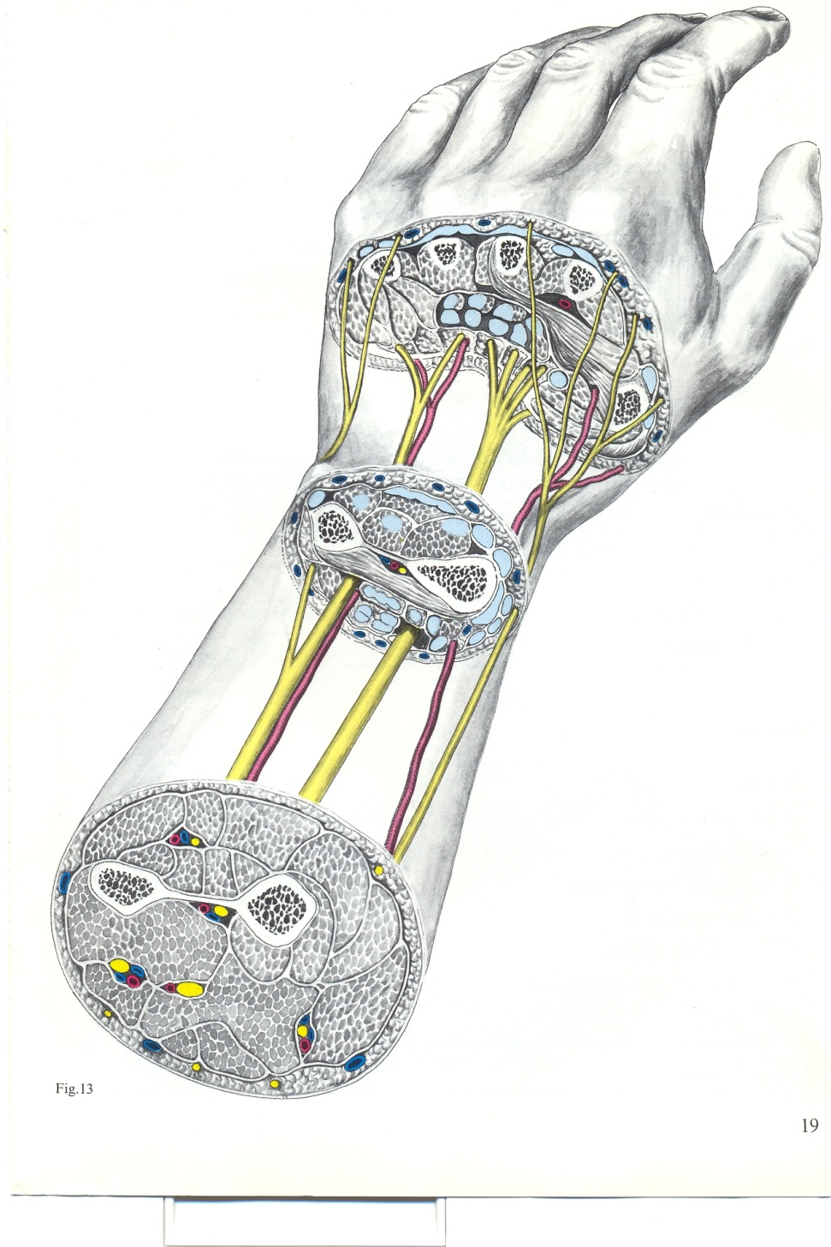
The hand-Sections at several levels

Slide 19
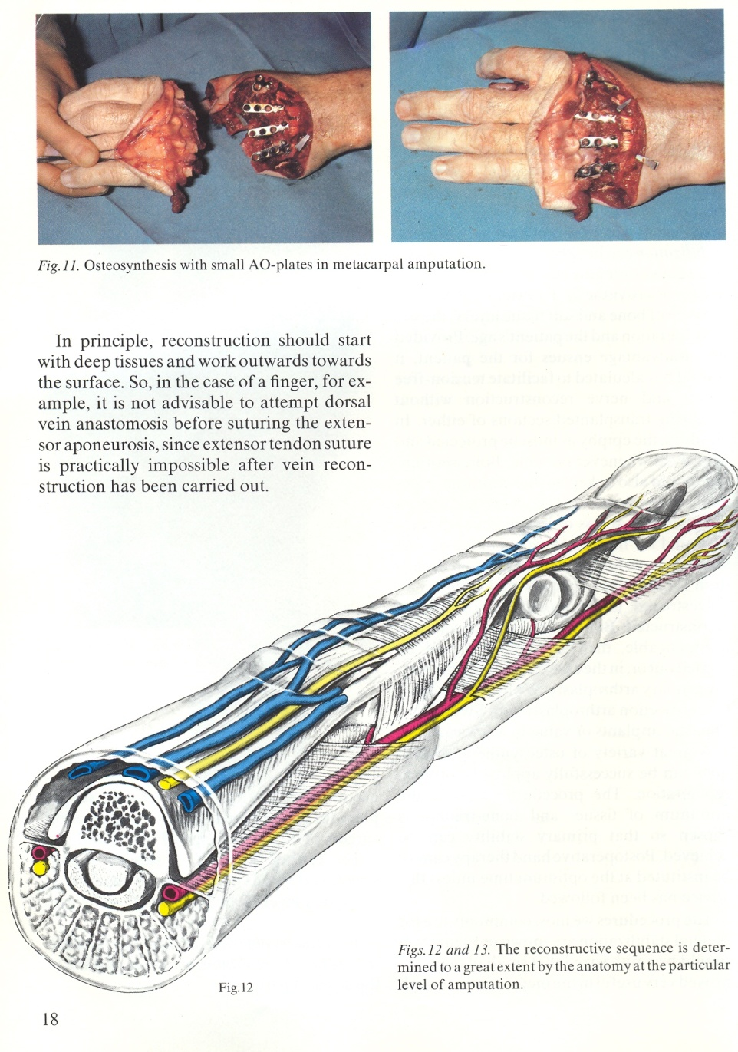
Metacarpal amputation-A.O. Transection of finger- NVB

Slide 20
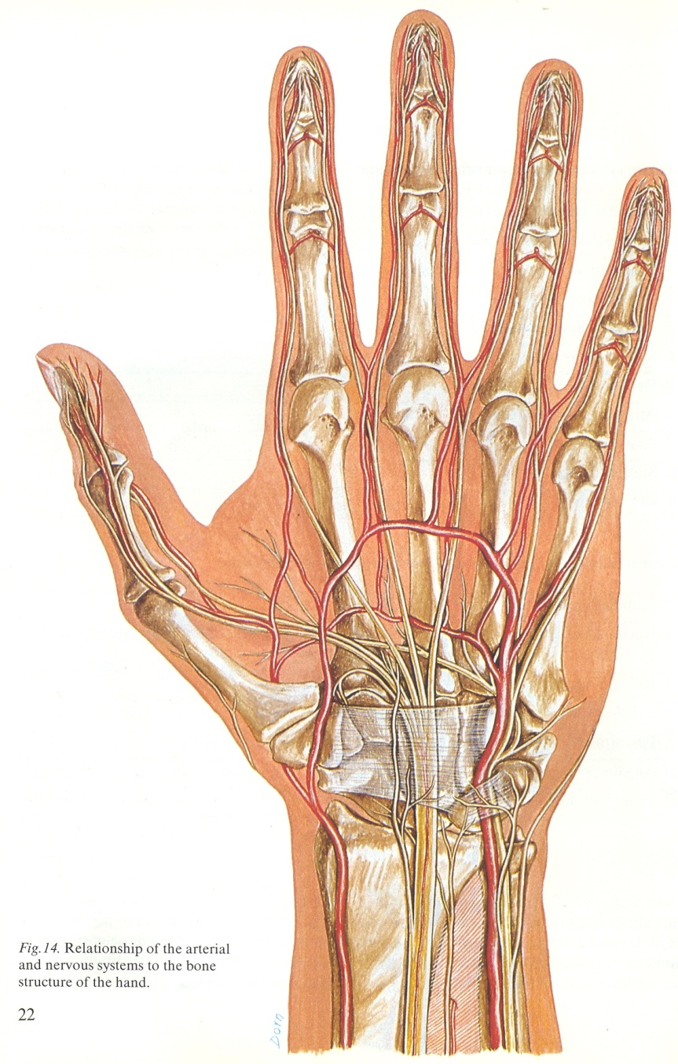
The blood supplies

Slide 21
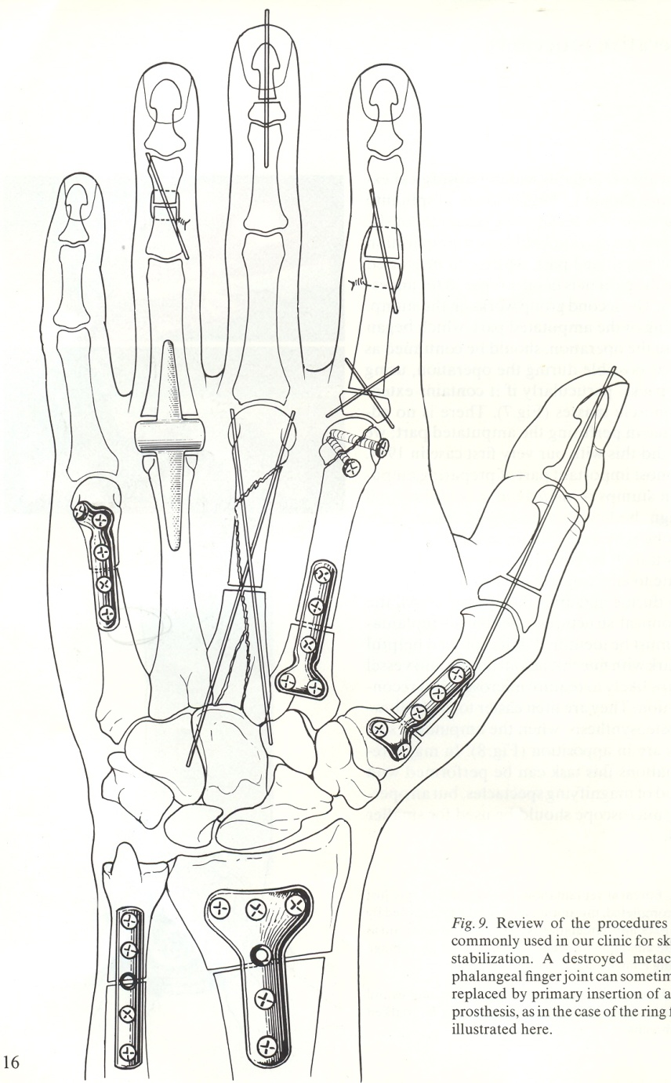
AO-osteosynthesis

Slide 22
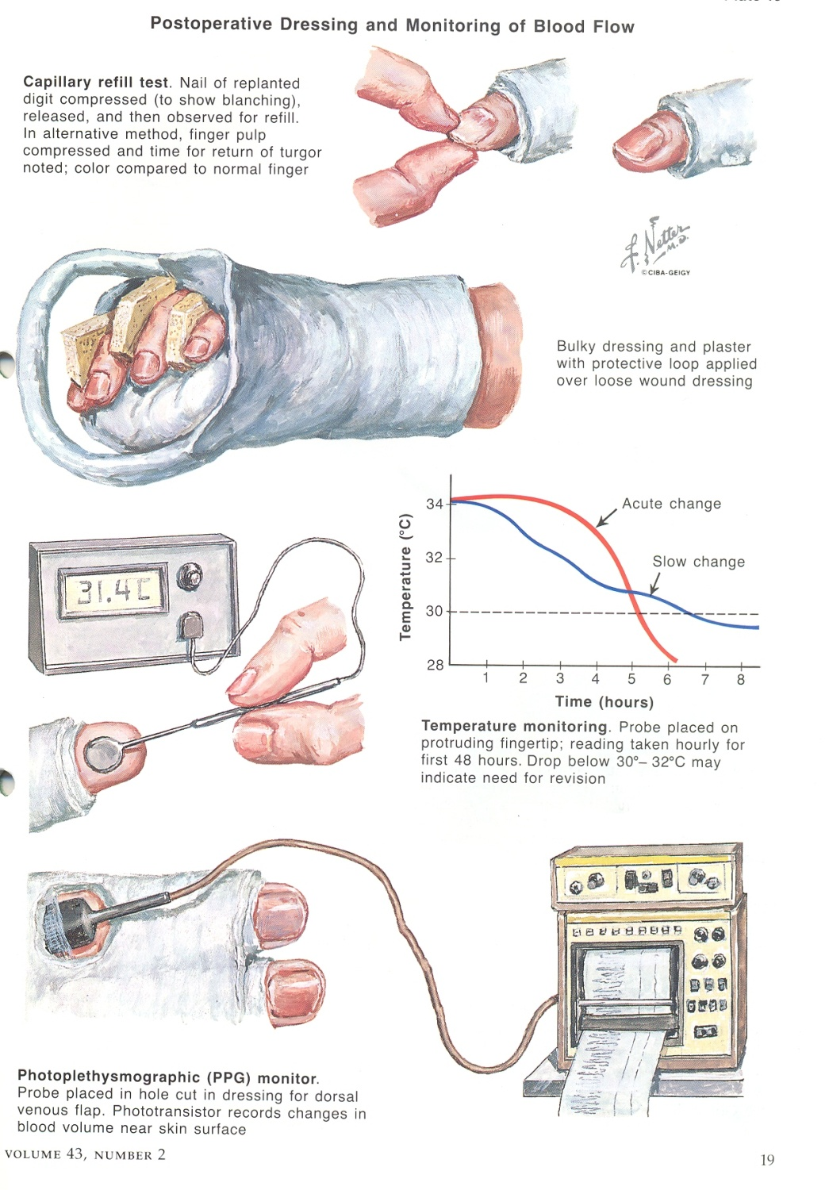
Postoperative control

Slide 23
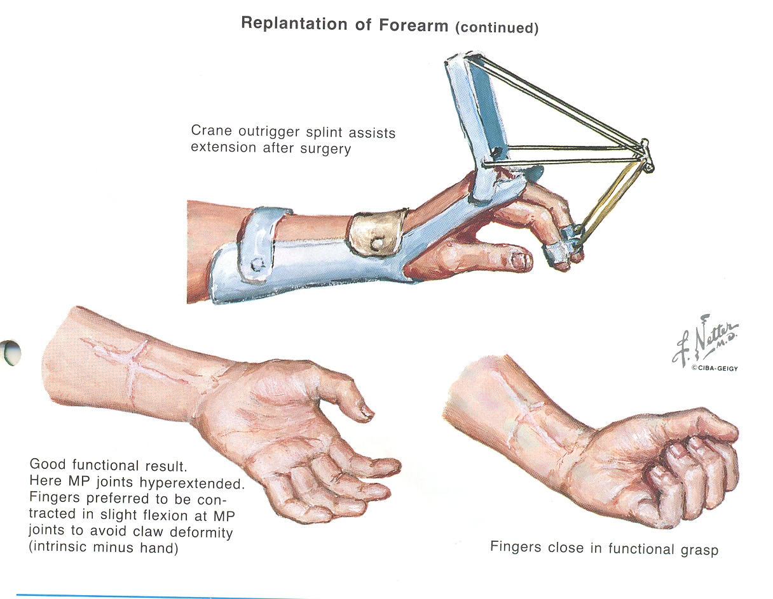
Replantation-Early physical therapy

Slide 24
Replantation
Post operative period
Complications:
- early complications
- late complications
Postoperative compartment syndrome
(Timely fasciotomy)
Static and dynamic imobilisation
Physical therapy and rehabilitation
Secondary operations

Slide 25
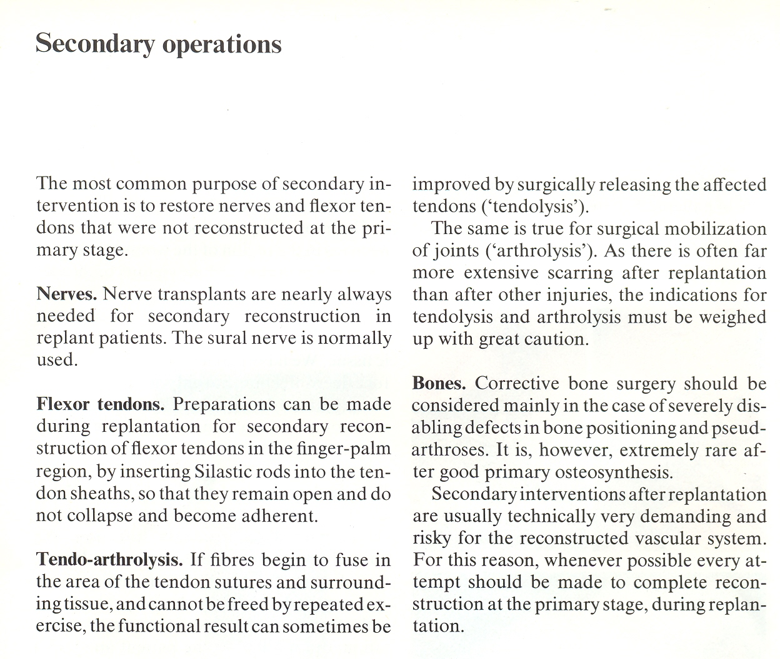
Secondary operations

Slide 26
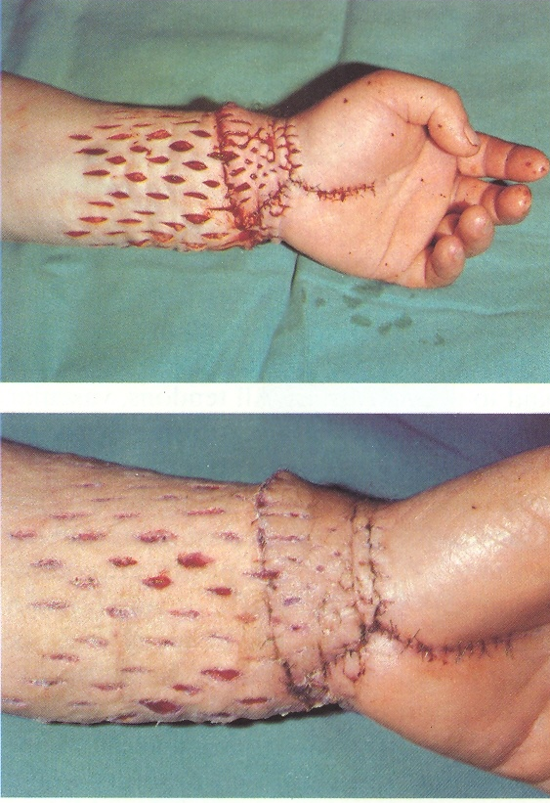
Compartment syndrome of the forearm

Slide 27
Complication

Slide 28
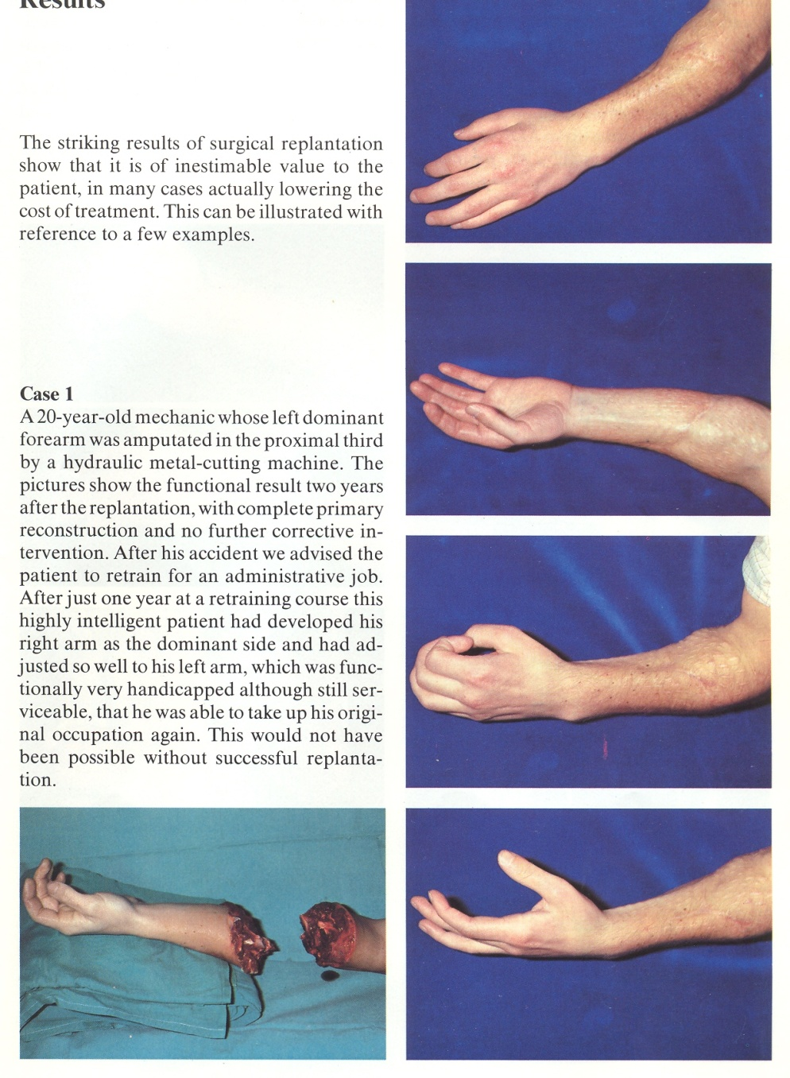
Forearm amputation

Slide 29
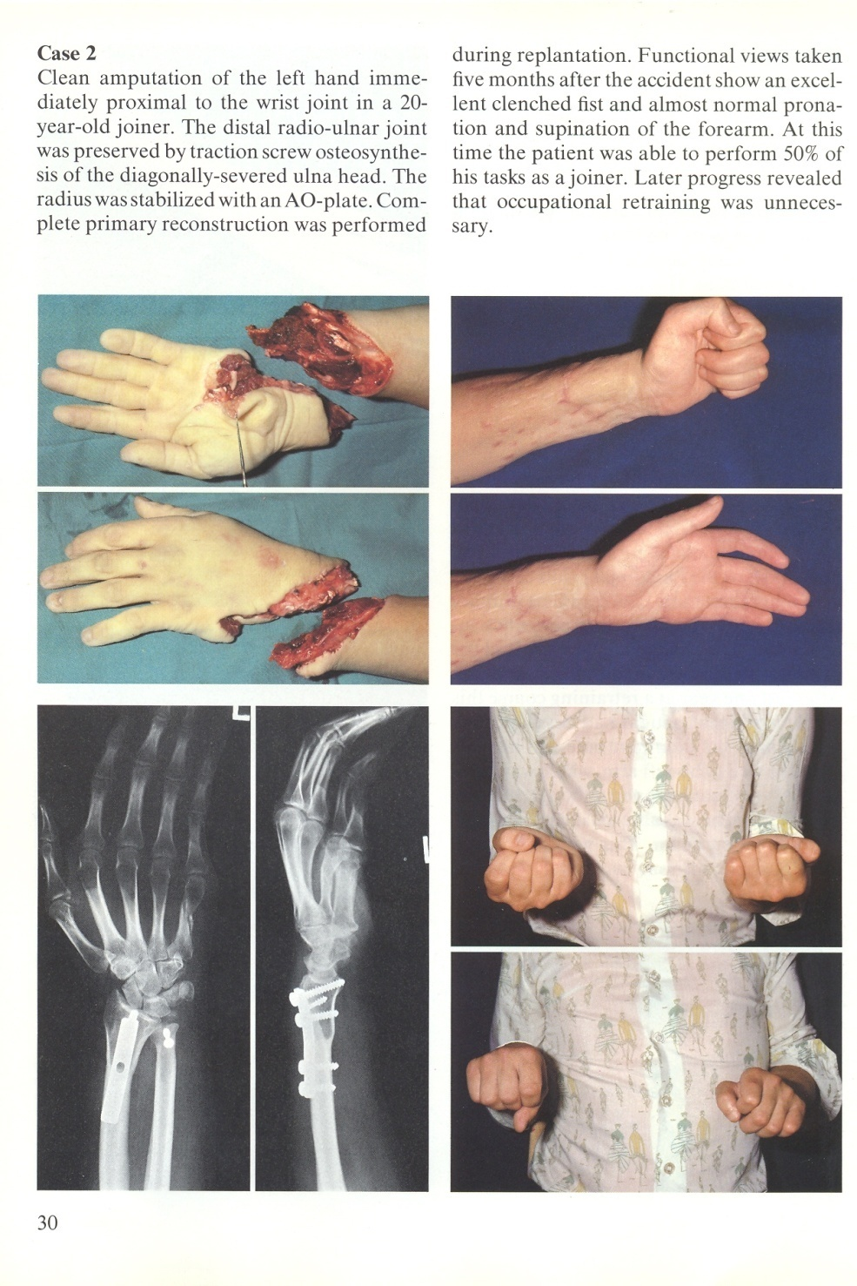
Distal forearm amputation

Slide 30
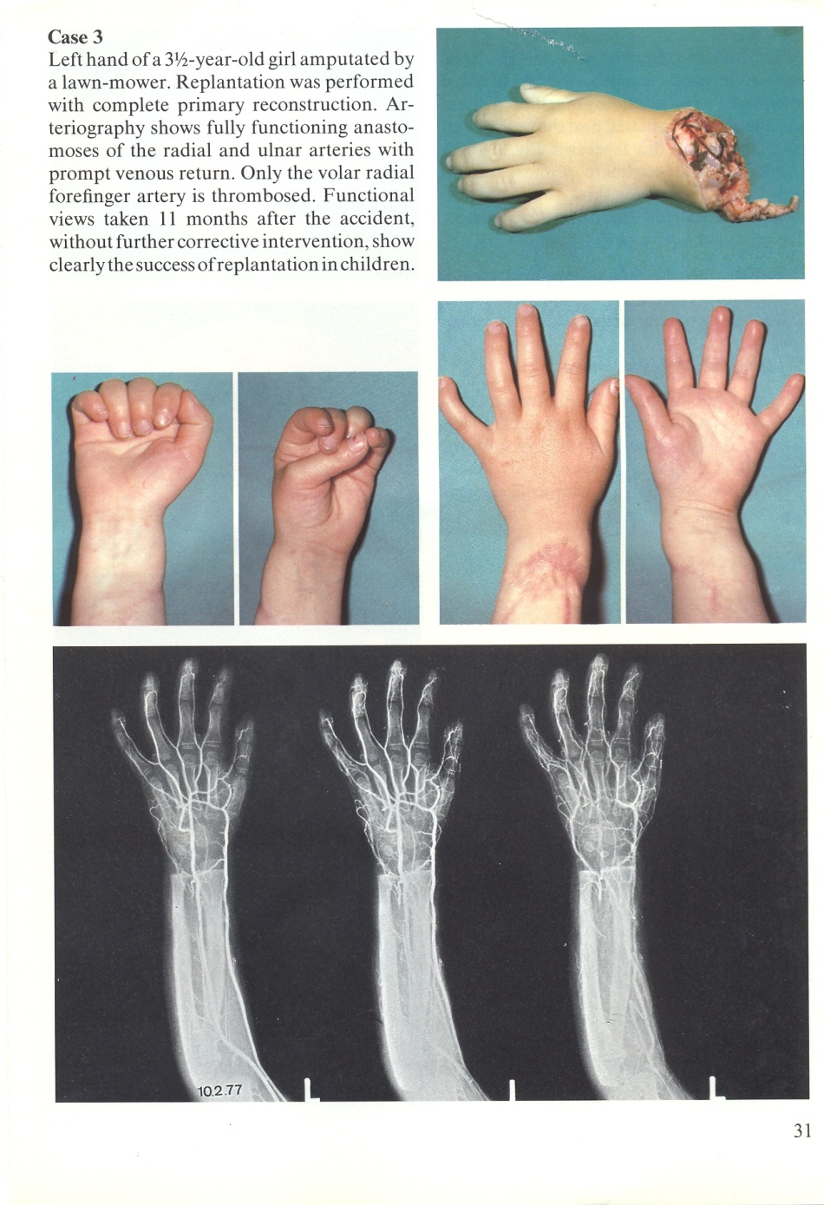
Radiocarpal amputation
Radiocarpal amputation

Slide 31
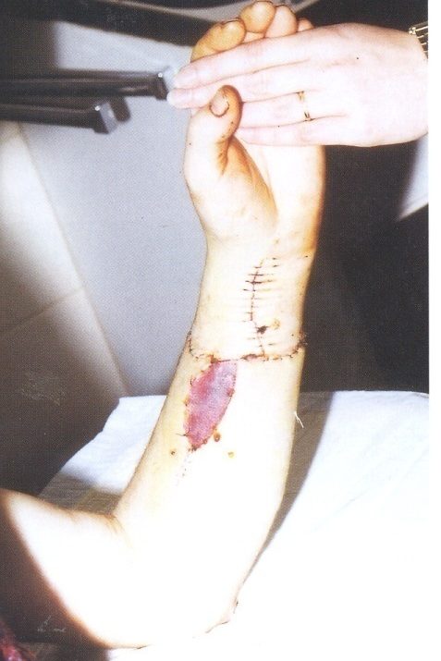
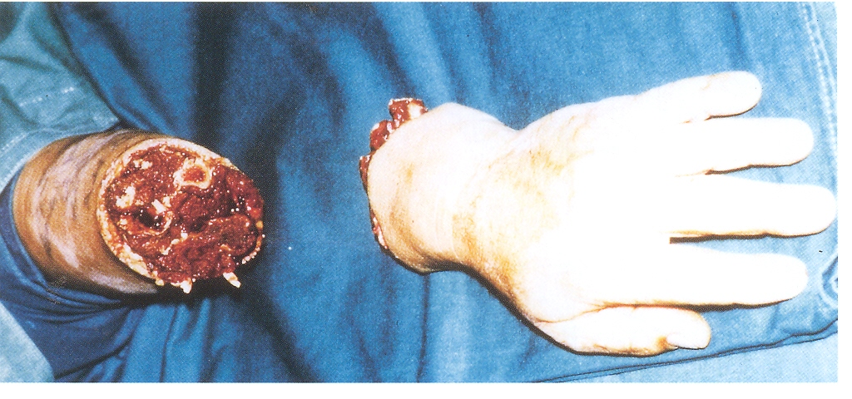
Forearm amputation

Slide 32
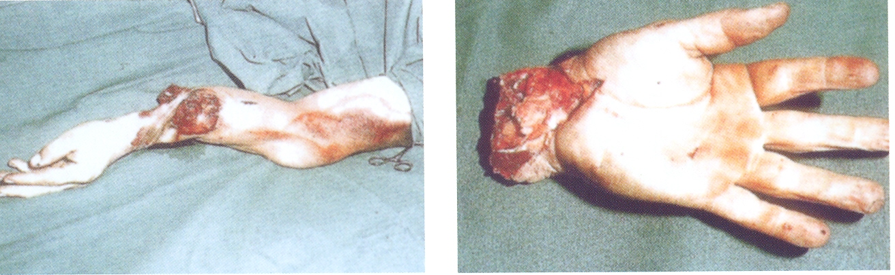
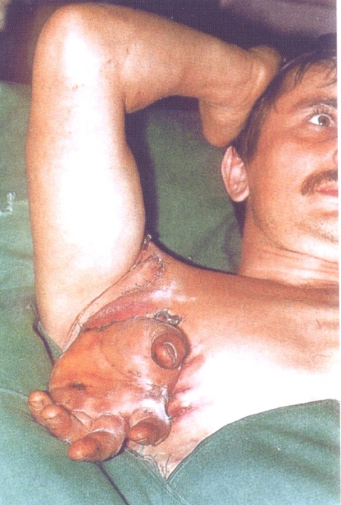
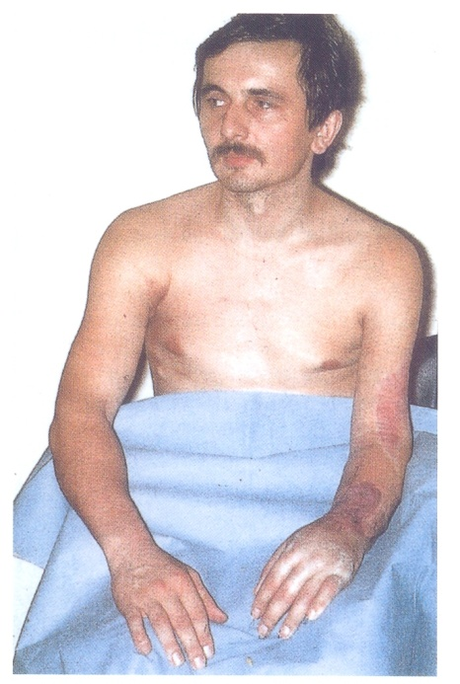
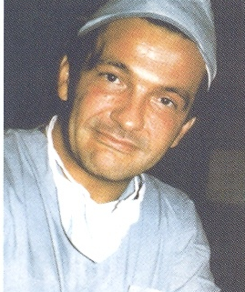
Radiocarpal amputation
Marko implant

Slide 33
Transmetacarpal amputation

Slide 34
Transmetacarpal amputation

Slide 35
Thumb amputation

Slide 36
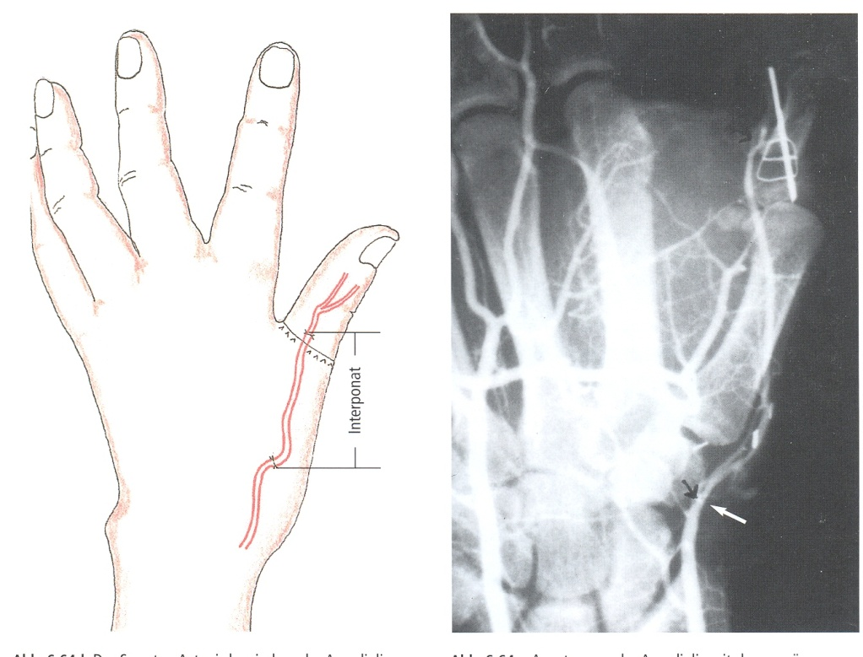
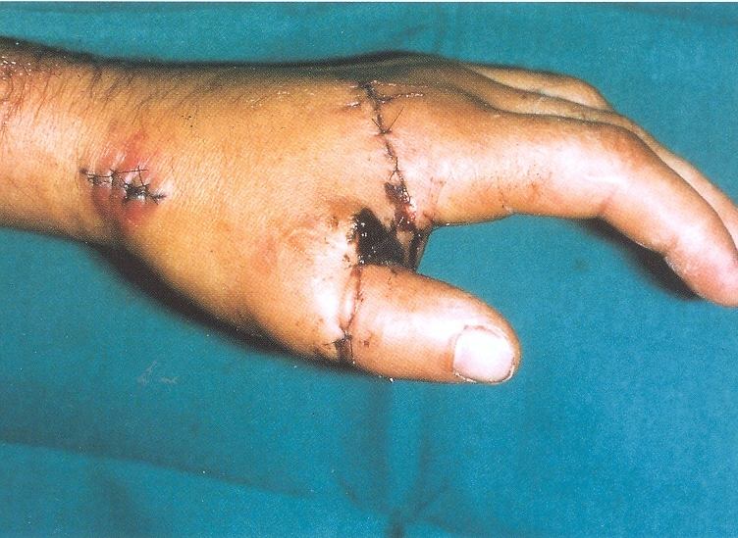
Thumb amputation-Interponat

Slide 37
Thumb amputation- K.I.

Slide 38
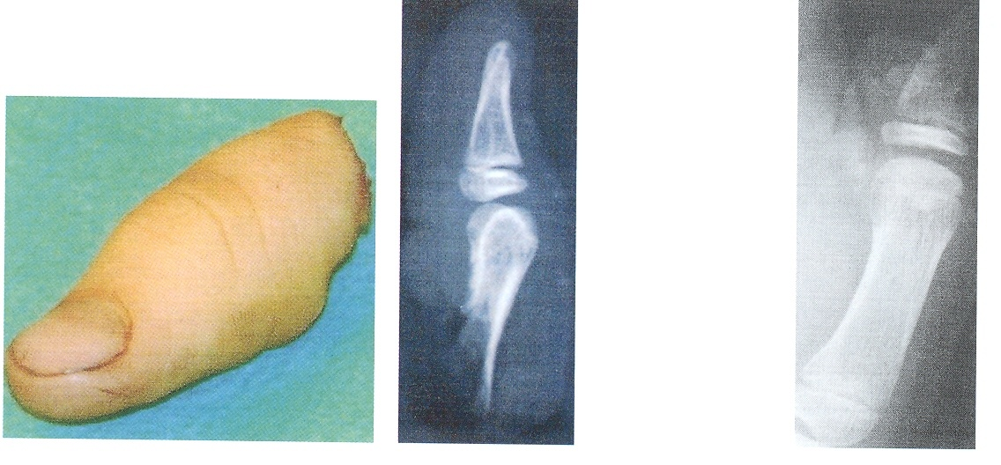
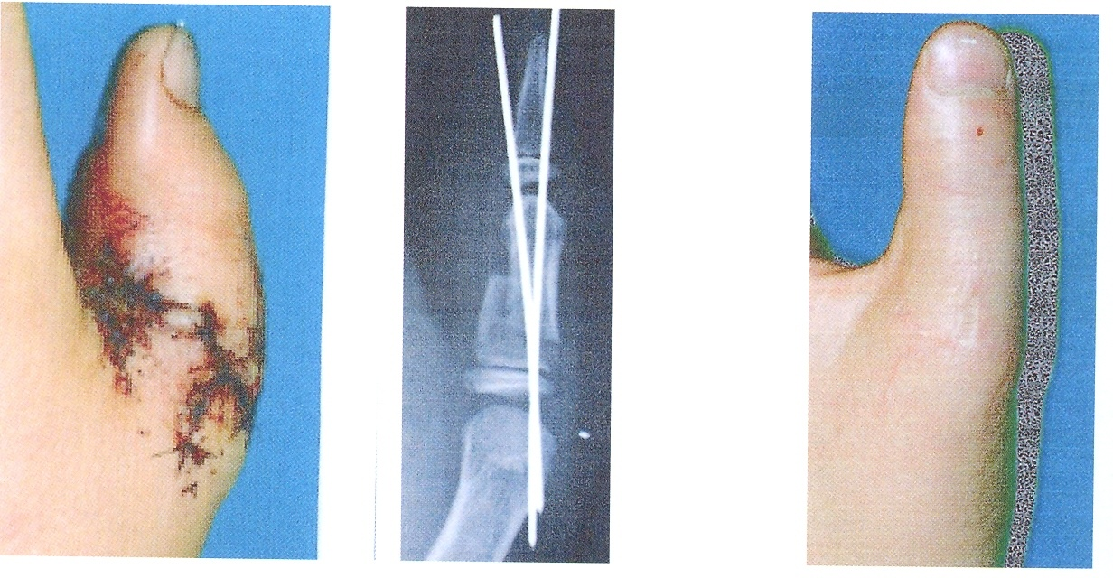
Thumb amputation

Slide 39
Amputation of two fingers

Slide 40
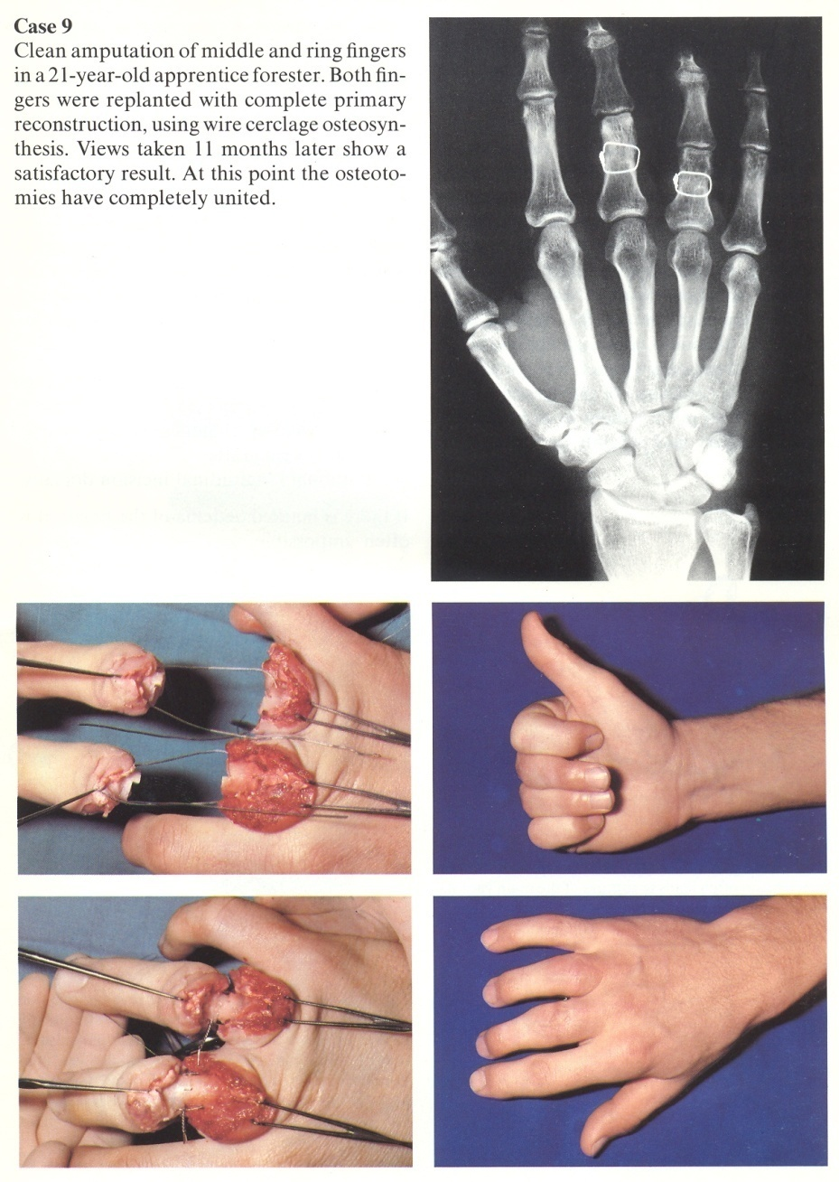
Amputation of two fingers
Two fingers amputation

Slide 41
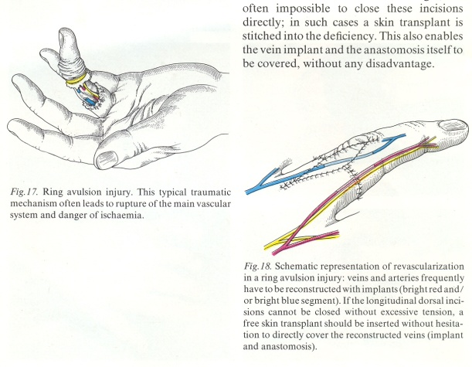
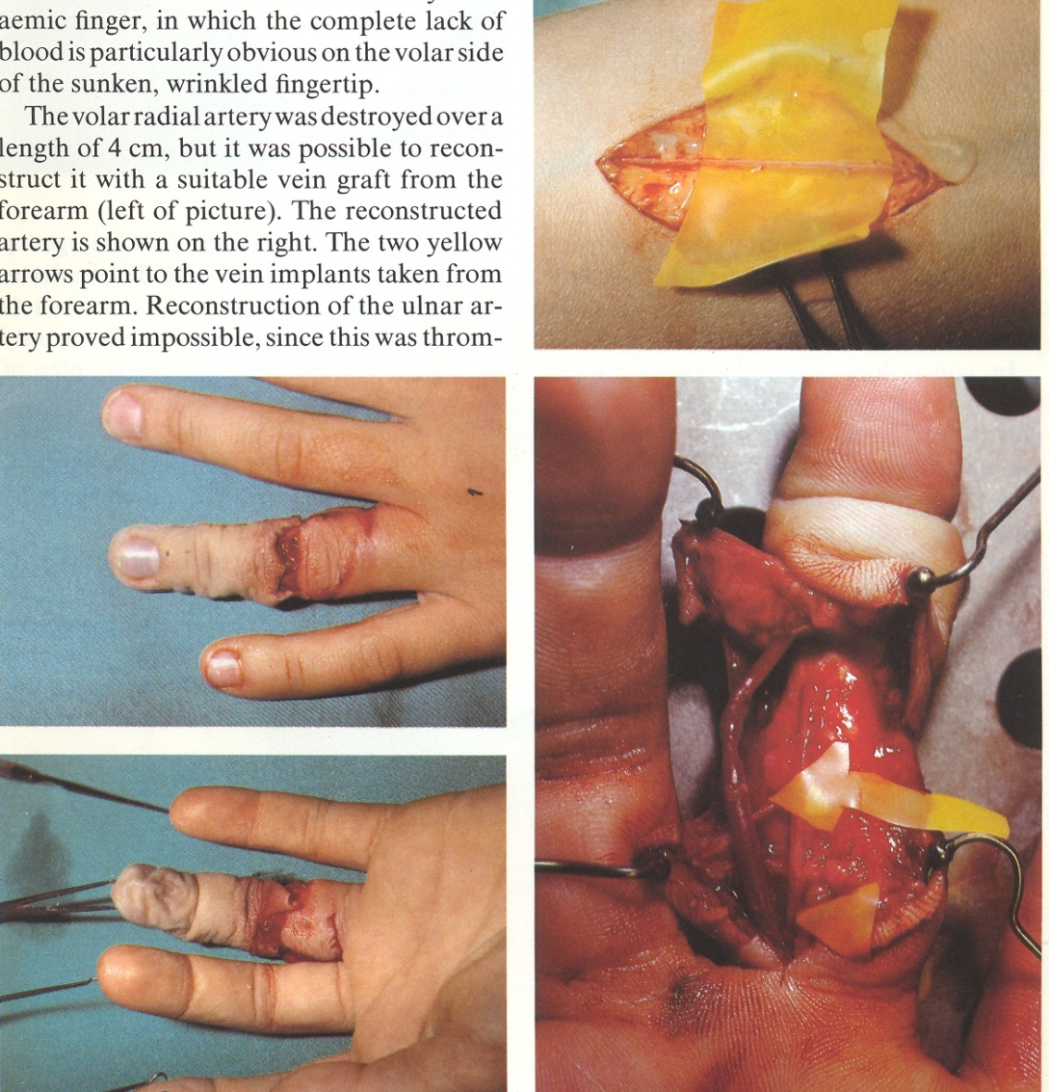
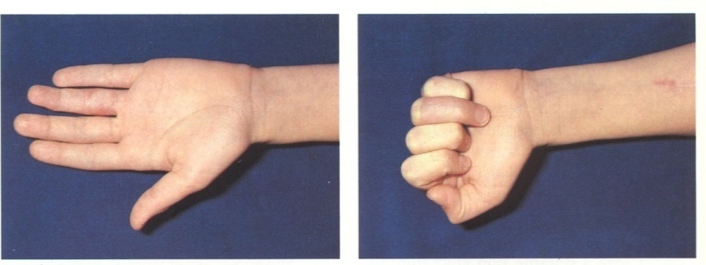
Avulsion injury
Avulsion injury

Slide 42
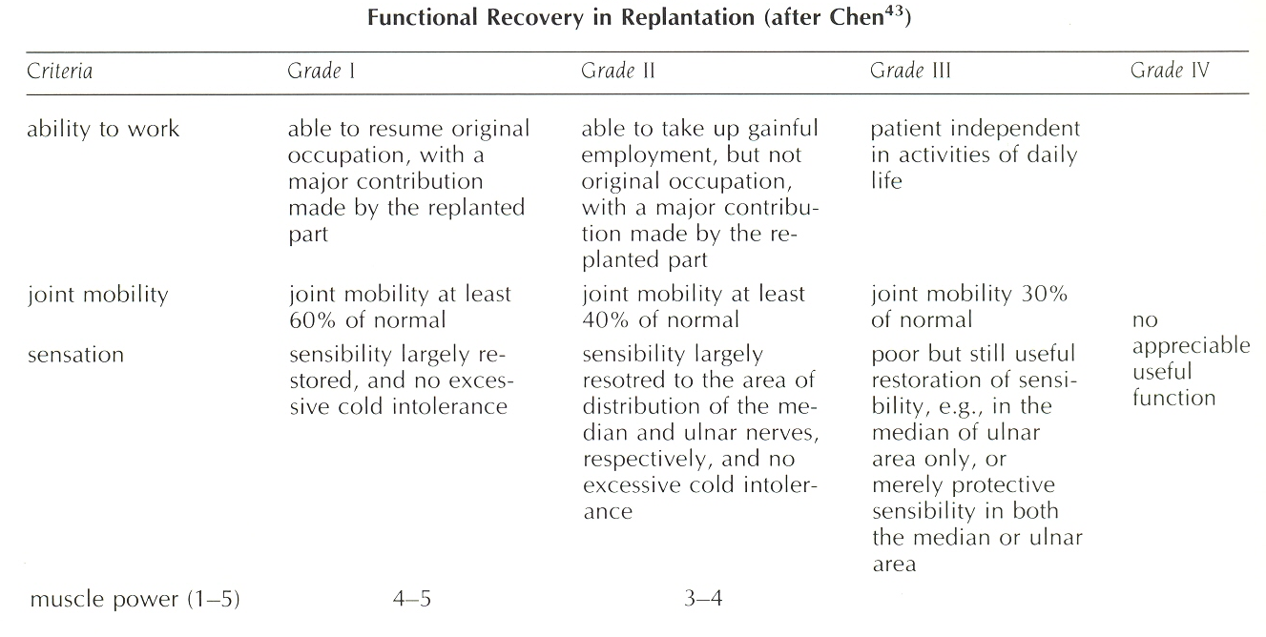
Results

