Slide 1
Hematologic Malignancy Mutations
ASCLS-ND Presentation, Monday April 25, 2022
mary.coleman@UND.edu

Slide 2
Objectives
The participant will be able to:
recognize hematologic malignancy mutations
correlate various mutations with specific hematologic malignancies
appreciate the complexity of specific hematologic malignancies

Slide 3
Introduction
No financial disclosures
My reason for topic choice: to learn more about this interesting and important topic in hematologic malignancies
In the last 30 years, the field of hematopathology:
Development of a classification system defining distinct, real entities, as outlined in the WHO classification of hematologic neoplasms
Advances in sophisticated immunophenotyping such as flow cytometry, and most recently an explosion in molecular/genetic testing that greatly expands how we understand the pathophysiology of hematologic disease.
Some of these advances in hematologic malignancy diagnosis will be discussed.
Notes:
Molecular Hematopathology, Beck and Moore, preface: In the last 30 years, the field of hematopathology has undergone several revolutionary periods, including the development of a classification system defining distinct, real entities, as outlined in the WHO classification of hematologic neoplasms, advances in sophisticated immunophenotyping such as flow cytometry, and most recently an explosion in molecular/genetic testing that greatly expands how we understand the pathophysiology of hematologic disease. Some of these advances if hematologic malignancy diagnosis will be discussed.

Slide 4
How Mutations Occurs
We all make mutations. When DNA is miscopied and not corrected, a mutation or a new polymorphism can occur.
Mutation is used to describe a deleterious change in a gene.
Polymorphism is used to describe the presence of multiple alternate copies ( alleles) of a gene and generally does not result in a functional abnormality. E.g. Single nucleotide polymorphism (SNP)
Some causes of mutations could be radiation, some viruses, some chemicals, or idiopathic/unknown causes
It is estimated that about 0.01% of 6 billion base pairs are copied incorrectly during DNA replication.
Fortunately we have mechanisms in place to stop mutations, and some of these mechanisms will be discussed.
Unfortunately mutations do occur. More than 50% of individuals with leukemia show an acquired abnormal karyotype in hematopoietic cells whereas other somatic cells are normal, or they have an aberration at the DNA level. In either case, the genomic changes in the abnormal cells lead to a survival and/or proliferative advantage over normal cells.
Notes:
McKenzie, 2021, p. 14. A region of DNA that differs in only a single DNA nucleotide is called a single-nucleotide polymorphism (SNP). SNPs are found in ~ 1 in every 1000 base pairs in the human genome ( resulting in about 2.5 million SNPs in the entire genome of a cell). To be considered a true polymorphism, a SNP must occur. with a frequency of more than 1% in the general population. If the SNP causes a disease, it is called a mutation. McKenzie, 2021, p. 23: Scattered throughout the human genome are genes that have the potential to cause cancer ( proto-oncogenes) and when then proto-oncogenes become activated through a mutation they are called oncogenes. Other genes have the power to block to block the mutations called tumor suppressor genes. In normal cells, proto-oncogenes encode proteins that promote the initiation of DNA replication, regulate cellular differentiation, and/or inhibit apoptosis. Conversely tumor suppressor genes function in opposition to proto-oncogenes. Mutations in proto-oncogenes result in growth-promoting activity, while mutations in tumor suppressor genes inactivate growth suppression; in either case, mutations in these genes contribute to tumor development.
Mckenzie, 2021, p. 499: cancer is a disease of gene mutations. Hematopoietic neoplasms are believed to occur as the result of a somatic mutation of a single hematopoietic stem or progenitor cell. Evidence for the clonal evolution of neoplastic cells comes from cytogenetic studies. More than 50% of individuals with leukemia show an acquired abnormal karyotype in hematopoietic cells whereas other somatic cells are normal. Using cytogenetic markers, normal and malignant cells can be demonstrated to populate the marrow simultaneously. In untreated leukemias and during relapse, the leukemic cells dominate, whereas during remission, usually only normal cells can be detected. … The mutations leading to malignant transformation of the cancer stem cell often are associated with an abnormal karyotype. When chromosome abnormalities are not found, aberrations may be at the DNA level. In either case, the genomic changes in the cancer cells lead to a survival and/or proliferative advantage over normal cells. … Molecular basis of cancer and leukemias
Strom , 2016. p2: mutations are events that result in changes of genomic DNA. Variants are deviations from the human genome reference sequence observed in a specimen.

Slide 5
General Principles of Blood Cell Production
Formation of cells in bone marrow and delivery to peripheral blood involves:
Stem cells differentiating to progenitor cells to maturing cells
Multiplication by mitotic division
Maturation
Release
Fig. 4.5, p. 52 2020 ed. Mckenzie et al.

Slide 6
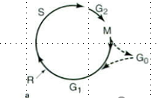
Cell Cycle For Multiplication
Stages Name DNA ploidy Time
G₁ Gap 1 2N 9 hrs
S DNA synthesis increasing 6 hrs
G₂ Gap 2 4N 3 hrs
M Mitosis back to 2N 1 hr
Cells at S phase become 4N and are larger than those at 2N stage.
Cells at M phase are 2N. Normal mature cells have 2N ploidy level
G_{o} is the resting stage for the hematopoietic stem cells
Notes:
The restriction point (R), also known as the Start or G₁/S checkpoint, is a cell cycle checkpoint in the G₁ phase of the animal cell cycle at which the cell becomes "committed" to the cell cycle, and after which extracellular signals are no longer required to stimulate proliferation. My thoughts: but CDK and Cyclin are needed. Old info: Some believe hematopoietic cells in M phase (mitosis) are normally found only in bone marrow (or are lymphocytes in lymph nodes). Mckenzie, 2020 ed, p. 16– Cell division.. The biochemical and morphological stages that a cell passes through when stimulated to divide are referred to as the cell cycle, which is conveniently divided into several phases. Replace this pic with one I have from MLS 101 McKenzie, 2010 p. 13 Not all of the cells in the body are actively dividing ( are actively engaged in the cell cycle). Cells may exit the cell cycle at G₁ and enter a nonproliferative phase called G_{o} or quiescence. To proliferate, a cell must enter the cell cycle; in response to specific mitogenic stimuli, quiescent cells exit G_{o} and reenter the cell cycle at the level of early G₁. In unicellular organisms such as bacteria, cell division is dependent only on an adequate supply of nutrients. In mammalian cells, all cell division cycles are initiated by specific growth factors, or mitogens, that drive the cell from G_{o} to G₁. G₁ is characterized by a period of cell growth and synthesis of components necessary for replication. Cells transit through the G₁ phase of the cell cycle, where in late G₁, they pass through what has been called the restriction point ®. R defines a point in the cell cycle after which the cell is no longer responsive to extracellular signals but is committed to completing that cell cycle independent of mitogenic stimuli. Cells then transit across the G₁/S boundary into the S phase of the cycle where DNA synthesis occurs, followed by the G₂ phase and finally mitosis ( where nuclear division ( karyokinesis) and cytoplasmic separation ( cytokinesis) occur.

Slide 7
Cyclins and Cyclin-Dependent Kinases (CdK)
The transition of the various phases of the cell cycle requires the enzymatic activities of the kinase proteins(cyclin-dependent kinases [CDKs]) that phosphorylate target molecules important for cell cycle control.
Cdk complexed with a regulatory protein called cyclin = functioning complex
Kinase proteins – phosphorylate target molecules important for cell cycle control
Cyclin-dependent kinase ( Cdk) + a regulatory subunit (cyclin) = kinase complex
Kinases drives the cell from one stage of the cell cycle to the next.
Fig. 2.4, p. 17. 2020 ed, McKenzie et al.
Notes:
Mckenzie, 2020, p. 17: The transition of the various phases of the cell cycle requires the enzymatic activities of the kinase proteins( cyclin-dependent kinases (CDKs) that phosphorylate target molecules important for cell cycle control. A Cdk must be complexed with a regulatory protein called cyclin in order to function. 2010 ed. P. 17 – At least 14 cyclins and at least 9 different Cdks have been discovered so far, although not all of them have been shown to play an essential role in regulating the cell cycle. The concentration of the different cyclin proteins rises and falls at specific times during the cell cycle, hence they are cycling proteins. Different cyclin/Cdk complexes are functional at different phases of the cell cycle as summarized in table 2-2 p. 17. Also see fig 2-4a. P. 17. A mammalian cell must receive external signals ( growth factors and/or hormones) that trigger the cell to proliferate. These external signals result in an increase of one ( or more) of the D cyclins ( of which there are three: D1, D2, D3). Cyclin D complexes with Cdk4 or Cdk6 and phsphorylates target molecules required for G1to S progression. The D cyclins are unique in that they are synthesized in response to growth factor stimulation and remain active in the cell as long as the mitotic stimulus is present. Toward mid to late G1, levels of cyclin E increase and bind with CdK2. The cyclin E/Cdk2 complex is required for the G1 to S transition. Once the cell enters S phase, cyclin E degrades rapidly and cyclin A takes over the activation of Cdk2. Cyclin A/Cdk2 is required for the onset of DNA synthesis, progression through S phase, and entry into mitosis. Toward the end of S phase, cyclin A starts to activate another kinase, Cdk1 ( previously called cdc2) which signals the completion of S phase and the onset of G2. Cyclin B takes over from cyclin A as the activting partner of Cdk1, and Cyclin B/Cdk1 controls the onset, sequence of events and the completion of mitosis. Cyclin B must be detroyed for the cell to exit mitosis and for cytokinesis ( cytoplasm separation) to take place. Mckenzie, 2004, p. 15 – Transitions between the various phases of the cell cycle is regulated by enzymatic activities of specific and unique kinases. These kinase proteins ( Cdks or cyclin dpendent kinases) phosphorylate target molecules important for cell cycle contro. To be active, the kinase ( Cdk) must be complexed with a regulatory subunit named cyclin ( hence the name, cyclin dependent kinase). Numerous cyclins and Cdks exist in the cell. Different kinase complexes with differing cyclin and Cdk components drive the cell fom one stage of the cell cycle to the next. The sequential activation of successive cyclin/kinase complexes, each of which in turn phosphorylates key substrates, facilitates or regulates the movement of the cell through the cycle. Cdk inhibitors alos exist that function to inhibit the active kinase activity be binding to the Cdks or the Cdk/cyclin complexes. At least 14 cyclins and at least 9 different Cdks have been discovered so far. Not all of them have been shown to play a universal role in regulating the cell cycle. The concentration of the cyclin proteins rises and falls at specific times during the cell cycle.

Slide 8
Cell-Cycle Kinase Regulation
Many levels of regulation
Final level of regulation
p21, p27, p57 protein
Nomenclature based on molecular weight; e.g. p21 – mol wt = 21,000
Bind cyclin/Cdk complex at the G1 and S phases, inhibiting those phases
p15,p16,p18,p19
Inhibit G1 phase ( Cdk4 and Cdk6)
Fig. 2.5. p. 18. 2020 ed McKenzie, et al.
Notes:
McKenzie, 2020, p. 18: cell proliferation requires cell-cycle checkpoints to monitor events at critical points in the cell cycle, and if necessary, halt the cycle’s progression. Four major cell cycle check points have been described. .. If defects are detected at any of these checkpoints, the cell cycle is stopped and repair pathways are initiated, or if, the damage is severe and/or irreparable, apoptosis can be triggered. There are proteeins ( e.g. ATM and ATR) that will activate p53, a transcription factor that can either activate or inhivbit gene expression, depending on the target gene 2015, p. 15 – Cell- cycle checkpoints: cell proliferation and differentiation depends on the accurate duplication and transfer of genetic information, which requires the precise ordering of cell-cycle events. Cells achieve this coordination by using cell-cycle checkpoints to monitor events at critical points in the cycle and, if necessary, halt cycle’s progression. The main functions of checkpoints are to detect malfunctions within the system and to assess whether certain events are properly completed before the cell is allowed to proceed through the next phase of the cycle. When problems are detected checkpoint mechanisms interrupt cell cycling to allow correction of the problem or elimination of the defective cell. Four major cell-cycle checkpoints have been described. The G₁ checkpoint checks for DNA damage and prevents progression into S phase if the genomic DNA is damaged. The S-phase checkpoint monitors the accuracy of DNA replication during S phase and checks for damaged orunreplicated DNA; it can block mitosis if any ( damaged or unreplicated DNA) is found. Mckenzie, 2010, p. 17- Control of cell-cycle kinase activity is somewhat unique in that protein levels of the enzyme ( kinase) subunit remain constant throughout the cell cycle and do not require activation from a proenzyme precursor form ( unlike the activation of the serine proteases of the blood coagulation cascade- ch 30). Regulation is achieved by varying the availability of the regulatory cofactor ( the cyclins) through periodic ( and cell-cycle phase specific) synthesis and degradation ( by the ubiquitin system) of the appropriate cyclin partners ( fig 2-4 b- p. 17). The periodic accumulation of different cyclins determines the sequential rise and fall of kinase activities, which in turn regulates the events of the cell cycle. Multiple mechanisms regulate cell-cycle kinase activity. In addition to the requirement for the appropriate cyclin partner ( controlled by cell-cycle specific synthesis and degradation of the different cyclins), the kinase subunit (Cdk) must be phosphorylated and dephosphorylated at specific amino acid residues. Full kinase activity requires the phosphorylation of threoine (Thr) 161 ( using the amino acid numbering of Cdk1. The kinase responsible for this activating phosphorylation is called CAK ( Cdk-activating-kinase) and is itself a Cdk ( Cdk7 complexed with cyclin H). CAK is responsible for the activating phosphorylation of all the kinases important for mammalian cell cycle control including Cdks 1,2,4 and 6. On the other hand, phosphorylation of Thr 14 and tyrosine (Tyr) 15 suppresses kinase activity, and these phosphates must be removed by the phosphatase called CDC25 in order to have a fully active cyclin/Cdk complex. The final level of regulation involves 2 groups of proteins that function as inhibitors of Cdks and cyclin/Cdk complexes (fig 2-5). The firt Cdk inhibitor identified was p21; other Cdk inhibitors with structural and functional similarities to p21 include p27 and p57. This nomenclature indicates they are proteins of the indicated molecular mass in kilodaltons, e.g. p 21 is a protein of mol weight of 21,000. These 3 inhibitors bind multiple cyclin/Cdk complexes of various phases of the cell cycle ( cyclin D/Cdk4/6, cyclin E/cdk2 and cyclin A/Cdk2. The second group of inhibitors is a family of structurally related proteins that include p15,p16,p18, p 19. These inhibitors are most restricted in their inhibitory activity, inhibit only Cdk4 and Cdk6, and can induce cell cycle arrest in G1. Mckenzie, 2004, p. 15-16 – The final level of regulation involves 2 grops of protiens that fxn as inhibitors of Cdks and cyclin/Cdk complexes. Fig 2-4.

Slide 9
Additional Cell Cycle Checkpoints
G₁ – checks for DNA damage
Rb (retinoblastoma susceptibility gene)
TP53 gene makes the p53 protein – molecular policeman/ guardian of the genome, tumor suppressor gene; most commonly mutated gene in human tumors
G₂-M checkpoint monitors the accuracy of DNA replication during S-phase
Metaphase checkpoint ( mitotic – spindle checkpoint) – functions to ensure that all chromosomes are properly aligned on the spindle apparatus prior to initiating chromosomal separation and segregation at anaphase
Notes:
Medline: tumor protein ( TP53) …the p53 protein is located in the nucleus of cells throughout the body, where it attaches (binds) directly to DNA. When the DNA in a cell becomes damaged by agents such as toxic chemicals, radiation, or ultraviolet (UV) rays from sunlight, this protein plays a critical role in determining whether the DNA will be repaired or the damaged cell will self-destruct (undergo apoptosis). If the DNA can be repaired, p53 activates other genes to fix the damage. If the DNA cannot be repaired, this protein prevents the cell from dividing and signals it to undergo apoptosis. By stopping cells with mutated or damaged DNA from dividing, p53 helps prevent the development of tumors. The RB1 gene provides instructions for making a protein called pRB. This protein acts as a tumor suppressor, which means that it regulates cell growth and keeps cells from dividing too fast or in an uncontrolled way. Under certain conditions, pRB stops other proteins from triggering DNA replication, the process by which DNA makes a copy of itself. Because DNA replication must occur before a cell can divide, tight regulation of this process controls cell division and helps prevent the growth of tumors. Additionally, pRB interacts with other proteins to influence cell survival, the self-destruction of cells (apoptosis), and the process by which cells mature to carry out special functions (differentiation).https://ghr.nlm.nih.gov/condition/retinoblastoma: When retinoblastoma is associated with a genetic change (mutation) that occurs in all of the body's cells, it is known as hereditary (or germinal) retinoblastoma. People with this form of retinoblastoma typically develop cancer in both eyes and also have an increased risk of developing several other cancers outside the eye. Specifically, they are more likely to develop a cancer of the pineal gland in the brain (pineoblastoma), a type of bone cancer known as osteosarcoma, cancers of soft tissues (such as muscle) called soft tissue sarcomas, and an aggressive form of skin cancer called melanoma. Retinoblastoma gene 13q4 Mckenzie, 2010 ed., p. 18-19 When problems are detected, check point mechanisms interrupt cell cycling to allow correction of the problem or elimination of the defective cell. Several major cell-cycle checkpoints have been described. The G1 checkpoint checks for DNA damage and prevents progression into S-phase if the integrity of the genome is compromised. The S-phase checkpoint monitors the accuracy of the DNA replication. The G2/ M checkpoint also monitors the accuracy of DNA replication during S-phase. It checks for damaged or unreplicated DNA and can block mitosis if any is found. The metaphase checkpoint ( also called mitotic-spindle checkpoint) functions to ensure that all chromosomes are properly aligned on the spindle apparatus prior to initiating chromosomal separation and segregation at anaphase. If defects are detected at any of these checkpoints, the cell cycle is stopped by inhibiting the cyclin/Cdk kinase complexes. Activation of repair pathways may be initiated, or if the damage is severe, apoptosis may be triggered. Two proteins critical for effective fucnction of the G1 checkpoint are p53 and Rb. Rb is the protein product of the retinoblastoma susceptibility gene, which predisposes individuals to retinoblastomas and other tumors when only one functional copy is present. Rb is present throughout the cell cycle, although its phosphorylation state changes markedly in different phases of the cell cycle. (Fig 2-6).

Slide 10
Knowledge Check
Which of the following are true?
Any change in nucleotides in DNA will end up in a mutation
Mutations can occur because of radiation, viruses, chemicals, and idiopathic reasons
We have mechanisms in place to stop mutations such as the CDK-cyclin complexes
To produce hematopoietic cells we need growth factors and cyclins and cyclin-dependent kinases. Kinases drive the cell from one stage of the cell cycle to the next.
p15-19, p21, p27,p57 proteins can inhibit specific phases of the cell cycle
P53 and the Rb can check for DNA damage
Notes:
F- no some will not cause abnormalities and are called polymorphisms, ,T,F no Rb and p53 are the molecular policemen,T,T,T

Slide 11
Overview of Genetic and Molecular Testing Methodologies Used in the Evaluation of Hematologic Disorders
Routine tests performed in the cytogenetics laboratory for hematologic conditions include:
Conventional cytogenetics, also known as karyotyping or chromosome analysis
Fluorescence in situ hybridization (FISH)
Chromosomal microarray(CMA) or single nucleotide polymorphism (SNP) karyotyping or molecular karyotyping
Routine tests performed in the molecular laboratory for hematological conditions include:
Polymerase chain reaction (PCR) for single or panel gene analysis
Next generation sequencing (NGS)
Note: In myeloid malignancies, identification of genetic abnormalities informs diagnostic classification, aids risk stratification, and often predicts response to clinical therapy. Multiple methodologies generally are necessary to detect these abnormalities given the diversity of genetic occurrences, which can range from single-nucleotide variants to chromosomal translocations. Conventional metaphase cytogenetic analysis—that is, karyotyping—remains the standard of care for detecting chromosome-level abnormalities. In some instances, it is supplemented with FISH. Single-gene polymerase chain-reaction–based assays or next-generation sequencing studies, or both, are used to identify smaller genetic abnormalities, single-nucleotide variants, and smaller insertions/deletions. Whole genome sequencing (WGS) has not commonly been used with diagnostic acute myeloid leukemia (AML) or myelodysplastic syndrome (MDS) samples, in part due to the high cost of sequencing, complexity of interpretation, and long turnaround times. Duncavage EJ, Schroeder MC, O’Laughlin M, et al. Genome sequencing as an alternative to cytogenetic analysis in myeloid cancers. N Engl J Med. 2021;384(10):924–935.
Notes:
CAP abstract: June 2021—In myeloid malignancies, identification of genetic abnormalities informs diagnostic classification, aids risk stratification, and often predicts response to clinical therapy. Multiple methodologies generally are necessary to detect these abnormalities given the diversity of genetic occurrences, which can range from single-nucleotide variants to chromosomal translocations. Conventional metaphase cytogenetic analysis—that is, karyotyping—remains the standard of care for detecting chromosome-level abnormalities. In some instances, it is supplemented with FISH. Single-gene polymerase chain-reaction–based assays or next-generation sequencing studies, or both, are used to identify smaller genetic abnormalities, single-nucleotide variants, and smaller insertions/deletions. Whole genome sequencing (WGS) has not commonly been used with diagnostic acute myeloid leukemia (AML) or myelodysplastic syndrome (MDS) samples, in part due to the high cost of sequencing, complexity of interpretation, and long turnaround times. …From Beck and Moore: Also, clonality assessment for T and B cells and Sequencing by the Sanger method or by high throughput, Beck and Moore, 2021, p. 304: Genetic testing is integral to the practice of hematopathology and the classification of myeloid and lymphoid disorders. The current WHO classification of hematologic neoplasms relies heavily on molecular and genetic findings. Cytogenetic testing examines chromosomal changes, while molecular testing analyzes lesions at the DNA level. Together, these techniques play an important role in DX, prognosis, RX, and residual ds detection.

Slide 12
Case 1
Patient history: A 57 yr old woman with a past medical history of obesity, hypertension and diabetes was noted to have leukocytosis on a routine CBC at her primary care physician’s office. She had shortness of breath. The CBC showed a WBC count of 327.9 X 10^9/L, with 104.9 X 10^9/L neutrophils, 984 basophils, and a shift to the left with metamyelocytes, myelocytes, promyelocytes, and 3% blasts. anemia, anisocytosis
What should be done next? Choices: Flow cytometry, bone marrow, chromosome study, FISH technique, molecular PCR or next generation sequencing test
Notes:
qRT-PCR is useful for quatifying the expression of a few genes, but it can only detect known sequences. In contrast, RNA sequencing (RNA-Seq) using NGS can detect both known and novel transcripts. Molecular Hematopathology, 2021, p. 2: bone marrow, flow cytometry, genetic studies
Bone marrow results: hypercellular, M:E ratio 12:1, myelocyte bulge in the differential, 1.5% blasts,
Flow cytometry: granulocyte predominance, 1% blasts without a phenotype abnormality, the monocytes showed partial expression of CD56. Chromsome analysis: 47,XX, +8, t (9;22) (q34;q11.2) in all 20 metaphases. FISH positive for BCR-ABL1 rearrangement in 97% of cells. The normalized copy number (NCN) of BCR-ABL fusion transcripts (BCR-ABL/ABL) as determined by qRT-PCR was 78.122% for the major breakpoint using the international scale (IS) and 0.13% NCN for the minor breakpoint fusion. DX: CML with trisomy 8.

Slide 13
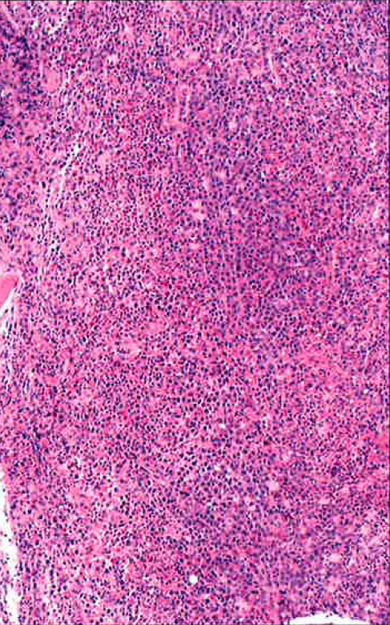
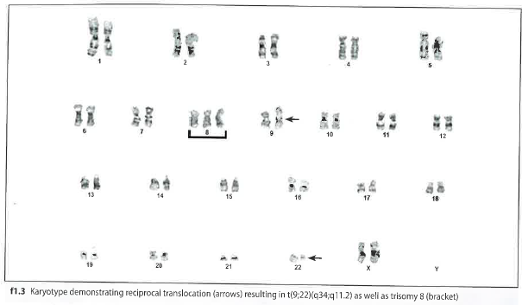
Case 1 Cytogenetic, FISH and Molecular Testing
Flow cytometry: granulocyte predominance, 1% blasts without a phenotype abnormality, the monocytes showed partial expression of CD56
Chromosome analysis: 47,XX, +8, t (9;22) (q34;q11.2) in all 20 metaphases. FISH positive for BCR-ABL1 rearrangement in 97% of cells. The normalized copy number (NCN) of BCR-ABL fusion transcripts (BCR-ABL/ABL) as determined by qRT-PCR
Diagnosis?
Notes:
DX, CML + chromosome 8. FISH technique: BCR probe is green, ABL1 probe is orange, and if there is a fusion Yellow. Beck,Moore, Molecular Hematopathology, 2021, The resulting fusion leads to a constitutively active ABL1 kinase that drives multiple molecular pathways leading to cell proliferation, growth-factor independence and decreased apoptosis of granulocytic progenitors. Exon 2-11 ( in which the tyrosine kinase domain reside)
p. 2: bone marrow, flow cytometry, genetic studies. Bone marrow results: hypercellular, M:E ratio 12:1, myelocyte bulge in the differential, 1.5% blasts, Flow cytometry: granulocyte predominance, 1% blasts without a phenotype abnormality, the monocytes showed partial expression of CD56. Chromosome analysis: 47,XX, +8, t (9;22) (q34;q11.2) in all 20 metaphases. FISH positive for BCR-ABL1 rearrangement in 97% of cells. The normalized copy number (NCN) of BCR-ABL fusion transcripts (BCR-ABL/ABL) as determined by qRT-PCR was 78.122% for the major breakpoint using the international scale (IS) and 0.13% NCN for the minor breakpoint fusion. DX: CML with trisomy 8. Mckenzie, 2021, p. 523: On chromosome 9, the breakpoint is spread across a 90kb region within the first exon of abl1, translocation the 3” end of exon 1 and exon 2-11 ( in which the tyrosine kinase domain reside) to chromosome 22. The breakpoint in Ch 22 occurs within the BCR gene, a large 70-kb gene with 25 exons. The breakpoint in ch 22 occurs in an area known as the major breakpoint cluster region ( M-BCR). When the breakpoint occurs in the M-BCR two different fusion genes are formed ( BCR-ABL1 and ABL1/BCR). Both fusion genes join the translocated portion of the ABL1 gene ( exons 2-11) with either exon 13 or 14 of the BCR. … Mckenzie 2021, p. 14: Most genes are composed of stretches of nucleotides that are organized into segments called exons and are interrupted by intervening sequences called introns. The exons contain the nucleotide sequences that correspond to the information for the final protein product, while the nucleotide base pairs of the introns do not code for protein.

Slide 14
BCR-ABL1 Mutation
f1.5 p. 6,2021, Beck et al
Notes:
p. 190 also seen in some ALLs

Slide 15
Case 1: Treatment
Gleevac/ imatinib( tyrosine kinase inhibitor ), and second and third generation tyrosine kinase inhibitors: second-generation (dasatinib, nilotinib, bosutinib) and third-generation TKIs (ponatinib)
Stem cell transplant
Notes:
Imatinib (Gleevac; Novartis), the first tyrosine kinase inhibitor (TKI), completely changed patients’ life expectancy.⁴ It was approved in 2001 (in Europe and the United States) for all CML phases and, as its patent has expired, is now available as a generic drug.⁵

Slide 16
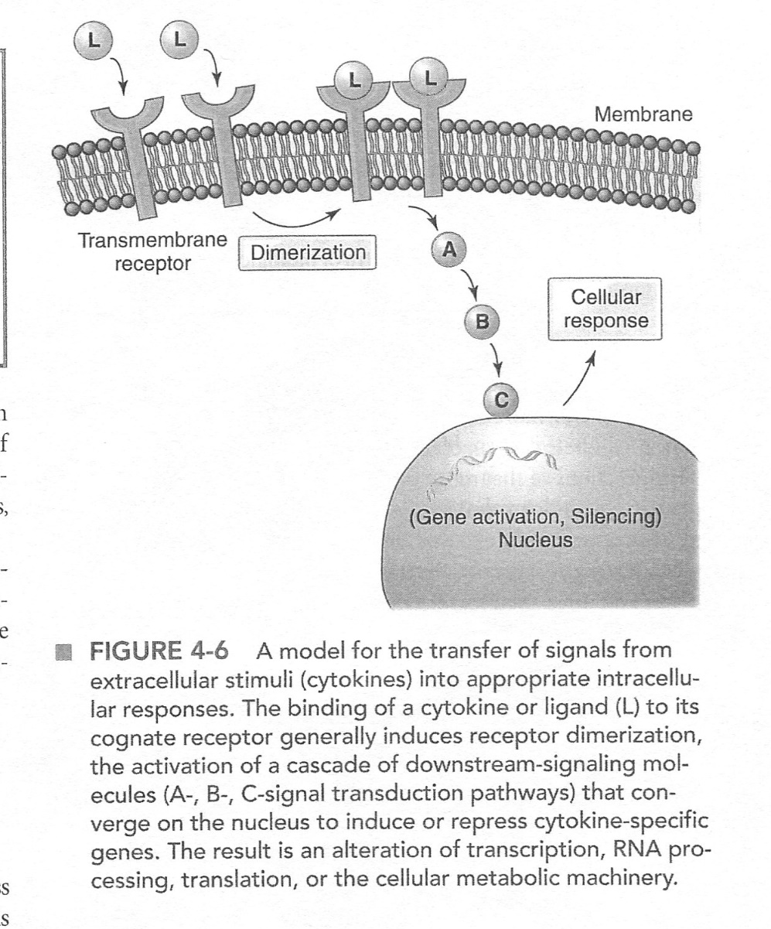
Cytoplasmic Tyrosine Kinase Domains
Some receptors are transmembrane proteins with cytoplasmic tails that contain a tyrosine kinase catalytic site or domain. When a growth factor binds to the receptor, the receptor chains dimerize enhancing the catalytic activity of kinase domain and activating intracellular pathways directly. M-CSF, SCF and FL bind to this type of a receptor.
Hematopoiesis receptors contain a kinase domain or activate a cytoplasmic kinase as part of the signaling pathway. The signaling cascades that are activated can involve the formation of multiprotein complexes, proteolytic cascades, and phosphorylation/ dephosphorylation reactions
Active ABL1 kinase drives multiple molecular pathways leading to cell proliferation, growth-factor independence and decreased apoptosis of granulocytic progenitors.
Fig. 4.7, p. 57, 2020 ed. Mckenzie
Fig 4.8, p. 59 2020 ed . Mckenzie,
Notes:
Dimerization: a compound formed by the union of two radicals or two molecules of a simpler compound. McKenzie 2020, p. 57: Cytokines must bind to surface receptors on their target cells to express their activity. They interact with membrane receptors restricted to cells of the appropriate lineage. Cells also need a mechanism to transfer signals from extracellular stimuli ( cytokines) into appropriate intracellular responses. Binding of a cytokine( ligand) to its specific receptor transduces an intracelllular signal through which the particular survival, proliferation, or differentiation responses are initiated. The intracellular portion of the receptor binds to associated intracellular molecules that activate signaling pathways. These signaling molecules translocate to the nucleus, recruit appropriate transcription factors, and activate or silence gene transcription. Ultimately, changes in protein synthesis lead to alteration sin cell proliferation or other modifications of cellular responses induced by the cytokine involved. 2015 ed p. 49- A model for the transfer of signals from extracellular stimuli ( cytokines) into appropriate intracellular responses. The binding of a cytokine or ligand to its cognate receptor generally induces receptor dimerization, the activation of a cascade of downstream-signaling molecules ( A-B-, C- signal transduction pathways) that converge on the nucleus to induce or repress cytokine-specific genes. The result is an alteration of transcription, RNA processing, translation, or the cellular metabolic machinery.
Catalytic: accelerates a reaction. imatinib mesylate, stem cell factor (SCF) and fetal liver tyrosine kinase 3 (FL)
dimerization: the chemical union of two identical molecules. dimer /di·mer/ (di´mer). 1. a compound formed by combination of two identical molecules. 2. a capsomer having two structural subunits.McKenzie, 2010 ed. P. 42 – These receptors are transmembrane proteins with cytoplasmic tails that contain a tyrosine kinase catalytic site or domain. When a growth factor binds to the receptor, the receptor chains dimerize enhancing the catalytic activity of the kinase domain and activating intracellular signaling pathways directly, included in this group are the receptors for M-CSF, SCF, and FL.
Mckenzie, 2004, p. 30 Cytokines require surface receptors on their target cells to express their activity. They interact with membrane receptors restricted to cells of the appropriate lineage. Binding of a cytokine (ligand) to its specific receptor transduces an intracellular signal through which the particular survival, proliferation or differentiation responses re initiated. The intracellular protein of the receptor binds to associated intracellular molecules that activate signaling pathways. These signaling molecules translocate to the nucleus and activate gene transcription. Ultimately, changes in protein synthesis lead to alterations in cell proliferation or other modifications of cellular response induced by the cytokine involved. Many of these receptors have been characterized and they can by grouped according to certain structural characteristics. Receptors with cytoplasmic tyrosine kinase domains- these are all transmembrane proteins with cytoplasmic domains that contain a tyrosine kinase catalytic site. When GF binds to the receptor, the receptor chains dimerize, which enhances the catalytic activity of the kinase domain and activates intracellular signaling pathways. Included in this group are the receptors for M-CSF, SCF and FL. Hematopoietic growth factor receptor superfamily –The receptors for the majority of hematopoietic GF do not posses intrinsic kinase activity but lead to phosphorylation of cellular substrates by serving as docking sites for adaptor molecules that do not have kinase activity. All are multichain integral membrane proteins that demonstrate enhanced binding and/or signalin transduction ( phosphorylation of cellular substrates by serving as docking sites for adaptor molecules that do have kinase activity. All are multichain integral membrane proteins that demonstrate enhanced binding and/or signal transduction ( phosphorylation of cellular proteins) when expressed as a heterodiimer or homodimer. The receptors for many of the GF receptors in this large group share peptide subunits with other receptors. There are 3 major subgroups: 1. IL-3, IL-5, and GM-CSF receptors have unique ligand-specific alpha chains but share a common beta chain. Association of the two chains, induced by ligand binding, results in the formation of a specific high-affinity receptor capable of effective signaling. 2. IL-6 and IL-11 similarly have ligand-specific alpha chains and share a common beta chain called GP 130. The GP 130 beta chain is also shared by 3 other cytokines, leukemia inhibitory factor (LIF) oncostatin M, and ciliary neurotrophic factor (CNTF). 3. The receptor complexes for many of the factors that influence lymphopoisis are shared as well, including the receptors for IL-2, IL-4, IL-7, IL-9, IL-13 and IL-15. All 6 receptors have unique,ligan specific alpha chains, and share a common gamma chain. IL-2 and IL-15 are trimeric structures and share a common beta subunit as well. IT has been suggested that the functional redundancy seen in the cytokine regulation of hematopoiesis ( the fact that multiple GFs have overlapping activities) may be at least partly explained by the sharing of common receptor subunits. For, eg. IL-3 and GM-CSF share a beta subunit and have similar spectra of biolgical activites. Likewise IL_6 and IL-11 both have megakaryocytic activity and both stimulate the hepatic acute phase response; similarly, they share a common beta subunit GP130.

Slide 17
Signaling Pathways
Ligands (molecules that bind to another molecule) bind to specific receptors
Initiates transfer of signals via signal transduction pathways
Activation of downstream signaling molecules
Converge on the nucleus: modulate transcription, RNA processing, protein synthetic machinery (translation), cellular metabolic machinery, or cytoskeletal-dependent functions.
Repeat: Hematopoiesis receptors contain a kinase domain or activate a cytoplasmic kinase as part of the signaling pathway. The signaling cascades that are activated can involve the formation of multiprotein complexes, proteolytic cascades, and phosphorylation/ dephosphorylation reactions
Active ABL1 kinase drives multiple molecular pathways leading to cell proliferation, growth-factor independence and decreased apoptosis of granulocytic progenitors.
Notes:
Ligands: a molecule that binds to another molecule, used especially to refer to a small molecule that binds specifically to a larger molecule, e.g., an antigen binding to an antibody, a hormone or neurotransmitter binding to a receptor, or a substrate or allosteric effector binding to an enzyme. Ligands are also molecules that donate or accept a pair of electrons to form a coordinate covalent bond with the central metal atom of a coordination complex. Mckenzie, 2015 ed. P. 50. As discussed, cells use a variety of signal transduction pathways to transfer signals from the receptor into an appropriate response. These are initiated by a ligand ( cytokine) binding to its specific receptor followed by the activation of “downstream signaling molecules”, which ultimately converge on the nucleus to modulate transcription, RNA processing, the protein synthetic machinery( translation), the cellular metabolic machinery, or cytoskeletal-dependent functions. Fig 4-6. ( 2010 ed- The downstream signals often result in a cascade of activation steps, ultimately converging on the nucleus to modulate transcription, RNA processing, the protein synthetic machinery ( translation), the cellular metabolic machinery, or cytoskeletal-dependent functions.) 2015 ed. P. 50- the signaling cascades that are activat5ed can involve the formation of multiprotein complexes, proteolytic cascades, and/or phorphorylation/dephosphorylation reactions. Protein phosphorylation is often an important prat of the signaling response from cell-surface receptors involved in hematopoiesis. Receptors that contain intrinsic kinase ( or phosphatase) activity are identified by the target amino acid to be phosphorylated or dephosphorylated as receptor tyrosine kinases (RTKs), receptor serine kinases (RSKs0 or receptor protein tyrosine phosphatases (PTPs). Ligands activate these receptors by promoting receptor oligomerization and activation of their cytoplasmic kinase domains.
(2010 ed: These receptors either contain a kinase domain as an integral component of the receptor itself or activate a cytoplasmic kinase as part of the signaling pathway. The signaling cascades that are activated can involve the formation of multiprotein complexes, proteolytic cascades, and phosphorylation/dephosphorylation reactions.) …

Slide 18
Growth Factors/ Cytokines and Cytokine Receptors
Cytokines bind to cytokine receptors on a cell membrane
Only bind to appropriate cell receptors
Once bound, cytokine signal can be expressed
Cells transfer cytokine signal intracellularly via different mechanisms and to different locations depending on the signal
Mechanisms used: translocate to nucleus, recruit transcription factors; transcription factors are proteins that bind to DNA on the promoter region and regulate expression of the gene
The end result is an interaction with DNA, transcription factors binding to one or more gene promoter regions and activation or repression of the target gene
Notes:
Mckenzie, 2015 – Cytokines must bind to surface receptors on their target cells to express their activity. They interact with membrane receptors restricted to cells of the appropriate lineage. Cells also need a mechanism to transfer signals from extracellular stimuli (cytokines) into appropriate intracellular responses. Binding of a cytokine (ligand) to its specific receptor transduces an intracellular signal through which the particular survival, proliferation, or differentiation responses are initiated. The intracellular portion of the receptor binds to associated intracellular molecules that activate signaling pathways. These signaling molecules translocate to the nucleus, recruit appropriate transcription factors, and activate or silence gene transcription. Ultimately, changes in protein synthesis lead to alterations in cell proliferation or other modifications of cellular response induced by the cytokine involved. Cytokine: A small protein released by cells that has a specific effect on the interactions between cells, on communications between cells or on the behavior of. Growth factors attach to specific receptors on the surface of cells When they attach, a message is sent through the receptor to the inside of the cell and tells the cell to do something There are several types of receptors based on the structure of the receptor and the pathways inside the cell that are stimulated Mckenzie, 2010 ed, p. 42: Cytokine receptors, Signaling pathways, and transcription factors. Cytokines must bind to surface receptors on their target cells to express their activity. They interact with membrane receptors restricted to cells of the appropriate lineage. Cells also need a mechanism to transfer signals from extracellular stimuli ( cytokines) into appropriate cellular responses intracellularly. Binding of a cytokine ( ligand) to its specific receptor transduces an intracellular signal through which the particular survival, proliferation, or differentiation response is initiated. … ultimately changes in protein synthesis lead to alterations in cell proliferation or other modifications of cellular response induced by the cytokine involved.

Slide 19
Knowledge Check
Which of the following are true?
The chromosome abnormality in CML is a JAK2 mutation
The mutation result in CML is an increased production of a tyrosine kinase
To counteract the increase in the enzyme, a tyrosine kinase inhibitor is given as treatment
Hematopoietic receptors have a kinase domain or activate a cytoplasmic kinase as part of the signaling pathway
Notes:
F- BCR-ABL1 mutation, T, T, T

Slide 20
Case 2
Patient history: A 68 year old female with a history of breast cancer treated with chemotherapy developed polycythemia one year later, with routine CBC showing a hemoglobin of 17.2 g/dL ( 172 g/L) and hematocrit 53.4% ( 0.534 L/L). Her serum erythropoietin level was 1.3 mIU/mL ( 1.3 IU/L) with reference intervals 2.6-18.5mIU/mL ( 2.6-18.5 IU/L). The peripheral blood showed no abnormalities.
What would we have seen if we looked at the peripheral smear?
What should be done next? Choices: Bone marrow, chromosome study, FISH technique, molecular PCR or next generation sequencing test
Notes:
Molecular Hematopathology, 2021, p. 10: The peripheral blood smear showed no morphologic abnormalities and the bone marrow aspirate showed normal erythropoiesis and granulopoiesis, with a M:E ratio of 1.7:1, normal, though few megakaryocytes with cloudlike nuclei were noted. The bone marrow core biopsy demonstrated hypercellularity for age (70%) cellular…
Order flow cytometry, cytogenetics, Molecular study, no FISH necessary

Slide 21
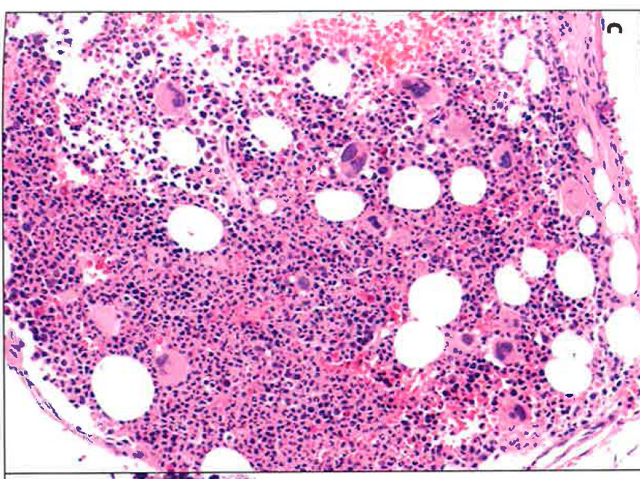
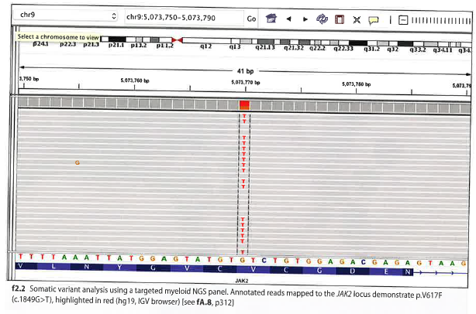
Case 2 Cytogenetic and Molecular Testing
Peripheral blood: crowding of RBCs
Bone Marrow
Chromosome analysis: 46,XX
Molecular studies: a targeted myeloid next generation screening panel was positive for JAK2.pV617F (c.1849G>T) with 73% variant allele frequency (VAF) and ASXL1pQ768* (c2302C>T) with 46% VAF.
c= coding sequence, followed by the position of the nucleotide change, the changed nucleotide, the symbol >, the new nucleotide.
Human Genome variation Society (HGVS). http://varnomen.hgvs.org
Diagnosis?
, Fig. 2.2 p. 12. 2021, Beck
Notes:
https://www.mayocliniclabs.com/test-catalog/overview/606821#SpecimenJAK2 (9p24.1) Rearrangement, Hematologic Disorders, FISH, TissueTesting Algorithm This test does not include a pathology consult. If a pathology consultation is requested, PATHC / Pathology Consultation should be ordered and the appropriate fluorescence in situ hybridization (FISH) test will be ordered and performed at an additional charge. This test includes a charge for application of the first probe set (2 FISH probes) and professional interpretation of results. Additional charges will be incurred for all reflex probes performed. Analysis charges will be incurred based on the number of cells analyzed per probe set. If no cells are available for analysis, no analysis charges will be incurred.
Bases, Pyrimidines: thymine, cytosine, Bases, Purines: adenine, guanine, FYI: Nucleoside: Base + deoxyribose sugar
(Mnemonic S from nucleoside: 2 parts Base Sugar), FYI: Nucleotide: Base, sugar, + PO4 ( T- three parts BSP)Instead of guanine they have the thymine nucleotide, 2010 article: Mutation of ASXL1 represents an important new molecular abnormality in CML. But this was seen in PV. Molecular Hematopathology, 2021, p. 10: PV is a chronic myeloproliferative neoplasm which results in unchecked production. Virtually app patients harbor a somatic JAK2 gain of function mutation at the stem cell level leading to cytokine-indepentent proliferation or erythroid cells, granulocytes, and megakaryocytes. This results in pan myelosis in the blood and bone marrow, but patients typically present with symptoms related specifically to increased red cell mass. .. ISCN, 2016, 2021. Nomenclature for referencing genomic sequences: the nucleotide numbering 1,2,3 from the first to the last nucleotide of the reference sequence. … Coding DNA reference sequences: protein coding region, numbering stats with c.1 at the A of the ATG translation initiation ( start) codon and ends with the last nucleotide of the translation termination ( stop) codon,.i.e. TAA< TAG< TGA. … c.78T>C is a variant in a protein coding sequence… Buckingham2019, p. 218: gene variant nomenclature: accurate testing and reporting of gene mutations requires a descriptive and consistent system of expressing mutations and polymorphisms. Recommendations have been reported and generally accepted. For DNA and cDNA, the first nucleotide of the first amino acid in the sequence, usually A of ATG for methionine is designated as position +1. The preceding nucleotide is position -1. There is no nucleotide position 0. Nucleotide changes are expressed as the position or nucleotide interval, the type of nucleotide change the changed nucleotide, the symbol>, and finally the new nucleotide. The c is for the coding sequence.
Strom SP, 2016, p. 3: variant allele frequency (VAF) is the percentage of sequence reads observed matching a specific DNA variant divided by the overall coverage at that locus. Because NGS provides a near random sample, VAF is thus a surrogate ( substitute) measure of the proportion of DNA molecules in the original specimen carrying the variant. For constitutional genetic testing, VAF is a measure of diploid zygosity; heterozygous loci should be near 50% VAF, homozygous loci should be near 100% and reference loci should be near 0%. … For somatic testing, contamination from normal cells and tumor heterogeneity combine to cause unpredictable VAFs. …

Slide 22
Case 2 Diagnosis: polycythemia vera
Swerdlow SH, Campo E, Harris NL, Jaffe ES, Pileri SA, Stein H, Thiele J, Arber DA, Hasserjian RP, Le Beau MM, Orazi A, Siebert R: WHO
Classification of Tumours of Haematopoietic and Lymphoid Tissues. Revised 4th Ed. Herndon, VA: Stylus Publishing. 2017.
Notes:
Williams, 2021,10th ed. p. 1369: RX; JAK2 inhibitors ( ruxolitinib) : may cause cytopenias, do not alter the natural course of the disease and expensive

Slide 23
Cytokine Receptor JAK-STAT Model of Signal Transduction
Cytokine ( E.g.EPO) interaction with its specific receptor leads to receptor dimerization and activation of JAK kinases associated with the activated receptor. Activated JAK kinases mediate autophosphorylation of the receptor, which then serves as a docking site for signal transducers and activators of transcription (STATS). The STATs translocate to the nucleus where they activate gene transcription
Fig 4.8 p 59 2020 ed McKenzie
Notes:
Components that actually establish the patterns of gene expression associated with lineage differentiation
More than half of the hematopoietic transcription factors identified have been shown to be involved in chromosomal translocations associated with leukemia Thus the impaired differentiation seen in leukemias is likely due to the perturbation of critical, discrete pathways of transcriptional control. Mckenzie, 2021, p 536: several mutations, most affecting the Janus-Kinas-STAT signal transduction pathway, have been identified in patients with PV. As is the case in ET, 3 mutations in particular drive the disease (JAK@, MPL, and CALR) and can occur in both sporadic and familiar forms. Some patients present with none of these three mutations and are called triple negative. Williams, 10th ed, p. 1366: The mutation located in the autoregulatory domain of JAK2 , results in increased JAK2 activity. This leads to deregulation of the hematopoietic process by bypassing erythropoietin interaction with its receptor, and also of thrombopoietin and granulocyte-stimulating factor receptors, causing the expansion of erythrocytes, granulocytes and platelets. The primary lesion associated with these disorders was discovered in exon 14, a single-nucleotide change JAk2 G1849T, resulting in the amino acid substitution V617F. Detection of the JAK2 mutation provides a qualitative diagnostic marker for the identification of the Philadelphia chromosome-neg subgroup of MPN…A few patients do not have the JAK2 mutation but have a mutation in the exon 12 location. Almost 40 different mutations in the exon 12 have been identified within codons 536-547 including substitutions, deletions, and duplications.
Signal transducer and activator of transcription STAT www.ncbi.nlm.nih.gov/... National Center for Biotechnology Information by TJ Mitchell - ‎2005 transcription ...JAK2 AND MYELOFIBROSIS :JAK2 is a non-receptor tyrosine kinase of the Janus kinase family that propagates cytokine-induced signals via signal transducers and activators of transcription (STATs).¹ ⁻ ³ Dysregulation of this pathway is associated with increased survival and proliferation of malignant cells, especially those of myeloid origin.² ⁻ ³ JAK2 mutations were described in approximately 50% of patients with primary myelofibrosis. It is also expressed in 95% of the polycythemia vera patients and in 50% of essential thrombocythemia patients. However, the precise contribution of these mutations is currently not yet defined. Still, certain mutations directly (eg, JAK2 or MPL mutations) or indirectly (eg, LNK or CBL mutations) induce JAK-STAT hyperactivation leading to myeloproliferative syndrome-associated features.⁴ Mckenzie 2010 ed, p. 44 Cytokine receptor JAK-STAT model of signal transduction. Cytokine ( e.g. EPO) interaction with its specific receptor leads to receptor dimerization and activation of JAK kinases associated with the activated receptor. Activated JAK kinases mediate autophosphorylation as well as phosphorylation of the recptor, which then serves as a docking site for STATS ( signal transducers and activators of transcription. These STATs are phosphorylated, dissociate with the receptor, dimerize, and translocate to the nucleus where they activate gene transcription. Mckenzie, 2010 ed, p. 44: The growth factors that maintain heamtopoiesis are not thought to be instructive for the pathway of differentiation but to be permissive for cell viability and proliferation. The components that actually establish the patterns of gene expression associated with lineage differentiation are the nuclear transcription factors (TF). Cell-fate decisions are regulated by the integrated effects of internal transcription factors and signaling pathways initiated by external regulatory cytokines. Different transcription factors are restricted in their expression to particular lineages and to particular differentiation states within one or more lineages. The effect of a particular TF may be either gene expression or gene suppression, depending on the additional molecules ( co-activators or co-repressors) recruited to the gene promoter region upon TF binding. TFs associated with activation of lineage-specific differentiation programs often simultaneously inhibit alternate lineage-specific transcription factors. …Mckenzie, 2010 ed, p. 44: The growth factors that maintain hematopoiesis are not thought to be instructive for the pathway of differentiation but to be permissive for cell viability and proliferation. The components that actually establish the patterns of gene expression associated with lineage differentiation are the nuclear transcription factors (TF). Cell-fate decisions are regulated by the integrated effects of internal transcription factors and signaling pathways initiiated by external regulatory cytokines. Different transcription factors are restricted in their expression to particular lineages and to particular differentiation states within one or more lineages. The effect of a particular TF may be either gene expression or gene suprression, depending on the additional molecules ( co-activators or co-repressors) recruited to the gene promoter region upon TF binding. TFs associated with activation of linearge-specific differentiation programs often simultaneously inhibit alternate lineage-specifc transcription factors. …

Slide 24
Signal Transducers and Activators of Transcription (STATS)
Components that actually establish the patterns of gene expression associated with lineage differentiation
More than half of the hematopoietic transcription factors identified have been shown to be involved in chromosomal translocations associated with leukemia
Thus the impaired differentiation seen in leukemias is likely due to the perturbation of critical, discrete pathways of transcriptional control
Notes:
Signal transducer and activator of transcription (STAT) proteins are a 7-member family of cytoplasmic transcription factors that contribute to signal transduction by cytokines, hormones, and growth factors. STAT proteins control fundamental cellular processes, including survival, proliferation, and differentiation.Apr 15, 2003. McKenzie 2021, p.14: Control of gene expression. Many signals that regulate genes come from outside the cell ( cytokine control of hematopoiesis). The external molecule or ligand( cytokine) binds to its specific receptor on the surface of the cell. The binding of ligand to receptor activates the receptor and initiates a cell-signaling pathway that conveys the activation signal from the receptor to the nucleus. The end result is that a protein called a transcription factor (TF) interacts with the DNA and either activates or represses transcription of the target gene.

Slide 25
Case 2: Treatment
Phlebotomy
Hydroxyurea
JAK2 inhibitors ( ruxolitinib)
Other treatments
Table 83-3. p. 1369. 2021. Williams Hematology
Notes:
Williams, 2021,10th ed. p. 1369: RX; JAK2 inhibitors ( ruxolitinib) : may cause cytopenias, do not alter the natural course of the disease and expensive

Slide 26
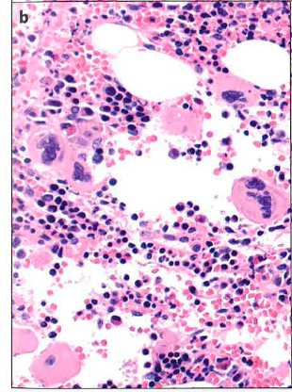
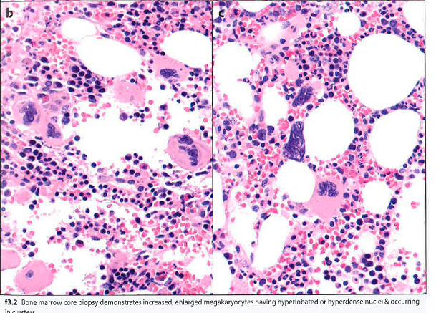
Case 3
Patient history: A 77 yr old female with past medical history of chronic fatigue, hypothyroidism, peripheral neuropathy, ataxia, and arthritis was referred to hematology for evaluation of macrocytic anemia. CBC showed 11.5 g/dL hemoglobin, MCV = 104 fL, platelets 641 X 10^9/L. The differential showed thrombocytosis with normal-appearing platelets and normal white blood cells.
What did the bone marrow show?
What should be done next? Choices: Chromosome study, FISH technique, molecular PCR or next generation sequencing test?
Notes:
Mol Hematopathology 2021, Ch.3 p. 14: The main finding in the peripheral blood smear was thrombocytosis with many small plts. The WBC appeared normal. The bone marrow aspirate smear was hemodilute and suboptimal for evaluation, but examination of the touch preparation showed complete, maturing erythropoiesis and granulopoiesis without evident of dysplasia. The megakaryocytes, however were atypically enlarged and hyperlobate. Increased atypical megakaryocytes were also present in the core biopsy, some in loose clusters, many with hyperlobate, staghorn nuclei. A reticulin stain showed no definite increase in reticulin fibrosis. Flow cytometry revealed no definitive abnormalities.

Slide 27
Case 3: Cytogenetics and Molecular Testing
Chromosome analysis 46,XX
FISH studies negative for del (5q), monosome 5, del (7q), monosomy 7, trisomy 8, del (17p), and del (20q).
A targeted myeloid NGS panel was positive for CALR p.L367fs*46(c.1099_1150del) with 43% variant allele frequency (VAF). Calrecticulin (CALR)p = protein.
Mutations in the calreticulin gene lead to truncate the C terminus of the protein, which contains an endoplasmic reticulum retention signal. As a result mutant proteins stimulate the thrombopoietin receptor.
Diagnosis?
Treatment:
Notes:
Williams 2021, p. 1377: ET is characterized by hyperactive cytokine signaling in close to 90% of cases, the result of somatic mutations targeting components of the thrombopoietin signaling pathway, including the JAK2 gene or the thrombopoietic receptor gene ( C-MPL). Mutations in the calreticulin gene (CALR) are present in the majority of JA2/MPL-wild type patients. Although there have been more than 50 different mutations id, all occur in the final exon of the gene and act to truncate the C –terminus of the protein, a region containing an endoplasmic reticulum retention signal. As a result he mutant proteins free to migrate the cell membrane and bind to and stimulate the thrombopoietin receptor. Of the ~ 10% of ET patients who NIH article 2015: the CALR gene is located in the short arm of chromosome 19 (19p13.2). It contains 9 exons and spans 4.2 kb. With the exception of a few non-recurrent point mutations, almost all these mutations are indels ( insertion or deletion) . Mol Hematopathology, 2021, Ch. 3, p. 14: Chromosome analysis showed a normal female karyotype and FISH studies were negative as stated on the slide…. ET is a MPN characterized by marked thrombocytosis in the peripheral blood and the absence of other accompanying cytoses or cytopenias. The 2017 WHO dx criteria, see table. , requires a thrombocytosis with plt count of ≥ 450 X 10^9/L and bone marrow biopsy with evidence of megakaryocyte proliferation, including mature, enlarged megakaryoctye proliferation, including mature ,enlarged megakaryocytes
Strom 2016, p. 9L Some findings such as the role of calreticulin (CALR) mutations in MLN has lead to rapidly adopted, high impact clinical tests.

Slide 28
Spectrum and Frequency of Somatic Mutations in Myeloid Neoplasms
Fig. 84-1, p. 1378. 2021, Williams

Slide 29
Patient Diagnosis: Patient diagnosis: Essential thrombocytosis
Swerdlow SH, Campo E, Harris NL, Jaffe ES, Pileri SA, Stein H, Thiele J, Arber DA, Hasserjian RP, Le Beau MM, Orazi A, Siebert R: WHO Classification of Tumours of Haematopoietic and Lymphoid Tissues. Revised 4th Ed. Herndon, VA: Stylus Publishing. 2017.
Notes:
Calreticulin or MPL = a gene that makes a protein that helps control the number of blood cells that are made in the bone marrow,especially platelets. Mutated Changes forms of the MPL gene may cause the body to make abnormal blood cells or too many platelets. Williams, 2021, 1377:Thrombopoietin receptor gene ( C-MPL)

Slide 30
Case 4
Patient history: A 68 yr old female with a long history of smoking and chronic obstructive pulmonary disease presented with decreased appetite, fatigue and gradual weigh loss over several months. CBC results showed a high WBC count, anemia, and thrombocytopenia. The peripheral blood demonstrated increased and abnormal monocytes, promonocytes, and blasts.
What should be done next? Choices: Bone marrow, , chromosome study, FISH technique, molecular PCR or next generation sequencing test
Notes:
Mol hematopathology, 2021, Ch. 21, p. 108: the peripheral blood demonstrated frequent blasts , some with Auer rods, and promonocytes ( blast equivalents), together comprising > 80% of the white cell differential. Some of the blasts had a cup-shaped indentation of the nucleus. Also an abnormal monocytosis was noted. The bone marrow aspirate revealed 71% blasts and promonocytes. Occasional erythroid forms with nuclear budding and atypical megakaryocyte forms with discrete separate nuclear lobes were also seen. BM flow cytometry showed 8% myeloblasts in the CD45dim region, the blasts had moderate expression of CD13, CD 33, HLA-DR, and CD 163 with heterogeneous expression of CD117 and partial myeloperoxidase positivity ( in 6% of the cells) and were negative for CD34, CD14, and CD56. In addition, there were 71% cells in the monocyte-gated region with brighter CD45 expression and higher side scatter. These cells showed partial aberrant CD117 and CD56 expression and aberrant partial loss of CD14. They were also negative for CD34. Preliminary dx :AML with evidence of myelomonocytic differentiation pending genetic/molecular studies

Slide 31
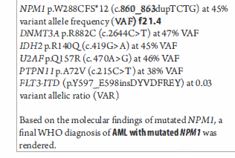
CaSe 4 Cytogenetic and Molecular Testing
Chromosome analysis 46,XX
Flow cytometry:8% myeloblasts, 71% cells monocyte gated region
FISH tech. negative for inv(3), t 3;3), t *8;21), del(5q), monosomy 7, del 7q, trisomy 8, inv (16), KMT2a (MLL) rearrangement, del 17q, and del (20q).
A targeted myeloid NGS panel was positive for some pathogenic variants::NPM1, nucleophosmin, nuclear protein that shuttles protein from the nucleus to cytoplasm
Diagnosis?
Notes:
Diagnosis: AML with mutated NPM1. Mol hematopathology, 2021, Ch. 21 p. 110: Genetics, Molecular results. the pt was treated Discussion: AML with mutated NPM1 is now recognized as a distinct entity in the 2017 WHO classification of hematopoietic neoplasms. As the name suggests it is defined by the presence of a mutation in the NPM1 gene, which encodes for nucleophosmin, ( Nucleo foes min) a nuclear protein that functions to shuttle proteins from the nucleus to the cytoplasm. Typically , the mutation is a 4-bp insertion, (rarely a deletion) in the terminal exon 12, causing a frameshift and resulting in a dysfunctional, abnormally localized and elongated protein. The aberrant cytoplasmic localization of mutated NPM1 protein is postulated to disrupt normal tumor suppressor activity, among other functions and can be detected with immunohistochemistry ( although rarely performed). At least 10 different types of pathogenic NPM1 mutations have been described in AML and the c.860_863dupTCTG ( type A) seen in this patient is the most frequent occurring in > 75% of cases.

Slide 32
Case 4: Treatment
The patient was treated with standard induction chemotherapy. The day 31 count recovery bone marrow biopsy showed nor morphologic or flow cytometric evidence of disease. However, NGS-based minimal residual disease( MRD) assays for both NPM1 and FLT3-ITD were both positive at a VAR of 1.93 X 10⁻⁴ and 1.2 X 10⁻⁵ respectively.
Notes:
Beck 2021p. 110: AML with mutated NPM! Is now recognizes as a distinct entity in the 2017 WHO classification of hematopoietic neoplasm. As the name suggests it is defined by the presence of a mutation in the NPM! Gene which encodes for nucleophosmin

Slide 33
Some More Mutations
26. Therapy-related acute myeloid leukemia with complex karyotype including amplification of KMT2A (MLL)
27. Acute megakaryoblastic leukemia with RAM phenotype & CFBA2T3-GLIS2
28. Transient abnormal myelopoiesis of Down syndrome with GATA1 mutation
29. Chronic lymphocytic leukemia/small lymphocytic lymphoma with TP53 mutation
30. B-cell prolymphocytic leukemia with gain of c-MYC
31. Hairy cell leukemia with BRAF V600E
32. Mantle cell lymphoma with t(11;14)(q13;q32) CCND1-IGH & mutations in NOTCH2 & ATM
33. Follicular lymphoma with del(1p36)
34. Pediatric-type nodal follicular lymphoma with MAP2K1 mutation
35. Lymphoplasmacytic lymphoma with mutations in MYD88 & CXCR4
36. Splenic marginal zone lymphoma with del(7q) & mutations in CARD11 & CXCR4
37. Extranodal marginal zone lymphoma with t(11;18) BIRC3-MALT1
38. High grade B-cell lymphoma with MYC & BCL2 & BCL6 rearrangements
39. Primary mediastinal large B-cell lymphoma with 9p24.1 amplification
40. Large B-cell lymphoma with IRF4 rearrangement
41. Plasma cell myeloma with rearrangement of CCND1
42. T-cell large granularlymphocytic leukemia with STAT3 mutation
43. T-cell prolymphocytic leukemia with inv(14)
44. Hepatosplenic T-cell lymphoma with RHOA mutation
45. Anaplastic large cell lymphoma, ALK-negative, with rearrangement of DUSP22
46. Angioimmunoblastic T-cell lymphoma with RHOA mutation
47. B-lymphoblastic leukemia/lymphoma with rearrangement of KMT2A (MLL)
48. B-lymphoblastic leukemia/lymphoma with t(1;19)(q23;p13.3) TCF3-PBX1
49. B-lymphoblastic leukemia/lymphoma with iAMP21
50. B-lymphoblastic leukemia/lymphoma with t(9;22)(q34.1;q11.2) BCR-ABL1
51. B-lymphoblastic leukemia/lymphoma BCR-ABL1-like, with P2YR8-CRLF2
52. Early T-cell precursor lymphoblastic leukemia with t(10;11)(p12;q14) MLLT10-PICALM
53. Mixed phenotype acute leukemia with t(9;22)(q34.1;q11.2) BCR-ABL1
54. Histiocytic sarcoma arising from a monocytic neoplasm in bone marrow, with mutations in KRAS, SRSF2 & TET2
1. Chronic Myeloid Leukemia presenting with t(9;22)(q34.1;q11.2)BCR-ABL1 & trisomy 8
2. Polycythemia vera with JAK2 V617F & ASXL1 mutation
3. Essential thrombocytosis with CALR type 1 mutation
4. Chronic neutrophilic leukemia with CSF3RT618I
5. Chronic eosinophilic leukemia with clonal abnormalities
6. Systemic mastocytosis with an associated hematopoietic neoplasm
7. Clonal cytopenia of undetermined significance with U2AF1 mutation
8. Myelodysplastic syndrome with excess blasts-1 with iso(17q) & mutations in SRSF2 & SETBP1
9. Myelodysplastic syndrome with isolated del(5q)
10. Myelodysplastic syndrome with ring sideroblasts & SF3B1 mutation
11. Myelodysplastic syndrome with germline GATA2 mutation
12. Chronic myelomonocytic leukemia with mutations in TET2 & SRSF2
13. Juvenile myelomonocytic leukemia with NRAS mutation
14. Atypical chronic myeloid leukemia with mutations in SETBP1, SRSF2, ZRSR2 & GATA2
15. Myelodysplastic/myeloproliferative neoplasm with ring sideroblasts & thrombocytosis, with mutations in JAK2 & SF3B1
16. Myeloid neoplasm with eosinophilia & FIP1L1-PDGFRA
17. Secondary polycythemia with JAK2 V617F clonal hematopoiesis of indeterminate potential
18. Aplastic anemia with clonal hematopoiesis
19. Acute myeloid leukemia with t(8;21)(q22;q22) RUNX1-RUNX1T1 & KIT mutation
20. Acute promyelocytic leukemia with subsequent therapy-related myeloid neoplasm (myelodysplastic syndrome)
21. Acute myeloid leukemia with mutated NPM1 & FLT3-ITD
22. Acute myeloid leukemia with biallelic mutation of CEBPA
23. Acute myeloid leukemia with mutated RUNX1 & concurrent isolated trisomy 1
24. Therapy-related acute myeloid leukemia with t(8;16)(p11.2;p13.3) KATA-CREBBP
25. Therapy-related myeloid neoplasm presenting as a myeloid sarcoma with rearrangement of KMT2A (MLL)

Slide 34
Summary
Hematologic malignant mutations:
Are numerous, meaning many different ones
Terminology can be difficult to understand for the novice
Knowledge of the type of mutation will provide pathways for treatment
Where will the medical laboratorian fit into the picture of laboratory testing
Most likely can perform the molecular studies
Most likely PhD and MD molecular biology specialists will be reporting the molecular interpretations and results

Slide 35
References
BeckR, Moore E. Molecular Hematopathology:an integrated Case-Based Approach. Chicago: ASCP Press. 2021
Buckingham L. Gene Mutations. In: Buckingham L (ed): Molecular Diagnostics, Fundamentals, Methods, and Clinical Applications. 3rd.ed. Philadelphia: FA Davis, 2019; 199-222
Duncavage EJ, Schroeder MC, O’Laughlin M, et al. Genome sequencing as an alternative to cytogenetic analysis in myeloid cancers. N Engl J Med. 2021;384(10):924–935.
Human Genome variation Society (HGVS). http://varnomen.hgvs.org
Kaushansky K, Lichtman MA,Prchal JT, Levi MM, Press OW, Burns LJ, Caligiuri: Williams Hematology, 10th ed. New York, McGraw-Hill, 2021.
Landis-Piwowar K. Cellular Homeostasis. In: McKenzie SB, Landis-Piwowar K, Williams JL (eds): Clinical Laboratory Hematology, 4th ed. Upper Saddle River, NJ: Pearson. 2020;9-26.
Strom SP. Current practices and guidelines for clinical next-generation sequencing oncology testing. Cancer Biol Med 2016.doi:10.28092/j.issn.2095-3941.2016.004
Swerdlow SH, Campo E, Harris NL, Jaffe ES, Pileri SA, Stein H, Thiele J, Arber DA, Hasserjian RP, Le Beau MM, Orazi A, Siebert R: WHO Classification of Tumours of Haematopoietic and Lymphoid Tissues. Revised 4th Ed. Herndon, VA: Stylus Publishing. 2017.
Notes:
Human Genome variation Society (HGVS). Accessed 4-20-22 at http://varnomen.hgvs.org

