Slide 1
The Autonomic Nervous System and the Adrenal Medulla
Prof. dr. Zoran Valić
Department of Physiology
University of Split School of Medicine

Slide 2
portion of the nervous system that controls most visceral functions of the body
arterial pressure, gastrointestinal motility, gastrointestinal secretion, urinary bladder emptying, sweating, body temperature
rapidity (seconds) and intensity of the change (100%) – most striking characteristics

Slide 3
General Organization of the ANS
centers located in:
spinal cord
brain stem
hypothalamus
+ limbic cortex
operates through visceral reflexes (subconscious)
sympathetic and parasympathetic nervous system

Slide 4
Physiologic Anatomy of the Sympathetic Nervous System
two paravertebral sympathetic chains of ganglia
two prevertebral ganglia
celiac
hypogastric
postganglionic nerves
sympathetic nerve fibers originate in the spinal cord along with spinal nerves between cord segments T-1 and L-2

Slide 5
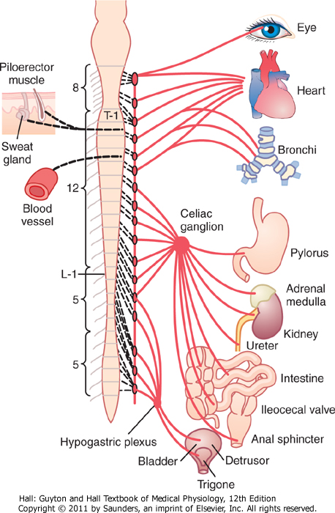

Slide 6
Preganglionic and Postganglionic Sympathetic Neurons
difference from skeletal motor nerves
cell body of each preganglionic neuron lies in the intermediolateral horn of the spinal cord
its fiber passes through an anterior root of the cord into the corresponding spinal nerve

Slide 7
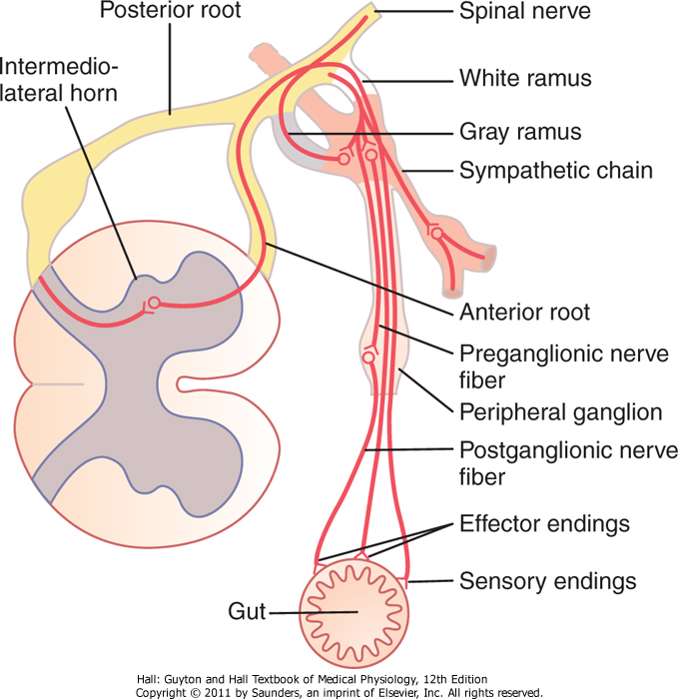

Slide 8
after the spinal nerve leaves the spinal canal, the preganglionic sympathetic fibers leave the spinal nerve
pass through a white ramus into one of the ganglia of the sympathetic chain

Slide 10
course of the fibers can be following:
synapse with postganglionic sympathetic neurons in the ganglion that it enters
pass upward or downward in the chain and synapse in one of the other ganglia of the chain
pass for variable distances through the chain and then through one of the sympathetic nerves radiating outward from the chain, finally synapsing in a peripheral sympathetic ganglion
postganglionic fibers then travel to their destinations in the various organs

Slide 12
some of the postganglionic fibers pass back from sympathetic chain into spinal nerves through gray rami at all levels of the cord
these are all very small type C fibers, and they extend to all parts of the body by way of the skeletal nerves
they control: blood vessels, sweat glands, and piloerector muscles of the hairs
they make 8% of fibers in average nerve

Slide 13
Segmental Distribution
sympathetic pathways are not necessarily distributed to the same part of the body as the somatic spinal nerve fibers from the same segments:
T1: head
T2: neck
T3-T6: thorax
T7-T11: abdomen
T12-L2: legs

Slide 14
distribution is only approximate and overlaps greatly
it is determined partly by the locus in the embryo from which the organ originated

Slide 15
Adrenal Medullae
preganglionic sympathetic nerve fibers pass, without synapsing, from the intermediolateral horn cells of the spinal cord, through the sympathetic chains, then through the splanchnic nerves, and finally into the two adrenal medullae

Slide 16
these secretory cells embryologically are derived from nervous tissue and are actually themselves postganglionic neurons (they even have rudimentary nerve fibers)
the endings of these fibers that secrete the adrenal hormones epinephrine and norepinephrine

Slide 17
Physiologic Anatomy of the Parasympathetic Nervous System
parasympathetic fibers leave the CNS through cranial nerves III, VII, IX, and X, additionally by 2nd and 3rd sacral spinal nerves (sometimes 1st and 4th)
75 percent of all parasympathetic nerve fibers are in the vagus nerves
vagus nerves supply: heart, lungs, esophagus, stomach, entire small intestine, proximal half of the colon, liver, gallbladder, pancreas, kidneys, and upper portions of the ureters

Slide 18
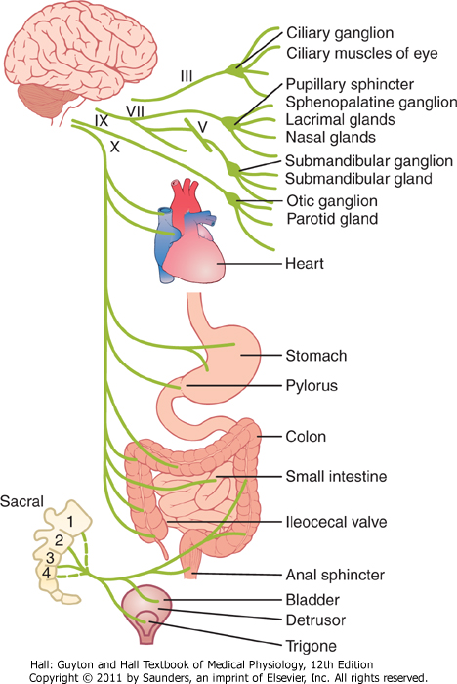
+ external genitalia - erection

Slide 19
Preganglionic and Postganglionic Parasympathetic Neurons
preganglionic fibers pass uninterrupted all the way to the organ that is to be controlled (except in the case of a few cranial nerves)
postganglionic neurons are located in the wall of the organ
postganglionic fibers, a fraction of a millimeter to several centimeters in length, leave the neurons to innervate the tissues of the organ

Slide 20
Cholinergic and Adrenergic Fibers
cholinergic fibers – secrete acetylcholine
adrenergic fibers – secrete norepinephrine (noradrenalin)

Slide 21
all preganglionic neurons (fibers) are cholinergic (sympathetic and parasympathetic)
all or almost all of the postganglionic neurons (fibers) of the parasympathetic system are also cholinergic
most of the postganglionic sympathetic neurons (fibers) are adrenergic

Slide 22
exemption: postganglionic sympathetic nerve fibers to the sweat glands, to the piloerector muscles of the hairs, and to a very few blood vessels are cholinergic

Slide 23
acetylcholine – parasympathetic neurotransmitter
norepinephrine – sympathetic neurotransmitter

Slide 24
Secretion of ACh and NE
few parasympathetic nerve endings are similar to, but much smaller, than those of the skeletal neuromuscular junction
majority of fibers merely touch the effector cells of the organs that they innervate
varicosities – bulbous enlargements – ACh and NE, mitochondria
action potential ⇨ entrance of Ca ⇨ secretion from terminals or varicosities

Slide 25
ACh
synthesized in the terminal endings and varicosities
stored in vesicles
acetyl-CoA + choline ⇨ acetylcholine
acetylcholinesterase from local connective tissue splits it to acetate ion and choline
choline secreted is then transported back into the terminal nerve ending (reuptake)

Slide 26
NE
synthesis in nerve endings, but is completed inside the secretory vesicles
tyrosine (hydroxylation) ⇨ DOPA (decarboxylation) ⇨ dopamine (transport into vesicles, hydroxylation) ⇨ NE ⇨ (in AM, 80%, methylation) epinephrine
removal:
reuptake (50-80%)
diffusion into surrounding body fluids (most of the remaining NE)
enzymatic degradation (MAO, COMT, small amounts)

Slide 28
NE secreted directly into a tissue remains active for only a few seconds
NE and epinephrine secreted into the blood by the AM remain active until they diffuse into some tissue (COMT, liver)
NE and epinephrine remain active for 10 to 30 seconds; but their activity declines to extinction over 1 to several minutes

Slide 29
Receptors
ACh and NE must first bind with specific receptors on the effector cells
receptor is on the outside of the cell membrane
binding of transmitter substance causes a conformational change in the structure of the protein molecule
change in cell membrane permeability
activating or inactivating an enzyme

Slide 30
Change in Membrane Permeability
opening or closing an ion channel
most frequently sodium and/or calcium ion channels
entrance of ions usually depolarizes the cell membrane and excites the cell
exit of K ions from the cell leads to hyperpolarization (inhibition) of the cell

Slide 31
Altering Intracellular "Second Messenger" Enzymes
binding NE ⇨  adenylyl cyclase ⇨  cAMP
exact effect depends on the chemical machinery of the effector cell

Slide 32
Acetylcholine Receptors
nicotinic receptors
activated by nicotine
muscarinic receptors
activated by muscarine (a poison from toadstools)
ACh activates both nicotinic and muscarinic receptors

Slide 33
1. Nicotinic receptors
found at the synapses between the preganglionic and postganglionic neurons of both the sympathetic and parasympathetic systems
also present at many nonautonomic nerve endings; at the neuromuscular junctions in skeletal muscle

Slide 34
ionotropic receptor (directly connected with the ion channel, does not utilize second messengers)
two subclasses:
nicotinic receptor of the muscle type
nicotinic receptor of the neuronal type

Slide 36
2. Muscarinic receptors
found on all effector cells that are stimulated by the postganglionic cholinergic neurons
either the parasympathetic nervous system or the sympathetic system

Slide 37
metabotropic receptor (receptor coupled with G protein)
five subclasses (M₁-M₅)

Slide 39
Adrenergic Receptors
α-receptors
in turn divided into α₁- i α₂-receptors
β-receptors
in turn divided into β₁-, β₂- i β₃-receptors
NE excites mainly α-receptors, β-receptors to a lesser extent
epinephrine excites both types of receptors approximately equally

Slide 40
metabotropic receptor (receptor coupled with G protein)
under the influence of catecholamins
isopropyl norepinephrine (isoprenaline or isoproterenol) acts on β-receptor

Slide 44
Excitatory and Inhibitory Actions
excitatory effects in some organs but inhibitory effects in others – there is no generalization, one must learn all the separate functions of these two nervous systems on each organ
when sympathetic stimulation excites a particular organ, parasympathetic stimulation sometimes inhibits it

Slide 45
most organs are dominantly controlled by one or the other of the two systems

Slide 46
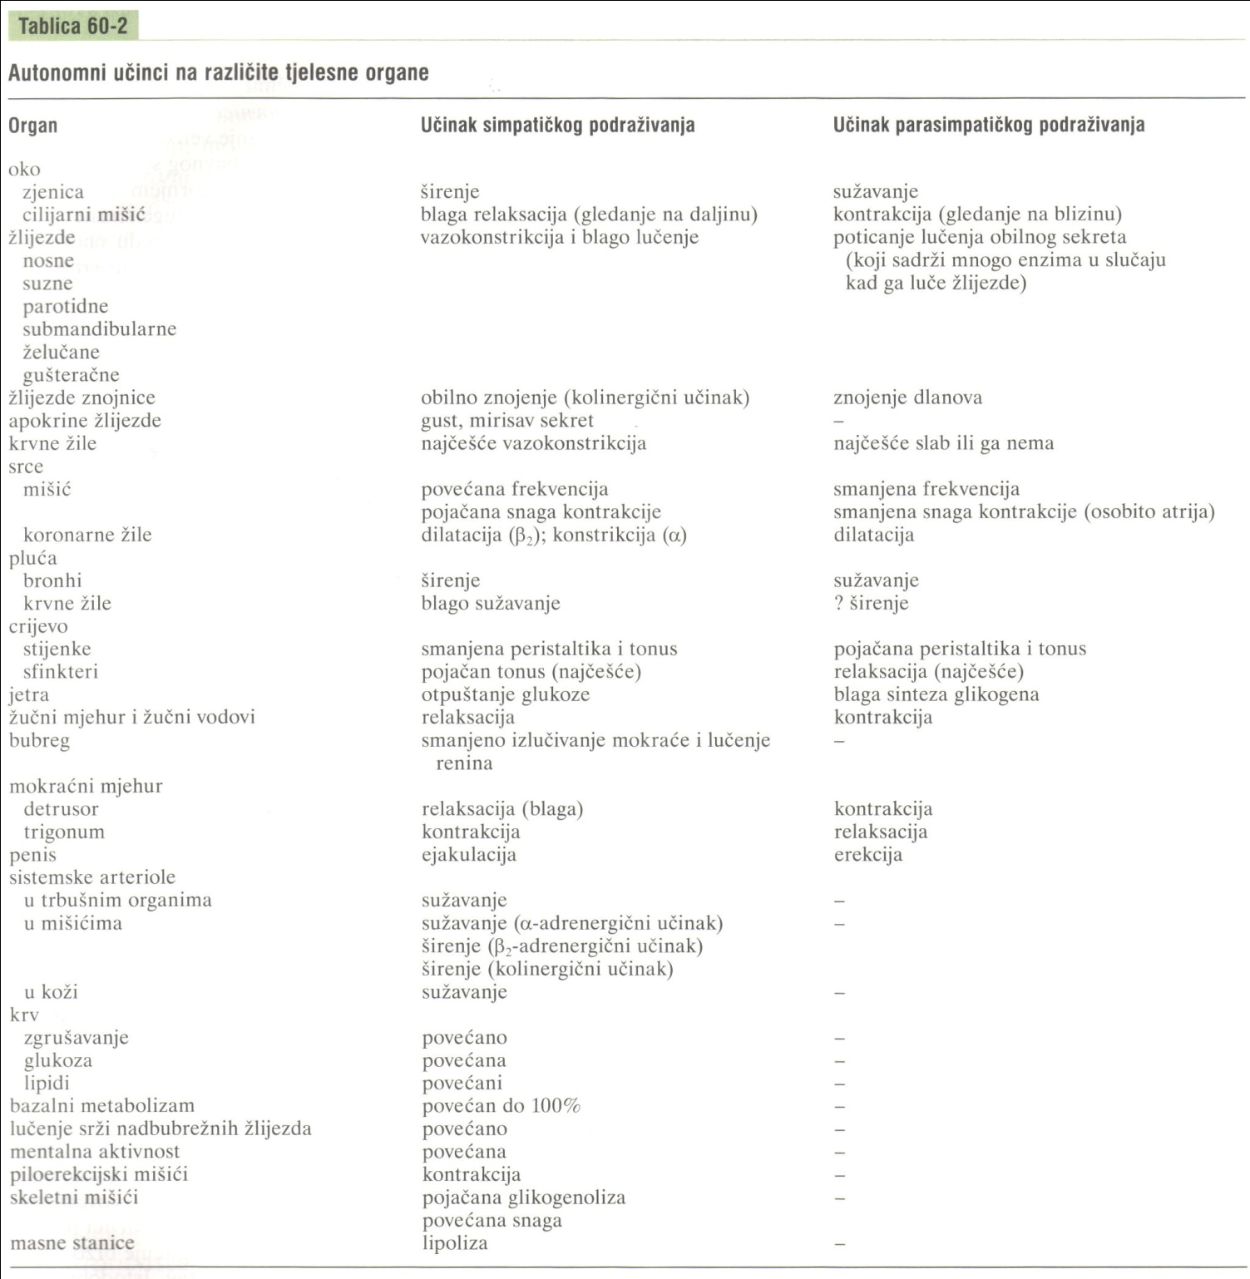

Slide 47
Function of the Adrenal Medullae
stimulation of the sympathetic nerves to the AM causes large quantities of epinephrine (80%) and NE (20%) to be released, although proportions can differ
almost the same effects as direct sympathetic stimulation, except that the effects last 5 to 10 times as long (2-4 min)

Slide 48
epinephrine has a greater effect on cardiac stimulation, less vasoconstrictive effect (especially in muscle, represent a major segment of the vessels of the body)
NE greatly increases the total peripheral resistance and elevates arterial pressure; epinephrine raises the arterial pressure to a lesser extent but increases the cardiac output more

Slide 49
epinephrine has 5 to 10 times as great a metabolic effect as NE

Slide 50
Value of the Adrenal Medullae to the Function of the SNS
stimulation of organs in two ways: directly by the sympathetic nerves and indirectly by the adrenal medullary hormones
two means of stimulation support each other, sometimes substitution for the other – safety factor

Slide 51
Value of the Adrenal Medullae to the Function of the SNS
capability of epinephrine and NE to stimulate structures of the body that are not innervated by direct sympathetic fibers (all the cells in the body)

Slide 52
Relation of Stimulus Rate to Degree of Effect
only a low frequency of stimulation is required for full activation of autonomic effectors (difference to skeletal nervous system)

Slide 53
Relation of Stimulus Rate to Degree of Effect
only one nerve impulse every few seconds suffices to maintain normal effect, and full activation occurs when the nerve fibers discharge 10 to 20 times per second
full activation in the skeletal nervous system requires 50 to 500 or more impulses per second

Slide 54
Sympathetic and Parasympathetic "Tone"
autonomic nervous system is continually active, and the basal rates of activity are known as sympathetic and parasympathetic tone
value of tone is that it allows a single nervous system both to increase and decrease the activity of a stimulated organ

Slide 55
sympathetic tone normally keeps almost all the systemic arterioles constricted to about one-half their maximum diameter
cutting the vagus nerves can cause serious constipation

Slide 56
Basal Secretion of AM
epinephrine – 0.2 μg/kg/min
NE – 0.05 μg/kg/min
quantities are considerable, enough to maintain the blood pressure even if all direct sympathetic pathways to the cardiovascular system are removed

Slide 57
Loss of Tone
in the case of transection of the nerves
blood vessels – within 5 to 30 seconds almost maximal vasodilation
over weeks intrinsic tone in the smooth muscle of the vessels increases
in the parasympathetic system, the compensation sometimes requires many months

Slide 58
Denervation Supersensitivity
first week after nerve is destroyed, the innervated organ becomes more sensitive to injected NE or acetylcholine
denervation supersensitivity
sympathetic and parasympathetic organs; increasing the response more than 10-fold
number of receptors in the postsynaptic membranes of the effector cells increases

Slide 59
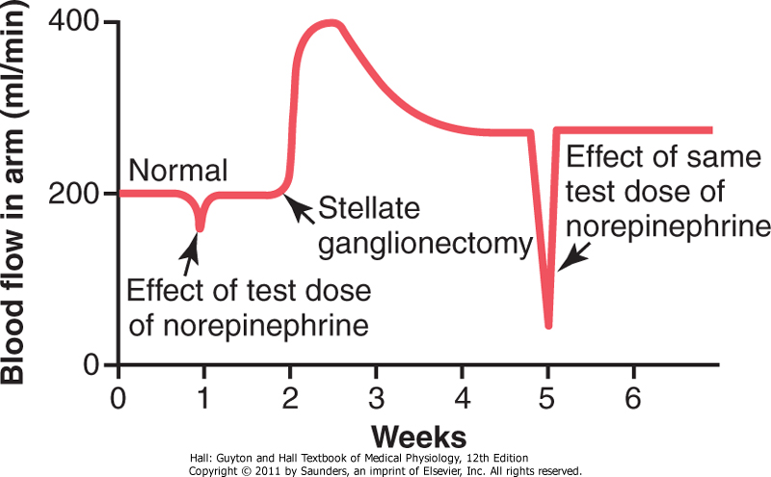

Slide 60
Autonomic Reflexes
regulating many visceral functions
cardiovascular autonomic reflexes baroreceptor reflex – arterial pressure and HR
gastrointestinal autonomic reflexes
smell of appetizing food or presence of food in mouth
stretching of rectum
other autonomic reflexes
emptying of the urinary bladder
sexual reflexes

Slide 61
Mass Discharge by Sympathetic System
in some instances, almost all portions of the sympathetic nervous system discharge simultaneously as a complete unit
fear or severe pain
alarm or stress response

Slide 62
Activation in isolated portions of the sympathetic nervous system
process of heat regulation control sweating and blood flow in the skin
local reflexes – heating a skin area causes local vasodilation and enhanced local sweating (cooling causes opposite effects)
reflexes that control gastrointestinal functions; motor or secretory activity

Slide 63
Specific Localized Responses caused by Parasympathetic
control functions by the parasympathetic system are often highly specific
parasympathetic cardiovascular reflexes usually act only on the heart
salivary secretion, gastric secretion and pancreatic secretion frequently occurs at the same time; rectal emptying reflex often initiates a urinary bladder emptying reflex

Slide 64
"Alarm" or "Stress" Response of the Sympathetic Nervous System
increases in many ways the ability of the body to perform vigorous muscle activity
⇧ arterial pressure
⇧ blood flow to active muscles,  inactive tissues
⇧ rates of cellular metabolism throughout the body
⇧ blood glucose concentration
⇧ glycolysis in the liver and in muscle
⇧ muscle strength
⇧ mental activity
⇧ rate of blood coagulation

Slide 65
sympathetic stress response – extra activation of the body in states of stress
state of rage – sympathetic alarm reaction, fight or flight reaction

Slide 66
Medullary, Pontine, and Mesencephalic Control of the ANS
control of arterial pressure, HR, respiratory rate, glandular secretion, peristalsis, and degree of contraction of the urinary bladder
transection below medulla causes arterial pressure to fall to less than one-half normal
higher areas can also play a role (pressure, temperature) – diseases (peptic ulcer, constipation, heart palpitation, heart attack)

Slide 67
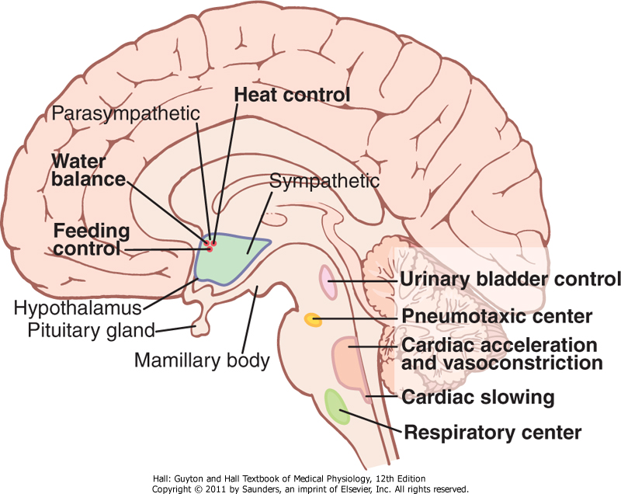

Slide 68
Pharmacology of ANS – Sympathetic Nervous System
drugs that act on adrenergic receptors – sympathomimetic drugs
α-receptors – phenylephrine
β-receptors – isoproterenol
β₂-receptors – albuterol
drugs that release NE from nerve endings
ephedrine, tyramine, amphetamine

Slide 69
drugs that block adrenergic activity – sympahtolytics
preventing synthesis and storage of NE – reserpine
blocking release of NE – guanethidine
blocking α-receptors – phentolamine
blocking β-receptors – propranolol
blocking β₁-receptors – metoprolol
blocking transmission of nerve impulses through the autonomic ganglia – hexamethonium

Slide 70
Pharmacology of ANS – Parasympathetic Nervous System
drugs that act on cholinergic receptors – parasympathomimetics (cholinergic drugs)
ACh – various effects due to cholinesterase destruction in the blood and body fluids
muscarinic receptors – pilocarpine and methacholine

Slide 71
drugs that have a parasympathetic potentiating effect – anticholinesterase drugs
neostigmine, pyridostigmine, and ambenonium
drugs that block cholinergic activity at effector organs – antimuscarinic drugs
atropine, homatropine, scopolamine;
- do not affect the nicotinic action of acetylcholine on the postganglionic neurons or on skeletal muscle

Slide 72
Drugs That Stimulate Postganglionic Neurons
injected ACh
nicotine (drugs that can stimulate postganglionic neurons – nicotinic drugs)
excites sympathetic and parasympathetic postganglionic neurons at the same time

Slide 73
Ganglionic Blocking Drugs
block impulse transmission from the preganglionic to the postganglionic neurons
tetraethyl ammonium ion, hexamethonium ion, pentolinium
block sympathetic and the parasympathetic systems simultaneously
used for blocking sympathetic activity
reducing arterial pressure, effects are difficult to control

