Slide 1
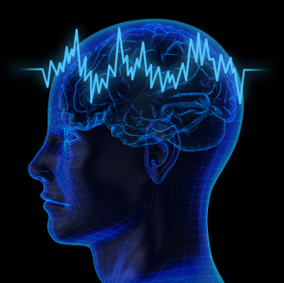
ALTERNATIVE TREATMENTS IN PEOPLE WITH ADHD/ADD
Presented by: Florencia Roberts
Jude Flisram
Patrick Edwards
Victoria Lopez

Slide 2
PURPOSE
Determine if people are aware of alternative treatments for ADD/ADHD and what does or doesn’t work

Slide 3
OBJECTIVES
To find alternative treatments that can help people experiencing
ADHD/ADD.
Provide parents with tools and techniques for managing their child’s
behavior.
Discover community’s awareness of alternative treatments for ADD/ADHD.
Identify treatments that the community finds to be effective (or ineffective)
Educate and provide resources to the community about effectiveness of alternative treatments for ADD/ADHD.

Slide 4
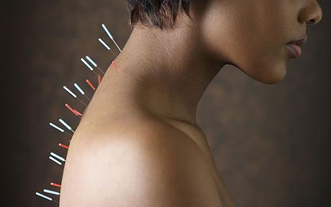
ALTERNATIVE TREATMENTS
Nutritional Therapies.
Neurofeedback.
Homeopathy.
Mind/body techniques.
Behavioral Therapy.
Relaxation Techniques.
Acupuncture.
Social skills training and parent skills training.

Slide 5
RESEARCH QUESTIONS
Are individual's aware of alternative treatments for ADHD/ADD other than medications?
Have individual’s found alternative treatments to be helpful?

Slide 6
METHODOLOGY
Research to determine awareness of and effectiveness of alternative treatments to ADD/ADHD
Data collected through survey given to ADDA-SR groups
Survey administered through an line service called Survey Monkey

Slide 7
RESULTS OF ANONYMOUS SURVEY QUESTIONNAIRE

Slide 8
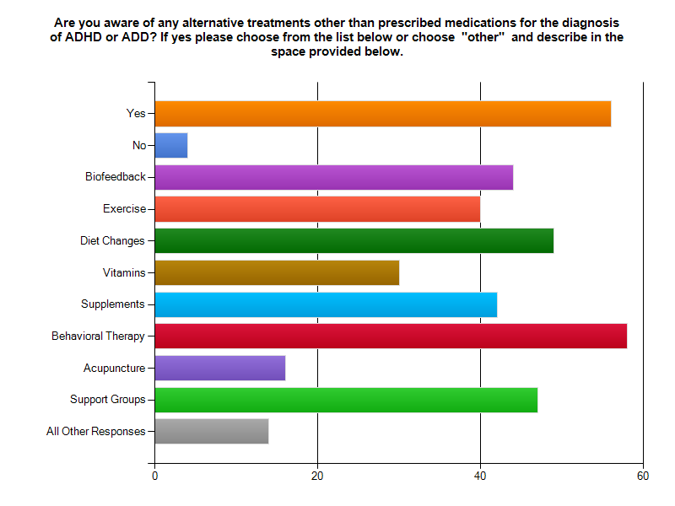

Slide 9
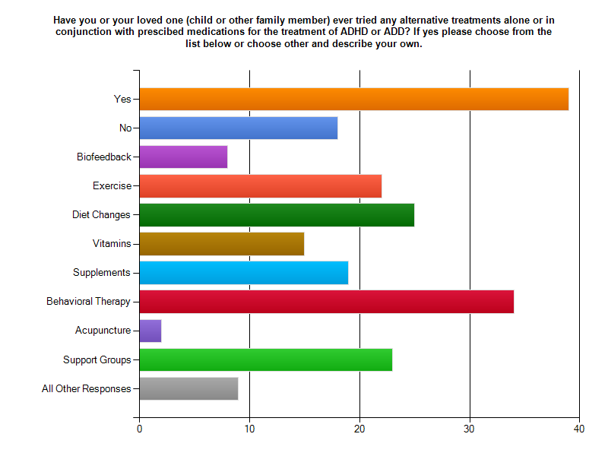

Slide 10
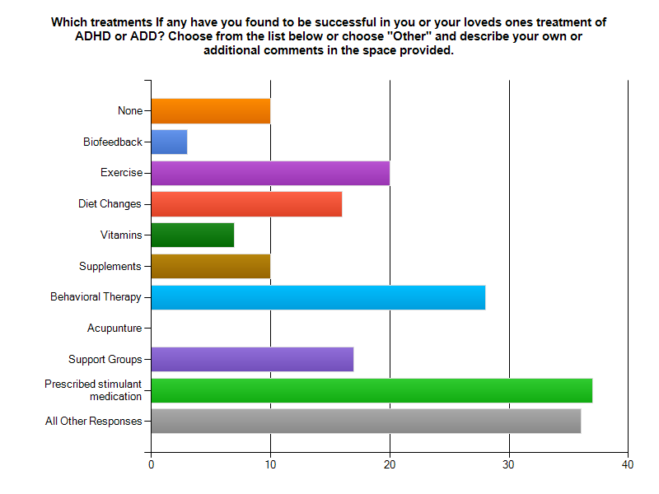

Slide 11
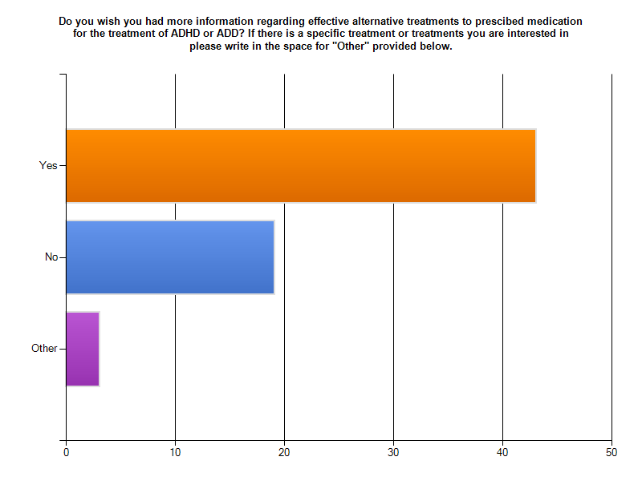

Slide 12
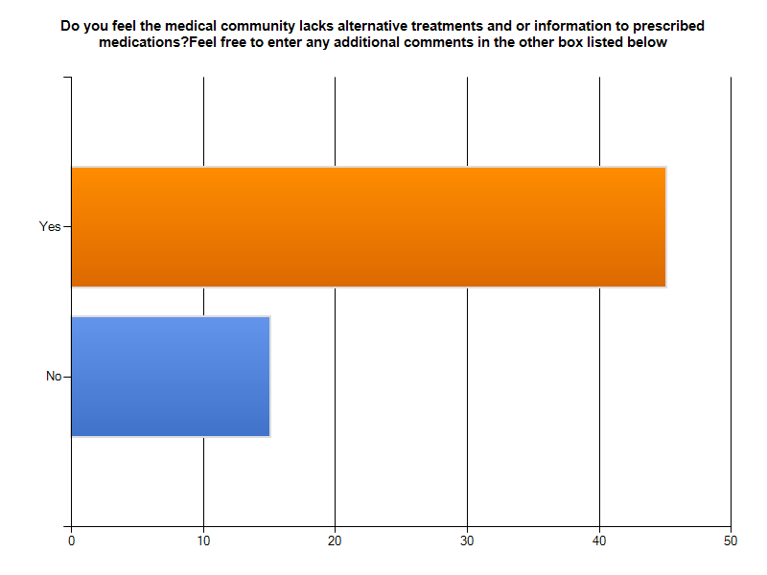

Slide 13
CONCLUSIONS
There is a need and a desire within the community for more information regarding alternative treatments
There is promising research with the use of alternative treatments

