Slide 1
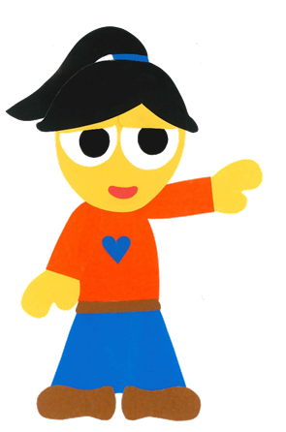
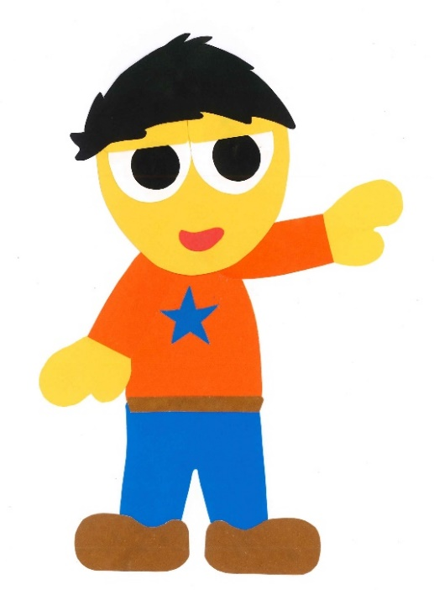
WE
CAN
READ
Teacher Donald

Slide 2
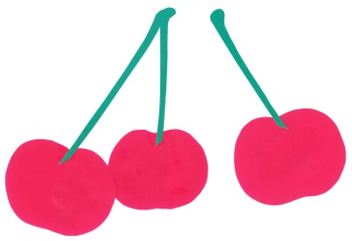
What Do You Like?
By:
Donald Joyce
WE CAN READ

Slide 3
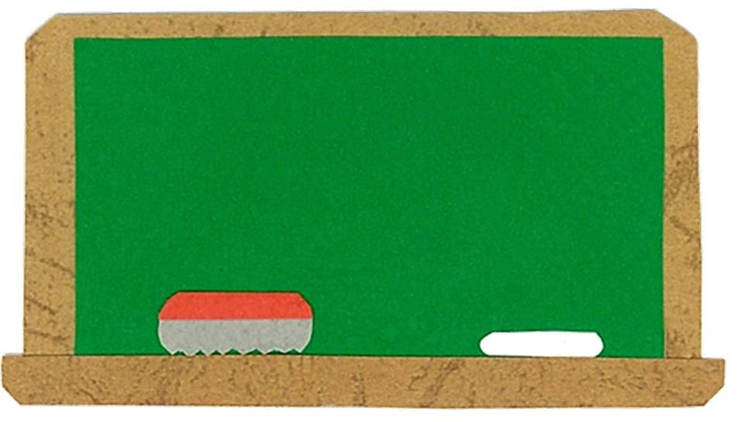
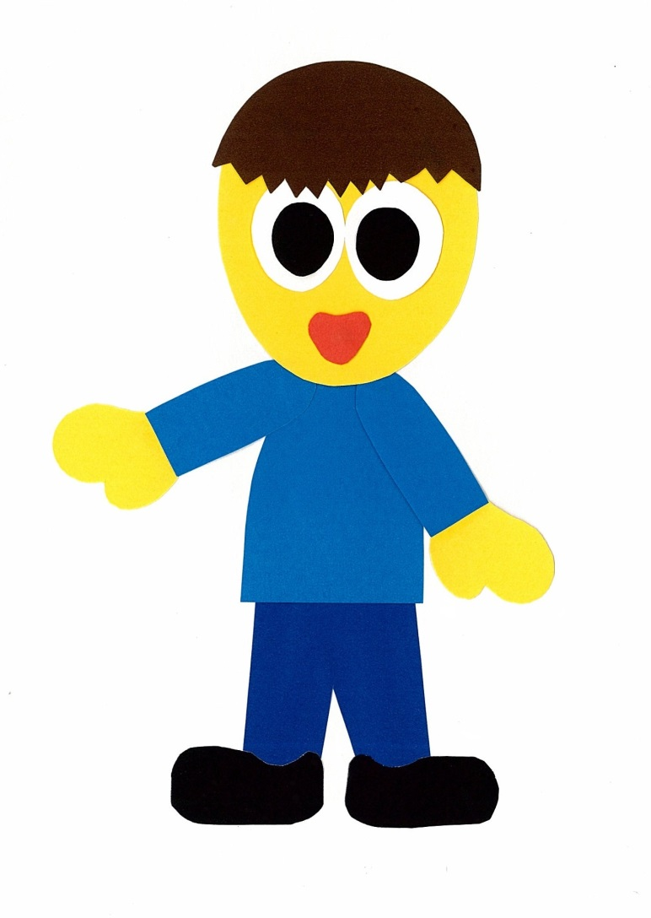
Let’s
Talk!

Slide 4
What fruit do you like?
I like ___.

Slide 5
What is your
favorite fruit?
I like ___.
Me too!

Slide 6
Let’s
Learn!

Slide 7
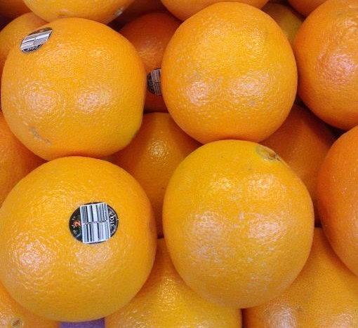
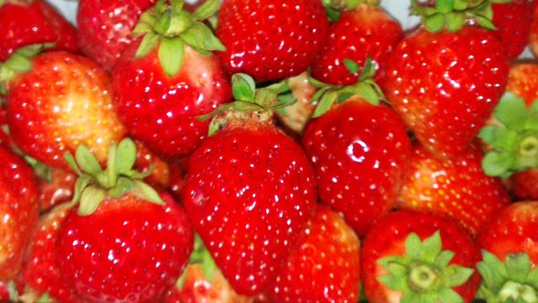
apples
oranges
strawberries
bananas
grapes
cherries

Slide 8
Let’s
Read!

Slide 9
What Do You Like?
By:
Donald Joyce
WE CAN READ

Slide 10
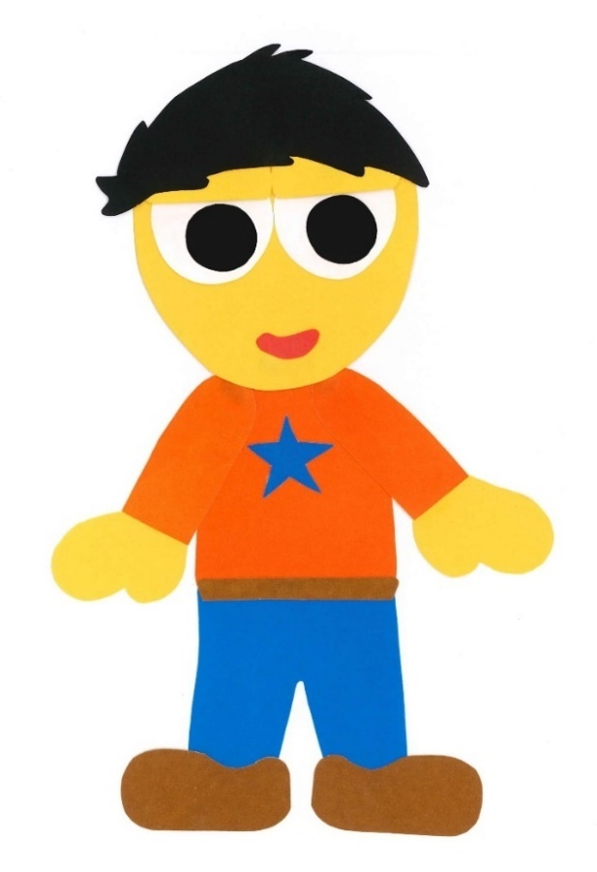
What do you like?

Slide 11
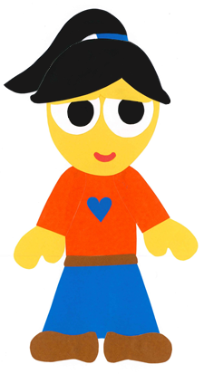
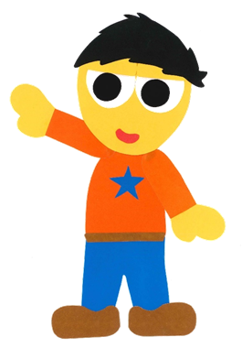
I like bananas.

Slide 12
What do you like?

Slide 13
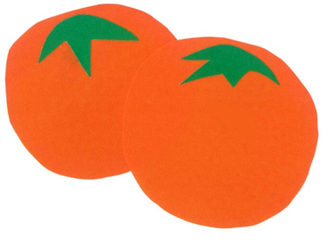
I like oranges.

Slide 14
What do you like?

Slide 15
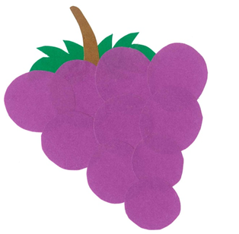
I like grapes.

Slide 16
What do you like?

Slide 17
I like cherries.

Slide 18
What do you like?

Slide 19
I like strawberries.

Slide 20
What do you like?

Slide 21
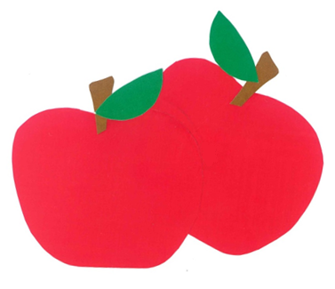
I like apples.

Slide 22
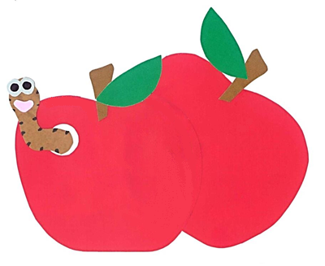
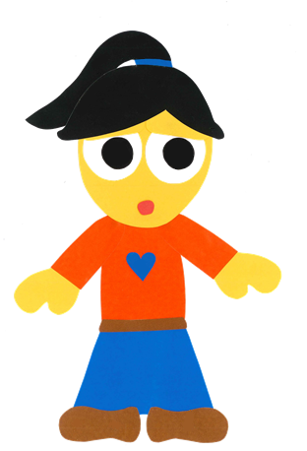
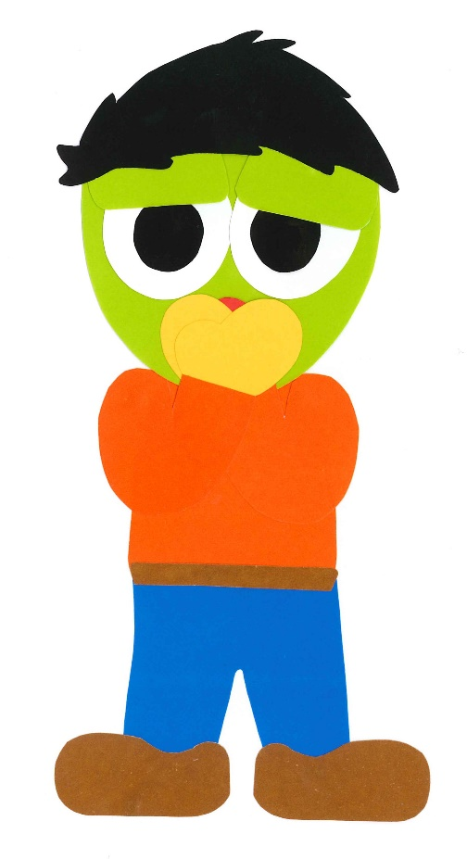
I like apples, too!

Slide 23
What Do You Like?
By:
Donald Joyce
WE CAN READ

Slide 24
Let’s
Review!

Slide 25
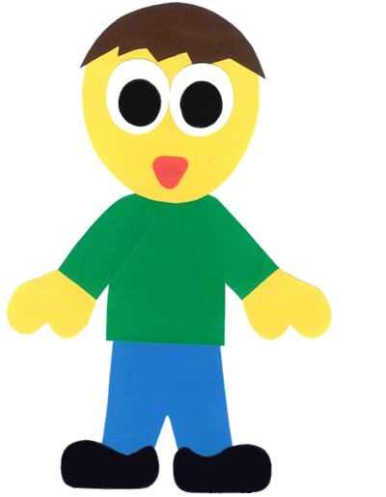
Sam likes _____.

Slide 26
Sam likes oranges.

Slide 27
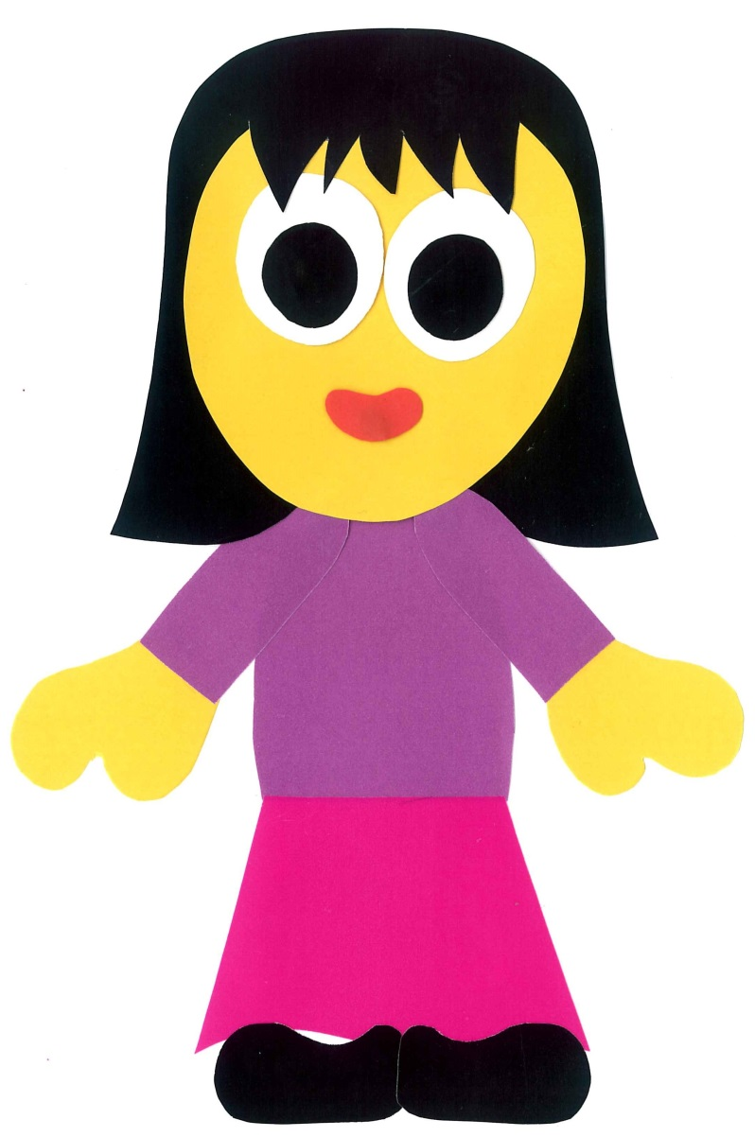
Pam likes _____.

Slide 28
Pam likes bananas.

Slide 29
Sam likes _____.

Slide 30
Sam likes apples.

Slide 31
Pam likes _____.

Slide 32
Pam likes strawberries.

Slide 33
Sam likes _____.

Slide 34
Sam likes cherries.

Slide 35
Pam likes _____.

Slide 36
Pam likes grapes.

Slide 37
Let’s
Connect!

Slide 38
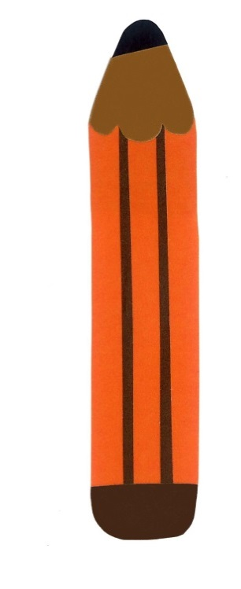
Get a pencil and paper!

Slide 39
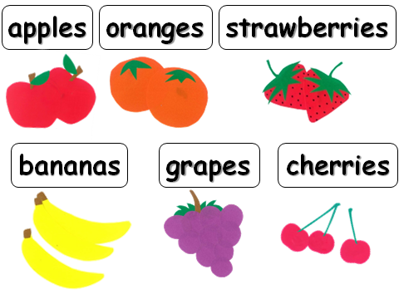
What fruit do you like?
I like ____.

Slide 40
Do you like ____?
Yes, I do.
No, I don’t.

Slide 41
WE
CAN
READ
Donald Joyce
www.teacherdonald.com

