Slide 1
Chapter 21 – The Muslim Empires
The Rise & Spread of the Ottoman Turks
The Safavid Empire
The Mughal Empire

Slide 2
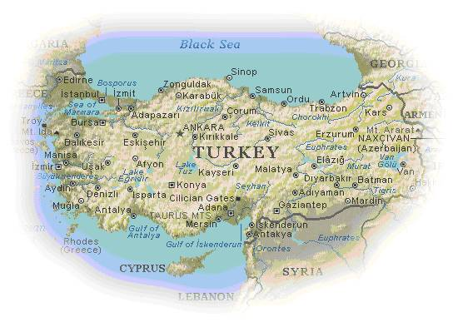
The Ottoman Capital -- Constantinople
Anatolian Peninsula – between the Black Sea and Mediterranean

Slide 3
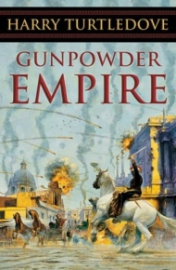
Gunpowder Empires
Refers to Ottomans, Safavid, and Mughal Empires
During the 16th & early17th c. the greatest gunpowder states were not European, but Islamic.
Ottoman based in Constantinople
Safavid – Based in Iran
Mughal – Base in India
Stable boundaries (not nomadic)

Slide 4
By 1500, Islam had become the dominate faith across a large part of the world from West Africa to Southeast Asia
Three large states dominated the Muslim world in the 1500’s (Ottomans, Safavids, & Mughals).

Slide 5
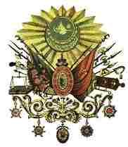
The Early
Ottoman Empire
1281 - 1600s
The Turkic peoples entered Anatolia after the Mongols defeated the Seljuk Turks in the middle of the 13th c.
During the 14th and 15th c. they moved into the Balkans
In 1453, they captured Constantinople and ended the Byzantine Empire

Slide 6
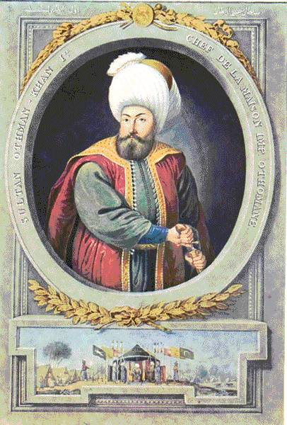
Osman I (r. 1299-1326)
Ottomans – Turkic people who advanced into Asia Minor during the 14th century; established an empire in the Middle East, north Africa, and eastern Europe that lasted until after World War I.
Osman I – founder of the Ottoman empire (Ottoman leader took the title of sultan)
Military leaders had a dominant role in the Ottoman state; policies geared toward war & expansion

Slide 7
The Ottomans
The Ottoman became more militaristic, they mastered the use of gunpowder with muskets and cannon
The Ottoman Empire qualified as one of the first “gunpowder empires.” These were created by ambitious rulers who unified regions that were not originally under their control

Slide 8
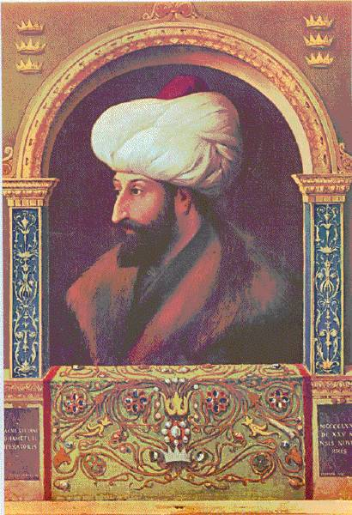
Mehmed II: r. 1451-1481 (“The Conqueror”)
Mehmed II – Ottoman sultan called the “Conqueror”, captured Constantinople and destroyed the Byzantine Empire
Turkish became the chosen language of the Ottoman court

Slide 9
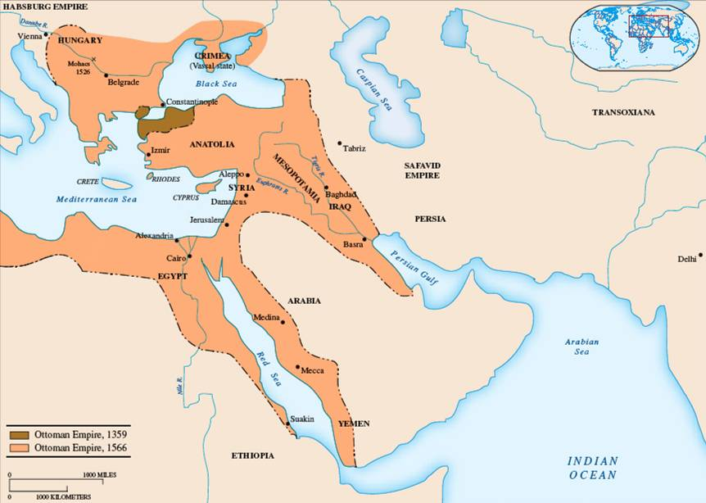
By 1350 the Ottomans had advanced from their strongholds in Asia Minor across the Bosporus into Europe

Slide 10
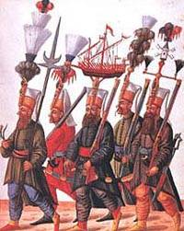
Janissaries – Elite Soldiers of Sultan Army
Janissaries – Christian youths from conquered regions who were trained as Ottoman infantry divisions; became an important political influence after the 15th century. After being converted and educated they were enrolled in the elite regiments.
Greatest slave-recruited Army in the Islamic world

Slide 11
Battle of Lepanto (1571)
Major Point in History – The Ottoman Expansion was stopped – Also the Siege of Vienna in 1529
Remember this battle from a previous chapter?...
Spanish fleet defeated Ottoman fleet showing the European superiority in sea-power.

Slide 12
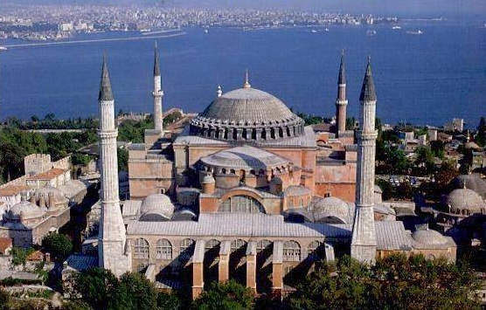
Hagia Sophia - Istanbul

Slide 13
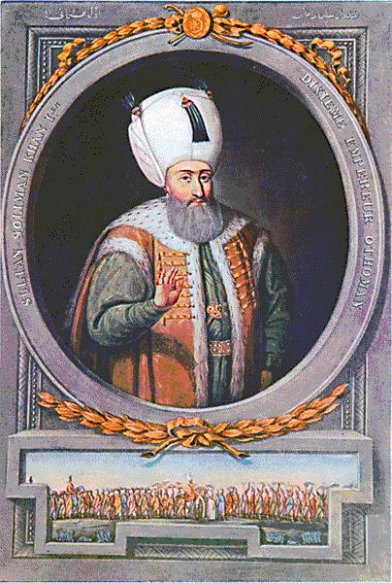
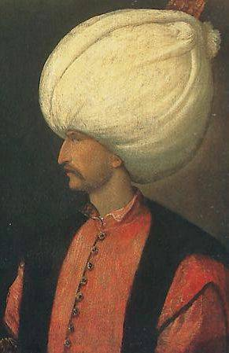
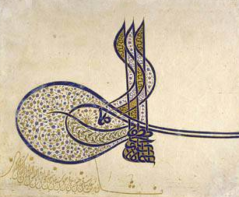
Suleiman the Magnificent: (1520-1566)
Suleiman’s Signature
1520-1566 – “Golden Age” – Ottoman ruled the largest empire, in Europe and the Middle East
Suleiman advance deeper into Europe, finally stopped at the “Siege of Vienna”

Slide 14
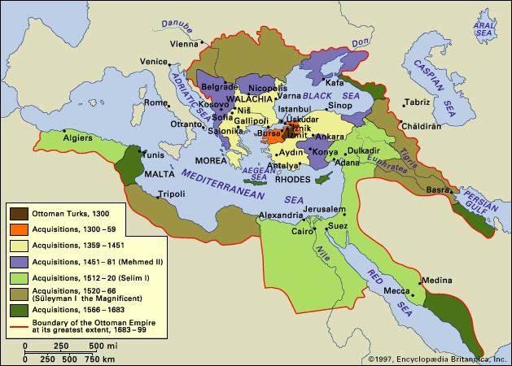
The Golden Age of the Ottomans
Golden Age under Suleiman the Magnificent

Slide 15
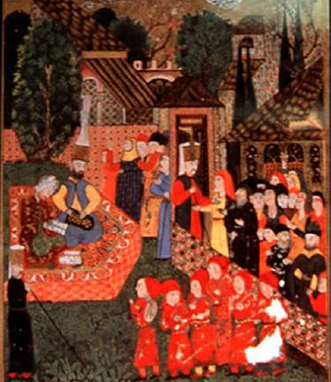
Collection of Taxes in Suleiman’s Court
At its height his empire stretched from Hungary to Arabia, Mesopotamia, and across North Africa
Suleiman as sultan had absolute power, but he ruled with the help of a grand vizier (lead advisor)

Slide 16
Qur’an Page: Arabic Calligraphy
Like the janissaries, non-Muslim girls from Eastern Europe were brought to serve as slaves in wealthy Muslim households
Some were freed after the death of their masters.

Slide 17
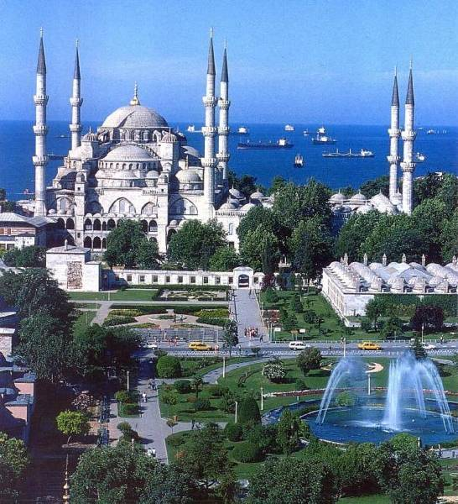
Blue Mosque
The Arts:
arts blossomed under Suleiman
Ottoman poets adapted Persian and Arab models to produce works in their own Turkish language

Slide 18
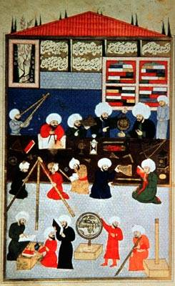
Decline of the Ottoman’s
By the 1700’s European advances in both commerce and military technology were leaving the Ottomans behind
European industry and trade pressed ahead, the aging Ottoman empire remained dependent on agriculture
Russia and their European powers chipped away at Ottoman lands, while local rulers in North Africa broke away from Ottoman control

Slide 19
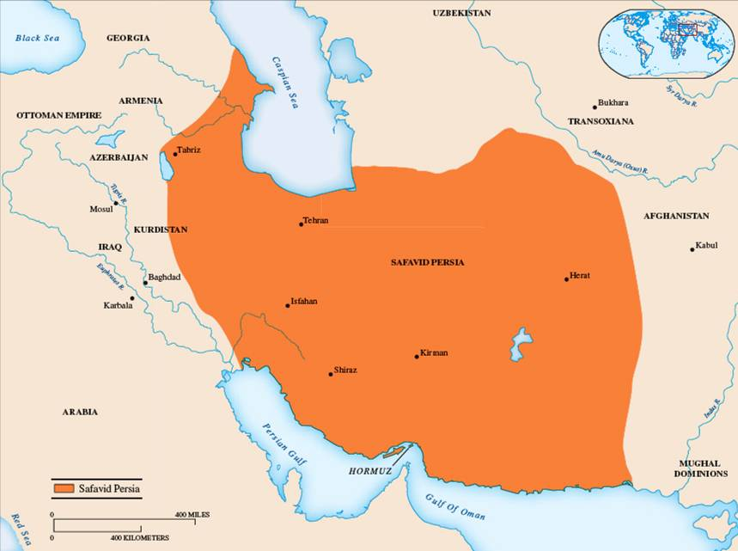
The Safavid (Sah Sas Veed)
The Safavids profited from the struggles of rival Turkic groups after Mongol invasion -The Shi’a Muslims, came from a family of Sufi preachers and mystics

Slide 20
Safavid Empire in Persia
Ismail and his successors called themselves shahs or kings of the Persian Empire and considered themselves to be the spiritual leaders of Islam (not the Ottoman caliph)
The Safavid Empire was located in modern-day Iran & Iraq, which still has a predominantly Shiite Muslim population. This population still has many conflicts with the Sunni Muslims of the region

Slide 21
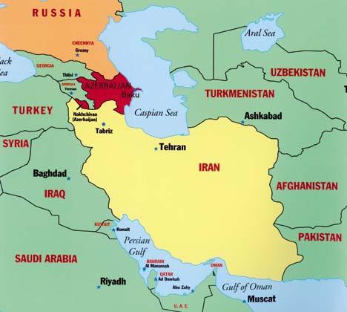
The Safavid planted Shiite traditions firmly in Iran and gave Persians a strong sense of their own identity
Tension between Shiite Safavid’s and Sunni Ottoman Turks arose in several events in the history of the Persian empire.

Slide 22
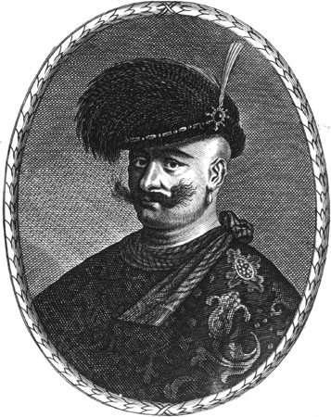
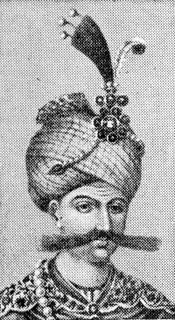
Abbas the Great – High Point
Abbas the Great:
He revived the glory of ancient Persia created a powerful military force modeled after the Ottoman Janissaries

Slide 23
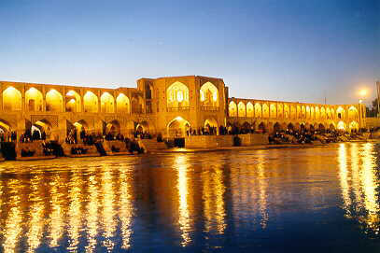
Abbas built a magnificent new capital at Isfahan (is fuh HAHN)
The Shah welcomed artists, poets, and scholars to the court
Safavid glory slowly faded after the death of Shah Abbas
Pressure from Ottoman armies, conservative Shiite scholars challenged the authority of the shah

Slide 24
The Safavid cuture
Isfahan the capital, the arts flourished under Shah Abba, Silk and carpet weaving spread through the region.

Slide 25
Chaldiran – Important battle between the Safavids and Ottomans in 1514; Ottoman victory demonstrated the importance of firearms and checked the western advance of their Shi’a state
Imams – Shi’a religious leaders who traced their descent to Ali’s successors
Mullahs – Religious leaders under the Safavids; worked to convert all subjects to Shi’i

Slide 26
The Quick Decline of the Safavid’s
Shah Abbas’ death (power void)
Bordering nations seized territory:
Afghans invaded from the East, Ottoman Turks from the West = Persia fell into a state of political chaos and anarchy.

Slide 27
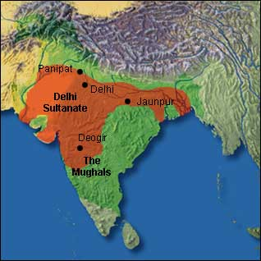
The Delhi Sultanate
Delhi sultanate lasted 1206-1526
Start of Muslim rule in northern India

Slide 28
The Mughal Dynasty (1526-1857)
Founder →Babur –father descended from Tamerlane (Timur) and his mother from Chinggis Khan
He inherited the rule of what remained of Timur’s empire
Established himself as the power of north India

Slide 29
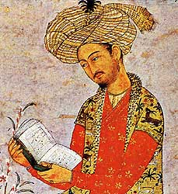
Babur – “the Tiger”
Military genius, poet, and author
Started Mughal dynasty which ruled from 1526 until 1857 (last emperor)
Swept away Delhi Sultanate, took over in its place

Slide 30
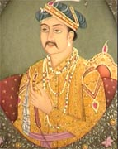
Akbar the Great (1556-1605)
Babur’s grandson
Started Din-i-Ilahi – new religion; attempted to blend elements of Hinduism and Islam as a means of reconciling Hindus and Muslims
Religion was rejected by both Muslims and Hindus after Akbar’s death
Akbar the Great strengthened Muslim rule by instituted a policy of religious toleration

Slide 31
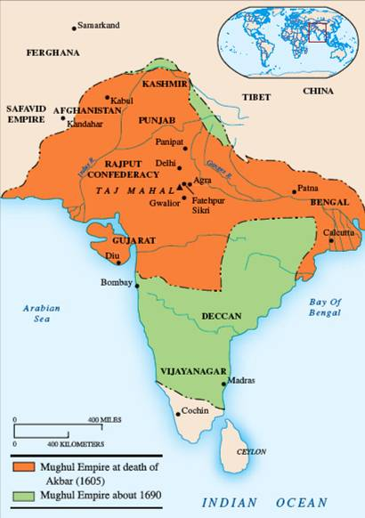
Mughal Empire
Akbar created the greatest empire in India since the Maurya dynasty
Outlawed Sati – Ritual burning of high-caste Hindu women on their husband’s body at funeral

Slide 32
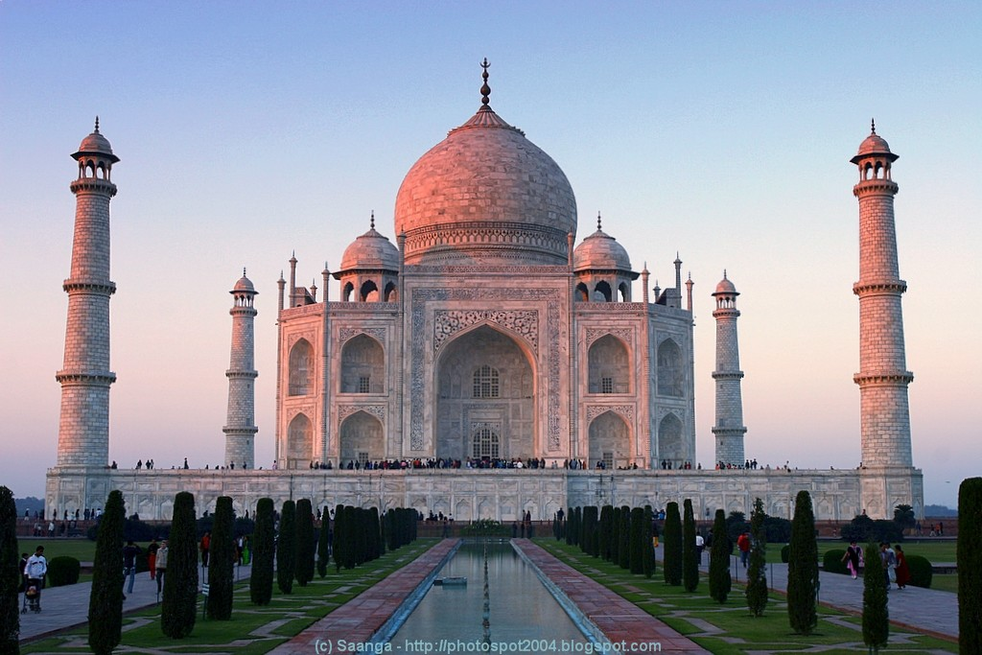
Taj Mahal (1650)– Mausoleum for Mumtaz Mahal, built by her husband Shah Jahan; most famous architectural achievement of Mughal India
Mumtaz Mahal – Wife of Shah Jahan; took an active political role in Mughal court; entombed in Taj Mahal

Slide 33
The Decline of the Mughal Empire
Akbar died in 1605
Shah Jahan began the decline – spent too much of treasury on the construction of the Taj Mahal in his wife's honor; completely draining the treasure
His son ruled after him and was not tolerant of other religions
Mughal and British trading increased; British army under Sir Robert Clive defeated Mughal army; British forces dominated India until 1947

Slide 34
Hindu-Muslim Differences
Hinduism
Ancient religion evolved over thousand of years
Many sacred texts, many gods and goddesses (polytheistic)
Hindus accepted differences in castes and honored Brahmans as a priestly caste
Muslims
Devout monotheists; saw the statues and carvings in Hindu temples as an offense to the one true god
Muslims taught the equality of all believers before God; no religious hierarchy

Slide 35
The Least You Need To Know
The Ottoman Turks emerged from central Asia to create an empire out of the territories of the Middle East, North Africa, and eastern Europe
Sulieman the Magnificent was the most able of all of the Ottoman sultans his reign also marked the high point in Ottoman power and culture

Slide 36
Continued
The Safavid dynasty came out of the political chaos and anarchy of the Persia to dominate the region and create a short-lived empire
The Moghuls established an empire which united the Hindu and Muslim kingdoms in India for over 300 years

