Slide 1
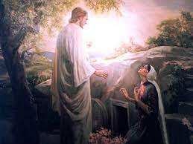
Trinity Evangelical Lutheran Church Easter Sunday-April 17th, 2022
WELCOME!
Notes:
Image: Five Loaves by Caroline Coolidge Brown. Copyright © Caroline Coolidge Brown. All rights reserved. Used by permission of the artist.

Slide 2
Prelude By Roxanne Groff
= Please stand if able
= Please be seated
Office of the Acolyte and Ringing of the Bell
Welcome
Notes:
Image: Five Loaves by Caroline Coolidge Brown. Copyright © Caroline Coolidge Brown. All rights reserved. Used by permission of the artist.

Slide 3
CONFESSION AND FORGIVENESS
All may make the sign of the cross, the sign marked at baptism…
L: We confess our sins before God and one another.
Pause for silence and reflection.
L: Risen Lord,
Notes:
Image: Five Loaves by Caroline Coolidge Brown. Copyright © Caroline Coolidge Brown. All rights reserved. Used by permission of the artist.

Slide 4
CONFESSION AND FORGIVENESS
C: We come to this house on a day of unadulterated joy. But we also come burdened by our sin. Remind us that you gave your life so that sin would no longer rule our lives. Forgive us, and make us new. These things we pray in your name. Amen.
Notes:
Image: Five Loaves by Caroline Coolidge Brown. Copyright © Caroline Coolidge Brown. All rights reserved. Used by permission of the artist.

Slide 5
CONFESSION AND FORGIVENESS
L: Our Lord Jesus forgives you all your sin and makes you clean. Walk into the world forgiven by the risen Lord!
C: Amen.
Notes:
Image: Five Loaves by Caroline Coolidge Brown. Copyright © Caroline Coolidge Brown. All rights reserved. Used by permission of the artist.

Slide 6
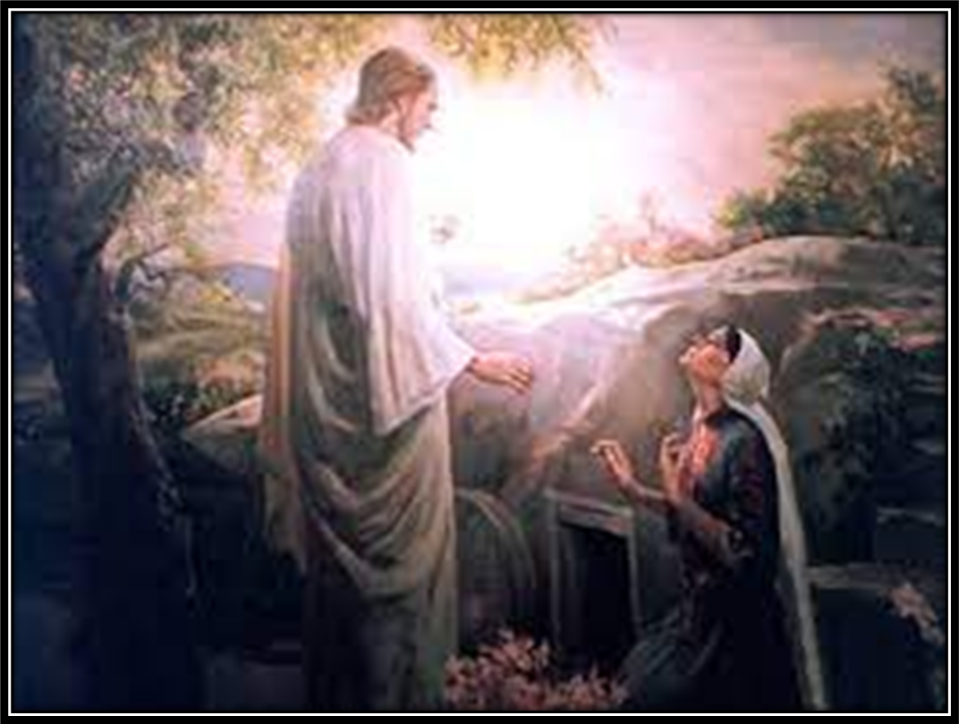
Gathering Song
Christ The Lord Is Risen Today
LBW 128
Notes:
Image: Five Loaves by Caroline Coolidge Brown. Copyright © Caroline Coolidge Brown. All rights reserved. Used by permission of the artist.

Slide 7
Christ The Lord Is Risen Today; Alleluia
LBW 128
1 Christ the Lord is ris'n today; Alleluia!
Christians, hasten on your way; Alleluia!
offer praise with love replete, Alleluia!
at the paschal victim's feet.
Alleluia!
Notes:
Image: Preparing yeast dough. Copyright © tomasworks/iStock/Thinkstock. Used by permission.

Slide 8
Christ The Lord Is Risen Today; Alleluia
LBW 128
2 For the sheep the Lamb has bled, Alleluia!
sinless in the sinner's stead. Alleluia!
Christ the Lord is ris'n on high; Alleluia!
now he lives, no more to die. Alleluia!
Notes:
Image: Preparing yeast dough. Copyright © tomasworks/iStock/Thinkstock. Used by permission.

Slide 9
Christ The Lord Is Risen Today; Alleluia
LBW 128
3 Christ, the victim undefiled, Alleluia!
God and sinners reconciled, Alleluia!
when contending death and life, Alleluia!
met in strange and awesome strife. Alleluia!
Notes:
Image: Preparing yeast dough. Copyright © tomasworks/iStock/Thinkstock. Used by permission.

Slide 10
Christ The Lord Is Risen Today; Alleluia
LBW 128
4 Christians, on this holy day, Alleluia!
all your grateful homage pay; Alleluia!
Christ the Lord is ris'n on high; Alleluia!
now he lives, no more to die. Alleluia!
Notes:
Image: Preparing yeast dough. Copyright © tomasworks/iStock/Thinkstock. Used by permission.

Slide 11
APOSTOLIC GREETING
P: The grace of our Lord Jesus Christ, the love of God, and the communion of the Holy Spirit be with you all.
C: And also with you.
Notes:
Image: Five Loaves by Caroline Coolidge Brown. Copyright © Caroline Coolidge Brown. All rights reserved. Used by permission of the artist.

Slide 12
KYRIE
Notes:
Image: Five Loaves by Caroline Coolidge Brown. Copyright © Caroline Coolidge Brown. All rights reserved. Used by permission of the artist.

Slide 13
KYRIE
Notes:
Image: Five Loaves by Caroline Coolidge Brown. Copyright © Caroline Coolidge Brown. All rights reserved. Used by permission of the artist.

Slide 14
KYRIE
Notes:
Image: Five Loaves by Caroline Coolidge Brown. Copyright © Caroline Coolidge Brown. All rights reserved. Used by permission of the artist.

Slide 15
PRAYER OF THE DAY
P: The Lord be with you.
C: And also with you.
P: Let us pray… Risen Lord, we celebrate today that you are alive! Not just for Mary and the disciples, but you are alive for us today. Live in us and shape us so that others may come to know you.
C: Amen
Notes:
Image: Five Loaves by Caroline Coolidge Brown. Copyright © Caroline Coolidge Brown. All rights reserved. Used by permission of the artist.

Slide 16
Scripture Reading
R: The Scripture reading is from the Gospel according to Saint John, the 20th chapter.
C: Glory to you O’ Lord! (Spoken)
Notes:
Image: Five Loaves by Caroline Coolidge Brown. Copyright © Caroline Coolidge Brown. All rights reserved. Used by permission of the artist.

Slide 17
GOSPEL: John 20:1-18
¹Early on the first day of the week, while it was still dark, Mary Magdalene came to the tomb and saw that the stone had been removed from the tomb. ²So she ran and went to Simon Peter and the other disciple, the one whom Jesus loved, and said to them, “They have taken the Lord out of the tomb, and we do not know where they
Notes:
Image: Five Loaves by Caroline Coolidge Brown. Copyright © Caroline Coolidge Brown. All rights reserved. Used by permission of the artist.

Slide 18
GOSPEL: John 20:1-18
have laid him.” ³Then Peter and the other disciple set out and went toward the tomb. ⁴The two were running together, but the other disciple outran Peter and reached the tomb first. ⁵He bent down to look in and saw the linen wrappings lying there, but he did not go in. ⁶Then Simon Peter came, following him, and went into the tomb.
Notes:
Image: Five Loaves by Caroline Coolidge Brown. Copyright © Caroline Coolidge Brown. All rights reserved. Used by permission of the artist.

Slide 19
GOSPEL: John 20:1-18
He saw the linen wrappings lying there, ⁷and the cloth that had been on Jesus’ head, not lying with the linen wrappings but rolled up in a place by itself. ⁸Then the other disciple, who reached the tomb first, also went in, and he saw and believed; ⁹for as yet they did not understand the scripture, that he must rise from the dead. ¹⁰Then
Notes:
Image: Five Loaves by Caroline Coolidge Brown. Copyright © Caroline Coolidge Brown. All rights reserved. Used by permission of the artist.

Slide 20
GOSPEL: John 20:1-18
the disciples returned to their homes.
¹¹But Mary stood weeping outside the tomb. As she wept, she bent over to look into the tomb; ¹²and she saw two angels in white, sitting where the body of Jesus had been lying, one at the head and the other at the feet. ¹³They said to her, “Woman, why are you weeping?” She said to them, “They
Notes:
Image: Five Loaves by Caroline Coolidge Brown. Copyright © Caroline Coolidge Brown. All rights reserved. Used by permission of the artist.

Slide 21
GOSPEL: John 20:1-18
have taken away my Lord, and I do not know where they have laid him.” ¹⁴When she had said this, she turned around and saw Jesus standing there, but she did not know that it was Jesus. ¹⁵Jesus said to her, “Woman, why are you weeping? Whom are you looking for?” Supposing him to be the gardener, she said to him, “Sir, if you
Notes:
Image: Five Loaves by Caroline Coolidge Brown. Copyright © Caroline Coolidge Brown. All rights reserved. Used by permission of the artist.

Slide 22
GOSPEL: John 20:1-18
have carried him away, tell me where you have laid him, and I will take him away.” ¹⁶Jesus said to her, “Mary!” She turned and said to him in Hebrew, “Rabbouni!” (which means Teacher). ¹⁷Jesus said to her, “Do not hold on to me, because I have not yet ascended to the Father. But go to my brothers and say to them,
Notes:
Image: Five Loaves by Caroline Coolidge Brown. Copyright © Caroline Coolidge Brown. All rights reserved. Used by permission of the artist.

Slide 23
GOSPEL: John 20:1-18
‘I am ascending to my Father and your Father, to my God and your God.’” ¹⁸Mary Magdalene went and announced to the disciples, “I have seen the Lord”; and she told them that he had said these things to her.
P: This is the Gospel of the Lord.
Notes:
Image: Five Loaves by Caroline Coolidge Brown. Copyright © Caroline Coolidge Brown. All rights reserved. Used by permission of the artist.

Slide 24
Sermon
Notes:
Image: Five Loaves by Caroline Coolidge Brown. Copyright © Caroline Coolidge Brown. All rights reserved. Used by permission of the artist.

Slide 25
SPECIAL MUSIC
Notes:
Image: Five Loaves by Caroline Coolidge Brown. Copyright © Caroline Coolidge Brown. All rights reserved. Used by permission of the artist.

Slide 26
NICENE CREED
C: We believe in one God, the Father, the Almighty, maker of heaven and earth, of all that is, seen and unseen.

Slide 27
NICENE CREED
C: We believe in one Lord, Jesus Christ, the only Son of God, eternally begotten of the Father, God from God, Light from Light, true God from true God, begotten, not made, of one Being with the Father.

Slide 28
NICENE CREED
C: Through him all things were made. For us and for our salvation he came down from heaven; by the power of the Holy Spirit he became incarnate from the virgin Mary, and was made man. For our sake he was crucified under Pontius Pilate;

Slide 29
NICENE CREED
C: he suffered death and was buried. On the third day he rose again in accordance with the Scriptures; he ascended into heaven and is seated at the right hand of the Father. He will come again in glory to judge the living and the dead, and his kingdom will have no end.

Slide 30
NICENE CREED
C: We believe in the Holy Spirit, the Lord, the giver of life, who proceeds from the Father and the Son. With the Father and the Son he is worshiped and glorified. He has spoken through the prophets. We believe in one holy catholic and apostolic Church.

Slide 31
NICENE CREED
C: We acknowledge one Baptism for the forgiveness of sins. We look for the resurrection of the dead, and the life of the world to come. Amen.

Slide 32
PRAYERS OF INTERCESSION
Each petition will end with the words,
A: Risen Lord,
The congregation will respond with:
C: hear our prayer.

Slide 33
PRAYERS OF INTERCESSION
The prayer concludes…
P: Christ is risen indeed. Hear all our prayers and gather them into one great joyful offering of praise, to the glory of our resurrected Savior.
C: Amen.

Slide 34
OFFERING PRAYER
Notes:
Image: Five Loaves by Caroline Coolidge Brown. Copyright © Caroline Coolidge Brown. All rights reserved. Used by permission of the artist.

Slide 35
THE GREAT THANKSGIVING
Communion by pre-packaged Communion Cups. All the Baptized are welcome to celebrate this Holy Meal.

Slide 36
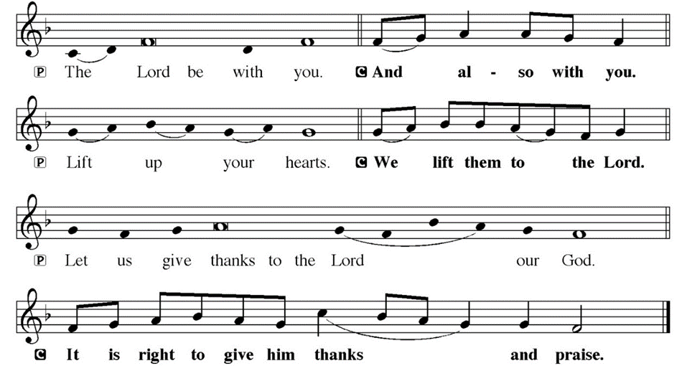
DIALOGUE

Slide 37
THE PREFACE
P: It is indeed right and salutary…
… we praise your name and join their unending hymn.

Slide 38
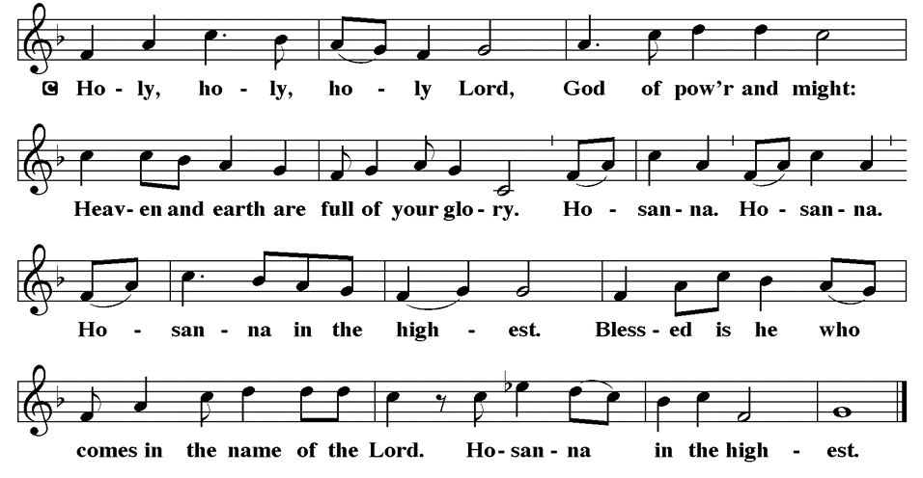
THE SANCTUS

Slide 39
EUCHARISTIC PRAYER
P: Holy, living, and loving God…
…both now and forever.
C: Amen.
THE LORD’S PRAYER
P: United into one through this heavenly food, we pray as Jesus taught…

Slide 40
THE LORD’S PRAYER
C: Our Father, who art in heaven, hallowed be thy name, thy kingdom come, thy will be done, on earth as it is in heaven. Give us this day our daily bread; and forgive us our trespasses, as we forgive those who trespass against us; and lead us not into temptation, but deliver us from evil.

Slide 41
THE LORD’S PRAYER
C: For thine is the kingdom, and the power, and the glory, forever and ever. Amen.

Slide 42
INVITATION TO COMMUNION
P: Jesus Christ gave everything so that we might live, and he is alive! Our Lord has risen from the grave, and in this meal, he shares eternal salvation with all who partake. Come to this feast, indulge in Christ’s goodness, for the sake of Jesus himself. Amen.

Slide 43
POST COMMUNION BLESSING
P: May this Body and Blood of our Lord and Savior, Jesus Christ, strengthen, keep, and unite us, now and forever.
C: Amen.

Slide 44
POST COMMUNION PRAYER
P: Let us pray… We give you thanks, gracious God, for we have feasted on the abundance of your house. Send us to bring good news and to proclaim your favor to all, strengthened with the richness of your grace in your Son, Jesus Christ.
C: Amen

Slide 45
ANNOUNCEMENTS
Notes:
Image: Five Loaves by Caroline Coolidge Brown. Copyright © Caroline Coolidge Brown. All rights reserved. Used by permission of the artist.

Slide 46
Sending Song
Jesus Christ Is Risen Today
LBW 151
Notes:
Image: Five Loaves by Caroline Coolidge Brown. Copyright © Caroline Coolidge Brown. All rights reserved. Used by permission of the artist.

Slide 47
Jesus Christ Is Risen Today LBW 151
1 Jesus Christ is ris'n today,
Alleluia!
our triumphant holy day,
Alleluia!
who did once upon the cross, Alleluia!
suffer to redeem our loss.
Alleluia!
Notes:
Image: Five Loaves by Caroline Coolidge Brown. Copyright © Caroline Coolidge Brown. All rights reserved. Used by permission of the artist.

Slide 48
Jesus Christ Is Risen Today LBW 151
2 Hymns of praise then let us sing, Alleluia!
unto Christ, our heav'nly king, Alleluia!
who endured the cross and grave, Alleluia!
sinners to redeem and save. Alleluia!
Notes:
Image: Five Loaves by Caroline Coolidge Brown. Copyright © Caroline Coolidge Brown. All rights reserved. Used by permission of the artist.

Slide 49
Jesus Christ Is Risen Today LBW 151
3 But the pains which he endured, Alleluia!
our salvation have procured; Alleluia!
now above the sky he's king, Alleluia!
where the angels ever sing. Alleluia!
Notes:
Image: Five Loaves by Caroline Coolidge Brown. Copyright © Caroline Coolidge Brown. All rights reserved. Used by permission of the artist.

Slide 50
Jesus Christ Is Risen Today LBW 151
Sing we to our God above,
Alleluia!
praise eternal as his love;
Alleluia!
praise him, all you heav'nly host, Alleluia!
Father, Son, and Holy Ghost. Alleluia!
Notes:
Image: Five Loaves by Caroline Coolidge Brown. Copyright © Caroline Coolidge Brown. All rights reserved. Used by permission of the artist.

Slide 51
DISMISSAL
P: Depart in Christ’s Love.
C: Seeking, welcoming, and serving all. Amen!
POSTLUDE
By Roxanne Groff
From sundaysandseasons.com. Copyright © 2022 Augsburg Fortress. All rights reserved. Reprinted by permission under Augsburg Fortress Liturgies Annual License #SAS023830. New Revised Standard Version Bible, Copyright © 1989, Division of Christian Education of the National Council of the Churches of Christ in the United States of America. Used by permission. All rights reserved. Revised Common Lectionary, Copyright © 1992 Consultation on Common Texts, admin Augsburg Fortress. Used by permission.

