Slide 1
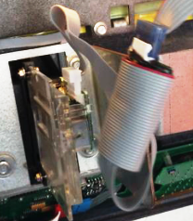
Skimming Devices
in Retail Motor Fuel Dispensers
Bureau of Weights & Measures
10/22/15

Slide 2
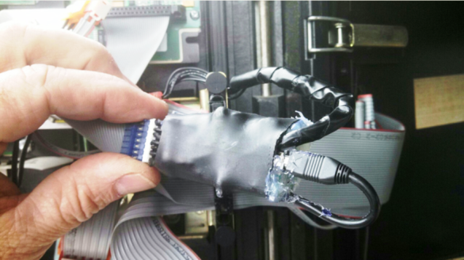
What is a Skimmer
An electronic magnetic or hard wired device, covertly placed, that is capable of stealing banking information encoded on credit/debit cards.

Slide 3
Purpose of this training
The Department of Agriculture and Markets Bureau of Weights & Measures wants to eliminate, or at least drastically reduce, the presence of illegal skimmers from devices it regularly inspects. To accomplish this, the Bureau is requesting municipal W&M agencies to check retail motor fuel dispensers for skimming devices.

Slide 4
Authority
W&M will be checking for skimmers as part of a statewide effort to identify these illegal devices and bring them to the attention of the police. W&M will use their technical knowledge of retail motor fuel dispensers to identify but it is the police who will investigate and pursue legal action.

Slide 5
Before checking for skimmers
Discuss and obtain permission from your superiors.
Know your protocols for dealing with the media.
Have the contact information of your public information officer (PIO).
Have the contact information for the police agency you are going to call if you find a skimmer.

Slide 6
Consequences of Skimming
Large inconvenience for victims.
Loss of confidence in electronic transactions.
Economic loss for everyone.

Slide 7
Who is looking for Skimmers
Dispenser owner/operators.
Service personnel.
W&M.
Law enforcement (local PD, Sheriff, State, Secret Service, etc.).

Slide 8
Types of Skimming Devices
Parasite pig-tailed at card reader and/or pin pad data cable (inside cabinet).
Exterior mounted skimmer (false card reader) placed over legitimate reader.
Often Bluetooth enabled (can retrieve data from short distances without opening the cabinet).

Slide 9
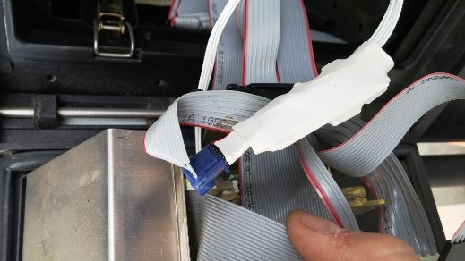
Parasite Pig-Tailed

Slide 10
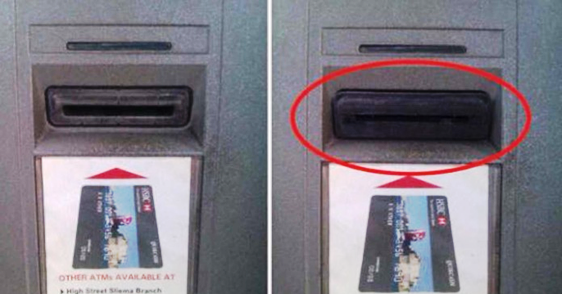
Exterior Mounted Skimmer

Slide 11
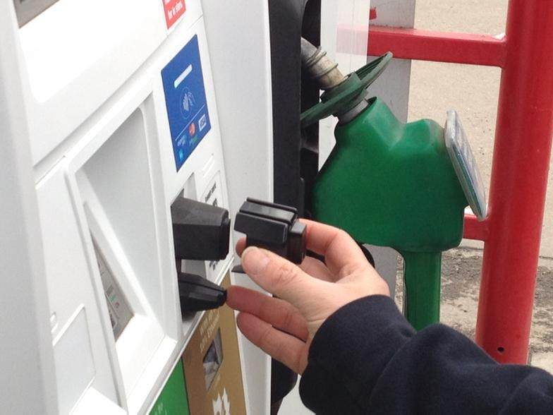
Exterior Mounted Skimmer continued

Slide 12
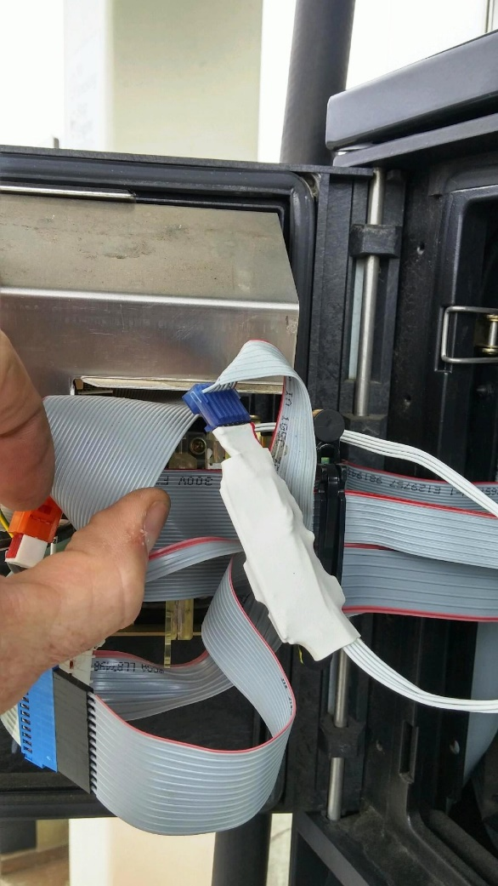
Interior Skimmer w/Bluetooth

Slide 13
What you need
Proper credentials (e.g. agency issued photo ID).
Identifying clothing (e.g. W&M hat, shirt jacket, etc.), if applicable.
NYS Petroleum Dispenser Skimmer audit worksheets.
Camera (recommended).
Flashlight.

Slide 14
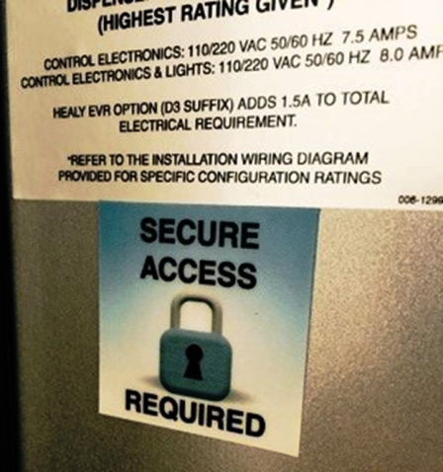
Checking for Skimmers
Introduce yourself to store owner/manager and explain the purpose of your visit.
Ask if the dispensers have any alarms you should be aware of.
Invite the store owner/manager to accompany you.
Obtain key for card reader cabinet.
(Low Skimmer Risk)

Slide 15
Checking for Skimmers continued
As appropriate, open each dispenser card reader cabinet and look for skimmer.
Examine the exterior card reader.
Also be on the look-out for keypad overlay skimmers and hidden cameras.

Slide 16
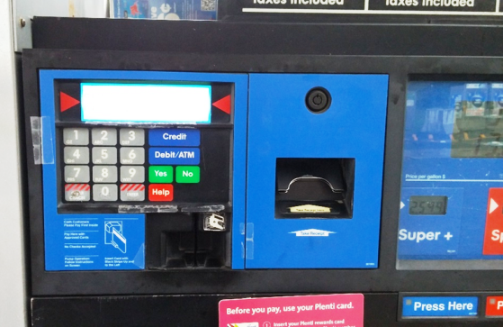
Card Reader Cabinet
This is where we are looking.
Some dispensers have separate cabinets for card reader and paper roll for receipts.
Examine the cabinet for tamper-evident seals.

Slide 17
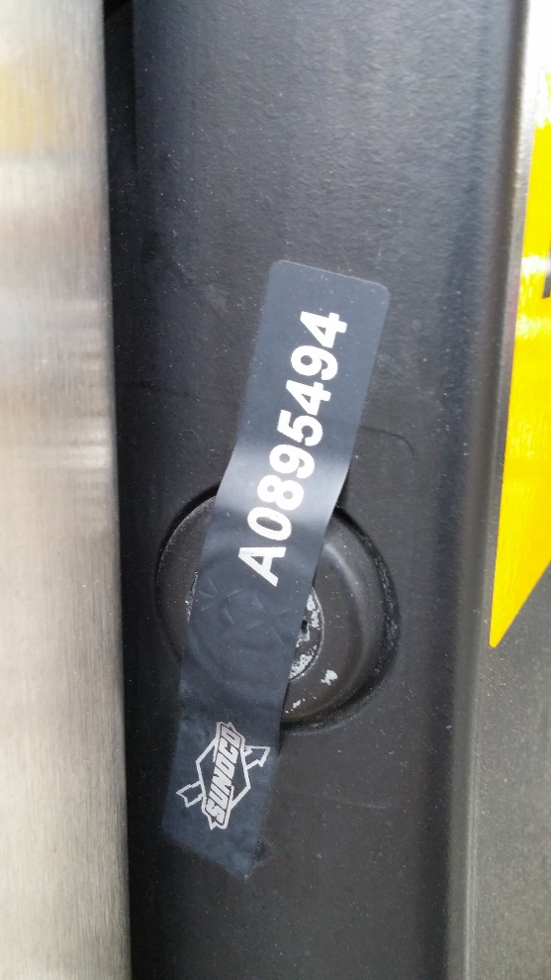
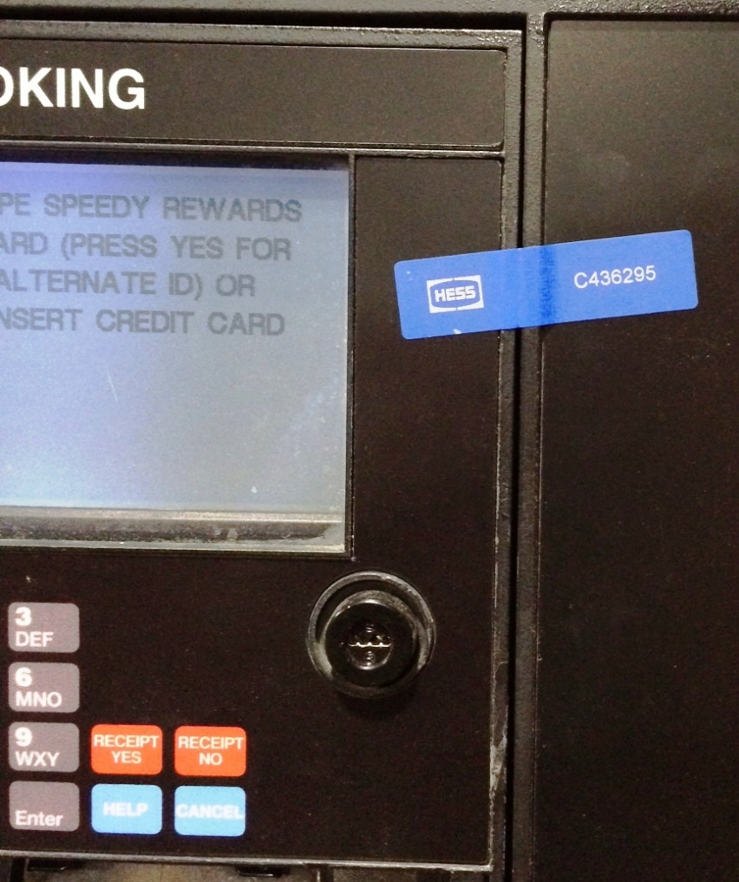
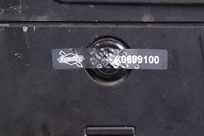
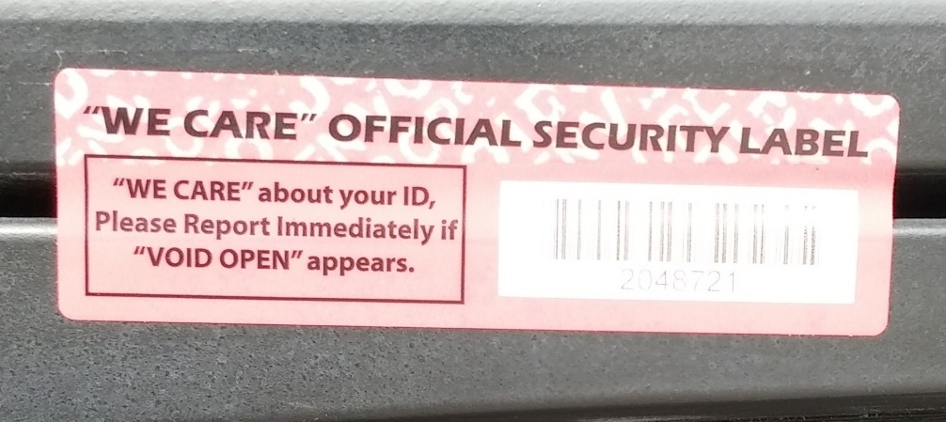
Tamper-evident seals

Slide 18
Tamper-evident seals continued
If the cabinet has an unbroken tamper-evident security seal in place and the station has replacement seals, use your best judgement in deciding if you should check. If the seals are serially numbered be aware that this number may be recorded and it may be best to not check. We do not want to disrupt any security measures that the station already has in place.

Slide 19
Tamper-evident seals continued
If the station does not have replacement security seals do not break the seals.
If the station has tamper-evident seals check all the seals for evidence of tampering.
If a cabinet has a broken tamper-evident security seal in place notify the station owner/manager and check for a skimming device.

Slide 20
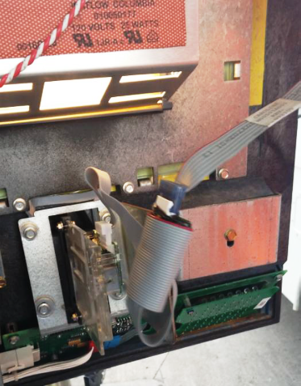
High priority stations
Stations with older dispensers (> 5 years).
Stations with lesser security (e.g. no video surveillance).
Stations with limited line-of-sight for certain dispensers.

Slide 21
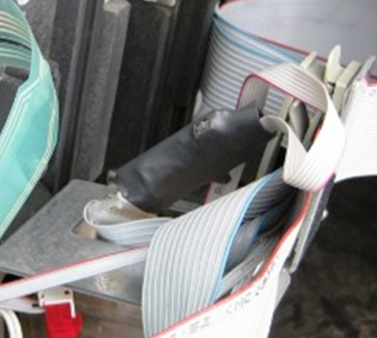
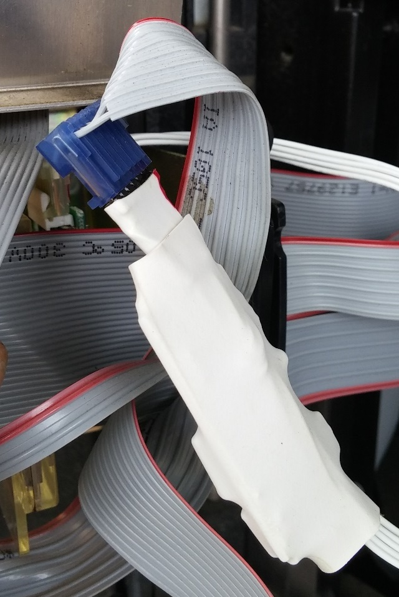
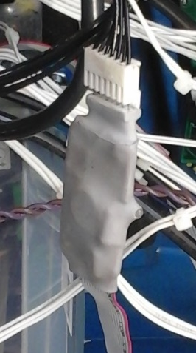
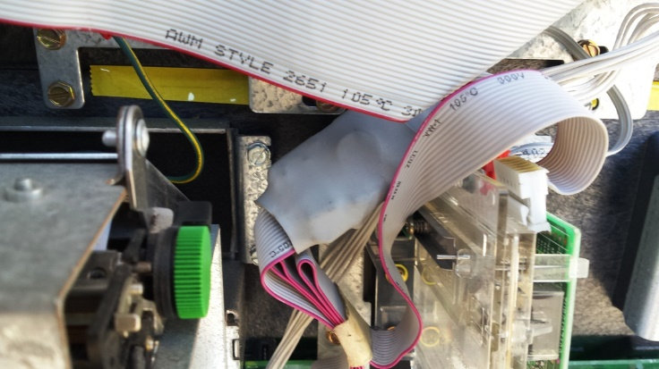
Checking for a Skimmer

Slide 22
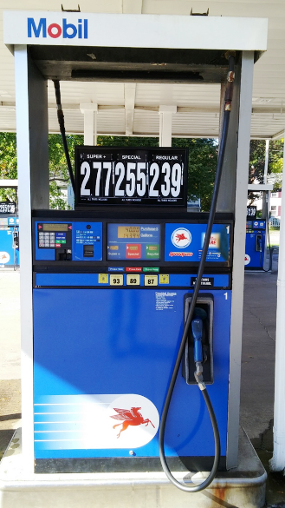
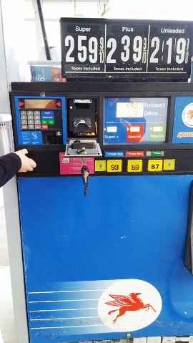
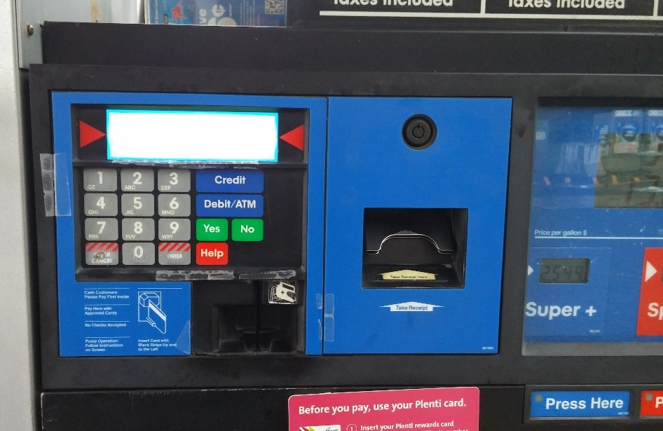
Wayne Vista
Access for receipt and card reader only opens the receipt tape cabinet.

Slide 23
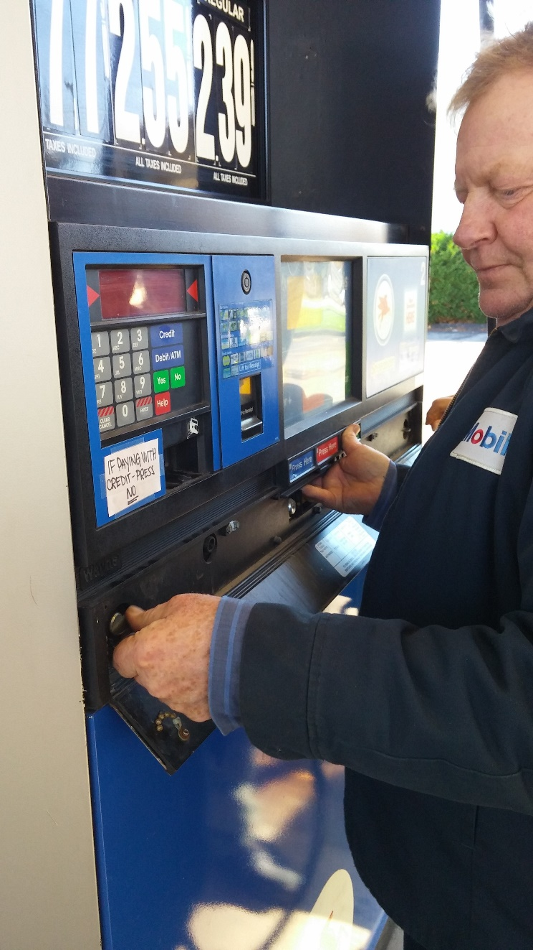
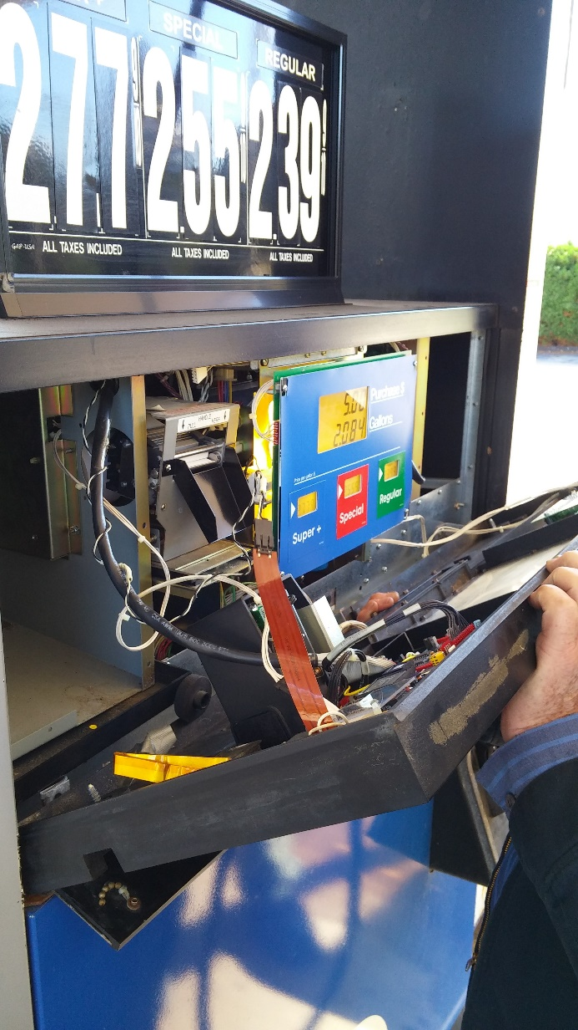
Wayne Vista
Easy to open (no keys are necessary to access the credit card reader).
Flip front plate down, you may have to pry it slightly.
Loosen the wing nuts.
Grab the indicator plate under the product selector buttons and lift slightly.
The indicator plate will flip outward towards you.
You may be able to see card reader on the other side of the dispenser.

Slide 24
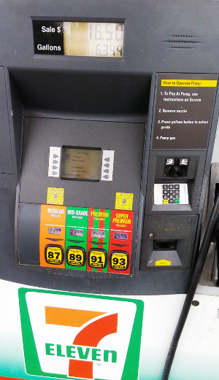
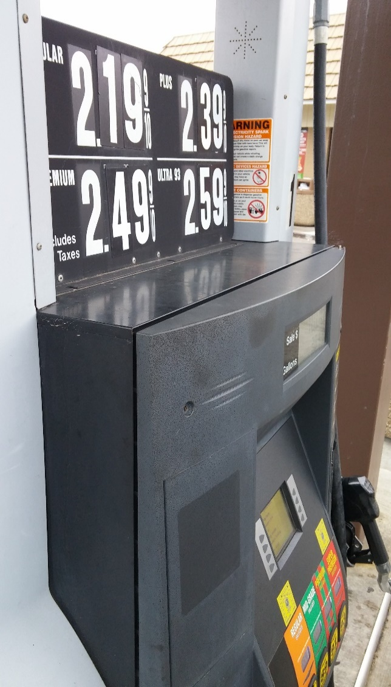
Wayne Ovation
Access to card reader is from behind the main panel, not the receipt tape access door. Loosen the two hex nuts, and open the door.

Slide 25
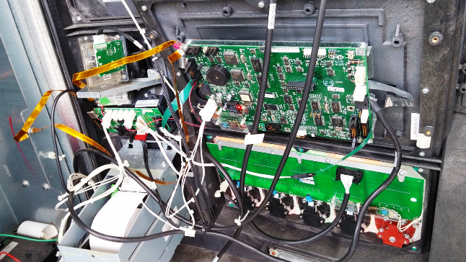
Wayne Ovation
NO SKIMMER

Slide 26
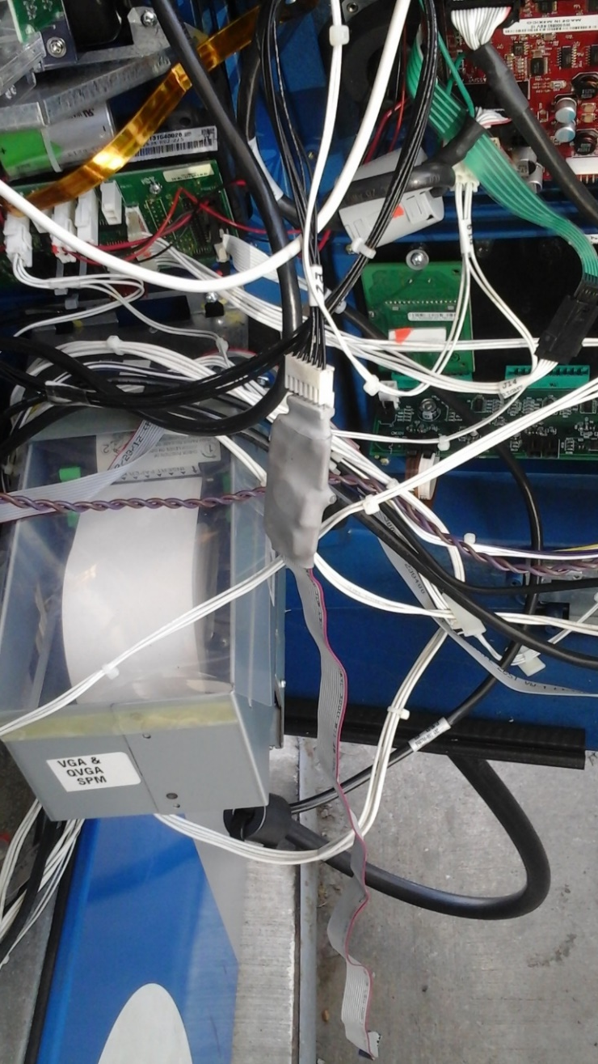
Wayne Ovation with Skimmer
The card reader is up in this corner.
The ribbon is detached in the photo.

Slide 27
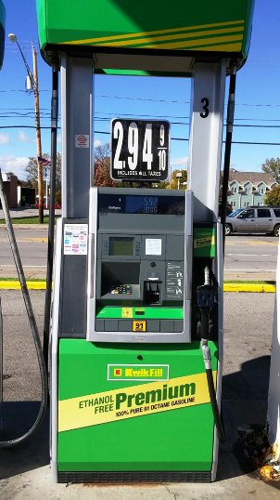
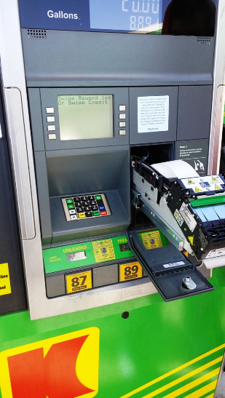
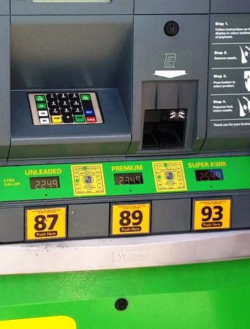
Wayne Helix
Higher Security
(Low Skimmer Risk)

Slide 28
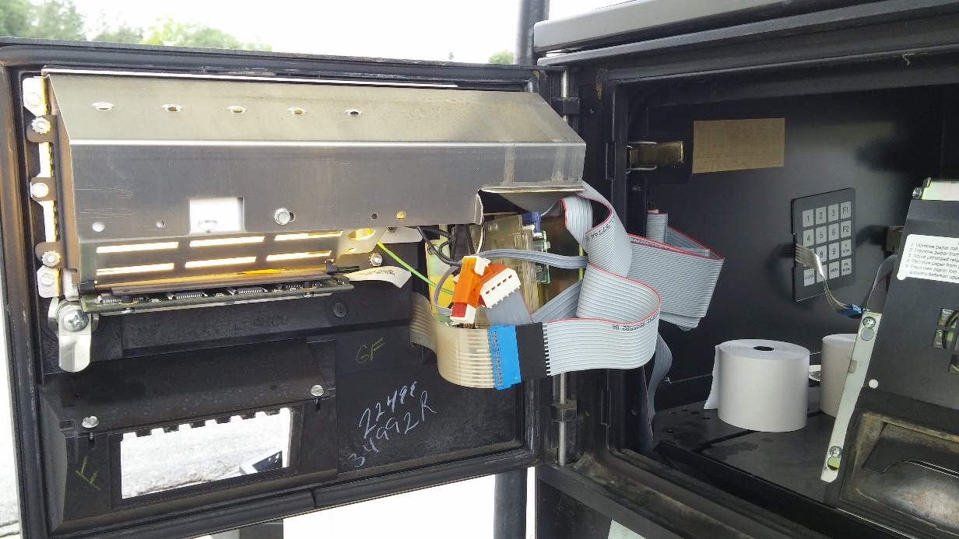
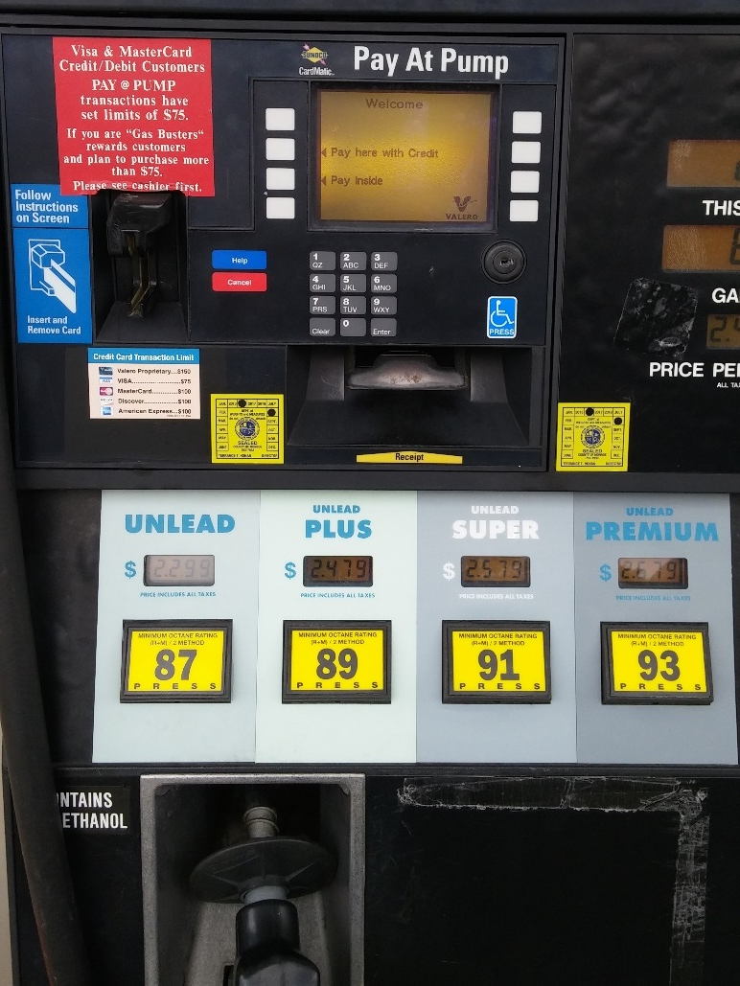
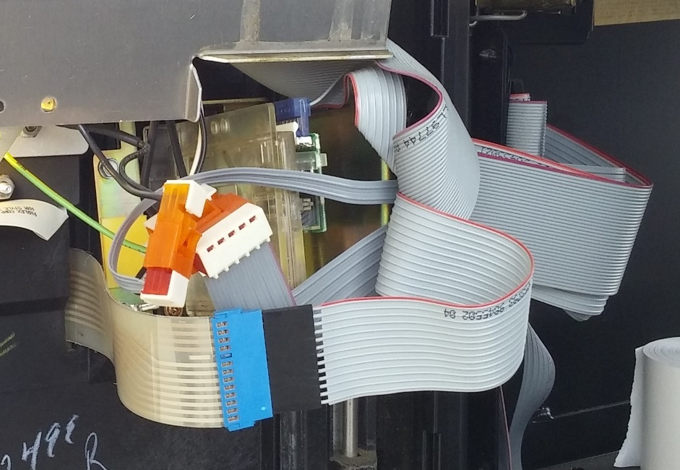
Gilbarco Advantage
Access for receipt and card reader.

Slide 29
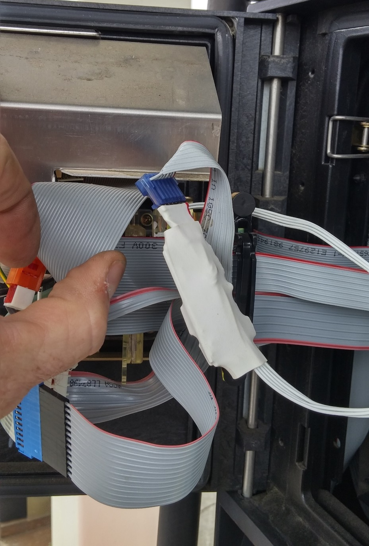
Gilbarco Advantage w/wo skimmer
No skimmer
Skimmer

Slide 30
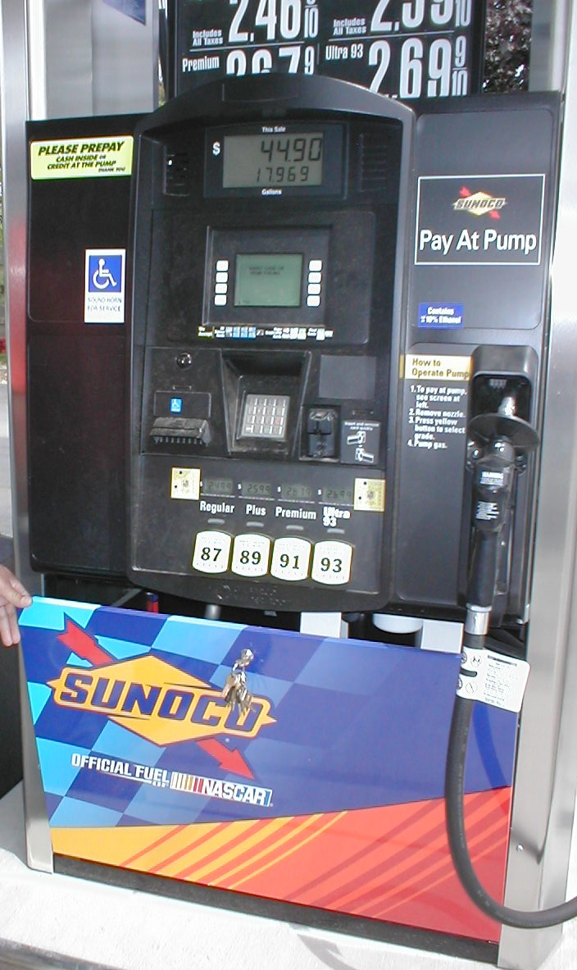
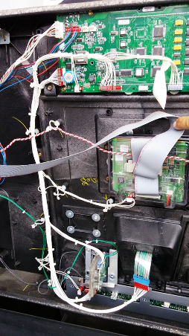
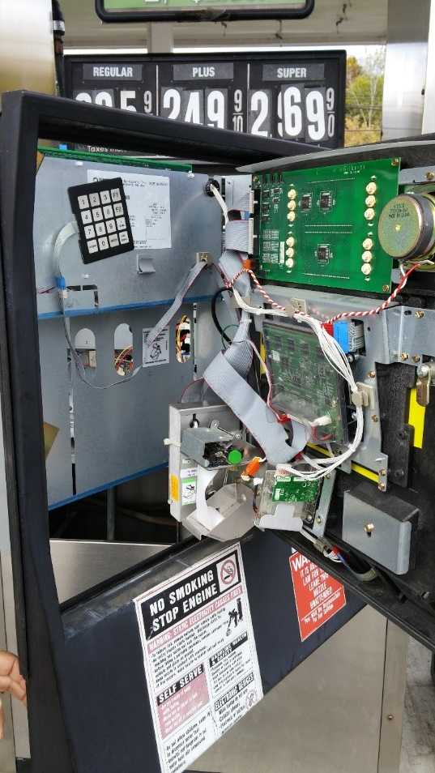
Gilbarco Encore
Access key for card reader and receipt tape.

Slide 31
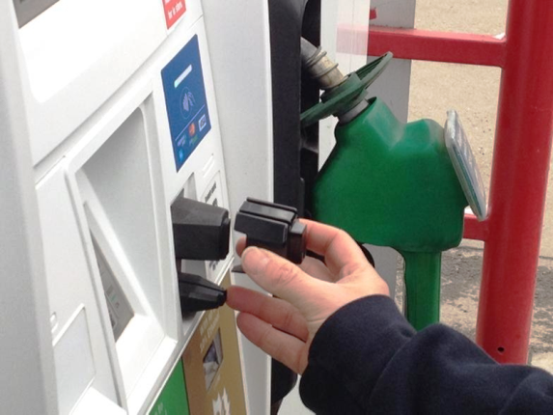
Checking for an exterior mounted card skimmer
Examine the reader to see if it is significantly different from the other readers.
If suspect, firmly wriggle the reader from side-to-side to see if it comes off.

Slide 32
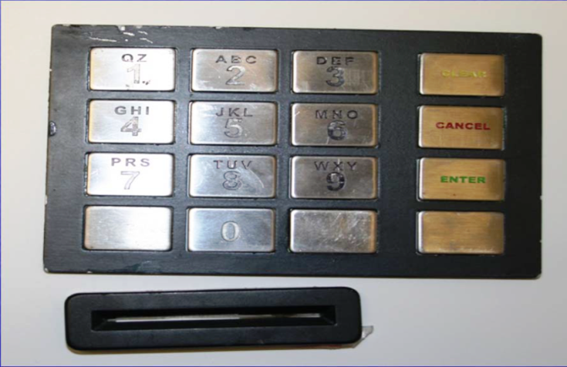
Also be on the look-out for:
Hidden cameras
Keypad overlay skimmers

Slide 33
If Skimmer is Suspected
DO NOT TOUCH!
Call Police, inform them that you found what you suspect to be a credit/debit card skimming device.
Follow their instructions.
Document findings (pictures).
Notify your superiors.
Notify Jim Willis at Albany Office 518-457-3146.
james.willis@agriculture.ny.gov

Slide 34
If Skimmer is Suspected continued
Important reminders:
Not finding a skimmer is a good thing.
Follow police instructions, EXACTLY.
Do not touch the skimmer or any component around the skimmer. Keep this in mind if you are taking any pictures.
Inform the station owner/manager only as instructed by the police.

Slide 35
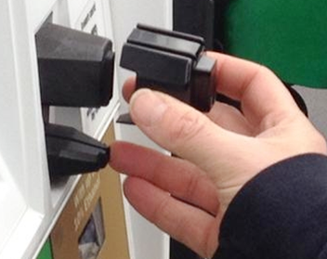
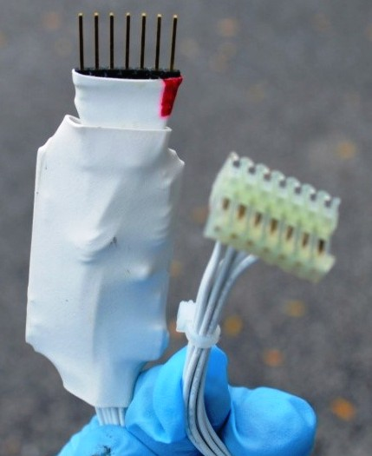
Questions

Slide 36
Contact Information
NYS Bureau of Weights & Measures
10B Airline Drive
Albany, NY 12235
518-457-3146
www.agriculture.ny.gov

