Slide 1
Everyone’s Committed: Year 5 analyse their commitments.
Caroline Cooper from Cumbria used the game ‘Everyone’s committed’ with her 9-10 year olds. They benefited fro m this speaking and listening approach in RE by thinking more deeply.

Slide 2
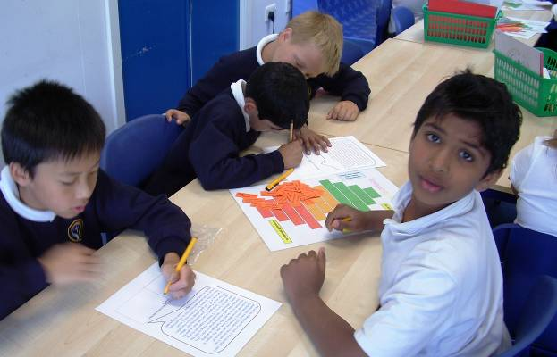
The Commitment Game
RE needs more interesting and interactive approaches – here’s one to try out.

Slide 3
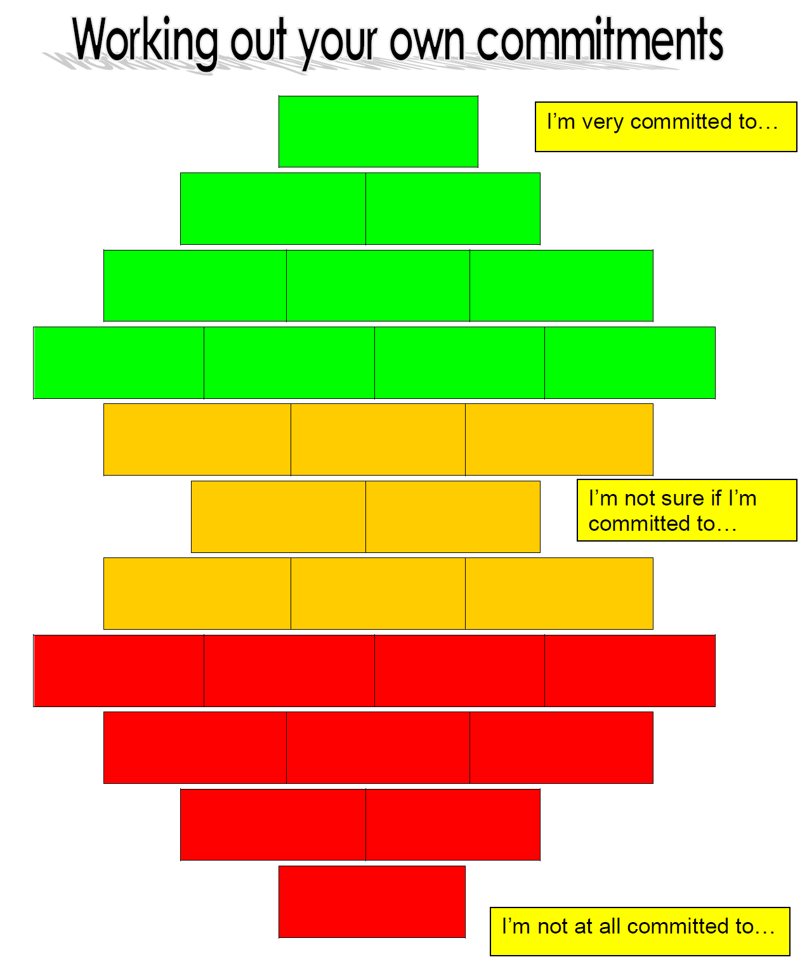
The aims of the game include;
Enabling pupils to discuss commitment in a structured and profound way
creating a conceptual framework for the understanding of religious commitment
providing for excellence and enjoyment in speaking and listening through RE.

Slide 4
The Commitment Game
On the board, a green square stands for things you are committed to, a red one for the things you are not committed to, and an orange space is for things you’re not so sure about.
Pupils must put the cards in a pile, face downwards, and play in turns, around the group.
When it’s your turn, you must do three things:
1. Read out the top card;
2. Ask the other players where they would put it and why;
3. Ignore them, and put it where you think it goes for you.
4. When it’s your turn, if you want to, you can also move another person’s card to a space that you choose: ‘Move one, place one’ is the rule.
5. All cards must be in one space only – no overlapping is allowed.
6. When the cards are all out, play three more rounds, in which you just swap two cards over. Say why.

Slide 5
Commitment
What does it mean?
“Commitments are things that you care about very much, that make a difference to your life”
“A commitment is something you take on, and then stick to”
What is a soldier committed to?
What is a police officer committed to?
What is Steven Gerrard committed to?
What is Angelina Jolie committed to?
How does it show?

Slide 6
Commitments: A discussion game.
Give pupils ten cards which have a word or drawing on them for something many people are committed to. Ask them to discuss each one and see where they think it goes on the discussion board above. There will be one left over. The learning is in the speaking and listening.

Slide 7
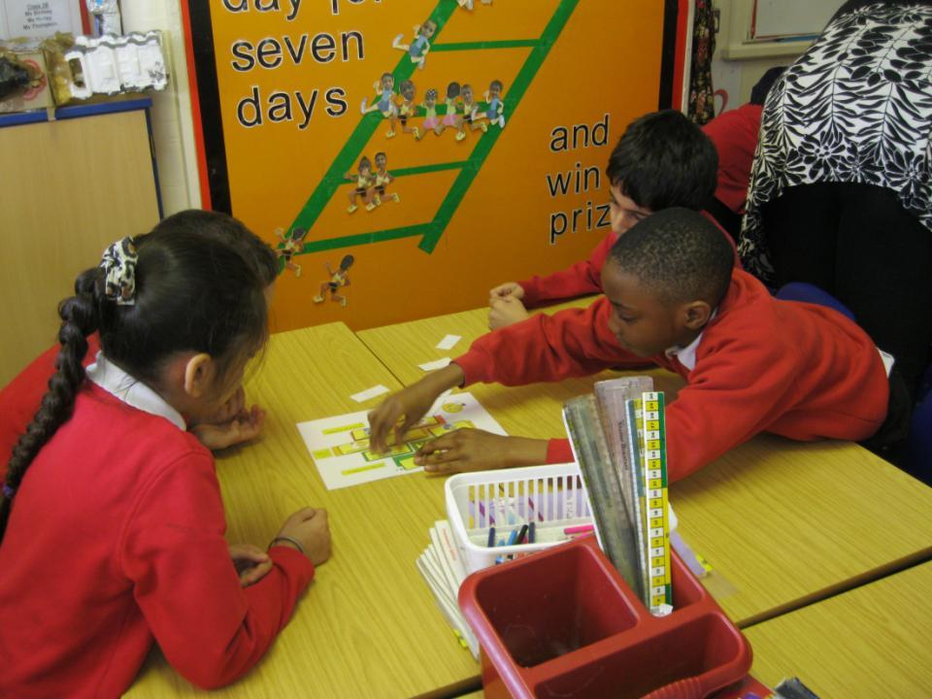
This discussion asks pupils to sort, rank and prioritise different commitments – is caring for pets as important as loving your family? What about eating a good diet, or serving your God? Different views strengthen learning.

Slide 8
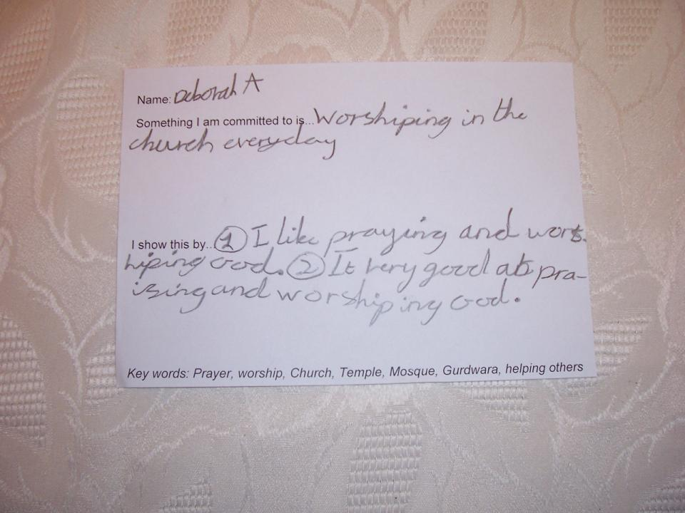
Commitment is sometimes religious, even for 8 year olds. Deborah says “I am committed to worshipping in the church every day. I like praying and worshipping. It is very good, praying and worshipping God.”

Slide 9
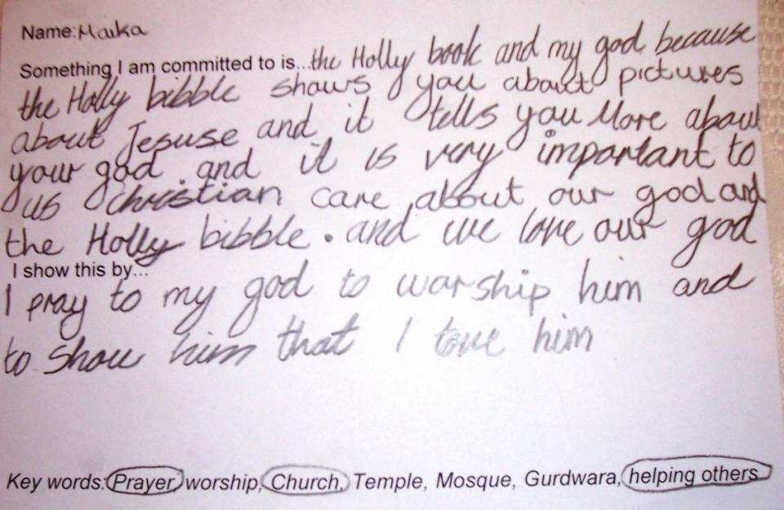
Maika, 7, writes about her commitments: “I am committed to the holy book and my God because the holy Bible shows you pictures about Jesus and it tells you more about your God and it is very important to us. Christians care about our God and about the Holy Bible and we love our God. I show this: I pray to my God to worship him and to show him that I love him.”

Slide 10
Karam: “I live in Leicester, which is a city of four religions. In my religion, we worship different gods and goddesses. At home we have a shrine to the god Shiva. There’s a murti (you would call it a statue) and we pray together there, all the family, in the morning. It helps us to be calm and to think clearly. I am learning to play rugby at school at the moment. Leicester has one of the best rugby clubs in Europe. One of my commitments is to be vegetarian. We never eat meat, because animals have lives just like us, so it’s better not to kill them. When I grow up, I’d like to run my own business, and make enough money to travel to visit my Indian relatives whenever I want to.”

Slide 11
Hannah: “We are a large family from London, and our faith makes a lot of differences to our way of life. I don’t go to a Jewish school (there isn’t one near to us) but we do lots of Jewish things in our family and on Shabbat at the Synagogue. We try to keep all the Commandments of the Torah. I like the festivals best, and my favourite is Pesach, because I’m the youngest in our family. I am a dancer, but sometimes I miss a performance if it’s on Shabbat. I don’t mind this, because it matters to me to follow the Torah. I want to be a professional dancer when I grow up.”

Slide 12
Christopher: “Me and my family live in Lincoln. I like football, and I usually play every Saturday in the season. I like Spiderman comics. I draw my own versions of Spiderman stories when I have time. My religion is important to me as well. My family go to worship every Sunday, and I enjoy my group at Church (It’s called ‘Pathfinders’, because we’re trying to find the best path to live life). I think it’s important to pray and worship. Jesus gave us life, and he gave his life for us, so I want to give something back. When I grow up, if I’m not good enough to be a footballer, then I’d like to work for Christian Aid, travelling in less developed countries to try and help people in need.”

Slide 13
Paper the walls with your wisdom...
One great thing about my religion is...
One funny thing about religion is...
If God sent a message to the earth this week, I think it would say...
It’s good to learn about other people’s religions because...
One question I’d like to ask God is...
My beliefs have an impact on my life because...
It’s important to understand your own beliefs because...
It’s important to understand other people’s beliefs because...
To make the world a better place, religious leaders should...
Religion can cause wars and conflict. I think this happens because...
Religion can make peace. One example of this is...
It’s important for schools to take religions and beliefs seriously because...
One thing I’d do to make RE better is...
My beliefs are growing stronger at the moment because...
My doubts are growing stronger at the moment because...
Prayer is good because.
A problem with praying is...
In RE I’d like to learn much more about...
Diversity is good for humanity because...
Another thing I’d like to say is...

Slide 14
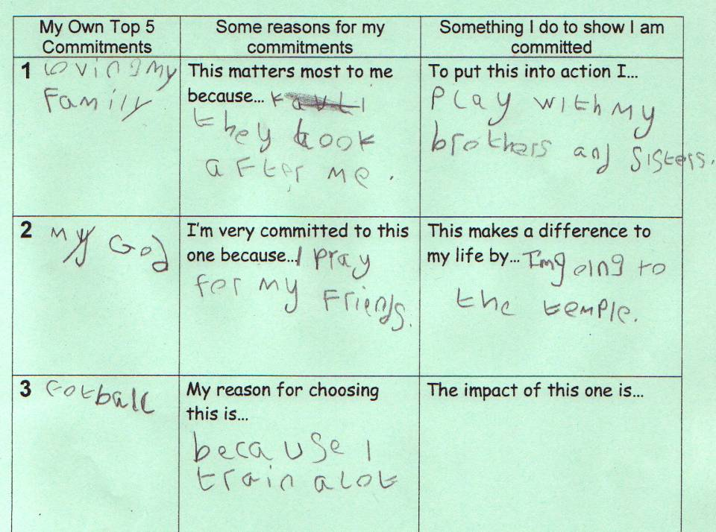

Slide 15
