Slide 1
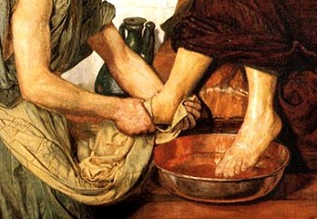
Welcome in the Name of
The Triune God
March 13, 2022
Jesus Washes the Feet of His Disciples
Prelude by Roxanne Groff
Office of the Acolyte
Ringing of the Bell
Scripture Focus: John 13:1-17
Notes:
Image: Preparing yeast dough. Copyright © tomasworks/iStock/Thinkstock. Used by permission.

Slide 2
CONFESSION AND FORGIVENESS
All may make the sign of the cross, the sign marked at baptism…
P: We confess our sins before God and one another.
Pause for silence and reflection.
P: Merciful God,
Notes:
Image: Five Loaves by Caroline Coolidge Brown. Copyright © Caroline Coolidge Brown. All rights reserved. Used by permission of the artist.

Slide 3
CONFESSION AND FORGIVENESS
C: These 40 days we reflect on how our sin bleeds into the world, leaving a mark that we cannot remove. Forgive all we have done and failed to do, and cleanse us from the stain of sin.
Notes:
Image: Five Loaves by Caroline Coolidge Brown. Copyright © Caroline Coolidge Brown. All rights reserved. Used by permission of the artist.

Slide 4
CONFESSION AND FORGIVENESS
L: Our God is gracious and forgiving. God does not desire that we wallow in the brokenness, but instead cleanses us and makes us new. Receive the entire forgiveness of all your sin, and walk in newness of life. For the sake of Jesus Christ we pray.
C: Amen.
Notes:
Image: Five Loaves by Caroline Coolidge Brown. Copyright © Caroline Coolidge Brown. All rights reserved. Used by permission of the artist.

Slide 5
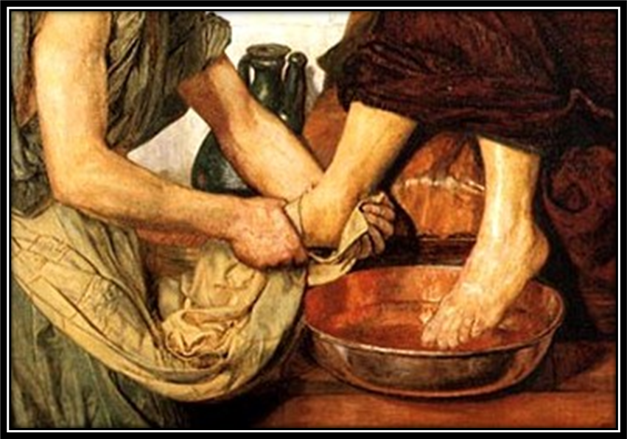
Hymn of Praise
“Lord, Speak to Us That We May Speak”
LBW 403
Notes:
Image: Five Loaves by Caroline Coolidge Brown. Copyright © Caroline Coolidge Brown. All rights reserved. Used by permission of the artist.

Slide 6
Lord, Speak to me that I May Speak LBW 403
1 Lord, speak to us, that we may speak
in living echoes of your tone;
as you have sought, so let us seek
your straying children, lost and lone.
2 Oh, lead us, Lord, that we may lead
the wand’ring and the wav’ring feet;
oh, feed us, Lord, that we may feed
your hung’ring ones with manna sweet.
Notes:
Image: Five Loaves by Caroline Coolidge Brown. Copyright © Caroline Coolidge Brown. All rights reserved. Used by permission of the artist.

Slide 7
Lord, Speak to me that I May Speak LBW 403
3 Oh, teach us, Lord, that we may teach
the precious truths which you impart;
and wing our words, that they may reach
the hidden depths of many a heart.
4 Oh, fill us with your fullness, Lord,
until our very hearts o’erflow
in kindling thought and glowing word,
your love to tell, your praise to show.
Notes:
Image: Five Loaves by Caroline Coolidge Brown. Copyright © Caroline Coolidge Brown. All rights reserved. Used by permission of the artist.

Slide 8
APOSTOLIC GREETING
P: The grace of our Lord Jesus Christ, the love of God, and the communion of the Holy Spirit be with you all.
C: And also with you.
Notes:
Image: Five Loaves by Caroline Coolidge Brown. Copyright © Caroline Coolidge Brown. All rights reserved. Used by permission of the artist.

Slide 9
PRAYER OF THE DAY
P: Let us pray… God of all who serve, when Jesus knelt to wash the feet of his friends, he taught us all a new way of being. Teach us to humble ourselves so that serving is our new normal.
C: Amen.
Notes:
Image: Five Loaves by Caroline Coolidge Brown. Copyright © Caroline Coolidge Brown. All rights reserved. Used by permission of the artist.

Slide 10
Notes:
Image: Preparing yeast dough. Copyright © tomasworks/iStock/Thinkstock. Used by permission.

Slide 11
Scripture Reading
R: The Scripture reading is from the Gospel according to Saint John, the 13th chapter.
C: Glory to you O’ Lord! (Spoken)
Notes:
Image: Five Loaves by Caroline Coolidge Brown. Copyright © Caroline Coolidge Brown. All rights reserved. Used by permission of the artist.

Slide 12
John 13:1-17
Now before the festival of the Passover, Jesus knew that his hour had come to depart from this world and go to the Father. Having loved his own who were in the world, he loved them to the end. ²The devil had already put it into the heart of Judas son of Simon Iscariot to betray him. And during supper ³Jesus, knowing that the Father had given all things into his hands, and that he had
Notes:
Image: Five Loaves by Caroline Coolidge Brown. Copyright © Caroline Coolidge Brown. All rights reserved. Used by permission of the artist.

Slide 13
John 13:1-17
come from God and was going to God, ⁴got up from the table, took off his outer robe, and tied a towel around himself. ⁵Then he poured water into a basin and began to wash the disciples’ feet and to wipe them with the towel that was tied around him. ⁶He came to Simon Peter, who said to him, “Lord, are you going to wash my feet?” ⁷Jesus answered, “You do not know now what I am doing, but
Notes:
Image: Five Loaves by Caroline Coolidge Brown. Copyright © Caroline Coolidge Brown. All rights reserved. Used by permission of the artist.

Slide 14
John 13:1-17
later you will understand.” ⁸Peter said to him, “You will never wash my feet.” Jesus answered, “Unless I wash you, you have no share with me.” ⁹Simon Peter said to him, “Lord, not my feet only but also my hands and my head!” ¹⁰Jesus said to him, “One who has bathed does not need to wash, except for the feet, but is entirely clean. And you are clean, though not all of you.”
Notes:
Image: Five Loaves by Caroline Coolidge Brown. Copyright © Caroline Coolidge Brown. All rights reserved. Used by permission of the artist.

Slide 15
John 13:1-17
¹¹For he knew who was to betray him; for this reason he said, “Not all of you are clean.” ¹²After he had washed their feet, had put on his robe, and had returned to the table, he said to them, “Do you know what I have done to you? ¹³You call me Teacher and Lord—and you are right, for that is what I am. ¹⁴So if I, your Lord and Teacher, have washed your feet, you also ought to
Notes:
Image: Five Loaves by Caroline Coolidge Brown. Copyright © Caroline Coolidge Brown. All rights reserved. Used by permission of the artist.

Slide 16
John 13:1-17
wash one another’s feet. ¹⁵For I have set you an example, that you also should do as I have done to you. ¹⁶Very truly, I tell you, servants are not greater than their master, nor are messengers greater than the one who sent them. ¹⁷If you know these things, you are blessed if you do them.”
Notes:
Image: Five Loaves by Caroline Coolidge Brown. Copyright © Caroline Coolidge Brown. All rights reserved. Used by permission of the artist.

Slide 17
John 13:1-17
P: This is the Gospel of the Lord.
C: Praise to You, O Christ (Spoken)
Notes:
Image: Five Loaves by Caroline Coolidge Brown. Copyright © Caroline Coolidge Brown. All rights reserved. Used by permission of the artist.

Slide 18
SERMON
Notes:
Image: Five Loaves by Caroline Coolidge Brown. Copyright © Caroline Coolidge Brown. All rights reserved. Used by permission of the artist.

Slide 19
SPECIAL MUSIC
Notes:
Image: Five Loaves by Caroline Coolidge Brown. Copyright © Caroline Coolidge Brown. All rights reserved. Used by permission of the artist.

Slide 20
APOSTLE’S CREED
C: I believe in God, the Father almighty, creator of heaven and earth.

Slide 21
APOSTLE’S CREED
C: I believe in Jesus Christ, his only Son, our Lord. He was conceived by the power of the Holy Spirit and born of the virgin Mary. He suffered under Pontius Pilate, was crucified, died, and was buried.

Slide 22
APOSTLE’S CREED
C: He descended into hell. On the third day he rose again. He ascended into heaven, and is seated at the right hand of the Father. He will come again to judge the living and the dead.

Slide 23
APOSTLE’S CREED
C: I believe in the Holy Spirit, the holy catholic Church, the communion of saints, the forgiveness of sins, the resurrection of the body, and the life everlasting. Amen.

Slide 24
NICENE CREED
C: We believe in one God, the Father, the Almighty, maker of heaven and earth, of all that is, seen and unseen.

Slide 25
NICENE CREED
C: We believe in one Lord, Jesus Christ, the only Son of God, eternally begotten of the Father, God from God, Light from Light, true God from true God, begotten, not made, of one Being with the Father.

Slide 26
NICENE CREED
C: Through him all things were made. For us and for our salvation he came down from heaven; by the power of the Holy Spirit he became incarnate from the virgin Mary, and was made man. For our sake he was crucified under Pontius Pilate;

Slide 27
NICENE CREED
C: he suffered death and was buried. On the third day he rose again in accordance with the Scriptures; he ascended into heaven and is seated at the right hand of the Father. He will come again in glory to judge the living and the dead, and his kingdom will have no end.

Slide 28
NICENE CREED
C: We believe in the Holy Spirit, the Lord, the giver of life, who proceeds from the Father and the Son. With the Father and the Son he is worshiped and glorified. He has spoken through the prophets. We believe in one holy catholic and apostolic Church.

Slide 29
NICENE CREED
C: We acknowledge one Baptism for the forgiveness of sins. We look for the resurrection of the dead, and the life of the world to come. Amen.

Slide 30
PRAYERS OF INTERCESSION
Each petition will end with the words,
A: Servant leader,
The congregation will respond with:
C: Hear our prayer.

Slide 31
PRAYERS OF INTERCESSION
The prayer concludes…
P: Lord, accept our prayers for all that we do not yet understand, and hold us in your steadfast embrace whenever we stumble. Hear us for the sake of Jesus, our servant and Lord.
C: Amen.

Slide 32
SHARING OF THE Peace
The Sharing of the Peace that began when the congregation arrived is now shared with the Pastor at this time...
P: The peace of the Lord be with you always.
C: And also with you.

Slide 33
OFFERING PRAYER
Notes:
Image: Five Loaves by Caroline Coolidge Brown. Copyright © Caroline Coolidge Brown. All rights reserved. Used by permission of the artist.

Slide 34
THE LORD’S PRAYER
P: Jesus is the “tie that Binds us together”, let us pray as Jesus taught…
C: Our Father, who art in heaven, hallowed be thy name, thy kingdom come, thy will be done, on earth as it is in heaven. Give us this day our daily bread; and forgive us our trespasses,

Slide 35
THE LORD’S PRAYER
C: as we forgive those who trespass against us; and lead us not into temptation, but deliver us from evil. For thine is the kingdom, and the power, and the glory, forever and ever. Amen.

Slide 36
ANNOUNCEMENTS
Notes:
Image: Five Loaves by Caroline Coolidge Brown. Copyright © Caroline Coolidge Brown. All rights reserved. Used by permission of the artist.

Slide 37
SENDING BLESSING
P: You are children of God, anointed with the oil of gladness and strengthened for the journey. Almighty God, ☩ majestic, and mighty, bless you this day and always.
C: Amen.

Slide 38
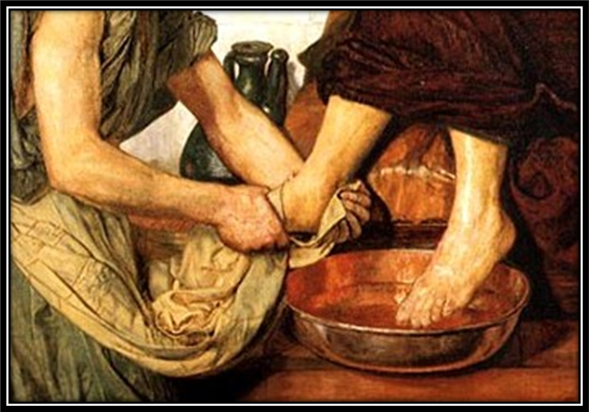
SENDING SONG
“O Master, Let Me Walk with Thee”
LBW 492
Notes:
Image: Five Loaves by Caroline Coolidge Brown. Copyright © Caroline Coolidge Brown. All rights reserved. Used by permission of the artist.

Slide 39
O Master, Let Me Walk with Thee LBW 492
1 O Master, let me walk with you
in lowly paths of service true;
tell me your secret; help me bear
the strain of toil, the fret of care.

Slide 40
O Master, Let Me Walk with Thee LBW 492
2 Help me the slow of heart to move
by some clear, winning word of love;
teach me the wayward feet to stay,
and guide them in the homeward way.

Slide 41
O Master, Let Me Walk with Thee LBW 492
3 Teach me your patience; share with me
a closer, dearer company,
in work that keeps faith sweet and strong,
in trust that triumphs over wrong,

Slide 42
O Master, Let Me Walk with Thee LBW 492
4 In hope that sends a shining ray
far down the future’s broad'ning way,
in peace that only you can give;
with you, O Master, let me live.

Slide 43
DISMISSAL
P: Until we gather again as God’s people to offer our worship and praise, depart in Christ’s Love,
C: Seeking, welcoming, and serving all. Amen!
Postlude by Roxanne Groff
Copyright © 2022 Augsburg Fortress. All rights reserved. Reprinted by permission under Augsburg Fortress Liturgies Annual License #SAS023830. New Revised Standard Version Bible, Copyright © 1989, Division of Christian Education of the National Council of the Churches of Christ in the United States of America. Used by permission. All rights reserved. Revised Common Lectionary, Copyright © 1992 Consultation on Common Texts, admin Augsburg Fortress. Used by permission.

