Slide 1
Comox Valley District PAC
Treasurer’s Workshop
May 28, 2012

Slide 2
Agenda
PAC structure
PAC Financial Activity
Role of the PAC Treasurer
Financial Controls and Best Practices
Financial reports
Gaming Grants
Budgets

Slide 3
PAC structure
School Act outlines Parent Advisory Council (PAC) purpose and structure
• PAC’s are a separate organization from the school district
• PAC’s have their own set of bylaws and constitution
• Only 1 PAC per school can exist
• PAC officers must be elected by its members
• Principal works with the school PAC on a consultative basis but should not be a signing officer

Slide 4
PAC Financial Activity
PAC’s are often involved in fundraising activities
Other PAC sources of revenue may include donations, other grants and Provincial gaming funds
PAC’s often incur expenditures for fundraising, donations and equipment or other school resources

Slide 5
Role of PAC Treasurer
Role of Treasurer is typically set out in the constitution and bylaws of the PAC
Responsibilities should include:
be a signing officer
ensure all funds of the Council are properly accounted for
disburse funds as authorized by the membership or executive
ensure that proper financial records and books of account are maintained
report on all receipts and disbursements at general and executive meetings
make financial records and books of account available to members upon request
have the financial records and books of account ready for inspection or audit annually
with the assistance of the executive, draft an annual budget
ensure that another signing officer has access to the financial records and books of account in the treasurer’s absence
submit an annual financial statement at the annual general meeting

Slide 6
Financial Controls and Practices
Why do we need to ensure there are proper financial controls & practices in place for PAC’s?
To provide accountability
To ensure funds are spent on intended purpose
To reduce the risk of error, misappropriation of funds, inaccuracy of reports, unauthorized and unsupported financial transactions
We provide controls as “CASH” is high risk in nature

Slide 7
Types of Controls
Basic/physical – physical access, reconciling of the bank regularly, keeping adequate books and records
Supervisory/oversight – approval of expenditures, review of transactions, oversight of fundraising activities
External review or audit

Slide 8
Financial Controls and Practices
1. Financial Authority
2. Records Maintenance
3. Collection and Deposit of Funds
4. Disbursement of Funds
5. Financial Reporting
Points to consider

Slide 9
Financial Authority
Minimum of 2 PAC executives as signing officers (3 recommended)
Treasurer often is one of the signing officers
School Principal should not be a signing officer of the PAC
All cheques should be signed by the 2 signing officers before issuance
Know what you are signing for!

Slide 10
Records Maintenance
All financial transactions must be recorded in a ledger (manual or computerized) that organizes both revenues and expenditures by activity or event and maintains a running total of the bank balance
All financial records must be kept for a minimum of 7 years including bank statements, cancelled cheques, cheque stubs, deposit books, bank reconciliations, supporting receipts/invoices, accounting ledgers, financial reports and budgets

Slide 11
Collection and Deposit of Funds
Collection of cash and cheques from fund raising activities should be recorded and deposited as soon as possible. Frequent deposits will help reduce the likelihood of theft or “missing” funds
Collected cash should not be used to pay for expenses
Cash from fund raising activities should be counted by 2 individuals (other than the treasurer), recorded on a PAC event deposit form and signed off

Slide 12
Disbursement of Funds
All payments should be made by pre-numbered cheque
All cheques should be signed by the 2 signing officers and only if the cheque is accompanied by original invoice/receipt or other sufficient backup documentation
Blank cheques should never be signed and cheque stock should be secured by the Treasurer at all times

Slide 13
Balancing and Financial Reporting
Bank reconciliations should be prepared each month for both the PAC general account and the gaming account by the Treasurer and submitted for review to the PAC Chair (Chair should sign and date all bank reconciliations)
Summary of revenues and expenses for each fundraising activity should be prepared on completion of the activity and submitted for review to the PAC executive
At each PAC meeting, the Treasurer should report on the bank balances and a summary of revenue and expenditures. The Treasurer’s report should be signed and dated by the Treasurer and approved by the PAC executive.

Slide 14
Balancing and Financial Reporting
PAC year end financial statements should be prepared by the Treasurer and submitted to the executive and membership for approval
PACs may want to have their financial statements reviewed by an external accounting firm or conduct its own internal review of the financial statements
It is also recommended that the Treasurer assist in preparing an annual budget and provide explanations for revenue and expenditure variances from budget

Slide 15
Financial Reports
Sample Parent Advisory Council
Statement of Financial Positon
Year Ended June 30, 20XX
 |  | Gaming | Non-gaming | Total
Cash in Bank |  | 1,520.85 | 3,144.31 | 4,665.16
Accounts Receivable |  |  | 2,500.00 | 2,500.00
Total Assets |  | 1,520.85 | 5,644.31 | 7,165.16
Equity | Surplus, current | (904.69) | 3,313.59 | 2,408.90
 | Surplus, previous | 2,425.54 | 2,330.72 | 4,756.26
 |  | 1,520.85 | 5,644.31 | 7,165.16
Sample Parent Advisory Council
Statement of Revenues and Expenses
Year Ended June 30, 20XX
 |  | Gaming | Non-gaming | Total
Revenue
Fund raising |  |  | 2,500.00 | 2,500.00
Gaming |  | 2,500.00 |  | 2,500.00
Ticket sales |  |  | 1,444.99 | 1,444.99
Misc |  |  | 97.00 | 97.00
 |  | 2,500.00 | 4,041.99 | 6,541.99
Expenditures |  |  |  | -
Parent Education |  | 2,433.55 | 379.30 | 2,812.85
Dues/Memberships |  | 65.00 |  | 65.00
Advertising |  | 757.64 |  | 757.64
Supplies/photocopy |  |  | 240.54 | 240.54
Conference |  | 148.50 | 108.56 | 257.06
 |  | 3,404.69 | 728.40 | 4,133.09
Surplus (Deficit), current |  | (904.69) | 3,313.59 | 2,408.90
 |  |  |  | -
Equity, previous year |  | 2,425.54 | 2,330.72 | 4,756.26
 |  |  |  | -
 |  | 1,520.85 | 5,644.31 | 7,165.16

Slide 16
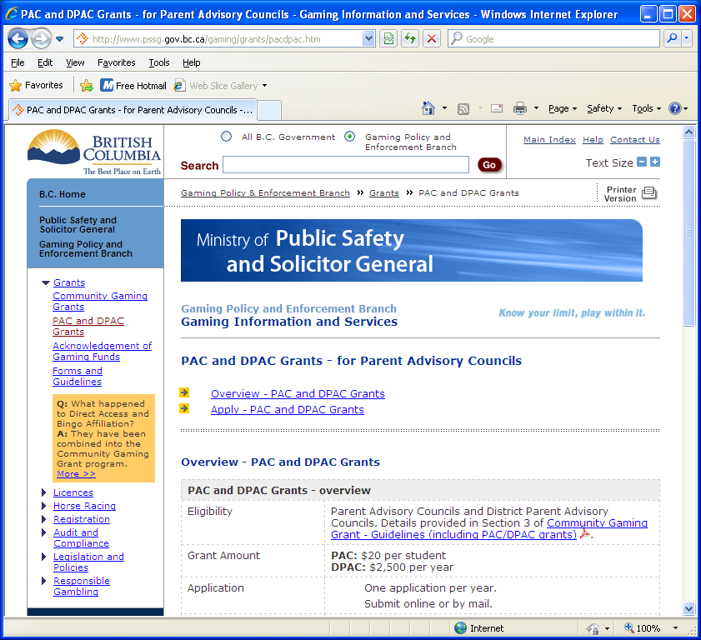
Gaming grants
Applying and reporting for Direct Access Grants for PAC/DPAC http://www.pssg.gov.bc.ca/gaming/grants/pacdpac.htm
Each year, PACs and DPAC apply for Direct Access Grants for PAC/DPAC via the Gaming Branch website or by mail.
Applications are accepted between April 1 and June 30
Gaming Account Summary Report of disbursements for the prior year must be filed within 90 days of year end
Currently grants are paid in September. PACs receive $20 per student based on last year’s enrolment and DPACs receive a flat rate of $2500.
Gaming funds must be spent according to the conditions as described in the following link: http://www.pssg.gov.bc.ca/gaming/grants/docs/cond-pac-dpac.pdf

Slide 17
Preparing a Budget
Determine your spending priorities
Determine your expenses
Estimate and plan your revenue
Build consensus
Pass budget via motion at a PAC/DPAC meeting
All money raised should have a purpose
All money kept should have a purpose

Slide 18
Annual Budget
Sample Parents Advisory Council
Budget
Year Ended June 30, 20XX
 |  |  |  |  |  | Actual
 |  | Gaming | Non-gaming | Total |  | at YTD
Revenue
Fund raising |  |  | 2,500 | 2,500 |  | 1,000
Gaming |  | 2,500 |  | 2,500 |  | 2,500
Ticket sales |  |  | 1,400 | 1,400 |  | -
Misc |  |  | 100 | 100 |  | -
 |  | 2,500 | 4,000 | 6,500 |  | 3,500
Expenditures |  |  |  | -
Parent Education |  | 2,275 | 400 | 2,675 |  | 2,500
Dues/Memberships |  | 75 |  | 75
Advertising |  |  | 800 | 800
Supplies/photocopy |  |  | 1,500 | 1,500 |  | 850
Conference |  | 150 | 100 | 250
 |  | 2,500 | 2,800 | 5,300 |  | 3,350
Surplus (Deficit), current |  | - | 1,200 | 1,200 |  | 150

Slide 19
From Pre-workshop Questions
District support funds (1-01-41-4673-xxx)- PACs are given an annual contribution from the board to “do parent education work”. It can be used to cover membership (BCCPAC) fees, conference/travel costs, or other costs associated with the PAC work ($100 plus per fte – approx. $150-350 annually)
Other reporting – copy of Bylaws shall be provided to the Secretary-Treasurer of the Board (Policy 1022)
Community Link funding – separate funding, Superintendent will request proposals through School administration generally in September

Slide 20
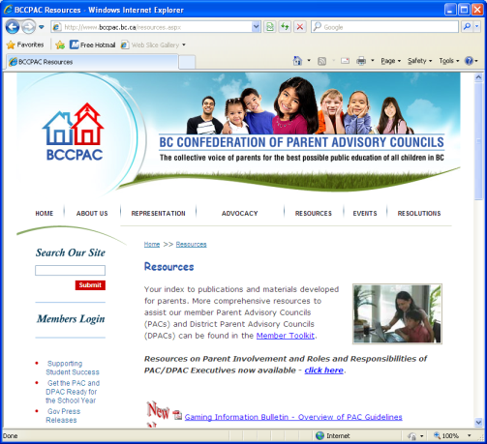
Links
Gaming information
http://www.pssg.gov.bc.ca/gaming/grants/pacdpac.htm
Direct Access online form (fillable)
http://www.pssg.gov.bc.ca/gaming/grants/docs/appl-pac-dpac.pdf
BCCPAC resources
http://www.bccpac.bc.ca/resources.aspx
Constitution/bylaw samples
http://www.bccpac.bc.ca/UserFiles/File/Leadership%20Manual/Tab6_Constitution_Bylaws_FINAL.pdf
BCCPAC Leadership Manual - this manual provides PACs and DPAC with alot of valuable information in more detail.
http://www.bccpac.bc.ca/UserFiles/File/Leadership%20Manual/Tab15_Financial_management_FINAL.pdf

Slide 21
Thanks!
Thank you for attending this workshop
Contacts:
Ron Amos, SD71- Director of Finance
ron.amos@sd71.bc.ca
Michelle Prior, Senior Accounts clerk
michelle.prior@sd71.bc.ca

