Slide 1

Minimal invasive gynecologic surgery
“MIGS”
Bacic

Slide 2
History
1901 George Kelling, Dresden isuflatio in dog abdomen filtrated air with Nitze cistoskopa first abdominal laparoscopy
1920 Zoilikofer used CO2
1966 Cold light and optical
1981 Kurt Semm first laparoscopy apendectomy
1984 LAVH Kurt Semm
1985 Dr Muhe (Prof Dr Med – Bobligen, Germany) first cholecystectomy
1988 First laparoscopic cholecystectomy at SAD

Slide 3
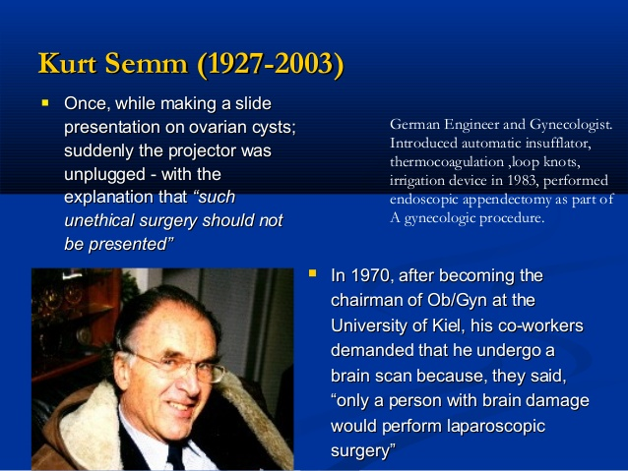
Notes:
3

Slide 4
During Kurt Semm‘s lectures about laparoscopic apendectomy chief of German Surgery association pursue from the Germany gynecology society to throw out K. Semm
American Journal of Obstetrics and Gynecology, rejected article about laparoscopy apendectomy because “ against medical ethics ”
2002, Kurt Semm get award of “Pioneer in endoscopy” od Board of Guvernors of the Society of American Gastrointestinal Endoscopic Surgeons (SAGES).

Slide 5
MIGS approach
Laparoskopski
Single Port Access Surgery (SILS)
Robotic Surgery
Natural Orifice Translumenal Endoscopic Surgery (NOTES)

Slide 6
Laparoscopic/Minimally Invasive Surgery
First laparoscopic hysterectomy 1988 Harry Reich in Kingston, Pennsylvania
First in Croatia 1998
Almost every sugery can be done by laparoscopic approach
15% of hysterectomies TLH
All starts with first diagnostic laparoscopies

Slide 7
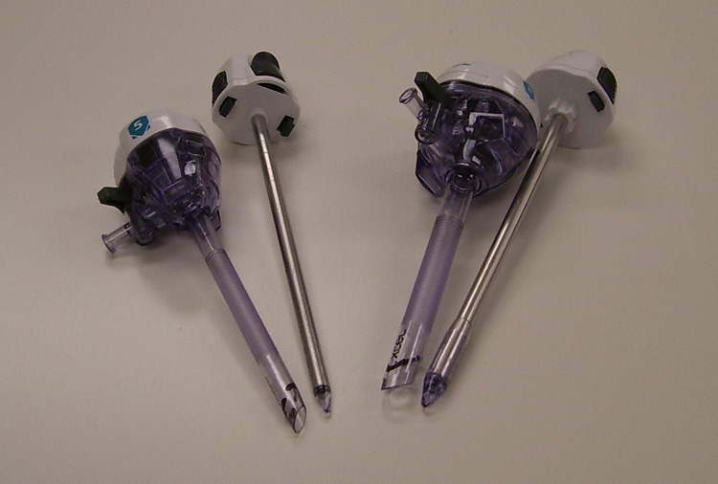
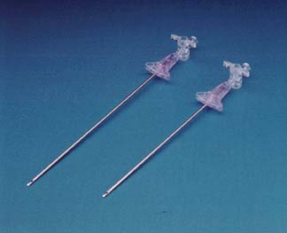
Instrumenti/Troakari/Pneumoperitoneum
Open technique (Hasson)
Verres needle
Optical Verres
Inssuflation of CO2

Slide 8
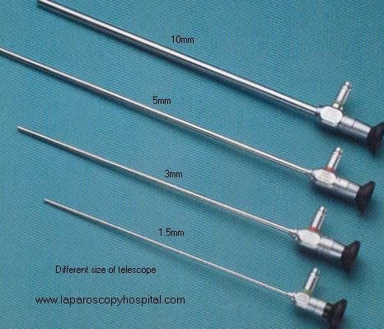
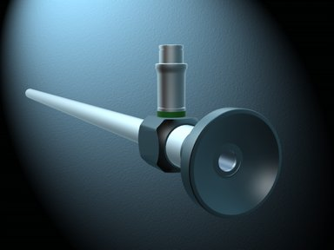
Laparoscopic optics
Size : 1.5mm, 3mm, 5mm, 10mm
Angle : 10, 30, 45

Slide 9
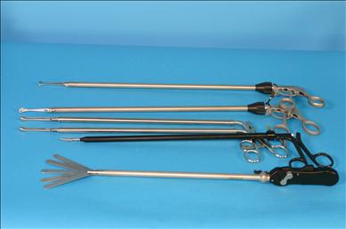
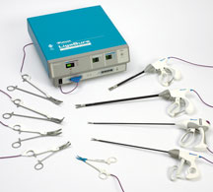
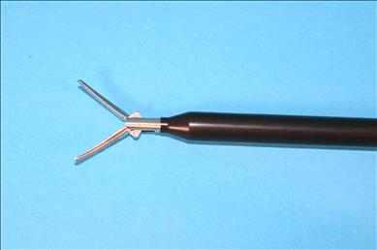
Instruments

Slide 10
Laparoscopy advatages
Cosmetics
Less pain
Short hospitalisation
Less adhesions
Less infections
Fewer post-operative complications
High resolution
Less blood loss

Slide 11
Type of operations in the Gynecology
Diagnostic laparoscopy
LPSC cystectomy
LPSC oophorectomy
LPSC myomectomy
LPSC Hysterectomy

Slide 12
Uroginekologija minimalno invazvni pristup
Robotska rekonstrukcija
Mini Arc, TVT - O
LPSC Abdominalna sakralna kolpopeksija
LPSC Burch, uretrovesicopexio

Slide 13
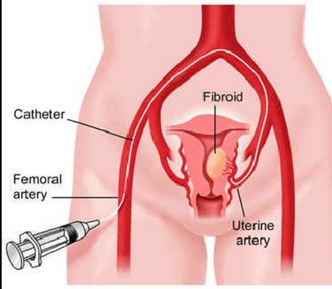
Embolisation

Slide 14
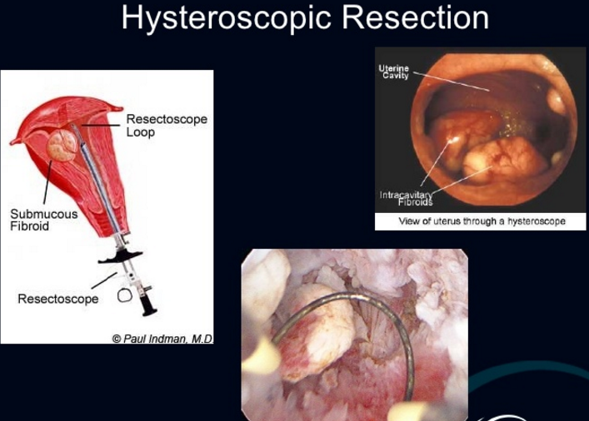
Hysterocopy

Slide 15
Endometrial Ablation

Slide 16
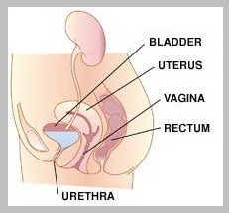
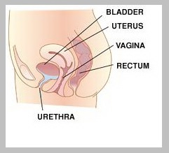

Slide 17
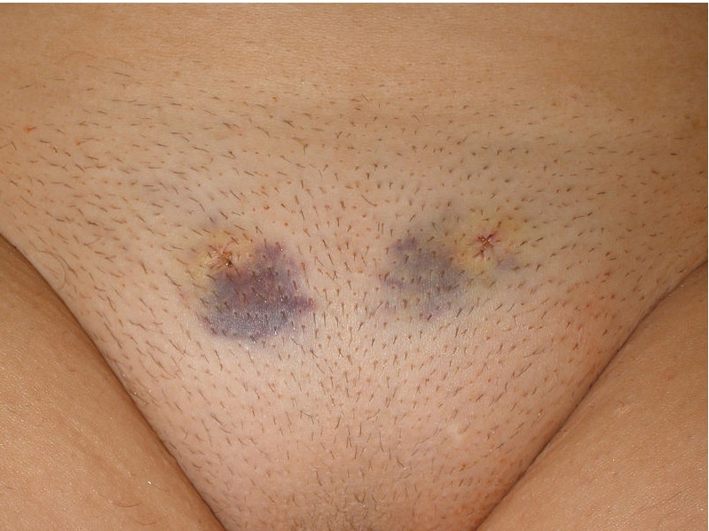
TVT day after

Slide 18
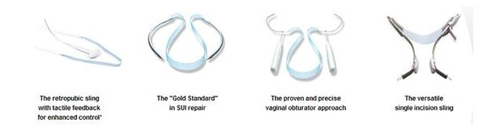
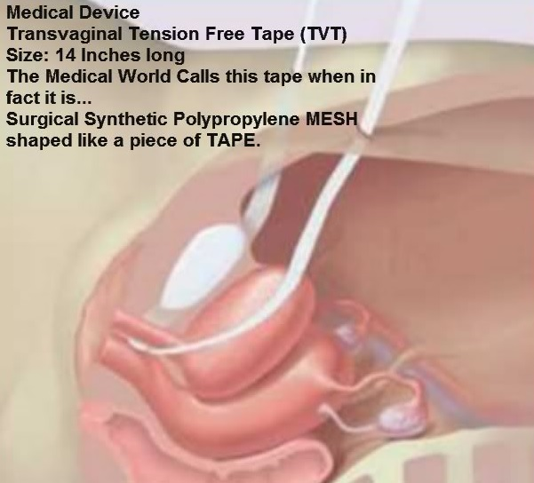
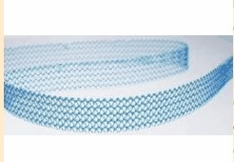

Slide 19
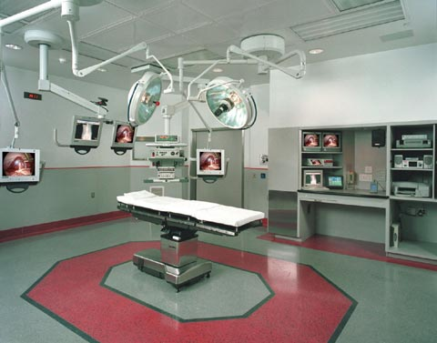
Minimally Invasive OR

Slide 20
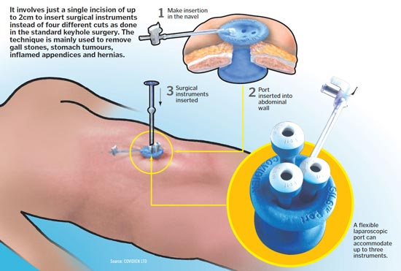
Single port surgery

Slide 21
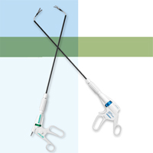
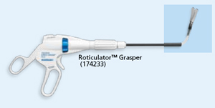
Single port surgery
Instrumenti:

Slide 22
Single Port
Pro :
  - Cosmetics
  - Less pain
  - Lower risk of herniation
Con :
  - Long learning curve
  - Longer operation time
  - Costs

Slide 23
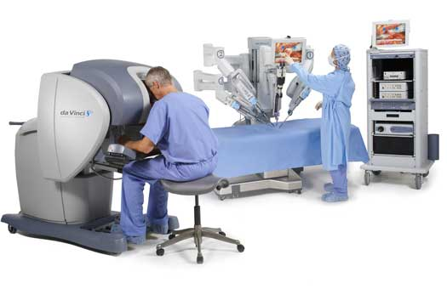
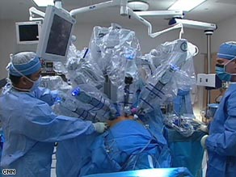
Robotic surgery

Slide 24
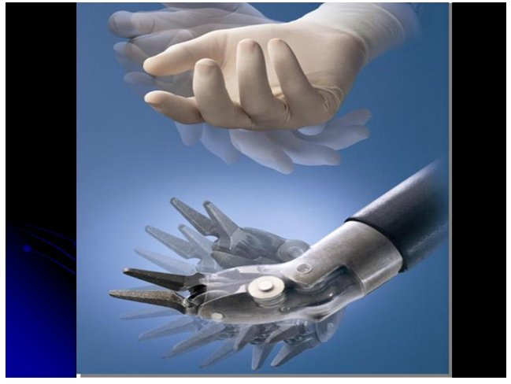
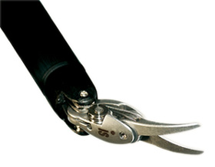
Robotic surgery
Pro :
  -More Precise/range of motion
  -3D Vision/magnified
  -More comfortable for Surgeon
  -Can be done remotely
Contra :
  -Price
  -Longer operative time

Slide 25
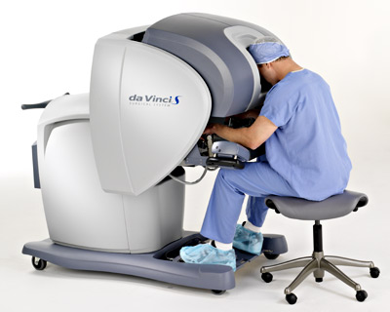
Robotic surgery
Most in :
  -Urology (prostatectomy)
  -Cardiosurgery
  -Gynekology (TLH)

Slide 26
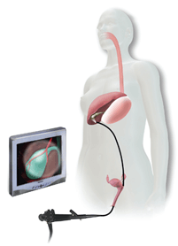
Natural Orifice Translumenal Endoscopic Surgery
  Experimental
  University hospitals
  Entrance :
    -Mouth / stomatch
    -Vagine
    -Rectum

