Slide 1
THE MEGIAR LANGUAGE
Presenter PETER CHANNEL DAREK
PRESERVICE YEAR 3
LAGUAGE & LITERAUTRE
THE UNIVERSITY OF GOROKA
27 SEPTEMBER 2012
LINGUISTIC CONFERENCE UKARUMPA

Slide 2
Overview
- Introducing the Megiar language
-reasons as to why Ross (1987: 357) has classified Megiar as a dialect of Takia,
This talk proposes that Megiar is a separate language.
Evidence based on the phonology, morphology, syntax, and sociolinguistics of the Megiar language

Slide 3
Introduction
The Megiar language is one of the Austronesian languages spoken in the North coast region of Madang province. The Megiar village lies just opposite Karkar Island, one of the biggest Islands in Madang province.

Slide 4
Main reason as to why Ross has classified the Megiar language as a dialect of Takia.
Not focusing on the Megiar language but many Austronesian languages.

Slide 5
Sociolinguistics
Migration of the Megiar people from the Bel area (near Madang town)
Introduction of the Bel language through inter- marriage
Also migration from Karkar island to the Megiar area
Megiar as a result of migration from these areas
Influence of the Bargam language

Slide 6
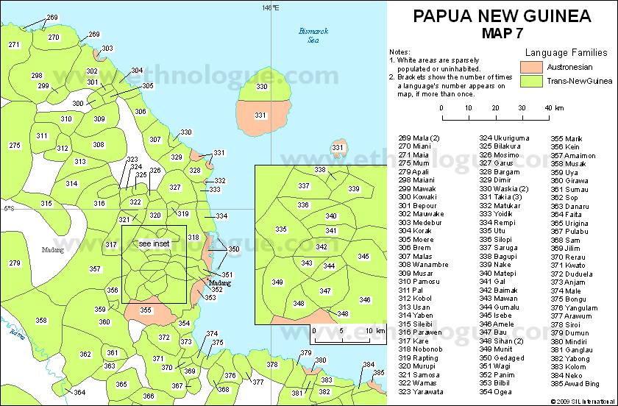
Megiar
Source: Ethnologue.com / SIL International

Slide 7
The migration of the Megiar people
The two distinct groups of migration;
People from Bel area near Madang town migrated further north to settle in the Megiar area.
Second wave of migration to Megiar was from the Southern tip of Karkar Island. They settled in Megiar a little bit later.

Slide 8
Introduction of the Bel language
When the people migrated to the Megiar area, the Non Austronesian speakers were already present. This has caused the Bargam language speakers to be far more influenced by the Bel speakers to adopt their language.

Slide 9
Classification of the Megiar language
A language of Papua New Guinea
Population: 1000
Region: Madang Province, Sumkar District, Sumgilbar LLG area, a coastal village along the North coast of Madang opposite Karkar Island. The Megiar village is near Serang village and Dylup estate.
Classification: Austronesian, Western Oceanic, North New Guinea linkage, Negero-Vitiaz, Bel, Nuclear Bel
Dialect: Megiar is a language with only one dialect
Language use: Domains gradually diminishing, generally elderly people and middle aged people.

Slide 10
Phonology in the Megiar language

Slide 11
Consonants in the Megiar language

Slide 12
Vowels in the Megiar language
/i/ iloman ‘cliff’ /ɔ/ ong ‘you’
iwon ‘husband/wife’ ona ‘there’
iwog ‘shout’ /u/ ute ‘see’
iwoiwon ‘four’ utur ‘stand’
urat ‘work’
/e/ ena ‘here’
en ‘this’
/a/ abi ‘garden’
ab ‘house’
atanman ‘plain/valley’

Slide 13
Syllable Structure
V - i ‘fish’
VC- ay ‘tree’
CVC- kam ‘rope’
CCV- ngi ‘I’

Slide 14
Suprasegmental (stress)
The stress is in Megiar language.
the stress in Megiar language is not restricted stress is place any where in the words.
stress a the word beginning
tim ‘wind’
stress place in the middle of the word
patui ‘star’
Stress place at the word ending
tamot ‘man’

Slide 15
Morphology of the Megiar language
The Megiar language uses its own morphemes, but some morphemes are similar to Takia.
For instance:
-(Megiar)present tense ngai abi a ngau
I garden locative go
'I am going to the garden.'
-Takia present tense ngai abi lon ngaue
I garden locative go
'I am going to the garden.'
The Megiar language is a more fusional language with affixes attached to the root words to mark tense, etc.

Slide 16
Pronouns in Megiar language

Slide 17
Use of affixes in the Megiar language
In most cases the verbs take a suffix or prefix to mark tense.
1) ngai ab a ngau
I house locative went
'I went to the house.'
2) ngai ab a ngau-s
I house locative going
I am going to the house
Takia:
1) ngai ab lon wau
I house locative went
'I am going to the house.'
2) ngai ab lon ngau-da
I house locative going
I am going to the house

Slide 18
Syntax in the Megiar language
Syntax in the Megiar language;
the basic word order in Megiar is Subject, Object and Verb or (SOV).
Ong anang uni. 2) ngi in ifuni
you food eat I him hit
‘ you eat the food’ ‘I hit him.’
3) Ngam fud nganis
we banana eating
‘ we are eating banana’

Slide 19
Vocabularies in Megiar language compare to Takia language.
Megiar Takia
Gublung ‘black’ bulkas ‘ black’
Ngamag aine sekmon ‘five’ kafen ‘five’
Mali ‘yellow’ kadabog ‘yellow’
Waibud ‘fog’ kawkaw ‘fog’
Lad ‘reef’ mal ‘reef’
Kakampein ‘young woman’ kbakan ‘young woman’

Slide 20
Conclusion
Megiar is a language of its own and not a dialect of Takia as shown by the differences between the phonology, morphology, syntax and vocabularies of Megiar and Takia.
More research needs to be done to study and work on Megiar.
It would be an honor and privilege for me as an indigenous speaker to further work on my own language.

Slide 21
The end of my presentation THANK-YOU!

