Slide 1
Serological diagnosis
Diagnosis of hepatitis

Slide 2
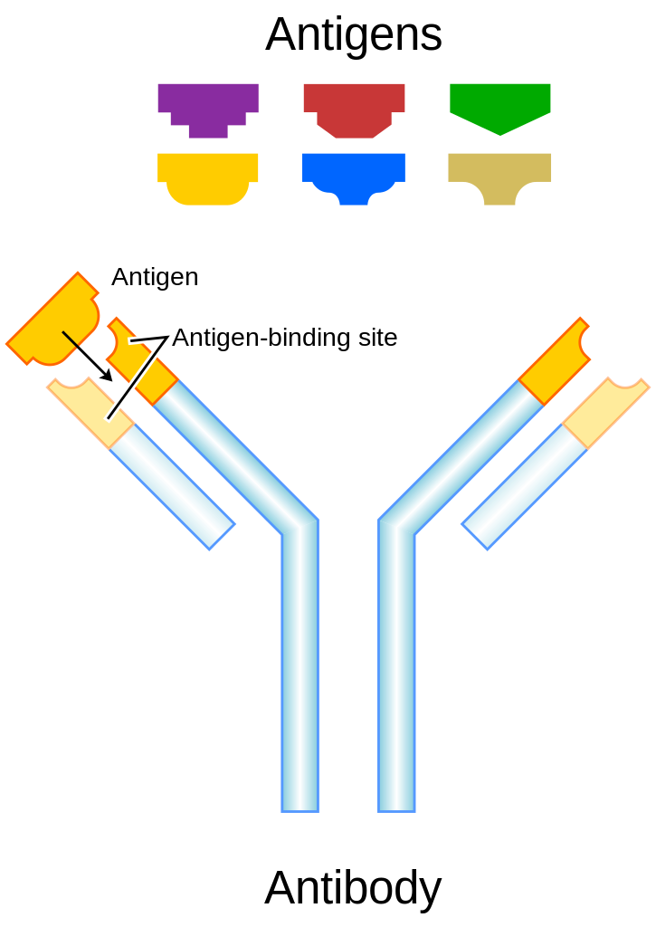
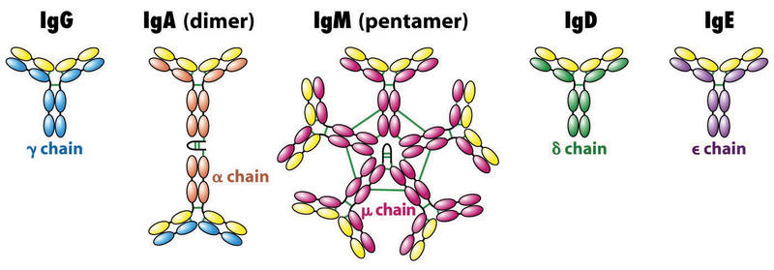
Serologic diagnosis
Specificity of the antibody-antigen reaction
Sensitivity of tests

Slide 3
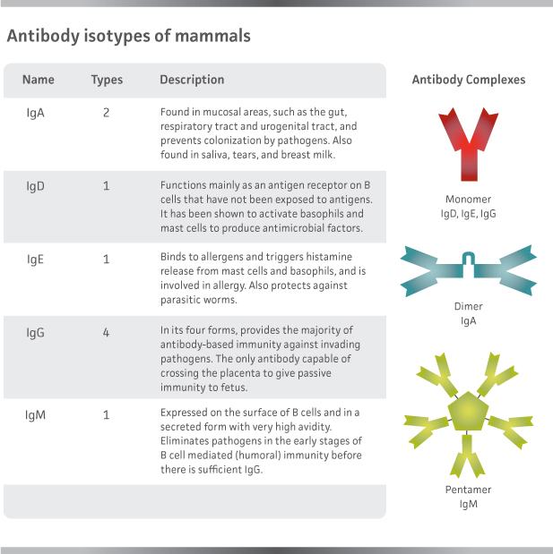

Slide 4
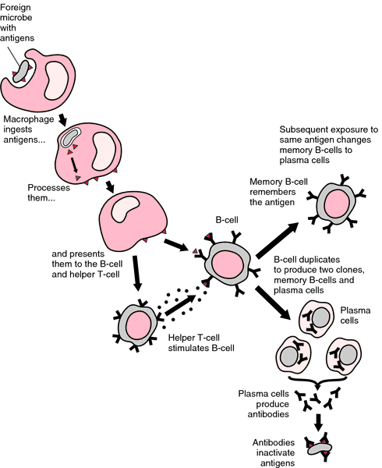

Slide 5
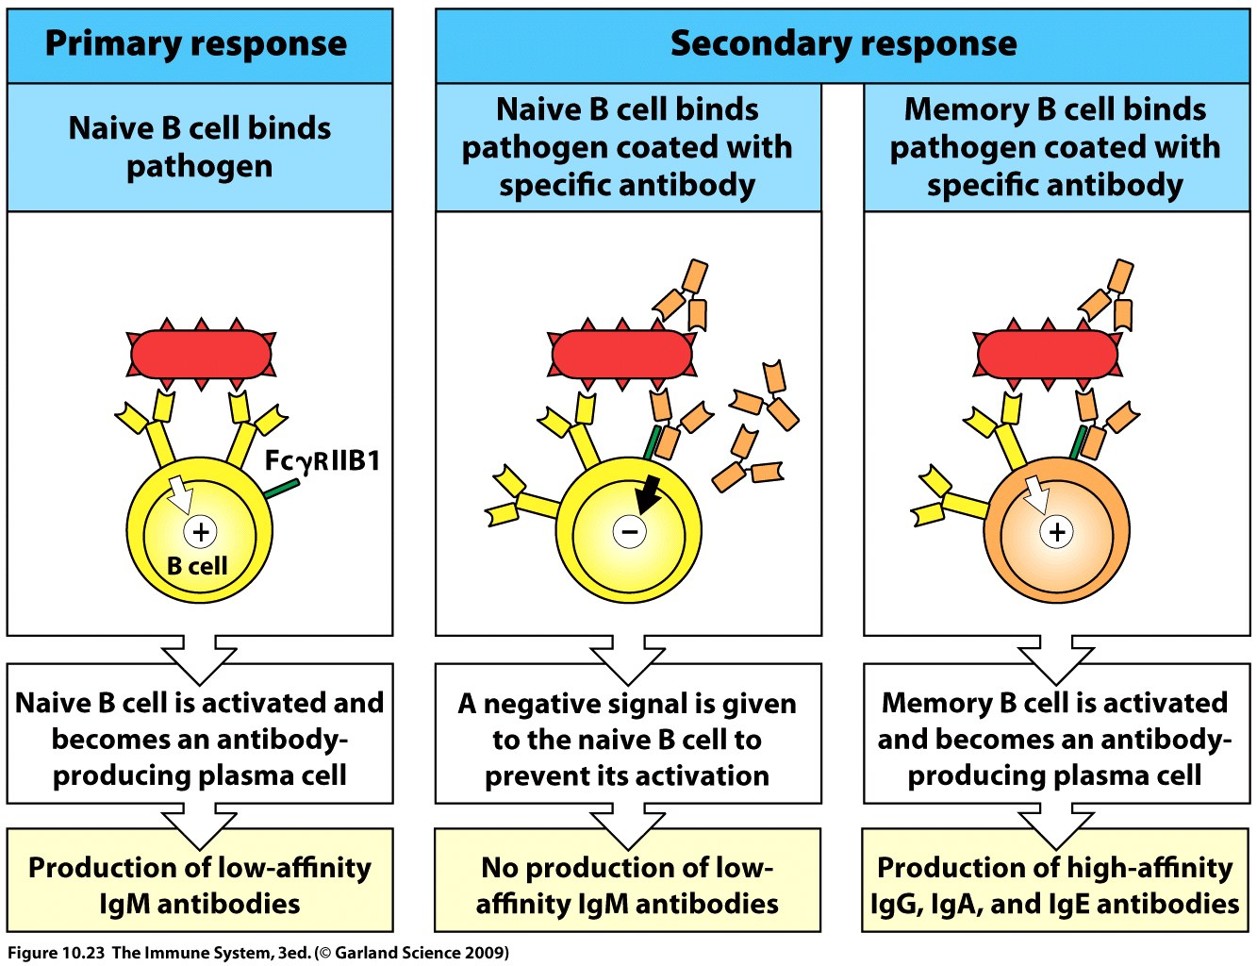

Slide 6
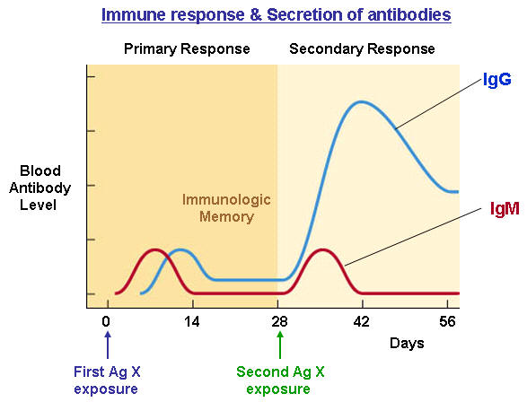

Slide 7
Primary Response
Occurs after a lag period
Initial production of IgM
Secondary Response (Anamnestic)
Repeated contact with the same antigen enhances and speeds up the immune response
Higher titer, lasts longer, consists predominately of IgG
The presence and level of antibodies is not
equivalent to illness

Slide 8
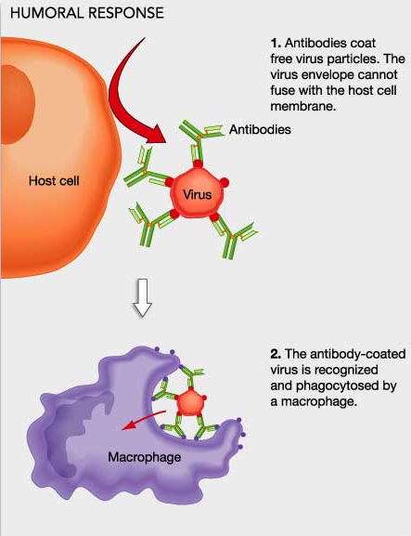
Antimicrobial action og antibodies
Opsonisation – promote ingestion and killing by phagocytic cells
Neutralization – (block attachment) toxines, viruses
Agglutination – bacteria
Combinig with Ag - Complement cascade activation:
membrane attack complex
Inflammatory response

Slide 9
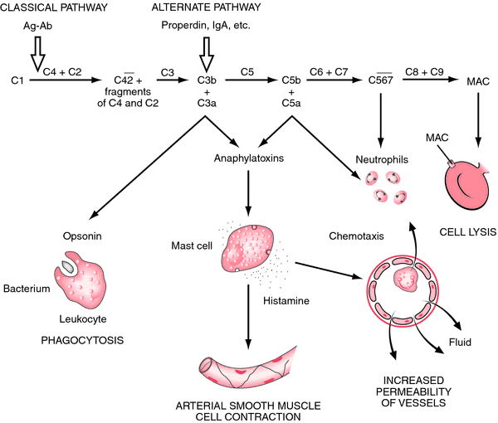

Slide 10
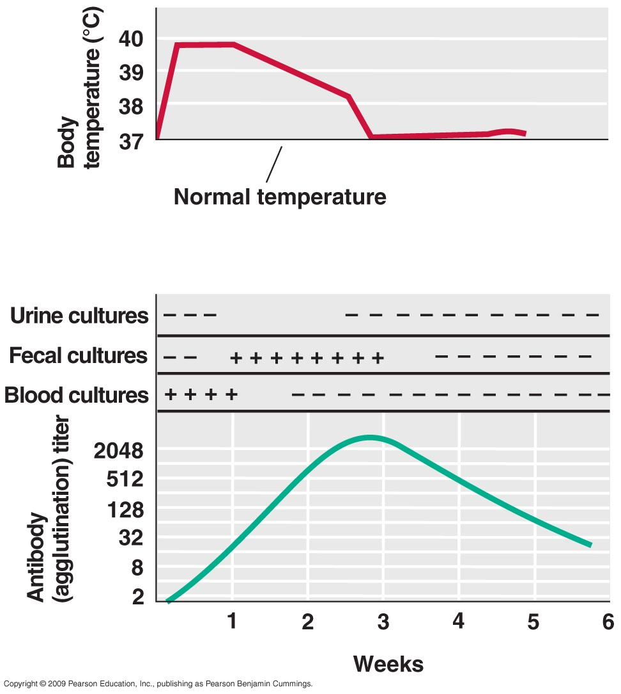
Acute phase
Reconvalescent phase

Slide 11
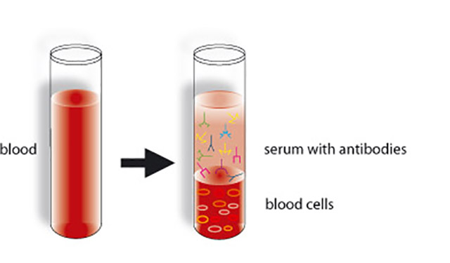
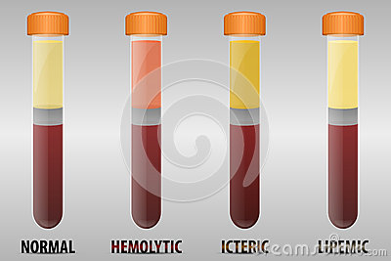
Serologic diagnosis
Detection of specific antibodies
Specimen = serum (+4°C, -20°C)

Slide 12
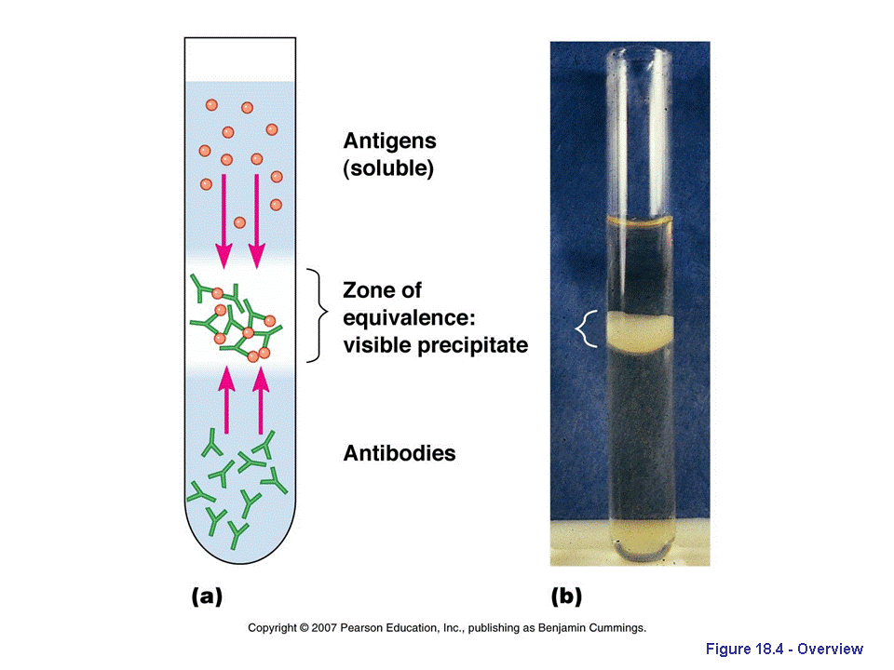
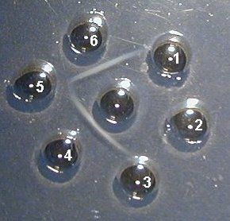
Methods of detection
Precipitation:
Soluble antigens; equivalence zone
Fungal antigen and antibody

Slide 13
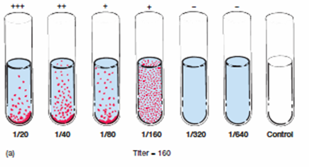
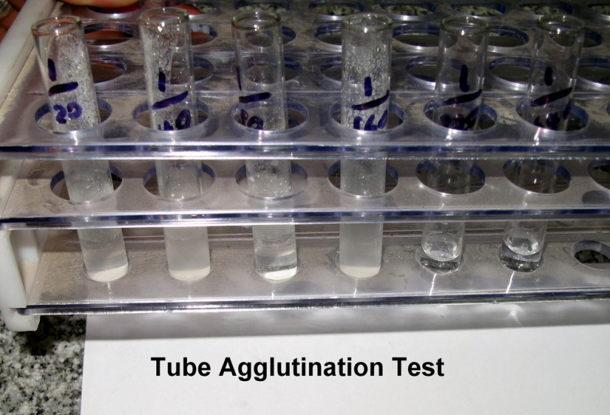
Methods of detection
Agglutination: particles = bacteria
Widal agglutination test - typhoid fever dg.
Wright agglutination test – brucellosis
Heterophile agglutination Weil-Felix test – rickettsial
infections

Slide 14
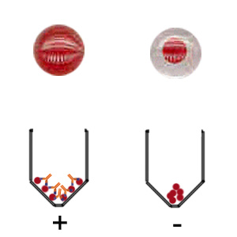
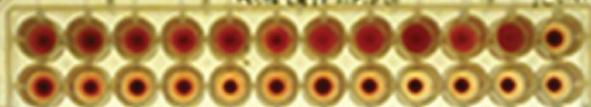
Methods of detection
Agglutination: particles = erythrocytes
hemagglutination

Slide 15
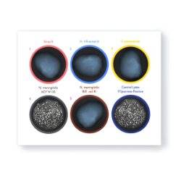
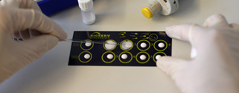
Methods of detection
Agglutination: particles = latex beads coated with a specific antibody or antigen
Latex agglutination

Slide 16
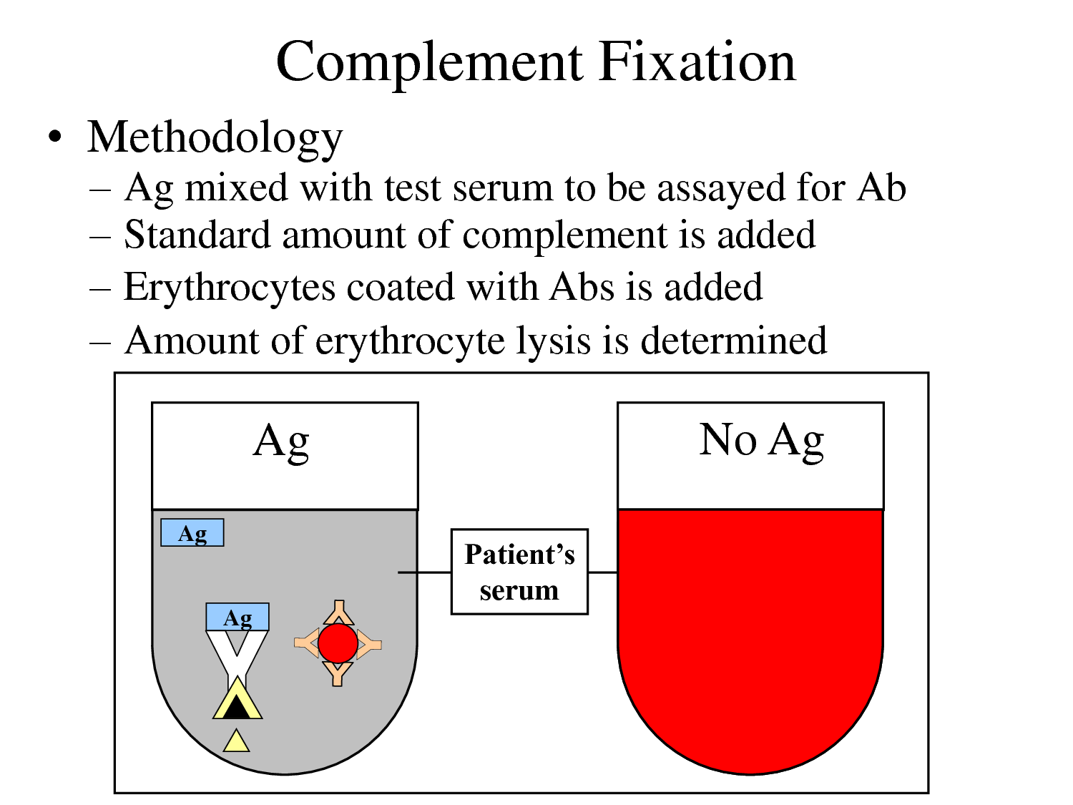

Slide 17
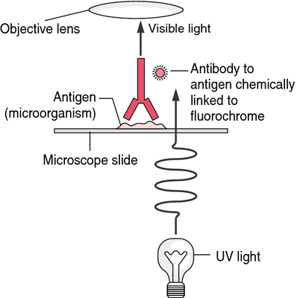
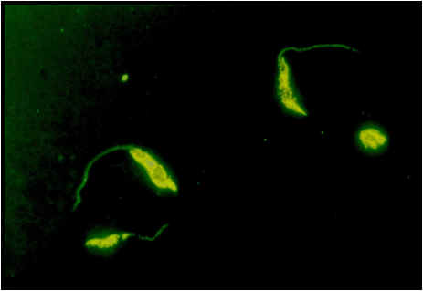
Methods of detection
Immunofluorescence

Slide 18
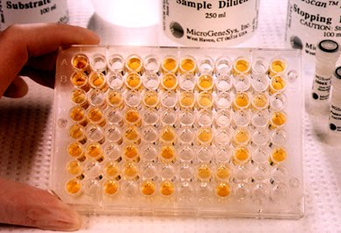
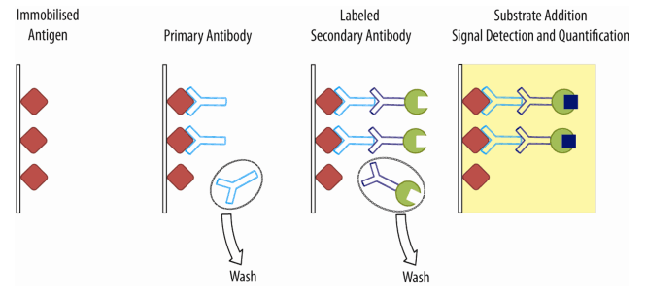
Methods of detection
ELISA: enzyme-linked immunosorbent assay

Slide 19
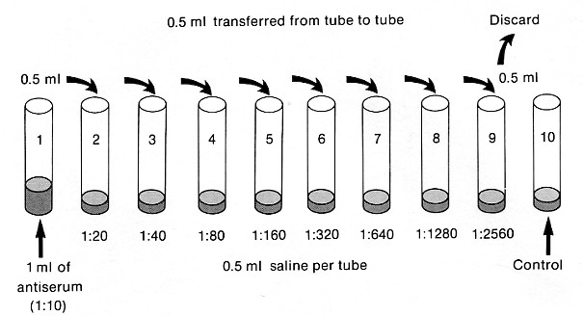
Quantitative information from an analytical procedure that inherently only evaluates as positive or negative = titer
The titer corresponds to the highest serum dilution that still yields a positive reading.
Titer testing employs serial dilution

Slide 20
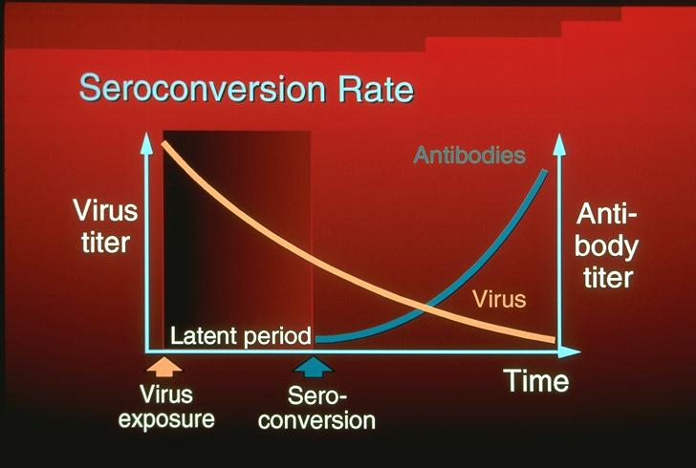
Paired specimens compared
        Antibodies may indicate current, recent or past infection.

Slide 21
Paired specimens compared
        Significant antibody responses:
        Seroconversion: specific Ab absent from the acute serum (pre-illness serum) but present in the convalescent serum
        Fourfold or greater increase in antibody titer supports a diagnosis of recent infection

Slide 22
Single serum may be useful in some circumstances
IgM resposes indicate acute infection
IgM | IgG | Dg. | notes
- | - | Susceptible | The sample too early collected, repeat
+ | - | Early acute inf.
+ | + | Acute infection
- | + | Past infection

Slide 23
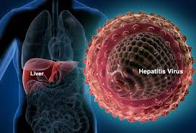
Hepatitis Viruses

Slide 24
VIRAL HEPATITIS
Infectious hepatitis A
Serum hepatitis B
NANB
Enteral E
Parenteral C
F, G, TTV (transfusion transmitted)

Slide 25
Family | Genus | Virus
Picornaviridae | Hepatovirus | Hepatitis A
Hepadnaviridae | Orthohepadnavirus | Hepatitis B
Flaviviridae | Hepacivirus | Hepatitis C
Unclasified | Deltavirus | Hepatitis D
Hepeviridae | Hepevirus | Hepatitis E

Slide 26
 | A | B | C | D | E
VIRION | 27 nm, icosahedral | 42 nm, spherical | 60 nm, spherical | 35 nm, spherical | 30-32 nm, icosahedral
ENVELOPE | No | Yes (HBsAg) | Yes | Yes (HBsAg) | No
GENOME | ss RNA | ds DNA | ss RNA | ss RNA | ss RNA
STABILITY | Heat and acid stabile | Acid sensitive | Ether sensitive, acid sensitive | Acid sensitive | Heat stabile

Slide 27
 | A | B | C | D | E
Transmission | Fecal-oral | Parenteral | Parenteral | Parenteral | Fecal-oral
Prevalence | High | High | Moderate | Low, regional | Regional
Fulminant disease | Rare | Rare | Rare | Frequent | In pregnancy
Chronic disease | Never | Often | Often | Often | Never
Oncogenic | No | Yes | Yes | ? | No

Slide 28
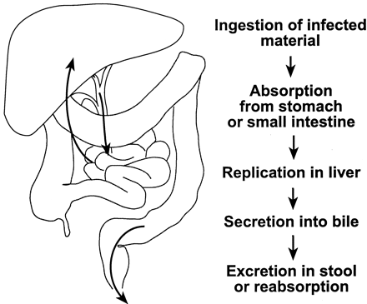
HEPATITIS A VIRUS
Picornaviridae
HAV –fekalno oralni put širenja
Izvor: školjke, plodovi mora, kontaminirana voda
Inaktivacija tek nakon >10 min pri 100°C

Slide 29
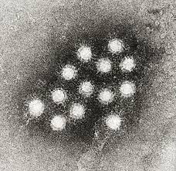
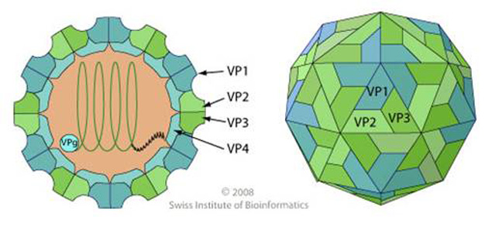
Hepatitis A virus (HAV)
Enterovirus 72
Family Picornaviridae
Genus Hepatovirus
Positive sense, ss RNA
Naked icosahedral capsid (27 nm)

Slide 30
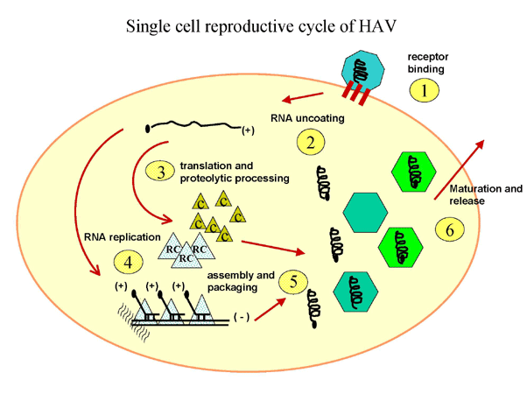
HAV replication
Unlike other picornaviruses HAV is not citolytic
Released by exocytosis
No apparent cytopathic effect in liver

Slide 31
Characteristics of Hepatitis A virus
Stabile to
Acid at pH 1
Solvents (ether, chloroform)
Detergents
Salt water, groundwater (months)
Drying (stabile)
Temperature
  4°C. weeks
  56°C for 30 min: stabile
  61°C for 20 min: partial inactivation

Slide 32
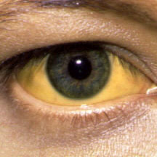
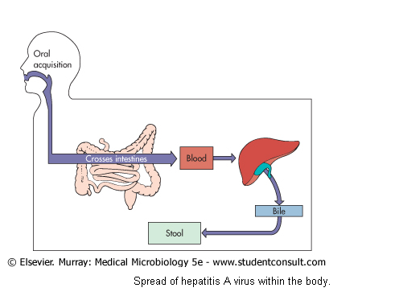

Slide 33
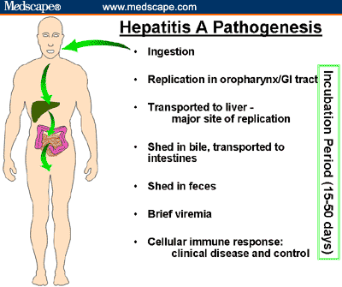

Slide 34
The hepatitis A virus concentration in different body fluids
Feces
Serum
Saliva
Urin
10⁰
10²
10⁴
10⁶
10⁸
10¹⁰
Infective dose / mL
Viral Hepatitis and Liver Disease 1984;9-22
J Infect Dis 1989;160:887-890

Slide 35
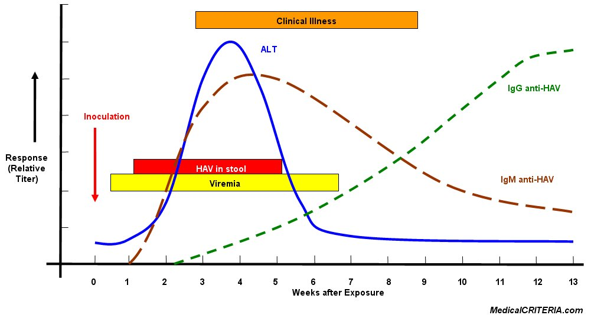
HAV – laboratory diagnosis

Slide 36
HAV – laboratory diagnosis
Clinical symptoms
Specific serologic tests
  Anti-HAV IgM (ELISA, RIA)
Isolation – not routinely performed

Slide 37
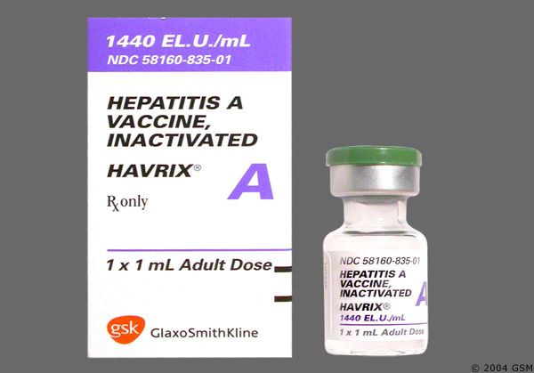
HAV – Treatment, Prevention and Control
Hand washing, chlorine treatment of drinking water
Prophylaxis with immune serum globuline (less than 2 weeks after exposure)
A killed HAV vaccine
A live vaccine (China)

Slide 38
Hepatitis B Virus (HBV)
Genus:
  Orthohepadnavirus
  Avihepadnavirus
Family:
  Hepadnaviridae
  Virion (Dane particle), unusually stabile for enveloped virus: resist treatment with ether, low pH, freezing, drying and moderate heating

Slide 39
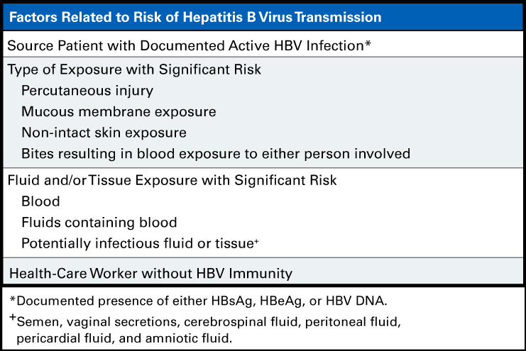

Slide 40
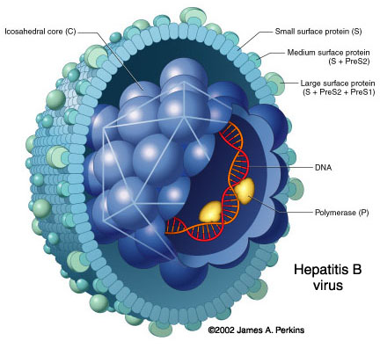
HBV - structure
envelope containing HBsAg
HBcAg hepatitis core antigen
HBeAg minor component of the virion, does not self assemble like HBcAg, is primarily secreted into serum

Slide 41
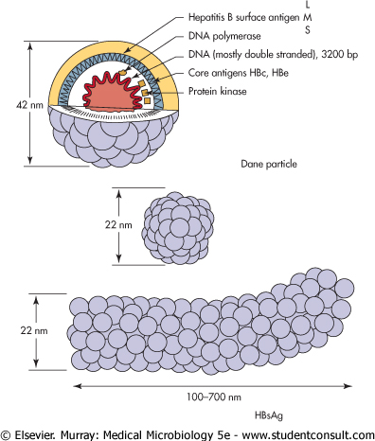
Schematic represantation of three HBsAg containing forms present in serum from HBV carriers
S, M, L

Slide 42
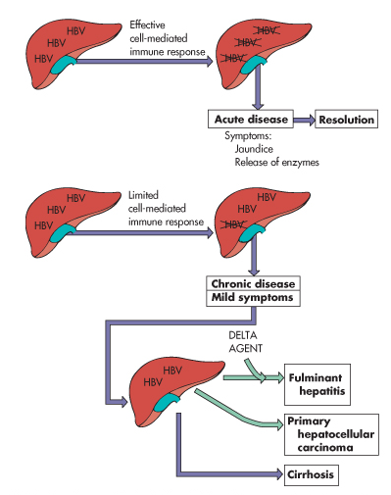

Slide 43
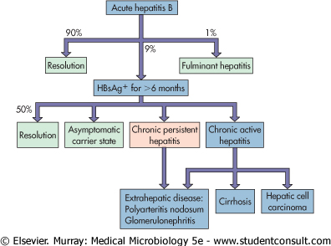

Slide 44
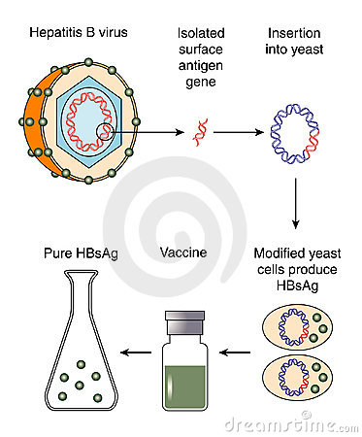
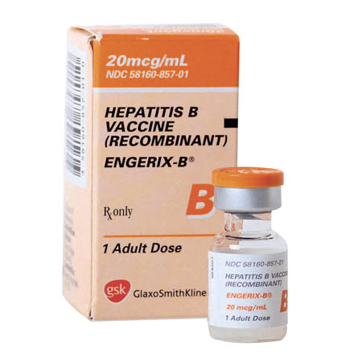
HBV vaccination

Slide 45
Laboratory diagnosis
Clinical symptoms and presence of liver enzymes in the blood
Serologic tests
  ELISA for HBV Ag and Ab
PCR for viral DNA

Slide 46
Laboratory diagnosis
HBsAg and HBeAg are secreted into the blood during viral replication
HBeAg –correlate to the presence of infectious virus
HBV-DNA – marker of active replication of the virus

Slide 47
Laboratory diagnosis
Anti-HBs – correlated with protection against and/or resolution of disease; marker of past infection or vaccination
Anti-HBe – virus is no longer replicating, but patient can still be positive for HBsAg (produced by integrated virus)

Slide 48
Laboratory diagnosis
Anti-HBc – seen in acute infection and chronic carriers
Anti-HBc IgM indicator of acute infection
Anti-HBc IgG marker of past or chronic infection

Slide 49
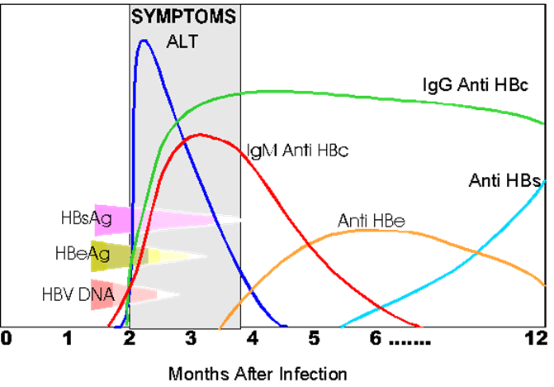

Slide 50
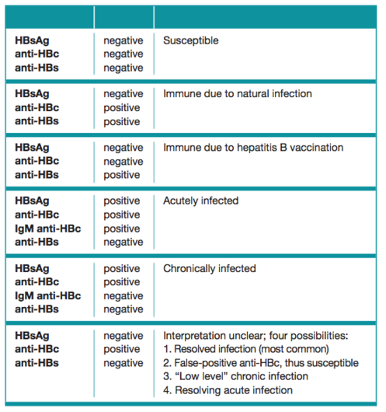

Slide 52
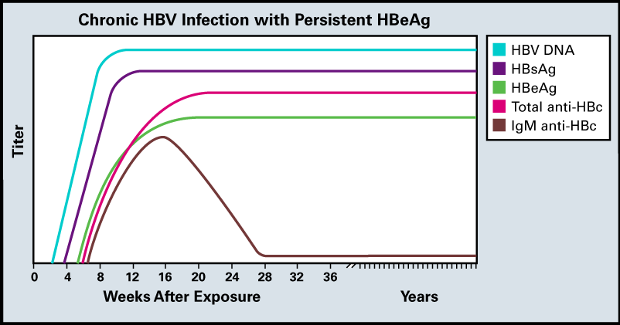

Slide 53
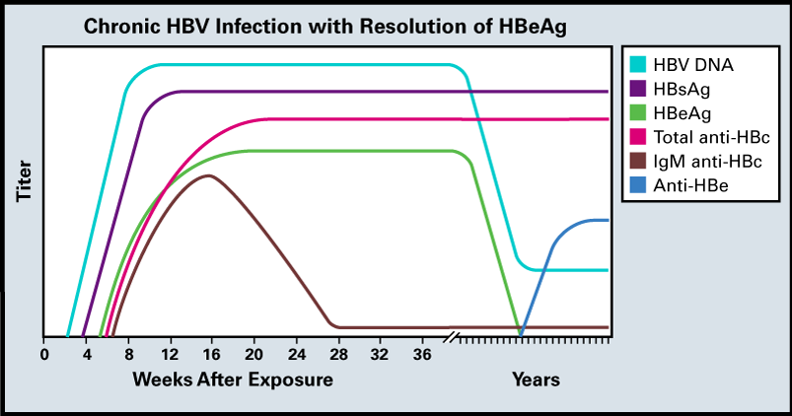

Slide 54
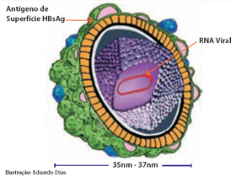
Hepatitis D virus
responsible for 40% of fulminant hepatitis infections
viral parasite
  uses HBV and target cell proteins to replicate,
  HBsAg essential for packaging the virus

Slide 55
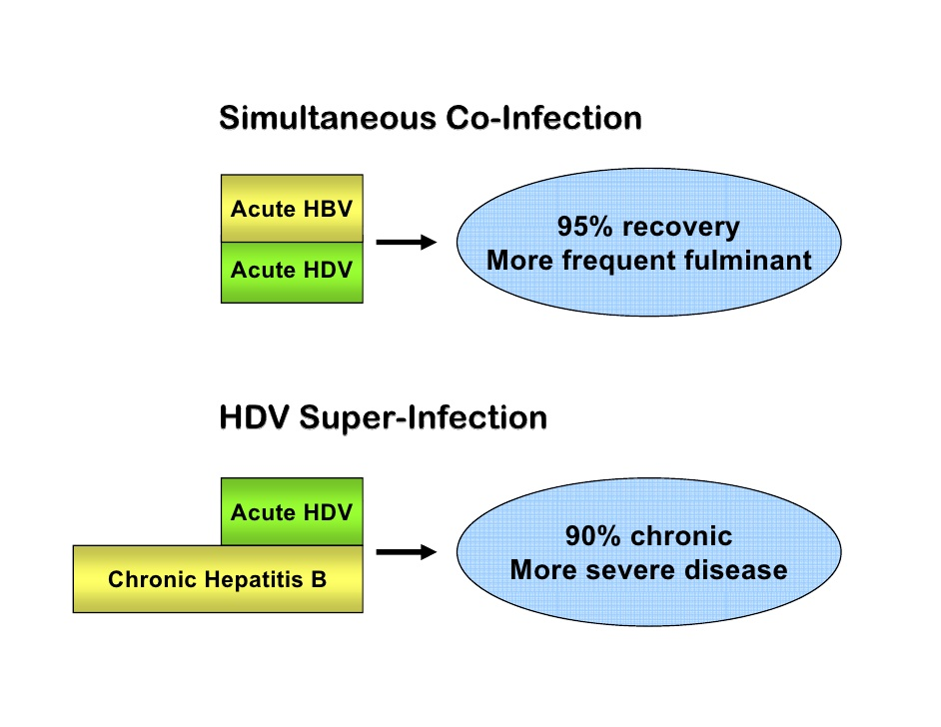

Slide 56
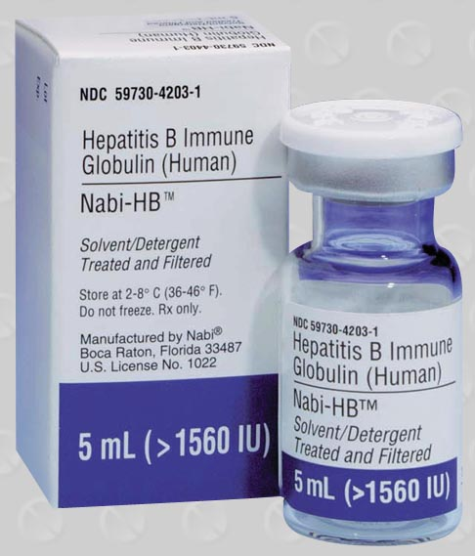

HDV - Prevention
HBV vaccine!

Slide 57

Hepatitis C virus (HCV)
Family
  Flaviviridae
Genus
  Hepacivirus

Slide 58

enveloped, positive sense RNA genome
hypervariabile regions of the glycoproteins (E1, E2) genes – variations during infection six major groups of variants (clades) in the world

Slide 59
HCV -Pathogenesis
HCV proteins inhibit apoptosis and INF-α action which prevents host cell death and promote persistent infection
Liver disease later in the life – high incidence of chronic asymptomatic infections
Tissue damage result of cell-mediated immunopathology

Slide 60
HCV - Clinical syndromes
Acute hepatitis with resolution of the infection and recovery (15%)
Chronic persistent infection with possible progression to disease much later in life (70%)
Severe rapid progression to cirrhosis (15%)

Slide 61

Laboratory diagnosis
Anti-HCV Ab (ELISA, Wb)
HCV-RNA (RT-PCR; branched-chain DNA)

Slide 62


Slide 63


Slide 64


Slide 65
Hepatitis E Virus (HEV)

Slide 66

Hepatitis E Virus (HEV)
E stands for enteric or epidemic
Spread by feco-oral route (contaminated water)
Family Hepeviridae;
Genus Hepevirus
Resembles caliciviruses

Slide 67

Virion icosahedral, no envelope, ss (+) RNA

Slide 68


Slide 69

HEV infection is especially serious in pregnant women

Slide 71

Hepatitis G Virus
Resembles HCV
Family Flaviviridae
Predilection for chronic hepatitis disease
Its role in causing significant liver disease is still controversial
Lab. dg.
  serology,
  PCR

