Slide 1

An Introduction to Mineral Economics &
Role of Geologist
Dr. P.K. Jain
Chief Mineral Economist
Indian Bureau of Mines
22nd June, 2020
e-Training on “Basic course on Resource Estimation for Mineral Deposits” RTD, GSI, CR, Nagpur
Disclaimer
The views expressed in this presentation are the author own and not necessarily those of the organization for whom he is working.

Slide 2
Mineral Economics
Mineral Economics –branch of Applied Economics
Mineral Economics deals with minerals.
It deals with the application of economic principles to the various aspects of mineral industry.
Problems of minerals require different approach.
Specialties to make approach to analysis of facts and problems pertaining to minerals.
Contd.

Slide 3
Mineral Economics
Mineral Economics is the academic discipline that investigates and promotes understanding of economic and policy issues associated with the production and use of mineral commodities
It emerged as a separate academic field only after World War II
In the decades following World War II, after early fears of a new depression and excess capacity evaporated, mineral economics focused on the long-run availability of nonrenewable commodities and the threat of supply interruptions for strategic and critical minerals from the Middle East, the Soviet Union, and southern Africa, concerns that persisted at least through the 1980s.

Slide 4
Mineral Economics v/s Pure Economics
Generally it was referred as a branch of Economics but in reality the specialties associated with minerals & mineral deposits make ‘Mineral Economics’ a very complex subject - quite apart from pure economics
Specialties are:-
  indispensability to survival of mankind
  finiteness & non-renewability
  hidden occurrence underground uncertainties of quality, quantity, usability hence need for prospecting/exploration
  unique to mineral resources
  independence of political boundaries
  location beyond human control
  long gestation period
  foundation of all economic activities directly or indirectly

Slide 5
Mineral Economics Education in world
In USA, started as an organised discipline of USBM in early 1920’s - just as in IBM in the 1950’s.
In 10 years, in 1932, Pennsylvania State University, USA introduced a nucleus set-up for research in the field of Mineral Economics.
In 1940, curriculum in Mineral Economics introduced in that university to offer academic degree.
In 1946, its School of Mineral Industries (now the College of Earth and Mineral Sciences) created a Department of Economics and began awarding B.S., M.S., and Ph.D. degree in field.
In 1968, in Colorado School of Mines, a separate department created.
In 1970’s, W. Virginia University of USA, University of Arizona & Michigan Technological University also introduced degree-granting programs at graduate level.
Stanford, Columbia, McGill University of Canada and Queens followed suit.
Curtin University of Technology in Australia, the University of the Witwatersrand in South Africa, the Catholic University of Chile –most of these programs have been initiated in 1993 .
Dundee in Scotland offer a program in mineral law with a focus on mineral economics.
Government agencies like IBM, Natural Resources Canada, the Australian Bureau of Agriculture and Resources (ABARE) & Chilean Copper Commission (Cochilco) today support a wide agenda of research in the field.

Slide 6
Mineral Economics education in India
      No formal education.
      Only a full or part paper in Post Graduate Applied Geology or B.Tech. Mining Engineering or MA (Economics).
      Mineral Economists of IBM are only Geologists & Mining Engineers by education who have acquired on-the-job working experience in the field of mineral economics.
      In sharp contrast to many other countries.
      Specialised academic centers for regular study/research in Agricultural Economics, Environmental Economics exist.
      Unlike in cases related to agriculture and environment, country is deprived of institutional back-up research on problems related to mineral sector.

Slide 7
Objective and Charter Functions of
Indian Bureau of Mines
The objective of the IBM is to promote systematic and scientific development and optimum utilisation of mineral resources of the country (both on-shore and off-shore). In order to achieve this objective the charter of functions of Indian Bureau of Mines is as follows:
To collect, collate and organise into a database, all information on exploration, prospecting, mines and minerals in the country in the shape of a National Mineral Information Repository and take steps to publish and disseminate the same;
Function as the National Technical Regulator in respect of the mining sector and lay down regulations, procedures and systems to guide the State Governments (first tier of regulation);
To build up capacity in the system, both for regulatory as well as the developmental work, at the central level as well as at the level of the States;

Slide 8
Objective and Charter Functions of
Indian Bureau of Mines
To establish institutional mechanisms of coordination between the Centre, the States, mineral industry, research and academic institutions, and all stake holders, so as to proactively develop solutions to the demands and problems faced by the industry;
To promote research on all aspects of practical relevance to the industry and to act as a bridge between research institutions on the one hand and user industry on the other;
To provide technical consultancy services;
To participate in international collaborative projects in the area of regulation and development of the mineral sector;
To advise Government on all matters relating to the mineral industry; and
To undertake any such other activity as has become necessary in the light of developments in the field of geology, mining, mineral beneficiation and the environment

Slide 9
Functions of Mineral Economics Division at Indian Bureau of Mines
Functions of Mineral Economics Division in IBM are :
    a) National Mineral Inventory (NMI)
    b) Indian Mineral Yearbook
    c) Market Survey Reports of Minerals & Metals
    d) Non-Ferrous Metal Consumption (Copper, Lead & Zinc)
    e) Mining Lease Directory
    f) Bulletin of Mineral Information
    g) World Mineral Intelligence
    h) Mineral Information & Advisory Services
    i) Mineral legislation, Trade, International cooperation

Slide 10
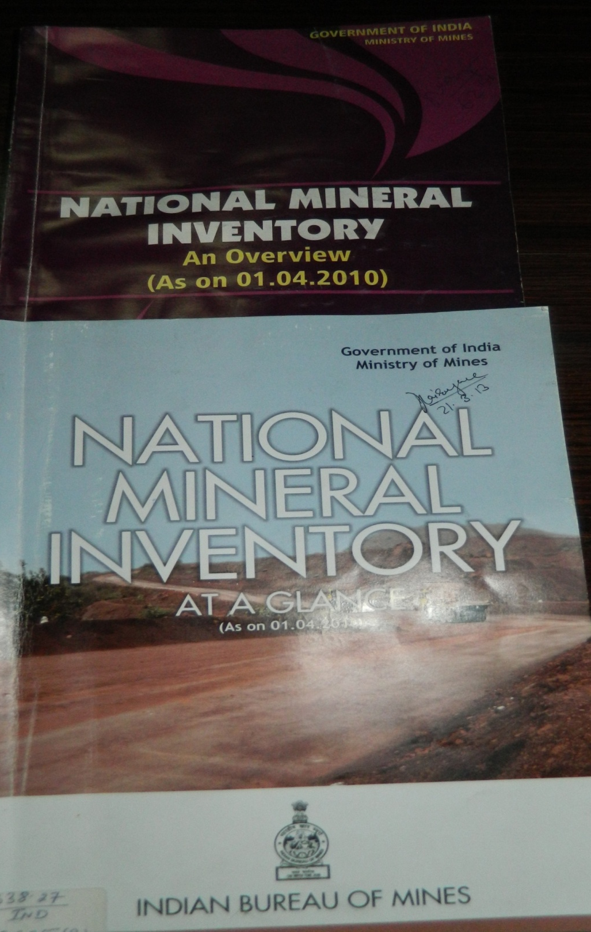
National Mineral Inventory

Slide 11
NATIONAL MINERAL INVENTORY (NMI)
Quinquennial updation of inventories of mineral resources in the country, covering mineral deposits in leasehold and freehold areas.
The NMI is fully computerized and the requisite information is available to interested persons/agencies on charge basis.
NMI in its present form covers - location of Mineral deposits/lease, nature of land, infrastructure, geology, exploration, physical and chemical properties, beneficiation, resources, reserves, status of freehold/leasehold, etc. along with the primary source of information.
Classification of quantities as per their end-use grade were accommodated.
The United Nations Framework Classification (UNFC), has been introduced successfully in the NMI since 01-04-2000.
At present, updation of “NMI as on 01.04.2015” is successfully completed .

Slide 12
NATIONAL MINERAL INVENTORY (NMI)
71 Minerals
Free Hold Deposits
(About 8,252 deposits)
Lease Hold Deposits
(About 11,792 deposits)
About 200 field parameters
for each block
Blocks
Deposits
Total 20,000 deposits (approx.)
Districts
States & U.T.
All India Mineral Inventory

Slide 13
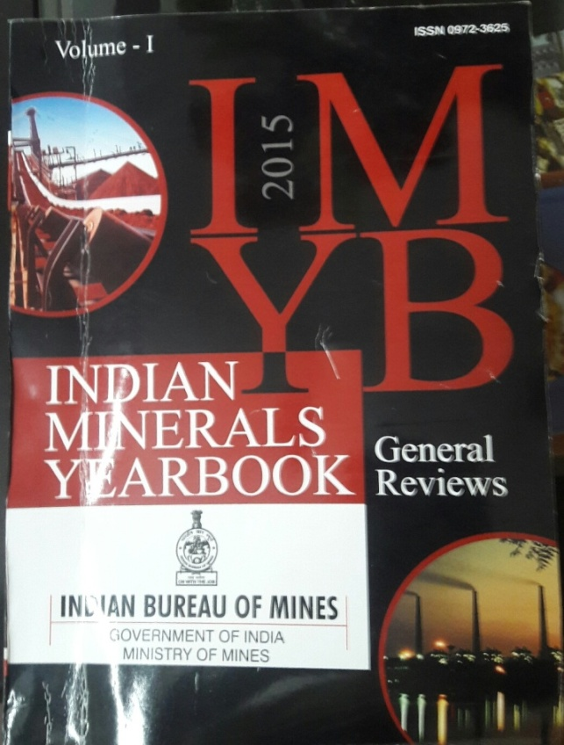
Indian Mineral Yearbook
Indian Minerals Year Book" (IMYB) depicts entire "gamut" of minerals and mineral based industries of India. It has over about last 50 years.
Preparation of IMYB involves correspondence for obtaining data/information on non-statutory basis from nearly 3000 parties engaged in mineral industries including State Directorates of Mines & Geology, R&D Institutions, Mineral Producers, Users, Traders, etc.
The data received are analysed and based on this data, consumption tables are prepared.
IMYB provides a status report of Mining and Mineral Industry in India on an annual basis as per Rule 45 of MCDR 2017. This publication has wide readership- both National and International.

Slide 14
INDIAN MINERALS YEARBOOK (IMYB)
IMYB consists of three volumes,
Volume-I consist of General Review and State Reviews,
Volume –II consist of Metals & Alloys Reviews
Volume-III consist of Mineral Reviews
Introduction
Resources
Exploration and Development
Mineral Inventory
Production & Stocks
Grade Analysis
Employment
Producers of Minerals/ Metals
Mining & Milling Process
Recycling
Consumption/ End Use Pattern
Substitute/Technical Possibilities
Policy & Standards
World Review
Foreign Trade
Future Outlook

Slide 15
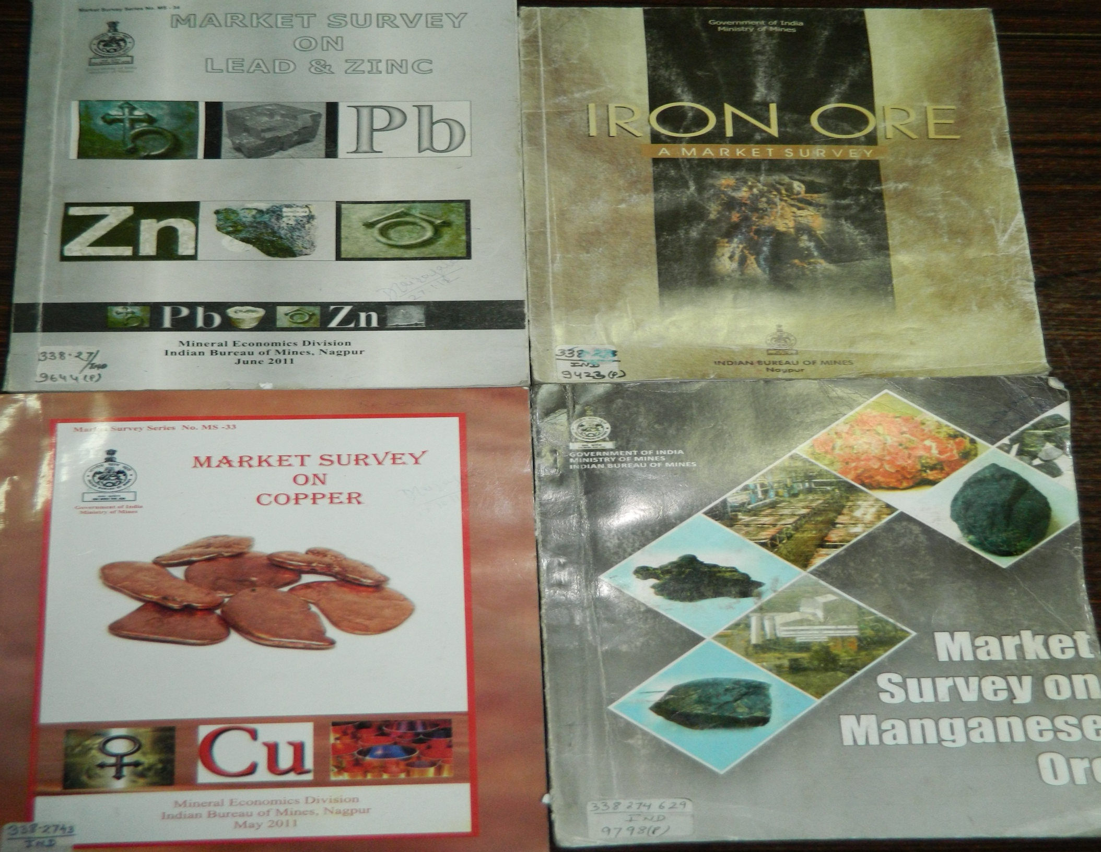
Market Survey

Slide 16
Contents of Market Survey
Chapter 1 Introduction
Chapter 2 Uses & Specifications
Chapter 3 Supply
Chapter 4 Foreign Trade
Chapter 5 Prices
Chapter 6 Demand & Supply
Chapter 7 Summary
List of Annexure
List of Figures

Slide 17
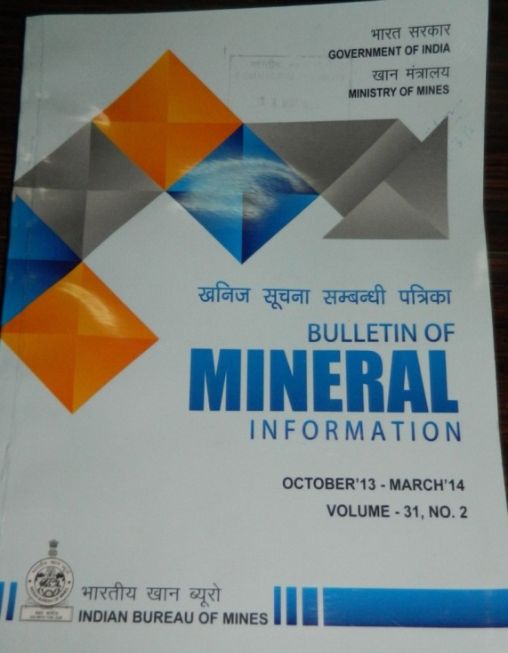
Bulletin of Mineral Information
The Bulletin of Mineral Information (BMI) is a Half Yearly Bulletin of Mineral Information in respect of returns and notices on grant of mining leases/prospecting licences, execution deeds, abstracts, renewal, amendments, revocation, surrender/determination etc. as per Rule 59(2) of MCR,2016.
Besides, mine owners send notices in prescribed proforma /returns.
Copies of PL / ML orders relating to approval / inclusion of additional mineral in the existing leases are received from the Central Government.
BMI Contents
Tables on trend in Mining & Prospecting licences.
Information on production of mineral based products.
Highlights of minerals & mining activities in domestic & abroad.

Slide 18
Bulletin
of
Mineral
Information
( BMI )
I Section-I
Abstracts of Notifications and court cases related to mines & minerals.
Section-II
Information in the form of letters, returns and notices for grant of mining leases, its execution, lapse, extension of period, execution deeds, revocation, surrender, determination, transfer, opening, discontinue, re-open, abandon, grant of PL, its execution, renewal, revocation, etc. and trend of RP’s.
Section-III
Information on production of mineral based products.
Section-IV
Highlights of domestic and abroad news.

Slide 19
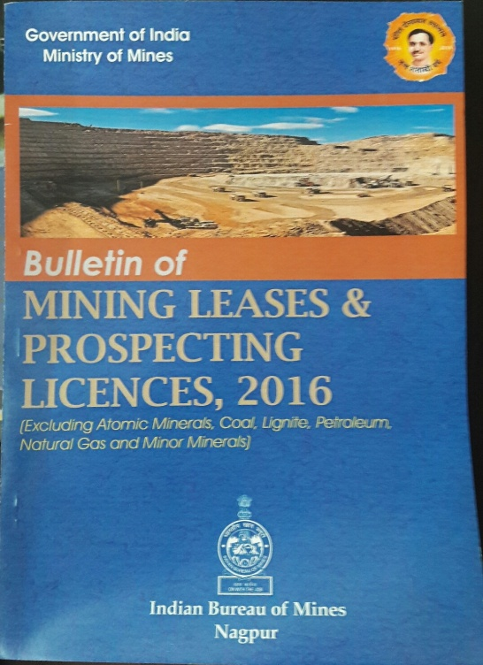
Bulletin of Mining Leases & Prospecting Licences
The data received from respective state governments as per Rule 59(2) of Mineral Concession Rule 2016 used to prepare mining lease directory and other required data generation.
ML Directory provides comprehensive overview of a mining lease like its location, lessee’s name and address, area, date of grant, execution, period of lease etc.
40 Minerals covered for mining lease information after 31 minerals notified as minor minerals w.e.f. 10.02.2015.
There are 3,529 leases have been granted by state governments as on 31.03.2019 which covered 3,16,290 hectare area.
31 minerals which are declared as minor minerals having 6000 leases (approx.).

Slide 20
World Mineral Intelligience (WMI)
Mineral Economics Division processes and maintain updated information on mineral reserves from USGS source and production data from BGS source for 60 minerals.
Maintain updated information on trade data from DGCI&S Kolkata source of different countries.
This information is essential to India keeping in view to assist government for bilateral co-operation treaty / agreement with different countries under global liberalized economic scenario.
Technology innovation, discovery of new deposits, its potentiality, international trade in minerals, global economy and international prices of minerals & metals can effect India’s import or export trade and interest in mineral sector of other countries of world.
Constant watch over world wide developments in mineral sector is required for proper utilization and long term planning of Indian mineral resources towards self sufficiency.

Slide 21

MINERAL LEGISLATION UNIT
ACTIVITIES
Renders advisory services to the Central Government i.e Ministry of Mines /State Governments and private parties and/individual in respect of matter related to mines/mineral sector; matter related to MMDR Act 1957 and rule made there under, export/import policy, duty structure, mineral royalty, national mineral policy etc.
Parliament Questions/Ministry References/State Governments/ Private References regarding legislation and policy related to mineral sector.
Data Collection on accrual of mineral royalty & NMET from states through respective nodal officers/State Govts. and its endorsement to NMET Secretariat, New Delhi periodically/as and when received.
Work related to information for Bulletin of Mineral Information (Half Yearly Publication of IBM, Section-1) covering abstracts pertaining to decisions of the Supreme Court/High courts on cases relating to Indian Mineral Legislation/ Laws and changes in trade policy, customs duties, and Notifications related to mines and minerals, etc. are documented and published.
Assist the Study Group constituted by Ministry of Mines to amend the Second Schedule to MMDR Act,1957.

Slide 22
Mineral Information & Advisory Service
Provides mineral related information including reserves/resources, exploration, production, consumption, exports/imports of minerals/metals; mineral based industries; mining leases; prices; etc. to the central/state government, government agencies and individuals.
Advise to the government on different mineral related issues and examines the problems and policy issues for rendering comments to the Govt. from time to time.
Provides information as and when required for Ministry references, Parliament Questions and also render assistance to Central and State Governments public and private agencies from time to time.
Prepares talking points/notes on minerals & other issues related thereto, keynote address/draft speeches/technical papers as and when required by the Hon’ble Minister, Secretary and Head of the Department.

Slide 23
Central Library
IBM’s library at the headquarters has rich collection of books, journals, published and unpublished reports of IBM and GSI, Annual Reports of various Ministries, organizations, Industrial houses, etc.
Mainly connected with mining and allied subjects.
The number of periodicals received on the subscription as well as exchange/ complimentary basis was 175 including 30 foreign periodicals. For the benefit of the users, library compiles subject wise bibliographies, which have been computerized.
Besides, it helps readers by providing Xeroxing services and information of reference enquiries.

Slide 24
Publication Section
The Publication Section is an important wing of IBM that publishes Technical Publications and undertakes the works of dissemination of information for the Bureau to all external Academic, Scientific and Government bodies. Located at IBM’s Headquarters, the Publication Section is a composite organ that comprises Editorial, DTP, Production, Printing Press, Binding and Sales & Distribution Units.
All technical publications at IBM are routed through definitive stages of publication process from editorial scrutiny, formatting & composing, production & plate making, to the final stage of printing & binding, which are undertaken under the single roof of Publication Section, before being finally released for distribution.
An approximate total of 30 publications including IBM’s flagship publication “Indian Minerals Yearbook” are brought out every year.
The Publication Section handles complimentary distribution & sales work of all publications.
A total of 3000 complimentary copies of IBM publications get distributed to an approximate 200 enlisted addresses (Indian & Foreign) in the Mailing List every year and an approximate of Rs. 7 lakhs gets generated as sales revenue every year.

Slide 25
Data base
The following four databases were established in Mineral Economics Division
Sr. No. | Title | Details
1. | National Mineral Inventory (NMI) | information on mineral resources
2. | Mineral Consumption (MC) | information on mineral consumption by the end user
3. | Mining Leases (ML) | Information on mining leases of the country
4. | World Mineral Intelligence (WMI) | Information on world mineral resources and production

Slide 26
Data base
Mineral Economics division is to collect, collate, analyze various mineral related data and processing the same for dissemination to the industry, policymaker and all stake holders concerned with mineral/ mining activities in country and abroad.
Backbone of ME Division is STRONG DATABASE

Slide 27
Flow Chart to Prepare the database
Data
Inflow
Data inflow: as per time schedule, in specified format, credible and complete.
Data
Collate
Data Collate: tabulation, synthesis, Data entry, physical verification etc
Data
Analyze
Data Analyze: Validation, processing etc
Data
Processing & Dissemination
Data Outflow in the form of publications, references, policy etc.

Slide 28
Utilisation of Mineral Economics Division
Inter-ministry, Intra Ministry & Niti Aayog references regarding minerals, mineral based industries is dealt.
Parliament Questions based on mining and minerals is dealt.
Mineral Policy and policies of other ministries like Steel, Labour, Commerce & Industry, Employment, Foreign Trade Policy, etc. and examines the problems and policy issues for rendering comments to the Government from time to time.
Offering comments on Court cases related to mining and mineral legislation.
provides a status report of Mining and Mineral Industry in India on an annual basis through Indian Bureau of Mines
Analysis and determine the future availability of minerals to end use industries through National Mineral Inventory.

Slide 29
Future Aspect & Vision of Mineral Economics
Mining Tenements system(MTS) has been conceptualized by the ministry of mines, wherein Indian Bureau of Mines (IBM), is the nodal agency for executing this system.
MTS primarily involves automating the entire mineral concession life-cycle, starting from identification of area and ending with closure of the mine; and connecting the various stakeholders for real-time transfer of electronic files and exchange of data. This shall enable effective management of mineral concession regime and transparency in mining operations.
Process for selection of a implementation agency for design, development, maintenance and operation of mining tenements system has been completed and contract signed on 10th November,2016 with selected agency i.e. M/s Wipro Ltd.
All the data related to current database will be automatically fetched up after implementation of MTS.
The output of NMI database, ML-PL data base and consumption of minerals database will be real time as on date.

Slide 30

Flow Chart for database after implementation of MTS
Data Enter
at Source
Data entered at source as per time schedule, in specified format, credible and complete.
Physical
verification
Physical verification
Data
Analyze
Data Analyze: Validation, processing etc
Data
Processing & Dissemination
Data Outflow in the form of publications, references, policy etc.

Slide 31
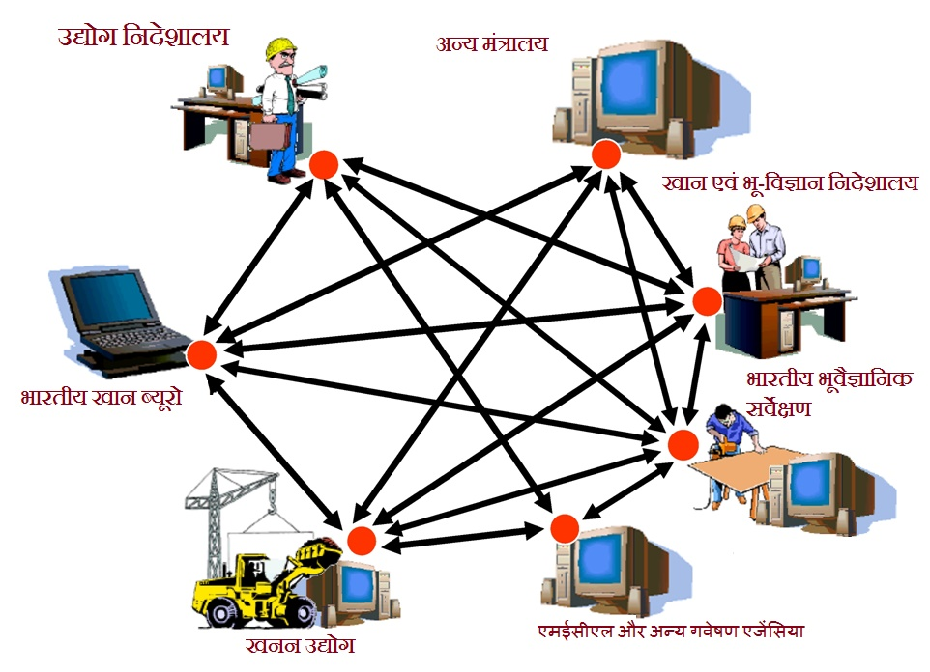
National Mineral Information Repository
Ministry of Mines
Royalty, NMET, DMF data
State Governments
Indian Bureau of Mines
GSI
Mineral Industries
MECL & other exploration agencies

Slide 32

cme@ibm.gov.in
Ibm.gov.in

