Slide 1
Hemostasis and Blood Coagulation
Prof. dr. Jasna Marinović
Department of Physiology

Slide 2
Hemostasis - prevention of blood loss
Mechanisms:
Vascular constriction
Formation of platelet plug
Formation of blood clot (blood coagulation)
Growth of fibrous tissue into blood clot (permanent)

Slide 3
1. Vascular Constriction
Immediate
Mechanisms:
Local myogenic spasm
Local autacoid factors (thromboxan A₂)
Nervous reflexes (pain)
Lasts minutes to hours

Slide 4
2. Formation of platelet plug
Platelets (thrombocytes):
Fragments of megakaryocytes; diameter 1-4 μm, 150-300x10⁹ /l of blood
Contain many active factors:
Actin, myosin, thrombosthenin
Endoplasmic reticulum, Golgi apparatus
Mitochondria
Enzymes for prostaglandin production
Fibrin-stabilizing factor
Growth factors for vascular repair
Glycoproteins on cell surface

Slide 5
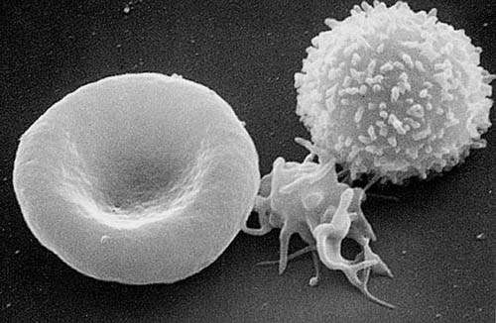
2. Mechanism of platelet plug
Contact with collagen fibers in subendothelium activates platelets:
Platelet swelling, irregular shape (pseudopods)
Release of granules with active factors
Adherence to collagen and vWF from injured tissue and each other forming clumps
4) Release ADP and thromboxane A2
5) Activation of other platelets –
platelet plug (loose without fibrin)
Notes:
Platelet plugging mechanism is extremely important for closing minute vascular holes in very small blood vessels. But also, platelets provide important factors to support normal blood coagulation. So, these are interconnected processes.

Slide 6
3. Blood coagulation
Begins ~ 15-20 s to 1 min after vascular damage
Initiated by:
Release of active factors from injured vessel wall
Activated platelets
Blood proteins adhering to damaged vessel wall
If vessel opening is not too large, in 3-6 min the bleeding is stopped.
In 20 min – clot retraction.

Slide 7
4. Fibrous organization or Clot Dissolution
Fibrous organization –
migration of fibroblasts
forming connective tissue within 1-2 weeks
Usually when clots are formed in the holes of the vessel wall
Dissolving the clot
Tissue clots

Slide 8
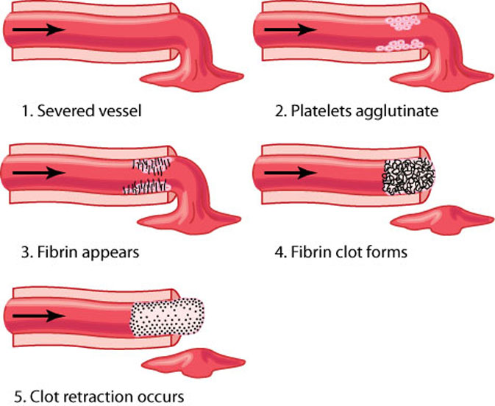
Figure 36-1

Slide 9
Blood coagulation
Balance of procoagulants and anticoagulants.
General mechanism:
Activation of prothrombin activator complex (initiated by vessel or blood injury)
Conversion of prothrombin to thrombin.
Conversion of fibrinogen to fibrin fibers - mesh of blood cells and plasma forming a clot.
Rate-limiting factor is step 1.

Slide 10
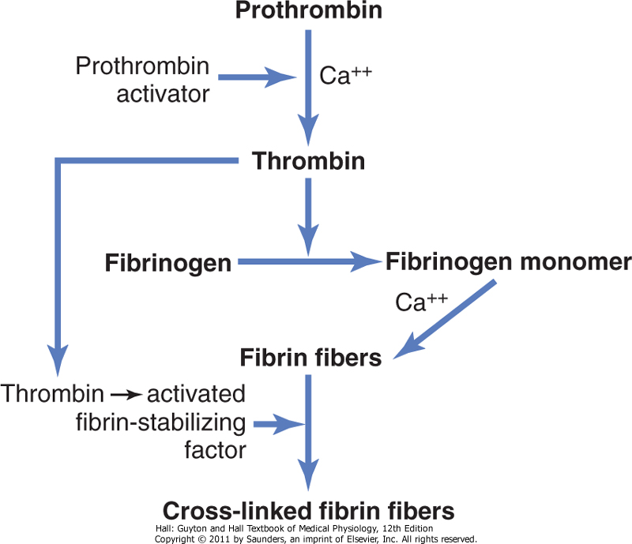
Figure 36-2

Slide 11
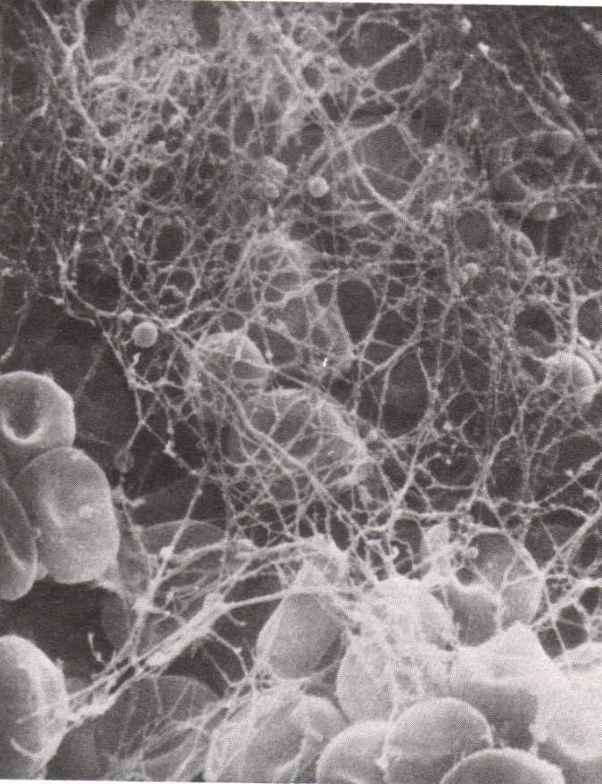
Blood clot
Mesh of fibring fibers with trapped blood cells, platelets and plasma.

Slide 12
Clot retraction - Serum
60 min after clot formation all the fluid is expressed out (serum)
Platelets are essential for retraction and pulling together the edges of broken vessel.

Slide 13
Positive Feedback of Clot Formation

Slide 14
Initiation of Coagulation: Formation of Prothrombin Activator
Clotting initiation:
Trauma to vascular wall and adjacent tissues
Trauma to blood itself
Contact of blood with collagen and damaged endothelium
Two cascade pathways for prothrombin activator formation:
intrinsic
extrinsic

Slide 15
Table 36-1
Notes:
In both extrinsic and intrinsic pathway a series of blood clotting factors plays a role. They are usually proteins – proteolytic enzymes circulating in their inactive form in blood, and upon conversion to active forms, cause successive enzmatic reactions activating downstream factors and amplifying the response.

Slide 16
Extrinsic Pathway
Initiates when injured vascular wall or extravascular tissues come in contact with blood.
Injured tissues release tissue factor (tissue thromboplastin) - lipoprotein (proteolytic) and phospholipid component

Slide 17
Figure 36-3. Extrinsic pathway

Slide 18
Intrinsic pathway
Starts with trauma to the blood or contact of blood with collagen
More steps in cascade and thus slower than extrinsic pathway.
All coagulation factors are in the blood.

Slide 19
Figure 36-4 Intrinsic pathway
Factor VIII – antihemophyilic factor
Ca²⁺ necessary for all, but first two steps
removal of calcium (citrate, oxalate) – prevention of clotting

Slide 20
Interaction between extrinsic and intrinsic pathways
Damage of blood vessel activates both pathways!
They converge at the level of factor X.
Extrinsic pathway – explosive (15 s).
Intrinsic patway – slower (1-6 min).

Slide 21
Prevention of Blood Clotting – Endothelial Factors
Very important.
Smoothness of endothelial surface
Prevents activation of intrinsic pathway
Glycocylix (mucopolisaccharide)
Repels platelets and clotting factors
Thrombomodulin
Bound to endothelial membrane
Binds thrombin, this complex activates protein C (inhibitor of Factors V and VIII)

Slide 22
Prevention of Blood Clotting – Blood Anticoagulants
Fibrin fibers
Adsorb 85-90 % of formed thrombin during clot formation.
Prevents excessive clot growth.
Antithrombin III
Also binds thrombin
Interacts with heparin

Slide 23
Heparin
Normally very low concentration in blood.
Polisaccharide produced by basophil mast cells (lung and liver capillaries).
Increases potency of antithrombin III 1000-fold.
Besides thrombin, removes also Factors XII, XI, X i IX
Great clinical importance

Slide 24
Lysis of Blood Clots - Plasmin
Plasmin
Strong proteolytic enzyme.
Cleaves fibrin and other clotting factors.
Precursor is plasminogen (inactive).
Plasmin is activated by tissue plasminogen activator (released from injured tissues 1-2 days after clot formation).

Slide 25
Conditions with excessive bleeding
Vitamin K deficiency and liver disease
Hemophylia
Thrombocytopenia

Slide 26
Vitamin K deficiency and liver disease
Liver produces most of clotting factors.
Vitamin K
important co-factor for synthesis of prothrombin, Factors VII, IX, and X, and protein C
Produced by intestinal bacteria
Absorbed in blood with fats
Liver insufficiency or lack of vitamin K (intestinal disease, bile obstruction, neonates)

Slide 27
Hemophylia
X-chromosome-related disease, affects males
85% cases – deficiency of Factor VIII (hemophilia A ili classic hemophilia)
15% cases– Factor IX
Various degrees of disease severity
Prolonged bleeding from larger vessels after injury
Therapy: recombinant factor VIII injection after injury

Slide 28
Thrombocytopenia
Bleeding from small venules and capillaries (thrombocytopenic purpura – blotchy skin)
No symptoms unless platelet count < 50 x 10⁹ /L (10 x 10⁹ /L – lethal)
Various causes:
Idiopathic – autoimmune
Iatrogenic – caused by bone-marrow supressing drugs (chemotherapy)

Slide 29
Thrombi and emboli
Thrombus – abnormal clot in blood vessel.
Embolus – freely flowing thrombus.
Causes:
Roughened endothelial surface
Arteriosclerosis, infection, trauma
Slow blood flow (blood stasis)
Prolonged sitting or prolonged immobility.
Hypercoagulability
Cancer-related, genetic

Slide 30
Thromboembolic conditions
Femoral venous thrombosis and massive pulmonary embolism
Occlusion of both pulmonary arteries – immediate death.
Otherwise therapy with t-PA or streptokinase.
Disseminated intravascular coagulation
Initiated by massive tissue damage (tissue factor) or sepsis (endotoxin).

Slide 31
Anticoagulants for Clinical Use
Treatment and prevention of thromboembolic conditions.
Heparin
Immediate action, applied by injection.
Short duration of anticoagulant effect (hours).
Coumarins (warfarin) –
Inhibit vitamin K epoxide complex 1 (inhibit reactivation of vitamin K in liver).
Decrease effectiveness of prothrombin, and factors VII, IX, and X .
Action after hours, but last longer (days).

Slide 32
Prevention of blood coagulation outside the body
Glass container– clotting in 6 min
Silicone container– >1 h
Prevents activation of platelets and factor XII
Heparin (heart-lung machine, artificial kidney)
Decreasing ionized calcium in blood (oxalate, citrate)

Slide 33
Blood coagulation tests
Bleeding time
After incision to fingertip or earlobe – 1-6 min
Clotting time
Blood colection in glass tube, invert tube every 30 s – wait until it clots (usually 6 min)
Not reliable – not used clinically

Slide 34
Blood coagulation tests
Prothrombin time
Relates to concentration of prothrombin in patient’s blood
Oxalated blood given large amounts of Ca²⁺ and tissue factor – time to form a clot depends on the amound of prothrombin
Usually 12 sec
Unreliable without normalization (INR) due to variability of effectiveness of tissue factor

Slide 35
Prothrombin time

Slide 36
Blood coagulation tests
International normalized ratio
Clinically used
Takes into account international sensitivity index (ISI: 1,0-2,0) for each tissue factor batch
Normal INR: 0,9-1,3
High INR:
4-5 (high risk for bleeding)
2,0-3,0 (warfarin therapy)

