Slide 1
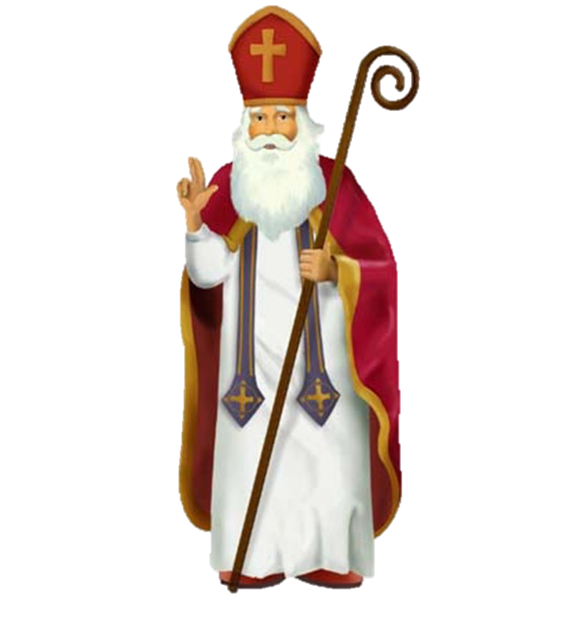
Trinity Evangelical Lutheran Church December 4, 2022
WELCOME!
Saint Nicholas Speaks
Scripture Reading: Esther 4:1-17
Notes:
Image: Five Loaves by Caroline Coolidge Brown. Copyright © Caroline Coolidge Brown. All rights reserved. Used by permission of the artist.

Slide 2
= Please stand if able
= Please be seated
Prelude – Roxanne Groff
Office of the Acolyte
Ringing of the Bell
Welcome
Notes:
Image: Five Loaves by Caroline Coolidge Brown. Copyright © Caroline Coolidge Brown. All rights reserved. Used by permission of the artist.

Slide 3
Lighting of the Advent Wreath
R: With Esther we see plainly the injustice at work in our world, O God.
C: And with Esther we know it is our call to stand up to injustice whatever the cost.
R: (light candle 1) We light this first candle as a beacon of hope for those who wait.
C: (light candle 2) We light this second candle as the fire of courage that we might bear witness to your justice.
Notes:
Image: Five Loaves by Caroline Coolidge Brown. Copyright © Caroline Coolidge Brown. All rights reserved. Used by permission of the artist.

Slide 4
CONFESSION AND FORGIVENESS
All may make the sign of the cross, the sign marked at baptism…
L: We confess our sins before God and one another.
Pause for silence and reflection.
L: Radiant God…
Notes:
Image: Five Loaves by Caroline Coolidge Brown. Copyright © Caroline Coolidge Brown. All rights reserved. Used by permission of the artist.

Slide 5
CONFESSION AND FORGIVENESS
C: You have come to live among us, yet we fail time and again to see you in the faces of our neighbors. We look to ourselves instead of those in need. We seek the shallow comforts of things we can buy instead of the deep and lasting comfort of your presence.
Notes:
Image: Five Loaves by Caroline Coolidge Brown. Copyright © Caroline Coolidge Brown. All rights reserved. Used by permission of the artist.

Slide 6
CONFESSION AND FORGIVENESS
C: Forgive our stubborn refusal to see, and open our eyes to the joy and wonder of your incarnation.
Notes:
Image: Five Loaves by Caroline Coolidge Brown. Copyright © Caroline Coolidge Brown. All rights reserved. Used by permission of the artist.

Slide 7
CONFESSION AND FORGIVENESS
L: Do not be afraid, for I bring you good news of great joy. The God of boundless grace forgives you all your sins, renewing your spirit for the sake of Immanuel, God with us.
C: Amen.
Notes:
Image: Five Loaves by Caroline Coolidge Brown. Copyright © Caroline Coolidge Brown. All rights reserved. Used by permission of the artist.

Slide 8
Hymn of Praise
“Good Saint Nicholas of Myra”
(Verses 1, 2, and 3 Only)
Notes:
Image: Five Loaves by Caroline Coolidge Brown. Copyright © Caroline Coolidge Brown. All rights reserved. Used by permission of the artist.

Slide 9
“Good Saint Nicholas Of Myra”
1 Good Saint Nicholas of Myra,
deeds and legends tell his fame.
Saintly Bishop, friend of children
Many pilgrims chant the name:
Refrain
Bless’d Nicholas, Bless’d Nicholas
He loved all in Jesus' name
Notes:
Image: Preparing yeast dough. Copyright © tomasworks/iStock/Thinkstock. Used by permission.

Slide 10
“Good Saint Nicholas Of Myra”
2 Miracles and signs and wonders,
he performed to praise the Lord.
For a poor and weary people source of care and joy outpoured:
Refrain
Bless’d Nicholas, Bless’d Nicholas
He loved all in Jesus' name
Notes:
Image: Preparing yeast dough. Copyright © tomasworks/iStock/Thinkstock. Used by permission.

Slide 11
“Good Saint Nicholas Of Myra”
Sailors, nations, people thank him
for the message that he brought. Young and old now hail the memory
Of the lessons that he taught:
Refrain
Bless’d Nicholas, Bless’d Nicholas
He loved all in Jesus' name
Notes:
Image: Preparing yeast dough. Copyright © tomasworks/iStock/Thinkstock. Used by permission.

Slide 12
APOSTOLIC GREETING
P: The grace of our Lord Jesus Christ, the love of God, and the communion of the Holy Spirit be with you all.
C: And also with you.
Notes:
Image: Five Loaves by Caroline Coolidge Brown. Copyright © Caroline Coolidge Brown. All rights reserved. Used by permission of the artist.

Slide 13
KYRIE
Notes:
Image: Five Loaves by Caroline Coolidge Brown. Copyright © Caroline Coolidge Brown. All rights reserved. Used by permission of the artist.

Slide 14
KYRIE
Notes:
Image: Five Loaves by Caroline Coolidge Brown. Copyright © Caroline Coolidge Brown. All rights reserved. Used by permission of the artist.

Slide 15
KYRIE
Notes:
Image: Five Loaves by Caroline Coolidge Brown. Copyright © Caroline Coolidge Brown. All rights reserved. Used by permission of the artist.

Slide 16
PRAYER OF THE DAY
P: Let us pray… God of grace and mercy, with Esther we fear for the future of our people and all the earth. As we wait for your promised savior, give us hope that all will be made right in you.
C: Amen.
Notes:
Image: Five Loaves by Caroline Coolidge Brown. Copyright © Caroline Coolidge Brown. All rights reserved. Used by permission of the artist.

Slide 17
Notes:
Image: Preparing yeast dough. Copyright © tomasworks/iStock/Thinkstock. Used by permission.

Slide 18
Scripture Reading
R: The Scripture reading is from the Book of Esther the 4th Chapter.
C: Glory to you O’ Lord! (Spoken)
Notes:
Image: Five Loaves by Caroline Coolidge Brown. Copyright © Caroline Coolidge Brown. All rights reserved. Used by permission of the artist.

Slide 19
Esther 4:1-17
Narrator 1: When Mordecai learned all that had been done, Mordecai tore his clothes and put on sackcloth and ashes, and went through the city, wailing with a loud and bitter cry; he went up to the entrance of the king’s gate, for no one might enter the king’s
Notes:
Image: Five Loaves by Caroline Coolidge Brown. Copyright © Caroline Coolidge Brown. All rights reserved. Used by permission of the artist.

Slide 20
Esther 4:1-17
Narrator 1: gate clothed with sackcloth. In every province, wherever the king’s command and his decree came, there was great mourning among the Jews, with fasting and weeping and lamenting, and most of them lay in sackcloth and ashes.
Notes:
Image: Five Loaves by Caroline Coolidge Brown. Copyright © Caroline Coolidge Brown. All rights reserved. Used by permission of the artist.

Slide 21
Esther 4:1-17
Narrator 2: When Esther’s maids and her eunuchs came and told her, the queen was deeply distressed; she sent garments to clothe Mordecai, so that he might take off his sackcloth; but he would not accept them.
Notes:
Image: Five Loaves by Caroline Coolidge Brown. Copyright © Caroline Coolidge Brown. All rights reserved. Used by permission of the artist.

Slide 22
Esther 4:1-17
Narrator 1: Then Esther called for Hathach, one of the king’s eunuchs, who had been appointed to attend her, and ordered him to go to Mordecai to learn what was happening and why. Hathach went out to Mordecai in the open square of the city in front
Notes:
Image: Five Loaves by Caroline Coolidge Brown. Copyright © Caroline Coolidge Brown. All rights reserved. Used by permission of the artist.

Slide 23
Esther 4:1-17
Narrator 1: of the king’s gate, and Mordecai told him all that had happened to him, and the exact sum of money that Haman had promised to pay into the king’s treasuries for the destruction of the Jews. Mordecai also gave him a copy of the written
Notes:
Image: Five Loaves by Caroline Coolidge Brown. Copyright © Caroline Coolidge Brown. All rights reserved. Used by permission of the artist.

Slide 24
Esther 4:1-17
Narrator 1: decree issued in Susa for their destruction, that he might show it to Esther, explain it to her, and charge her to go to the king to make supplication to him and entreat him for her people.
Notes:
Image: Five Loaves by Caroline Coolidge Brown. Copyright © Caroline Coolidge Brown. All rights reserved. Used by permission of the artist.

Slide 25
Esther 4:1-17
Narrator 2: Hathach went and told Esther what Mordecai had said. Then Esther spoke to Hathach and gave him a message for Mordecai, saying,
Notes:
Image: Five Loaves by Caroline Coolidge Brown. Copyright © Caroline Coolidge Brown. All rights reserved. Used by permission of the artist.

Slide 26
Esther 4:1-17
Esther: “All the king’s servants and the people of the king’s provinces know that if any man or woman goes to the king inside the inner court without being called, there is but one law—all alike are to be put to death. Only if the king holds out the golden
Notes:
Image: Five Loaves by Caroline Coolidge Brown. Copyright © Caroline Coolidge Brown. All rights reserved. Used by permission of the artist.

Slide 27
Esther 4:1-17
Esther: scepter to someone, may that person live. I myself have not been called to come in to the king for thirty days.”
Narrator 1: When they told Mordecai what Esther had said, Mordecai told them to reply to Esther,
Notes:
Image: Five Loaves by Caroline Coolidge Brown. Copyright © Caroline Coolidge Brown. All rights reserved. Used by permission of the artist.

Slide 28
Esther 4:1-17
Mordecai: “Do not think that in the king’s palace you will escape any more than all the other Jews. For if you keep silence at such a time as this, relief and deliverance will rise for the Jews from another quarter, but you and your father’s family will perish.
Notes:
Image: Five Loaves by Caroline Coolidge Brown. Copyright © Caroline Coolidge Brown. All rights reserved. Used by permission of the artist.

Slide 29
Esther 4:1-17
Mordecai: Who knows? Perhaps you have come to royal dignity for just such a time as this.”
Narrator 2: Then Esther said in reply to Mordecai,
Esther: “Go, gather all the Jews to be found in Susa, and hold a fast on my behalf, and neither eat nor drink
Notes:
Image: Five Loaves by Caroline Coolidge Brown. Copyright © Caroline Coolidge Brown. All rights reserved. Used by permission of the artist.

Slide 30
Esther 4:1-17
Esther: for three days, night or day. I and my maids will also fast as you do. After that I will go to the king, though it is against the law; and if I perish, I perish.”
Narrator 1: Mordecai then went away and did everything as Esther had ordered him.
Notes:
Image: Five Loaves by Caroline Coolidge Brown. Copyright © Caroline Coolidge Brown. All rights reserved. Used by permission of the artist.

Slide 31
Esther 4:1-17
Esther: for three days, night or day. I and my maids will also fast as you do. After that I will go to the king, though it is against the law; and if I perish, I perish.”
Narrator 1: Mordecai then went away and did everything as Esther had ordered him.
Notes:
Image: Five Loaves by Caroline Coolidge Brown. Copyright © Caroline Coolidge Brown. All rights reserved. Used by permission of the artist.

Slide 32
Esther 4:1-17
P: This is the Word of the Lord.
C: Praise to You, O Christ (Spoken)
Notes:
Image: Five Loaves by Caroline Coolidge Brown. Copyright © Caroline Coolidge Brown. All rights reserved. Used by permission of the artist.

Slide 33
Saint Nicholas Speaks
Notes:
Image: Five Loaves by Caroline Coolidge Brown. Copyright © Caroline Coolidge Brown. All rights reserved. Used by permission of the artist.

Slide 34
Saint Nicholas Speaks
Notes:
Image: Five Loaves by Caroline Coolidge Brown. Copyright © Caroline Coolidge Brown. All rights reserved. Used by permission of the artist.

Slide 35
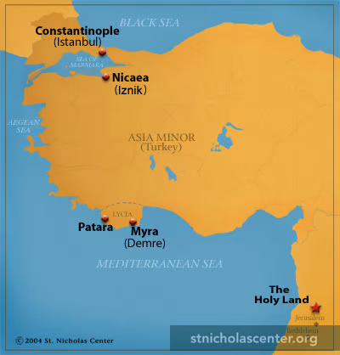
Saint Nicholas
240 AD – 342 AD
Saint Nicholas Speaks
Notes:
Image: Five Loaves by Caroline Coolidge Brown. Copyright © Caroline Coolidge Brown. All rights reserved. Used by permission of the artist.

Slide 36
APOSTLE’S CREED
C: I believe in God, the Father almighty, creator of heaven and earth.

Slide 37
APOSTLE’S CREED
C: I believe in Jesus Christ, his only Son, our Lord. He was conceived by the power of the Holy Spirit and born of the virgin Mary. He suffered under Pontius Pilate, was crucified, died, and was buried.

Slide 38
APOSTLE’S CREED
C: He descended into hell. On the third day he rose again. He ascended into heaven, and is seated at the right hand of the Father. He will come again to judge the living and the dead.

Slide 39
APOSTLE’S CREED
C: I believe in the Holy Spirit, the holy catholic Church, the communion of saints, the forgiveness of sins, the resurrection of the body, and the life everlasting. Amen.

Slide 40
NICENE CREED
C: We believe in one God, the Father, the Almighty, maker of heaven and earth, of all that is, seen and unseen.

Slide 41
NICENE CREED
C: We believe in one Lord, Jesus Christ, the only Son of God, eternally begotten of the Father, God from God, Light from Light, true God from true God, begotten, not made, of one Being with the Father.

Slide 42
NICENE CREED
C: Through him all things were made. For us and for our salvation he came down from heaven; by the power of the Holy Spirit he became incarnate from the virgin Mary, and was made man. For our sake he was crucified under Pontius Pilate;

Slide 43
NICENE CREED
C: he suffered death and was buried. On the third day he rose again in accordance with the Scriptures; he ascended into heaven and is seated at the right hand of the Father. He will come again in glory to judge the living and the dead, and his kingdom will have no end.

Slide 44
NICENE CREED
C: We believe in the Holy Spirit, the Lord, the giver of life, who proceeds from the Father and the Son. With the Father and the Son he is worshiped and glorified. He has spoken through the prophets. We believe in one holy catholic and apostolic Church.

Slide 45
NICENE CREED
C: We acknowledge one Baptism for the forgiveness of sins. We look for the resurrection of the dead, and the life of the world to come. Amen.

Slide 46
PRAYERS OF INTERCESSION
Each petition will end with the words,
A: We call on our God,
The congregation will respond with:
C: O come, o come Immanuel.

Slide 47
PRAYERS OF INTERCESSION
The prayer concludes…
P: In faith, hope, and love, we lift our prayers to you, in the name of your promised savior, Jesus Christ.
C: Amen.

Slide 48
OFFERING
Notes:
Image: Five Loaves by Caroline Coolidge Brown. Copyright © Caroline Coolidge Brown. All rights reserved. Used by permission of the artist.

Slide 49
CONGREGATIONAL OFFERTORY
“Let the Vineyards”
Notes:
Image: Five Loaves by Caroline Coolidge Brown. Copyright © Caroline Coolidge Brown. All rights reserved. Used by permission of the artist.

Slide 50
CONGREGATIONAL OFFERTORY

Slide 51
CONGREGATIONAL OFFERTORY

Slide 52
OFFERING PRAYER
P: God, you call us to bold action on behalf of the world. Accept now these gifts for the good of all your beloved creation.
C: Amen.

Slide 53
THE GREAT THANKSGIVING
Communion “At The Rail”. All the Baptized are welcome to celebrate this Holy Meal.

Slide 54
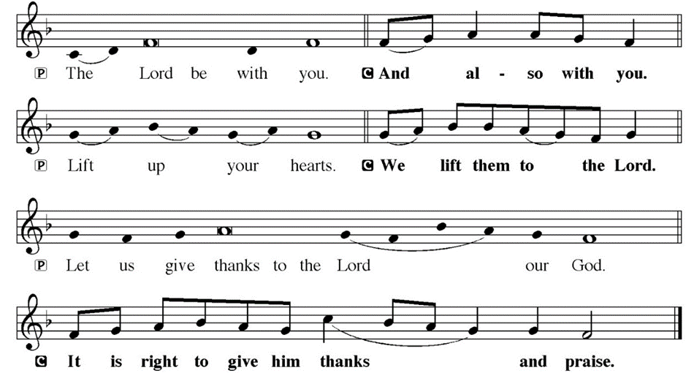
DIALOGUE

Slide 55
THE PREFACE
P: It is indeed right and salutary…
… we praise your name and join their unending hymn.

Slide 56
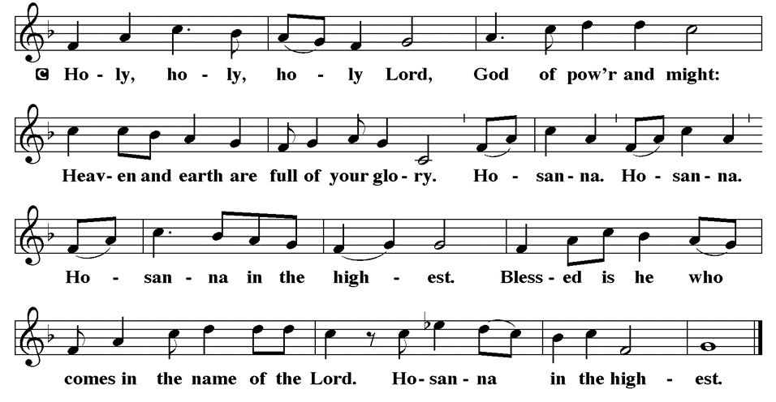
THE SANCTUS

Slide 57
EUCHARISTIC PRAYER
P: Holy God, the beginning and the end…
…both now and forever.
C: Amen.
THE LORD’S PRAYER
P: United into one through this heavenly food, we pray as Jesus taught…

Slide 58
THE LORD’S PRAYER
C: Our Father, who art in heaven, hallowed be thy name, thy kingdom come, thy will be done, on earth as it is in heaven.

Slide 59
THE LORD’S PRAYER
C: Give us this day our daily bread; and forgive us our trespasses, as we forgive those who trespass against us; and lead us not into temptation, but deliver us from evil.

Slide 60
THE LORD’S PRAYER
C: For thine is the kingdom, and the power, and the glory, forever and ever. Amen.

Slide 61
INVITATION TO COMMUNION
P: God sets a feast before us in the presence of our enemies, and strengthens us for the work ahead. Let us prepare our hearts and minds that we might answer God’s call. Come and be satisfied.

Slide 62
COMMUNION DISTRIBUTION
The Communion follows. The bread may be broken for distribution. As the ministers give the bread and wine, they say these words to each communicant:
The body of Christ, given for you.
The blood of Christ, shed for you.
The communicant may say: Amen.

Slide 63
POST COMMUNION BLESSING
P: May Christ, the Sun of righteousness, shine upon you and scatter the darkness from before your path. Almighty God, Father, ☩ Son, and Holy Spirit, bless you now and forever.
C: Amen.

Slide 64
POST COMMUNION PRAYER
P: Let us pray… God for whom we wait, you come to us in the broken bread and the cup we share. Make us ready always to welcome Christ into our hearts, and send us forth to be your people in the world, announcing your coming among us in Jesus Christ our Lord.
C: Amen

Slide 65
ANNOUNCEMENYS
Notes:
Image: Five Loaves by Caroline Coolidge Brown. Copyright © Caroline Coolidge Brown. All rights reserved. Used by permission of the artist.

Slide 66
SENDING BLESSING
P: God the eternal Word, who dwells with us in Jesus, and who holds us in the grace of the Holy Spirit, bless you now and forever.
C: Amen.
☩

Slide 67
SENDING SONG
Good Saint Nicholas of Myra
(Verses 4 & 5 Only)
Notes:
Image: Five Loaves by Caroline Coolidge Brown. Copyright © Caroline Coolidge Brown. All rights reserved. Used by permission of the artist.

Slide 68
“Good Saint Nicholas Of Myra”
4 May his ways of true devotion
guide us on our earthly way.
Challenge us to be more like him
as Christ's gospel we obey:
Refrain
Bless’d Nicholas, Bless’d Nicholas
He loved all in Jesus' name
Notes:
Image: Preparing yeast dough. Copyright © tomasworks/iStock/Thinkstock. Used by permission.

Slide 69
“Good Saint Nicholas Of Myra”
5 Father, Son and Holy Spirit
bind us in community,
so that we with holy Nicholas
might eternal glory see:
Refrain
Bless’d Nicholas, Bless’d Nicholas
He loved all in Jesus' name
Notes:
Image: Preparing yeast dough. Copyright © tomasworks/iStock/Thinkstock. Used by permission.

Slide 70
DISMISSAL
P: … depart in Christ’s Love.
C: Seeking, welcoming, and serving all. Amen!
POSTLUDE
By
Roxanne Groff
From sundaysandseasons.com. Copyright © 2022 Augsburg Fortress. All rights reserved. Reprinted by permission under Augsburg Fortress Liturgies Annual License #SAS023830. New Revised Standard Version Bible, Copyright © 1989, Division of Christian Education of the National Council of the Churches of Christ in the United States of America. Used by permission. All rights reserved. Revised Common Lectionary, Copyright © 1992 Consultation on Common Texts, admin Augsburg Fortress. Used by permission.

