Slide 1
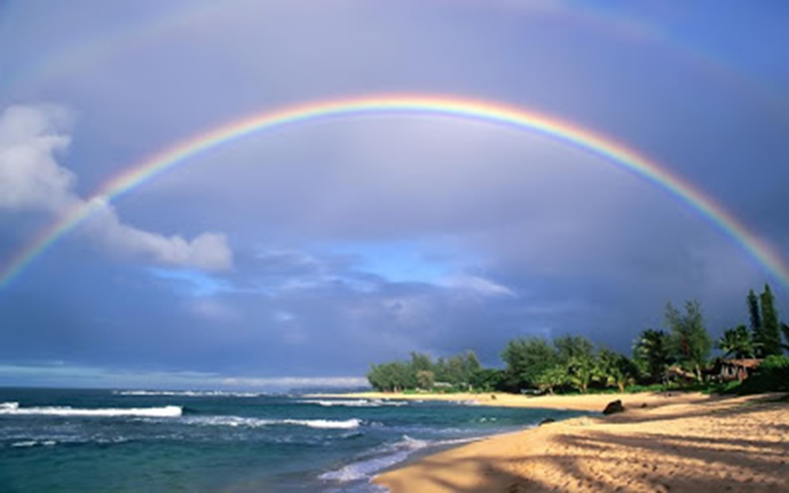
Welcome in the Name of
The Triune God
September 11, 2022
God’s Covenant With Noah
Prelude by Roxanne Groff
Office of the Acolyte
Ringing of the Bell
Scripture Focus:
Genesis 6:5-22; 8:6-12; 9:8-17
Notes:
Image: Preparing yeast dough. Copyright © tomasworks/iStock/Thinkstock. Used by permission.

Slide 2
CONFESSION AND FORGIVENESS
All may make the sign of the cross, the sign marked at baptism…
P: We confess our sins before God and one another.
Pause for silence and reflection.
P: God of promise,
Notes:
Image: Five Loaves by Caroline Coolidge Brown. Copyright © Caroline Coolidge Brown. All rights reserved. Used by permission of the artist.

Slide 3
CONFESSION AND FORGIVENESS
C: You have given us all we are and all we have, and still we have not trusted you fully. We have tried to be god in our own lives, hurting ourselves and those around us in our attempts to control. Wash us clean in the waters of your salvation, and bring us back into right relationship with you.
Notes:
Image: Five Loaves by Caroline Coolidge Brown. Copyright © Caroline Coolidge Brown. All rights reserved. Used by permission of the artist.

Slide 4
CONFESSION AND FORGIVENESS
L: God welcomes you home with open arms, and forgives you all your sin, for the sake of Jesus Christ. By the power of the Holy Spirit, live in the promise of God’s love, freely given.
C: Amen.
☩
Notes:
Image: Five Loaves by Caroline Coolidge Brown. Copyright © Caroline Coolidge Brown. All rights reserved. Used by permission of the artist.

Slide 5
Hymn of Praise
“O Master, Let Me Walk with You”
LBW 492
Notes:
Image: Five Loaves by Caroline Coolidge Brown. Copyright © Caroline Coolidge Brown. All rights reserved. Used by permission of the artist.

Slide 6
O Master, Let Me Walk with You-LBW 492
1 O Master, let me walk with you
in lowly paths of service true;
tell me your secret; help me bear
the strain of toil, the fret of care.
2 Help me the slow of heart to move
by some clear, winning word of love;
teach me the wayward feet to stay,
and guide them in the homeward way.
Notes:
Image: Five Loaves by Caroline Coolidge Brown. Copyright © Caroline Coolidge Brown. All rights reserved. Used by permission of the artist.

Slide 7
O Master, Let Me Walk with You-LBW 492
3 Teach me your patience; share with me
a closer, dearer company,
in work that keeps faith sweet and strong,
in trust that triumphs over wrong,
4 In hope that sends a shining ray
far down the future's broad'ning way,
in peace that only you can give;
with you, O Master, let me live.
Notes:
Image: Five Loaves by Caroline Coolidge Brown. Copyright © Caroline Coolidge Brown. All rights reserved. Used by permission of the artist.

Slide 8
APOSTOLIC GREETING
P: The grace of our Lord Jesus Christ, the love of God, and the communion of the Holy Spirit be with you all.
C: And also with you.
Notes:
Image: Five Loaves by Caroline Coolidge Brown. Copyright © Caroline Coolidge Brown. All rights reserved. Used by permission of the artist.

Slide 9
PRAYER OF THE DAY
P: Let us pray… Saving God, you promised Noah you would never again destroy the world by flood. Remind us daily of your intense love for your whole creation, and help us to love as you love.
C: Amen.
Notes:
Image: Five Loaves by Caroline Coolidge Brown. Copyright © Caroline Coolidge Brown. All rights reserved. Used by permission of the artist.

Slide 10
Notes:
Image: Preparing yeast dough. Copyright © tomasworks/iStock/Thinkstock. Used by permission.

Slide 11
Scripture Reading
R: The Scripture includes readings from the book of Genesis, Chapters 6, 8, and 9.
C: Glory to you O’ Lord! (Spoken)
Notes:
Image: Five Loaves by Caroline Coolidge Brown. Copyright © Caroline Coolidge Brown. All rights reserved. Used by permission of the artist.

Slide 12
Genesis 6:5-22; 8:6-12; 9:8-17
⁵The Lord saw that the wickedness of humankind was great in the earth, and that every inclination of the thoughts of their hearts was only evil continually.
⁶And the Lord was sorry that he had made humankind on the earth, and it grieved him to his heart. ⁷So the Lord said, “I will blot out from the earth the human beings I have created—people together with animals and creeping
Notes:
Image: Five Loaves by Caroline Coolidge Brown. Copyright © Caroline Coolidge Brown. All rights reserved. Used by permission of the artist.

Slide 13
Genesis 6:5-22; 8:6-12; 9:8-17
things and birds of the air, for I am sorry that I have made them.”
⁸But Noah found favor in the sight of the Lord. ⁹These are the descendants of Noah. Noah was a righteous man, blameless in his generation; Noah walked with God. ¹⁰And Noah had three sons, Shem, Ham, and Japheth.
¹¹Now the earth was corrupt in God’s sight, and the earth was filled with
Notes:
Image: Five Loaves by Caroline Coolidge Brown. Copyright © Caroline Coolidge Brown. All rights reserved. Used by permission of the artist.

Slide 14
Genesis 6:5-22; 8:6-12; 9:8-17
violence. ¹²And God saw that the earth was corrupt; for all flesh had corrupted its ways upon the earth.
¹³And God said to Noah, “I have determined to make an end of all flesh, for the earth is filled with violence because of them; now I am going to destroy them along with the earth. ¹⁴Make yourself an ark of cypress wood; make rooms in the ark, and
Notes:
Image: Five Loaves by Caroline Coolidge Brown. Copyright © Caroline Coolidge Brown. All rights reserved. Used by permission of the artist.

Slide 15
Genesis 6:5-22; 8:6-12; 9:8-17
cover it inside and out with pitch. ¹⁵This is how you are to make it: the length of the ark three hundred cubits, its width fifty cubits, and its height thirty cubits. ¹⁶Make a roof for the ark, and finish it to a cubit above; and put the door of the ark in its side; make it with lower, second, and third decks. ¹⁷For my part, I am going to bring a flood of waters on the earth, to destroy from under
Notes:
Image: Five Loaves by Caroline Coolidge Brown. Copyright © Caroline Coolidge Brown. All rights reserved. Used by permission of the artist.

Slide 16
Genesis 6:5-22; 8:6-12; 9:8-17
heaven all flesh in which is the breath of life; everything that is on the earth shall die. ¹⁸But I will establish my covenant with you; and you shall come into the ark, you, your sons, your wife, and your sons’ wives with you. ¹⁹And of every living thing, of all flesh, you shall bring two of every kind into the ark, to keep them alive with you; they shall be male and female. ²⁰Of the birds
Notes:
Image: Five Loaves by Caroline Coolidge Brown. Copyright © Caroline Coolidge Brown. All rights reserved. Used by permission of the artist.

Slide 17
Genesis 6:5-22; 8:6-12; 9:8-17
according to their kinds, and of the animals according to their kinds, of every creeping thing of the ground according to its kind, two of every kind shall come in to you, to keep them alive. ²¹Also take with you every kind of food that is eaten, and store it up; and it shall serve as food for you and for them.”
Notes:
Image: Five Loaves by Caroline Coolidge Brown. Copyright © Caroline Coolidge Brown. All rights reserved. Used by permission of the artist.

Slide 18
Genesis 6:5-22; 8:6-12; 9:8-17
²²Noah did this; he did all that God commanded him.
⁶At the end of forty days Noah opened the window of the ark that he had made ⁷and sent out the raven; and it went to and fro until the waters were dried up from the earth. ⁸Then he sent out the dove from him, to see if the waters had subsided from the face of the ground; ⁹but the dove found no place to set its
Notes:
Image: Five Loaves by Caroline Coolidge Brown. Copyright © Caroline Coolidge Brown. All rights reserved. Used by permission of the artist.

Slide 19
Genesis 6:5-22; 8:6-12; 9:8-17
foot, and it returned to him to the ark, for the waters were still on the face of the whole earth. So he put out his hand and took it and brought it into the ark with him. ¹⁰He waited another seven days, and again he sent out the dove from the ark; ¹¹and the dove came back to him in the evening, and there in its beak was a freshly plucked olive leaf; so Noah knew that the waters had
Notes:
Image: Five Loaves by Caroline Coolidge Brown. Copyright © Caroline Coolidge Brown. All rights reserved. Used by permission of the artist.

Slide 20
Genesis 6:5-22; 8:6-12; 9:8-17
subsided from the earth. ¹²Then he waited another seven days, and sent out the dove; and it did not return to him any more.
⁸Then God said to Noah and to his sons with him, ⁹“As for me, I am establishing my covenant with you and your descendants after you, ¹⁰and with every living creature that is with you, the birds, the domestic animals, and
Notes:
Image: Five Loaves by Caroline Coolidge Brown. Copyright © Caroline Coolidge Brown. All rights reserved. Used by permission of the artist.

Slide 21
Genesis 6:5-22; 8:6-12; 9:8-17
every animal of the earth with you, as many as came out of the ark. ¹¹I establish my covenant with you, that never again shall all flesh be cut off by the waters of a flood, and never again shall there be a flood to destroy the earth.”
¹²God said, “This is the sign of the covenant that I make between me and you and every living creature that is
Notes:
Image: Five Loaves by Caroline Coolidge Brown. Copyright © Caroline Coolidge Brown. All rights reserved. Used by permission of the artist.

Slide 22
Genesis 6:5-22; 8:6-12; 9:8-17
with you, for all future generations: ¹³I have set my bow in the clouds, and it shall be a sign of the covenant between me and the earth. ¹⁴When I bring clouds over the earth and the bow is seen in the clouds, ¹⁵I will remember my covenant that is between me and you and every living creature of all flesh; and the waters shall never again become a flood to destroy all
Notes:
Image: Five Loaves by Caroline Coolidge Brown. Copyright © Caroline Coolidge Brown. All rights reserved. Used by permission of the artist.

Slide 23
Genesis 6:5-22; 8:6-12; 9:8-17
flesh. ¹⁶When the bow is in the clouds, I will see it and remember the everlasting covenant between God and every living creature of all flesh that is on the earth.” ¹⁷God said to Noah, “This is the sign of the covenant that I have established between me and all flesh that is on the earth.”
Notes:
Image: Five Loaves by Caroline Coolidge Brown. Copyright © Caroline Coolidge Brown. All rights reserved. Used by permission of the artist.

Slide 24
Genesis 6:5-22; 8:6-12; 9:8-17
P: This is the Word of the Lord.
C: Praise to You, O Christ (Spoken)
Notes:
Image: Five Loaves by Caroline Coolidge Brown. Copyright © Caroline Coolidge Brown. All rights reserved. Used by permission of the artist.

Slide 25
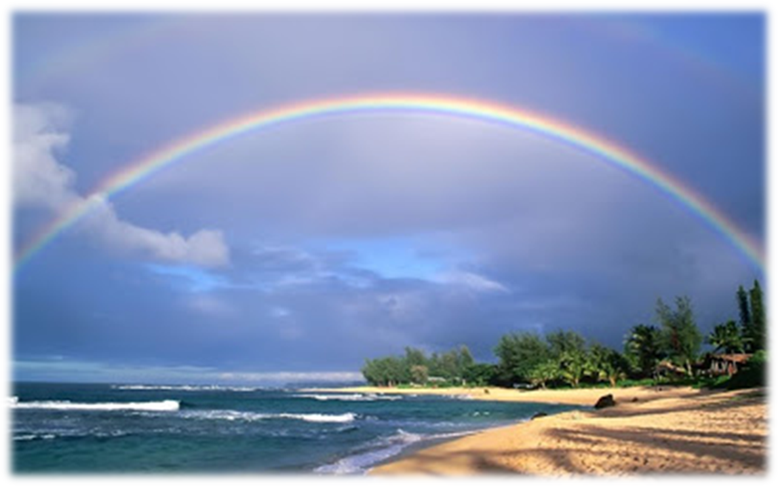
SERMON
Notes:
Image: Five Loaves by Caroline Coolidge Brown. Copyright © Caroline Coolidge Brown. All rights reserved. Used by permission of the artist.

Slide 26
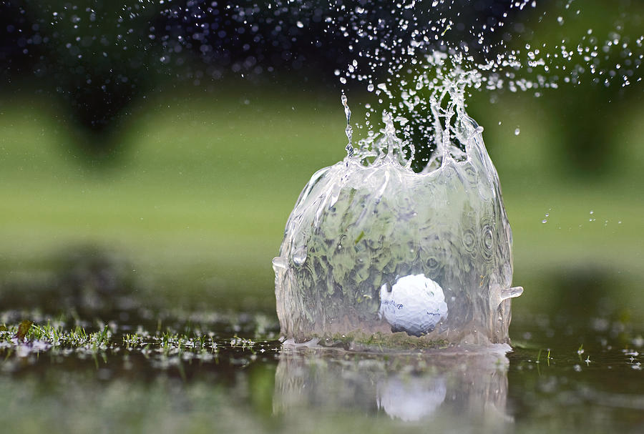
Notes:
Image: Five Loaves by Caroline Coolidge Brown. Copyright © Caroline Coolidge Brown. All rights reserved. Used by permission of the artist.

Slide 27
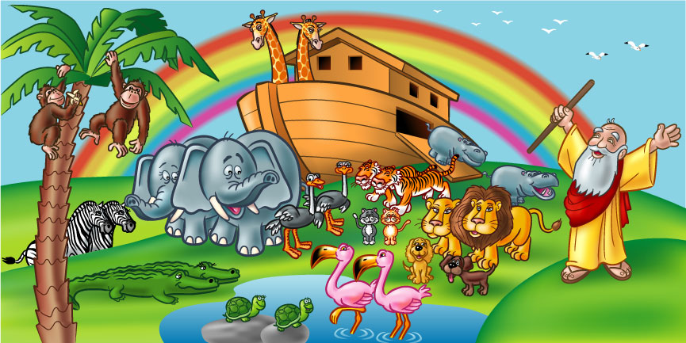
Notes:
Image: Five Loaves by Caroline Coolidge Brown. Copyright © Caroline Coolidge Brown. All rights reserved. Used by permission of the artist.

Slide 28
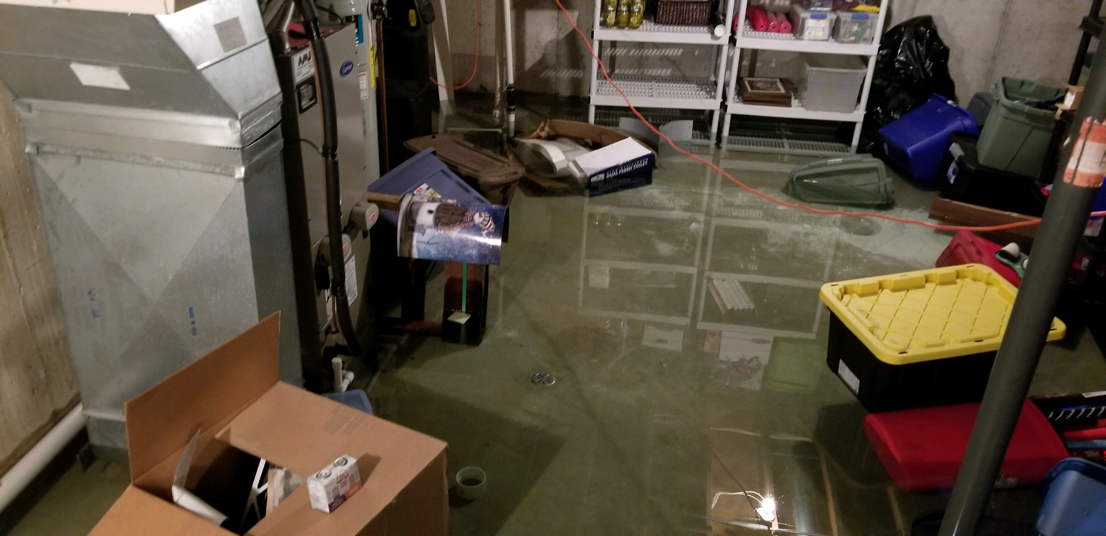
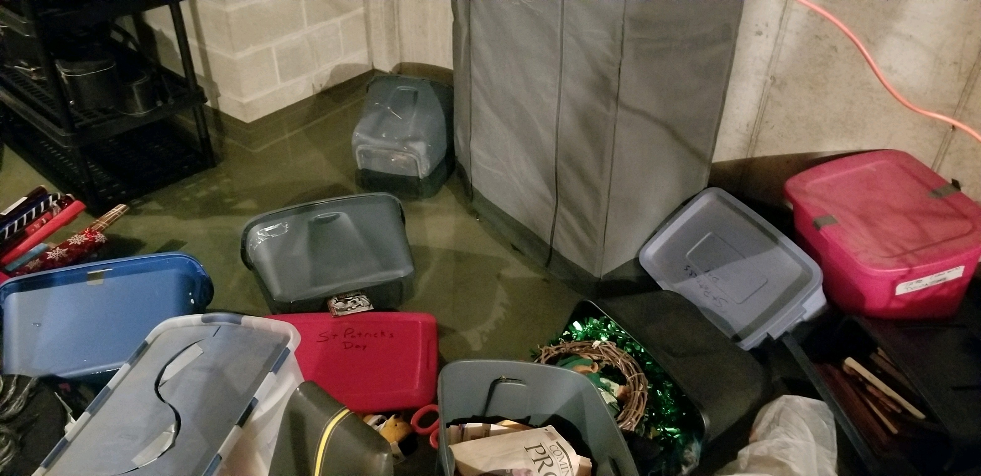
Notes:
Image: Five Loaves by Caroline Coolidge Brown. Copyright © Caroline Coolidge Brown. All rights reserved. Used by permission of the artist.

Slide 29
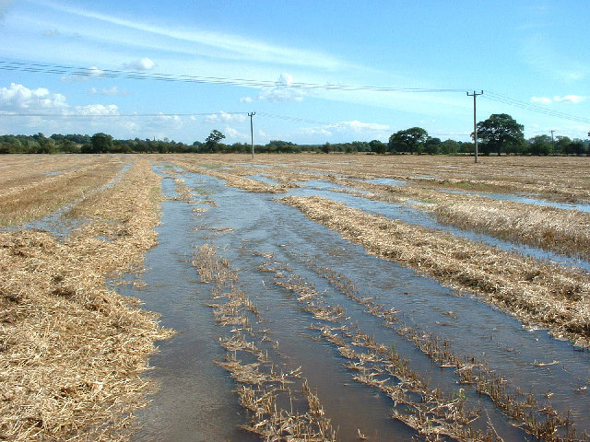
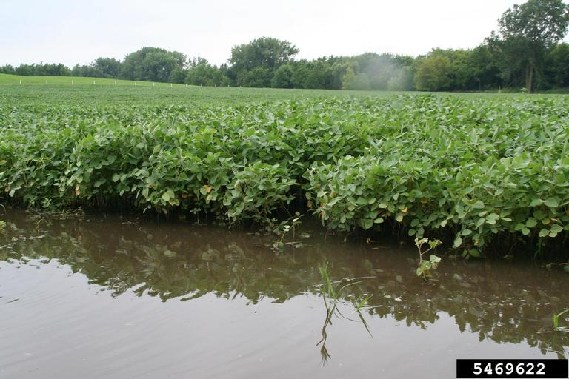
Notes:
Image: Five Loaves by Caroline Coolidge Brown. Copyright © Caroline Coolidge Brown. All rights reserved. Used by permission of the artist.

Slide 30
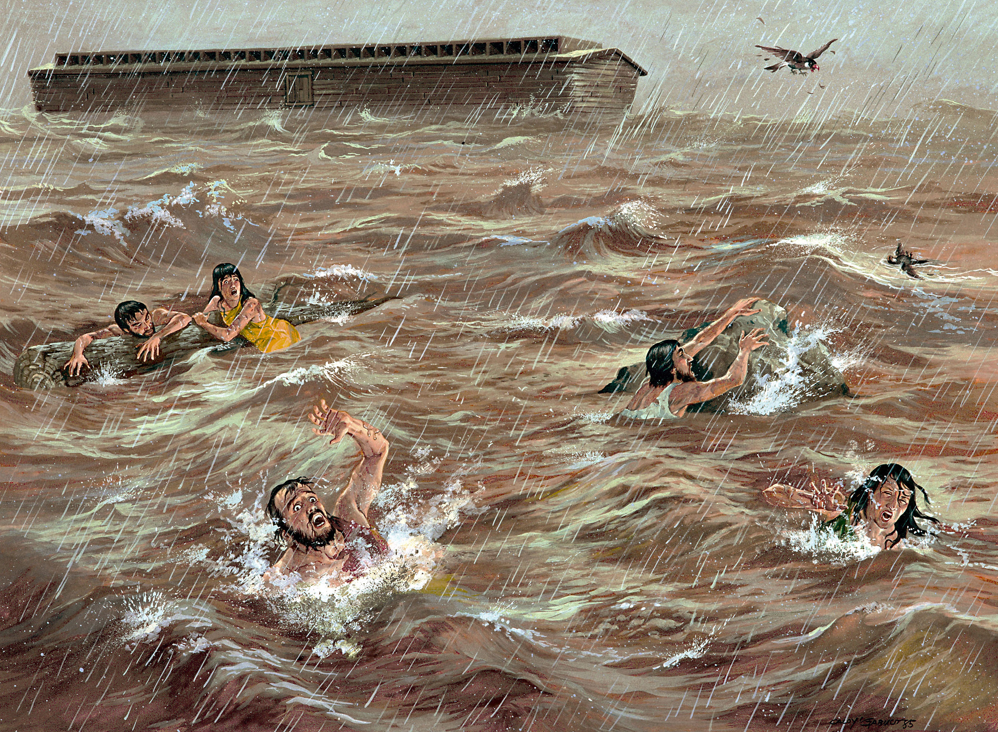
Notes:
Image: Five Loaves by Caroline Coolidge Brown. Copyright © Caroline Coolidge Brown. All rights reserved. Used by permission of the artist.

Slide 31
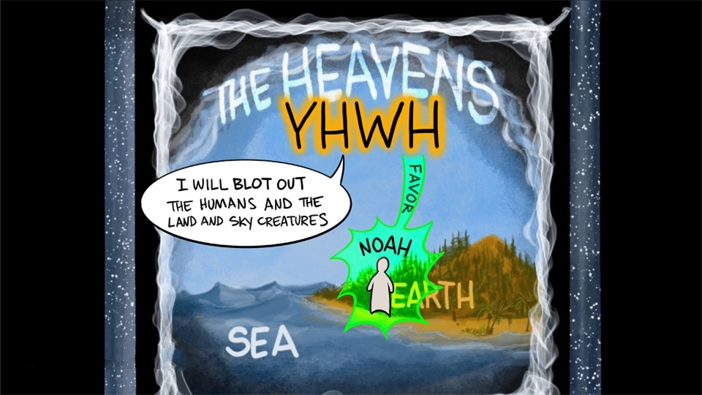
Notes:
Image: Five Loaves by Caroline Coolidge Brown. Copyright © Caroline Coolidge Brown. All rights reserved. Used by permission of the artist.

Slide 32
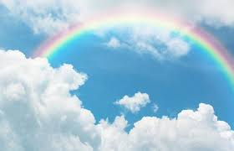
Notes:
Image: Five Loaves by Caroline Coolidge Brown. Copyright © Caroline Coolidge Brown. All rights reserved. Used by permission of the artist.

Slide 33
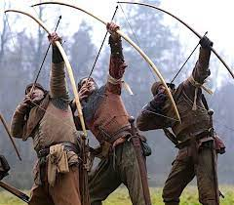
Notes:
Image: Five Loaves by Caroline Coolidge Brown. Copyright © Caroline Coolidge Brown. All rights reserved. Used by permission of the artist.

Slide 34
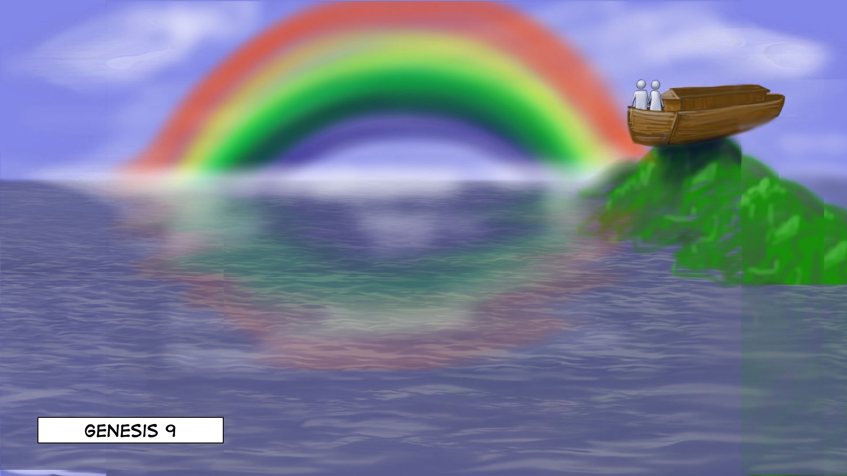
God’s
Riches
At
Christ’s
Expense
Notes:
Image: Five Loaves by Caroline Coolidge Brown. Copyright © Caroline Coolidge Brown. All rights reserved. Used by permission of the artist.

Slide 35
God’s
Riches
At
Christ’s
Expense
Notes:
Image: Five Loaves by Caroline Coolidge Brown. Copyright © Caroline Coolidge Brown. All rights reserved. Used by permission of the artist.

Slide 36
APOSTLE’S CREED
C: I believe in God, the Father almighty, creator of heaven and earth.

Slide 37
APOSTLE’S CREED
C: I believe in Jesus Christ, his only Son, our Lord. He was conceived by the power of the Holy Spirit and born of the virgin Mary. He suffered under Pontius Pilate, was crucified, died, and was buried.

Slide 38
APOSTLE’S CREED
C: He descended into hell. On the third day he rose again. He ascended into heaven, and is seated at the right hand of the Father. He will come again to judge the living and the dead.

Slide 39
APOSTLE’S CREED
C: I believe in the Holy Spirit, the holy catholic Church, the communion of saints, the forgiveness of sins, the resurrection of the body, and the life everlasting. Amen.

Slide 40
NICENE CREED
C: We believe in one God, the Father, the Almighty, maker of heaven and earth, of all that is, seen and unseen.

Slide 41
NICENE CREED
C: We believe in one Lord, Jesus Christ, the only Son of God, eternally begotten of the Father, God from God, Light from Light, true God from true God, begotten, not made, of one Being with the Father.

Slide 42
NICENE CREED
C: Through him all things were made. For us and for our salvation he came down from heaven; by the power of the Holy Spirit he became incarnate from the virgin Mary, and was made man. For our sake he was crucified under Pontius Pilate;

Slide 43
NICENE CREED
C: he suffered death and was buried. On the third day he rose again in accordance with the Scriptures; he ascended into heaven and is seated at the right hand of the Father. He will come again in glory to judge the living and the dead, and his kingdom will have no end.

Slide 44
NICENE CREED
C: We believe in the Holy Spirit, the Lord, the giver of life, who proceeds from the Father and the Son. With the Father and the Son he is worshiped and glorified. He has spoken through the prophets. We believe in one holy catholic and apostolic Church.

Slide 45
NICENE CREED
C: We acknowledge one Baptism for the forgiveness of sins. We look for the resurrection of the dead, and the life of the world to come. Amen.

Slide 46
PRAYERS OF INTERCESSION
Each petition will end with the words,
A: God of promise,
The congregation will respond with:
C: You hear our prayer.

Slide 47
PRAYERS OF INTERCESSION
The prayer concludes…
P: Trusting in your grace and mercy, we lift these prayers to you, in the name of Jesus Christ.
C: Amen.

Slide 48
SHARING OF THE Peace
The Sharing of the Peace that began when the congregation arrived is now shared with the Pastor at this time...
P: The peace of the Lord be with you always.
C: And also with you.

Slide 49
OFFERING PRAYER
Notes:
Image: Five Loaves by Caroline Coolidge Brown. Copyright © Caroline Coolidge Brown. All rights reserved. Used by permission of the artist.

Slide 50
THE LORD’S PRAYER
P: Jesus is the “tie that Binds us together”, let us pray as Jesus taught…
C: Our Father, who art in heaven, hallowed be thy name, thy kingdom come, thy will be done, on earth as it is in heaven. Give us this day our daily bread; and forgive us our trespasses,

Slide 51
THE LORD’S PRAYER
C: as we forgive those who trespass against us; and lead us not into temptation, but deliver us from evil. For thine is the kingdom, and the power, and the glory, forever and ever. Amen.

Slide 52
ANNOUNCEMENTS
Notes:
Image: Five Loaves by Caroline Coolidge Brown. Copyright © Caroline Coolidge Brown. All rights reserved. Used by permission of the artist.

Slide 53
SENDING BLESSING
P: God, who gives life to all things and frees us from despair, bless you with truth and peace. And may the holy Trinity, ☩ one God, guide you always in faith, hope, and love.
C: Amen.
☩

Slide 54
Sending Song
“Eternal Father, Strong to Save”
LBW 467
Notes:
Image: Five Loaves by Caroline Coolidge Brown. Copyright © Caroline Coolidge Brown. All rights reserved. Used by permission of the artist.

Slide 55
Eternal Father, Strong to Save-LBW 467
1 Eternal Father, strong to save,
whose arm has bound the restless wave,
who bade the mighty ocean deep
its own appointed limits keep:
oh, hear us when we cry to thee
for those in peril on the sea.
Notes:
Image: Five Loaves by Caroline Coolidge Brown. Copyright © Caroline Coolidge Brown. All rights reserved. Used by permission of the artist.

Slide 56
Eternal Father, Strong to Save-LBW 467
2 O Savior, whose almighty word
the winds and waves submissive heard,
who walked upon the foaming deep,
and calm amid the storm didst sleep:
oh, hear us when we cry to thee
for those in peril on the sea.
Notes:
Image: Five Loaves by Caroline Coolidge Brown. Copyright © Caroline Coolidge Brown. All rights reserved. Used by permission of the artist.

Slide 57
Eternal Father, Strong to Save-LBW 467
3 O Holy Spirit, who didst brood
upon the chaos dark and rude,
and bid its angry tumult cease,
and give, for wild confusion, peace:
oh, hear us when we cry to thee
for those in peril on the sea.
Notes:
Image: Five Loaves by Caroline Coolidge Brown. Copyright © Caroline Coolidge Brown. All rights reserved. Used by permission of the artist.

Slide 58
Eternal Father, Strong to Save-LBW 467
4 O Trinity of love and pow'r,
all trav'lers guard in danger's hour
from rock and tempest, fire and foe,
protect them wheresoe'er they go;
thus evermore shall rise to thee
glad hymns and praise from land and sea.
Notes:
Image: Five Loaves by Caroline Coolidge Brown. Copyright © Caroline Coolidge Brown. All rights reserved. Used by permission of the artist.

Slide 59
DISMISSAL
P: Until we gather again as God’s people to offer our worship and praise, depart in Christ’s Love,
C: Seeking, welcoming, and serving all. Amen!
Postlude by Roxanne Groff
Copyright © 2022 Augsburg Fortress. All rights reserved. Reprinted by permission under Augsburg Fortress Liturgies Annual License #SAS023830. New Revised Standard Version Bible, Copyright © 1989, Division of Christian Education of the National Council of the Churches of Christ in the United States of America. Used by permission. All rights reserved. Revised Common Lectionary, Copyright © 1992 Consultation on Common Texts, admin Augsburg Fortress. Used by permission.

