Slide 1
Hardeeville Elementary School 5th Grade Mentoring Program
Delta Sigma Theta Sorority, Inc.
Hilton Head Island – Bluffton Alumnae Chapter
February 20, 2019
Dr. Patricia Montgomery Mrs. Connie Pouncy, Mrs. Marion Shumake, Mrs. Diane Neal

Slide 2
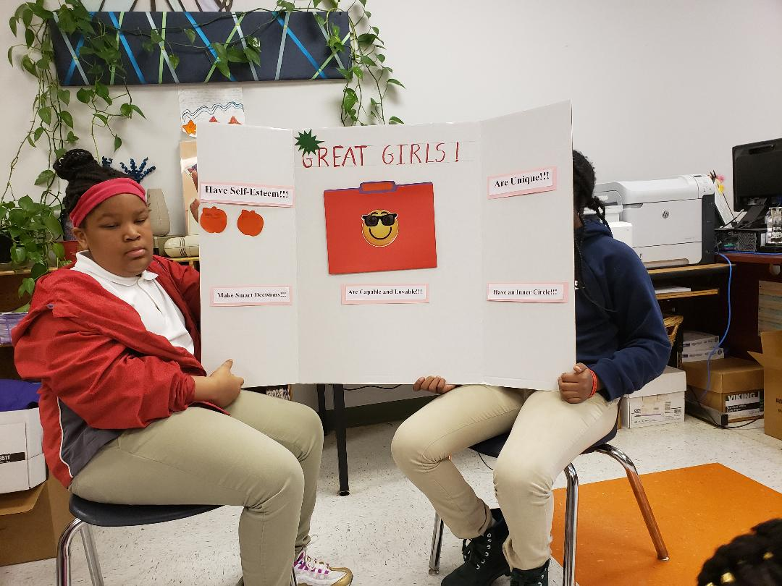

Slide 3
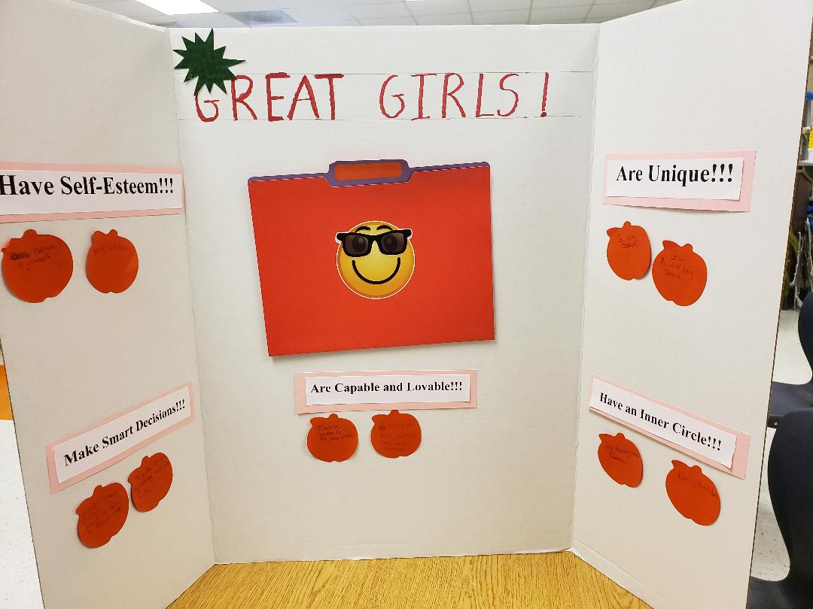

Slide 4
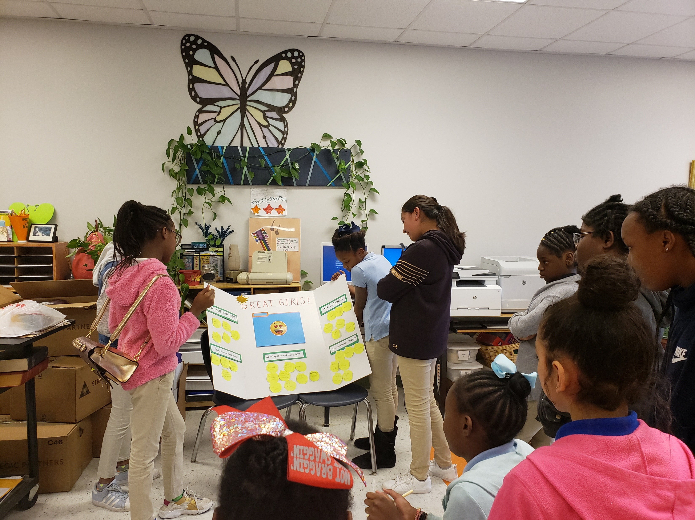
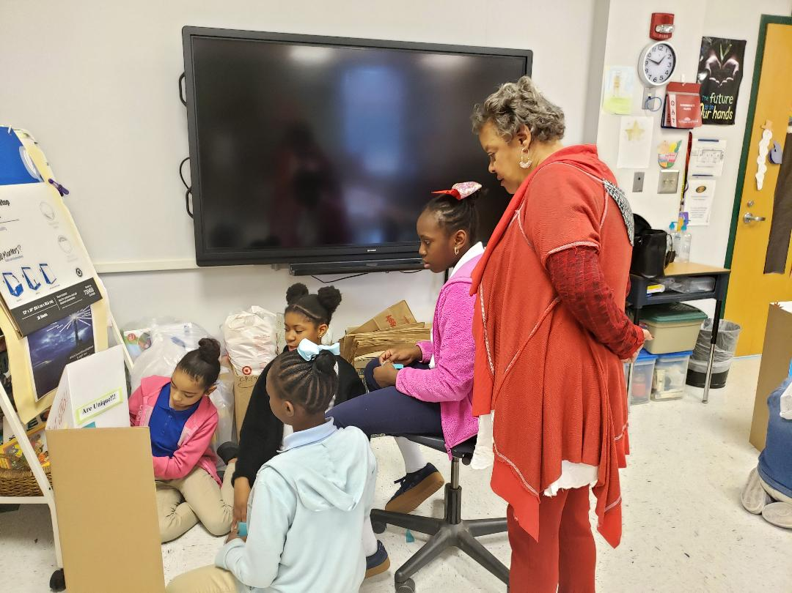

Slide 5
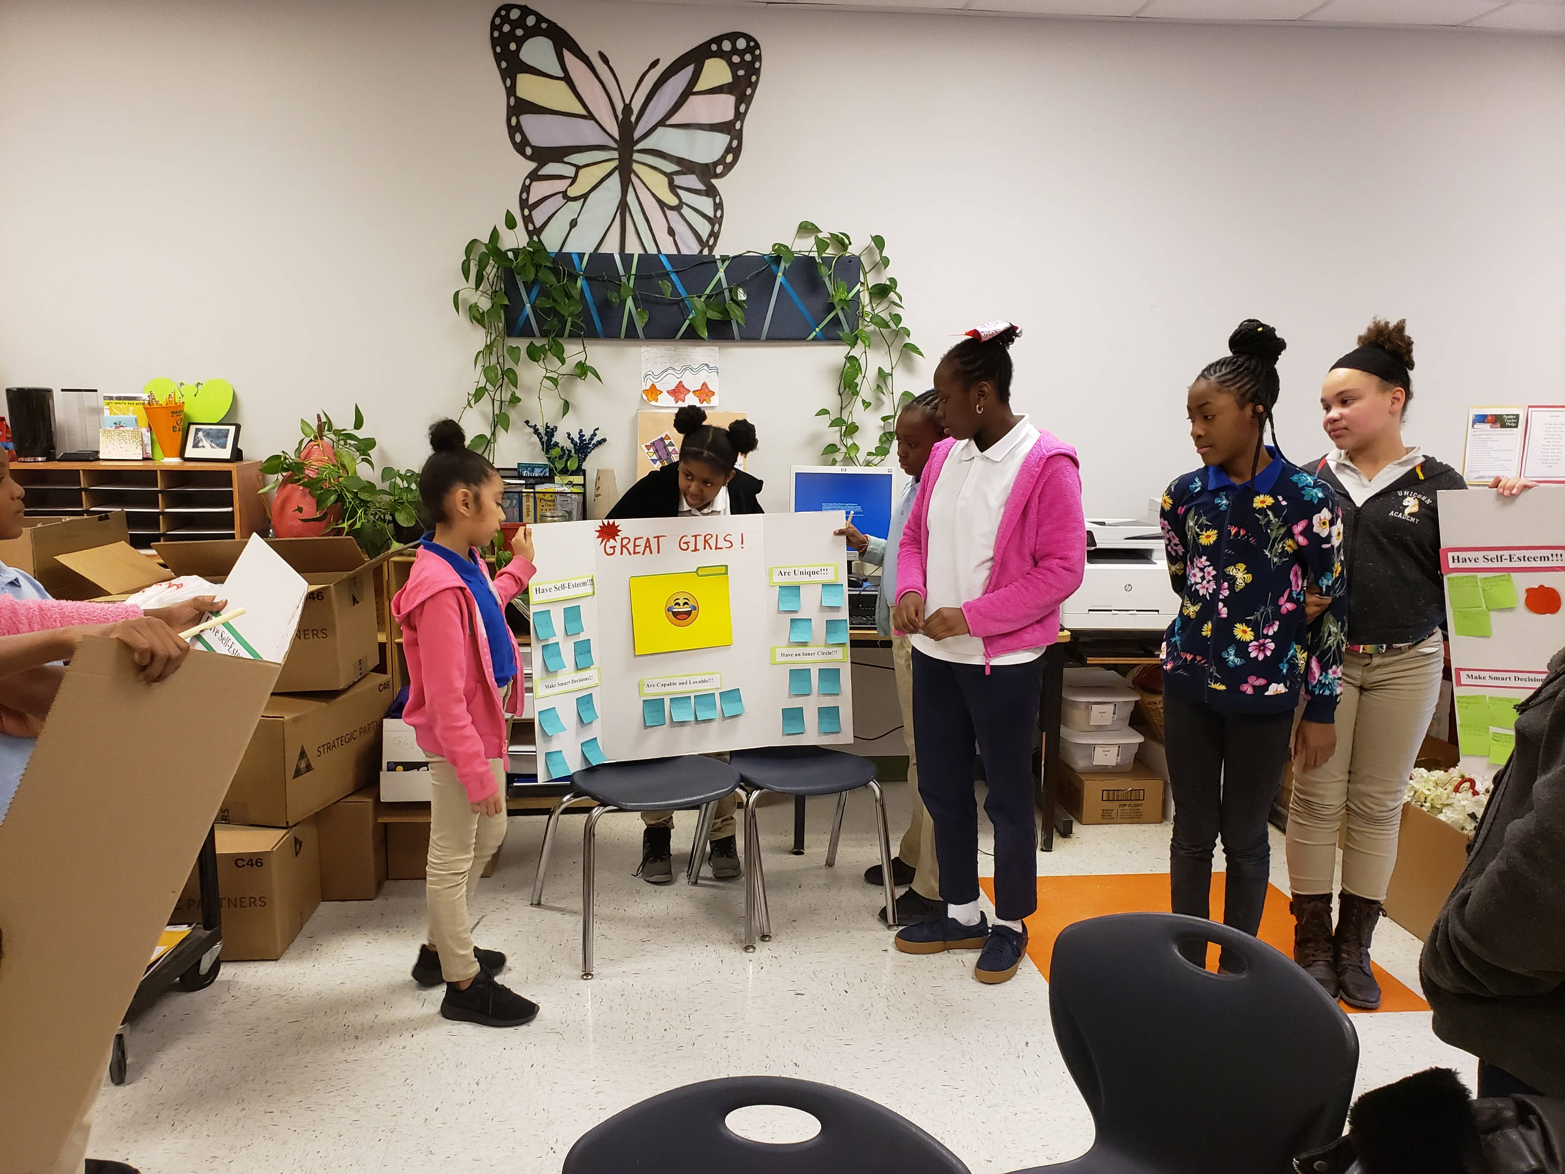

Slide 6
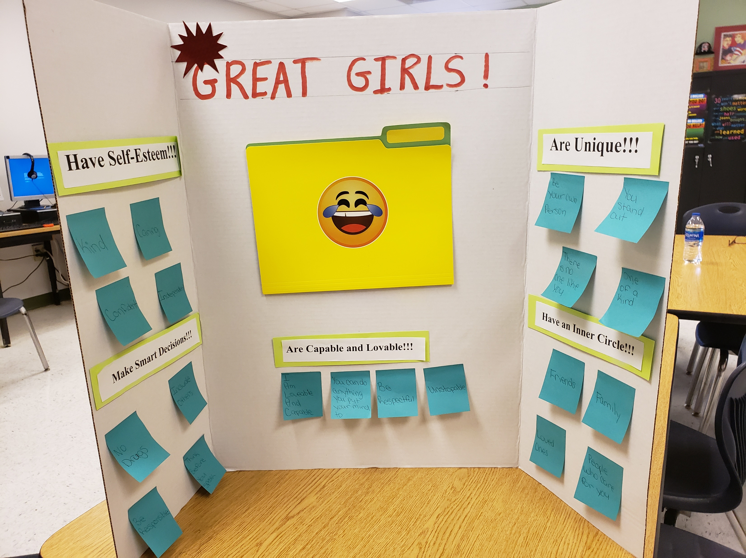

Slide 7
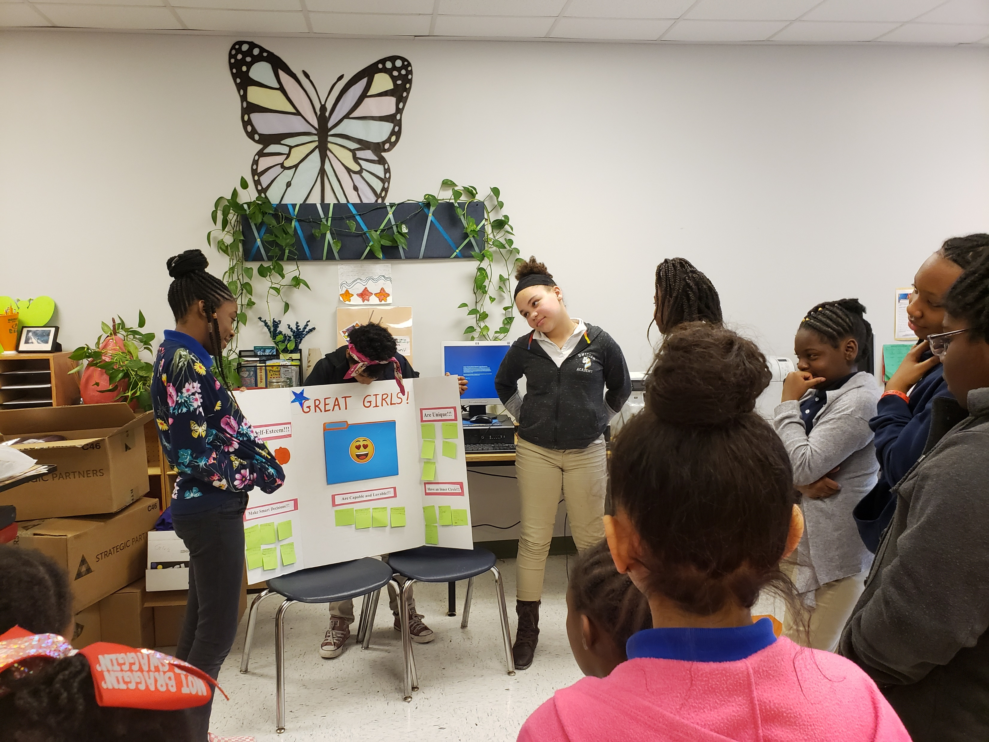

Slide 8
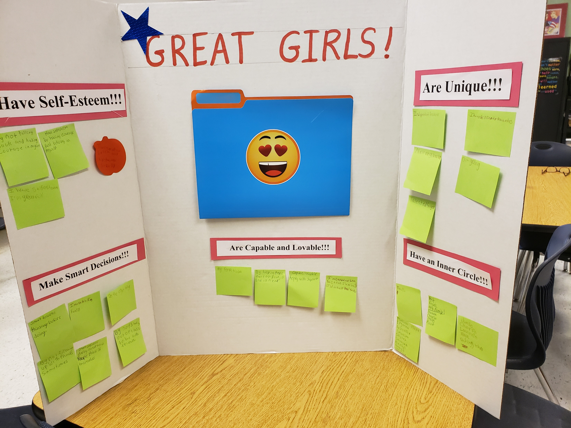

Slide 9
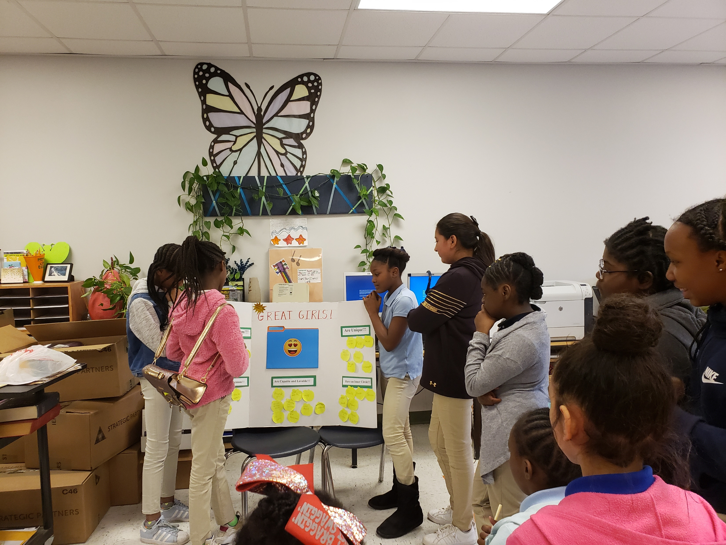

Slide 10
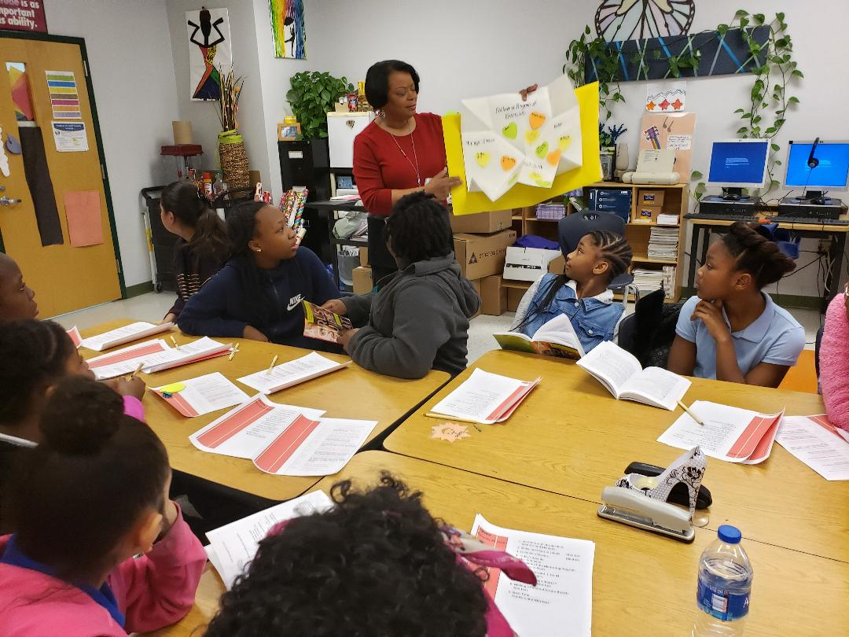
PRIDE
Perseverance – pressing on when the workload is heavy
Respect – consideration for peers, leaders, and yourself
Integrity – being honest in school and in the workplace
Discipline – doing what you must do even when you don’t feel like it
Excellence – by applying all of the acronyms, you can achieve excellence in any situation

