Slide 1
Trinity Evangelical Lutheran Church October 16, 2022
WELCOME!
Joshua 24:1-26
Notes:
Image: Five Loaves by Caroline Coolidge Brown. Copyright © Caroline Coolidge Brown. All rights reserved. Used by permission of the artist.

Slide 2
= Please stand if able
= Please be seated
Prelude – Darrell Fryman
Office of the Acolyte
Ringing of the Bell
Welcome
Notes:
Image: Five Loaves by Caroline Coolidge Brown. Copyright © Caroline Coolidge Brown. All rights reserved. Used by permission of the artist.

Slide 3
CONFESSION AND FORGIVENESS
All may make the sign of the cross, the sign marked at baptism…
L: We confess our sins before God and one another.
Pause for silence and reflection.
L: God of promise…
Notes:
Image: Five Loaves by Caroline Coolidge Brown. Copyright © Caroline Coolidge Brown. All rights reserved. Used by permission of the artist.

Slide 4
CONFESSION AND FORGIVENESS
C: You have given us all we are and all we have, and still we have not trusted you fully. We have tried to be god in our own lives, hurting ourselves and those around us in our attempts to control. Wash us clean in the waters of your salvation, and bring us back into right relationship with you.
Notes:
Image: Five Loaves by Caroline Coolidge Brown. Copyright © Caroline Coolidge Brown. All rights reserved. Used by permission of the artist.

Slide 5
CONFESSION AND FORGIVENESS
L: God welcomes you home with open arms, and forgives you all your sin, for the sake of Jesus Christ. By the power of the Holy Spirit, live in the promise of God’s love, freely given.
C: Amen.
Notes:
Image: Five Loaves by Caroline Coolidge Brown. Copyright © Caroline Coolidge Brown. All rights reserved. Used by permission of the artist.

Slide 6
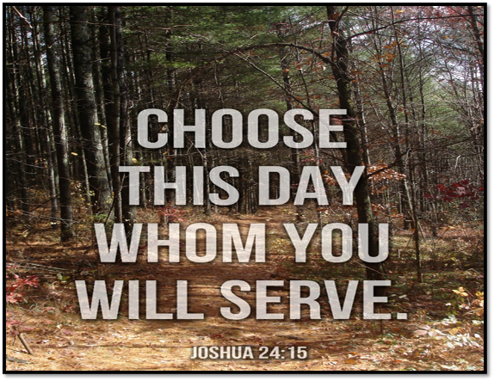
Hymn of Praise
“O Jesus, I Have Promised”
ELW 810
Notes:
Image: Five Loaves by Caroline Coolidge Brown. Copyright © Caroline Coolidge Brown. All rights reserved. Used by permission of the artist.

Slide 7
“O Jesus, I Have Promised” ELW 810
1 O Jesus, I have promised
to serve you to the end;
remain forever near me,
my master and my friend.
I shall not fear the battle
if you are by my side,
nor wander from the pathway
if you will be my guide.
Notes:
Image: Preparing yeast dough. Copyright © tomasworks/iStock/Thinkstock. Used by permission.

Slide 8
“O Jesus, I Have Promised” ELW 810
2 Oh, let me feel you near me;
the world is ever near.
I see the sights that dazzle,
the tempting sounds I hear.
My foes are ever near me,
around me and within;
but, Jesus, then draw nearer
to shield my soul from sin.
Notes:
Image: Preparing yeast dough. Copyright © tomasworks/iStock/Thinkstock. Used by permission.

Slide 9
“O Jesus, I Have Promised” ELW 810
3 Oh, let me hear you speaking
in accents clear and still
above the storms of passion,
the murmurs of self-will.
Now speak to reassure me,
to hasten or control;
now speak and make me listen,
O Guardian of my soul.
Notes:
Image: Preparing yeast dough. Copyright © tomasworks/iStock/Thinkstock. Used by permission.

Slide 10
“O Jesus, I Have Promised” ELW 810
4 O Jesus, you have promised
to all who follow you
that where you are in glory
your servant shall be too.
And Jesus, I have promised
to serve you to the end;
oh, give me grace to follow,
my master and my friend.
Notes:
Image: Preparing yeast dough. Copyright © tomasworks/iStock/Thinkstock. Used by permission.

Slide 11
APOSTOLIC GREETING
P: The grace of our Lord Jesus Christ, the love of God, and the communion of the Holy Spirit be with you all.
C: And also with you.
Notes:
Image: Five Loaves by Caroline Coolidge Brown. Copyright © Caroline Coolidge Brown. All rights reserved. Used by permission of the artist.

Slide 12
KYRIE
A: In peace let us pray to the Lord.
C: Lord have mercy.
A: For the peace from above, and for our salvation, let us pray to the Lord.
C: Lord have mercy.
A: For the peace of the whole world, for the well being of the Church of God, and for the unity of all, let us pray to the Lord.
C: Lord have mercy.
Notes:
Image: Five Loaves by Caroline Coolidge Brown. Copyright © Caroline Coolidge Brown. All rights reserved. Used by permission of the artist.

Slide 13
KYRIE
A: For this Holy House, and for all who offer here their worship and praise, let us pray to the Lord.
C: Lord have mercy.
A: Help, save, and defend us, gracious Lord.
C: Amen.
Notes:
Image: Five Loaves by Caroline Coolidge Brown. Copyright © Caroline Coolidge Brown. All rights reserved. Used by permission of the artist.

Slide 14
PRAYER OF THE DAY
P: Let us pray… Faithful God, your servant, Joshua, challenged the people to renew their commitment to you. In the same way, challenge us each day to declare with our actions that we love and serve only you.
C: Amen.
Notes:
Image: Five Loaves by Caroline Coolidge Brown. Copyright © Caroline Coolidge Brown. All rights reserved. Used by permission of the artist.

Slide 15
Notes:
Image: Preparing yeast dough. Copyright © tomasworks/iStock/Thinkstock. Used by permission.

Slide 16
Scripture Reading
R: The Scripture reading is from the Book of Joshua, Chapter 24.
C: Glory to you O’ Lord! (Spoken)
Notes:
Image: Five Loaves by Caroline Coolidge Brown. Copyright © Caroline Coolidge Brown. All rights reserved. Used by permission of the artist.

Slide 17
Joshua 24:1-26
Then Joshua gathered all the tribes of Israel to Shechem, and summoned the elders, the heads, the judges, and the officers of Israel; and they presented themselves before God. ²And Joshua said to all the people, “Thus says the Lord, the God of Israel: Long ago your ancestors—Terah and his sons Abraham and Nahor—lived beyond the Euphrates and served other gods. ³Then I took your father Abraham from
Notes:
Image: Five Loaves by Caroline Coolidge Brown. Copyright © Caroline Coolidge Brown. All rights reserved. Used by permission of the artist.

Slide 18
Joshua 24:1-26
beyond the River and led him through all the land of Canaan and made his offspring many. I gave him Isaac; ⁴and to Isaac I gave Jacob and Esau. I gave Esau the hill country of Seir to possess, but Jacob and his children went down to Egypt. ⁵Then I sent Moses and Aaron, and I plagued Egypt with what I did in its midst; and afterwards I brought you out. ⁶When I brought your ancestors out of Egypt,
Notes:
Image: Five Loaves by Caroline Coolidge Brown. Copyright © Caroline Coolidge Brown. All rights reserved. Used by permission of the artist.

Slide 19
Joshua 24:1-26
you came to the sea; and the Egyptians pursued your ancestors with chariots and horsemen to the Red Sea. ⁷When they cried out to the Lord, he put darkness between you and the Egyptians, and made the sea come upon them and cover them; and your eyes saw what I did to Egypt. Afterwards you lived in the wilderness a long time. ⁸Then I brought you to the land of the Amorites, who lived on the
Notes:
Image: Five Loaves by Caroline Coolidge Brown. Copyright © Caroline Coolidge Brown. All rights reserved. Used by permission of the artist.

Slide 20
Joshua 24:1-26
other side of the Jordan; they fought with you, and I handed them over to you, and you took possession of their land, and I destroyed them before you. ⁹Then King Balak son of Zippor of Moab, set out to fight against Israel. He sent and invited Balaam son of Beor to curse you, ¹⁰but I would not listen to Balaam; therefore he blessed you; so I rescued you out of his hand. ¹¹When you went over the Jordan and came to
Notes:
Image: Five Loaves by Caroline Coolidge Brown. Copyright © Caroline Coolidge Brown. All rights reserved. Used by permission of the artist.

Slide 21
Joshua 24:1-26
Jericho, the citizens of Jericho fought against you, and also the Amorites, the Perizzites, the Canaanites, the Hittites, the Girgashites, the Hivites, and the Jebusites; and I handed them over to you. ¹²I sent the hornet ahead of you, which drove out before you the two kings of the Amorites; it was not by your sword or by your bow. ¹³I gave you a land on which you had not labored, and towns that you had not built, and
Notes:
Image: Five Loaves by Caroline Coolidge Brown. Copyright © Caroline Coolidge Brown. All rights reserved. Used by permission of the artist.

Slide 22
Joshua 24:1-26
you live in them; you eat the fruit of vineyards and oliveyards that you did not plant. ¹⁴“Now therefore revere the Lord, and serve him in sincerity and in faithfulness; put away the gods that your ancestors served beyond the River and in Egypt, and serve the Lord.
¹⁵Now if you are unwilling to serve the Lord, choose this day whom you will serve, whether the gods your ancestors served in the region beyond
Notes:
Image: Five Loaves by Caroline Coolidge Brown. Copyright © Caroline Coolidge Brown. All rights reserved. Used by permission of the artist.

Slide 23
Joshua 24:1-26
the River or the gods of the Amorites in whose land you are living; but as for me and my household, we will serve the Lord.”
¹⁶Then the people answered, “Far be it from us that we should forsake the Lord to serve other gods; ¹⁷for it is the Lord our God who brought us and our ancestors up from the land of Egypt, out of the house of slavery, and who did those great signs in our sight. He
Notes:
Image: Five Loaves by Caroline Coolidge Brown. Copyright © Caroline Coolidge Brown. All rights reserved. Used by permission of the artist.

Slide 24
Joshua 24:1-26
protected us along all the way that we went, and among all the peoples through whom we passed; ¹⁸and the Lord drove out before us all the peoples, the Amorites who lived in the land. Therefore we also will serve the Lord, for he is our God.” ¹⁹But Joshua said to the people, “You cannot serve the Lord, for he is a holy God. He is a jealous God; he will not forgive your transgressions or your sins. ²⁰If you
Notes:
Image: Five Loaves by Caroline Coolidge Brown. Copyright © Caroline Coolidge Brown. All rights reserved. Used by permission of the artist.

Slide 25
Joshua 24:1-26
forsake the Lord and serve foreign gods, then he will turn and do you harm, and consume you, after having done you good.” ²¹And the people said to Joshua, “No, we will serve the Lord!” ²²Then Joshua said to the people, “You are witnesses against yourselves that you have chosen the Lord, to serve him.” And they said, “We are witnesses.” ²³He said, “Then put away the foreign gods that are among you,
Notes:
Image: Five Loaves by Caroline Coolidge Brown. Copyright © Caroline Coolidge Brown. All rights reserved. Used by permission of the artist.

Slide 26
Joshua 24:1-26
and incline your hearts to the Lord, the God of Israel.” ²⁴The people said to Joshua, “The Lord our God we will serve, and him we will obey.” ²⁵So Joshua made a covenant with the people that day, and made statutes and ordinances for them at Shechem. ²⁶Joshua wrote these words in the book of the law of God; and he took a large stone, and set it up there under the oak in the sanctuary of the Lord.
Notes:
Image: Five Loaves by Caroline Coolidge Brown. Copyright © Caroline Coolidge Brown. All rights reserved. Used by permission of the artist.

Slide 27
Joshua 24:1-26
P: This is the Word of the Lord.
C: Praise to You, O Christ (Spoken)
Notes:
Image: Five Loaves by Caroline Coolidge Brown. Copyright © Caroline Coolidge Brown. All rights reserved. Used by permission of the artist.

Slide 28
Sermon
Notes:
Image: Five Loaves by Caroline Coolidge Brown. Copyright © Caroline Coolidge Brown. All rights reserved. Used by permission of the artist.

Slide 29
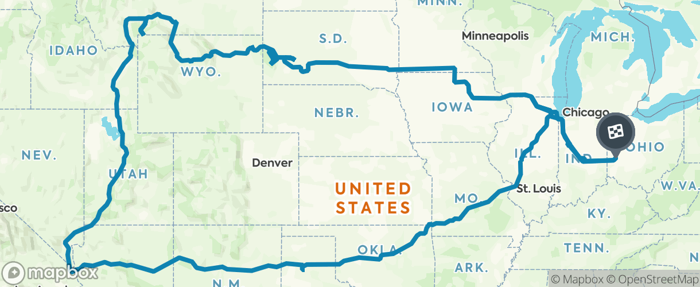
20 Days
18 States
5,564 miles
Sermon
Notes:
Image: Five Loaves by Caroline Coolidge Brown. Copyright © Caroline Coolidge Brown. All rights reserved. Used by permission of the artist.

Slide 30
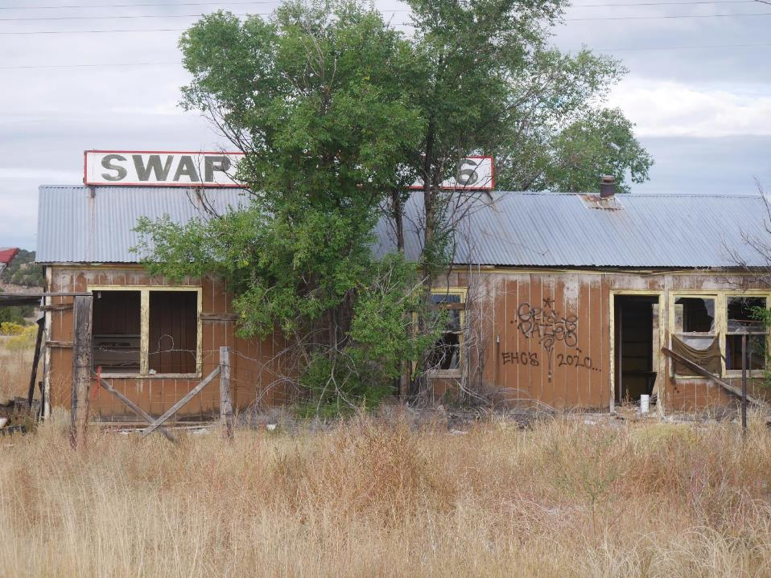
Sermon
Notes:
Image: Five Loaves by Caroline Coolidge Brown. Copyright © Caroline Coolidge Brown. All rights reserved. Used by permission of the artist.

Slide 31
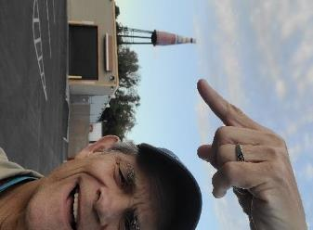
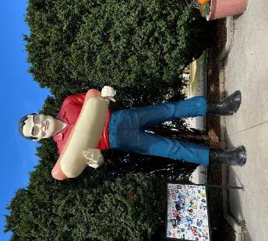
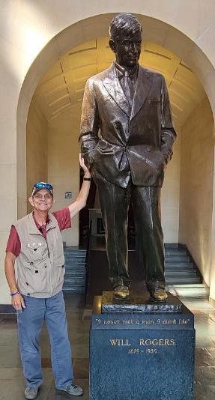
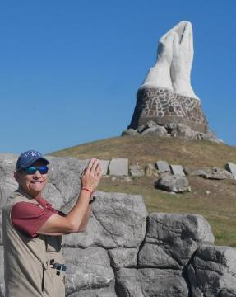
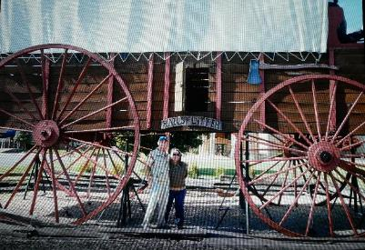
Sermon
Notes:
Image: Five Loaves by Caroline Coolidge Brown. Copyright © Caroline Coolidge Brown. All rights reserved. Used by permission of the artist.

Slide 32
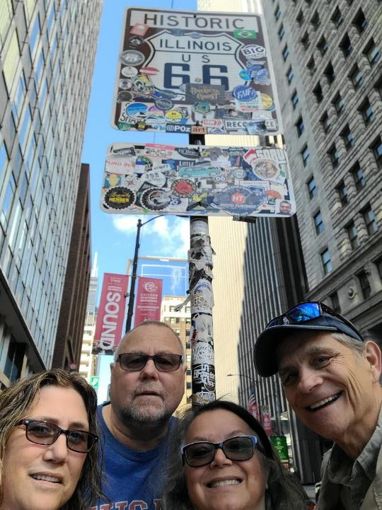
Sermon
Notes:
Image: Five Loaves by Caroline Coolidge Brown. Copyright © Caroline Coolidge Brown. All rights reserved. Used by permission of the artist.

Slide 33
Sermon
Notes:
Image: Five Loaves by Caroline Coolidge Brown. Copyright © Caroline Coolidge Brown. All rights reserved. Used by permission of the artist.

Slide 34
Sermon
Notes:
Image: Five Loaves by Caroline Coolidge Brown. Copyright © Caroline Coolidge Brown. All rights reserved. Used by permission of the artist.

Slide 35
Sermon
Notes:
Image: Five Loaves by Caroline Coolidge Brown. Copyright © Caroline Coolidge Brown. All rights reserved. Used by permission of the artist.

Slide 36
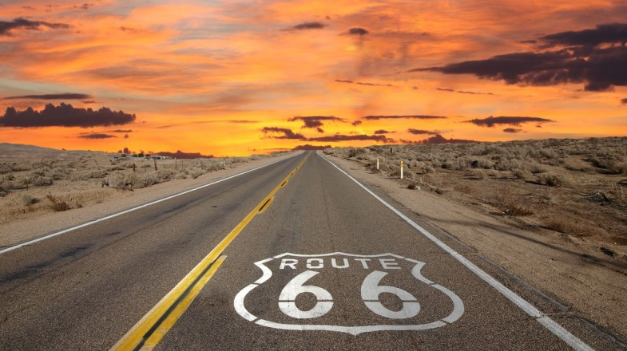
Sermon
Notes:
Image: Five Loaves by Caroline Coolidge Brown. Copyright © Caroline Coolidge Brown. All rights reserved. Used by permission of the artist.

Slide 37
Sermon
Notes:
Image: Five Loaves by Caroline Coolidge Brown. Copyright © Caroline Coolidge Brown. All rights reserved. Used by permission of the artist.

Slide 38
APOSTLE’S CREED
C: I believe in God, the Father almighty, creator of heaven and earth.

Slide 39
APOSTLE’S CREED
C: I believe in Jesus Christ, his only Son, our Lord. He was conceived by the power of the Holy Spirit and born of the virgin Mary. He suffered under Pontius Pilate, was crucified, died, and was buried.

Slide 40
APOSTLE’S CREED
C: He descended into hell. On the third day he rose again. He ascended into heaven, and is seated at the right hand of the Father. He will come again to judge the living and the dead.

Slide 41
APOSTLE’S CREED
C: I believe in the Holy Spirit, the holy catholic Church, the communion of saints, the forgiveness of sins, the resurrection of the body, and the life everlasting. Amen.

Slide 42
NICENE CREED
C: We believe in one God, the Father, the Almighty, maker of heaven and earth, of all that is, seen and unseen.

Slide 43
NICENE CREED
C: We believe in one Lord, Jesus Christ, the only Son of God, eternally begotten of the Father, God from God, Light from Light, true God from true God, begotten, not made, of one Being with the Father.

Slide 44
NICENE CREED
C: Through him all things were made. For us and for our salvation he came down from heaven; by the power of the Holy Spirit he became incarnate from the virgin Mary, and was made man. For our sake he was crucified under Pontius Pilate;

Slide 45
NICENE CREED
C: he suffered death and was buried. On the third day he rose again in accordance with the Scriptures; he ascended into heaven and is seated at the right hand of the Father. He will come again in glory to judge the living and the dead, and his kingdom will have no end.

Slide 46
NICENE CREED
C: We believe in the Holy Spirit, the Lord, the giver of life, who proceeds from the Father and the Son. With the Father and the Son he is worshiped and glorified. He has spoken through the prophets. We believe in one holy catholic and apostolic Church.

Slide 47
NICENE CREED
C: We acknowledge one Baptism for the forgiveness of sins. We look for the resurrection of the dead, and the life of the world to come. Amen.

Slide 48
PRAYERS OF INTERCESSION
Each petition will end with the words,
A: God of promise,
The congregation will respond with:
C: You hear our prayer.

Slide 49
PRAYERS OF INTERCESSION
The prayer concludes…
P: Trusting in your grace and mercy, we lift these prayers to you, in the name of Jesus Christ.
C: Amen.

Slide 50
Offering Prayer
Notes:
Image: Five Loaves by Caroline Coolidge Brown. Copyright © Caroline Coolidge Brown. All rights reserved. Used by permission of the artist.

Slide 51
THE GREAT THANKSGIVING
Communion by pre-packaged Communion Cups. All the Baptized are welcome to celebrate this Holy Meal.

Slide 52
DIALOGUE
P: The Lord be with you.
C: And also with you.
P: Lift up your hearts.
C: We lift them to the Lord.
P: Let us give thanks to the Lord our God.
C: It is right to give him thanks and praise.

Slide 53
Preface
P: It is indeed right…
…join their unending hymn

Slide 54
Sanctus
C: Holy, holy, holy Lord, God of power and might: Heaven and earth are full of your glory. Hosanna. Hosanna. Hosanna in the highest. Blessed is he who comes in the name of the Lord. Hosanna in the highest.

Slide 55
Eucharistic Prayer
P: Holy God, our Maker, Redeemer, and Healer…
…in your holy Church, both now and forever.
C: Amen

Slide 56
THE LORD’S PRAYER
C: Our Father, who art in heaven, hallowed be thy name, thy kingdom come, thy will be done, on earth as it is in heaven. Give us this day our daily bread; and forgive us our trespasses, as we forgive those who trespass against us; and lead us not into temptation, but deliver us from evil.

Slide 57
THE LORD’S PRAYER
C: For thine is the kingdom, and the power, and the glory, forever and ever. Amen.

Slide 58
INVITATION TO COMMUNION
P: Our God has done marvelous things for us and today calls us in love to full participation in the body of Christ Jesus. Come declare your love for the source of all life, and share in the eternal feast.

Slide 59
POST COMMUNION BLESSING
P: May this Body and Blood of our Lord and Savior, Jesus Christ, strengthen, keep, and unite us, now and forever.
C: Amen.

Slide 60
POST COMMUNION PRAYER
P: Let us pray… God of the abundant table, you have refreshed our hearts in this meal with bread for the journey. Give us your grace on the road that we might serve our neighbors with joy; for the sake of Jesus Christ, our Lord.
C: Amen

Slide 61
Announcements
Notes:
Image: Five Loaves by Caroline Coolidge Brown. Copyright © Caroline Coolidge Brown. All rights reserved. Used by permission of the artist.

Slide 62
SENDING BLESSING
P: God, who gives life to all things and frees us from despair, bless you with truth and peace. And may the holy Trinity, ☩ one God, guide you always in faith, hope, and love.
C: Amen.

Slide 63
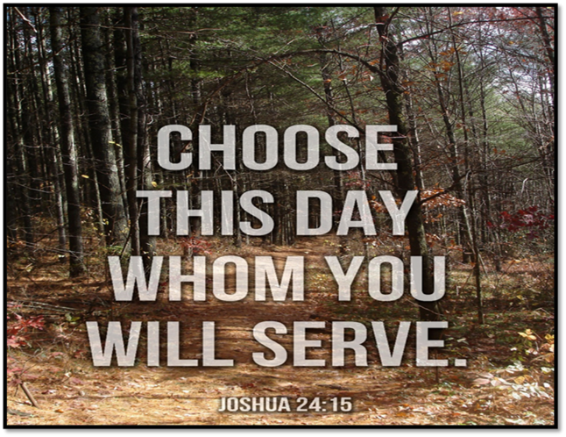
Sending Song
“Come, We That Love the Lord”
ELW 625
Notes:
Image: Five Loaves by Caroline Coolidge Brown. Copyright © Caroline Coolidge Brown. All rights reserved. Used by permission of the artist.

Slide 64
“Come, We That Love the Lord” ELW 625
1 Come, we that love the Lord,
and let our joys be known;
join in a song with sweet accord,
join in a song with sweet accord
and thus surround the throne,
and thus surround the throne.
Notes:
Image: Five Loaves by Caroline Coolidge Brown. Copyright © Caroline Coolidge Brown. All rights reserved. Used by permission of the artist.

Slide 65
“Come, We That Love the Lord” ELW 625
Refrain
We're marching to Zion,
beautiful, beautiful Zion:
we're marching upward to Zion,
the beautiful city of God.
Notes:
Image: Five Loaves by Caroline Coolidge Brown. Copyright © Caroline Coolidge Brown. All rights reserved. Used by permission of the artist.

Slide 66
“Come, We That Love the Lord” ELW 625
2 Let those refuse to sing
who never knew our God;
but children of the heav'nly king,
but children of the heav'nly king
may tell their joys abroad,
may tell their joys abroad.
Notes:
Image: Five Loaves by Caroline Coolidge Brown. Copyright © Caroline Coolidge Brown. All rights reserved. Used by permission of the artist.

Slide 67
“Come, We That Love the Lord” ELW 625
Refrain
We're marching to Zion,
beautiful, beautiful Zion:
we're marching upward to Zion,
the beautiful city of God.
Notes:
Image: Five Loaves by Caroline Coolidge Brown. Copyright © Caroline Coolidge Brown. All rights reserved. Used by permission of the artist.

Slide 68
“Come, We That Love the Lord” ELW 625
3 The hill of Zion yields
a thousand sacred sweets
before we reach the heav'nly fields,
before we reach the heav'nly fields,
or walk the golden streets,
or walk the golden streets.
Notes:
Image: Five Loaves by Caroline Coolidge Brown. Copyright © Caroline Coolidge Brown. All rights reserved. Used by permission of the artist.

Slide 69
“Come, We That Love the Lord” ELW 625
Refrain
We're marching to Zion,
beautiful, beautiful Zion:
we're marching upward to Zion,
the beautiful city of God.
Notes:
Image: Five Loaves by Caroline Coolidge Brown. Copyright © Caroline Coolidge Brown. All rights reserved. Used by permission of the artist.

Slide 70
“Come, We That Love the Lord” ELW 625
4 Then let our songs abound,
and ev'ry tear be dry;
we're marching through Immanuel's ground,
we're marching through Immanuel's ground,
to fairer worlds on high,
to fairer worlds on high.
Notes:
Image: Five Loaves by Caroline Coolidge Brown. Copyright © Caroline Coolidge Brown. All rights reserved. Used by permission of the artist.

Slide 71
“Come, We That Love the Lord” ELW 625
Refrain
We're marching to Zion,
beautiful, beautiful Zion:
we're marching upward to Zion,
the beautiful city of God.
Notes:
Image: Five Loaves by Caroline Coolidge Brown. Copyright © Caroline Coolidge Brown. All rights reserved. Used by permission of the artist.

Slide 72
DISMISSAL
P: … depart in Christ’s Love.
C: Seeking, welcoming, and serving all. Amen!
POSTLUDE
By
Darrell Fryman
From sundaysandseasons.com. Copyright © 2022 Augsburg Fortress. All rights reserved. Reprinted by permission under Augsburg Fortress Liturgies Annual License #SAS023830. New Revised Standard Version Bible, Copyright © 1989, Division of Christian Education of the National Council of the Churches of Christ in the United States of America. Used by permission. All rights reserved. Revised Common Lectionary, Copyright © 1992 Consultation on Common Texts, admin Augsburg Fortress. Used by permission.

