Slide 1
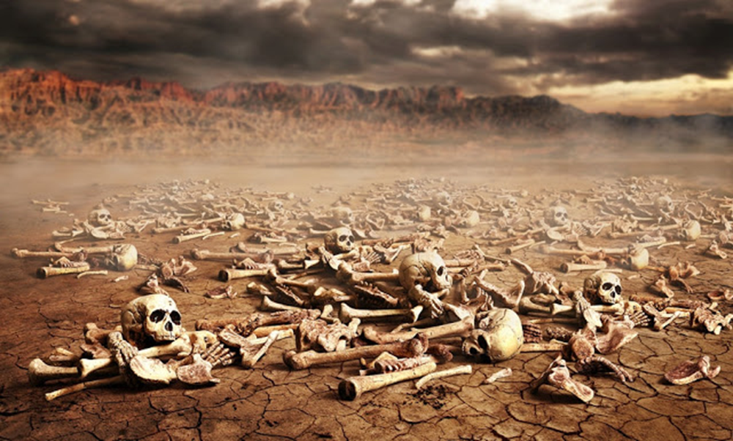
Welcome in the Name of
The Triune God
October 3, 2021
Second Sunday of Advent
Prelude by Roxanne Groff
Office of the Acolyte
Ringing of the Bell
Scripture Focus: Ezekiel 37:1-14
Notes:
Image: Preparing yeast dough. Copyright © tomasworks/iStock/Thinkstock. Used by permission.

Slide 2
LIGHTING THE FIRST ADVENT CANDLE
HOPE
L: Just as Ezekiel saw a world of violence, despair, injustice, and unfairness, so we too see the dry bones filling the valleys of this war-torn world.
P: But God sets forth a light of peace, delivering flesh to bare bones, bringing workers for harmony and justice in places of discord and strife.
Notes:
Image: Preparing yeast dough. Copyright © tomasworks/iStock/Thinkstock. Used by permission.

Slide 3
LIGHTING THE FIRST ADVENT CANDLE
HOPE
L: (Light candle 1)
We light first the candle of hope, trusting that hope for a savior remains.
P: (Light candle 2)
And we light the second, believing that God’s Son might usher in a new order, where lion and lamb lie peacefully together.
Notes:
Image: Preparing yeast dough. Copyright © tomasworks/iStock/Thinkstock. Used by permission.

Slide 4
CONFESSION AND FORGIVENESS
All may make the sign of the cross, the sign marked at baptism…
P: We confess our sins before God and one another.
Pause for silence and reflection.
P: Healing God,
Notes:
Image: Five Loaves by Caroline Coolidge Brown. Copyright © Caroline Coolidge Brown. All rights reserved. Used by permission of the artist.

Slide 5
CONFESSION AND FORGIVENESS
C: We come into this house broken and lost. We bring our worries and our fears. We bring the weight of having acted out in ways that hurt others, you, and ourselves. We wonder if there will ever be a time when light will find us.
Notes:
Image: Five Loaves by Caroline Coolidge Brown. Copyright © Caroline Coolidge Brown. All rights reserved. Used by permission of the artist.

Slide 6
CONFESSION AND FORGIVENESS
C: Forgive what we have done and heal us, for the sake of the one who gave everything for us, Jesus Christ our Lord. Amen.
Notes:
Image: Five Loaves by Caroline Coolidge Brown. Copyright © Caroline Coolidge Brown. All rights reserved. Used by permission of the artist.

Slide 7
CONFESSION AND FORGIVENESS
L: God offers light and healing. God invites us into a new way of being. Despite our sin, God forgives. Receive and welcome God’s forgiveness, for you are made clean and whole again. In Jesus’ name we pray.
C: Amen.
Notes:
Image: Five Loaves by Caroline Coolidge Brown. Copyright © Caroline Coolidge Brown. All rights reserved. Used by permission of the artist.

Slide 8
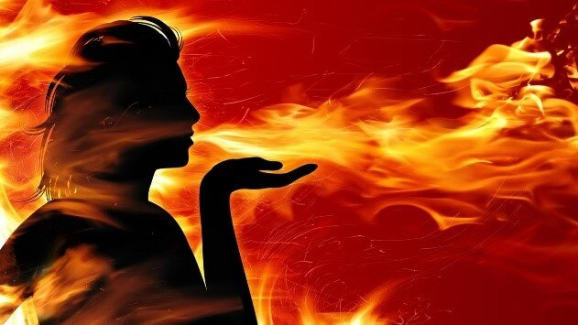
Hymn of Praise
Breathe on Me, Breath of God
LBW 488
Notes:
Image: Five Loaves by Caroline Coolidge Brown. Copyright © Caroline Coolidge Brown. All rights reserved. Used by permission of the artist.

Slide 9
Breathe on Me, Breath of God LBW 488
1 Breathe on me, breath of God;
fill me with life anew,
that I may love all that you love
and do what you would do.
Notes:
Image: Five Loaves by Caroline Coolidge Brown. Copyright © Caroline Coolidge Brown. All rights reserved. Used by permission of the artist.

Slide 10
Breathe on Me, Breath of God LBW 488
2 Breathe on me, breath of God,
until my heart is pure,
until with you I will one will
to do and to endure.
3 Breathe on me, breath of God;
so shall I never die,
but live with you the perfect life
of your eternity.
Notes:
Image: Five Loaves by Caroline Coolidge Brown. Copyright © Caroline Coolidge Brown. All rights reserved. Used by permission of the artist.

Slide 11
APOSTOLIC GREETING
P: The grace of our Lord Jesus Christ, the love of God, and the communion of the Holy Spirit be with you all.
C: And also with you.
Notes:
Image: Five Loaves by Caroline Coolidge Brown. Copyright © Caroline Coolidge Brown. All rights reserved. Used by permission of the artist.

Slide 12
KYRIE
The congregation may respond with facemasks on:
A: In peace let us pray to the Lord.
C: Lord have mercy.
A: For the peace from above, and for our salvation, let us pray to the Lord.
C: Lord have mercy.
A: For the peace of the whole world, for the well being of the Church of God, and for the unity of all, let us pray to the Lord.
C: Lord have mercy.
Notes:
Image: Five Loaves by Caroline Coolidge Brown. Copyright © Caroline Coolidge Brown. All rights reserved. Used by permission of the artist.

Slide 13
KYRIE
The congregation may sing with facemasks on:
A: For this Holy House, and for all who offer here their worship and praise, let us pray to the Lord.
C: Lord have mercy.
A: Help, save, and defend us, gracious Lord.
C: Amen.
Notes:
Image: Five Loaves by Caroline Coolidge Brown. Copyright © Caroline Coolidge Brown. All rights reserved. Used by permission of the artist.

Slide 14
PRAYER OF THE DAY
P: Let us pray… God of new life, You showed Ezekiel that you have the ability and willingness to restore Israel to new life. We ask that you restore us, too, to new life filled with abundant blessings and gratitude.
C: Amen.
Notes:
Image: Five Loaves by Caroline Coolidge Brown. Copyright © Caroline Coolidge Brown. All rights reserved. Used by permission of the artist.

Slide 15
Notes:
Image: Preparing yeast dough. Copyright © tomasworks/iStock/Thinkstock. Used by permission.

Slide 16
Scripture Reading
R: The Scripture reading is from Ezekiel, Chapter 37.
C: Glory to you O’ Lord! (Spoken)
Notes:
Image: Five Loaves by Caroline Coolidge Brown. Copyright © Caroline Coolidge Brown. All rights reserved. Used by permission of the artist.

Slide 17
Ezekiel 37:1-14
The hand of the Lord came upon me, and he brought me out by the spirit of the Lord and set me down in the middle of a valley; it was full of bones. ²He led me all around them; there were very many lying in the valley, and they were very dry. ³He said to me, “Mortal, can these bones live?” I answered, “O Lord God, you know.” ⁴Then he said to me, “Prophesy to these bones, and say to
Notes:
Image: Five Loaves by Caroline Coolidge Brown. Copyright © Caroline Coolidge Brown. All rights reserved. Used by permission of the artist.

Slide 18
Ezekiel 37:1-14
them: O dry bones, hear the word of the Lord. ⁵Thus says the Lord God to these bones: I will cause breath to enter you, and you shall live. ⁶I will lay sinews on you, and will cause flesh to come upon you, and cover you with skin, and put breath in you, and you shall live; and you shall know that I am the Lord.” ⁷So I prophesied as I had been commanded; and as I prophesied,
Notes:
Image: Five Loaves by Caroline Coolidge Brown. Copyright © Caroline Coolidge Brown. All rights reserved. Used by permission of the artist.

Slide 19
Ezekiel 37:1-14
suddenly there was a noise, a rattling, and the bones came together, bone to its bone. ⁸I looked, and there were sinews on them, and flesh had come upon them, and skin had covered them; but there was no breath in them. ⁹Then he said to me, “Prophesy to the breath, prophesy, mortal, and say to the breath: Thus says the Lord God: Come from the four winds, O breath, and
Notes:
Image: Five Loaves by Caroline Coolidge Brown. Copyright © Caroline Coolidge Brown. All rights reserved. Used by permission of the artist.

Slide 20
Ezekiel 37:1-14
breathe upon these slain, that they may live.” ¹⁰I prophesied as he commanded me, and the breath came into them, and they lived, and stood on their feet, a vast multitude. ¹¹Then he said to me, “Mortal, these bones are the whole house of Israel. They say, ‘Our bones are dried up, and our hope is lost; we are cut off completely.’ ¹²Therefore prophesy, and say to them, Thus says
Notes:
Image: Five Loaves by Caroline Coolidge Brown. Copyright © Caroline Coolidge Brown. All rights reserved. Used by permission of the artist.

Slide 21
Ezekiel 37:1-14
the Lord God: I am going to open your graves, and bring you up from your graves, O my people; and I will bring you back to the land of Israel. ¹³And you shall know that I am the Lord, when I open your graves, and bring you up from your graves, O my people.
Notes:
Image: Five Loaves by Caroline Coolidge Brown. Copyright © Caroline Coolidge Brown. All rights reserved. Used by permission of the artist.

Slide 22
Ezekiel 37:1-14
¹⁴I will put my spirit within you, and you shall live, and I will place you on your own soil; then you shall know that I, the Lord, have spoken and will act,” says the Lord.
P: This is the Word of the Lord.
C: Praise to You, O Christ (Spoken)
Notes:
Image: Five Loaves by Caroline Coolidge Brown. Copyright © Caroline Coolidge Brown. All rights reserved. Used by permission of the artist.

Slide 23
Sermon
Notes:
Image: Preparing yeast dough. Copyright © tomasworks/iStock/Thinkstock. Used by permission.

Slide 24
Special Music
Notes:
Image: Preparing yeast dough. Copyright © tomasworks/iStock/Thinkstock. Used by permission.

Slide 25
APOSTLE’S CREED
C: I believe in God, the Father almighty, creator of heaven and earth.

Slide 26
APOSTLE’S CREED
C: I believe in Jesus Christ, his only Son, our Lord. He was conceived by the power of the Holy Spirit and born of the virgin Mary. He suffered under Pontius Pilate, was crucified, died, and was buried.

Slide 27
APOSTLE’S CREED
C: He descended into hell. On the third day he rose again. He ascended into heaven, and is seated at the right hand of the Father. He will come again to judge the living and the dead.

Slide 28
APOSTLE’S CREED
C: I believe in the Holy Spirit, the holy catholic Church, the communion of saints, the forgiveness of sins, the resurrection of the body, and the life everlasting. Amen.

Slide 29
NICENE CREED
C: We believe in one God, the Father, the Almighty, maker of heaven and earth, of all that is, seen and unseen.

Slide 30
NICENE CREED
C: We believe in one Lord, Jesus Christ, the only Son of God, eternally begotten of the Father, God from God, Light from Light, true God from true God, begotten, not made, of one Being with the Father.

Slide 31
NICENE CREED
C: Through him all things were made. For us and for our salvation he came down from heaven; by the power of the Holy Spirit he became incarnate from the virgin Mary, and was made man. For our sake he was crucified under Pontius Pilate;

Slide 32
NICENE CREED
C: he suffered death and was buried. On the third day he rose again in accordance with the Scriptures; he ascended into heaven and is seated at the right hand of the Father. He will come again in glory to judge the living and the dead, and his kingdom will have no end.

Slide 33
NICENE CREED
C: We believe in the Holy Spirit, the Lord, the giver of life, who proceeds from the Father and the Son. With the Father and the Son he is worshiped and glorified. He has spoken through the prophets. We believe in one holy catholic and apostolic Church.

Slide 34
NICENE CREED
C: We acknowledge one Baptism for the forgiveness of sins. We look for the resurrection of the dead, and the life of the world to come. Amen.

Slide 35
PRAYERS OF INTERCESSION
Each petition will end with the words,
A: Life-giving God,
The congregation will respond with:
C: Hear our prayer.

Slide 36
PRAYERS OF INTERCESSION
The prayer concludes…
P: Renew our strength and rekindle our zeal for your word and your work in this world, and make of us the living answers to prayer for the sake of all whom you love.
C: Amen.

Slide 37
SHARING OF THE Peace
The Sharing of the Peace that began when the congregation arrived is now shared with the Pastor at this time...
P: The peace of the Lord be with you always.
C: And also with you.

Slide 38
Offering Prayer
Notes:
Image: Preparing yeast dough. Copyright © tomasworks/iStock/Thinkstock. Used by permission.

Slide 39
THE GREAT THANKSGIVING
Communion is by pre-filled kits. All the Baptized are welcome to celebrate this Holy Meal.
Please do not open the Communion Chalice until instructed to do so.

Slide 40
DIALOGUE
P: The Lord be with you.
C: And also with you.
P: Lift up your hearts.
C: We lift them to the Lord.
P: Let us give thanks to the Lord our God.
C: It is right to give him thanks and praise.

Slide 41
Preface
P: It is indeed right…
…join their unending hymn

Slide 42
Sanctus
C: Holy, holy, holy Lord, God of power and might: Heaven and earth are full of your glory. Hosanna. Hosanna. Hosanna in the highest. Blessed is he who comes in the name of the Lord. Hosanna in the highest.

Slide 43
Eucharistic Prayer
P: Holy, God, the beginning and the end…
… in your holy Church, both now and forever.
C: Amen.

Slide 44
THE LORD’S PRAYER
P: We are united into one Body by this heavenly food, so let us pray as Jesus taught…
C: Our Father, who art in heaven, hallowed be thy name, thy kingdom come, thy will be done, on earth as it is in heaven. Give us this day our daily bread; and forgive us our trespasses,

Slide 45
THE LORD’S PRAYER
C: as we forgive those who trespass against us; and lead us not into temptation, but deliver us from evil. For thine is the kingdom, and the power, and the glory, forever and ever. Amen.

Slide 46
INVITATION TO COMMUNION
P: God breathes new life into our lifeless souls and continues to feed us with grace and goodness. As we gather at this holy meal, we are revived to new life so that we might serve a new day as God’s faithful followers. Arise, come, and be renewed!
Please dispose of the empty cup in the trash receptacle on your way out of the Sanctuary.

Slide 47
POST COMMUNION BLESSING
P: May this Body and Blood of our Lord and Savior, Jesus Christ, strengthen, keep, and unite us.
C: Amen.

Slide 48
POST COMMUNION PRAYER
P: Let us pray… Jesus, Bread of life, we have received from your table more than we could ever ask. As you have nourished us in this meal, now strengthen us to love the world with your own life. In your name we pray.
C: Amen

Slide 49
Announcements
Notes:
Image: Preparing yeast dough. Copyright © tomasworks/iStock/Thinkstock. Used by permission.

Slide 50
SENDING BLESSING
P: People of God, you are Christ’s body, bringing new life to a suffering world. The holy Trinity, ☩ one God, bless you now and forever.
C: Amen.

Slide 51
Sending Song
Holy Spirit, Ever Dwelling
LBW 523
Notes:
Image: Preparing yeast dough. Copyright © tomasworks/iStock/Thinkstock. Used by permission.

Slide 52
Holy Spirit, Ever Dwelling LBW 523
1 Holy Spirit, ever dwelling
in the holiest realms of light;
Holy Spirit, ever brooding
o'er a world of gloom and night;
Holy Spirit, ever raising
those of earth to thrones on high;
living, life-imparting Spirit,
you we praise and magnify.

Slide 53
Holy Spirit, Ever Dwelling LBW 523
2 Holy Spirit, ever living
as the church's very life;
Holy Spirit, ever striving
through us in a ceaseless strife;
Holy Spirit, ever forming
in the church the mind of Christ:
you we praise with endless worship
for your gifts and fruits unpriced.

Slide 54
Holy Spirit, Ever Dwelling LBW 523
3 Holy Spirit, ever working
through the church's ministry;
quick'ning, strength'ning, and absolving,
setting captive sinners free;
Holy Spirit, ever binding
age to age and soul to soul
in communion never ending,
you we worship and extol.

Slide 55
DISMISSAL
P: Until we gather again as God’s people to offer our worship and praise, depart in Christ’s Love,
C: Seeking, welcoming, and serving all. Amen!
Postlude by Roxanne Groff
Copyright © 2021 Augsburg Fortress. All rights reserved. Reprinted by permission under Augsburg Fortress Liturgies Annual License #SAS023830. New Revised Standard Version Bible, Copyright © 1989, Division of Christian Education of the National Council of the Churches of Christ in the United States of America. Used by permission. All rights reserved. Revised Common Lectionary, Copyright © 1992 Consultation on Common Texts, admin Augsburg Fortress. Used by permission.

