Slide 1
Trinity Evangelical Lutheran Church July 3, 2022
Happy Independence Day!
Notes:
Image: Five Loaves by Caroline Coolidge Brown. Copyright © Caroline Coolidge Brown. All rights reserved. Used by permission of the artist.

Slide 2
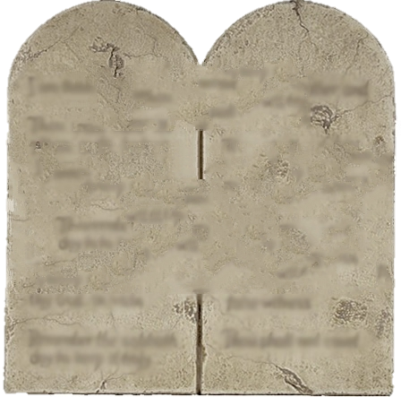
Trinity Evangelical Lutheran Church July 3, 2022
WELCOME!
The Ten
Commandments
Part Quatro
Notes:
Image: Five Loaves by Caroline Coolidge Brown. Copyright © Caroline Coolidge Brown. All rights reserved. Used by permission of the artist.

Slide 3
Prelude Roxanne Groff
= Please stand if able
= Please be seated
Office of the Acolyte and Ringing of the Bell
Welcome Pastor Mel Musser
Notes:
Image: Five Loaves by Caroline Coolidge Brown. Copyright © Caroline Coolidge Brown. All rights reserved. Used by permission of the artist.

Slide 4
CONFESSION AND FORGIVENESS
All may make the sign of the cross, the sign marked at baptism…
L: We confess our sins before God and one another.
Pause for silence and reflection.
L: God of liberation…
Notes:
Image: Five Loaves by Caroline Coolidge Brown. Copyright © Caroline Coolidge Brown. All rights reserved. Used by permission of the artist.

Slide 5
CONFESSION AND FORGIVENESS
C: We are quick to forget all that you have done for us. We ignore your commandments, choosing ourselves over you and our neighbors time and again. Lead us out of the wilderness of our sin, and into new lives of love.
Notes:
Image: Five Loaves by Caroline Coolidge Brown. Copyright © Caroline Coolidge Brown. All rights reserved. Used by permission of the artist.

Slide 6
CONFESSION AND FORGIVENESS
L: Our God bears us on eagle’s wings and lovingly gathers us into a community of faith. Receive the entire forgiveness of all your sins and walk in the freedom and confidence of God’s deliverance, in Jesus Christ, our savior.
C: Amen.
Notes:
Image: Five Loaves by Caroline Coolidge Brown. Copyright © Caroline Coolidge Brown. All rights reserved. Used by permission of the artist.

Slide 7
Hymn of Praise
“Amazing Grace”
LBW 448
Notes:
Image: Five Loaves by Caroline Coolidge Brown. Copyright © Caroline Coolidge Brown. All rights reserved. Used by permission of the artist.

Slide 8
Amazing Grace LBW 448
1 Amazing grace, how sweet the sound,
that saved a wretch like me!
I once was lost, but now am found;
was blind, but now I see.
Notes:
Image: Preparing yeast dough. Copyright © tomasworks/iStock/Thinkstock. Used by permission.

Slide 9
Amazing Grace LBW 448
2 ’Twas grace that taught my heart to fear,
and grace my fears relieved;
how precious did that grace appear
the hour I first believed!
Notes:
Image: Preparing yeast dough. Copyright © tomasworks/iStock/Thinkstock. Used by permission.

Slide 10
Amazing Grace LBW 448
3 Through many dangers, toils, and snares
I have already come;
’tis grace has brought me safe thus far,
and grace will lead me home.
Notes:
Image: Preparing yeast dough. Copyright © tomasworks/iStock/Thinkstock. Used by permission.

Slide 11
Amazing Grace LBW 448
4 The Lord has promised good to me;
his word my hope secures;
he will my shield and portion be
as long as life endures.
Notes:
Image: Preparing yeast dough. Copyright © tomasworks/iStock/Thinkstock. Used by permission.

Slide 12
APOSTOLIC GREETING
P: The grace of our Lord Jesus Christ, the love of God, and the communion of the Holy Spirit be with you all.
C: And also with you.
Notes:
Image: Five Loaves by Caroline Coolidge Brown. Copyright © Caroline Coolidge Brown. All rights reserved. Used by permission of the artist.

Slide 13
KYRIE
A: In peace let us pray to the Lord.
C: Lord have mercy.
A: For the peace from above, and for our salvation, let us pray to the Lord.
C: Lord have mercy.
A: For the peace of the whole world, for the well being of the Church of God, and for the unity of all, let us pray to the Lord.
C: Lord have mercy.
Notes:
Image: Five Loaves by Caroline Coolidge Brown. Copyright © Caroline Coolidge Brown. All rights reserved. Used by permission of the artist.

Slide 14
KYRIE
A: For this Holy House, and for all who offer here their worship and praise, let us pray to the Lord.
C: Lord have mercy.
A: Help, save, and defend us, gracious Lord.
C: Amen.
Notes:
Image: Five Loaves by Caroline Coolidge Brown. Copyright © Caroline Coolidge Brown. All rights reserved. Used by permission of the artist.

Slide 15
PRAYER OF THE DAY
P: Let us pray… Blessed YAHWEH, You provide us with all that we need to flourish. Turn us away from envy and give us a heart of gratitude, for the sake of your son, Jesus Christ.
C: Amen.
Notes:
Image: Five Loaves by Caroline Coolidge Brown. Copyright © Caroline Coolidge Brown. All rights reserved. Used by permission of the artist.

Slide 16
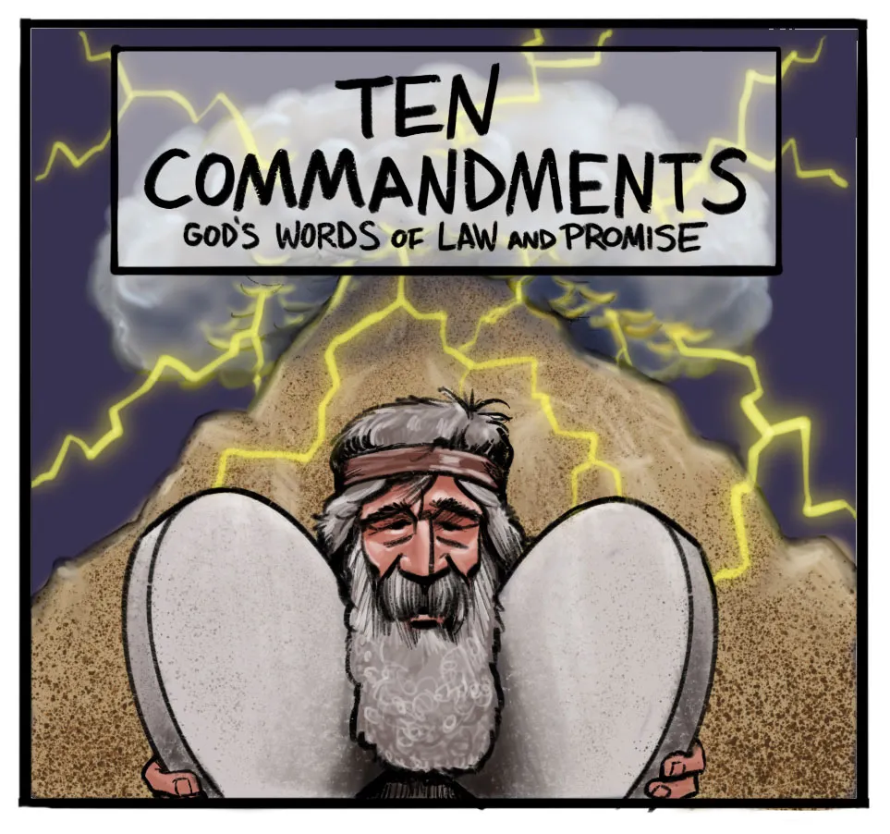
Notes:
Image: Preparing yeast dough. Copyright © tomasworks/iStock/Thinkstock. Used by permission.

Slide 17
Scripture Reading
R: The Scripture reading is from the Book Exodus, Chapter 20.
C: Glory to you O’ Lord! (Spoken)
Notes:
Image: Five Loaves by Caroline Coolidge Brown. Copyright © Caroline Coolidge Brown. All rights reserved. Used by permission of the artist.

Slide 18
Exodus 20:17
¹⁷You shall not covet your neighbor’s house; you shall not covet your neighbor’s wife, or male or female slave, or ox, or donkey, or anything that belongs to your neighbor.
Notes:
Image: Five Loaves by Caroline Coolidge Brown. Copyright © Caroline Coolidge Brown. All rights reserved. Used by permission of the artist.

Slide 19
Exodus 20:17
P: This is the Word of the Lord.
C: Praise to You, O Christ (Spoken)
Notes:
Image: Five Loaves by Caroline Coolidge Brown. Copyright © Caroline Coolidge Brown. All rights reserved. Used by permission of the artist.

Slide 20
Sermon
Notes:
Image: Five Loaves by Caroline Coolidge Brown. Copyright © Caroline Coolidge Brown. All rights reserved. Used by permission of the artist.

Slide 21
The Barna Report: 1991-92
No other God’s - 76%
Honor parents - 77%
Do not murder - 93%
No adultery - 82%
No stealing - 86%
No False Witnessing – 52%
No Coveting – 53%

Slide 22
Sermon
Notes:
Image: Five Loaves by Caroline Coolidge Brown. Copyright © Caroline Coolidge Brown. All rights reserved. Used by permission of the artist.

Slide 23
APOSTLE’S CREED
C: I believe in God, the Father almighty, creator of heaven and earth.

Slide 24
APOSTLE’S CREED
C: I believe in Jesus Christ, his only Son, our Lord. He was conceived by the power of the Holy Spirit and born of the virgin Mary. He suffered under Pontius Pilate, was crucified, died, and was buried.

Slide 25
APOSTLE’S CREED
C: He descended into hell. On the third day he rose again. He ascended into heaven, and is seated at the right hand of the Father. He will come again to judge the living and the dead.

Slide 26
APOSTLE’S CREED
C: I believe in the Holy Spirit, the holy catholic Church, the communion of saints, the forgiveness of sins, the resurrection of the body, and the life everlasting. Amen.

Slide 27
NICENE CREED
C: We believe in one God, the Father, the Almighty, maker of heaven and earth, of all that is, seen and unseen.

Slide 28
NICENE CREED
C: We believe in one Lord, Jesus Christ, the only Son of God, eternally begotten of the Father, God from God, Light from Light, true God from true God, begotten, not made, of one Being with the Father.

Slide 29
NICENE CREED
C: Through him all things were made. For us and for our salvation he came down from heaven; by the power of the Holy Spirit he became incarnate from the virgin Mary, and was made man. For our sake he was crucified under Pontius Pilate;

Slide 30
NICENE CREED
C: he suffered death and was buried. On the third day he rose again in accordance with the Scriptures; he ascended into heaven and is seated at the right hand of the Father. He will come again in glory to judge the living and the dead, and his kingdom will have no end.

Slide 31
NICENE CREED
C: We believe in the Holy Spirit, the Lord, the giver of life, who proceeds from the Father and the Son. With the Father and the Son he is worshiped and glorified. He has spoken through the prophets. We believe in one holy catholic and apostolic Church.

Slide 32
NICENE CREED
C: We acknowledge one Baptism for the forgiveness of sins. We look for the resurrection of the dead, and the life of the world to come. Amen.

Slide 33
PRAYERS OF INTERCESSION
Each petition will end with the words,
A: God of liberation,
The congregation will respond with:
C: You hear our prayer.

Slide 34
PRAYERS OF INTERCESSION
The prayer concludes…
P: With humble hearts we lift these prayers to you, in the name of Jesus Christ our savior.
C: Amen.

Slide 35
OFFERING PRAYER
Notes:
Image: Five Loaves by Caroline Coolidge Brown. Copyright © Caroline Coolidge Brown. All rights reserved. Used by permission of the artist.

Slide 36
THE GREAT THANKSGIVING
Communion by pre-packaged Communion Cups. All the Baptized are welcome to celebrate this Holy Meal.

Slide 37
DIALOGUE
P: The Lord be with you.
C: And also with you.
P: Lift up your hearts.
C: We lift them to the Lord.
P: Let us give thanks to the Lord our God.
C: It is right to give him thanks and praise.

Slide 38
Preface
P: It is indeed right…
…join their unending hymn

Slide 39
Sanctus
C: Holy, holy, holy Lord, God of power and might: Heaven and earth are full of your glory. Hosanna. Hosanna. Hosanna in the highest. Blessed is he who comes in the name of the Lord. Hosanna in the highest.

Slide 40
Eucharistic Prayer
P: Holy God, our Maker, Redeemer, and Healer…
…in your holy Church, both now and forever.
C: Amen

Slide 41
THE LORD’S PRAYER
C: Our Father, who art in heaven, hallowed be thy name, thy kingdom come, thy will be done, on earth as it is in heaven. Give us this day our daily bread; and forgive us our trespasses, as we forgive those who trespass against us; and lead us not into temptation, but deliver us from evil.

Slide 42
THE LORD’S PRAYER
C: For thine is the kingdom, and the power, and the glory, forever and ever. Amen.

Slide 43
INVITATION TO COMMUNION
P: God, who gives us all we need, offers us now divine communion with Christ. Come and join in the feast that truly satisfies. All is prepared for you.

Slide 44
POST COMMUNION BLESSING
P: May this Body and Blood of our Lord and Savior, Jesus Christ, strengthen, keep, and unite us, now and forever.
C: Amen.

Slide 45
POST COMMUNION PRAYER
P: Let us pray… Life-giving God, through this meal you have bandaged our wounds and fed us with your mercy. Now send us forth to live for others, both friend and stranger, that all may come to know your love. This we pray in the name of Jesus.
C: Amen

Slide 46
ANNOUNCEMENTS
Notes:
Image: Five Loaves by Caroline Coolidge Brown. Copyright © Caroline Coolidge Brown. All rights reserved. Used by permission of the artist.

Slide 47
SENDING BLESSING
P: The God of peace, Father, ☩ Son, and Holy Spirit, bless you, comfort you, and show you the path of life this day and always.
C: Amen.

Slide 48
SENDING SONG
“Here I Am, Lord” ELW 574
Notes:
Image: Five Loaves by Caroline Coolidge Brown. Copyright © Caroline Coolidge Brown. All rights reserved. Used by permission of the artist.

Slide 49
SENDING SONG
“Here I Am, Lord” ELW 574
1 "I, the Lord of sea and sky,
I have heard my people cry.
All who dwell in dark and sin
my hand will save.
I, who made the stars of night,
I will make their darkness bright.
Who will bear my light to them?
Whom shall I send?"
Notes:
Image: Five Loaves by Caroline Coolidge Brown. Copyright © Caroline Coolidge Brown. All rights reserved. Used by permission of the artist.

Slide 50
SENDING SONG
“Here I Am, Lord” ELW 574
Refrain
Here I am, Lord. Is it I, Lord?
I have heard you calling in the night.
I will go, Lord, if you lead me.
I will hold your people in my heart.
Notes:
Image: Five Loaves by Caroline Coolidge Brown. Copyright © Caroline Coolidge Brown. All rights reserved. Used by permission of the artist.

Slide 51
SENDING SONG
“Here I Am, Lord” ELW 574
2 "I, the Lord of snow and rain,
I have borne my people's pain.
I have wept for love of them.
They turn away.
I will break their hearts of stone,
give them hearts for love alone.
I will speak my word to them.
Whom shall I send?"
Notes:
Image: Five Loaves by Caroline Coolidge Brown. Copyright © Caroline Coolidge Brown. All rights reserved. Used by permission of the artist.

Slide 52
SENDING SONG
“Here I Am, Lord” ELW 574
Refrain
Here I am, Lord. Is it I, Lord?
I have heard you calling in the night.
I will go, Lord, if you lead me.
I will hold your people in my heart.
Notes:
Image: Five Loaves by Caroline Coolidge Brown. Copyright © Caroline Coolidge Brown. All rights reserved. Used by permission of the artist.

Slide 53
SENDING SONG
“Here I Am, Lord” ELW 574
3 "I, the Lord of wind and flame,
I will tend the poor and lame.
I will set a feast for them.
My hand will save.
Finest bread I will provide
till their hearts be satisfied.
I will give my life to them.
Whom shall I send?"
Notes:
Image: Five Loaves by Caroline Coolidge Brown. Copyright © Caroline Coolidge Brown. All rights reserved. Used by permission of the artist.

Slide 54
SENDING SONG
“Here I Am, Lord” ELW 574
Refrain
Here I am, Lord. Is it I, Lord?
I have heard you calling in the night.
I will go, Lord, if you lead me.
I will hold your people in my heart.
Notes:
Image: Five Loaves by Caroline Coolidge Brown. Copyright © Caroline Coolidge Brown. All rights reserved. Used by permission of the artist.

Slide 55
DISMISSAL
P: … depart in Christ’s Love.
C: Seeking, welcoming, and serving all. Amen!
POSTLUDE
By
Roxanne Groff
From sundaysandseasons.com. Copyright © 2022 Augsburg Fortress. All rights reserved. Reprinted by permission under Augsburg Fortress Liturgies Annual License #SAS023830. New Revised Standard Version Bible, Copyright © 1989, Division of Christian Education of the National Council of the Churches of Christ in the United States of America. Used by permission. All rights reserved. Revised Common Lectionary, Copyright © 1992 Consultation on Common Texts, admin Augsburg Fortress. Used by permission.

