Slide 1
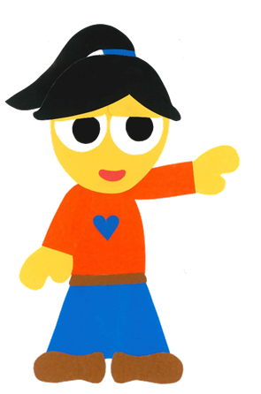
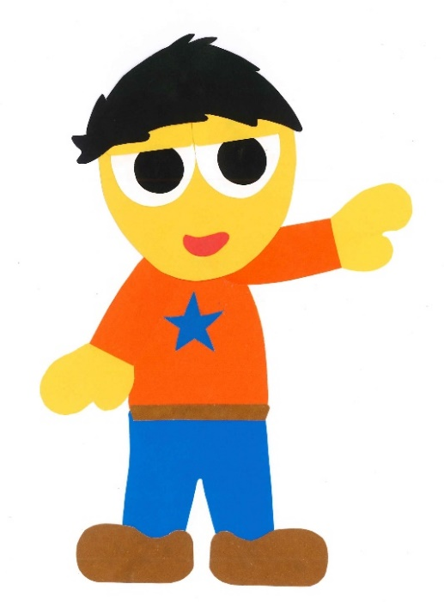
WE
CAN
READ
Donald Joyce

Slide 2
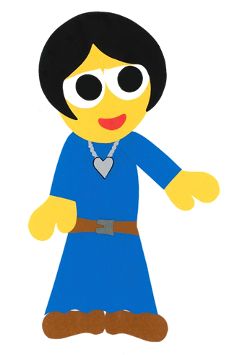
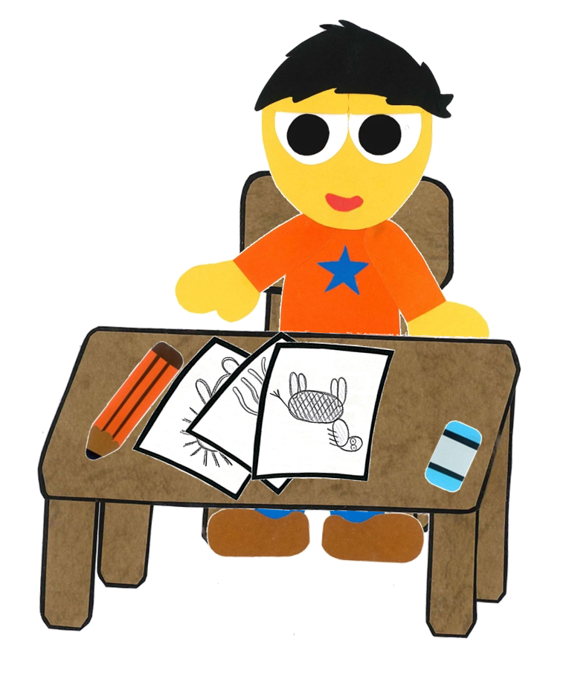
What Is It?
By:
Donald Joyce
WE CAN READ

Slide 3
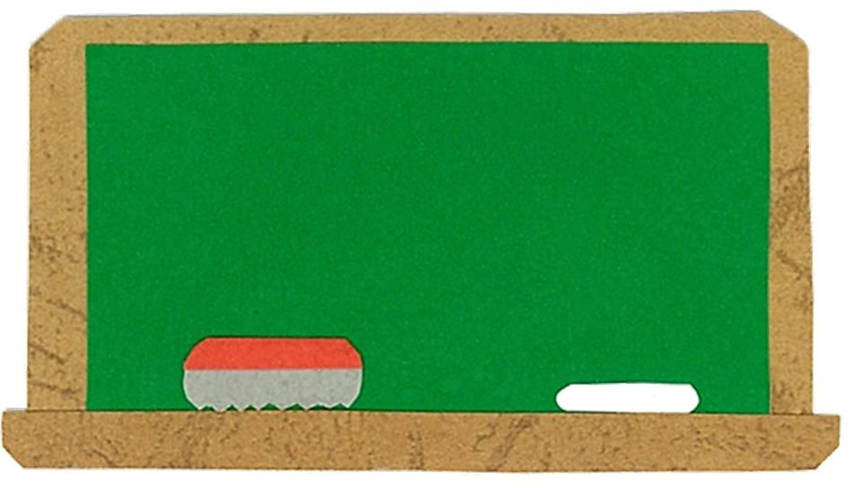
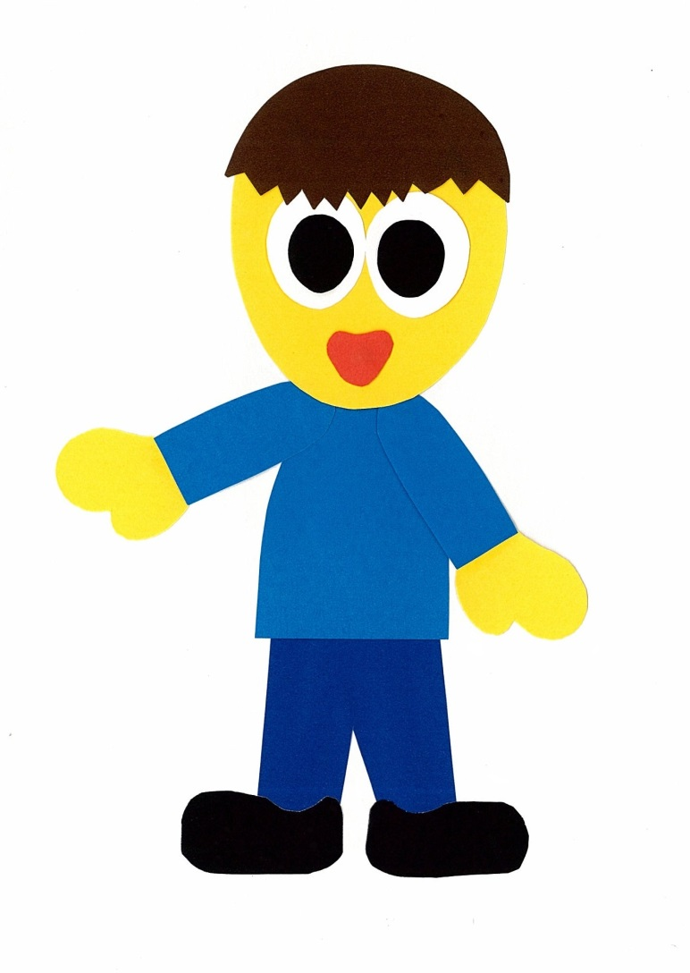
Let’s
Talk!

Slide 4
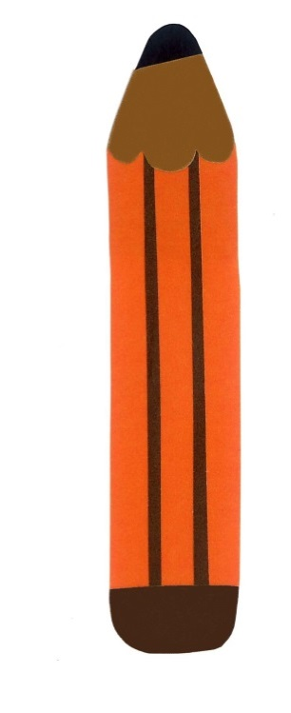
Do you like to draw?
Yes, I do.
No, I don’t.

Slide 5
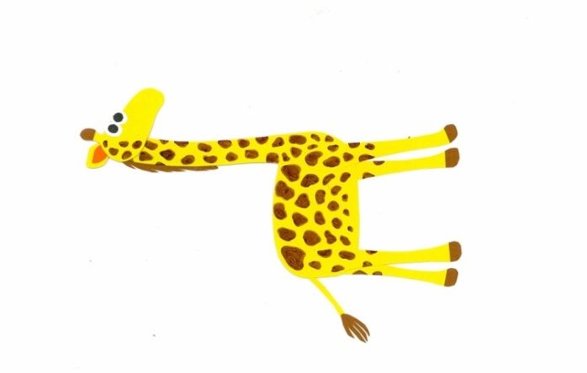
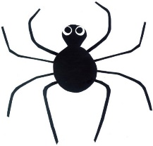
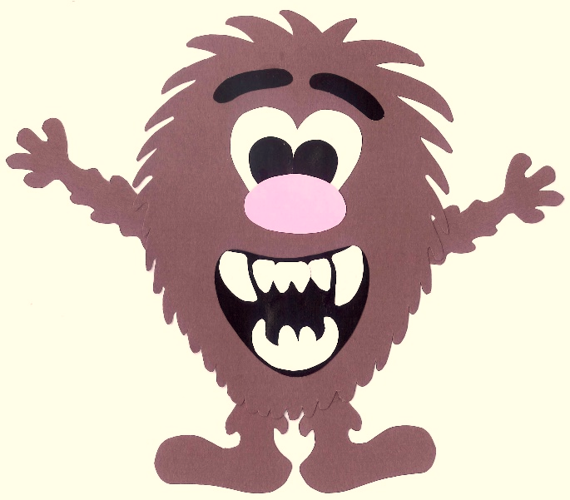
What things do you like to draw?
I like to draw ___.

Slide 6
Let’s
Learn!

Slide 7
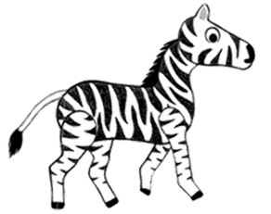
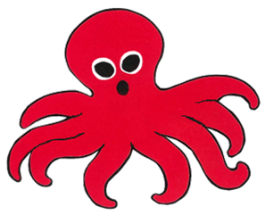
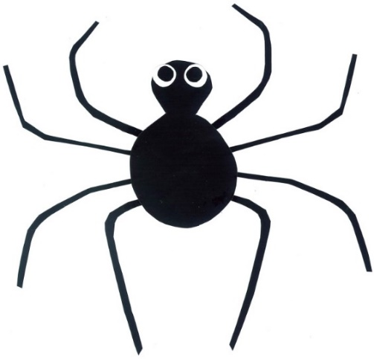
a giraffe
a zebra
a monster
an octopus
a spider

Slide 8
Let’s
Play!

Slide 9
What is it?

Slide 10
It is _____.

Slide 11
It is an octopus.

Slide 12
What is it?

Slide 13
It is _____.

Slide 14
It is a spider.

Slide 15
What is it?

Slide 16
It is _____.

Slide 17
It is a giraffe.

Slide 18
What is it?

Slide 19
It is _____.

Slide 20
It is a zebra.

Slide 21
What is it?

Slide 22
It is _____.

Slide 23
It is a monster.

Slide 24
Good Job!

Slide 25
Let’s
Read!

Slide 26
What Is It?
By:
Donald Joyce
WE CAN READ

Slide 27
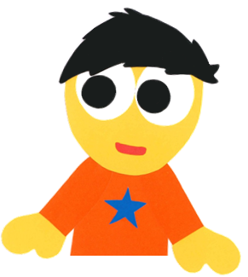
What are you doing?

Slide 28
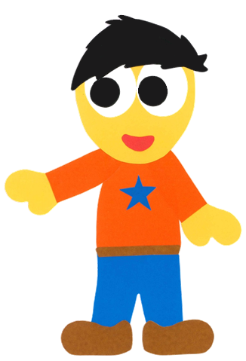
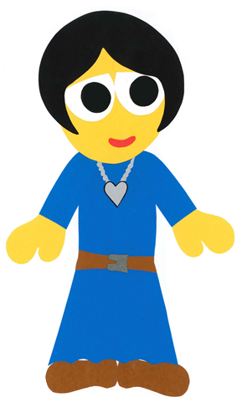
I am drawing.

Slide 29
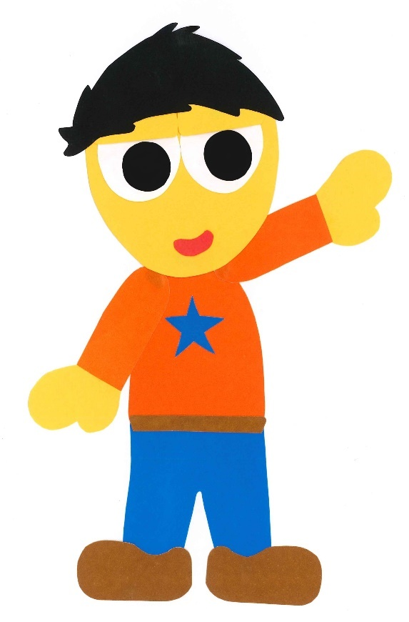
Look at my picture.

Slide 30
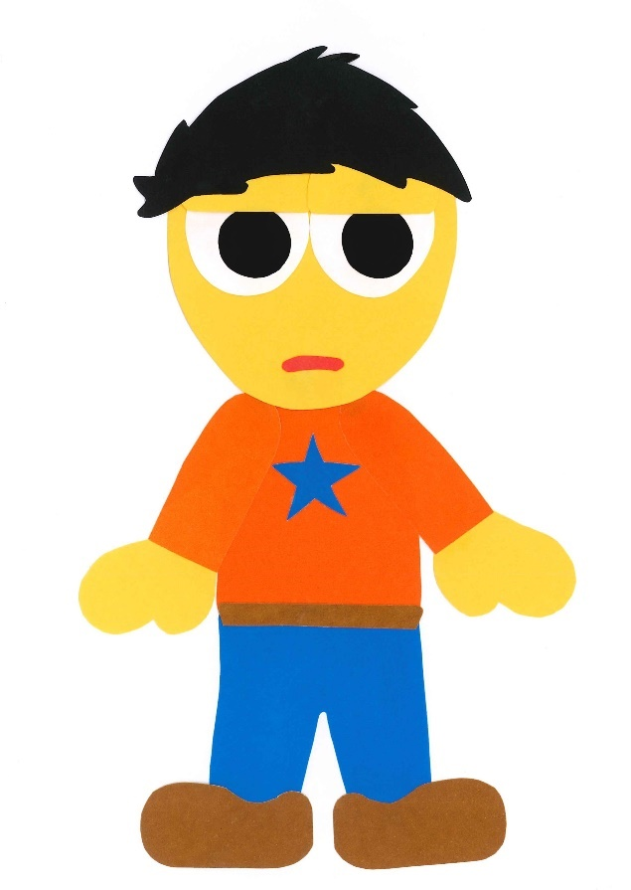
Is it a giraffe?

Slide 31
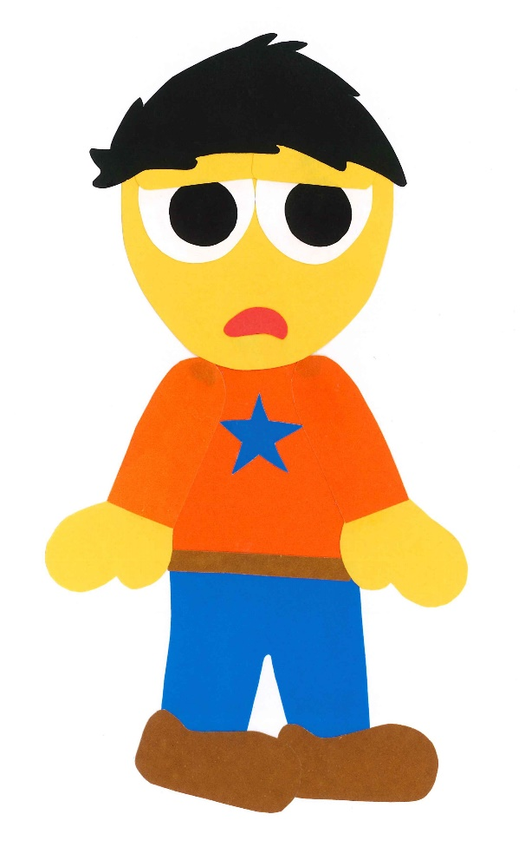
No, it isn’t.

Slide 32
What is it?

Slide 33
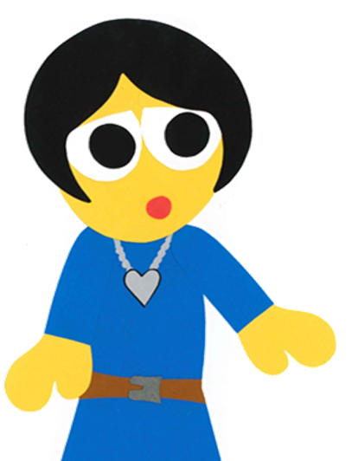
It is a zebra.

Slide 34
Look at this one.

Slide 35
Is it a spider?

Slide 36
No, it isn’t.

Slide 37
What is it?

Slide 38
It is an octopus.

Slide 39
Do you like this one?

Slide 40
Yes, I do.

Slide 41
It is a monster.

Slide 42
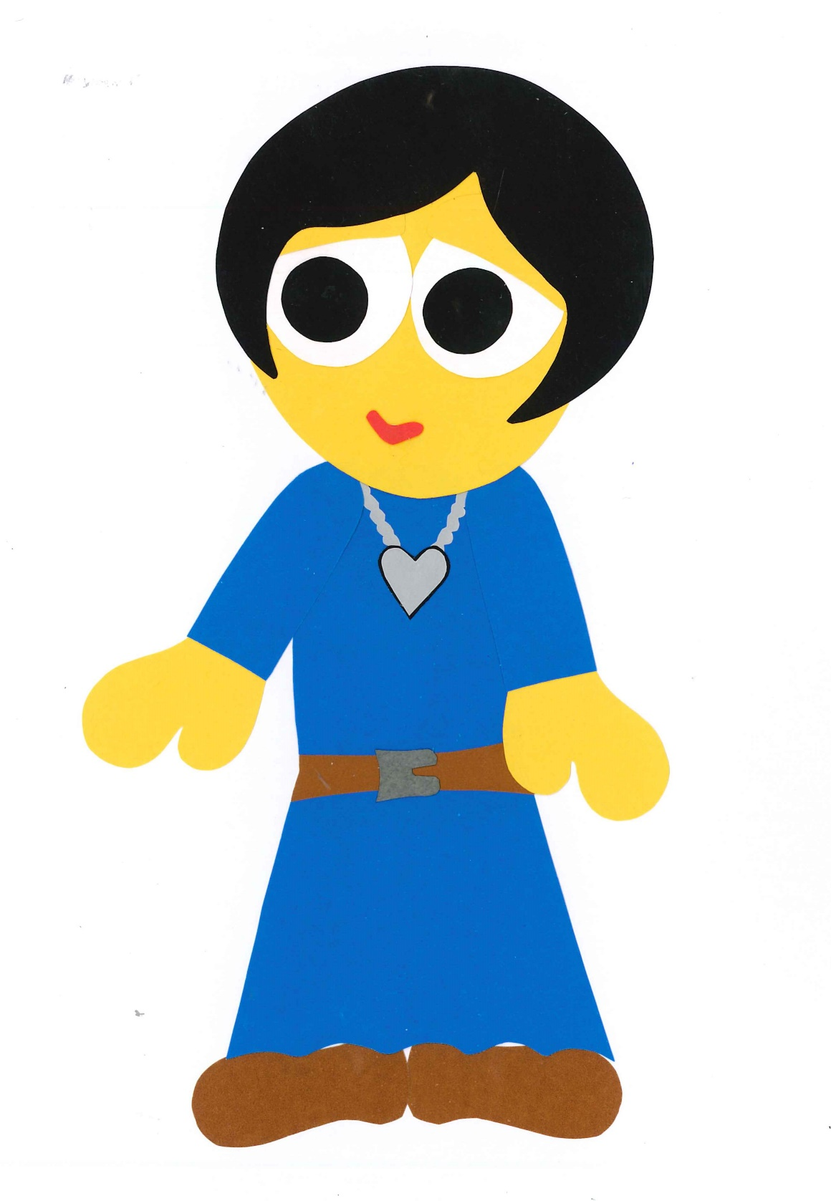
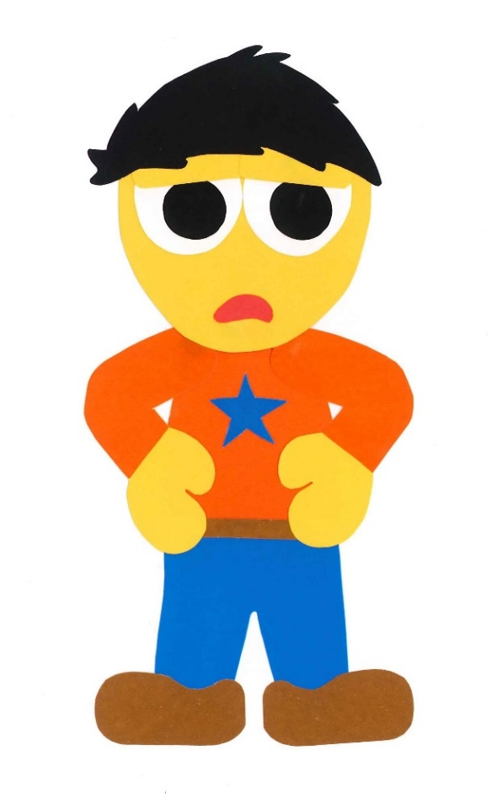
No, it isn’t.

Slide 43
What is it?

Slide 44
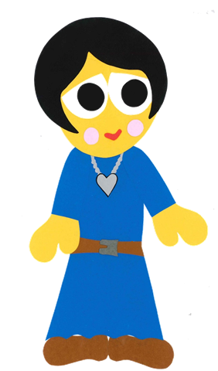
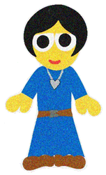
It is you.

Slide 45
What Is It?
By:
Donald Joyce
WE CAN READ

Slide 46
Let’s
Review!

Slide 47
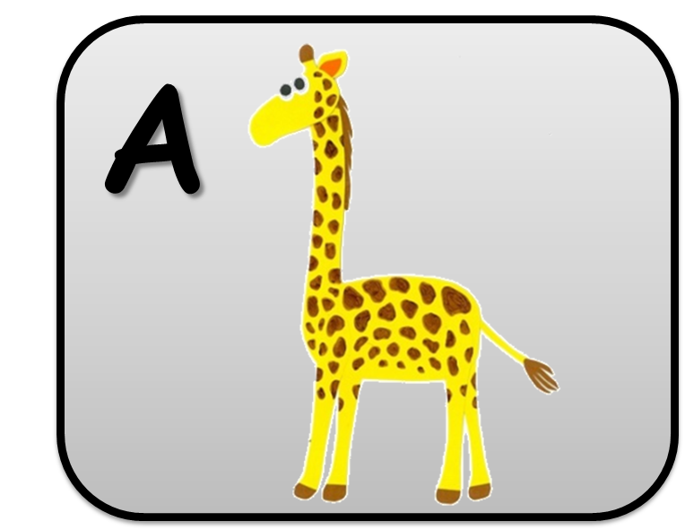
What is it?

Slide 48
What is it?
It is
a zebra.

Slide 49
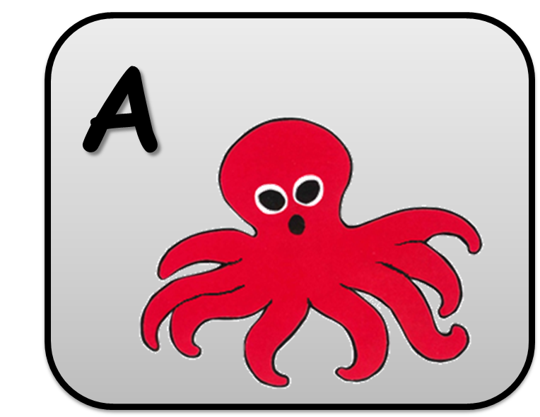
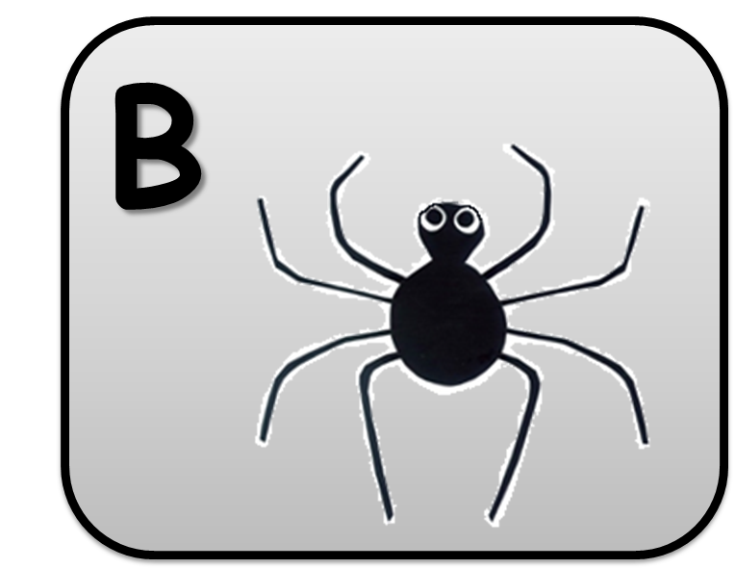
What is it?

Slide 50
What is it?
It is an octopus.

Slide 51
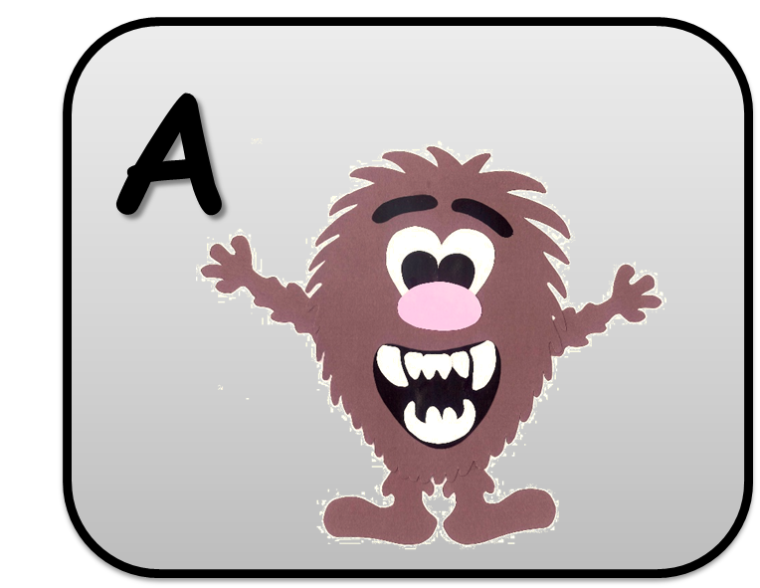
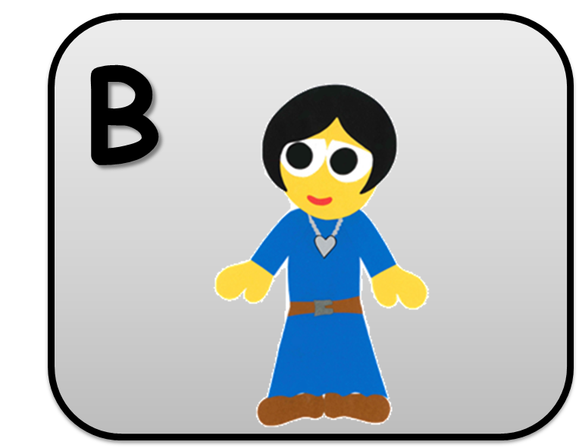
What is it?

Slide 52
What is it?
It is a mother.

Slide 53
Good Job!

Slide 54
Let’s
Connect!

Slide 55
Get a pencil and paper!

Slide 56
Draw a picture.

Slide 57
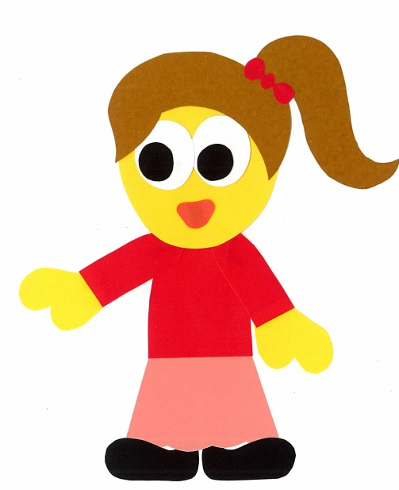
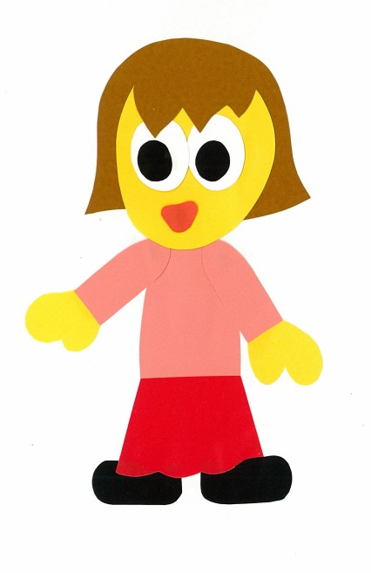
Show your friends.
What is it?
It is
a bird.

Slide 58
WE
CAN
READ
Donald Joyce
www.teacherdonald.com

