Slide 1
Adrenocorticosteroids and adrenocortical antagonists

Slide 2
Chapter 39
- Cortisol (hydrocortisone): pharmacokinetic and pharmacodynamic properties, physiologic effects
- Synthetic corticosteroids: prednisolone and prednisone, betamethasone, dexamethasone (indications, effects and ADRs)
- Mineralocorticoids: fludrocortisone
- Antagonists of adrenocortical agents: mifepristone (see also chapter 40), spironolactone, eplerenone (see also in chapters 11,13,and 15)
Tables 39.1 and 39.2 can be test material

Slide 3
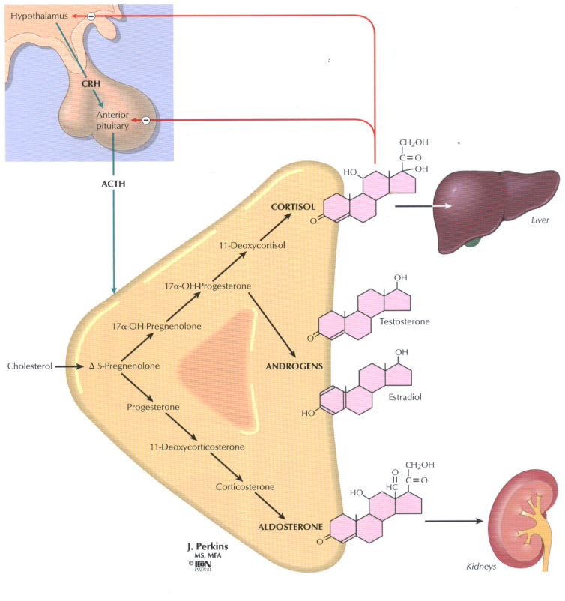
POMC=Proopiomenocorticotropine
Notes:
Adenal cortex produce adrenocorticosteridal hormons. Under the influence of hypothalamus and anterior pituitary gland. Hypothalamus secretes corticotropine releasing hormone that induces anterior pituitary to secrete Adrenocorticotropic hormone that affects adrenal cortex to produce corticosteroids. There are 3 major classes of corticosteroids: glucocorticoides which are under major control of ACTH, cortisol beinig the main hormone 2. mineralocorticoids, aldosterone, salt retaining hormone, which is produced under the influence of angiotensin and steroids having androgenic or estrogenic activity. Dehydroepiandrosterone and androstendion can be converted into estrogens and they are major precursors of estrogen in women after menopause. ACTH is synthesized as a part of greater molecule POMC which is cleved to form beta endorphin and melanocyte – stimulating hormone. When there are adenomas of anterior pituitary, hyperpigmentation as symtom exists asociated with overproduction of POMC.

Slide 4
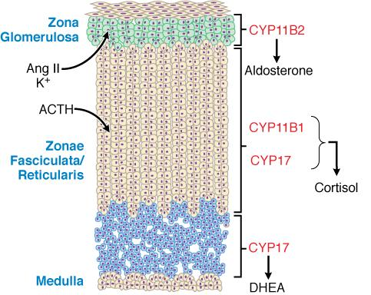
Dehidroepiandrosteron
Notes:
Depending on the enzymes that are expressed in cortical cells in zona glomerulosa aldosteron in zona fasciculata cortisol and in zona reticularis dehidroepiandrosteron is synthetized.

Slide 5
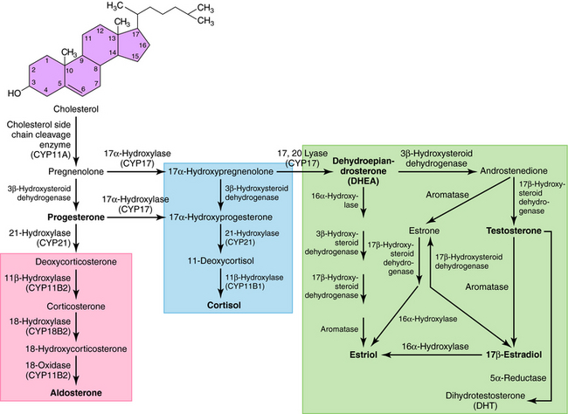
CORTISOL=HYDROCORTISONE=COMPOUND
F=ENDOGENOUS GLUCOCORTICOID
SYNTHETIC GLUCOCORTICOIDS:
PREDNISOLONE, BETAMETHASONE,
DEXAMETHASONE, TRIAMCINOLONE,…
Notes:
Cholesterol must be cleaved from the phospholipids of cell membrain and transported to the inner mitochondrial membrane where steroids are synthesized.

Slide 6
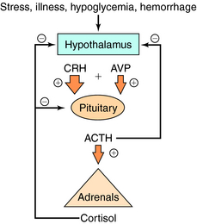
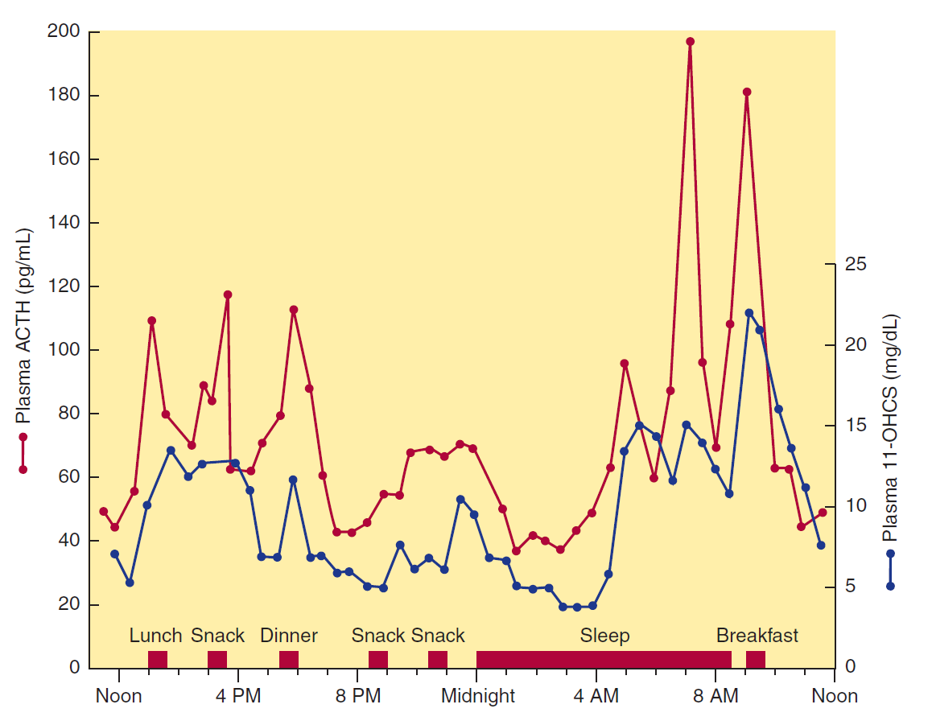
Notes:
In the normal adult, in the absence of stress, 10-20mg of cortisol is secreted daily. The rate of secretion follows a circadian rhythm governed by pulses of ACTH that peak in the early morning hours and after meals, especially after lunch.

Slide 7
Introduction
Main therapeutic uses:
Glucocorticoids
Mineralocorticoids
Replacement therapy for patients with inadequate endogenous cortisol production
Antiinflammatory and immunosuppresant agents
Adjuvants in the treatment of myeloproliferative diseases and other malignant conditions
Replacement therapy for patients with inadequate endogenous aldosterone production

Slide 8
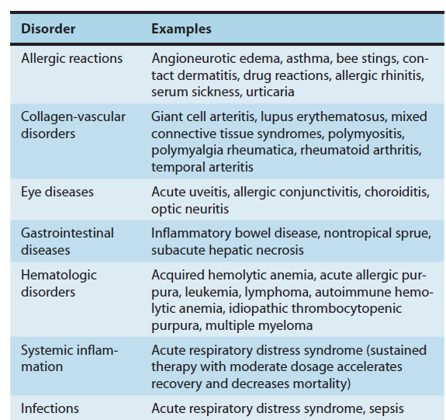

Slide 9
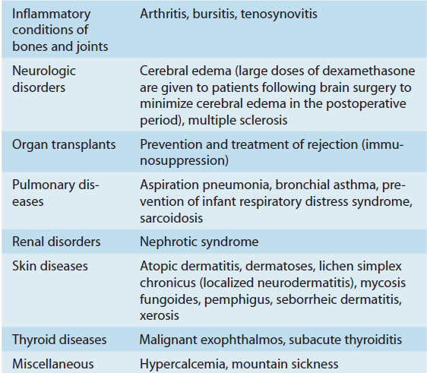

Slide 10
Introduction
CORTISOL
ALDOSTERON
Major endogenous glucocorticoid
Immune response, the stress responese, metabolism, CNS function
The synthesis and secretion tightly reglulated by the hypothalamic-pituitary-adrenal axis
Major endogenous mineralocorticoid
Contributes to the regulation of the Na⁺ and K⁺in extracellular fluid
The synthesis and secretion reglulated primarily by the renin –angiotensin system, K⁺ i ACTH

Slide 11
CORTISOL
Pharmacokinetics: in plasma bound to corticosteroid binding globulin
(CBG)
-half life 60-90 min
-20% of cortisol is converted to CORTISONE
-One third excreted in the urine as 17-hydroxysteroids
-Conjugation with glucuronic acid or sulphate
Pharmacodynamics: glucocorticoid receptors-target genes
-10-20% of expressed genes in cells are regulated by GC
-the effects are due to proteins synthesized from mRNA
transcribed from their target genes.
2 classes of receptors:
1. GR
2. MR binds both
aldosterone and cortisol

Slide 12
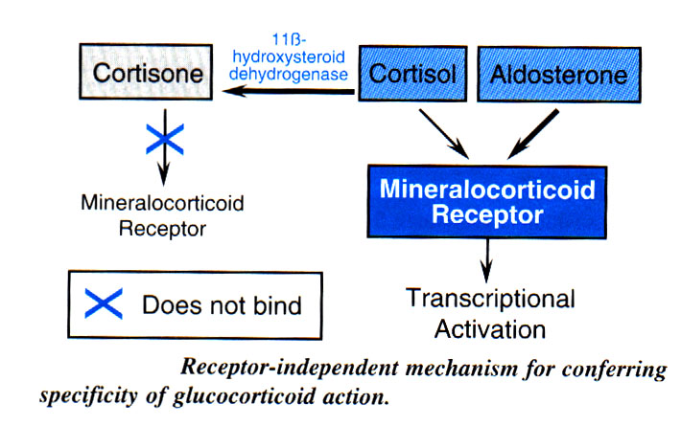

Slide 13
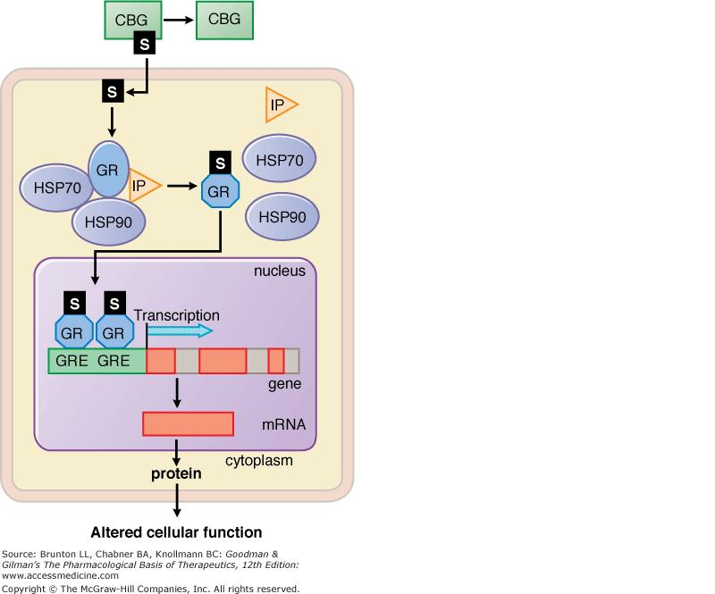
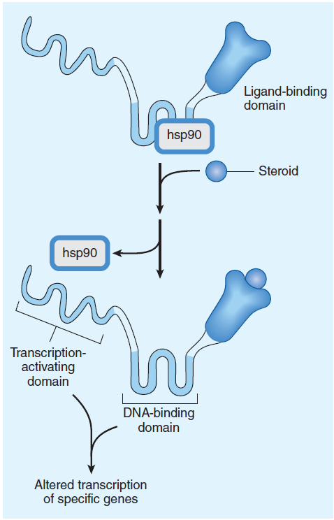
Notes:
In the absence of hormonal molecule, glucocorticoid receptors are primarily cytoplasmic in oligomeric complexes withheta shock proteins. Binding of the free hormone induce conformational changes in receptor that allow it to dissociate from the heat shock proteins. The ligand-bound receptor comlex is then actively transportet into the nucleus where it reacts with DNA and proteins. As a homodimer it binds to glucocorticoid receptor elements in the promoters of responsive genes. Receptor-hormone complex also interacts with transctription factors such as nucler factor kappa B which acts on non GRE containing promoters.

Slide 14
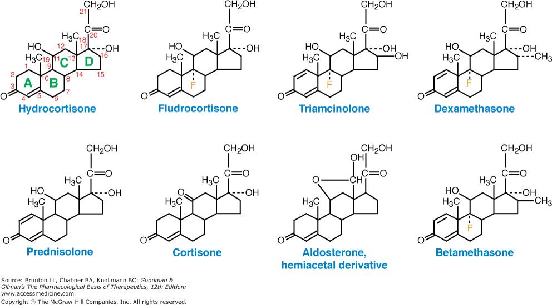
SYNTHETIC CORTICOSTEROIDS

Slide 15
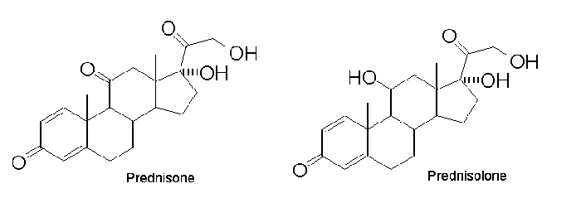
SYNTHETIC CORTICOSTEROIDS
Pharmacokinetics: synthesized from cholic acid obtained from cattle or
steroid sapogenines found in plants
- absorbed completely after per orally administration
-StructureActivityRelationship: alterations in molecule
affects its affinity for glucocorticoid and mineralocorticoid receptors,
rate of elimination, metabolic products, protein-binding affinity,..
Pharmacodynamics: same specific receptor (as cortisol), produce
the same effects but have different ratios of glucocorticoid to
mineralocorticoid potency
Prednisone, inactive is rapidly converted to the active product, Prednisolone

Slide 18
GLUCOCORTICOIDS-effects
Permissive effects- without which many normal organ function and
reactivity to other hormons or neurotransmitters become deficient:
-normal vascular and bronchial smooth musle reactivity
to catecholamines
-the lipolytic response of fat cells to catecholamines,
ACTH and growth hormon
″Direct ″ effects - due to direct, dose-related, actions of cortisol in the
cells.
Effects as the result of homeostatis responsese - due to homeostatic
effects of glucagon and insulin.

Slide 19
GLUCOCORTICOIDS-effects
Metabolic effects:
CARBOHYDRATES:
-increase serum glucose level and thus stimulate insulin release
-stimulate gluconeogenesis and glycogen synthezis in fasting state
-inhibit the uptake of glucose in muscle cells
PROTEINS:
-stimulate muscle catabolism and the release of amino acids
FAT:
-stimulate lipolysis
-increased insulin level stimulates lipogenesis (homestatic response to
incresed glucose levels)
-net result: incresed fat deposition and incresed release of fatty acids
and gycerol in circulation

Slide 20
GLUCOCORTICOIDS-effects
Net effects on metabolism are most apperent in the fasting state:
The supply of glucose from gluconeogenesis+
The relaese of amino acids from muscle catabolism+
The inhibition of peripheral glucose uptake+
The stimulation of lipolysis=
SUFFICIENT GLUCOSE SUPPLY TO THE BRAIN

Slide 21
GLUCOCORTICOIDS-effects
CATABOLIC AND ANTIANABOLIC EFFECTS:
DECREASED MUSCLE MASS , THINNING OF THE SKIN
OSTEOPOROSIS: major limitation of long term therapeutic use of
glucocorticoides
3. In children glucocorticoides REDUCE GROWTH

Slide 22
GLUCOCORTICOIDS-effects
ANTI-INFLAMMATORY AND IMMUNOSUPPRESSIVE EFFECTS:
REDUCED MANIFESTATIONS OF INFAMMATION
CELLS:
concentration, distribution and function of leucocytes :
-INCREASED number of NEUTROPHILS,
-DECREASED number of lymphocytes (T and B),
monocytes, eosinophils and basophils
-INHIBIT the functions of tissue macrophages and antigen-presenting
cells (decreased phogocytosis and killing of microorganisms)
2. MEDIATORS OF INFLAMMATION:
- decreased synthesis of cytokines and chemokines, factors that result
from the activation of phospholipase A₂ and COX-2
- Suppressed mast cells degranulation, and release of histamine

Slide 23
GLUCOCORTICOIDS-effects
CNS:
- adrenal insufficiency: depression
- increased amounts of glucocorticoides: initially insomnia and
euphoria and subsequently depression ; increased intracranial pressure
(pseudotumor cerebri)
2. SUPPRESSION OF PITUITARY RELEASE OF: ACTH, growth hormone,
thyroid stimulating hormone, luteinizing hormone
3. PEPTIC ULCER
4. FAT REDISTRIBUTION: increase of visceral, facial, nuchal and
supraclavicular fat
5. Antagonizing the effects of vitamin D on calcium absorption
6. Development of the fetal lungs

Slide 24
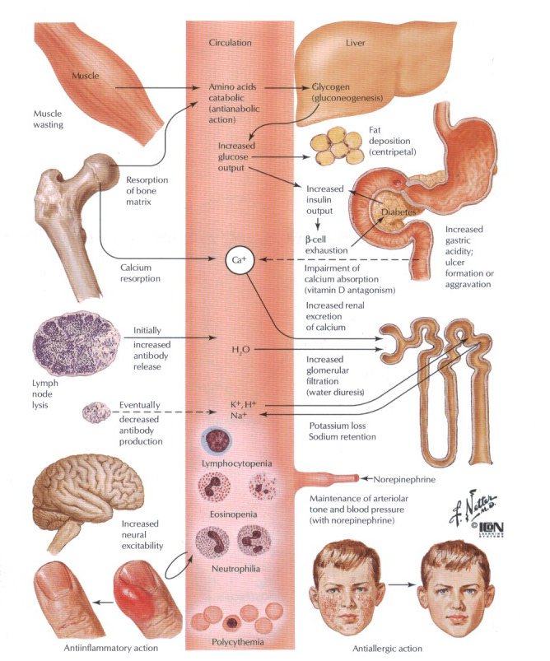

Slide 25
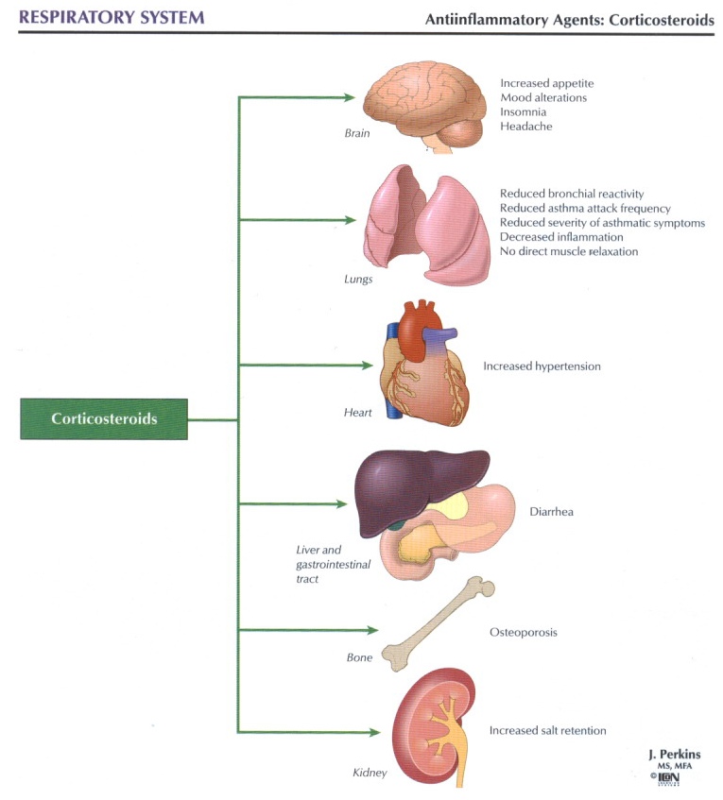

Slide 26
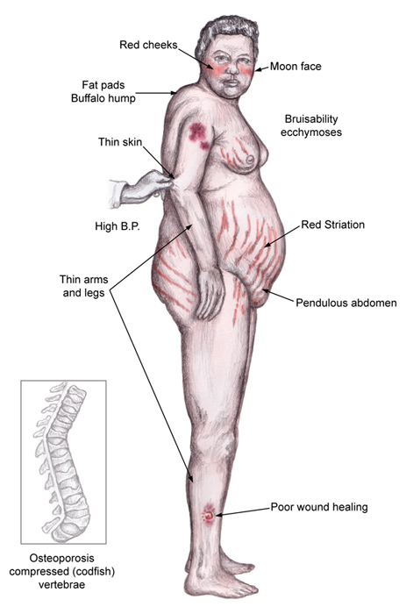
GLUCOCORTICOIDS- adverse effects
Iatrogenic Cushing's syndrome-induced by corticosteroid therapy

Slide 27
GLUCOCORTICOIDS- adverse effects
increased growth of fine hair over the face, thighs and trunk
steroid-induced punctate acne
insomnia and increased appetite
hypomania or acute psychosis
increased intraocular pressure, glaucoma
steroids which have mineralocorticoid effects cause sodium
and fluid retention and loss of potassium:
In patients with normal cardiovascular and renal function,
this leads to a hypokalemic, hypochloremic alkalosis and
a rise in blood pressure.
In patients with heart disease, even small degrees of sodium
retention may lead to heart failure.

Slide 28
Adrenal Suppression
The regulatory centers respond to synthetic glucocorticoids as they do to cortisol. Administration of exogenous cortisol or any other glucocorticoid reduces the amount of endogenous cortisol needed to maintain homeostasis. Release of CRH and ACTH declines ("inhibition of higher centers by exogenous glucocorticoid”) and, thus, cortisol secretion (“adrenocortical suppression”).
After weeks of exposure to unphysiologically high glucocorticoid doses, the cortisol-producing portions of the adrenal cortex shrink (“adrenocortical atrophy”). When glucocorticoid medication is suddenly withheld, the atrophic cortex is unable to produce sufficient cortisol and a potentially life-threatening cortisol deficiency may develop. Therefore, glucocorticoid therapy should always be tapered off by gradual reduction of the dosage.
Notes:
Release of cortisol depends
on stimulation by hypophyseal ACTH,
which in turn is controlled by hypothalamic
corticotropin-releasing hormone
(CRH). In both the hypophysis and hypothalamus
there are cortisol receptors
through which cortisol can exert a feedback
inhibition of ACTH or CRH release.
By means of these cortisol “sensors,” the
regulatory centers can monitor whether
the actual blood level of the hormone
corresponds to the “set-point.” If the
blood level exceeds the set-point, ACTH
output is decreased and, thus, also the
cortisol production. In this way cortisol
level is maintained within the required
range.

Slide 29
Regimens for prevention of
adrenocortical atrophy. Cortisol secretion
is high in the early morning and low in the late evening (circadian rhythm). This fact implies that the regulatory centers continue to release CRH or ACTH in the face of high morning
blood levels of cortisol; accordingly, sensitivity to feedback inhibition must be low in the morning, whereas the opposite holds true in the late evening.
a) Circadian administration: The daily dose of glucocorticoid is given in the morning. Endogenous cortisol production will have already begun, the regulatory centers being relatively insensitive to inhibition. In the early morning hours of the next day, CRF/-ACTH release and adrenocortical stimulation will resume.
b) Alternate-day therapy: Twice the daily dose is given on alternate mornings. On the “off” day, endogenous cortisol production is allowed to occur.

Slide 30
Mineralocorticoids: ALDOSTERONE
- Major endogenous mineralocorticoid
- Contributes to the regulation of the Na⁺ and K⁺in extracellular fluid
- The synthesis and secretion reglulated primarily by the renin –angiotensin system, K⁺ i ACTH

Slide 31
ALDOSTERONE
Pharmacodynamics: mineralocorticoid receptors-target genes-
increased expression of Na-K ATPase and the epithelial sodium
channel (ENaC)
Effects: promotes the reabsorption of sodium from the distal part of the
distal convoluted tubule and from the cortical collecting renal tubules,
coupled to the excretion of potassium and hydrogen ion;
-hypokalemia, metabolic alkalosis
-increased plasma volume, hypertension
MR binds both
aldosterone and cortisol
The specificity for mineralocorticoids in the kidney appears to be conferred by the presence of the enzyme 11beta -hydroxysteroid dehydrogenase type 2, which converts cortisol to cortisone. The latter has low affinity for the receptor and is inactive as a mineralocorticoid or glucocorticoid.

Slide 32
Mineralocorticoids: fludrocortisone
-glucocorticoid and mineralocorticoid effect
-replacement therapy for patients with inadequate endogenous aldosterone
production
-too small doses for significant anti-inflammatory or antigrowth effects

Slide 33
Antagonists of adrenocortical agents:
mifepristone
- glucocorticoid receptor antagonist
- strong antiprogestin activity:a contraceptive-contragestive agent
high doses of mifepristone exert antiglucocorticoid activity by blocking
the glucocorticoid receptor, mifepristone binds to it with high affinity
-the mean half-life of mifepristone is 20 hours
In humans, mifepristone causes generalized glucocorticoid resistance
Clinical indications: inoperable patients with ectopic ACTH secretion or
adrenal carcinoma who have failed to respond to other therapeutic
manipulations

Slide 34
Mifepristone as a progesterone antagonist (Chapter 40)
- binds strongly to the progesterone receptor and inhibits the activity of progesterone
- effective emergency postcoital contraceptive
Mifepristone's major use: to terminate early pregnancies
(usually in combination with oral misoprostol)
-The adverse effects of the medications: vomiting, diarrhea, and abdominal or pelvic pain

Slide 35
Antagonists of mineralocorticoid agents:
spironolactone and eplerenone
-compete with aldosterone for its receptor and decrease its effect peripherally
-Spironolactone onset of action is slow; the effects last for 2–3 days after the drug is discontinued
the treatment of primary aldosteronism
an androgen antagonist;used in the treatment of hirsutism in women
-as a diuretic has benefits in heart failure greater than those predicted from its diuretic effects alone
- Adverse effects:hyperkalemia, cardiac arrhythmia, menstrual abnormalities, gynecomastia, sedation, headache, gastrointestinal disturbances, and skin rashes

Slide 36
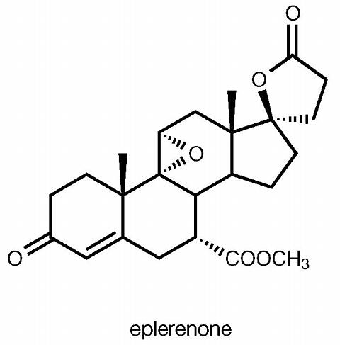
Eplerenone - aldosterone antagonist
the treatment of hypertension
more selective than spironolactone; no reported effects on androgen receptors
- the most common toxicity is hyperkalemia but this is usually mild.

