Slide 1
Making sense of the single central record, DBS and other vetting checks what you need to know Carolyn Eyre

Slide 2
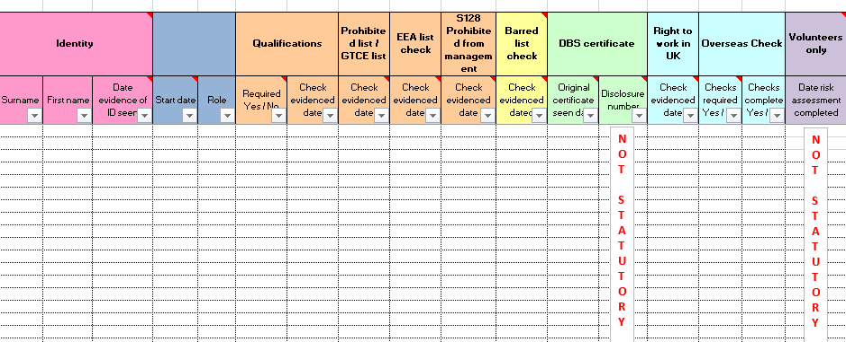
A stick to beat you with
carolyneyre.com

Slide 3
A stick to beat you with - ISI
carolyneyre.com

Slide 4
Changes to DBS introduced in 2012
New definition of regulated activity for adult and children’s sector
Repeal of registration & monitoring; controlled activity; and ‘additional information’
Introduced a minimum age (16) at which someone can apply for a criminal check
More rigorous relevancy test for when police release information on criminal record checks
DfE issued guidance on ‘supervision’ in relation to children.
Most people will be barred only if they have engaged, are engaging in or might in the future engage in Regulated Activity
carolyneyre.com

Slide 5
What didn’t change
School leaders have a legal duty to make appropriate referrals to DBS for consideration of barring when an employee is dismissed as a result of a safeguarding matter
Schools must not employ someone whom they know has been barred from working with children
People on the children’s barred list are breaking the law if they seek work with children. Those on the adult barred list are breaking the law seeking work in regulated activity with adults.
Those only on the children’s barred list can work with vulnerable adults and vice versa
carolyneyre.com

Slide 6
Scope of regulated activity: children
Unsupervised activities: teach, train, instruct, care for or supervise children, or provide advice / guidance on wellbeing, moderate an online service or drive a vehicle only for children
Work in a limited range of establishments, (specified places) e.g school, children’s home, childcare premises ... but not by supervised volunteers
Relevant personal care, such as washing, dressing, feeding, healthcare by or supervised by a health-care professional
Registered child-minding / foster carers
carolyneyre.com

Slide 7
Regulated activity: children (cont’d)
Work under (1) or (2) is Regulated only if done regularly (by same person once per week or more, 4 or more days in a 30 day period or in some cases* overnight)
Regulated activity excludes:
Family arrangements
Personal, non-commercial arrangements
*between 2am – 6am
carolyneyre.com

Slide 8
No longer in RA (1)
Activities
Activity supervised at a reasonable level
Healthcare not by (or directed or supervised by) a health care professional
Legal advice
Treatment / therapy (instead covered by ‘health care’ )
BUT relevant personal care is Regulated Activity even if only done once and even if supervised
carolyneyre.com

Slide 9
No longer in RA (2)
Establishments
Occasional or temporary services, e.g. maintenance (not teaching, etc)
Volunteers supervised at a reasonable level
Office holders (England)
All positions removed, e.g. governors, trustees
Inspectorates removed
carolyneyre.com

Slide 10
DfE guidance on ‘supervision’
The DfE issued guidance in September 2012 (also in KCSiE 2020) to clarify what is meant by ‘supervision’ in relation to volunteers, contractors and other visitors to schools.
‘Supervision’ must be sufficient and regular, and undertaken by someone who has been checked against the barred list BUT
It does not have to be constant
It does not mean visitors must be accompanied at all times
It is for schools to determine what level of supervision is needed, bearing in mind the nature of the activity, how vulnerable the pupils are, the layout of the room, etc.
carolyneyre.com

Slide 11
Regulated activity: adults
From 10th September 2012, those who provide:
Healthcare: a health care professional or acting under the direction or supervision of one, e.g. doctor, physiotherapist
Personal care: assistance with washing, dressing, eating, drinking and toileting – or teaching someone to do these things
Social work: provision by a social care worker of social work in connection with health need or social services
carolyneyre.com

Slide 12
Regulated activity: adults (cont’d)
Assistance with a person’s cash, bills or shopping due to their age, illness or disability
Assistance with conduct of an adult’s own affairs, e.g lasting or enduring power of attorney*
Conveying adults for reasons of age, illness, disability to, from or between places where they receive healthcare, personal care or social work. This would not include friends, family or taxi drivers
NB There is no requirement to do activities a certain number of times before a person is engaging in regulated activity with adults
carolyneyre.com

Slide 13
The different DBS checks
Standard DBS Enhanced DBS DBS enhanced
check check with list check
PNC
PNC
Police information
PNC
Children’s barred list
Police information
Adult’s barred list

Slide 14
Changes to be aware of
These roles are no longer in regulated activity:
Occasional or temporary services, e.g. maintenance, building contractors, etc
Volunteers supervised at a reasonable level
Governors
Ofsted / ISI inspectors
Some central LA staff, unless they work directly and unsupervised with children on a regular basis
This means we cannot check the barred lists for these individuals … we would be breaking the law...
BUT we can still undertake DBS certificates on
volunteers and some contractors if we feel it is appropriate
carolyneyre.com

Slide 15
In short
You can only check someone against the DBS barred list if you have a legal right to do so …..
…. this means you can only check the barred list if you are the employer and the person is (or will be) in regulated activity
As the employer, you may still be able to ask them to undertake a DBS certificate
carolyneyre.com

Slide 16
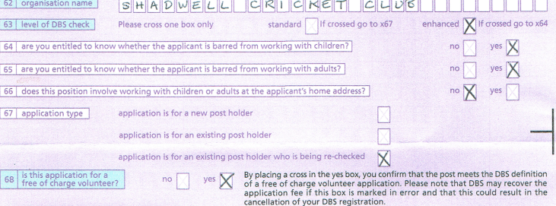
In short
carolyneyre.com

Slide 17
Teaching Regulation Agency
Standard DBS Enhanced DBS DBS enhanced TRA
check check with list check
PNC
Prohibited list
S128 prohibited from management
GTCE sanctions
EEA sanctions
Did not complete induction
PNC
Police information
PNC
Children’s barred list
Additional police information
Adult’s barred list

Slide 18
Prohibited list checks
Covered by Education (independent school standards) Regulations 2014
People in ‘teaching work’ recruited after September 2012 must be checked against the TRA prohibited list before they commence in post
This is not done as part of the DBS certificate
Schools need to register with Teacher Services (formerly Employer Access Online – now accessed via DfE Sign in) to undertake these checks
You can check by DfE number (if they have QTS) or by clicking on the ‘Prohibited list’ link
The check is instant and there is no charge
The regulations state that the prohibited list check must be recorded on the school’s SCR
carolyneyre.com

Slide 19
Teachers Services website
carolyneyre.com

Slide 20
S128 Prohibition from management
Applies to independent schools, free schools and academies
Anyone in management in those schools must be checked against the s128 list
‘Management’ means members of SLT, other senior managers in schools and governors / trustees / proprietors
You can check via their teacher number (if QTS) or by clicking on the s128 link on Teachers Services website
There are currently only 12 people subject to s128 prohibition from management!
Maintained school governors should also be checked to ensure they are not on s128 list
carolyneyre.com

Slide 21
European Economic Area (EEA) checks
Check any new recruit whose employment history indicates that they have previously taught in an EEA nation
The list is accessed via the Teacher Services website – click on the EEA list hyperlink
There are currently about 500 named individuals on this list
Other EEA members must check any new recruits that have previously worked in the UK
NB – At the moment, we do not know what impact Brexit will have but it is likely that EEA checks will end
carolyneyre.com

Slide 22
GTCE list
There are a small number of teachers on the GTCE list who were not transferred to the prohibited list
Since September 2018, it has been a statutory duty for academies and independent schools to check this list (previously only maintained schools)
The list is accessed via the Teacher Services/ DfE Sign in website – click on the GTCE list hyperlink
carolyneyre.com

Slide 23
Disqualification under the Childcare Act 2006 (Regulations 2018)
Applies to:
Staff working in early years provision including teachers/support staff in nursery & Reception classes
Lunch time supervisors caring for under 5s
Staff working in later years provision (for children under age 8) such as before & after school care
Staff in residential / boarding schools where there are children under the age of 8
Staff directly concerned in managing this provision
It does not apply to after school / hobby clubs
It does not apply to office staff or staff who are employed to work with older year groups but occasionally assist in the foundation stage
carolyneyre.com

Slide 24
carolyneyre.com

Slide 25
‘Disqualification from caring for children’ Regs 2002
This is different to Disqualification under the Childcare Act 2006.
Applies to:
Staff employed to work in children’s homes
Private / public foster carers
Social workers
It does not apply to care staff in residential special schools
carolyneyre.com

Slide 26
Childcare disqualification requirements
Who is disqualified?
People convicted of certain violent and sexual offences against children
Grounds relating to care of their own child
Have previously been prevented from running a children’s home or private fostering
carolyneyre.com

Slide 27
The Update service
If Mr A is offered a new job in your school, he will apply for a DBS certificate in the usual way.
From submitting his application to DBS to 30 days after the certificate being issued, Mr A can contact the DBS to register with the Update service. If he wishes to do so, he will provide the DBS with his bank details and they will debit £13 registration fee.
Every year, he will be asked whether he wishes top remain registered and the £13 will be debited from his account
The DBS has no facility for employers to pay the £13 on Mr A’s behalf
carolyneyre.com

Slide 28
Update service continued
Mr A then volunteers as a football coach on Sunday mornings
He takes his DBS certificate to show to the football club along with evidence of his identity.
The football club is able to check his DBS status on-line – if his status is ‘unchanged’ then he can start coaching immediately.
The football club does not need to undertake a new disclosure
carolyneyre.com

Slide 29
Update service continued
He is also asked to do some volunteering with adults at a local residential centre for people with severe learning difficulties
He takes his DBS certificate to show to the centre manager along with evidence of his identity
The manager notes that the DBS certificate has been undertaken for the children’s workforce NOT the adult sector. The manager cannot accept the check as portable and must ask Mr A to undertake a new certificate
carolyneyre.com

Slide 30
Update service continued
In 2 years’ time, Mr A applies for a new role in another school.
Once the new school offers him the post, he takes his DBS certificate to show them along with evidence of his identity.
The new school is able to check his DBS status on-line – if his status is ‘unchanged’ then he can start work immediately.
The school does not need to undertake a new disclosure.
carolyneyre.com

Slide 31
If the situation changes
Suppose Mr A is convicted of an offence against children.
The football club and the new school should become aware - often via the LADO - that a new check is needed because his status has changed (i.e. there is new information)
The football club and new employer would need to undertake a new disclosure to determine whether he is still suitable for the role
Your school will not be informed as he is no longer employed by you
carolyneyre.com
Notes:
LADO would be notified because the police would see on the system that he has a DBS certificate

Slide 32
Mr A then decides to apply to be a cricket coach.
He takes his DBS certificate (which is now 3 or 4 years old) and evidence of identity to the cricket club.
The cricket club do an online check – this tells them that his status has changed (i.e. that there is new information since his certificate was printed) so the cricket club must seek a new DBS disclosure.
The cricket club thus sees his criminal conviction and can decide whether he is suitable for the role.
carolyneyre.com

Slide 33
Benefits of the Update service
Staff who have more than one role will no longer need multiple checks (if the roles are similar)
There will be no need to undertake routine renewals on existing staff – releasing more money for schools to spend on other things
Once this is embedded, recruitment will be speedier as we will rarely have to wait for DBS certificates to be applied for and issued
Employers will not be able to check staff online without their knowledge – they can only check if you give consent
Individuals will be able to see via their personal account who has checked them online & when
carolyneyre.com

Slide 34
Looks great – so what’s the problem?
We can each choose to register with the Update service on an individual basis
The DBS has no facility for employers to pay the £13 annual fee on behalf of staff
It will be for employers to decide whether they wish to reimburse employees and, if so, how this might be achieved
Whilst we might want to make registration with the Update service a requirement of the role for any future appointees, the issue of reimbursement will need to be resolved first
Further advice / consultation is needed with employers, governing bodies and trade union / staff representatives on whether existing staff could be required to register with the Update service – or will rely on goodwill
carolyneyre.com
Notes:
* It has just become an ofsted requirement for childcare providers … watch this space!!!

Slide 35
The Single Certificate
Until 2013, when we applied for a criminal disclosure the individual and the employer both received a copy
This is no longer the case – employees and prospective employees will receive the single certificate and are then required to bring this certificate in for the Head teacher* to see
Employer MUST see the actual certificate – not a photocopy or electronic snapshot from the registered body
If an individual does not agree with the information on their certificate, they are able to challenge this with the DBS before an employer or registered body has seen the details
There will be no ‘soft intelligence’ (information disclosed to the employer by the police about an individual but not included on their certificate)
carolyneyre.com
Notes:
* 28 day rule

Slide 36
Implications for schools & colleges – single certificate
You will see the individual’s DBS certificate which may include criminal information – all schools must therefore adopt a ‘recruitment of ex-offenders’ policy before you next recruit
Need to think through the training implications of this – who will see the certificate? Are they aware of the ROA legislation? Have they had training in how to handle criminal data? *
Who is going to undertake the interview / risk assessment when criminal information is disclosed? How will you tie in what was disclosed prior to interview with DBS disclosure?
How will you store this information?
carolyneyre.com

Slide 37
Filtering and protected offences
The law changed in 2013 to allow for ‘filtering’ – certain minor or old convictions and cautions are no longer disclosed on DBS certificates
These are referred to as ‘protected’ offences
Applicants must not be asked to disclose ‘spent’ convictions – ensure your application form has been amended!!!!
If an applicant accidentally discloses ‘protected’ offences, it would be unlawful for the employer to take them into consideration – ensure all recruiting staff know this
carolyneyre.com

Slide 38
Filtering and protected offences
“Job application forms will need to reflect the filtering changes so that a) employers ask the right questions and b) employees give the right (legally accurate) answer.” Employers are encouraged to include the paragraph below in their standard application forms:
The amendments to the Exceptions Order 1975 (2013) provide that certain spent convictions and cautions are 'protected' and are not subject to disclosure to employers , and cannot be taken into account. Guidance and criteria on the filtering of these cautions and convictions can be found on the Disclosure and Barring Service website.

Slide 39
Implications for schools & colleges - recruitment
Safer recruitment techniques apply to volunteers – do you have a person spec / application form, do you take up references?
Any volunteers not in regulated activity must have a written risk assessment to determine whether a DBS certificate is appropriate
Have you changed all adverts / application forms / other materials to reflect DBS changes?
If you need to undertake stand-alone Barred list checks, will your RB do this for you and do they charge?
carolyneyre.com

Slide 40
Implications for schools & colleges - other
Are staff aware that you expect them to notify you of any cautions / convictions gained during their employment?
Will you provide all potential applicants with the ‘recruitment of ex-offenders’ policy or just include a paragraph about it & direct them to your website?
How do you ensure that applicants understand the filtering rules and do not disclose protected offences?
Single central record ……
carolyneyre.com

Slide 41
Further information
DBS website www.gov.uk/government/organisations/disclosure-and-barring-service
Keeping children safe in education (DfE 2020) https://www.gov.uk/government/uploads/system/uploads/attachment_data/file/350747/Keeping_children_safe_in_education.pdf
DfE statutory supervision guidance (Sep 2012) www.education.gov.uk/aboutdfe/statutory/g00213977/supervision-guidance
Disqualification under the Childcare Act 2006 (Regulations 2018) https://www.gov.uk/government/publications/disqualification-under-the-childcare-act-2006/disqualification-under-the-childcare-act-2006

