Slide 1
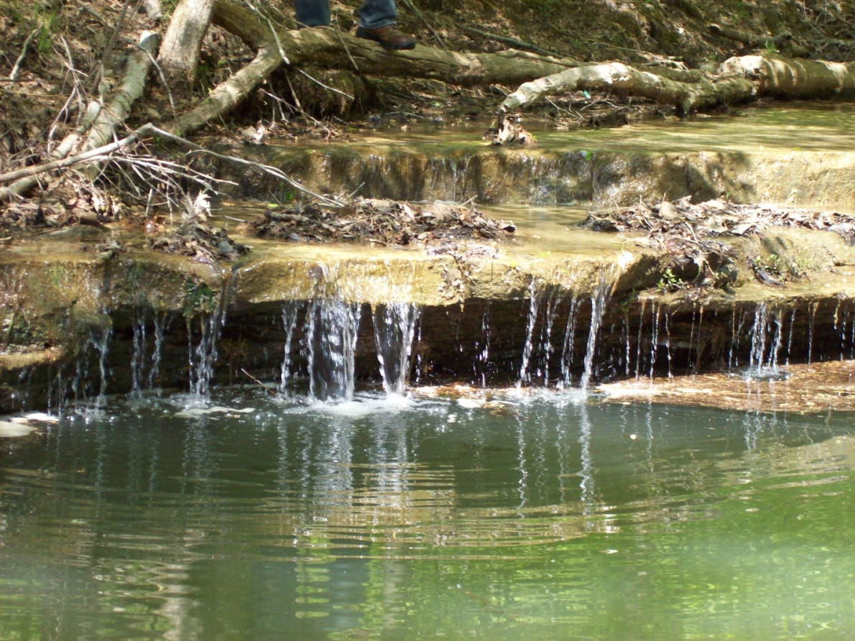
Central Muscatatuck Watershed

Slide 2
BMPs Cost-Shared by Central Muscatatuck Watershed Project

Slide 3
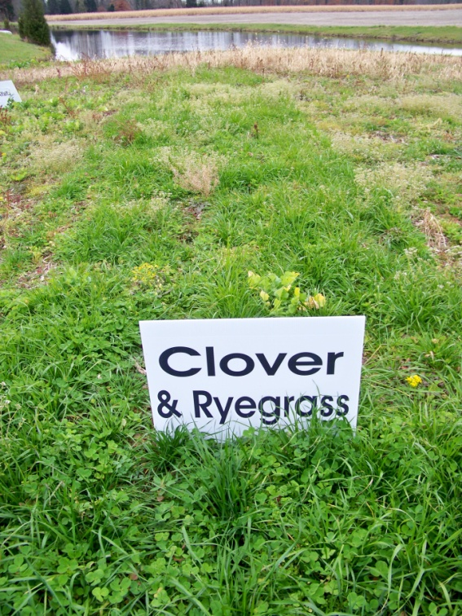
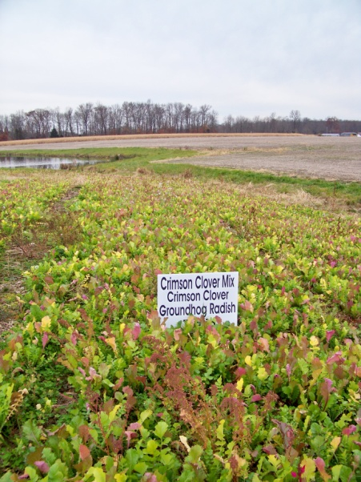
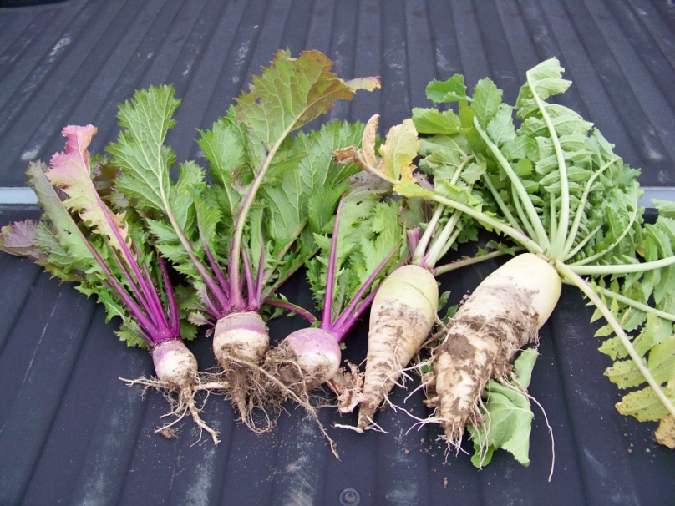
Cover Crops
Benefits:
Reduce Erosion
Increase Soil Organic Matter
Provide Supplemental Forage
Minimize & Reduce Soil Compaction
CMW Cost-Share not to Exceed
up to $70 per acre

Slide 4
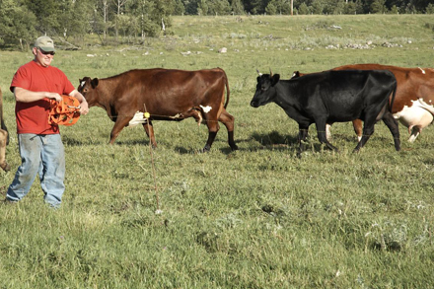
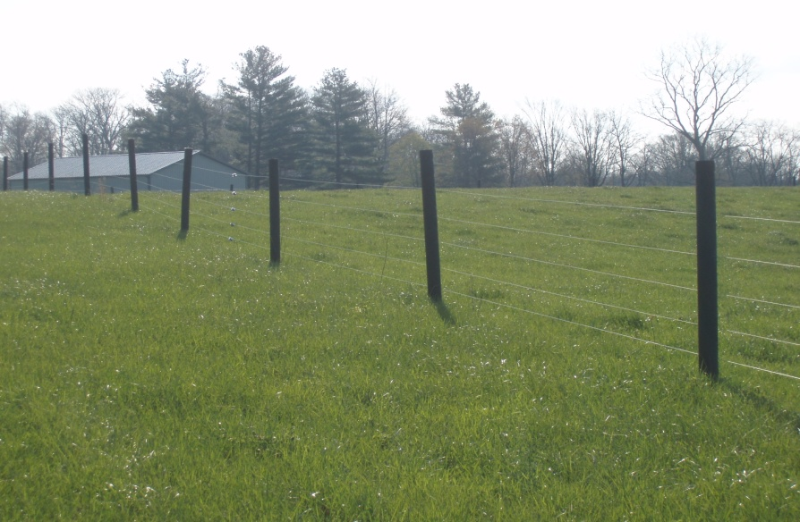
Fencing
Benefits:
Improve Livestock Production
Rotationally Graze Pastures
Reduce Feed Costs
Improve Pasture Quality
CMW Cost-Share not to Exceed
Permanent Interior: $4/ft
Temporary Interior: $1/ft

Slide 5
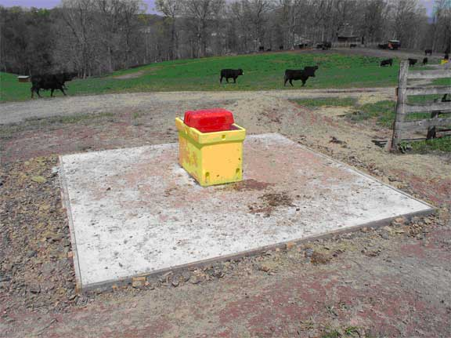
Alternative Watering Systems
Benefits:
Keep livestock out of waterbodies
Help you manage your pastures to make them more productive
Reduce stream bank erosion caused by livestock

Slide 6
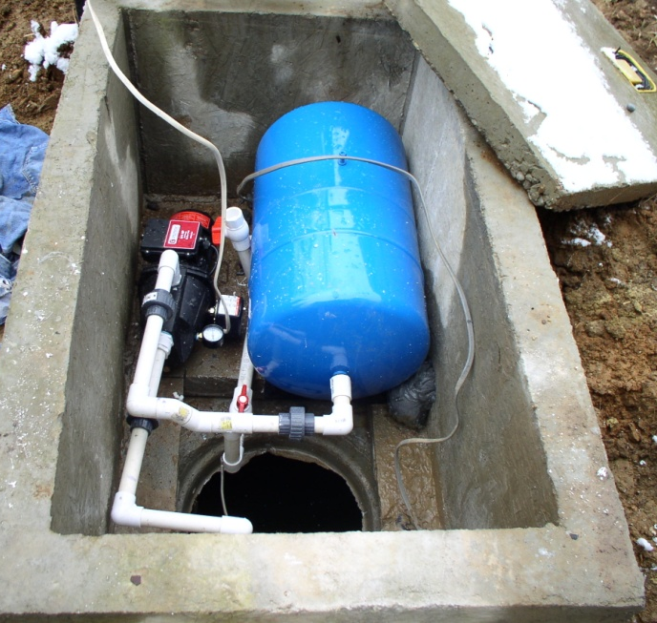
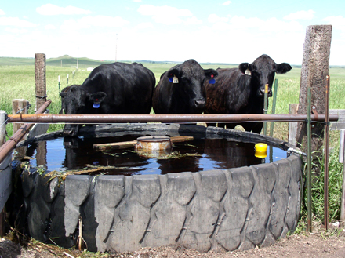
Alternative Watering Systems
CMW Cost-Share not to exceed:
Spring Development $2000/ea
Pond $11,200/ea
Well $40/ft
Pump $1500/ea
Pipeline $3/ft
Tank $700/ea
Temp/Poly Tank $500/ea

Slide 7
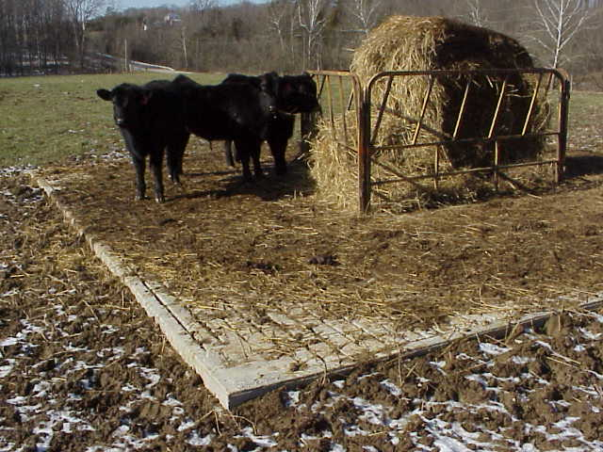
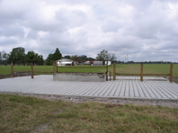
Heavy Use Area Protection
Benefits:
Improve Livestock Health
Improve Water Quantity & Quality
Reduce Soil Erosion
Improve Air Quality
CMW Cost-Share not to Exceed
Gravel & Textile: $1.60 sq ft
Concrete: $3.20 sq ft

Slide 8
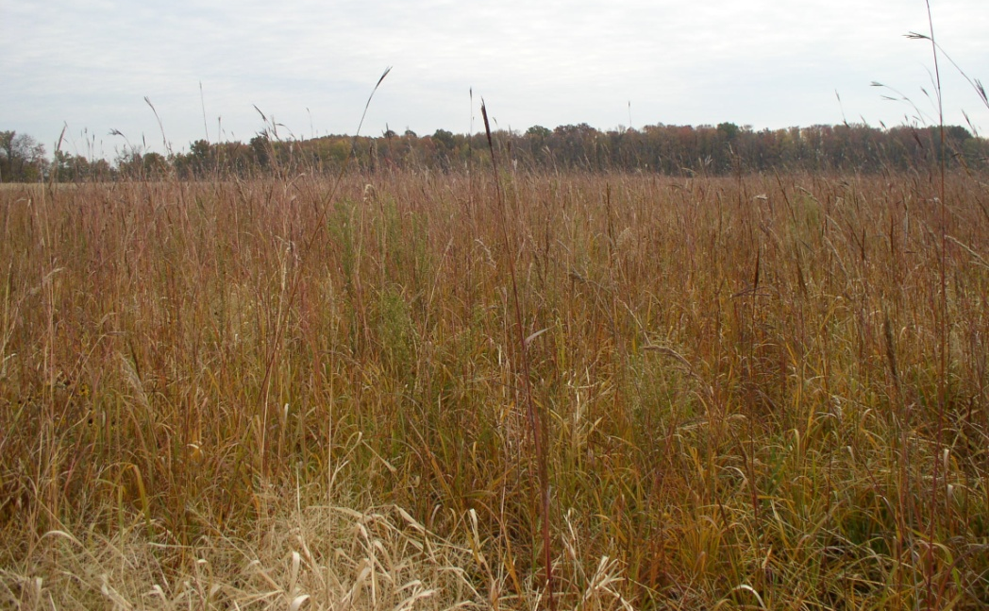
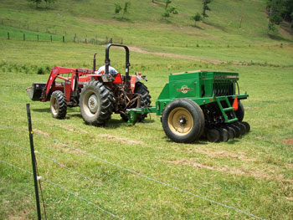
Pasture & Hayland Seeding
Benefits:
Improve Forage Quality & Yield
Reduce Soil Erosion
Improve Water Quality
Feed Less Hay & Silage
Improve/Maintain Livestock Health
CMW Cost-Share not to Exceed
Warm Season Grasses: $400/ac
Cool Season Grasses: $350/ac
Legumes within Established Grass: $150/ac

Slide 9
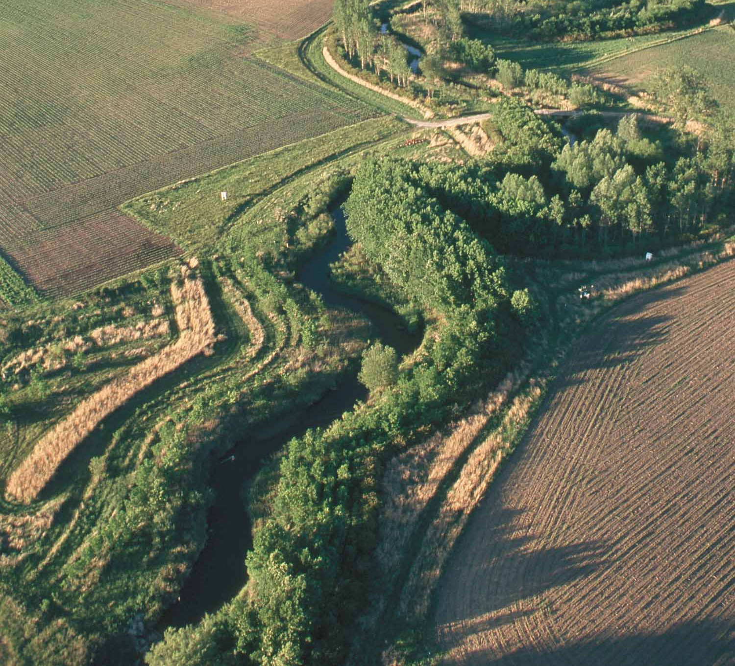
Riparian Buffers
Benefits:
Reduce Pesticide Drift Entering the Waterbody
Create Shade to Lower or Maintain Water Temperatures to Improve Habitat for Aquatic Organisms
Reduces sediment, organic material, nutrients and pesticides in surface runoff and reduce excess nutrients and other chemicals in ground water flow
CMW Cost-Share not to Exceed
Trees, Shrubs and Grass Planting along Streams (est.): $750/ac

Slide 10
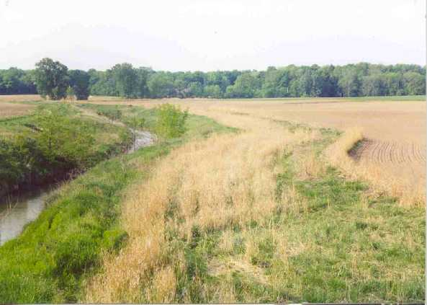
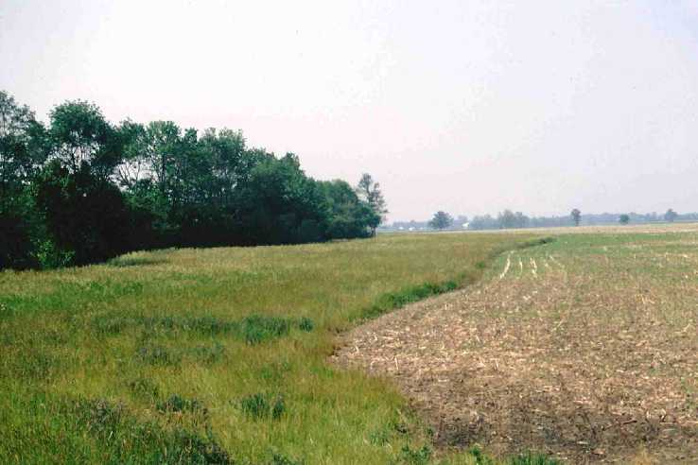
Conservation Cover/Filter Strip
Benefits:
Reduce soil erosion & sedimentation
Improve water quality
Enhance wildlife habitat
Improve air quality
Improve soil quality
Manage plant pests
CMW Cost-Share not to Exceed
Warm Season Grasses: $400/ac
Cool Season Grasses: $350/ac
Tree & Shrub Establishment: $750/ac

Slide 11
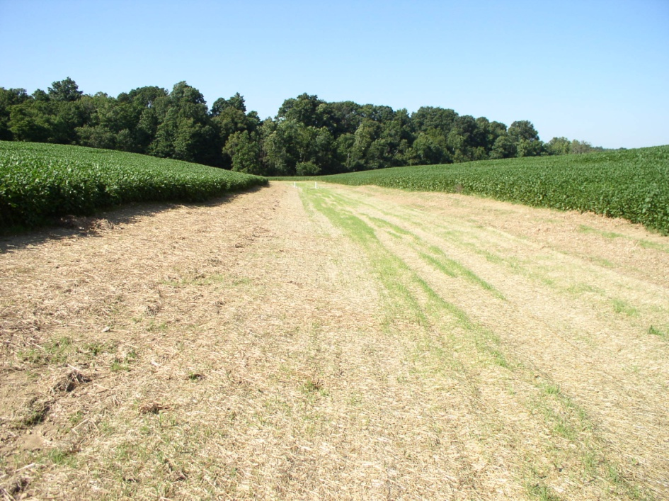
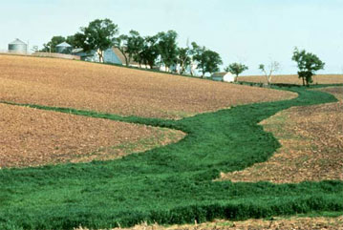
Grass Waterways
Benefits:
Convey runoff from terraces, diversions, or other water concentrations without causing erosion or flooding
Reduce gully erosion
Protect/improve water quality
CMW Cost-Share not to Exceed
(Earth moving only): $4.50/ft
Seeding, Mulch &/or with Blanket: $1.80 sq. yd.
Tile: $3/ft
Lined Outlet: $75/ft

Slide 12
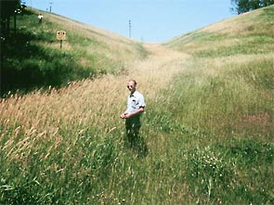
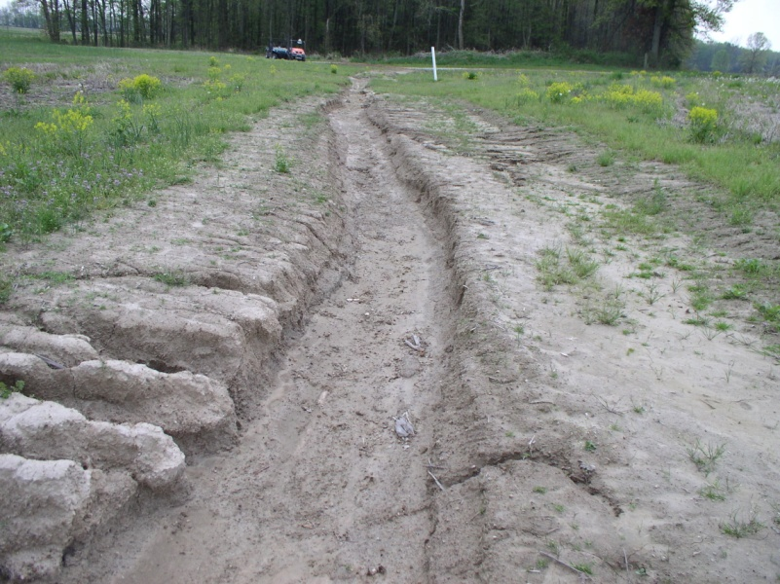
Critical Area Planting
Benefits:
Stabilize areas with existing or expected high rates of soil erosion by water or wind
Rehabilitate & revegetate degraded sites that cannot be stabilized through normal farming practices
CMW Cost-Share not to Exceed
$1000/ac

Slide 13
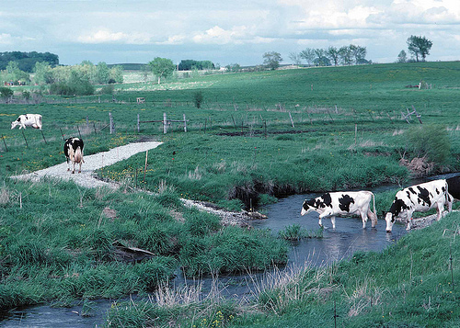
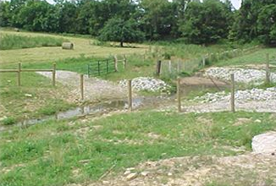
Stream Crossing (Rock & Concrete)
Benefits:
Improve water quality by reducing sediment, nutrient, organic, and inorganic loading of the stream
Reduce streambank & streambed erosion
Provide crossing for access to another land unit
CMW Cost-Share not to Exceed
Rock: $6000
Concrete: $8000

Slide 14
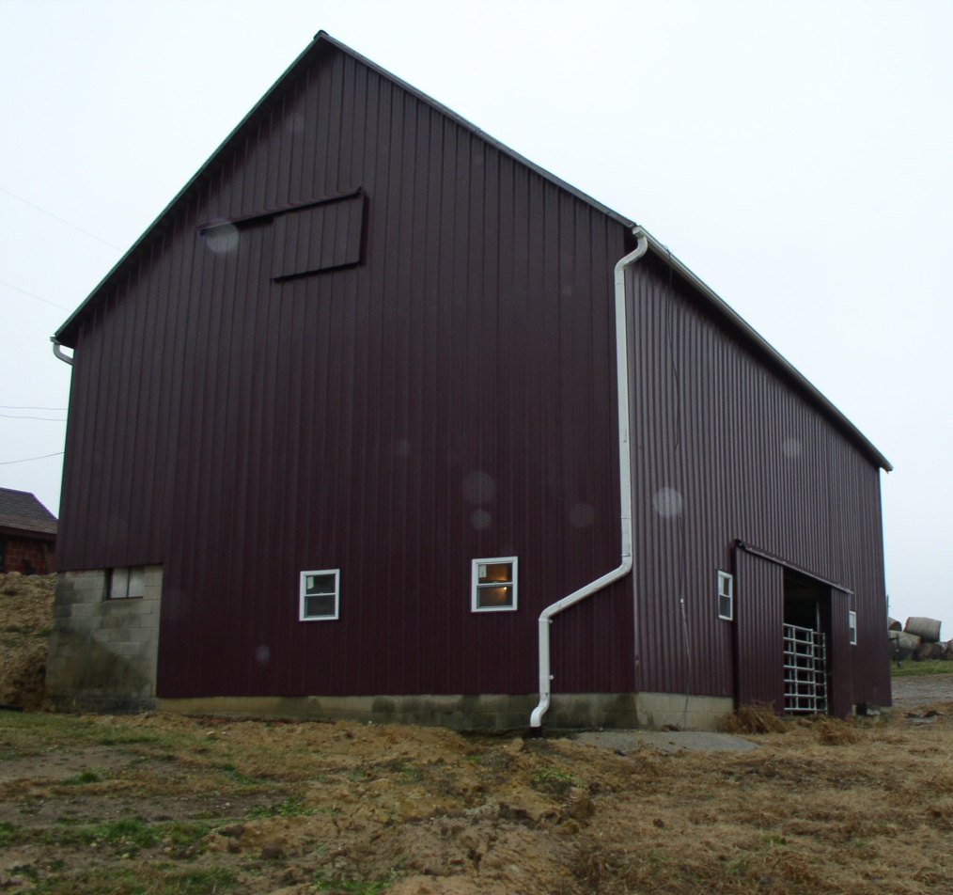
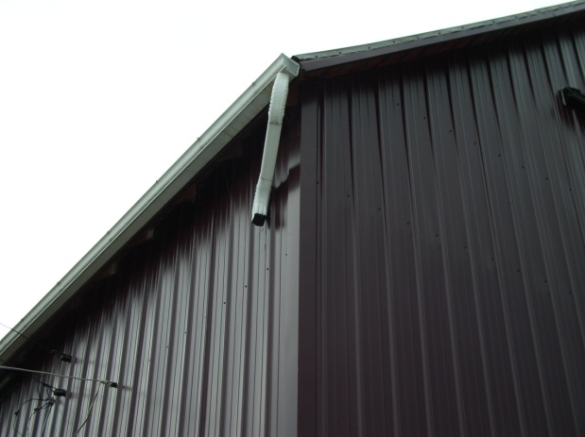
Roof Runoff System
Benefits:
Improve water quality
Reduce soil erosion
Increase infiltration
Protect structures
Increase water quantity
CMW Cost-Share not to Exceed
$4/ft

Slide 15
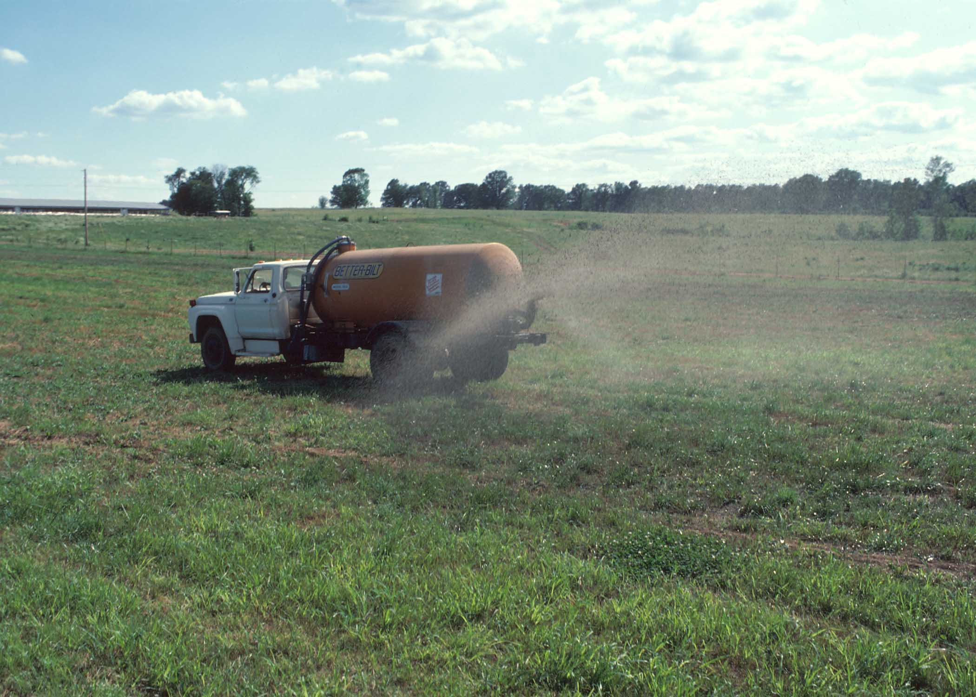
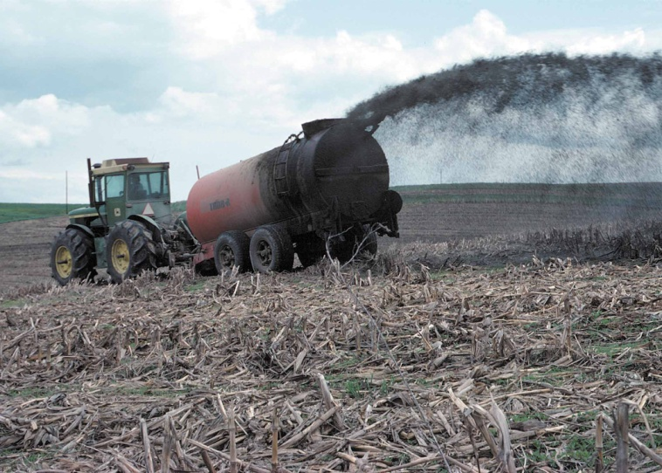
Waste Utilization
Benefits:
Protect water & air quality
Improve or maintain soil quality
Provide feedstock for livestock
Provide a source of energy
CMW Cost-Share not to Exceed
$30/ac

Slide 16
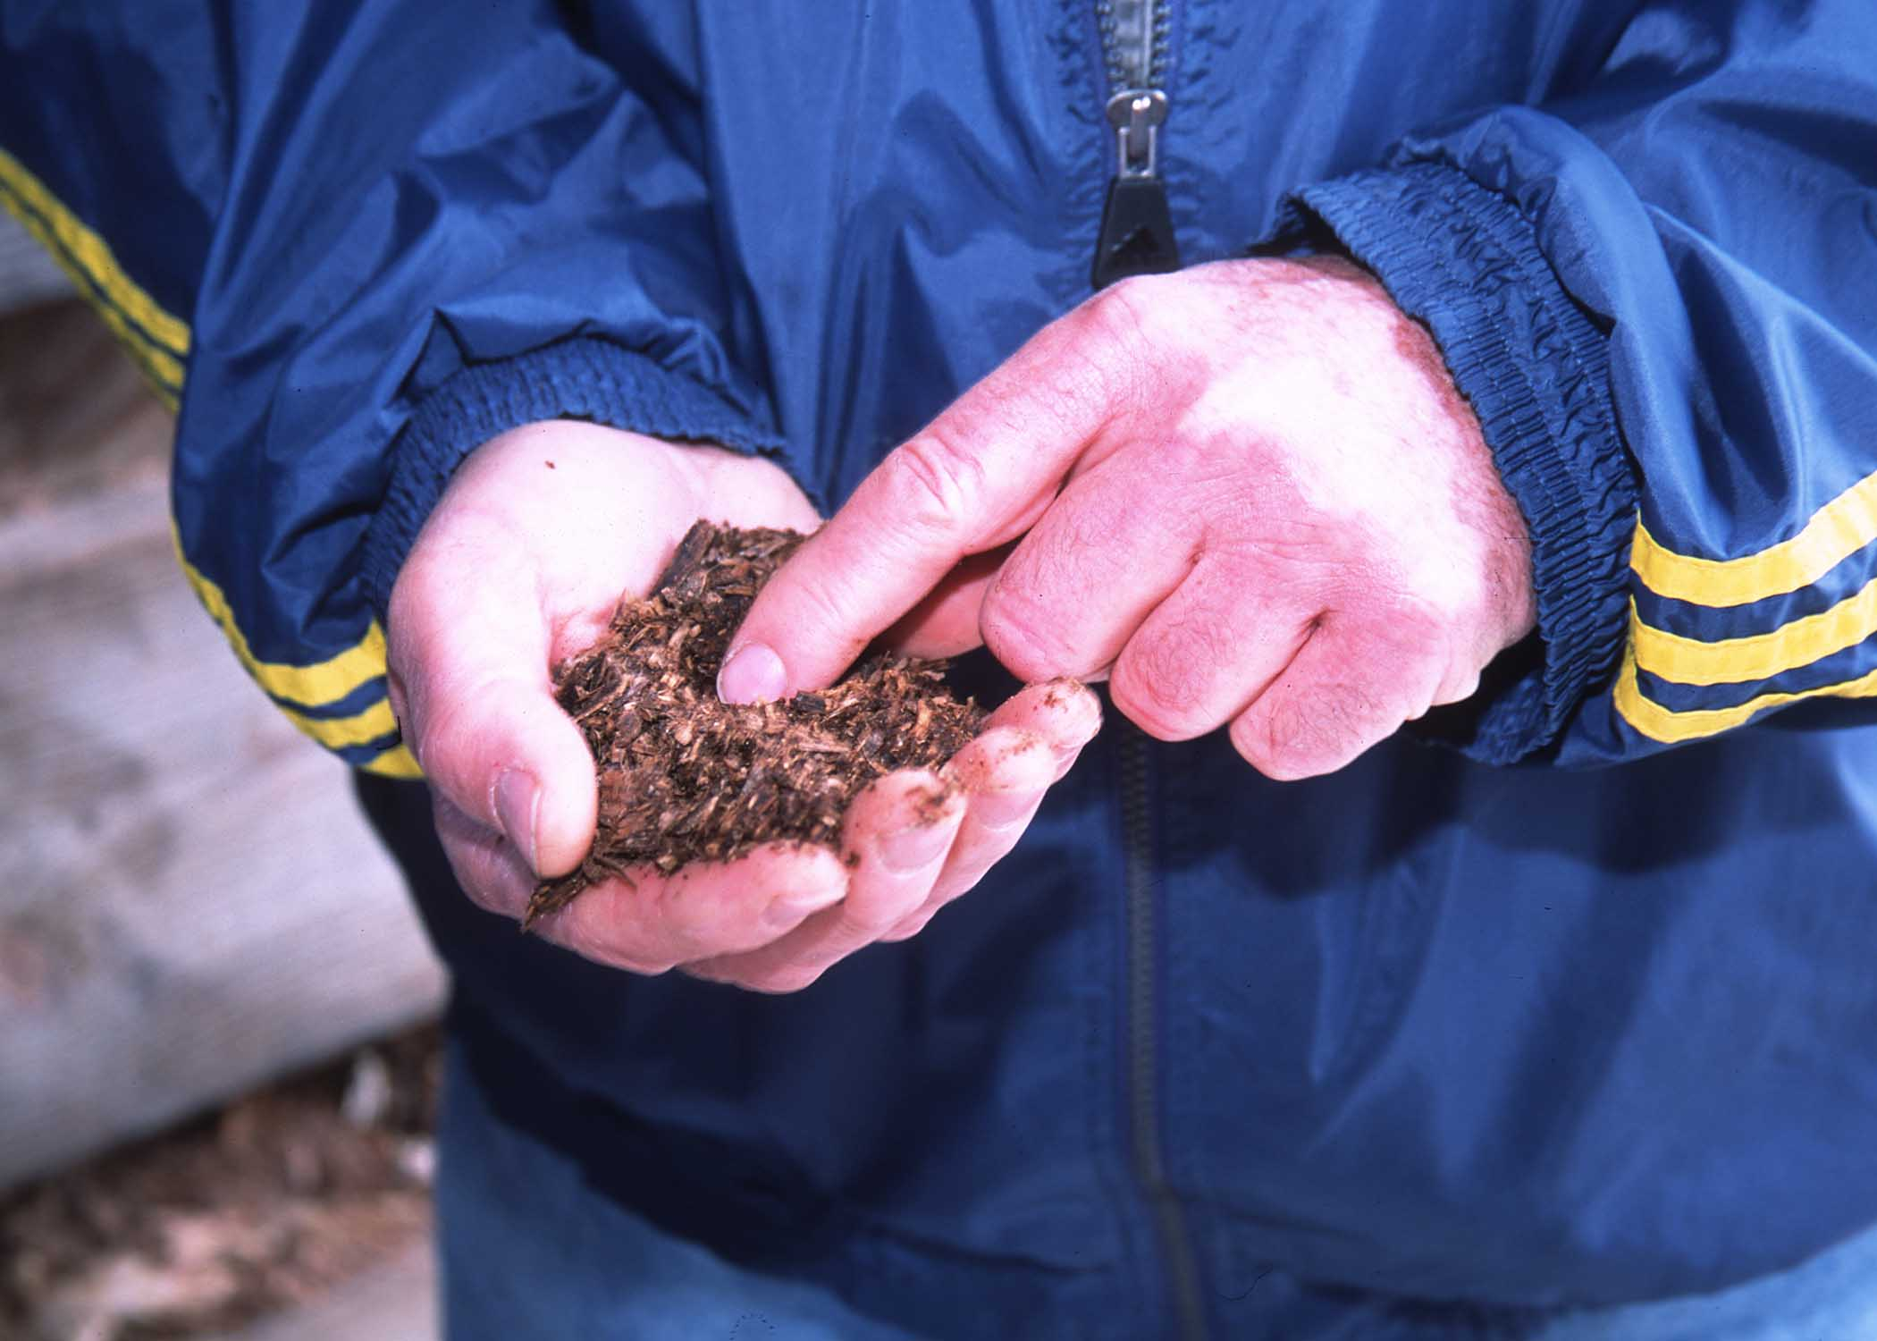
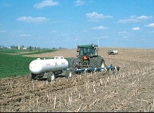
Comprehensive Nutrient Mgnt. Plan
Benefits:
Budget & supply nutrients for plant production
Minimize agricultural pollution of surface & ground water resources
Maintain or improve the physical, chemical and biological condition of soil
CMW Cost-Share not to Exceed
90% of cost

Slide 18
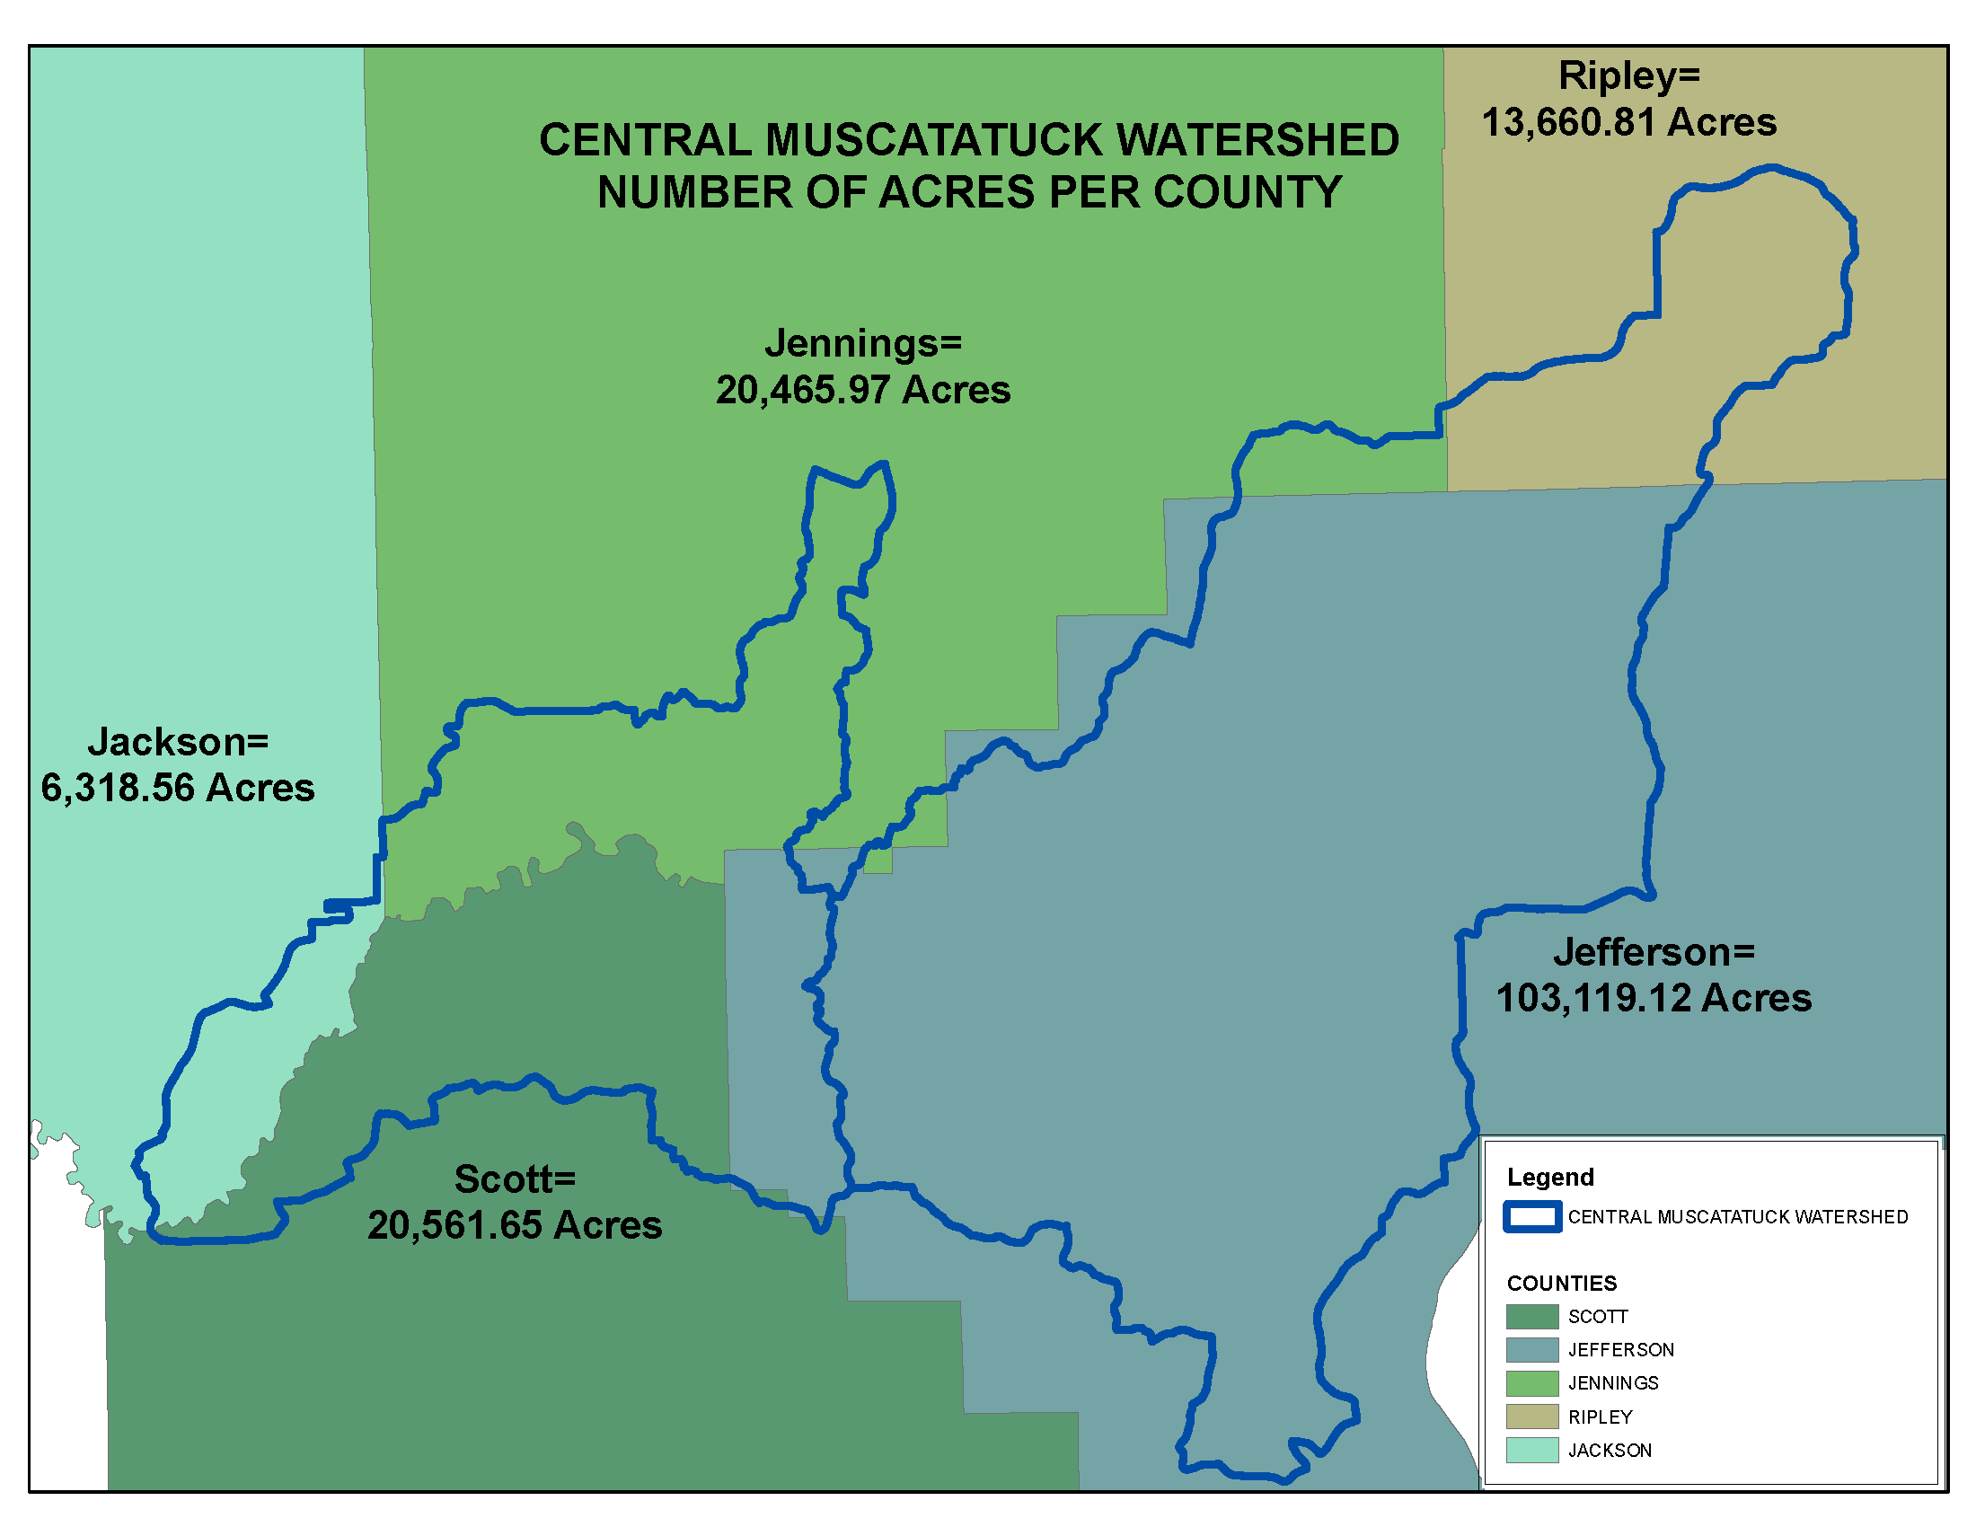

Slide 19
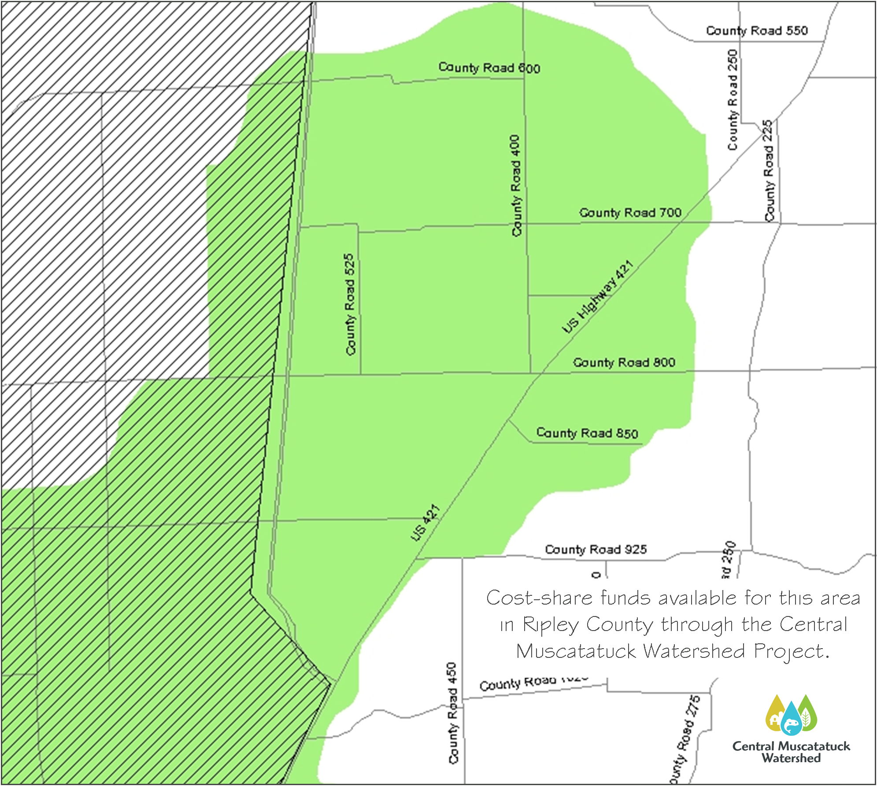

Slide 20
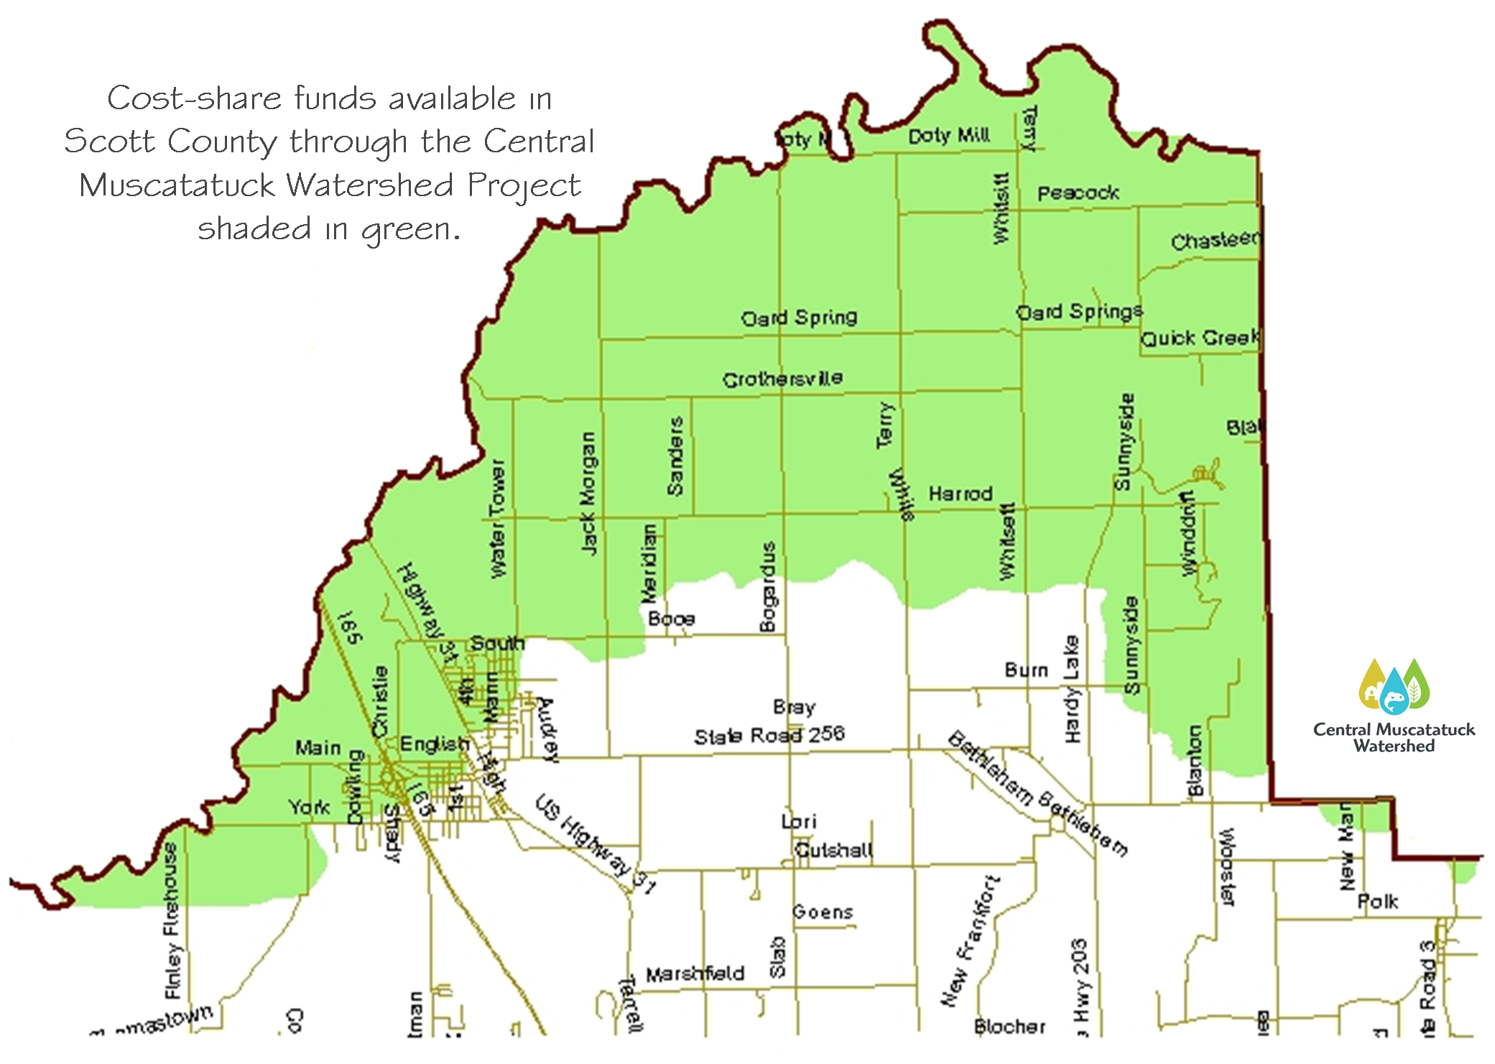

Slide 21
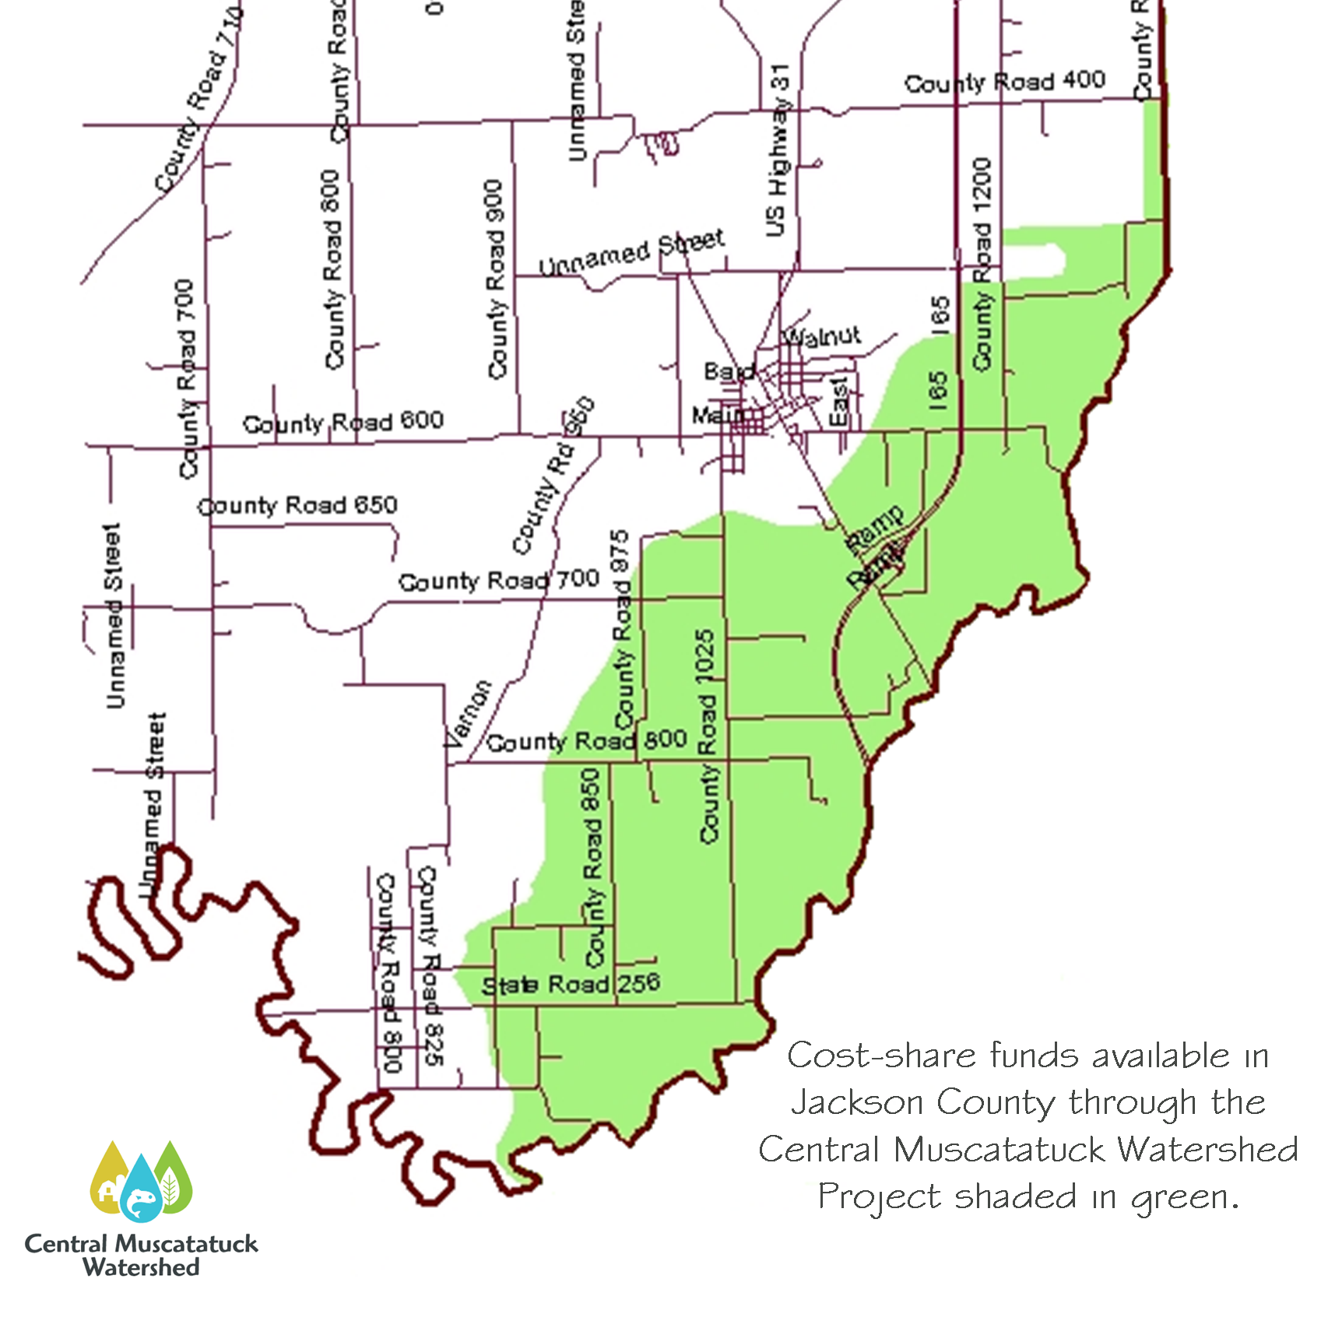

Slide 22
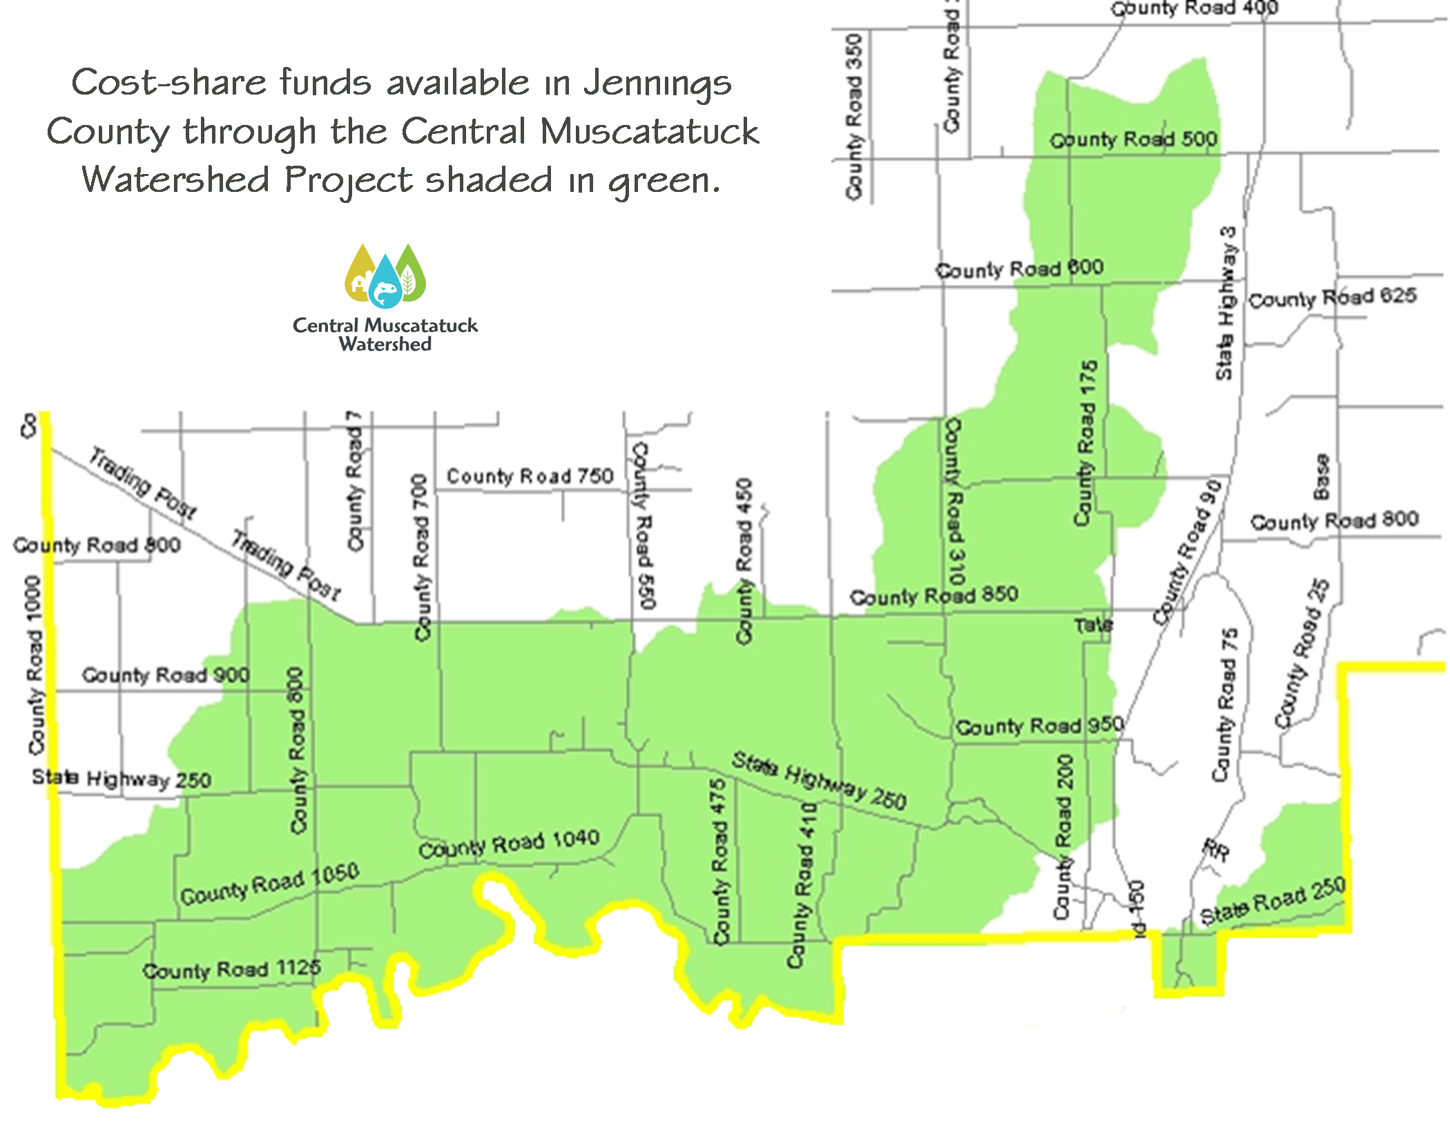

Slide 23
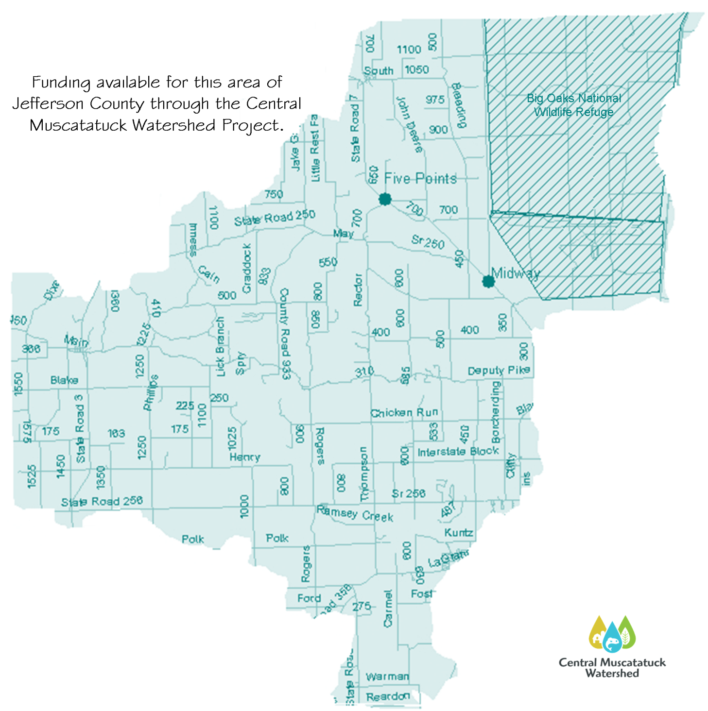

Slide 24
Facts About the Cost-Share Program
$250,000 Available
Voluntary Cost-Share Program
Program to Provide Landowners with Financial & Technical Assistance to Install Conservation Practices
Program will Pay Up To 60% of Total Cost if Approved
Overall Cap for Each Participant $25,000 if Approved

Slide 25
How to Apply for Funding
Contact:
Steve Franklin
1981 S. Industrial Park Road
Versailles, IN
E-mail: steve.franklin@in.nacdnet.net
Ph: (812) 689-6410 ext. 5

Slide 26
Check Us Out on the Web
www.hhhills.org/CentralMuscatatuck.html

Slide 27
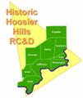
Partners
Soil & Water Conservation Districts:
Jackson, Jefferson, Jennings,
Ripley & Scott Counties

Slide 28
“This project has been funded wholly or in part by the US EPA under assistance agreement C6975750-09 to IDEM. The contents of this document do not necessarily reflect the views and policies of EPA, nor does mention of trade names or commercial products constitute endorsement or recommendation for use.”
“Historic Hoosier Hills RC&D is an Equal Opportunity Provider & Employer”

Slide 29
Central Muscatatuck Watershed

