Slide 1

Chapter 5 and Chapter 7 with a touch of chapter 2
The first 2 videos are regarding dementia and Alzheimer's. We will go over these diseases in class.
For all slides, make sure you turn up your volume. I have narrated the PowerPoint for you.

Slide 2

Hallucinations and your response
https://youtu.be/cpV57QGdU7I

Slide 3
ALZHEIMERS DISEASE
https://www.bing.com/videos/search?q=song+crosses+boundaries&view=detail&mid=69954A69C6D93C9D337769954A69C6D93C9D3377&FORM=VIRE

Slide 4

Intake and Output page 185 in textbook
Why is it so important?

Slide 5

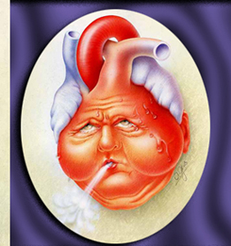
Sometimes patients get fluid overloaded. Some specific diseases where this is common are:
Congestive Heart Failure (CHF)
Renal failure
Liver failure
This Photo by Unknown Author is licensed under CC BY-SA-NC

Slide 6
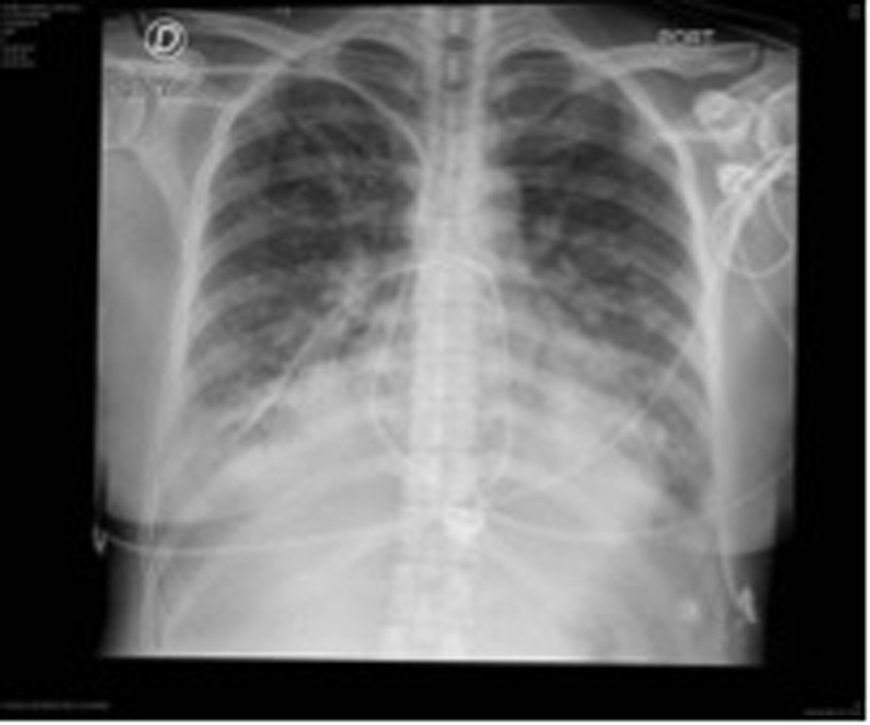

Congestive Heart Failure (CHF)- this means a weak heart muscle. It cannot pump fluids effectively and backup of fluid around the heart, lungs and legs are common. Swelling is also known as EDEMA.
This Photo by Unknown Author is licensed under CC BY-NC
This Photo by Unknown Author is licensed under CC BY-SA

Slide 7
How is the fluid removed in CHF patients?
DIURETICS
a medication that removes fluid. Your patient will urinate a LOT.
Fluids may be restricted in these patients to one liter or 1,000ml per day.
It is important that we know if the diuretics are working.
There are only 2 ways to know for sure:
Urine output
Daily weight
Your patient can lose even up to 40 pounds on just fluid alone! If they GAIN weight, we are concerned that it is more fluid.

Slide 8
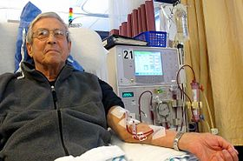
Renal Failure- The kidneys (renal system) are no longer working. The kidneys clean our blood of all un-needed toxins, waste, and fluids the body doesn’t need
If the kidneys fail, the patient will no longer urinate! What happens to all the extra fluid?
It backs up in the body. The body cannot handle the extra fluids and the patient. This is a SERIOUS problem and will lead to death unless……….
……the patient goes on dialysis. This machine pulls blood out, filters it and puts cleaned blood back in while taking off extra un-needed fluids.
This Photo by Unknown Author is licensed under CC BY-SA

Slide 9

Dialysis patients must go three days a week and watch their fluid intake!
What if a patient goes to dialysis and 2 liters of fluid is removed from the body and the patient drinks, drinks, drinks….. They will be overloaded before their next treatment.

Slide 10

Fistula or shunt
Dialysis patients will have some form of dialysis access. Usually they get a Quinton catheter in the neck or a fistula in the arm.
If a patient has a fistula, NEVER check a blood pressure in that arm! You can ruin their fistula- it is their lifeline!
To the left is an image of a dialysis fistula during dialysis. They are raised, pulsate, and even buzz when you touch it.
This Photo by Unknown Author is licensed under CC BY-SA-NC

Slide 11

Liver Failure
We can identify liver failure patients by their yellow eyes and skin (jaundice)
These patients will have too much fluid on them as well (EDEMA).
They BLEED easily
May become confused because their ammonia levels get high
To Reduce ammonia levels, we give laxatives so they are major FALL RISKS!! If they fall, remember they bleed easily!!

Slide 12
So why is this important to you?

Slide 13
The treatment for these diseases requires careful measurement of their intake and output.
We must measure how much fluid they drink
We must account for all fluid leaving the body- urine, bowel movements, and even emesis (vomit)
We must compare what goes in to what comes out!
The output of urine should be a little less than their intake

Slide 14
Intake and Output (I&O’s)
All fluid is measured in milliliters (ml) or cubic centimeters (cc), which are exactly the same thing.
1ml=1cc
So 5ml is the same as 5cc’s.

Slide 15
YOU CANNOT MEASURE IN OUNCES ALTHOUGH YOUR PATIENTS DO!
When you ask your patient, how much did you drink since 0700, they will likely reply in ounces.
You must know how to convert ounces to ml’s (or cc’s).
One ounce is equal to 30ml
1oz=30ml
So if a patient drank 3 oz, how many ml’s is that?

Slide 16
PRACTICE:
How many ml’s is 5 oz?
How many ml’s is 3 oz?
How many ml’s is 8oz?
If one juice is 120ml and the patient drank 3 of them, how many ml’s is that?
A patient drank one juice (120ml) and one carton of milk (240ml), how much did your patient take in?
5 x 30= 150
3 x 30= 90
8 x 30= 240
120 x 3= 360
120+240=360ml’s

Slide 17
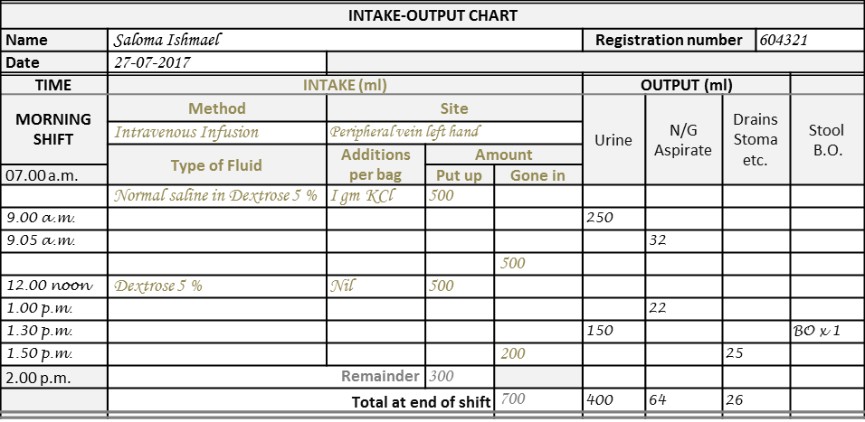
Document intake and output (I&O)
This Photo by Unknown Author is licensed under CC BY-NC
Here is an example of an intake and output flowsheet.

Slide 18
So again, why are these diseases important to understand?
If your patient’s intake and output is as follows:
Intake 3,000ml
Output 200ml
____________
2,700ml is still in the body!!
EDEMA EDEMA EDEMA!!!! The lungs are not happy having all this fluid around them!
On the flip side if a patient’s intake and output is as follows:
Intake 100ml
Output 30ml
__________
70ml was used by the body.
We need at least 36oz of fluid a day! (1,080ml) per day… this patient is probably dehydrated.

Slide 19
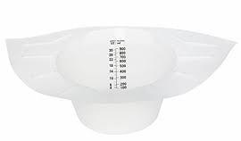
Measuring Output
This is a specipan. It goes in the toilet for your patient to urinate into (females). Another word for urinate is to VOID.

Slide 20
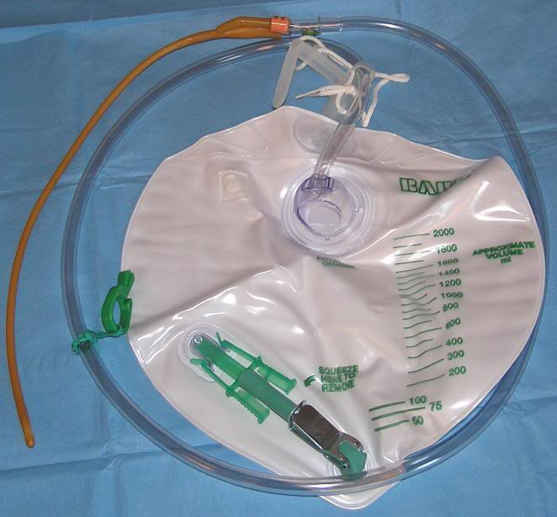
Other places to find urine:
This is a foley catheter. The tube is in the patient’s bladder and drains into the bag. You will get to practice emptying these during class. Never use the measurement on the bag- this is just an estimate. It will have to be emptied into a solid container and measured at eye level.
This Photo by Unknown Author is licensed under CC BY-SA

Slide 21
Catheter Overview
A catheter is called an indwelling catheter or a Foley Catheter
A catheter is used during surgery, to measure accurate output, to help with wound healing in incontinent (cannot control urine) patients, inability to urinate, and even in males with prostate enlargement that cannot pass urine
TERMS:
Indwelling or Foley Catheter is held inside the bladder by inflating a balloon.
Straight catheter- placed inside the bladder only long enough to drain the urine and then removed
Condom catheter- placed on men like a condom and attached to a tube so urine drains into the bag

Slide 22
Catheter FACTS
Always keep the catheter bag lower than the bladder
Hook the catheter bag to the bed frame- NEVER the siderail
Ensure the tubing is not kinked or urine will have no place to go!
Secure the catheter to the patient’s inner thigh with tape or a catheter secure device
Empty the bag before it gets full (usually empty every 6 hours)
Note the color of the urine
If no urine, check to make sure the tubing is not kinked- if it is unkink it and watch the urine flow! If not kinked notify the nurse! Patients should have 30ml of urine out per hour. If less, notify the nurse.

Slide 23
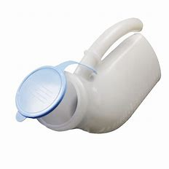
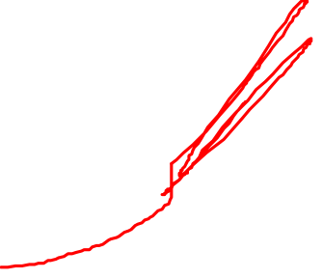
Urinals are for men to void into

Slide 24
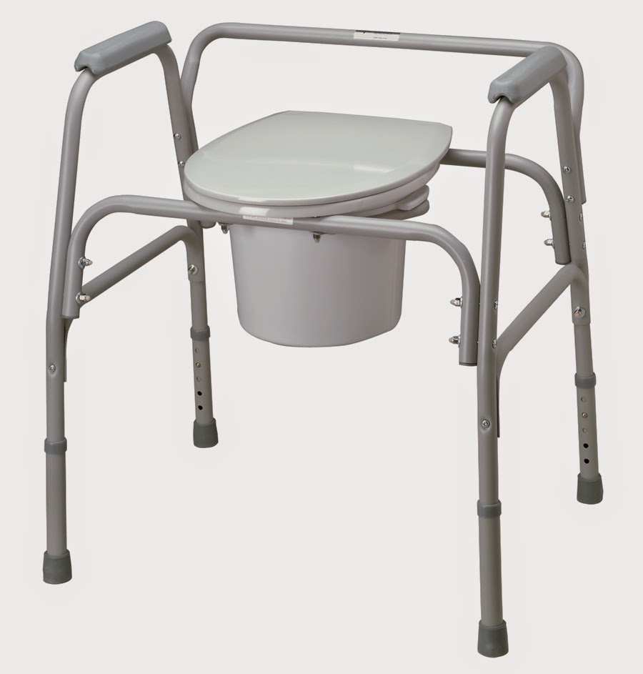
Bedside Commode (BSC) are used for patients that cannot ambulate to the restroom.
This Photo by Unknown Author is licensed under CC BY-SA

Slide 25

Increments to measure in:
For a specipan or urinal, the ml’s are on the RIGHT, ounces are on the LEFT?
Measure in increments that it is measured in:
Which will you measure?
Ounces or ml?
ALWAYS ML’S!
-900 For example, this one is measured in 50’s. The
-
-800 highlighted one would be 750ml.
-
-700
-
-600 If the urine is between 500 and 550, you need to say it is
-
-500 500ml or 550ml but NOT 525ml. The state wants you
-
-400 only to use increments that qare
-
-300
-
-200

Slide 26
Collecting urine specimens
The first morning specimen is best
Patient should wash hands
Patient should clean around meatus (urinary opening) first from front to back
Urinate into toilet a small amount
Urinate into cup (only 2 teaspoons are usually needed)
Patient should be instructed not to touch the inside of the cup or the inside of the lid
Label the urine specimen at the bedside!
NEVER collect a urine specimen from a catheter bag

Slide 27
Collecting a stool specimen
Have patient defecate into a specimen container turned around backwards in the toilet
Tell patient to urinate first to avoid getting urine mixed with stool
Tell patient to throw toilet paper in toilet, not specipan
Use a spoon or a tongue blade to scoop stool into a sterile container
A few spoonfuls should be enough
Label at the bedside

Slide 28
That concludes Intake and Output

