Slide 1
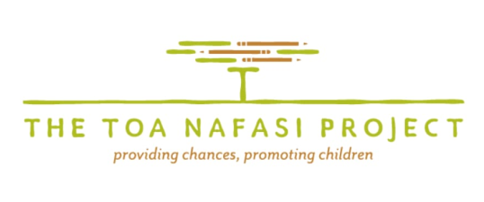
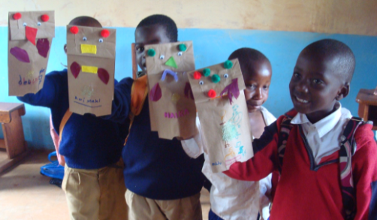
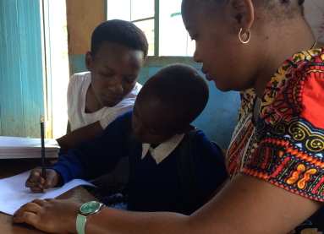
Students
Assessed 475Standard One schoolchildren across 4 Tanzanian Schools
Helped 30students obtain medical or psychosocial care
Placed an additional 3students in a locally-run rehabilitation center for children with more severe disabilities increasing the number of students we assist to 13
Provided support to over 230 children with learning difficulties via our pullout program
Staffing
Provided further training to our current 12 tutors and our head tutor
Hired and trained an additional 15 tutors to help with our proposed expansion into five new schools in 2019
Partners
Sustained our partnership with the Gabriella Rehabilitation Centre which provides expert support for children with special needs
Continued our work with the International Association of Special Education, including hosting their volunteers from the States and being a part of their steering committee for the next biennial conference in July 2019
Developed new relationship with the Diaspora Council of Tanzanians in America, Tanzanians stateside who are dedicated to improving the development of Tanzania
Funding
Gained new funding of more than $65 000 in support of our 2019 expansion
The Toa Nafasi Project’s achievements for 2018
Events
Held our 5th anniversary celebration which was attended by local luminaries in Moshi
Showcased The Toa Nafasi Project in a presentation at a TEDx event in Modena, Italy
Celebrated special “days” such as International Women’s Day, World Down Syndrome Day, and World Autism Awareness Day
Attended several conferences such as Humentum’s Capacity for Humanity

Slide 2
The Toa Nafasi Project—In a Nutshell

