Slide 1
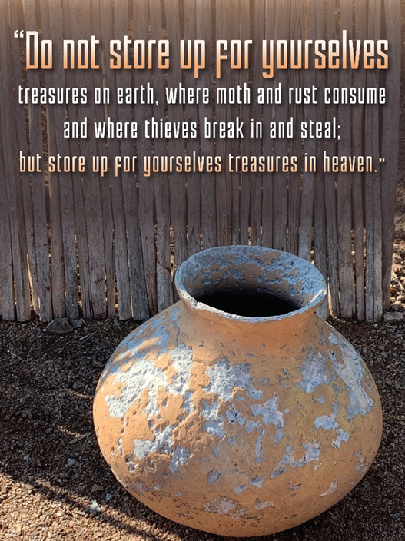
Trinity Evangelical Lutheran Church January 29, 2023
WELCOME!
Treasure In Heaven
Matthew 6:7-21, [25-34]
Notes:
Image: Five Loaves by Caroline Coolidge Brown. Copyright © Caroline Coolidge Brown. All rights reserved. Used by permission of the artist.

Slide 2
= Please stand if able
= Please be seated
Prelude – Roxanne Groff
Office of the Acolyte
Ringing of the Bell
Welcome
Notes:
Image: Five Loaves by Caroline Coolidge Brown. Copyright © Caroline Coolidge Brown. All rights reserved. Used by permission of the artist.

Slide 3
CONFESSION AND FORGIVENESS
All may make the sign of the cross, the sign marked at baptism…
L: We confess our sins before God and one another.
Pause for silence and reflection.
L: Merciful God…
Notes:
Image: Five Loaves by Caroline Coolidge Brown. Copyright © Caroline Coolidge Brown. All rights reserved. Used by permission of the artist.

Slide 4
CONFESSION AND FORGIVENESS
C: Christ came into the world and showed us how to live, but we have failed to live by what he taught. We have not loved you with all our heart, soul, mind and strength, we have not done to others as we would have done to ourselves. Shine a light on our hearts, that we might turn from the shadows of our sin and walk in your ways.
Notes:
Image: Five Loaves by Caroline Coolidge Brown. Copyright © Caroline Coolidge Brown. All rights reserved. Used by permission of the artist.

Slide 5
CONFESSION AND FORGIVENESS
L: Jesus came not to condemn the world, but that the world might be saved through him. By his abundant love, all your sins are forgiven, that you might walk in the light of Christ.
C: Amen.
Notes:
Image: Five Loaves by Caroline Coolidge Brown. Copyright © Caroline Coolidge Brown. All rights reserved. Used by permission of the artist.

Slide 6
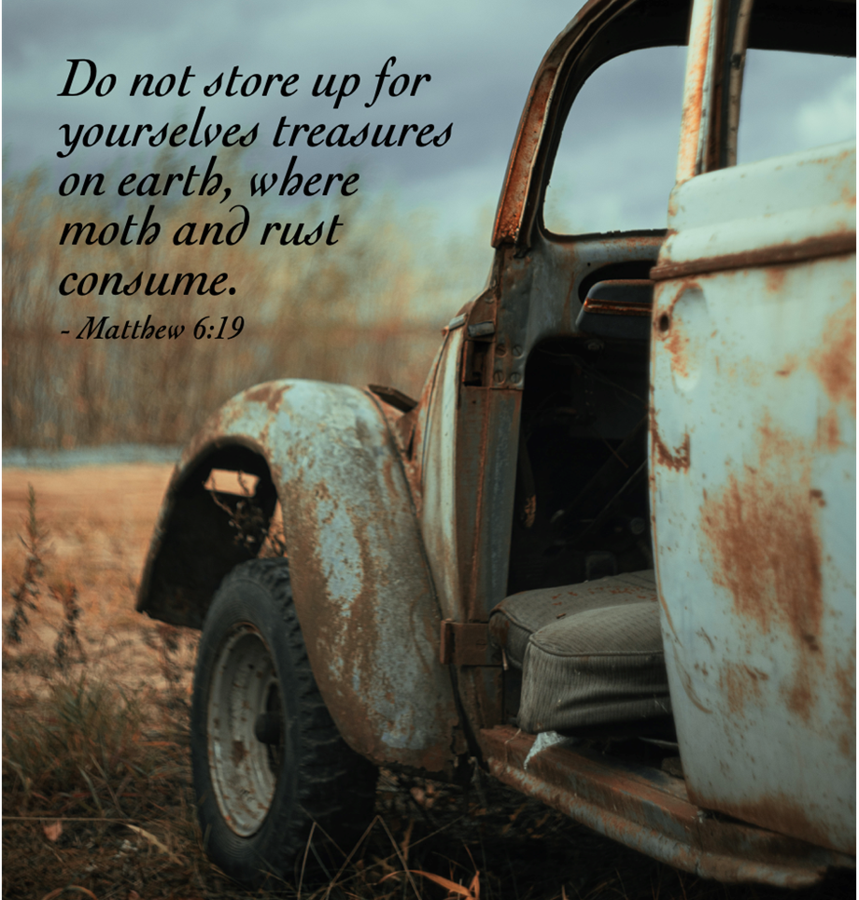
Hymn of Praise
“How Firm A Foundation”
LBW 507
Notes:
Image: Five Loaves by Caroline Coolidge Brown. Copyright © Caroline Coolidge Brown. All rights reserved. Used by permission of the artist.

Slide 7
“How Firm A Foundation” LBW 507
1 How firm a foundation, O saints of the Lord,
is laid for your faith in his excellent word!
What more can he say than to you he has said
who unto the Savior for refuge have fled?
Notes:
Image: Preparing yeast dough. Copyright © tomasworks/iStock/Thinkstock. Used by permission.

Slide 8
“How Firm A Foundation” LBW 507
2 “Fear not, I am with you, oh, be not dismayed,
for I am your God nd will still give you aid;
I’ll strengthen you, help you, and cause you to stand,
upheld by my righteous, omnipotent hand.
Notes:
Image: Preparing yeast dough. Copyright © tomasworks/iStock/Thinkstock. Used by permission.

Slide 9
“How Firm A Foundation” LBW 507
3 “When through fiery trials your pathway shall lie,
my grace, all-sufficient, shall be your supply.
The flames shall not hurt you; I only design
your dross to consume and your gold to refine.
Notes:
Image: Preparing yeast dough. Copyright © tomasworks/iStock/Thinkstock. Used by permission.

Slide 10
“How Firm A Foundation” LBW 507
4 “Throughout all their lifetime my people shall prove
my sov’reign, eternal, unchangeable love;
and then, when gray hairs shall their temples adorn,
like lambs they shall still in my bosom be borne.”
Notes:
Image: Preparing yeast dough. Copyright © tomasworks/iStock/Thinkstock. Used by permission.

Slide 11
APOSTOLIC GREETING
P: The grace of our Lord Jesus Christ, the love of God, and the communion of the Holy Spirit be with you all.
C: And also with you.
Notes:
Image: Five Loaves by Caroline Coolidge Brown. Copyright © Caroline Coolidge Brown. All rights reserved. Used by permission of the artist.

Slide 12
PRAYER OF THE DAY
P: Let us pray… Gracious God, you invite us to come to you in prayer, and offer us a promise of your never-ending care. Give us the humility to ask only for what we need and to be grateful when we receive it.
C: Amen.
Notes:
Image: Five Loaves by Caroline Coolidge Brown. Copyright © Caroline Coolidge Brown. All rights reserved. Used by permission of the artist.

Slide 13
Notes:
Image: Preparing yeast dough. Copyright © tomasworks/iStock/Thinkstock. Used by permission.

Slide 14
Scripture Reading
R: Our scripture reading for this day is from the Gospel according to Matthew, the 6th chapter.
C: Glory to you O’ Lord! (Spoken)
Notes:
Image: Five Loaves by Caroline Coolidge Brown. Copyright © Caroline Coolidge Brown. All rights reserved. Used by permission of the artist.

Slide 15
Matthew 6:7-21, [25-34]
⁷“When you are praying, do not heap up empty phrases as the Gentiles do; for they think that they will be heard because of their many words. ⁸Do not be like them, for your Father knows what you need before you ask him.
⁹“Pray then in this way: Our Father in heaven, hallowed be your name. ¹⁰Your kingdom come. Your will be done, on earth as it is in heaven. ¹¹Give us this
Notes:
Image: Five Loaves by Caroline Coolidge Brown. Copyright © Caroline Coolidge Brown. All rights reserved. Used by permission of the artist.

Slide 16
Matthew 6:7-21, [25-34]
day our daily bread. ¹²And forgive us our debts, as we also have forgiven our debtors. ¹³And do not bring us to the time of trial, but rescue us from the evil one. ¹⁴For if you forgive others their trespasses, your heavenly Father will also forgive you; ¹⁵but if you do not forgive others, neither will your Father forgive your trespasses.
¹⁶“And whenever you fast, do not look
Notes:
Image: Five Loaves by Caroline Coolidge Brown. Copyright © Caroline Coolidge Brown. All rights reserved. Used by permission of the artist.

Slide 17
Matthew 6:7-21, [25-34]
dismal, like the hypocrites, for they disfigure their faces so as to show others that they are fasting. Truly I tell you, they have received their reward. ¹⁷But when you fast, put oil on your head and wash your face, ¹⁸so that your fasting may be seen not by others but by your Father who is in secret; and your Father who sees in secret will reward you.
Notes:
Image: Five Loaves by Caroline Coolidge Brown. Copyright © Caroline Coolidge Brown. All rights reserved. Used by permission of the artist.

Slide 18
Matthew 6:7-21, [25-34]
¹⁹“Do not store up for yourselves treasures on earth, where moth and rust consume and where thieves break in and steal; ²⁰but store up for yourselves treasures in heaven, where neither moth nor rust consume and where thieves do not break in and steal. ²¹For where your treasure is, there your heart will be also.”
[²⁵“Therefore I tell you, do not worry
Notes:
Image: Five Loaves by Caroline Coolidge Brown. Copyright © Caroline Coolidge Brown. All rights reserved. Used by permission of the artist.

Slide 19
Matthew 6:7-21, [25-34]
about your life, what you will eat or what you will drink, or about your body, what you will wear. Is not life more than food, and the body more than clothing? ²⁶Look at the birds of the air; they neither sow nor reap nor gather into barns, and yet your heavenly Father feeds them. Are you not of more value than they? ²⁷And can any of you by worrying add a single hour to your
Notes:
Image: Five Loaves by Caroline Coolidge Brown. Copyright © Caroline Coolidge Brown. All rights reserved. Used by permission of the artist.

Slide 20
Matthew 6:7-21, [25-34]
span of life? ²⁸And why do you worry about clothing? Consider the lilies of the field, how they grow; they neither toil nor spin, ²⁹yet I tell you, even Solomon in all his glory was not clothed like one of these. ³⁰But if God so clothes the grass of the field, which is alive today and tomorrow is thrown into the oven, will he not much more clothe you—you of little faith? ³¹Therefore do
Notes:
Image: Five Loaves by Caroline Coolidge Brown. Copyright © Caroline Coolidge Brown. All rights reserved. Used by permission of the artist.

Slide 21
Matthew 6:7-21, [25-34]
not worry, saying, ‘What will we eat?’ or ‘What will we drink?’ or ‘What will we wear?’ ³²For it is the Gentiles who strive for all these things; and indeed your heavenly Father knows that you need all these things.
Notes:
Image: Five Loaves by Caroline Coolidge Brown. Copyright © Caroline Coolidge Brown. All rights reserved. Used by permission of the artist.

Slide 22
Matthew 6:7-21, [25-34]
³³But strive first for the kingdom of God and his righteousness, and all these things will be given to you as well. ³⁴“So do not worry about tomorrow, for tomorrow will bring worries of its own. Today’s trouble is enough for today.”
Notes:
Image: Five Loaves by Caroline Coolidge Brown. Copyright © Caroline Coolidge Brown. All rights reserved. Used by permission of the artist.

Slide 23
Matthew 6:7-21, [25-34]
R: This is the Word of the Lord.
C: Praise to You, O Christ (Spoken)
Notes:
Image: Five Loaves by Caroline Coolidge Brown. Copyright © Caroline Coolidge Brown. All rights reserved. Used by permission of the artist.

Slide 24
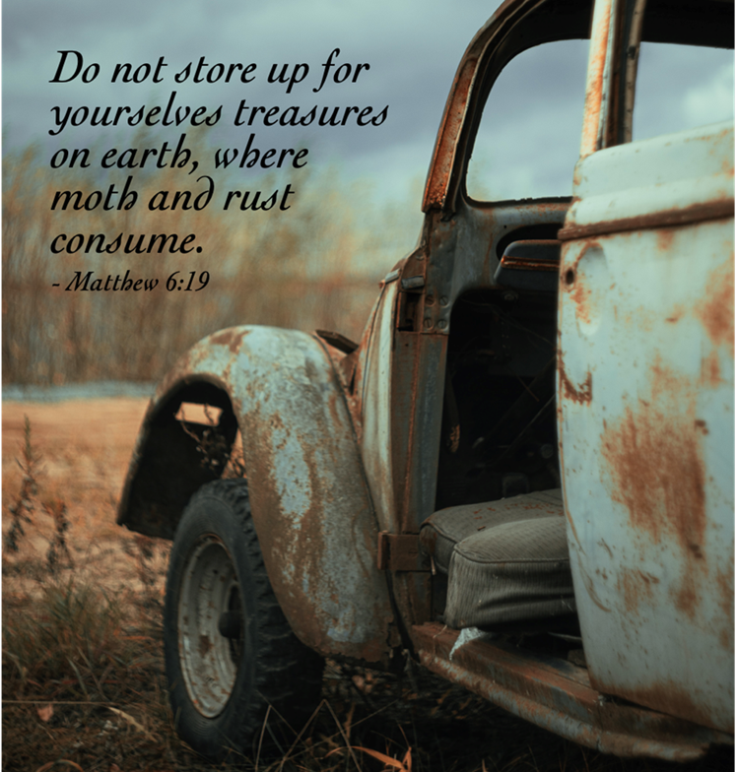
Sermon
Sermon
Notes:
Image: Five Loaves by Caroline Coolidge Brown. Copyright © Caroline Coolidge Brown. All rights reserved. Used by permission of the artist.

Slide 25
Hymn of the Day
Sermon
Seek Ye First
With One Voice # 783
Notes:
Image: Five Loaves by Caroline Coolidge Brown. Copyright © Caroline Coolidge Brown. All rights reserved. Used by permission of the artist.

Slide 26
“Seek Ye First” WOV 783
Seek ye first the kingdom of God And His righteousness And all these things Shall be added unto you Allelu alleluia
Notes:
Image: Preparing yeast dough. Copyright © tomasworks/iStock/Thinkstock. Used by permission.

Slide 27
“Seek Ye First” WOV 783
2 Man shall not live by bread alone But by ev'ry word That proceeds From the mouth of God Allelu alleluia
Notes:
Image: Preparing yeast dough. Copyright © tomasworks/iStock/Thinkstock. Used by permission.

Slide 28
“Seek Ye First” WOV 783
3 Ask and it shall be given unto you Seek and ye shall find Knock and the door Shall be opened unto you Allelu alleluia
Notes:
Image: Preparing yeast dough. Copyright © tomasworks/iStock/Thinkstock. Used by permission.

Slide 29
APOSTLE’S CREED
C: I believe in God, the Father almighty, creator of heaven and earth.

Slide 30
APOSTLE’S CREED
C: I believe in Jesus Christ, his only Son, our Lord. He was conceived by the power of the Holy Spirit and born of the virgin Mary. He suffered under Pontius Pilate, was crucified, died, and was buried.

Slide 31
APOSTLE’S CREED
C: He descended into hell. On the third day he rose again. He ascended into heaven, and is seated at the right hand of the Father. He will come again to judge the living and the dead.

Slide 32
APOSTLE’S CREED
C: I believe in the Holy Spirit, the holy catholic Church, the communion of saints, the forgiveness of sins, the resurrection of the body, and the life everlasting. Amen.

Slide 33
NICENE CREED
C: We believe in one God, the Father, the Almighty, maker of heaven and earth, of all that is, seen and unseen.

Slide 34
NICENE CREED
C: We believe in one Lord, Jesus Christ, the only Son of God, eternally begotten of the Father, God from God, Light from Light, true God from true God, begotten, not made, of one Being with the Father.

Slide 35
NICENE CREED
C: Through him all things were made. For us and for our salvation he came down from heaven; by the power of the Holy Spirit he became incarnate from the virgin Mary, and was made man. For our sake he was crucified under Pontius Pilate;

Slide 36
NICENE CREED
C: he suffered death and was buried. On the third day he rose again in accordance with the Scriptures; he ascended into heaven and is seated at the right hand of the Father. He will come again in glory to judge the living and the dead, and his kingdom will have no end.

Slide 37
NICENE CREED
C: We believe in the Holy Spirit, the Lord, the giver of life, who proceeds from the Father and the Son. With the Father and the Son he is worshiped and glorified. He has spoken through the prophets. We believe in one holy catholic and apostolic Church.

Slide 38
NICENE CREED
C: We acknowledge one Baptism for the forgiveness of sins. We look for the resurrection of the dead, and the life of the world to come. Amen.

Slide 39
PRAYERS OF INTERCESSION
Each petition will end with the words,
A: Merciful God,
The congregation will respond with:
C: You hear our prayer.

Slide 40
PRAYERS OF INTERCESSION
The prayer concludes…
P: Receive our prayers and hold all for whom we pray in your loving arms, in the name of your son, Jesus Christ.
C: Amen.

Slide 41
SHARING OF THE PEACE
P: The peace of the Lord be with you all!
C: And also with you.

Slide 42
OFFERING
OFFERTORY PRAYER
Notes:
Image: Five Loaves by Caroline Coolidge Brown. Copyright © Caroline Coolidge Brown. All rights reserved. Used by permission of the artist.

Slide 43
THE LORD’S PRAYER
P: United into one body, let us pray as Jesus taught…
C: Our Father, who art in heaven, hallowed be thy name, thy kingdom come, thy will be done, on earth as it is in heaven.

Slide 44
THE LORD’S PRAYER
C: Give us this day our daily bread; and forgive us our trespasses, as we forgive those who trespass against us; and lead us not into temptation, but deliver us from evil. For thine is the kingdom, and the power, and the glory, forever and ever. Amen.

Slide 45
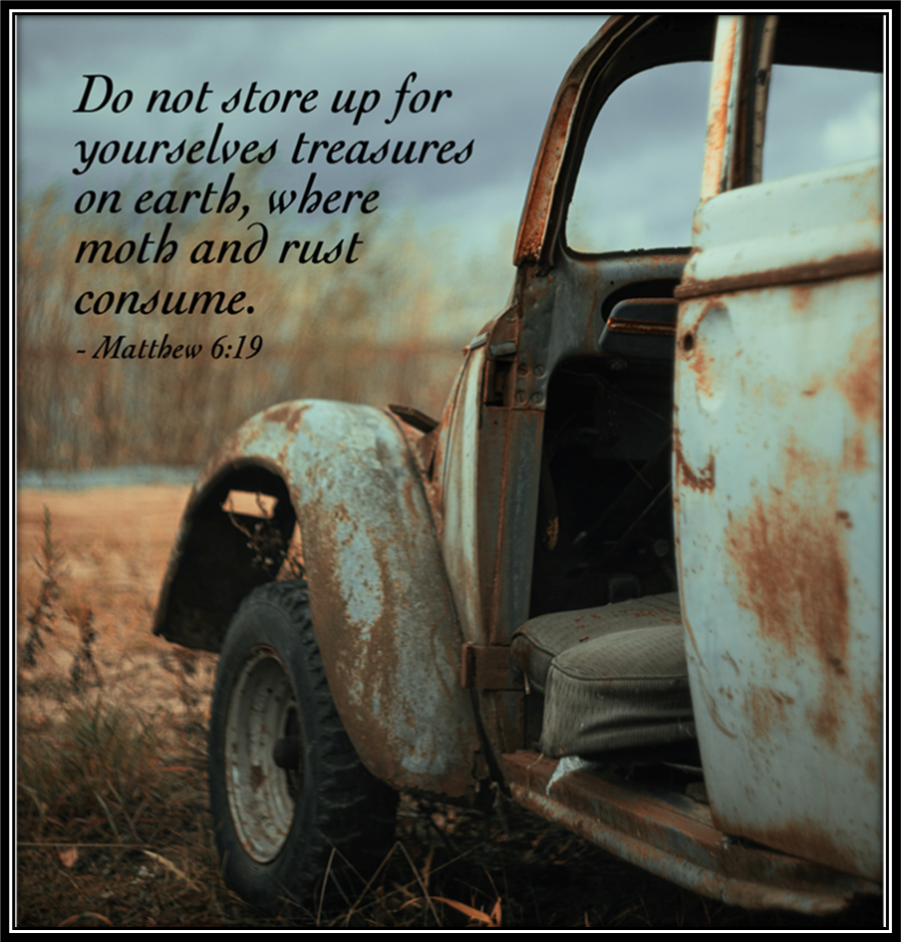
ANNOUNCEMENTS
Notes:
Image: Five Loaves by Caroline Coolidge Brown. Copyright © Caroline Coolidge Brown. All rights reserved. Used by permission of the artist.

Slide 46
SENDING BLESSING
P: The God who faithfully brings forth justice and breaks the oppressor’s rod bless, strengthen, and uphold you, today and always.
C: Amen.
☩

Slide 47
SENDING SONG
“We Plow the Fields and Scatter”
LBW 362
Notes:
Image: Five Loaves by Caroline Coolidge Brown. Copyright © Caroline Coolidge Brown. All rights reserved. Used by permission of the artist.

Slide 48
We Plow The Fields And Scatter LBW 362
1 We plow the fields and scatter
the good seed on the land,
but it is fed and watered
by God’s almighty hand.
He sends the snow in winter,
the warmth to swell the grain,
the breezes and the sunshine,
and soft refreshing rain.
Notes:
Image: Preparing yeast dough. Copyright © tomasworks/iStock/Thinkstock. Used by permission.

Slide 49
We Plow The Fields And Scatter LBW 362
Refrain
All good gifts around us
are sent from heav’n above.
Then thank the Lord, oh, thank the Lord
for all his love.
Notes:
Image: Preparing yeast dough. Copyright © tomasworks/iStock/Thinkstock. Used by permission.

Slide 50
We Plow The Fields And Scatter LBW 362
2 He only is the maker
of all things near and far;
he paints the wayside flower,
he lights the evening star.
The winds and waves obey him;
by him the birds are fed.
Much more to us, his children,
he gives our daily bread.
Notes:
Image: Preparing yeast dough. Copyright © tomasworks/iStock/Thinkstock. Used by permission.

Slide 51
We Plow The Fields And Scatter LBW 362
Refrain
All good gifts around us
are sent from heav’n above.
Then thank the Lord, oh, thank the Lord
for all his love.
Notes:
Image: Preparing yeast dough. Copyright © tomasworks/iStock/Thinkstock. Used by permission.

Slide 52
We Plow The Fields And Scatter LBW 362
3 We thank you, our creator,
for all things bright and good,
the seedtime and the harvest,
our life, our health, our food.
No gifts have we to offer
for all your love imparts,
but what you most would treasure--
our humble, thankful hearts.
Notes:
Image: Preparing yeast dough. Copyright © tomasworks/iStock/Thinkstock. Used by permission.

Slide 53
We Plow The Fields And Scatter LBW 362
Refrain
All good gifts around us
are sent from heav’n above.
Then thank the Lord, oh, thank the Lord
for all his love.
Notes:
Image: Preparing yeast dough. Copyright © tomasworks/iStock/Thinkstock. Used by permission.

Slide 54
DISMISSAL
P: … depart in Christ’s Love.
C: Seeking, welcoming, and serving all. Amen!
POSTLUDE
By
Roxanne Groff
From sundaysandseasons.com. Copyright © 2023 Augsburg Fortress. All rights reserved. Reprinted by permission under Augsburg Fortress Liturgies Annual License #SAS023830. New Revised Standard Version Bible, Copyright © 1989, Division of Christian Education of the National Council of the Churches of Christ in the United States of America. Used by permission. All rights reserved. Revised Common Lectionary, Copyright © 1992 Consultation on Common Texts, admin Augsburg Fortress. Used by permission.

