Slide 1
PRINCIPLES OF DESIGN
The use or arrangement of the building blocks of visual art
Pattern
Rhythm/Movement
Proportion
Balance
Unity
Variety
Emphasis
Contrast

Slide 2
Pattern
The repetition or re-occurrence of a design element, exact or varied, which establishes a visual beat.
Patterns can be natural or man-made, organic or geometric, regular or irregular, structural or decorative, positive or negative and repeating or random.

Slide 3
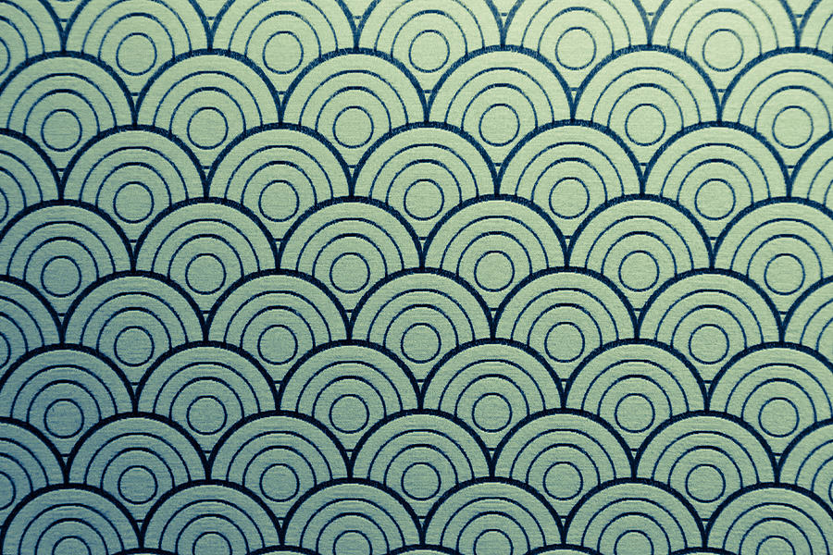

Slide 4
Rhythm / Movement
The suggestion of motion through the use of various elements.

Slide 5
Rhythm causes the viewers eye to follow the visual beats through a work of art.
Rhythms result for repetition.

Slide 6
Motif and Pattern are often used to talk about repetition in art.
A motif is a unit that is repeated in visual rhythm.

Slide 7
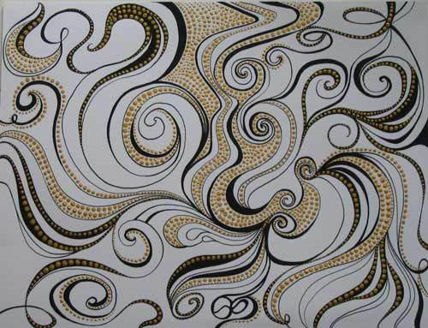

Slide 8
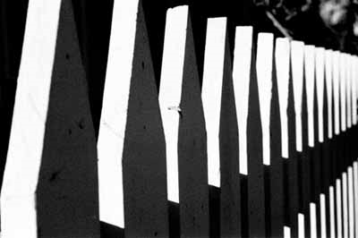

Slide 9
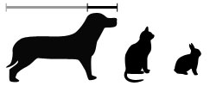
Proportion / Scale
The size relationship of parts to a whole and to one another.
Scale refers to relating size to a constant, such as a human body.

Slide 10
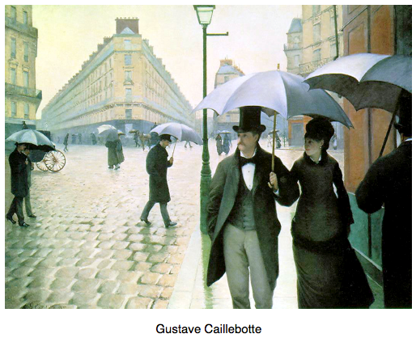

Slide 11
a/b=a+b/a
The Golden Ratio is a term used to describe aesthetically pleasing proportioning within a piece. However, it is not merely a term -- it is an actual ratio.

Slide 12
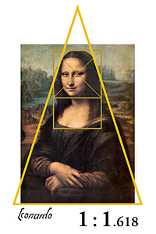
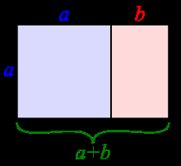
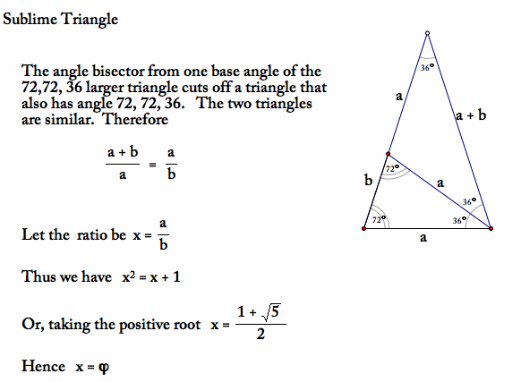
Golden Ratio
Notes:
a/b=a+b/a
A golden rectangle is a rectangle with the property that if it is dissected into two pieces -- a square and a rectangle -- then the new rectangle is similar to the original rectangle.
The Sublime Triangle is an isosceles triangle with base of length a and angles of measure 72, 72, and 36. If you construct the angle bisector of one of the base angles, its intersection with the opposite side divides the sublime triangle into two similar triangles by the AA similarity conditions. Let the base of the smaller triangle be b and therefore the lengths of the two sides of the sublime triangle are each a + b.

Slide 13
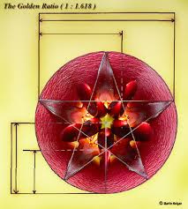
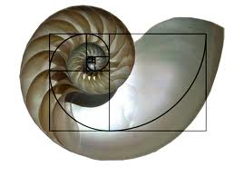
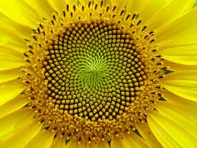
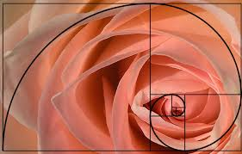
Golden Ratio in Nature

Slide 14
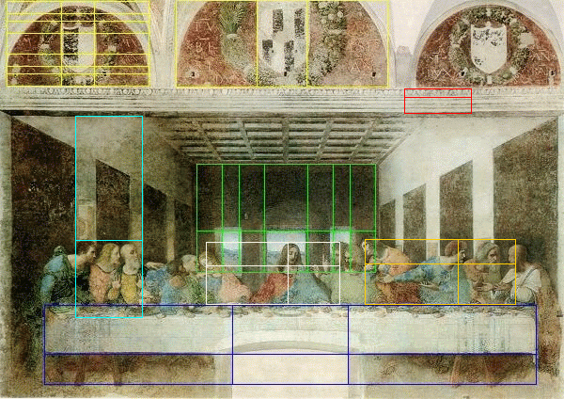
The Last Supper Leonardo Da Vinci
Notes:
The Golden Section was used extensively by Leonardo Da Vinci. Note how all the key dimensions of the room, the table and ornamental shields in Da Vinci’s “The Last Supper” were based on the Golden Ratio, which was known in the Renaissance period as The Divine Proportion.

Slide 15
Proportions of the Human Body
The average human is about 8 head heights tall.
The shoulders are about 2 head heights wide.
The waist is about 1 head height wide.
The legs are half of the body.

Slide 16
Proportions of the Face
The eyes are halfway down the head.
The space between the eyes is approximately the width of an eye.
The head is about 5 eyes wide.
The corners of the mouth line up with the pupils of the eyes.
The bottom of the nose is 1/3 up from the chin.
The eyebrows are 1/3 from the top of the head.

Slide 17
Balance
The impression of equilibrium in a pictorial or sculptural composition. Balance is often referred to as symmetrical, asymmetrical, or radial.

Slide 18
Symmetrical Balance
Symmetrical balance refers to balance that is achieved by arranging elements on either side of the center of a composition in an equally weighted manner. Symmetrical balance can be thought of as 50/50 balance or like a mirror image.

Slide 19
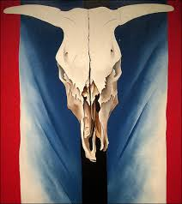

Slide 20
Asymmetrical Balance
Asymmetrical Balance looks balanced despite a lack of symmetry. The two sides are not identical but create a sense of equal weight. Both sides differ from one another.

Slide 21
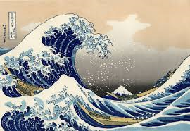

Slide 22
Radial Balance
Radial balance is any type of balance based on a circle with its design extending from the center. A star, the iris around each pupil of your eyes, a wheel with spokes, and a daisy are examples of radial balance.

Slide 23
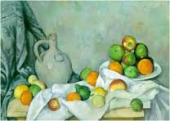
What Type of Balance is this?

Slide 24
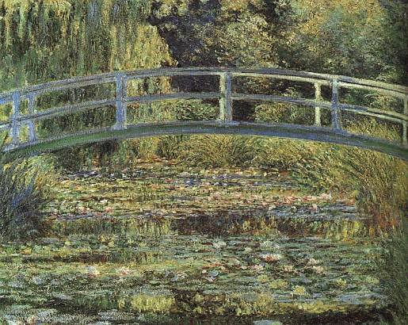
Unity
The components of a work of art that are perceived as harmonious, giving the work a sense of completion.

Slide 25
Creating Unity in your Artwork
Simplicity- Reducing the amount of variety…(or Elements used)
Repetition- Repetition of an Element of Art throughout a composition will ass to a feeling of wholeness.
Proximity-Refers to the closeness of different components in a work of art . By placing parts close together, the mind is able to see the parts as one.

Slide 26
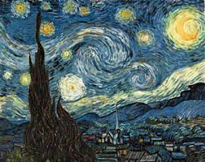

Slide 27
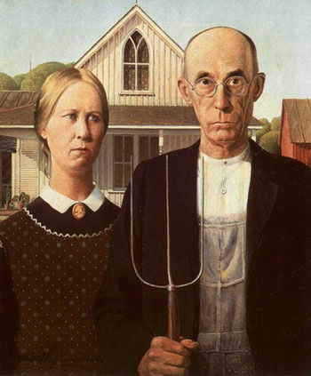

Slide 28
Variety
The use of different elements of art to add interest to an artwork.

Slide 29
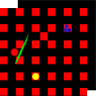
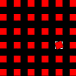
Variety provides contrast to harmony and unity
If this is harmony,
then variety might be something like this.
Variety consists of the differences in objects that add interest to a visual image.
Breaking a repeating pattern can enliven a visual image.

Slide 30
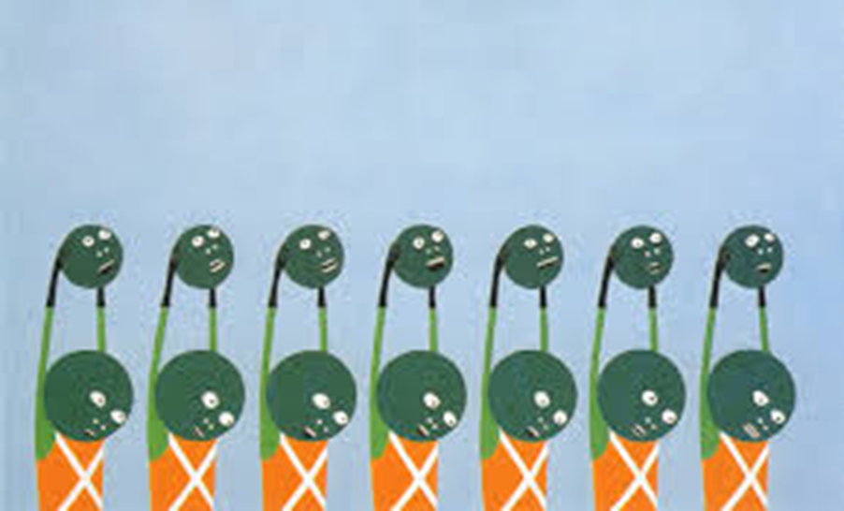

Slide 31
Emphasis
The created center of interest, the place in an artwork where your eye first lands. This is also called a focal point.

Slide 32
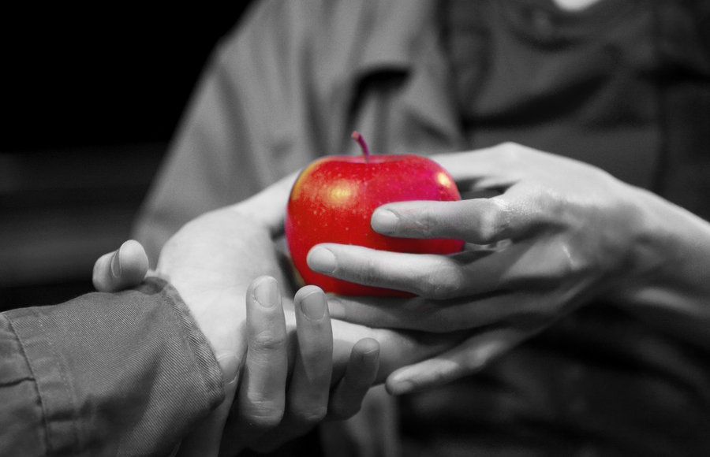

Slide 33
Ways to Create Emphasis
Size and Repetition.
Contrast a shape with its surroundings.
Create contrast of temperature.
Use a darker or lighter value.
Focus attention with converging lines.
Isolate the objet you want to emphasize.
Increase an objects intensity of color.

Slide 34
Contrast
A principle of art that refers to the arrangement of opposite elements (light vs. dark colors, rough vs. smooth textures, large vs. small shapes, etc.) to create visual interest in a work of art.

Slide 35
High Contrast
The more Contrast there is in an art work, the more a viewer’s attention is engaged.

Slide 36
Low Contrast
If there is little contrast in an art work, then there may be too much similarity and the art work could become monotonous and uninteresting.

