Slide 1
Midwife - client
Notes:
How would you feel?
intimidated?
Scared?
Unsure of what you were teaching ?

Slide 2
Questions
Do we need to know everything about a mum for us to teach affectively?
What if’s: we are asked something we don’t know?
What if we are confronted about our qualifications by a professional caregiver?
What if …
Notes:
There are lots of what ifs … discuss good to be prepared

Slide 3
Notes:
A Lady arrives smoking
How do you feel?
What are your immediate thoughts about her?
How would you support/guide?

Slide 4
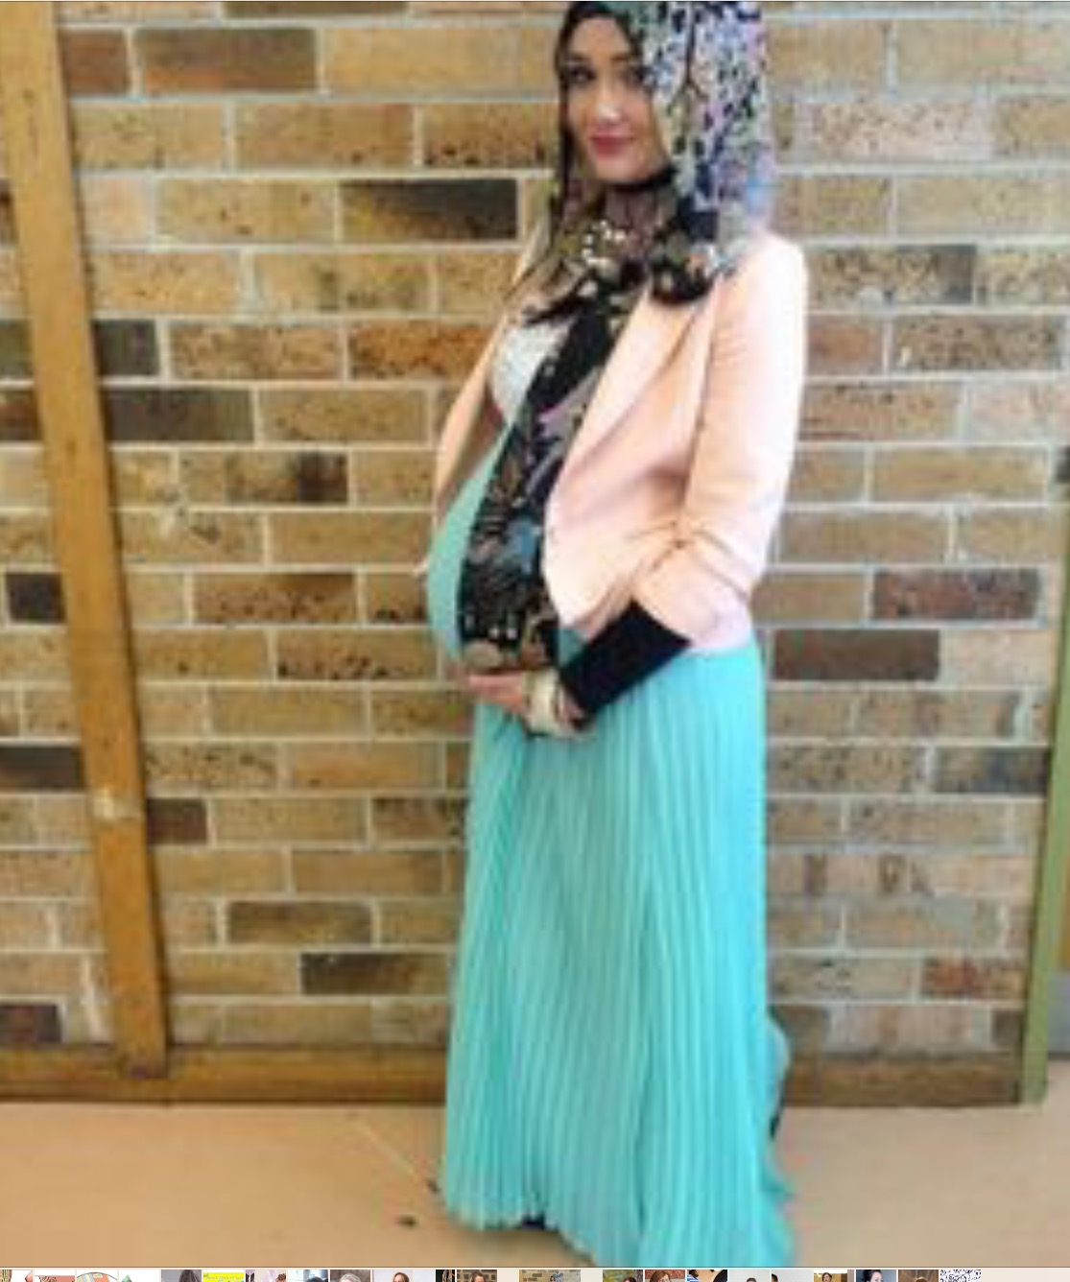
Notes:
Religon
First reaction?
How can you prepare?
Would you alter your class to suit individual needs?
how would you know?
Would you treat differently?
Communication?
Resources
Remember:
others on the course have paid to cover an amount of material - do you slow the class down for one person? Thoughts
Birth or not to birth
Medications

Slide 5
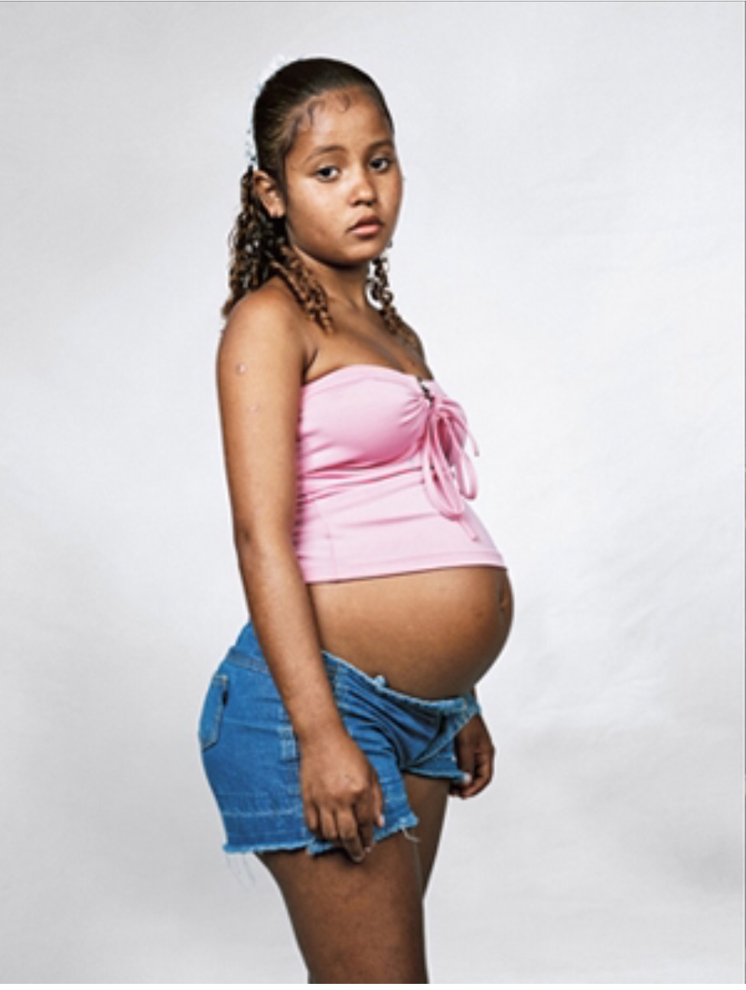
Notes:
Young mum
*any special needs?
*would you alter your class approach?
Would you give her ‘special attention’?
Would you pobe her position ie: whos the father, how old
* be prepared for the under age pregnancy – older father
* do you report? Refer to social services? None of our business?
Discuss

Slide 6
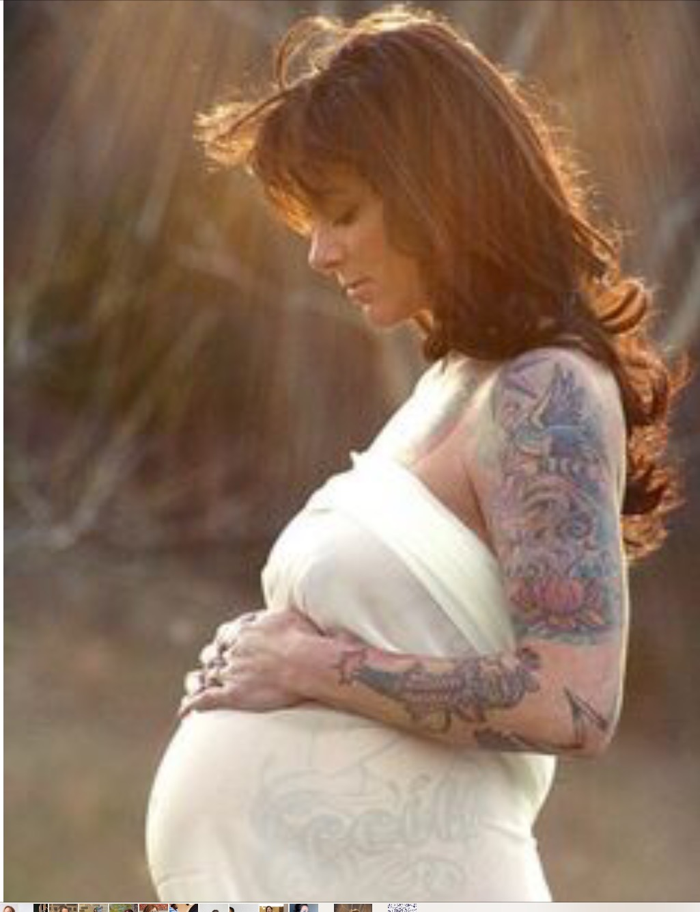
Notes:
Tatoos/ obvious piercings
judgements?
Health? – belly button piercings?
Do we judge?
ivf? Do we ask? If so why
Special care? With midwives?
Dont assume they are older, many ladies can look older than their age
Do they mix well in the class?

Slide 7
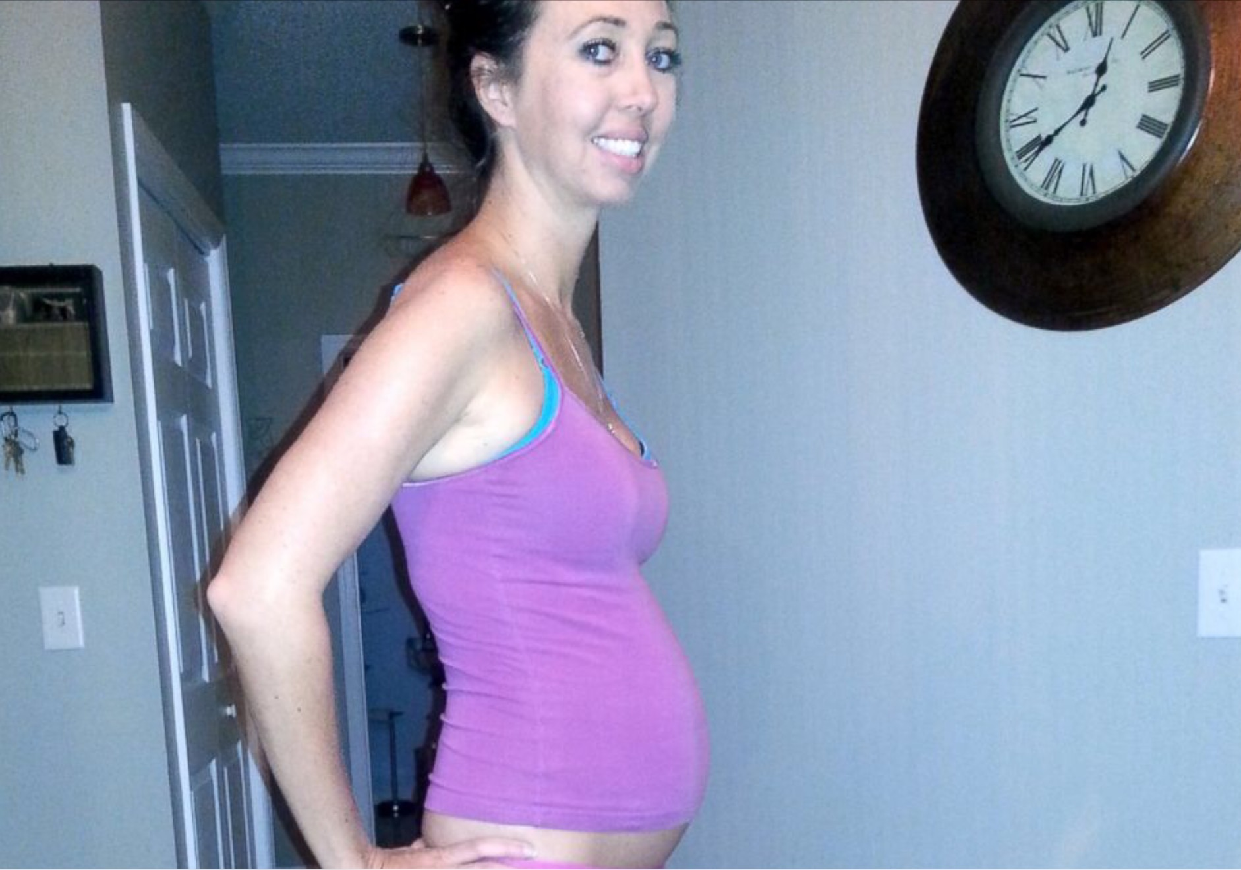
Notes:
Very slim
Any concern?
How would you approach?

Slide 8
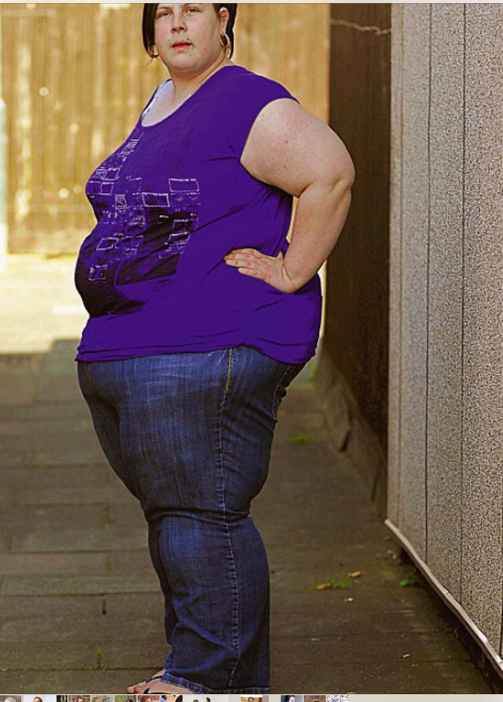
Notes:
Large
Do we judge
Do we discuss affects on baby and childbirth?
Dieting during pregnancy???
Think about interacction games in our classes – could she do most things?
older mum?
Single mum?
Should we ask?

Slide 9
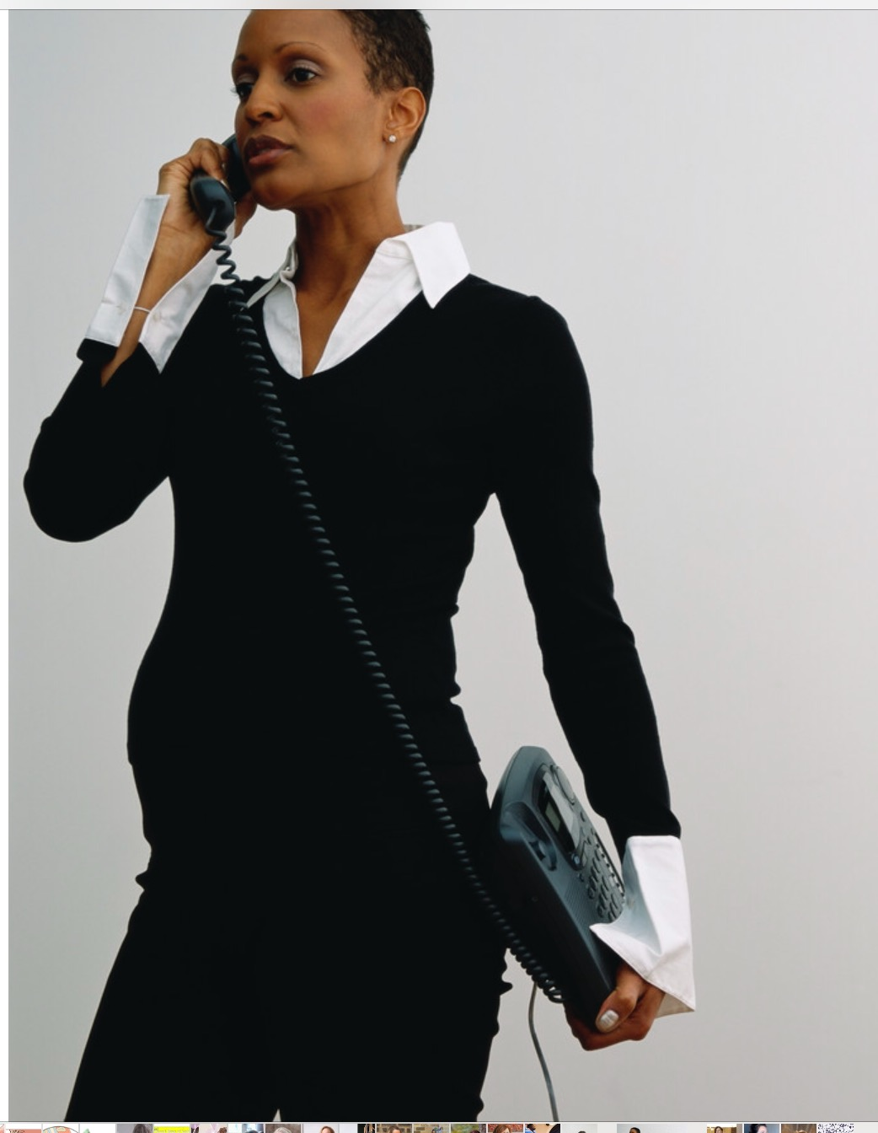
Notes:
Professional lady
Do you feel intimidated?
Would you treat her different?

Slide 10
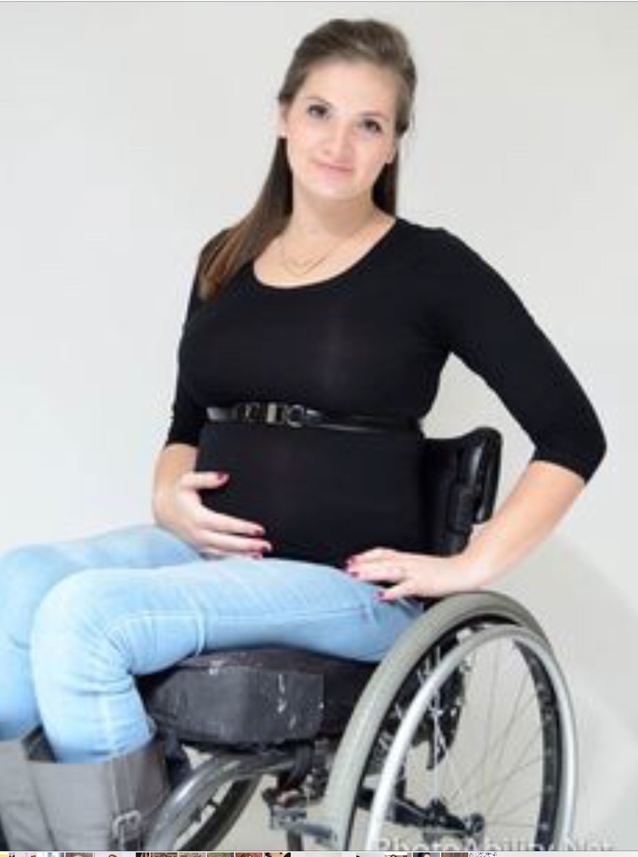
Notes:
Wheelchair – or disability
Do you offer support?
Special needs?
single?
Needs more information?

Slide 11
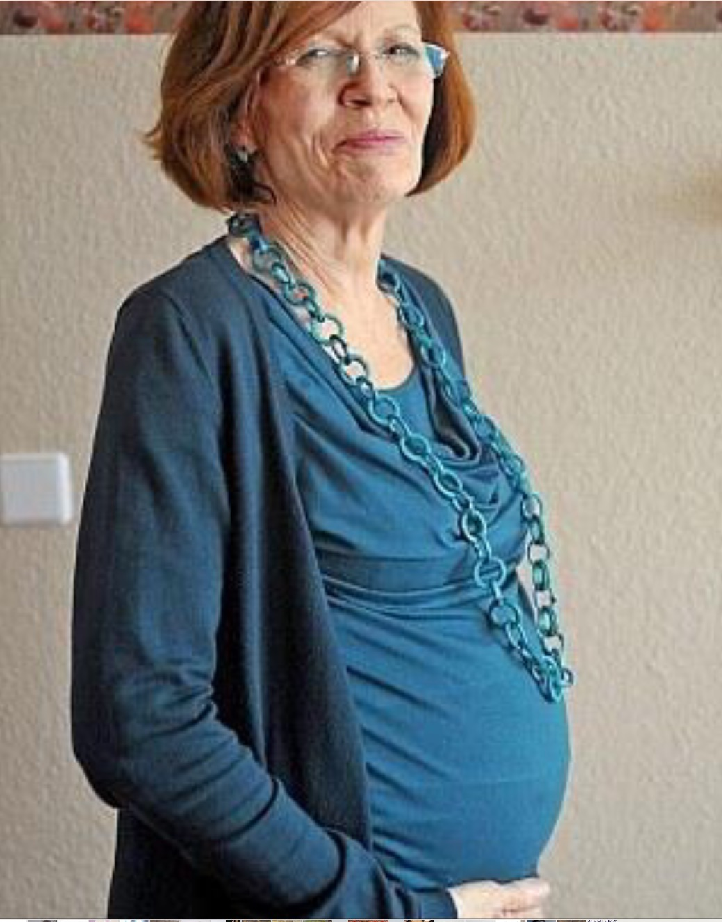
Notes:
Older mum
How do you feel personally?
Do you offer more support?

