Slide 1
Wilms‘ tumor, Neuroblastoma, Rhabdomyosarcoma, Teratoma, Liver tumors
Prof. Ivo Jurić, MD, PhD

Slide 2
CASE 1

Slide 3
CASE REPORT
Girls age: one month
Noted painless, oval, grayish-whitish tumor formation in the LS region, the size of 1.3 x 0.8 cm
The tumor was covered with normal skin
Laboratory findings were within normal values
Physical examination found a systolic murmur 2/6 strength as a result of no closed ductus arteriosus

Slide 4
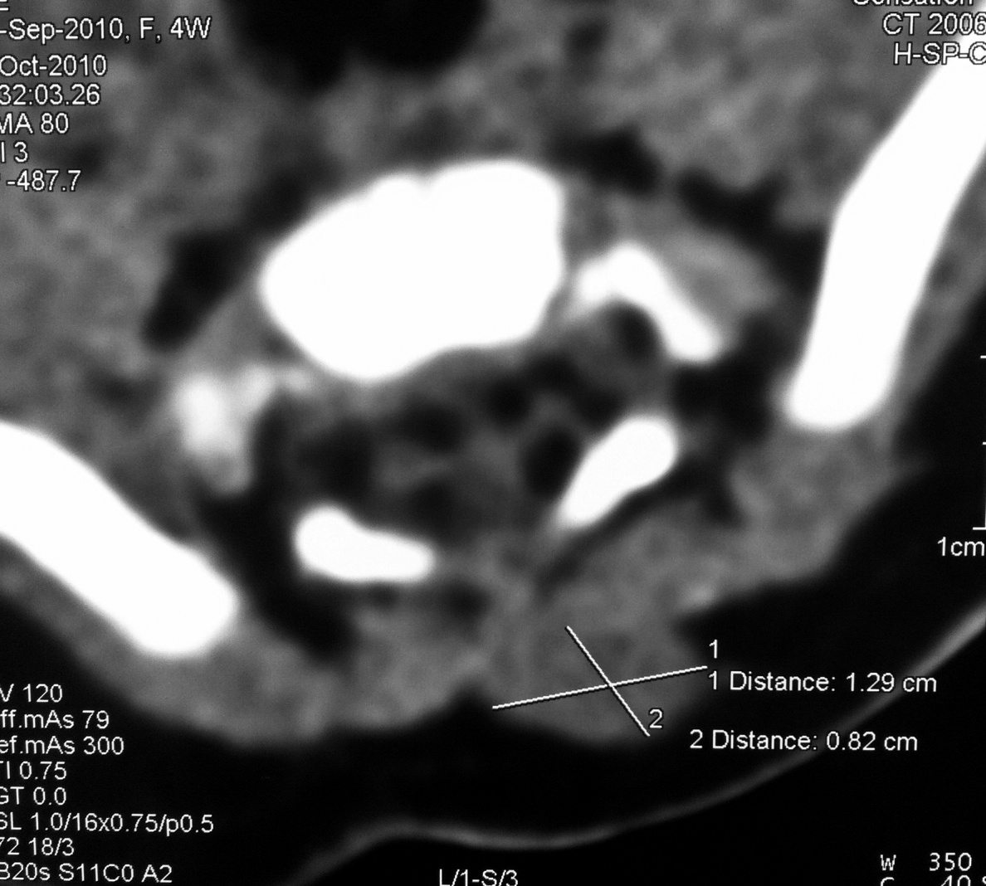
The tumor was detected on the 20th day of life, and the girl was admitted to Children's Hospital for diagnostic examination
MSCT
Size of a tumor
1.3 x 0.8 cm

Slide 5
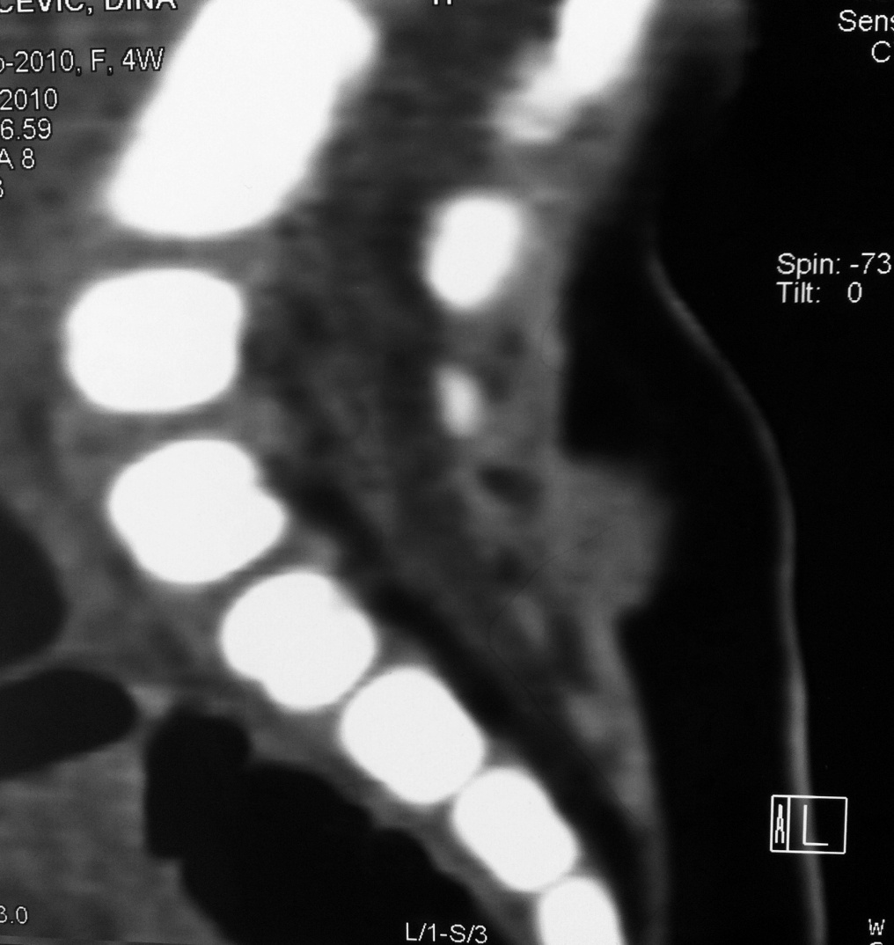
The tumor was located in the subcutaneous tissue and has not spread
into the spinal canal

Slide 6
There has been a surgical procedure during which the tumor is removed along with the subcutaneous tissue
Since the resection margins were made clean is another procedure, during which the tissue is excised and additionally the tumor was removed in its entirety.

Slide 7
Histopathologic findings:
Nephroblastoma - mixed type
Well expressed all three components of the tumor:
- epithelial
- stromal
- blastemal

Slide 8
Tumor is WT-1 positive

Slide 9
Ki-67 proliferative index was 60% of the blastemal component and 20% of the epithelial component

Slide 10
After surgery, chemotherapy was conducted according to the protocol Nephroblastoma SIOP 2001
Was used as a chemotherapy for Stage I Wilms' tumor high risk for 27 weeks
The girl is regularly verified for two years after surgery, good general condition and no evidence of the disease

Slide 11
EXTRARENAL WILMS TUMOR
It is defined as Wilms located anywhere outside the kidney
This tumor is extremely rare - incidence of 0.5-1% of cases
The diagnosis of cancer is almost always set after surgery
Localization: retroperitoneal, inguinal canal, paravertebral soft tissue, bladder, ovaries, uterus, vagina, prostate, colon, adrenal gland, mediastinum, chest wall

Slide 12
EXTRARENAL WILMS TUMOR
In English literature so far described only about 60 cases of extrarenal nephroblastoma
The most common places described as retroperitoneal and inguinal canal
Although extrarenal nephroblastoma occurs in children, described several cases of invasive disease in adults
The most commonly used diagnostic methods were ultrasound and MSCT, but no characteristic findings based on which to conclude that this is a extrarenal nephroblastoma - diagnosis is always set after surgery

Slide 13
EXTRARENAL WILMS TUMOR
Differential dijagnosis: Supernumerary kidney, metastatic renal tumors, teratomas with component Wilms' tumor and other primitive mesenchymal tumors
Detection of WT1 protein is confirmed diagnosis of Wilms' tumor, if the tumor is located outside the kidney it is the extrarenal Wilms tumor
The exact mechanism of extrarenal Wilms' tumor is not known
It is believed that extrarenal form of tumor arises from primitive germ cells
Most likely arises from ectopic metanephritic blastems cells

Slide 14
EXTRARENAL WILMS TUMOR
The symptomatology depends on where the tumor is located
Tumors localized in sacrococccigeal or lumbosacral area may have an extension into the spinal canal
TREATMENT: surgical
Chemotherapy is administered according to the same protocol as that affected kidney

Slide 15
Our case is interesting not only because of the rarity of this type of tumor, but also for rare localization as well as the age at which the reported
So far there is only one case described the appearance of tumors in the subcutaneous tissue LS region
Also, there is only one reported case of invasive disease in newborn
Armanda V, Culić S, Pogorelić Z, Kuljiš D, Budimir D, Kuzmić-Prusac I. Rare localization of extrarenal nephroblastoma in 1-month-old female infant.
J Pediatr Urol. 2012:8(4):e43-45.

Slide 16
CASE 2

Slide 17
CASE REPORT
Girls age 9 years
Sent to emergency unit because of pain in the right upper abdomen that began a day earlier
The pains are spasmodic, intermittent character. Since this morning the pain constantly
The pain is localized in the ileocoecal region
It is not vomited, had nausea, stools regular without pathological impurities
Epidemiological sporadic case

Slide 18
Clinical exam:
Conscious, oriented, afebrile, euhydrotic, cardiopulmonary compensated
Soft, painful on palpation in the right lower part in the periumbilical area. There are no signs of peritoneal irritation. Digitorectal: b.o.
Blumberg I +; Blumberg II -; Grassman +; Rowsing -; Perman -
LAB: L 9.8; 52% neutrophils, CRP 3.4
T ax: 36.9 ° C, T rec: 37.4 ° C
Acute appendicitis?

Slide 19
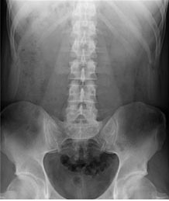
NATIVE ABDOMEN
UZV
- Normal
- Something more voluminous bladder

Slide 20
The next two days will come again because of convulsive abdominal pains that last for a short and go
Hospitalized in Children's Hospital for diagnostic examination
Laboratory findings - within the limits of normality
Repeated digitorectal exam: suspected formation in the projection of the right adnexa

Slide 21
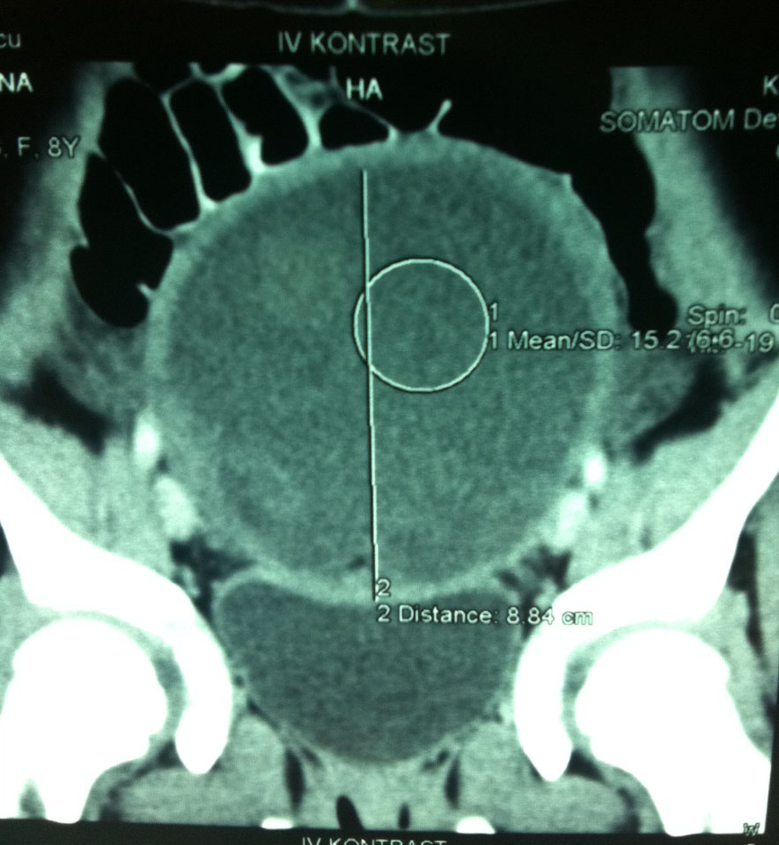
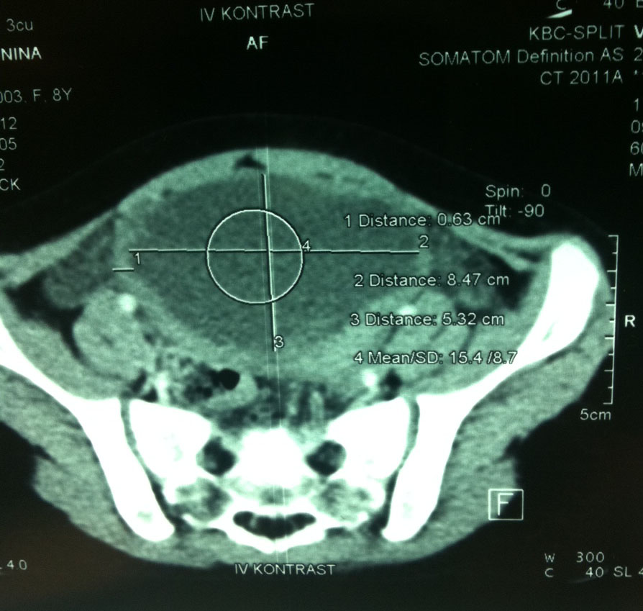
MSCT
Tumor of the right adnexa
size 15 x 8 cm

Slide 22
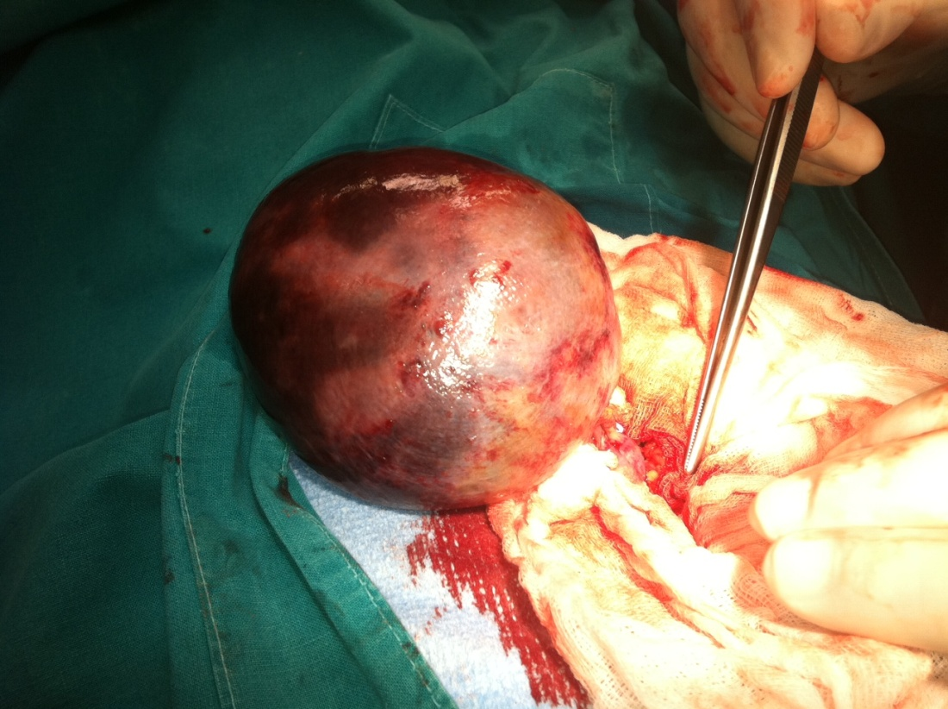
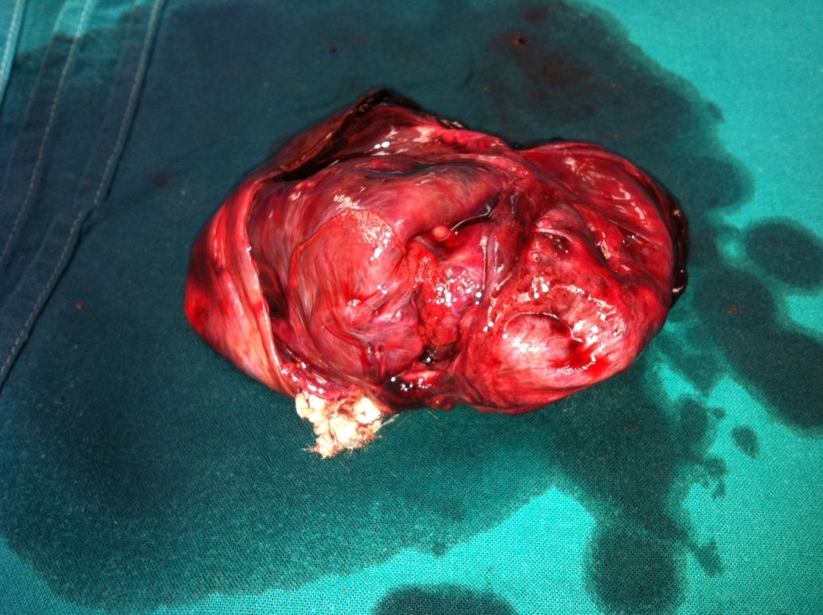
INTRAOPERATIVE FINDING
Teratoma ovarii l. dex.

Slide 23
CASE 3

Slide 24
CASE REPORT
A boy aged 13 years
Comes in HKP because of a painless swelling of the left testicle
The last few days he noticed that his left testicle twice the size of the right
Denies pain

Slide 25
CLINICAL EXAMINATION:
Conscious, oriented, afebrile, hydrated, age-appropriate bone and muscle structure, cardiopulmonal compensated.
Belly in the thorax, soft, painless on palpation. There are no signs of peritoneal irritation
The external genitals b.o. Left testicle voluminous in relation to the right, painless testicle can not palpate around due to hydrocele
LAB: within normal values
Hydrocele?
Acute scrotum?

Slide 26
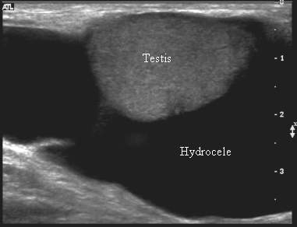
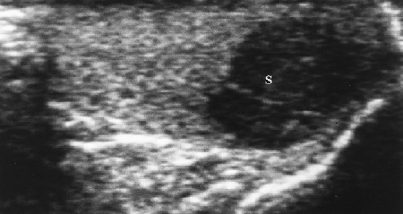
TUMOR MARKERS
ßHCG – normal
AFP 897 ng/ml (<20 ng/ml)
LDH 563 U/L (<241 U/L)
ULTRASOUND

Slide 27
DIAGNOSTIC EVALUATION
MSCT of brain
Ray of lungs
PET/CT of the abdomen
Sceletal scyntigraphy

Slide 28
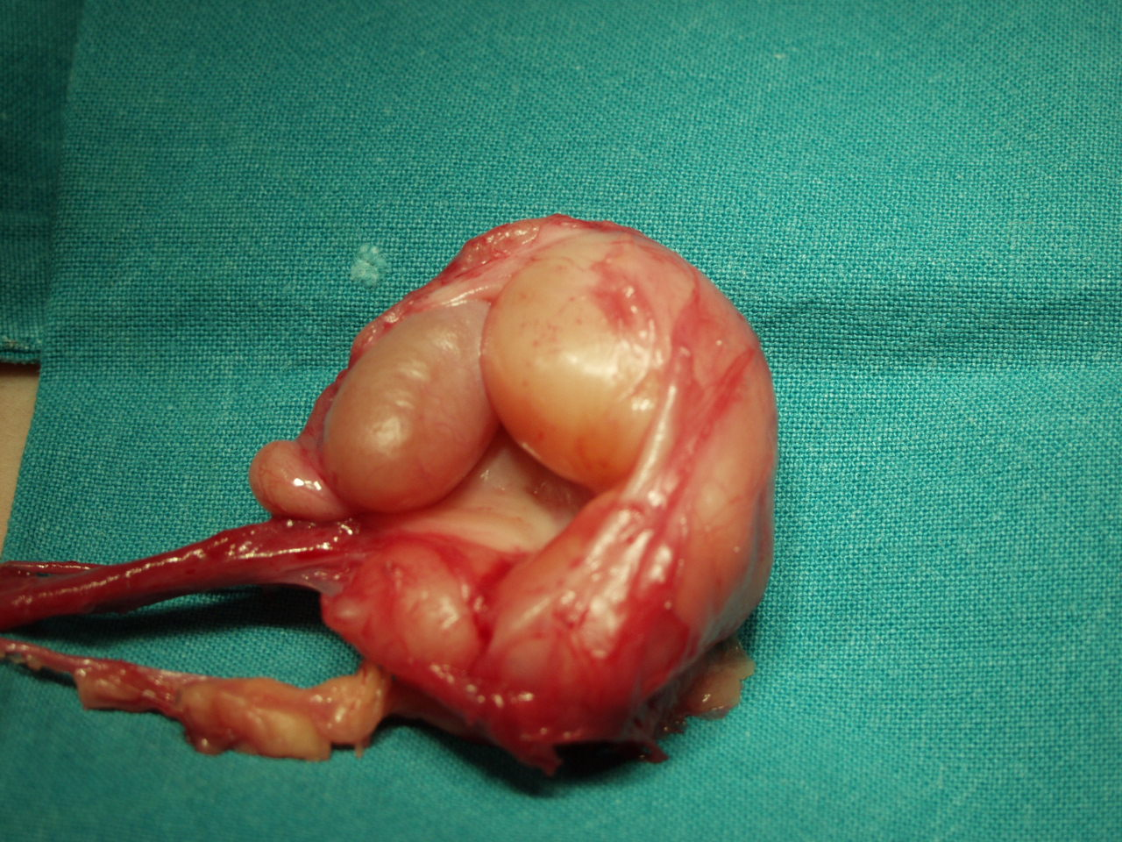
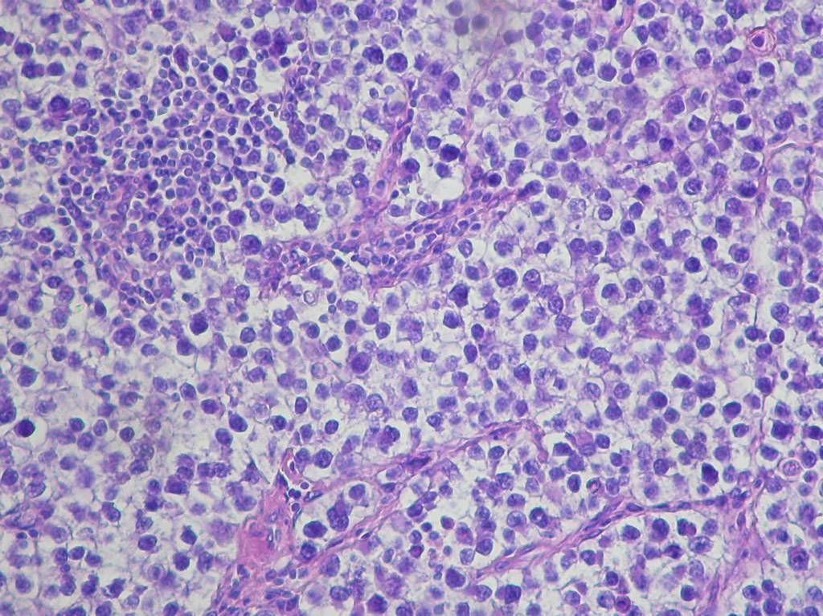
OPERATIVE FINDING
PHD
Seminoma testis l. sin.

Slide 29
CASE 4

Slide 30
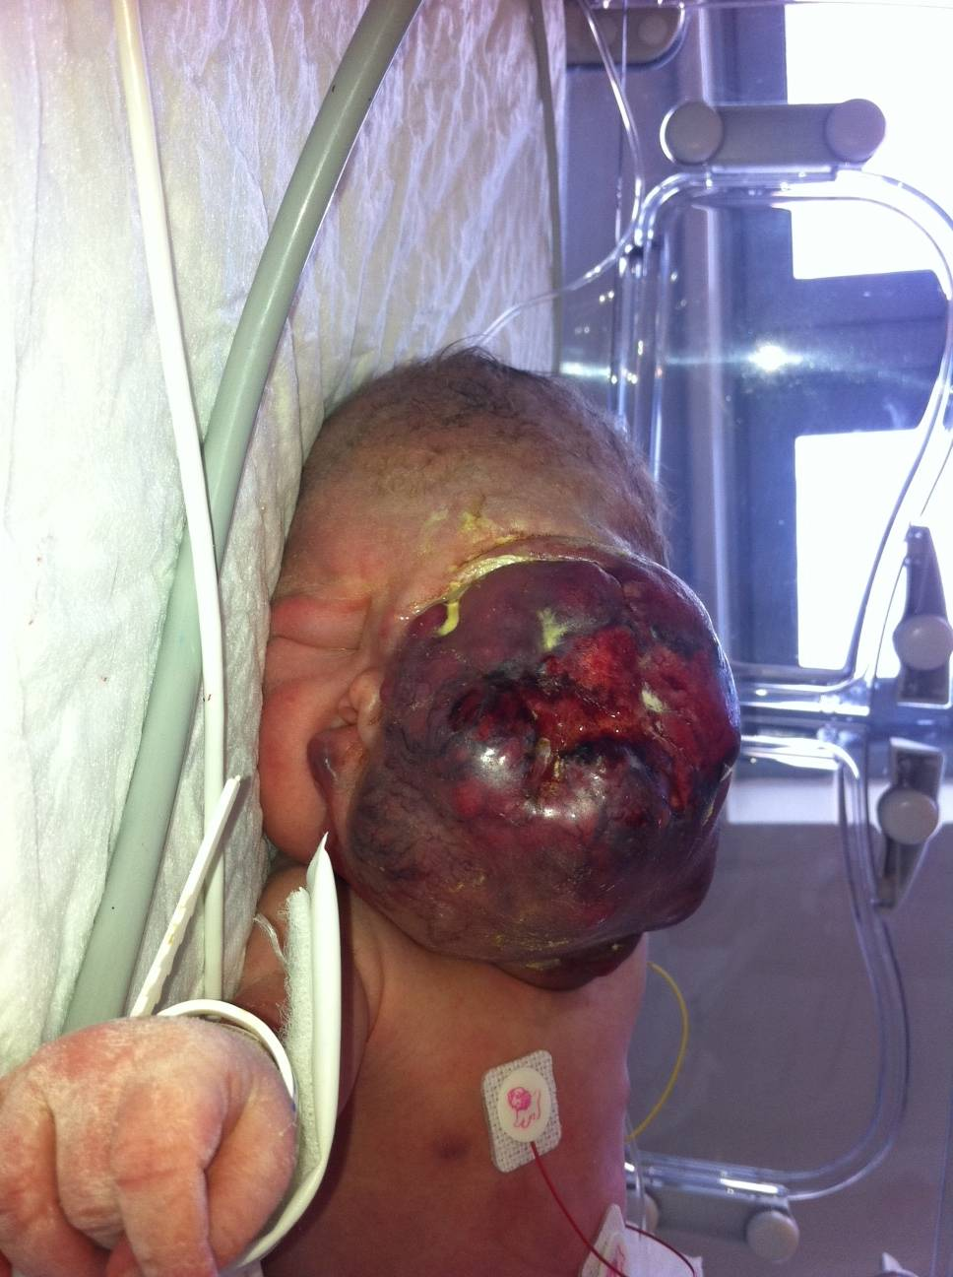
Born 13.04.2011. to 06:07 h - OB Sisak
Childbirth: vaginally
MA 38 + 4 ie; RM 3160 g; RD 49 cm; Apgar 8.8
A child born in the 4th controlled pregnancy
(3rd delivery)
Family history:
There are two good sisters
Mother‘s grandfather originally from Kenya
After the birth, observed a large tumor on the
left side of the face
(Hemangioma)
Left eye is not developed, the left eye and nose is
suppress the right

Slide 31
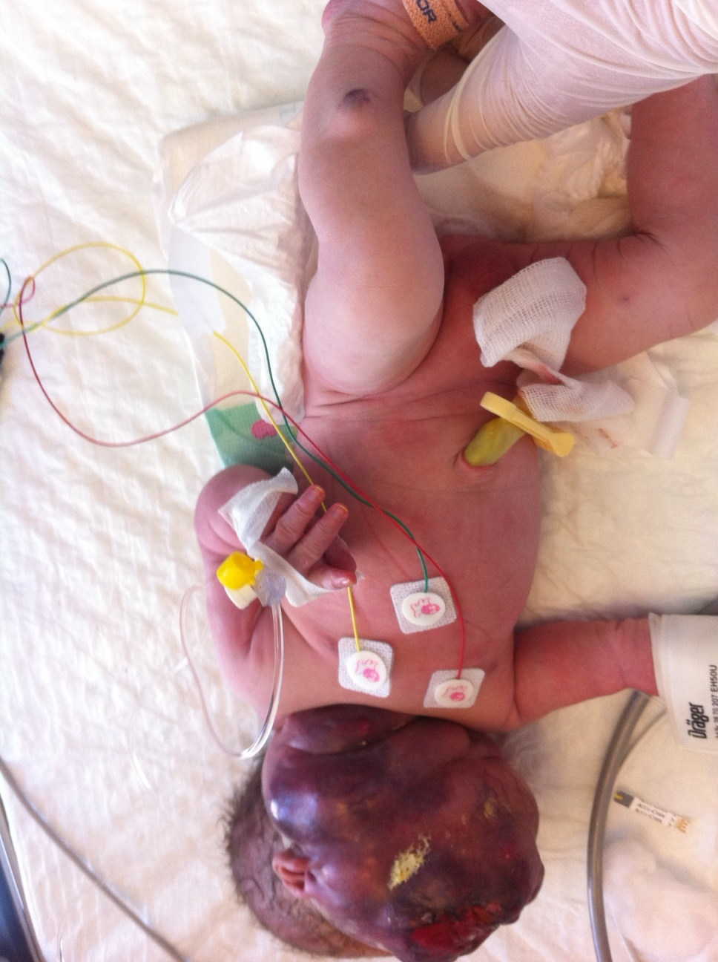
The tumor affects the left side of the face, neck, shoulder and expands on the back
Smaller hemangiomas on the left lower leg, the right knee and back

Slide 32
MAHAČEK neonatus ♂
Emergency transport incubator an ambulance from OB Sisak
STATUS OF THE RECEPTION
- Firstborn male in the age of 4 hours
Permagnum tumor formation on the face of macerated, bleeding
breathes independently
pale-grey colors
hypotonic
tahidispnoic
normal cardiac activity

Slide 33
MAHAČEK neonatus ♂
Angiografija

Slide 35
Kasabach–Merritt sindrom

Slide 36
CASE 5

Slide 37
CASE REPORT
Girl aged 16
It occurs due to intermittent abdominal pain, lasting three months
The pain is localized in the epigastric and supraumbilical
It is not vomited, had nausea, stools regular without pathological impurities
I lost a few pounds in weight
Epidemiological sporadic case

Slide 38
Clinical examination:
Conscious, oriented, afebrile, euhidrotic, cardiopulmonary compensated
Stomach in the thorax, soft, painful on palpation in the epigastric where palpable sharply limited tumor formation diameter of about 8 cm digtorectal: b.o.
LAB: within the limits of normality
Tumor markers (CEA 19-9, CEA) AFP within the limits of normality
Differential diagnosis?

Slide 39
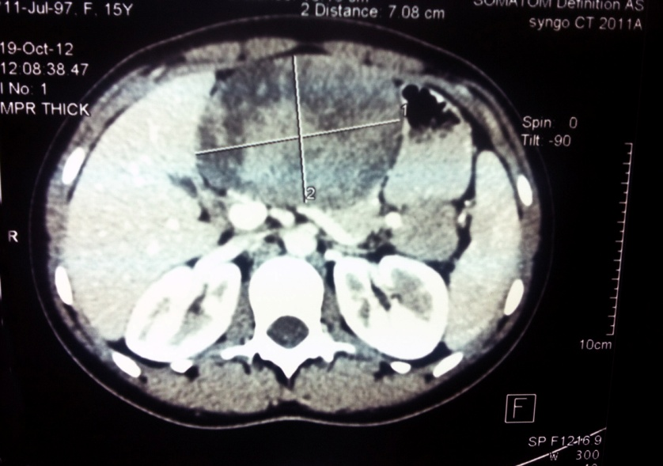
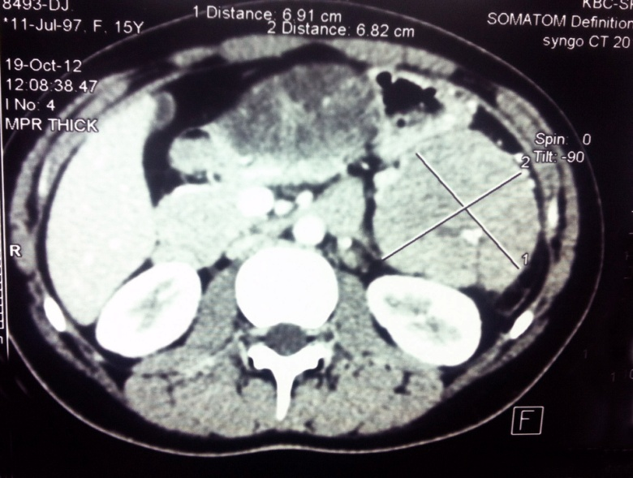
ULTRASOUND
Two encapsulated tumor formations of unknown etiology
MSCT
Two encapsulated heterogeneous tumor formations partly solid, partly cystic, with calcification
The first is based on the formation of pancreatic head (10.2 x 7.1 x 6 cm)
Another formation starts from the tail pancreas (6.9 x 6.8 x 6.5 cm)
No lymphadenopathy and no other pathological substrate

Slide 40
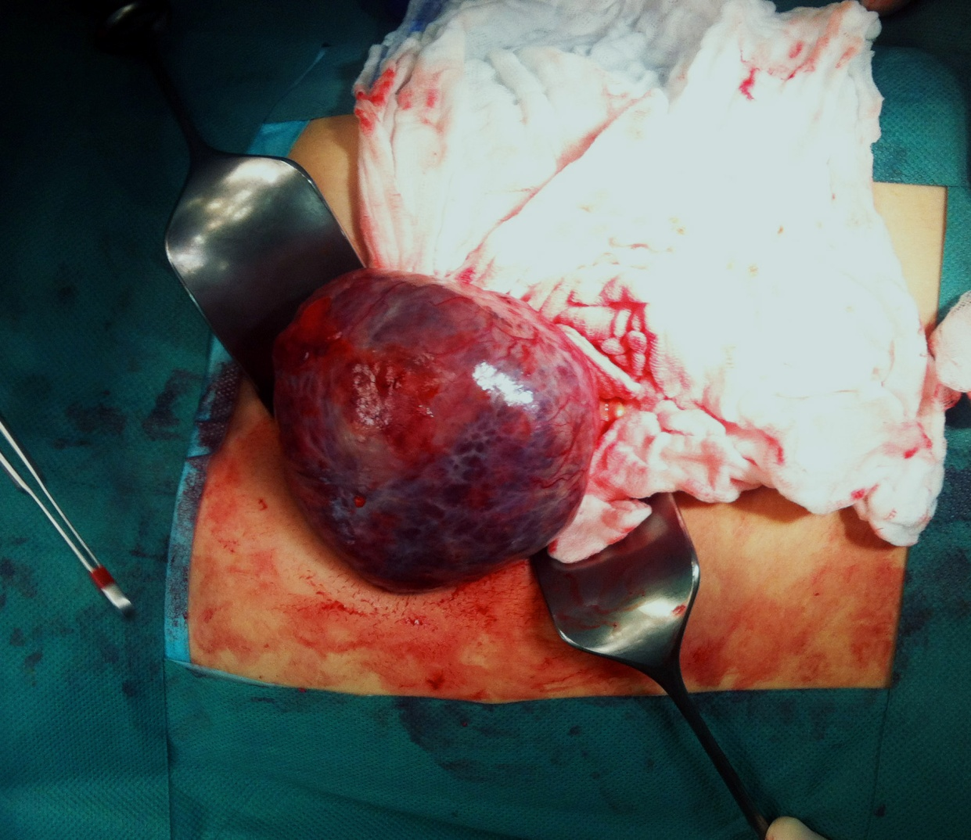
INTRAOPERARATIVE
Two solid sharply limited encapsulated tumor
The first starts from the head of the pancreas, the second tail
No there is metastasis or spread to surrounding tissues and organs
The patient underwent enucleation of both tumors

Slide 41
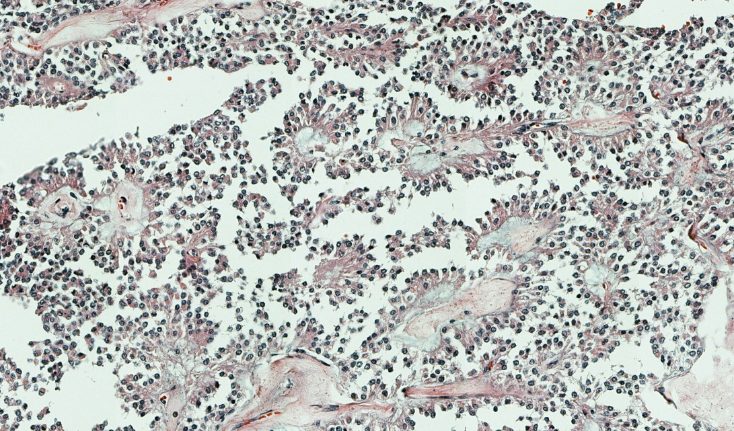
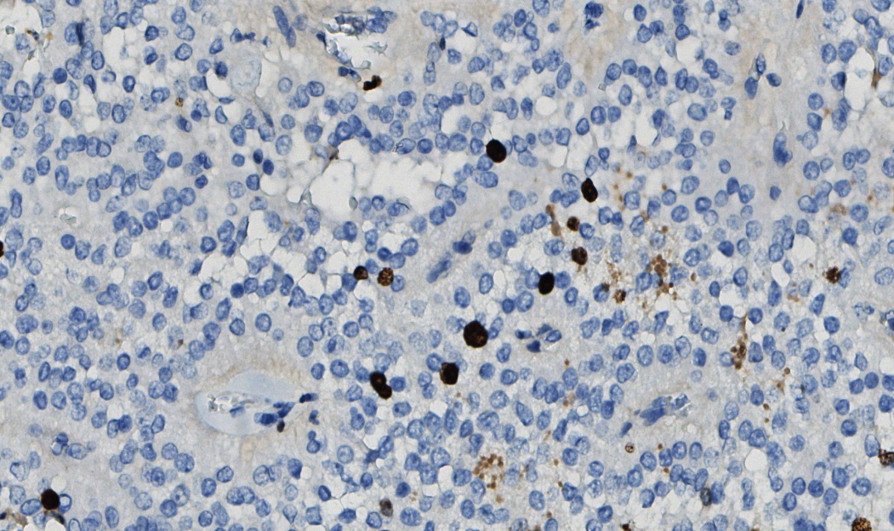
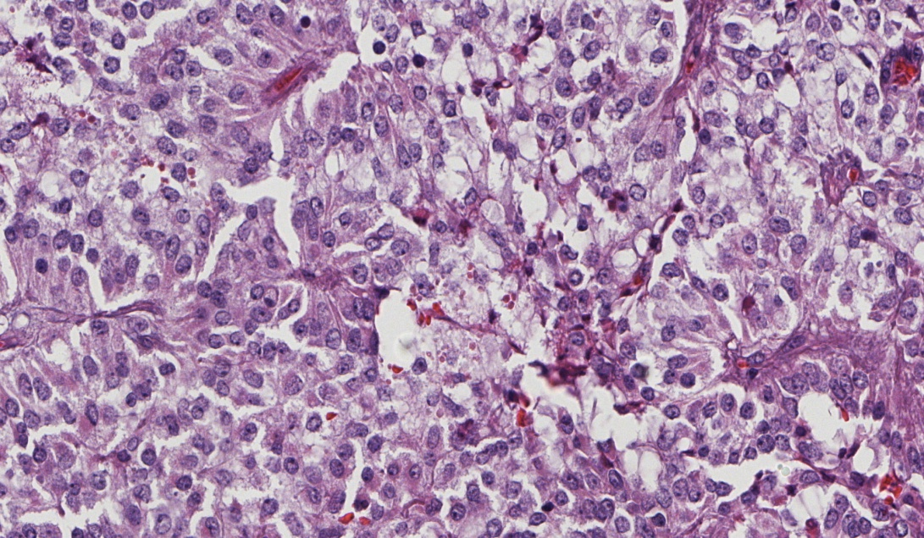
Patohistological:
Pseudopapillary pancreatic tumor (Tm. Frantz)

Slide 42
PSEUDOPAPILAR TUMOR OF PANCREAAS
First described in 1959 (tumors Frantz)
This tumor is extremely rare - incidence of 1% of all pancreatic tumors
It generally occurs in young females
Rarely causes symptoms, can be located anywhere in the pancreas
Symptoms are non-specific (abdominal pain, dyspepsia, nausea, vomiting, weight loss)
The tumor forming monomorphic poorly cohesive cells that form pseudopapile, there is often a hemorrhagic cystic degeneration

Slide 43
PSEUDOPAPILAR TUMOR OF PANCREAS
These tumors have low malignant potential
They have a good prognosis
Only 10-15% of patients develop metastases
Local invasion of surrounding structures extremely rare
Tumor markers are mostly negative
Differential diagnosis: acinar carcinoma, mixed acinar-endocrine cancer, pancreatoblastom, endocrine neoplasms of the pancreas
So far about 800 cases described in the English literature and about 550 in China
62.5% of patients with these tumors have a positive markers for HBV

Slide 44
PSEUDOPAPILAR TUMOR OF PANCREAS
Ki-67 is correlated with the clinical picture
Low Ki-67 is mainly associated with a good prognosis
Patients with a high expression of Ki-67 mainly develop metastases or finding a local invasion
Weather even in patients with metastatic disease is good
5-year survival rate of > 95%
Local recurrence occurs in about 10% of patients
It is preferred that enucleation of the tumor and minimal resection if there is invasion

Slide 45
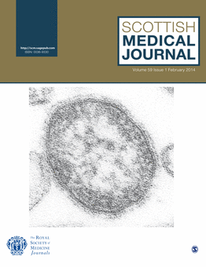
Our case is interesting because for the first time shown synchronously incidence of tumors in the head and tail of the pancreas
Jurić I, Pogorelić Z, Stepan – Giljević J, Kuzmić-Prusac I. Extremely rare presentation of Frantz’s tumor: synchronous localisation in the pancreatis head and tail
Scott Med J. 2014: Article in press

Slide 46
CASE 6

Slide 47
CASE REPORT
Girls age 8 years
Comes in pediatric admission due to constipation, abdominal pain and general weakness
The parents claim that the last 5-6 months lost more than 10 kg in weight
Refusing food, constipated for a long time

Slide 48
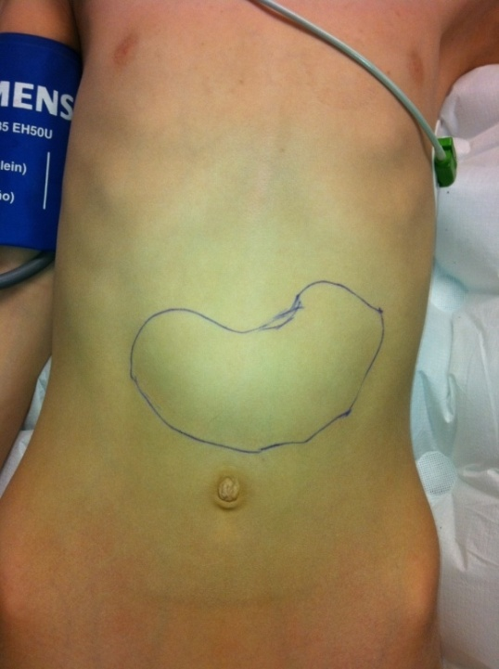
Clinical examination:
Conscious, oriented, afebrile, euhidrotic, pale, ill-fed, cardiopulmonary compensated.
Abdomen tumor formation below the rib cage, soft, painless on palpation. There are no signs of peritoneal irritation. The epigastric and under the left rib palpable tumor formation is a 10 x 5 cm. The formation of a movable, painless and not fixed to the base.
Digitorectal: b.o.
LAB: Anemia
T ax: 36.5 ° C, T rec: 37.1 ° C
The tumor of the abdomen?

Slide 49
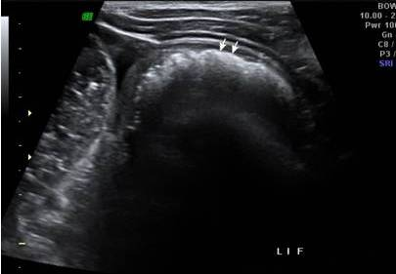
NATIVE ABDOMEN
ULTRASOUND
Hyperechoic mass in the
left hypochondria
GASTROSCOPY – lack of access to the stomac

Slide 50
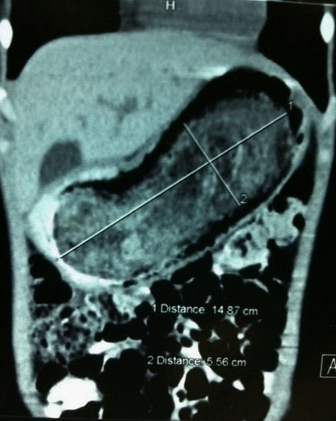
MSCT
Intraluminal mass, size
14.87 x 5.56 cm, which causes
dilatation of the stomach

Slide 51
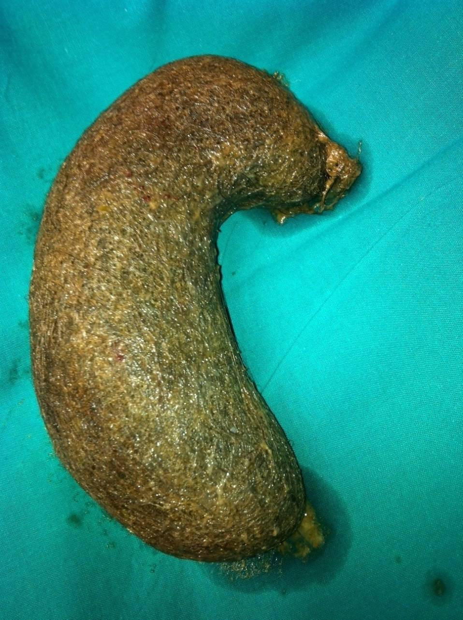
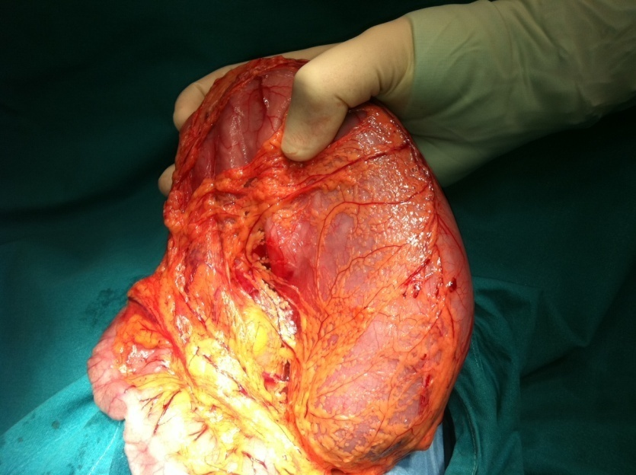
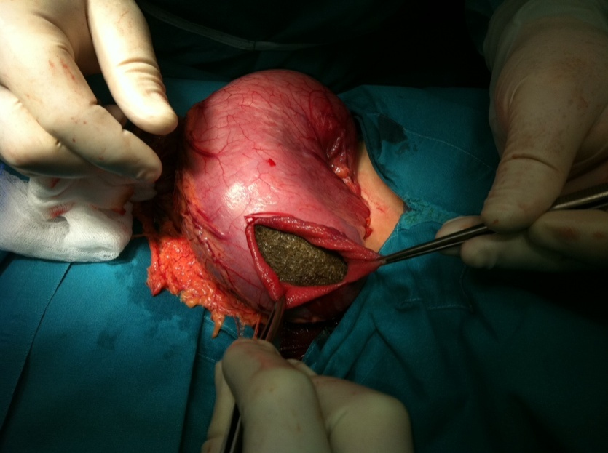
INTRAOPERATIVE FINDING
Weight:1400 g; Size: 22 x 9.5 cm

Slide 52
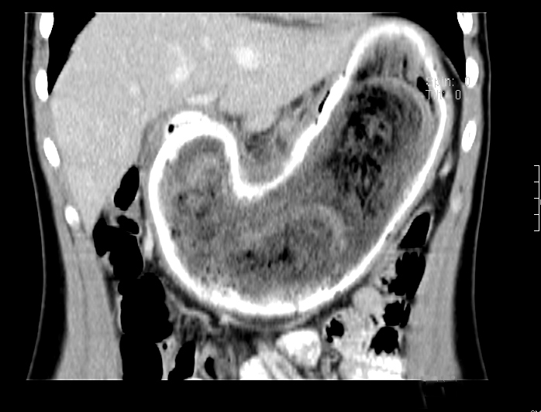
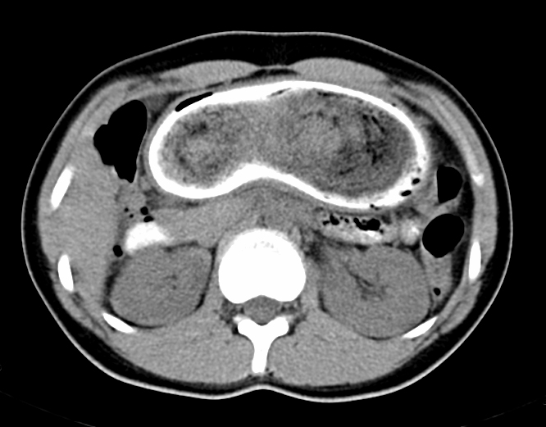
15-year-old girl
Last 6 months complaining of occasional pains in the abdomen, according to weight loss.
Parents cite figures on trichotillomania
Clinical examination:
- alopecia
- Tumor formation that is palpable in the epigastrric
and left hypochondric area
Laboratory examination:
- anemia
- Amylase (urine) 743 U / l
Native abdomen: normal results
Thr belly: hyperechogenic mass in epihastric area
Gastroscopy: trichobezoar, inability passage into
the duodenum
MSCT: intraluminal mass that fills the entire stomach

Slide 53
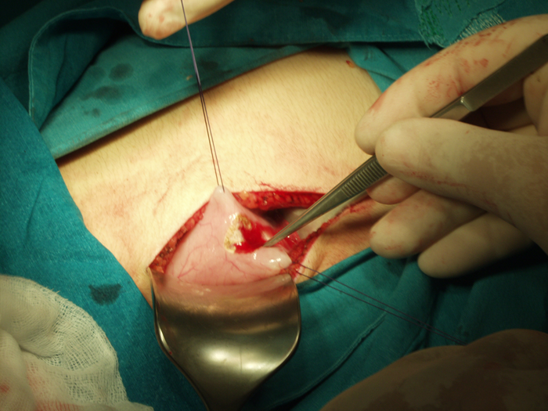
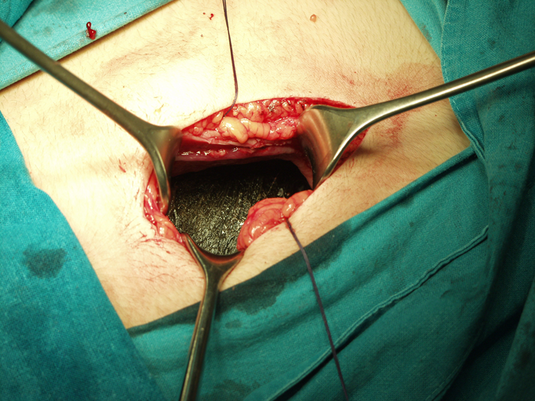
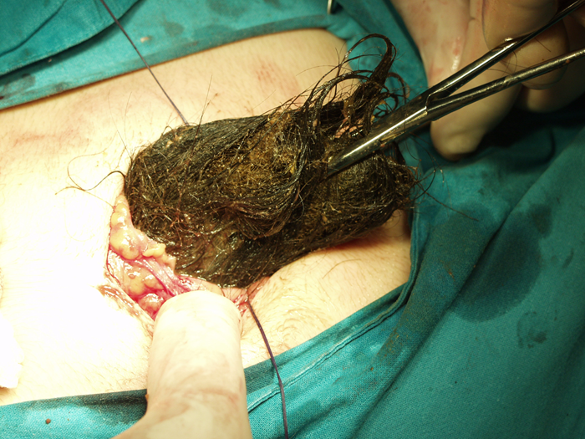
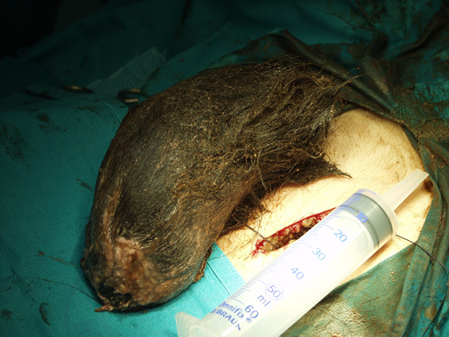
INTRAOPERATIVE FINDING
Weight:1250 g; Size: 21 x 8.5 cm

Slide 54
Pogorelić Z, Jurić I, Žitko V, Britvić-Pavlov S, Biočić M. Unusual cause of palpable mass in upper abdomen-giant gastric trichobezoar: report of a case. Acta Chir Belg. 2012;112(2):160-3.

Slide 55
Thank you for your attention!

