Slide 1

The following presentation and its content is exclusive property of CPM SAS and is considered strictly confidential and reserved
exclusively to the partecipants. It is prohibited the divulgation without the consent of CPM SAS

Slide 2

Ari well d-one®

Slide 3
Acute Respiratory Infections (ARI) are one of the major health problems in the world and on pediatric ages are one of the leading causes of mortality and morbidity. The microbiological diagnosis of respiratory infections turns out to be complex and diverse depending on the location of the infectious process, its severity, samples available and the patient's age.

Slide 4
Additionally the etiological agents responsible are diverse and the epidemiology may vary in relation to specific factors (community-acquired pneumonia, hospitalized patients, immunosuppressed patients, geographic area, among others). In developing countries bacteria are often the most isolated in severe pneumonia in untreated patient’s etiologic agents, and constitute a serious health problem in children and the elderly. Rapid diagnosis currently recommended may involve the use of expensive tests, which although excellent methods, are usually not available in all hospitals, or insufficient to permit identification of all stakeholders.

Slide 5
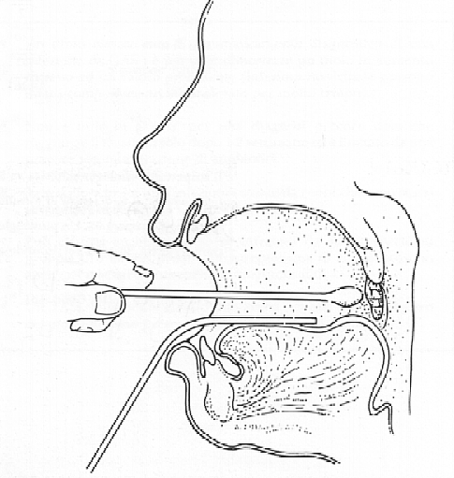
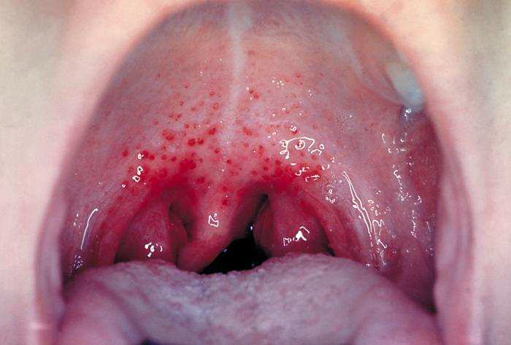

Slide 6
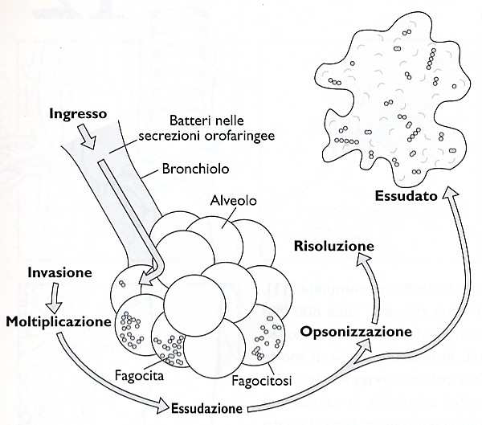

Slide 7
It is common that regions with limited resources chooses to implement antimicrobial treatment as a priority, rather than devoting resources in the microbiological diagnosis, which requires an adequate infrastructure for its realization.
Therefore a system that allows growing rapidly, along with the antimicrobial susceptibility in just 18-24 hours, without additional equipment, can be a useful tool in the hands of the microbiologist and clinician.

Slide 8
ARI WELL D-ONE®
System composed of a polypropylene plate containing 32 tapered wells designed for better visualization of the colorimetric reactions that occur as a result of the growth of microorganisms, media specially prepared for the selective cultivation of
Streptococcus pneumoniae,
Streptococcus pyogenes (Group A),
Streptococcus agalactiae (Group B),
Haemophilus influenzae,
Haemophilus spp,
Staphylococcus aureus,
Mycoplasma spp.,
Mycoplasma pneumoniae,
Pseudomonas spp.,
Candida spp.,
Candida albicans,

Slide 9
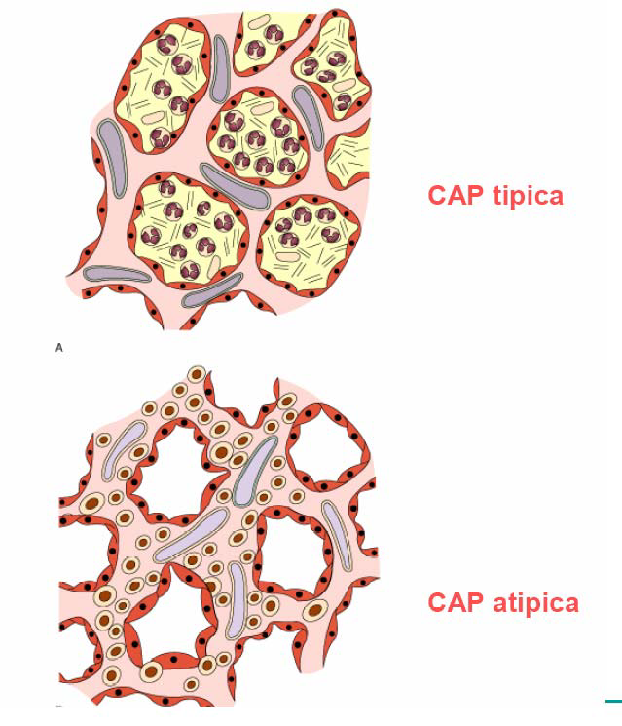

Slide 10
Polmonite atipica da Mycoplasma pneumoniae

Slide 11
ARI WELL D-ONE ®
A combined system of 32 conical wells with specific formulations to define the presumptive diagnosis of one or more microorganisms present in the sample.
It is essential the general analysis of all the results obtained in the various wells by the microbiologist, to interpret the obtain result in the identification panel.

Slide 12
The microbiological diagnosis can be confirmed by serological tests, microscopic examination or culture, directly from positive wells.
The plate contains growth control wells and guidance wells that can enable accelerated growth of other agents not mentioned herein, for which can be used serological or conventional diagnosis as well as other laboratory tests available.

Slide 13
The antimicrobial susceptibility is designed to help identify, with points of cuts sensitivity/resistance as a function of antimicrobials used more frequently in those respiratory infections caused by agents most commonly isolated.
Antimicrobial treatment of IRA has a strict protocol implemented in each care unit, the results obtained by the ARI WELL D-ONE® system should be consulted depending on the identified agent and the identification scheme procedures present in the technical sheet of the system.

Slide 14
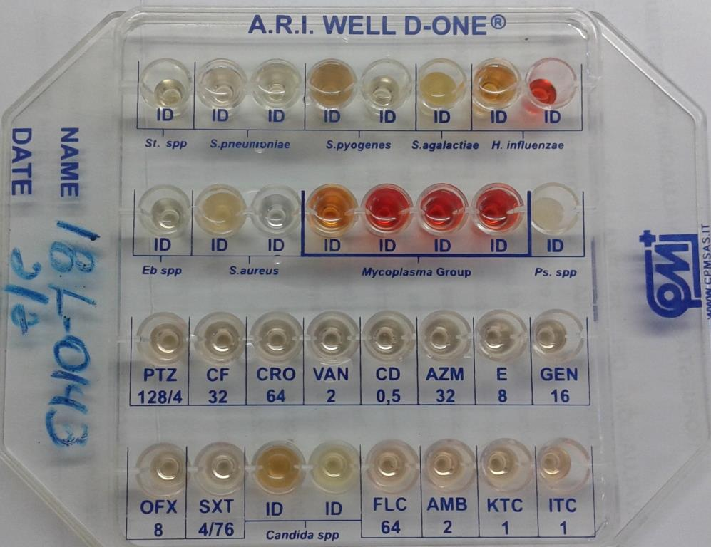

Slide 15
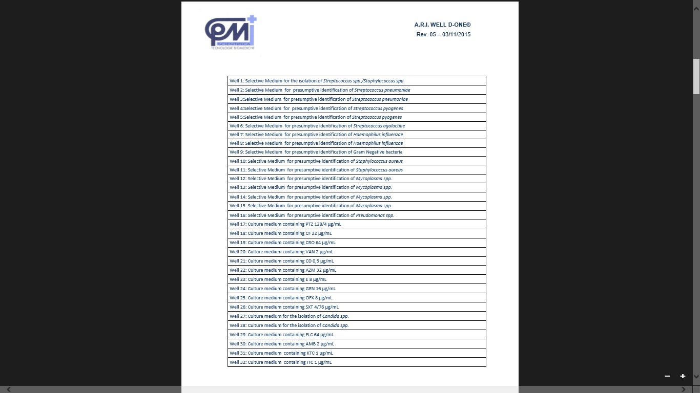

Slide 16
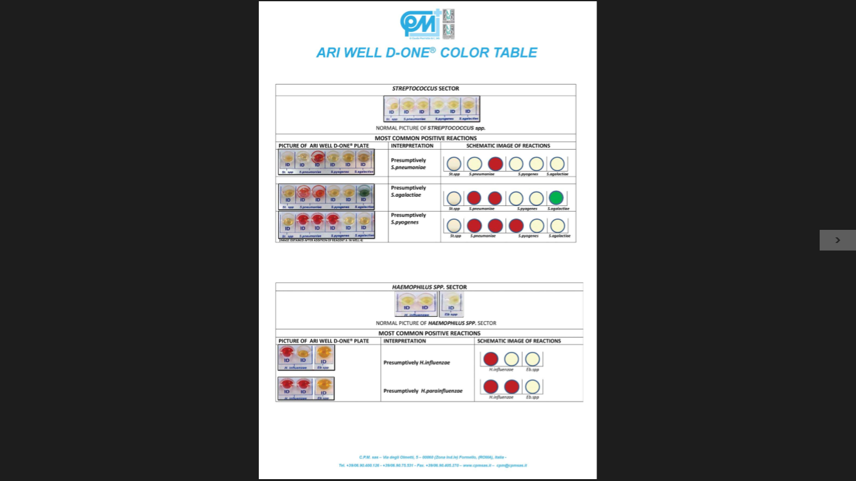

Slide 17
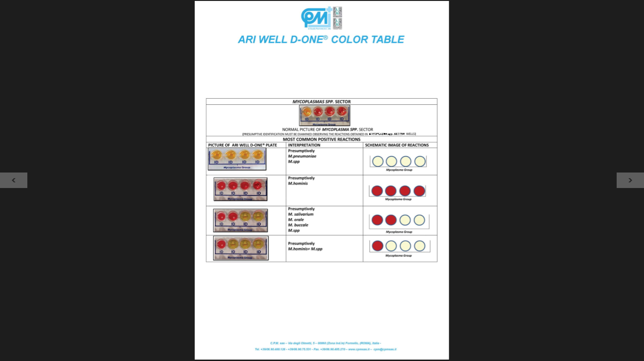

Slide 18
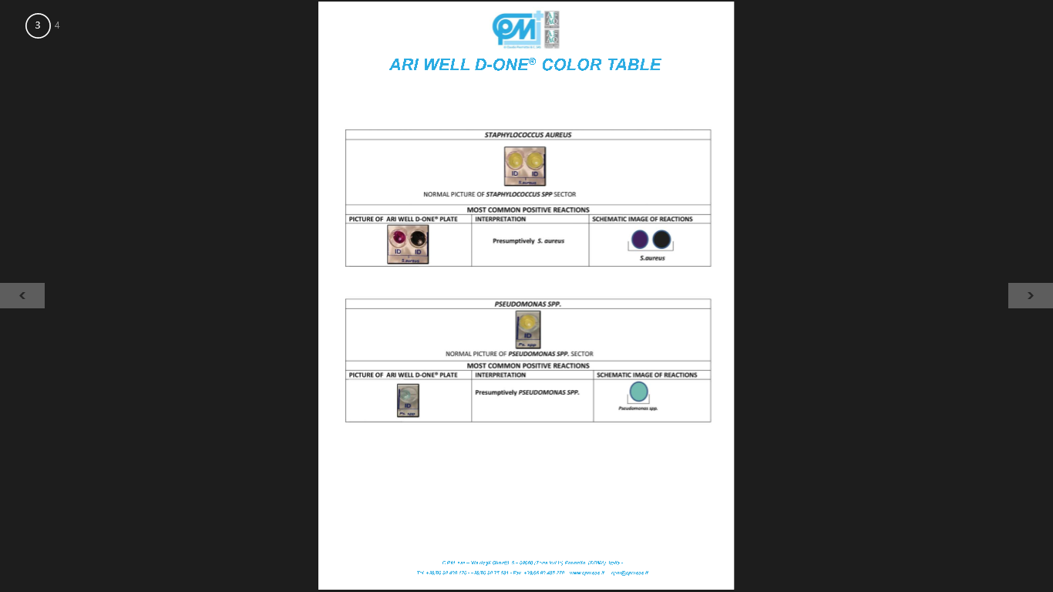

Slide 19
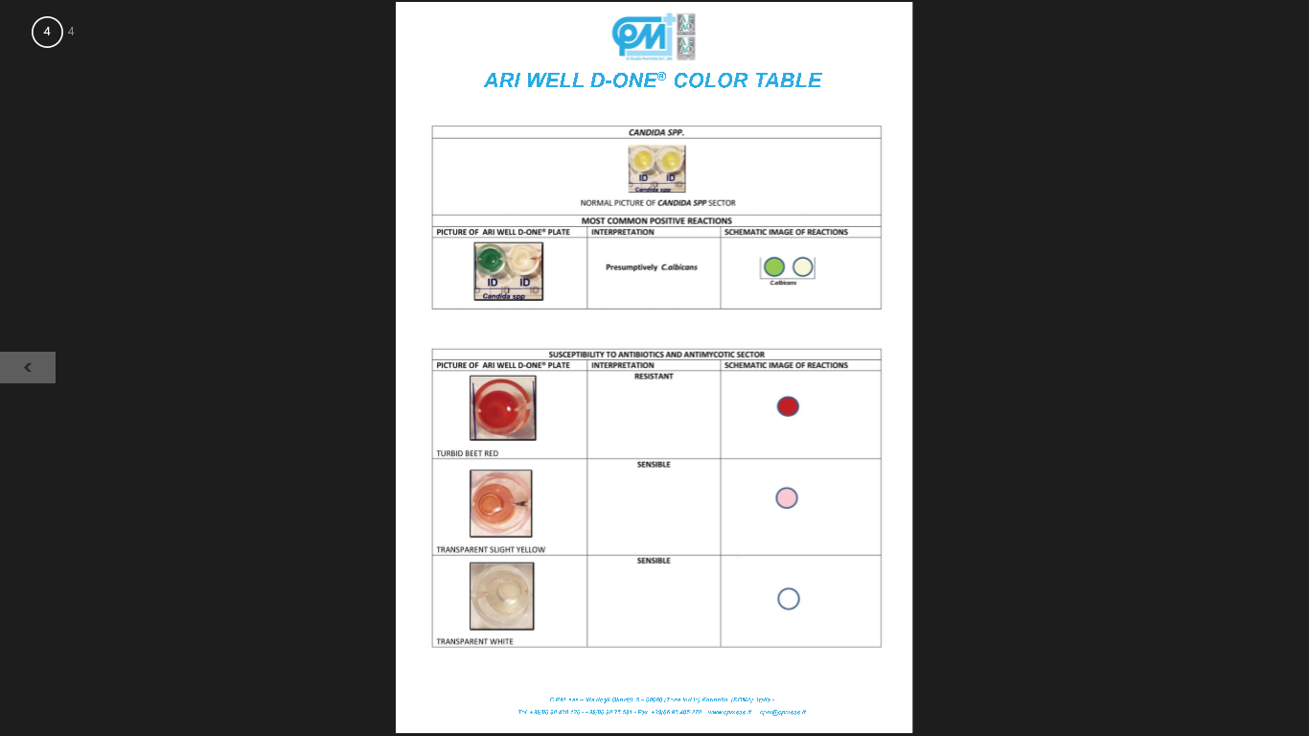

Slide 20
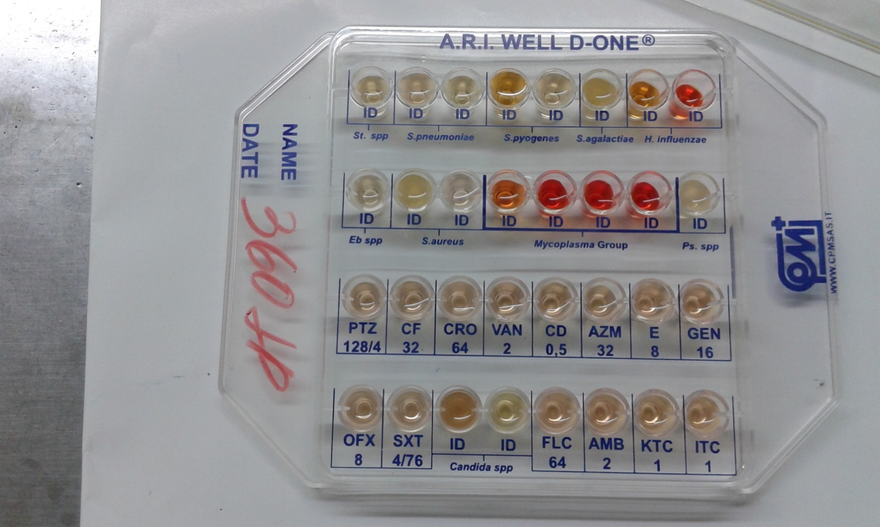
Pleural Liquid - Negative

Slide 21
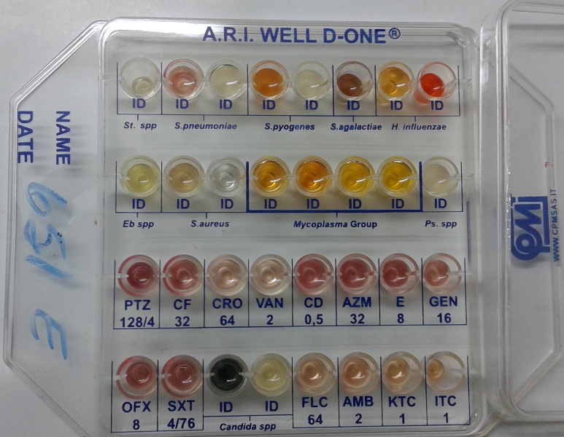
Sputum – Positive for M.pneumoniae + Candida albicans

Slide 22
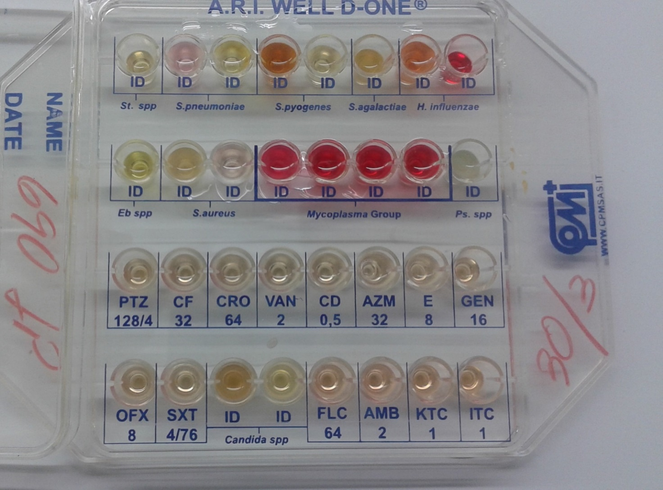
Pleural Liquid – Positive for M.hominis

Slide 23
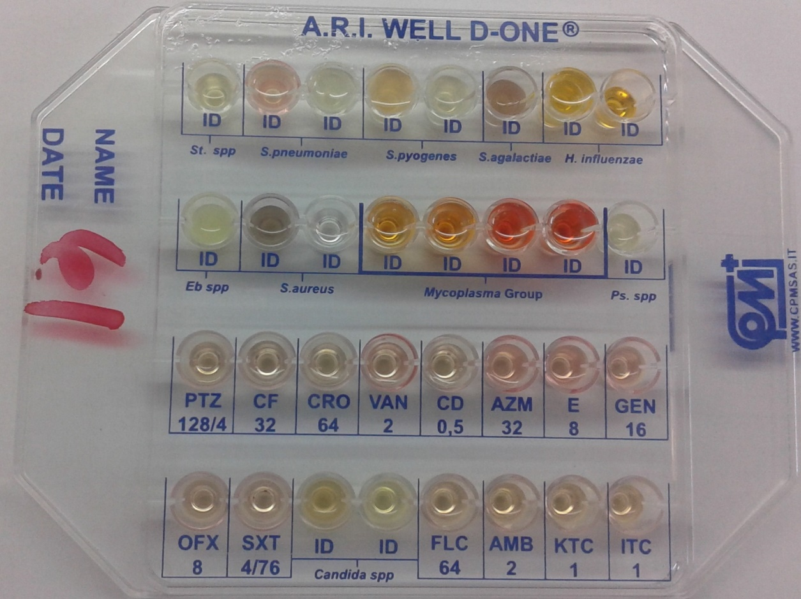
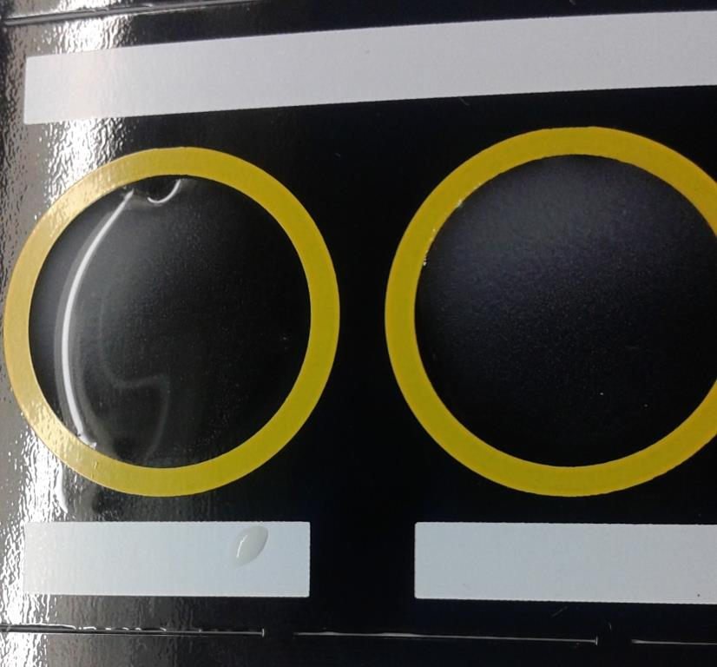
Positive for S.pneumoniae + M.pneumoniae in Hemoculture

Slide 24
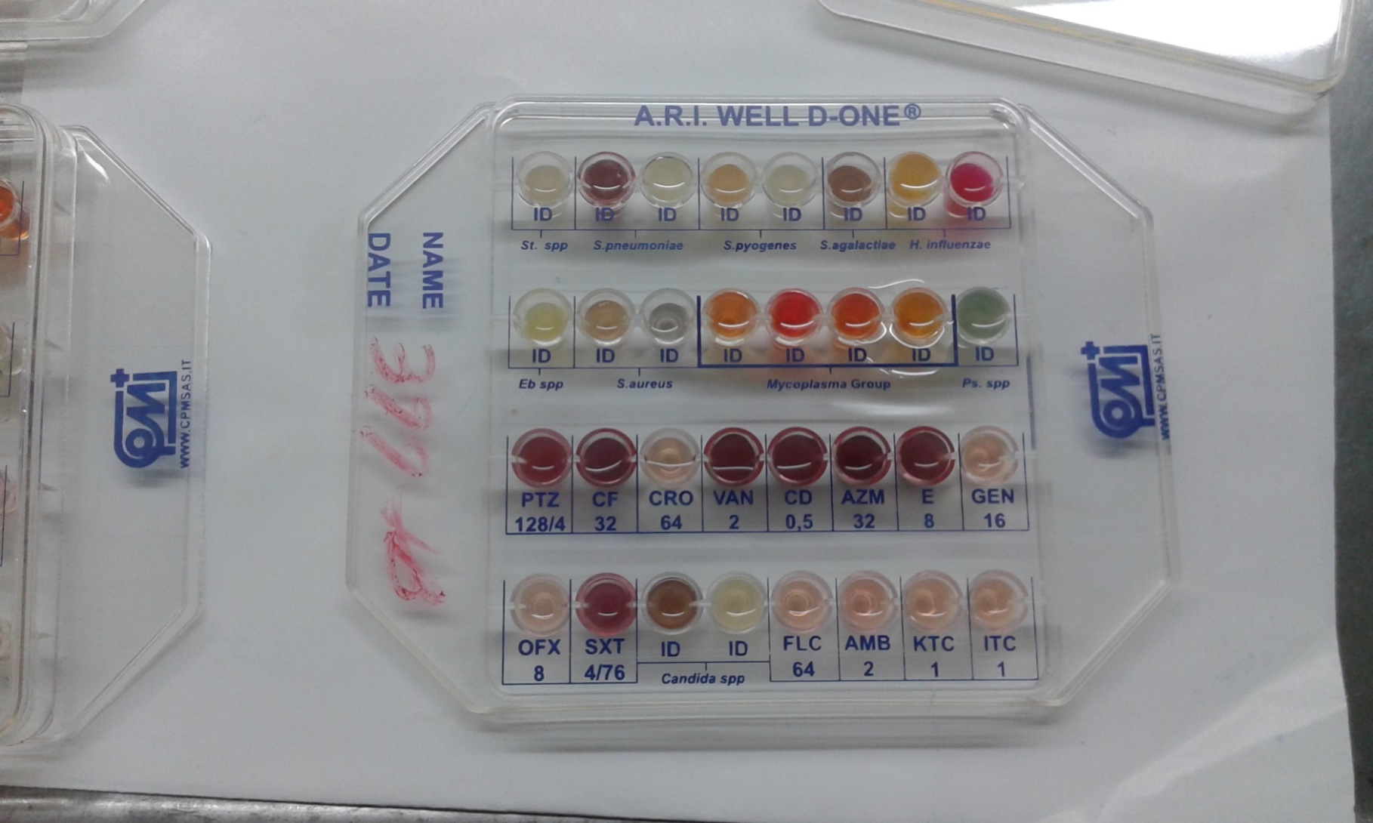
Positive for Pseudomonas in Broncheal Wash

Slide 25
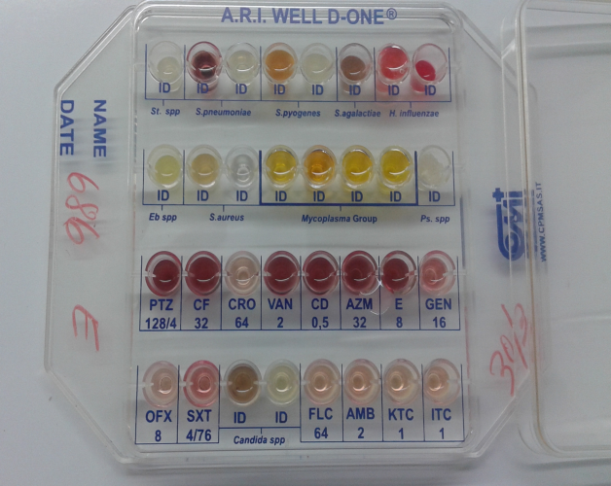
POSITIVE FOR H.PARA INFLUENZAE – M. PNEUMONIAE / M.SPP

Slide 26
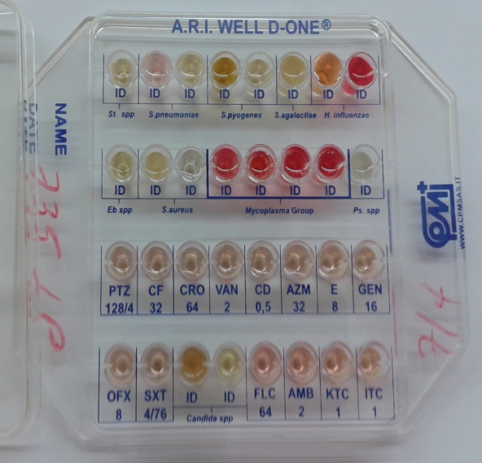
POSITIVE FOR H.PARAINFLUENZAE - M.HOMINIS

Slide 27
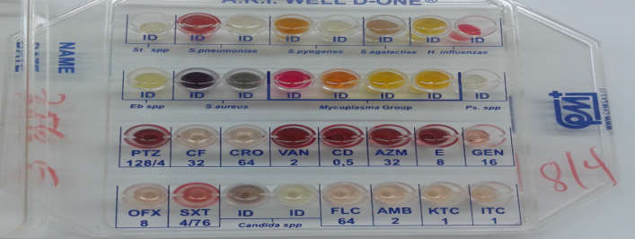
POSITIVE FOR S.AUREUS

Slide 28
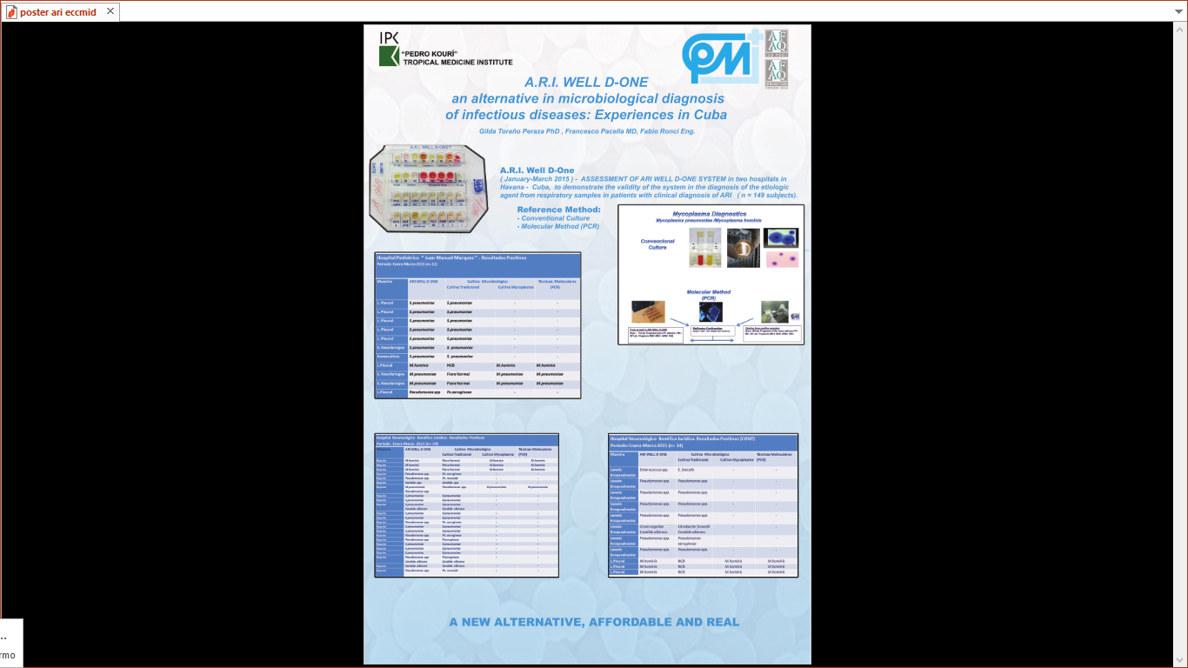

Slide 29

A.R.I. WELL D-ONE
Validation JMM
Sample | Quantity
Pleural liquid | 13
Pharingal Swab | 54
Hemoculture | 3
Humor vítreo | 1
TOTAL | 71
Results | Conventional* | A.R.I. WELL D-ONE
Positive | 17 (+2)** | 20
Negative | 54 (-2)** | 51
Total | 71 | 71
Clínical sensibility |  | 19/19+1= 95 %
Clínical specificity |  | 52/52+1= 98 %

Slide 33
CONCLUSION
“The greater danger for most of us lies not in setting our aim too high and falling short; but in setting our aim too low, and achieving our mark.” (Michelangelo)
THANKS!
Prof. Isis Tamargo Martinez, PhD
Dr.ssa Sabina Ripani
Dr. Francesco Pacella
La seguente presentazione ed il suo contenuto è di proprietà della CPM SAS ed è da ritenersi strettamente confidenziale e riservata
esclusivamente ai destinatari. Se ne vieta la divulgazione senza il consenso della CPM SAS

