Slide 1
Where’s the Money?
Pulling Back the Curtain
On School Finance

Slide 2
Where is the Money?
Taxpayer Funded Accounts
Held at the County Treasurer’s Office
Controlled by the County Treasurer
Controlled by Budget which is approved by the School Board
Cash Accounts
“Other Revenue”
Held at local banks
Off Budget
Controlled by the District Office
Signature Authority defined by District policy

Slide 3
Fund Restrictions
0320 RESTRICTED FUND BALANCE —Amounts that are restricted to specific purposes. Fund balance should be reported as restricted when constraints placed on the use of resources are either:
a. Externally imposed by creditors (such as through debt covenants), grantors, contributors, or laws or regulations of other governments; or
b. Imposed by law through constitutional provisions or enabling legislation.
0330 COMMITTED FUND BALANCE —Amounts that can only be used for specific purposes pursuant to constraints imposed by the formal action of the governing board. These amounts cannot be used for any other purpose unless the governing board removes or changes the specific purpose by taking the same kind of formal action previously used to commit these amounts.
0340 ASSIGNED FUND BALANCE —Amounts that are constrained by a district’s intent to be used for specific purposes, but are neither restricted nor committed.
0350 UNASSIGNED FUND BALANCE —For the general fund, spendable amounts that are not restricted, committed, or assigned.

Slide 4
Example
SAF BAND-WJHS FUND BALANCE
850.000.0000.0330.104.6011.104
Fund 850 – Student Activities
Object 0330 – Committed
Unit 104 – Specific Account
6011 – Expenditure

Slide 5
Special Funds
§15-1125 — Auxiliary Operations Fund
… all activities of school bookstores and athletic activities.
§15-1121 — Student Activities Monies
.. all activities of student organizations, clubs, school plays, or other student entertainment other than funds specified in §§15-1125
§15-1151 —School Meal Programs (Food Service)
The Food Service Fund is used to account for monies raised by operating meal programs … including a program under which federal assistance is received.

Slide 11
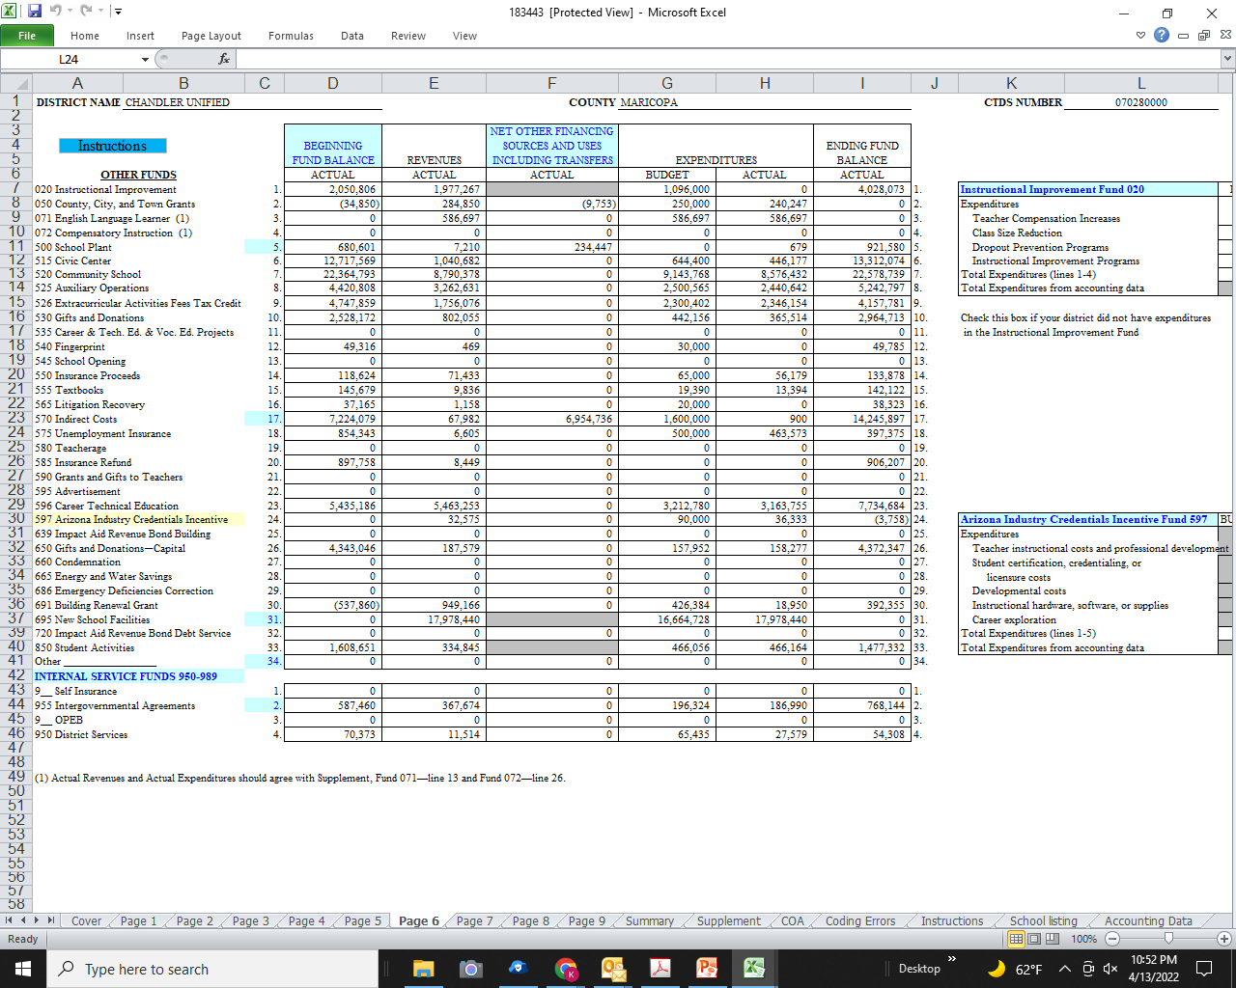

Slide 12
List of
Cash Funds

Slide 13
011-099 Maintenance & Operations
Fund Description
001 M&O
002 Other Monies
010 Classroom Site Fund (Prop 301)
011 Prop 301 Base Salary
012 Prop 301 Performance
013 Prop 301 Site Improvement
020 Instruction Improvement (Prop 202 Gaming)
040 Clearing

Slide 14
100-399 Federal Projects
110 Title I Instruction 200 Title VI Indian Education 310 AFROTC
111 Targeted Support 220 IDEA Part 2 322 Health and Wellness
114 Education for the Homeless 221 IDEA Part 2 Priority 325 DEMA
130 Title I Migrant Education 230 Johnson-O'Malley Fund (JOM) 326 ESSR I
140 Title IIA Improvement 260 Vocational Education 328 ESG
160 Title IV Drug Free Schools 263 CTE Programs 336 ESSR II
190 Title VII Bilingual Education 290 Medicaid 374 E-Rate (Telephone)
191 Emergency Immigrant Support 291 Medicaid in Public Schools (MIPS) 385 CLSD

Slide 15
400-499 State Projects
400 Vocational Grants
450 Gifted Education
456 College Credit
457 Results based
467 Safe Schools
480 First Things First (FTF)
481 FTF Incentive
487 Early Literacy

Slide 16
500-599 Other Funds
500 School Plant
510 Food Service 550 Insurance Proceeds
511 Food Service Fed thru State 555 Lost Texts
515 Civic Center 565 Litigation Recovery
520 Community School 570 Indirect Costs
525 Auxilliary Operations 575 Unemployment Insur
526 Tax Credit 585 Insurance Refund
530 Gifts 596 JTED/CTED
540 Fingerprints 597 CTE

Slide 17
Misc and Capital Funds
850 School Activities
950 Internal Services
955 IGA
Capital Accounts
610 Unrestricted Capital
620 Adjacent Ways
632 Bond Building
650 Gift-Capital
691 Building Renewal Grant (SFB)
695 New Schools
645 TAN
745 TAN Debt Service
700 Debt Service

Slide 18
Cash Fund Controls
Example: SUSD Policy DB-R defines funding guidelines
To be included in new
AZ School Board Coalition Policy Advisory

