Slide 1
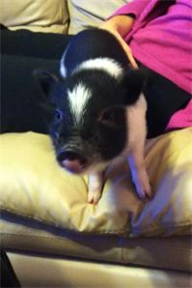
My Pet Piggy
Buyers Guide

Slide 2
Bringing Home Your Pet Pig
Welcome Home
-When you bring your new pig home, he (or she) will probably be very nervous and scared, even if it was well socialized by the breeder, since he has left everything familiar behind and has to adjust to all new people and surroundings. Be patient at first. You will want to keep him or her in a small confined area until he is more comfortable. Let the pig explore a bit and get comfortable with his new surroundings, and once he doesn't seem apprehensive, try to get him to approach you by tempting him with food. Sit on the floor with the pig, and offer a bit of food (for piglets, it is probably best to just use their regular food. You may just need to put the food on the floor in front of you at first, and gradually work up to the piglet taking the food from you. Do this repeatedly over the course of the first few days at home and have everyone in the family have a turn so that the piglet can bond with all the family members. Work with them like you would a young puppy or kitten in the sense that you don't over handle them, let them come to you and at the same time get them used to being touched, but don't overdo it. I know its tough but take it slow and allow your pet time to warm up and earn your trust.
-Once your piglet is comfortable with being near you and taking food from your hand, you can reach out and try to scratch your piglet gently under the chin or along the sides. Move slowly, and speak calmly and gently to your pig. Remember to give treats as you do this, and the piglet will eventually realize this is a pleasant experience. Move at a pace that your piglet is comfortable with, though. If he resists being scratched or petted, back off a bit until he is more accepting. There is a fairly fine line between spending enough time with your piglet and spending too much time, though. While you want to take the time to get to know your pig and have him or her trust you, you also want to make sure you do not lavish too much attention on your baby, or he will come to expect attention all the time. Keep the bonding and training sessions short and regular, with breaks to give the pig time to rest and develop the ability to entertain himself a bit too.
Do not Allow the animal to roam around in a non-fenced open area until they are fully trained.
Do Not!
Use a harness and leash on animal when taking him out to the bathroom or when going for a walk. These animals are extremely fast and tough to catch. If loose use food as incentives.

Slide 3
Basic Information
Living area
An ideal house is a big dog kennel or small garden shed/stable, something to keep the wind, drafts and rain off. The type of bedding material can vary from straw to blankets to cuddle into, it really depends on if they will live indoors or out. When they sleep inside the house, you can use an open dog bed and blanket to snuggle up into and confine them to a small area of the house so you know they are safe during the night.
Care and Maintenance
When you first bring home your mini pig, take him to the vet for a piggy well check. After that, take him to the vet yearly for annual checks, vaccinations, and tusk trimmings. Have your vet neuter or spay your mini pig, which should be done to improve your mini pig's pet quality and prevent certain cancers. A simple dog harness will work for taking your mini pig on a stroll in the park or around the block every day to prevent obesity and have some bonding time with your mini pig. Pigs tend to get dry skin so applying baby lotion is recommended. To protect from flees, ticks, mites, and worms use IVOMEC.
Bathing and Cleaning
First time bathing the animal is a two person job. Firmly hold front legs with one hand, cradle body with the other hand in a small body of warm water. While washing remember to wash slowly and carefully with baby shampoo and a sponge. Firmly wrap in a large towel and dry. Bathing is something they enjoy “in time” but never the first time. Be careful with soaps, lotions, or perfumes because they can cause dry out or irritate their skin. You should apply kiddy sunblock if kept outside for long periods of time especially on the tips of their ears and nose.

Slide 4
Training
Basic Training
Positive reinforcement is the key to success. They won't respond to force or punishment very well at all. To a pig, the most obvious kind of positive reinforcement is food, remembering that most pigs will be happy to work for small tidbits such as raisins, small pieces of apple or other fruit, or even pieces of their regular ration. When you are trying to tame a stubborn piglet, you may even want to hand feed all their food, since the quickest way to a pig's heart is through his stomach. However, obesity is a common problem, so keep treat foods to a minimum and make sure you are not overfeeding your pig by feeding full meals and supplementing with extra food for training. Be careful with feeding from your hand though, just like feeding a dog with your hand, only give it when it is being gentle to avoid teaching it to grab food out of your hand and accidently nipping your fingers. We encourage putting the food in a dish or on the ground rather than your hand. Your pet will soon come to you naturally when you call their name. You can teach them tricks all in due time.
Toilet Training
To toilet train your pig you will need to use a small area at first so they establish their toilet area. Leave at least one “poop" in the box/pad. The scent of it stimulates him to go, and tells him that this is the proper place. They generally go to one spot. A good time to try is after they have had their food. Take them onto a shallow tray with paper and say “toilet”. It is just like teaching a puppy, so be patient. Alternative is to take them outside before bed and early morning, as well as outdoor playtime. Young pigs are prone to accidents. Keep that in mind and don't get mad or hit your pig because they had an accident! It is up to you to teach your pig where to go. Remember, they are very intelligent. Most learn to use a litter box in 1 - 5 days.

Slide 5
Feeding
Feed your pig at least twice a day. At around 1 year you may need to decrease the amount slightly. This will depend on your pigs metabolism and activity level. Each pig is different and you will need to experiment how much feed it needs to stay health, fit and not fat. Supplemental timothy or orchard grass hay is a nice way to keep their fiber content up if they cannot access grazing. Will make a mess in the house, so building a feeding box will help for indoor and a rubber mat to catch the spillage will help. A lot of people allocate a closet for their piggy to freely go in and out of that they can to go to hang out and eat the hay without getting it all over the house.
FOODS TO AVOID
Lettuce, onions, kitchen scraps, junk food, sweets, high sugar fruits, white flour products of any kind. Corn: unless from certified organic sources (NON-GMO) and in very limited amounts Potatoes: Too starchy and high in calories. Tomatoes: Highly acidic. Meat or Dairy, Please, do not feed your pig chocolate!!! Or any type of candy
TREATS
Some of the most popular treats used are raisins, fresh veggies, raw nuts and seeds, whole grains, bite size shredded wheat, and un-buttered, un-salted air popped popcorn. Popular training treats are pot belly pig biscuits, we like to use grapes, almonds, cut up veggies and of course popcorn. raw eggs ok if from your own hens or ones you know are fresh.
Water
Make sure your pig always has access to clean drinking water. It is as important to them as it is to us. A water feeder is the best option for your pig to always have access to water.
~ Important Note! ~
Overfeeding pigs is a problem, a lot of caring people are killing their mini pigs with kindness. There are a lot of Pot Belly pig sites on the net claiming that we mini pig breeders are encouraging underfeeding our pigs to keep them small, that would be not only ridiculous but cruel. Pigs LIVE for food, they act like they are starving even with a full belly, good training is key to keeping your pet pig well mannered when it comes to food and feeding time. They should learn to be quiet and calm, not squealing out of control in excitement, but that will take gentle leadership on your part, the caregiver.

Slide 6
Size
Typical growth from a piglet to adult:
Year 1 - fastest growth phase, newborn piglets are similar in size in all breeds, they gain weight very fast, up to a pound a week for miniatures, more for the larger breeds. They grow 70% of their final height in this year.
Year 2 - growth slows down, most have reached their adult height by 18 months, muscle and fat accumulate. Starting year 2, diet should be carefully watched to avoid excessive weight gain, this is a major problem for pet pig owners. A pig that can be healthy and fit at 35 lbs, can easily double that and more with fat gain ... but what comes with that is diabetes, hoof disorders, arthritis, blindness and more. Keep your pig fit! (and of course, NOT underfed either, you should never see ribs or hips bones on a pig) A pig can grow inches taller just because of body fat increases, they gain weight on the top line first, then tummy and jowl. Fat around the face, rolls on sides and a very round rump are signs of an overweight pig. Evaluate your pig like you would your dog in terms of body condition.
Year 3 and 4 - Miniature pigs are considered adults, weight gain needs to be monitored as bored pigs are hungry pigs, they also do not need as many calories, grazing and exercise is very important at this stage to keep them moving ... once pigs are fully grown and not active, they will get slower, sleep more often and gain weight ... this is up to you as an owner to do things with your pig other than have it live in a pen doing nothing, unless it has lot's of room to roam and companionship it needs something to do. Pigs that have to live in mud pens and eat slop twice a day is not a happy life.
~ please note, these size references are general guidelines and can vary, just like us, genetics vary and we can only estimate. For height, pigs are measured from the ground up to the top of the shoulder.

Slide 7
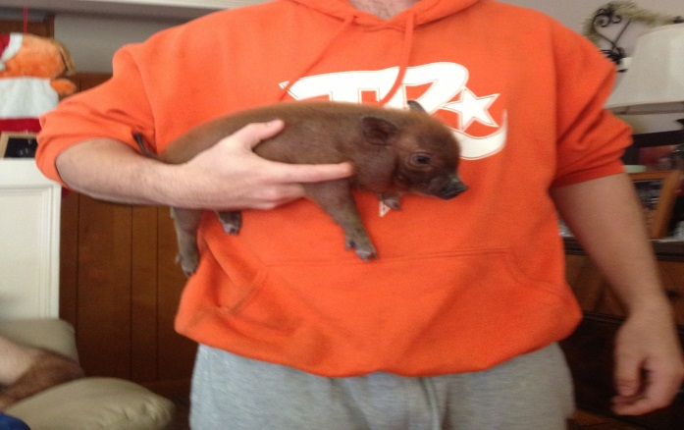
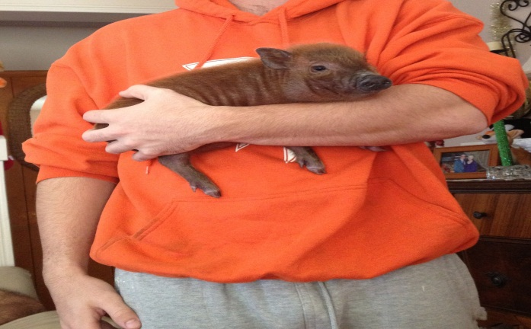
Handling and Habits
How to Hold your pet
Vs.
Incorrect
Correct
Habits
Pigs are very playful and curious animals. One of there methods of playing is called burrowing/rooting. They do this by either burying there head in the dirt or mulch and digging for grubs. They also do it to you. If you notice your pig continuously burying his nose into your arm or hand its their way of playing. Just hold your hand steady and either rock with him or try to push him back. They also have other toys that they like such as antlers, ropes, and solid slightly heavy items they can push.
Pigs have an amazing sense of smell and are extremely smart. A pig will be able to locate food up to a mile. A word of advice is if you currently have a dog would be to elevate the food to wear the pig cannot reach. I would also recommend making sure all cupboards are closed securely. Pigs get bored easily I would recommend keeping a lot of toys available.

Slide 8
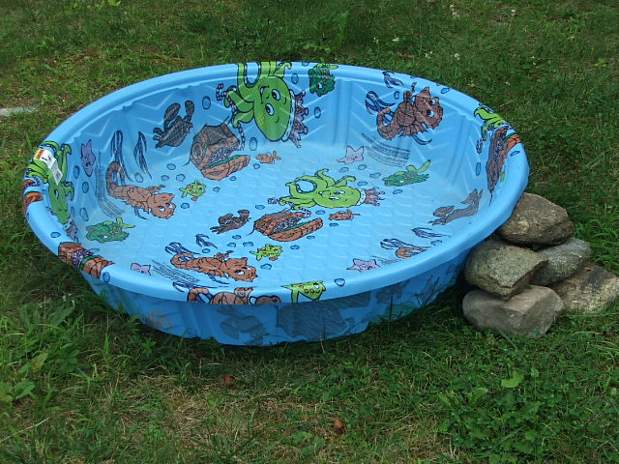
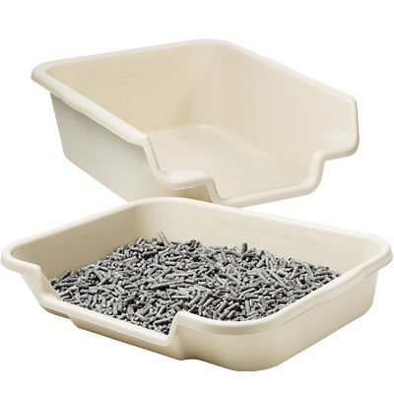
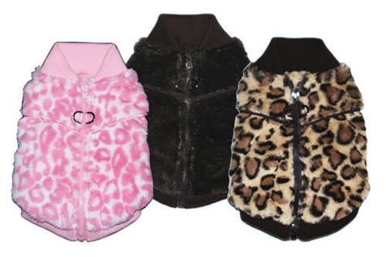
Recommended products
Toys:
Pigs like a variety of different toys. Stuffed animals, toddler toys, balls, dog chew toys, rope, etc. It is best to give them a toy or two and swap out toys every few days or so. Pigs love to hunt for treats, You can have a container filled with plastic balls (like those play places that have all of those balls you jump and swim in) Put the balls in a low profile bin and sprinkle some snacks in there before you go to work. You can also put treats in a paper lunch bag and crumple it up and it will keep them entertained for a while. Pigs are easily bored. They do like some dog treats to chew on. Some of mine love “busy bones” and Greenies (the bigger ones) it keeps them entertained for a while. One of their favorite games is “kill the plastic bag”. (cut the handles open on the plastic shopping bags so they do not get them stuck on their heads) They like to have fun shredding paper bags as well as TP, PT, cardboard boxes, newspaper. Because of their high level of intelligence, pigs that are kept as FULL time house pets can become bored easily and are often destructive when finding ways to entertain themselves. Be sure that your PB has plenty to entertain them!
Products:
Fights against mites, fleas, and worms
A kiddy pool for the summer
A comfortable little dog bed
Litter box with wood litter
Pig food
Pig/dog clothes

Slide 9
Pig Talk
Pigs are VERY verbal. They have a myriad of vocalizations and they mean different things. They have some vocals that sound similar but will have a slightly different pitch to mean something else. The more aware of these vocalizations you are, the better you will be at communicating and understanding your pet. Pigs have over 20 different vocalizations, from oinks, grunts, squeals, barks, whines, air blowing, teeth grinding, lip smacking... and some of them sound alike but pay attention to the pitch.
Whining- well, that is pretty straight forward, they want food, someone made them mad, or is messing with them when they do not want
"Aroooooo"- means feed me NOW!
"Ahhhh ahhhh ahhh"- is a familial greeting. It means they see you as family
"oink, oink, reeeeeee"- means they are searching for someone, or something and they are a bit nervous about it
"Woof"- it sounds like a bark. This has two meanings. Excited in a good way, they will bark and run and play. If they say it in a higher pitch it means DANGER and they will run away.
"Ooof" (while blowing air) - usually means annoyed, but can mean nervousness
"Rarararaa grumble grumble"- means I AM NOT moving off the couch!

Slide 10
Pig Talk Continued
Teeth grinding- can be confusing, it can mean they are teething and have discomfort, in pain, and some do it for contentment
lip smacking- can merely mean they are enjoying their food, they have food stuck in their mouth, (sometimes they will froth at the mouth) this usually means they are angry and ready to fight (with another animal), it can also mean they are horny (part of the mating ritual)
Continuous oinking- I call this "echo location"- they are just oinking to see if someone is around, searching for their family, usually the first few days it means they are searching for us, after that they are searching for the members of their new family.
Screaming- this means they are mad because they are hungry, confined or cant find you. Now dont be fooled by this one, if they are screaming to be fed at a non-scheduled feeding time- DO NOT give in,. just ignore them or they will continue this behavior
Grunts- they have soooo many of these.... Most are happy grunts, they have different sounding ones that come with belly rubs, when you get the "right spot", petting, happy I am eating food grunts
It is hard to list all of them and all of the meanings as each Pig will adapt a different sound to different things. Some develop noises for wanting to go outside, having to potty, I do not like this, I am scared, I am happy, I want to play......

Slide 11
Recommended Websites
Food: www.Mazuri.com
Ivomec: www.valleyvet.com
More Information
www.micropigscanada.com
www.mistiroranch.com
www.google.com “Search”:Micro Pigs
Bibliography
www.poshpigs.net

