Slide 1
RESPIRATORY EMERGENCIES
Alja Štefelin, SEMINAR, 19.3.2015

Slide 2
RESPIRATORY EMERGENCIES
Pulmonary embolism
Pneumothorax
Haemoptysis (coughing of blood)
Acute pulmonary edema
Pleural effusion
ARDS
Respiratory failure
Drowning
Foreign body in respiratory tract

Slide 3
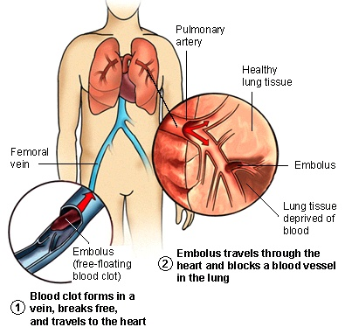
1) PULMONARY EMBOLISM

Slide 4
It results from DVTs that have broken off and traveled to the pulmonary arterial circulation
About half patients with DVT develops PE, which is often asymptomatic
PE is often fetal usually due to progressive RV failure
Chronic thromboembolic pulmonary hypertension is another complication of PE
RISK FACTORS:
→ DVTs
Genetic risk factors (Leiden V mutation, prothrombin mutations)
Immobilization during prolonged travel
Cancer
Obesity
Surgery
Trauma
Pregnancy
Oral contraceptives
Postmenstrual hormone replacement

Slide 5
PHYSICAL EXAMINATION
Tachypnea
Tachycardia
DYSPNEA
Hypotension, cyanosis, shock, syncope suggest massive PE
Decreased blood O2 level may be present (hypoxemia)
Chest pain during inspiration
DIAGNOSIS:
D-dimer blood tests
it its normal in the patients with low to moderate risk of PE, you can exclude the possibility of thrombotic PE.
D-dimer is highly sensitive but not very specific→ a positive D-dimer is not synonymous with PE, but a negative D-dimer is an indication of absence of a PE (many hospitalized patients have increased D-dimer due to other disease processes)
Arterial blood gases (hypoxemia can be seen)
Chest CT with IV contrast (PRIMARY DIAGNOSTIC STUDYING)
ECG
Echocardiography

Slide 6
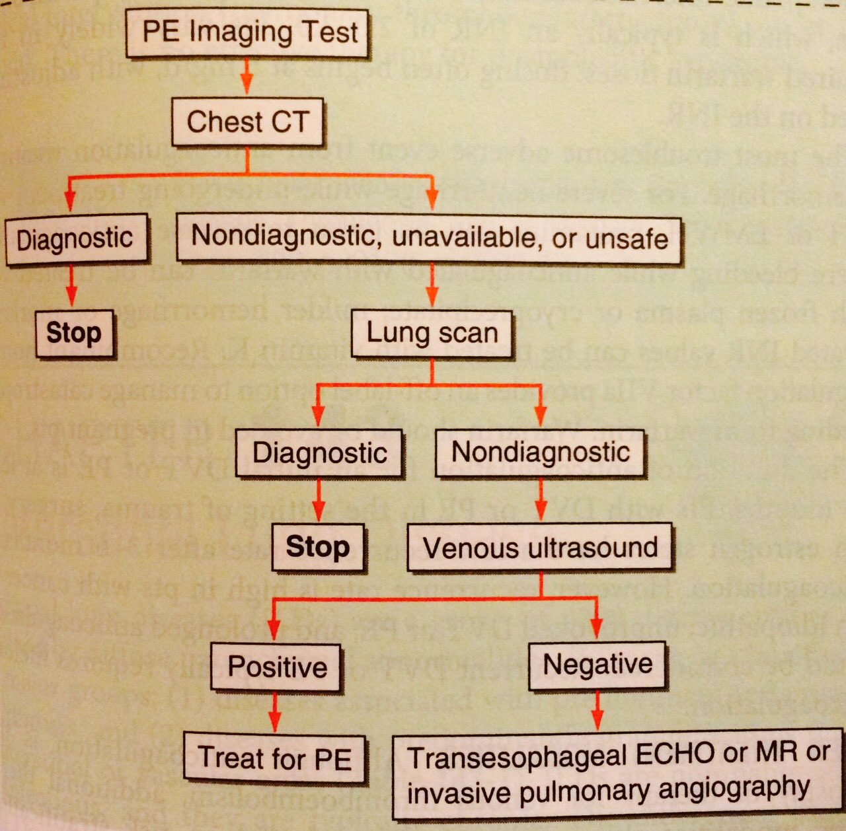
ALGORITHM FOR PE DIAGNOSIS

Slide 7
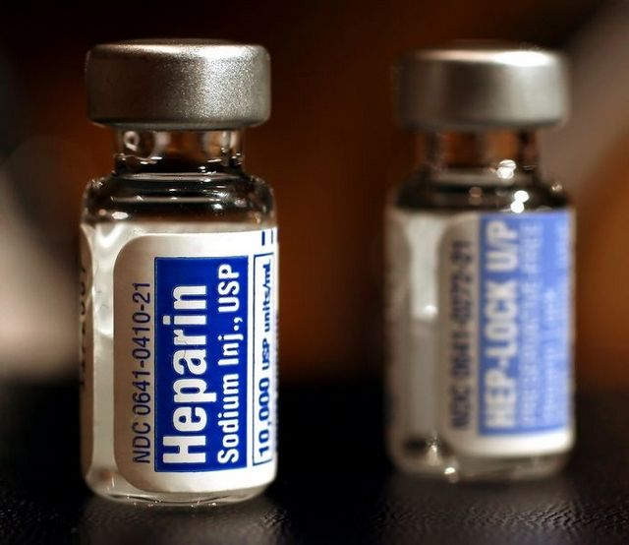
TREATMENT
1) ANTICOAGULANTS – MAINSTAY OF THERAPY FOR PE!
they don’t resolve existing clot directly, but they limit further thrombus formation (secondary prevention treatment)
UFH, LMWH (parenteral)
Warfarin (long term oral anticoagulant, can be given soon after the parenteral agent is given, 5-7 days are needed for warfarin to achieve therapeutic anticoagulation)
2) Primary treatment:
FIBRINOLYTIC THERAPY (streptokinase)
For PE causing R heart failure
Risk for hemorrhage is significant
SURGERY → CATHETER EMBOLECTOMY

Slide 8
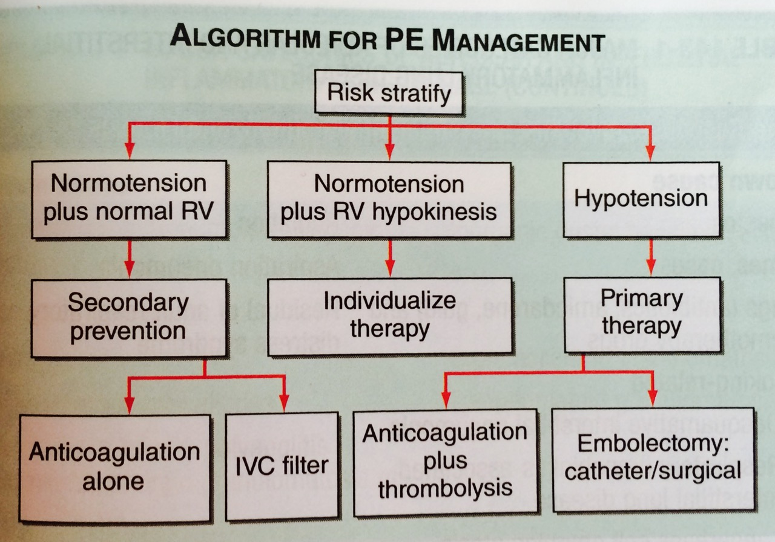
ALGORITHM FOR PE MANAGEMENT

Slide 9
2) PNEUMOTHORAX
= GAS IN THE PLEURAL SPACE
1) Primary spontaneous Ptx occurs in the absence of underlying lung disease
Usually due to rupture of apical pleural blebs (small cystic spaces that lie in or under visceral pleura)
Mostly it occurs in smokers!!!
T: aspiration
If aspiration doenst help or in pts with recurrences: thoracoscopy with stapling of blebs and pleural abrasion
2) Secondary Ptx- presence of underlying lung disease
Most commonly COPD is the cause
More dangerous than primary Ptx
T: tube thoracotomy or thoracoscopy with stapling of blebs and pleural abrasion
Spontaneous Ptx occurs without trauma to the thorax

Slide 10
3) Traumatic Ptx- results from chest injuries
both: penetrating and non-penetrating trauma
T: tube thoracotomy
4) Tension Ptx- pressure in the pleural space is + throughout the respiratory cycle
Usually occurs during mechanical ventilation or trauma
The + pleural pressure is life- threatening because
VentilatIon is severely compromised
+ pressure is transmitted to mediastinum (→ dec. venous return and CO)
- Urgent treatment is required→ chest tube (if its not available: large-bore needle inserted into the pleural place through the second ant. Intercostal space)

Slide 11
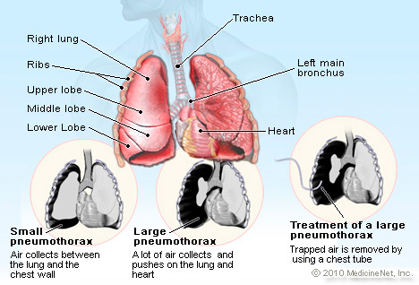

Slide 12
SYMPTOMS:
SHARP chest pain that usually has a sudden onset.
Dyspnea
Tachycardia
Tachypnea
Cough
Cyanosis due to decreased blood oxygen levels
Anxiety
Diminished breath sounds on the affected side
DIAGNOSIS
CHEST X-RAY:
Serial chest radiographs every 6hrs on the first day after injury to rule out pneumothorax is ideal, but two or three chest X-ray taken every 4-6hrs are sufficient.
Air in the pleural cavity, with contralateral deviation of mediastinal structures, is suggestive of a tension pneumothorax.

Slide 13
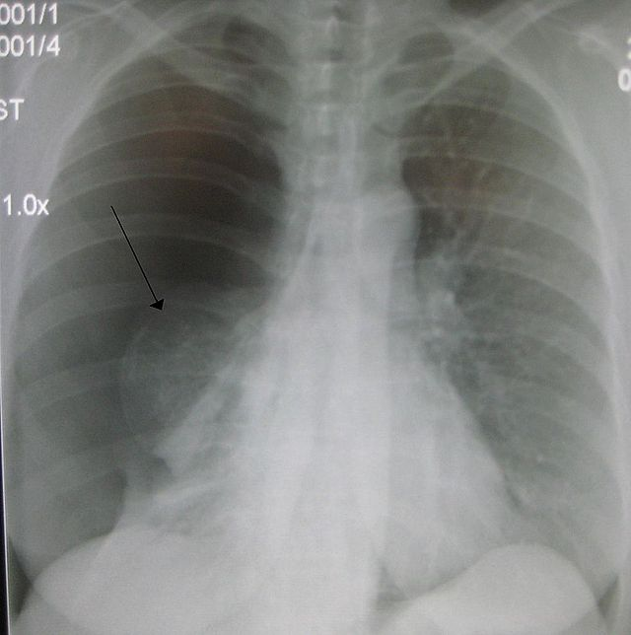
A large right-sided spontaneous pneumothorax (left in the image). An arrow indicates the edge of the collapsed lung

Slide 14
3) HAEMOPTYSIS
= EXPECTORATION OF BLOOD FROM THE RESPIRATORY TRACT (it can be from any part of the tract- from alveoli to glottis)
Bleeding from alveoli = diffuse alveolar hemorrhage (DAH)
- Can be inflammatory (capillary vasculitis, SLE…)
- Or non-inflammatory (direct inhalational injury→ thermal injury from fires, cocaine inhalation…)
bleeding from small to medium size airways- most common site of haemoptysis, irritation or injury of mucosa
Any infection of respiratory tract can cause haemoptysis (acute bronchitis- most common cause for haemoptysis is US)
All types of pneumonias (tuberculosis- most common cause worldwide!!!
Only 10% of pts with lung cancer have haemoptysis. Central airways cancers (squamous cell carcinoma, small cell carcinoma, carcinoid tumors)→ more often cause haemoptysis
Congestive heart failure
Pulmonary embolism with infarction

Slide 15
CLINICAL ASSESSMENT:
Find the source of bleeding
It needs to be differentiated from expectorated blood originating from the nasopharynx and GI tract
Quantity of blood should be estimated
Massive hemoptysis (200-600mL in 24h)→ emergent care
Presence of purulent or frothy secretions should ne assessed
Fever (= indicator of acute inf.)
Recent drug abuse (inh. cocaine)
TESTS:
x ray, CT, bronchoscopy (bronchiectasis, pneumonia, lung cancer, pul. embolism) , complete blood test + coagulation studies, renal function + urinalysis, sputum tests (culture, Gram’s stain), bronchoscopy

Slide 16
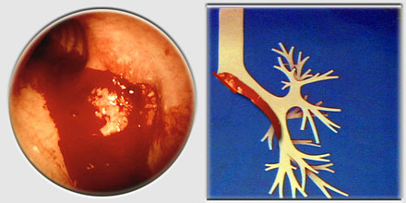
TREATMENT:
Massive h.: may require endotracheal intubation and mechanical ventilation to provide airway stabilization
If the source of bleeding is found→ isolation of bleeding lung with the endobronchial blocker
Pts need to be positioned with the bleeding side down
If bleeding persists: bronchial arterial embolization or angiography may be beneficial
Surgical resection to stop bleeding (last option)
Cough supression with narcotics

Slide 17
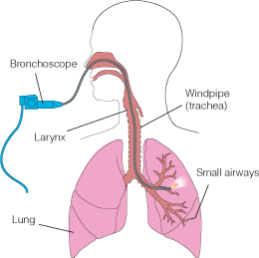
BRONCHOSCOPY

Slide 18
4) ACUTE PULMONARY EDEMA
Acute pulmonary edema occurs due to one or more of the following:
Elevation of hydrostatic pressure in pulmonary capillaries (L heart failure, mitral stenosis)
Increased permeability of pulmonary alveolar- capillary membrane (non-cardiogenic pulm. edema)
Direct injury to lung
Hematogenous injury to lung
3) Precipitants resulting in cardiogenic pulm. edema in pts with previous cardiac history

Slide 19
PRECIPITANTS in cardiogenic pulmonary edema:
Acute tachy or bradyarrhythmia
Infection, fever
Severe hypertension
Acute mitral or aortic regurgitation
Increased circulatory volume (Na ingestion, blood transfusion, pregnancy)
Increased metabolic demands (hyperthyroidism, exercise)
Pulmonary embolism
FINDINGS: Pts severily ill, diaphoretic, sitting bolt upright, tachypneic, cyanosis may be present. Third sound heart may be present. Bloody sputum may occur.
LAB: At the beginning PaO2 and PaCO2 are decreased. With progressive respiratory failure→ PaCO2 increases (hypercapnia) and acidemia appears.
CHEST X-RAY: pulmonary vascular redistribution and lung fields with butterfly appearance.

Slide 20
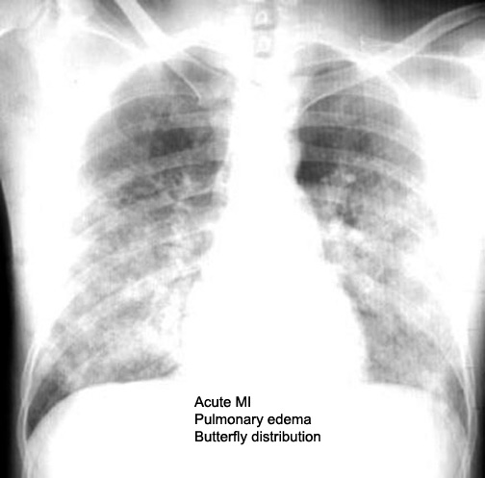

Slide 21
TREATMENT:
Acute aggressive therapy is needed for survival
Administer 100% OXYGEN by mask
Reduce preload
1) seat pt upright
2) IV loop diuretics (furosemide)
3) NITROGLYCERIN (vasodilator- sublingually)
4) MORPHINE
5) If patient is hypertensive→ give ACE INHIBITORS
6) NESIRITIDE (don’t use it in acute MI or cardiogenic shock)
INOTROPIC AGENTS are indicated in cardiogenic pulm. Edema and severe LV dysfunction (dopamine, dobutamine)
Treat precipitating factors of cardiogenic pulm. edema (infections, arrhythmias…)
For refractory pulm.edema associated with cardiac ischemia→ coronary revascularization
For noncardiac pulm-edema- identify and treat/remove the cause

Slide 22
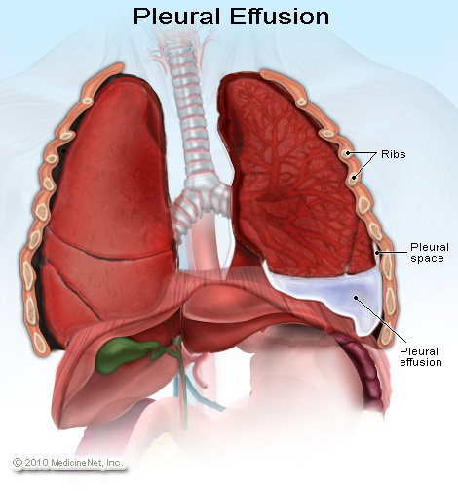
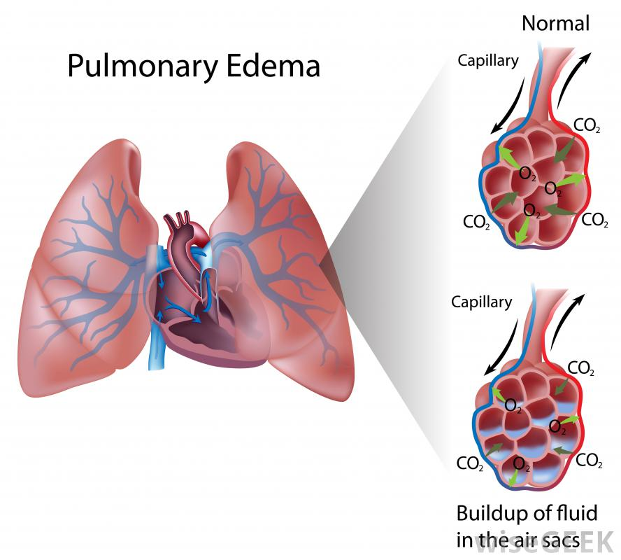
5) PLEURAL EFFUSION
What is a difference between pulmonary edema and pleural effusion?
Pleural effusion: excess quantity of fluid in pleural space
Lung edema: fluid in lung airspaces and parenchyma

Slide 23
Pleural effusion
May develop when there is excess pleural fluid formation or decreased fluid removal by lymphatics.
Main thing is to determinate if effusion is TRANSUDATE or EXUDATE
1) TRANSUDATE→ occurs when systemic factors that influence the formation and absorption of pleural fluid are altered (LV heart failure, cirrhosis, nephrotic syndrome)
2) EXUDATE → occurs when local factors are altered (bacterial pneumonia, malignancy, viral infections, pulmonary embolism)
DIAGNOSIS: Exudates fulfill at least one of the following criteria (transudates typically do NOT) → high fluid protein ration (> 0.5), pleural fluid LDH greater than 2/3 of the normal upper limit for serum LDH, pleural LDH ratio > 0.6
→ If a person has a exudative pleural effusion→ description of fluid, glucose level, differential cell count, microbiologic studies & cytology.

Slide 24
EFFUSION DUE TO HEART FAILURE→ LV failure, transudative pleural effusion, usually bilateral, if unilateral: mostly on R side. → thoracentesis needs to be performed if effusion is unilateral, if pt is febrile or if the pt has pleuritic chest pain – otherwise the pt’s heart failure is treated.
MALIGNANT PLEURAL EFFUSION→ mostly lung carcinoma, breast carcinoma and lymphoma, exudative pleural effusion, diagnosis is made via cytology of pleural fluid or thoracoscopy.
PARAPNEUMONIC EFFUSION/EMPYSEMA→ Exudates associated with contiguous bacterial lung infections, including pneumonia and lung abscess. If the pleural fluid is grossly purulent, its referred to as an empyema.
T: Chest tube drainage or surgery.
EFFUSIONS RELATED TO PULMONARY TE→ Usually exudative, but can be transudative, Pleural effusion does not change the treatment of PE.
TUBERLULUS PLEURITIS→ usually associated with primary tuberculosis (Tb) infection. Effusion is exudative with predominant lymphocytosis. Tb markers are found. Cultures from fluid or pleural biopsy confirm the diagnosis.

Slide 25
COMMON CAUSES OF TRANSUDATIVE AND EXUDATIVE PLEURAL EFFUSION:
TRANSUDATIVE PLEURAL EFFUSIONS | EXUDATIVE PLEURAL EFFUSIONS
1) LV heart failure | 1) Malignancy
2) Cirrhosis | 2) Bacterial pneumonia
3) Nephrotic syndrome | 3) PE
4) PE | 4) Viral infections
5) Peritoneal dialysis | 5) GI diseases
6) SVC obstruction | 6) Hemothorax
7) Myxedema | 7) Drug- induced plural disease
8) Urinothorax | 8) Sarcoidosis
 | 9) Asbestos exposure
 | 10) Collagen- vascular diseases

Slide 26
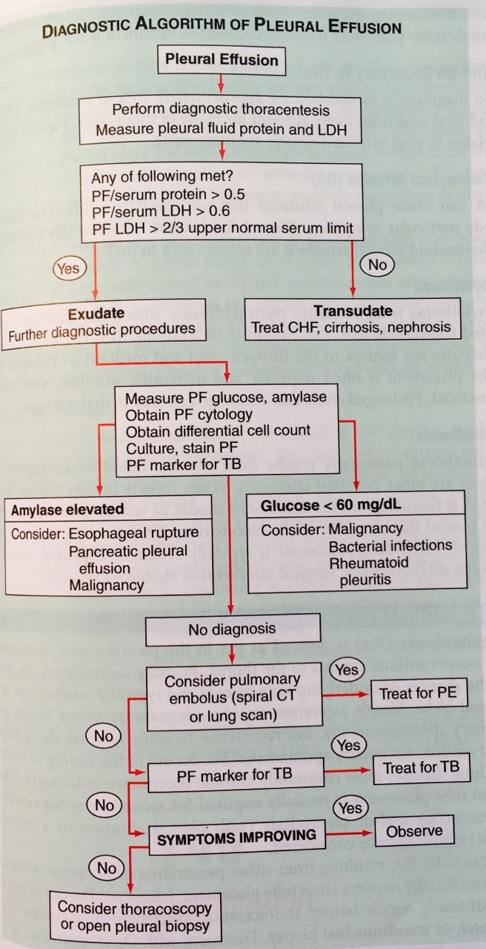
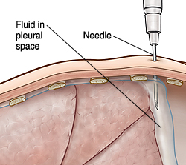
DIAGNOSTIC ALGORITHM FOR PLEURAL EFFUSION

Slide 27
6) ARDS
SYMPTOMES
Severe dyspnea
Diffuse pulmonary infiltrates
Hypoxemia
CAUSES
→ Most common cause is sepsis (more than 80%)
→ Bacterial pneumonia
→ Multiple transfusions
→ Acute lung injury (trauma) can lead to ARSD
→ Gastric acid aspiration,
Drug overdose
Older age
Chronic alcohol abuse
Metabolic acidosis
Surgery
People with more risk factor have a greater risk for developing ARDS
It develops rapidly and typically causes respiratory failure

Slide 28
3 PHASES OF ARDS:
EXUDATIVE PHASE→ alveolar edema (due to increased pulmonary vascular permeability) and leukocytic inflammation
Diffuse alveolar damage, atelectasis and reduced lung compliance from pulm.edema. Alveolar collapse can occur due to fluid accumulation and loss of surfactant.
Hypoxemia, tachypnea, progressive dyspnea
Chest X-RAY: bilateral pulmonary opacity
Differential diagnosis: cardiogenic pulmonary edema, pneumonia and alveolar hemorrhage
Unlike cardiogenic pulmonary edema, the chest X-RAY in ARDS rarely shown cardiomegaly, pleural effusions or pulmonary vascular redistribution!!!
Lasts up to 7 days
2) PROLIFERATIVE PHASE
During this phase most pts will recover, but some will develop progressive lung injury and evidence of pulmonary fibrosis. Dyspnea and hypoxemia are usually still present.
Lasts from 7-21 days from the onset
3) FIBROTIC PHASE
Most people recover within 3-4 weeks of the initial pulmonary injury, but some of them develop progressive pulmonary fibrosis.
Ventilation support and supplemental oxygen are needed for those patients.
They also have increased risk for pneumothorax, reductions in lung compliance and increased pulmonary dead space.

Slide 29
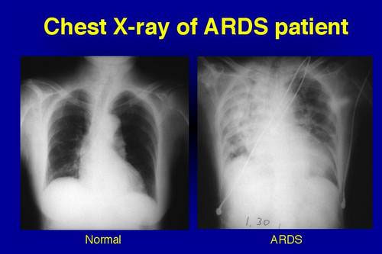
DIAGOSIS of ARDS
→ Chest X-RAY→ diffuse BILATERAL pulmonary infiltrates (opacity)
→ PaO2/Fi02 ≤ 200 mmHg
Absence or elevated LA pressure

Slide 30
TREATMENT
No drug has proved beneficial in the prevention and management of APDS.
Treatment of UNDERLYING DISEASE or SURGICAL problem that caused lung injury
MECHANICAL VENTILATORY SUPPORT (low tidal volume ventilation!)
Patients need ventilatory support due to hypoxemia and increased work of breathing.
IV FLUIDS → to achieve adequate CO and tissue 02 delivery as assessed by urine output, acid-base status and arterial pressure.
Minimize acidosis (diuresis→ but avoid hypoperfusion!)
No evidence to support the use of glucocorticoids!!!

Slide 31
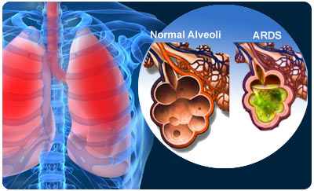
OUTCOMES
mortality: 26-44%
Most deaths due to sepsis and nonpulomonary organ failure
Increased risk for mortality is associated with advanced age, preexisting organ dysfunction (renal, liver diseases, immunosuppression)
Most surviving pts do not have significant long-term pulmonary disability

Slide 32
7) RESPIRATORY FAILURE
DIFINITION: inadequate gas exchange due to malfunction of one or more components of the respiratory system.
→ Respiratory failure can be ACUTE or CHRONIC
→ Two main types of acute respiratory failure:
HYPOXEMIC
HYPERCARBONIC

Slide 33
Two main types of acute respiratory failure:
HYPOXEMIC (= arterial O2 saturation <90% while receiving an inspired 02)
Can result from pneumonia, pulmonary edema (cardiogenic or non-cardiogenic) and alveolar hemorrhage
Hypoxemia results from ventilation-perfusion mismatch and intrapulmonary shunting
2) HYPERCARBONIC (= respiratory acidosis with pH < 7.30)
Results from decreased minute ventilation or increased anatomical dead space.
Usually results from neuromuscular diseases (myasthenia gravis) or respiratory diseases such as asthma and COPD.
Usually PaCO2 is >50mmHg
Two other types of resp. failure are:
1) Perioperative respiratory failure related to atelectasis
2) Hypoperfusion of respiratory muscles related to shock

Slide 34
SIGNS AND SYMPTOMS:
Shortness of breath (dyspnea)
Rapid breathing (tachypnea)
“Air hunger” (feeling like you can't breathe in enough air)
Arrhythmia (because of decreased O2)
Cyanosis can appear
Extreme sleepiness and confusion (because of increased CO2)
TESTS:
Pulse oximetry to check oxygen saturation
Arterial blood gas test
Chest x ray, to help find the underlying cause of respiratory failure
EKG (check for arrhythmias)

Slide 35
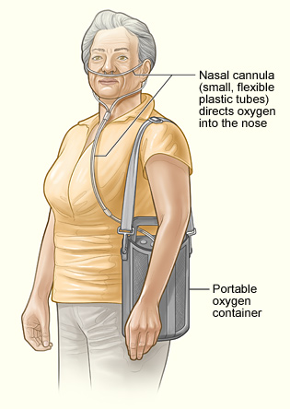
TREATMENT: One of the main goals of treating respiratory failure is to get oxygen to your lungs and other organs and remove carbon dioxide from your body. Another goal is to treat the underlying cause of the condition.
MECHANICAL VENTILATION:
2 general classes:
Noninvasive ventilation
(nasal or full face mask)
Widely used on chronic patients
(COPD, severe asthma)
Less complications
(for example ventilator associated pneumonia)
2) Conventional mechanical ventilation
Most people with acute respiratory failure require conventional mechanical ventilation (ENDOTRACHEAL TUBE)
More risk factors
Three modes of mechanical ventilation
A) Assist control ventilation
B) Synchronized intermittent mandatory ventilation
C) Pressure support ventilation

Slide 36
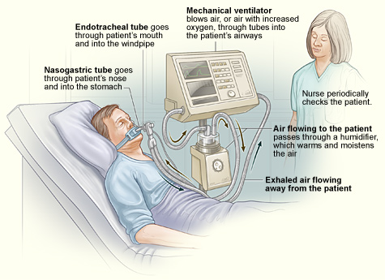

Slide 37
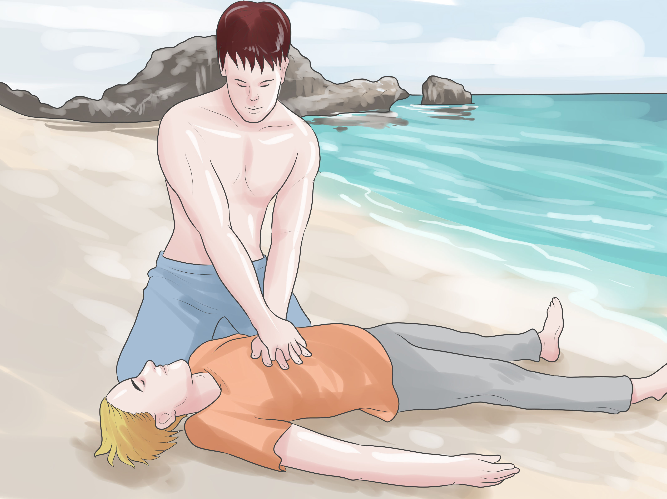
8) DROWNING
Call for a help.
Take the person out of the water.
3. Check for breathing
4. If the person is Not Breathing, check pulse
5. If there is no pulse, start CPR

Slide 38
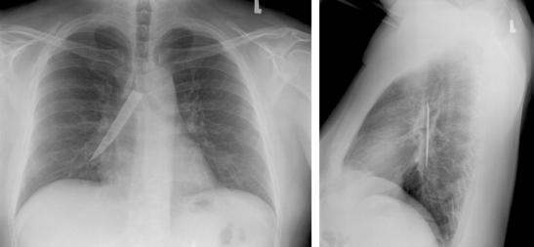
9) FOREIGN BODY ASPIRATION

Slide 39
CHILDREN mostly
A foreign body may become lodged in the larynx, trachea, or bronchus. The right bronchus is more commonly affected than the left (lesser angle and greater diameter).
Larger foreign bodies may become lodged in the larynx.
Laryngotracheal foreign bodies are associated with increased morbidity and mortality.
SYMPTOMS:
The most common symptoms of foreign-body aspiration are coughing, choking, and wheezing
DIAGNOSIS:
Because many children are asymptomatic at the beginning, history and a high index of suspicion are crucial to an early diagnosis of foreign body aspiration.
CHEST X-RAY
CT
Bronchoscopy (diagnostic and therapeutic procedure)
TREATMENT:
Bronchoscopy is used to remove the subject + give antibiotics for possible secondary infections

Slide 40
Heimlich Maneuver → only when a person is choking and his or her life is endangered by an obstruction.

