Slide 1
NRCS And Watersheds
Brief Overview of Programs
Sonya Keith, KY Partnership Coordinator

Slide 2
NRCS has been in the Watershed Business for Years!
Watershed Operations
PL534 since 1944
PL566 since 1954
Watershed Rehabilitation (since 2000)
Emergency Watershed Protection (1950s)

Slide 3
Infrastructure Investment and Jobs Act – Additional Funding
Watershed Operations - $500 million
Watershed Rehabilitation - $18 million
Emergency Watershed Protection - $300 million

Slide 4
Watershed Programs are Different
Must have a sponsor with legal authority of implement, operate, and maintain
Not a “one on one” farmer program

Slide 5
Watershed Operations
Can Assist Sponsors with:
Flood Prevention or Flood Damage Reduction
Watershed Protection
Public Recreation
Public Fish and Wildlife
Agricultural Water Management
Municipal and Industrial Water Supply
Water Quality Management
***Cost Share Rates Depend on Issue being Addressed

Slide 6
Watershed Operations
Process is Lengthy and Phased:
Project Feasibility Phase
Planning Phase
Design Phase
Construction Phase

Slide 7
Watershed Operations
Local Sponsors are the key to Watershed Operation Project success.

Slide 8
Watershed Operations
Watershed Sponsors can be:
state government entities,
local municipalities,
conservation districts,
federally recognized tribal organizations
Watershed Sponsors Must:
Have interest and some control over the watershed
Have authority to levy taxes
Obtain property rights and permits
Provide long term O&M

Slide 9
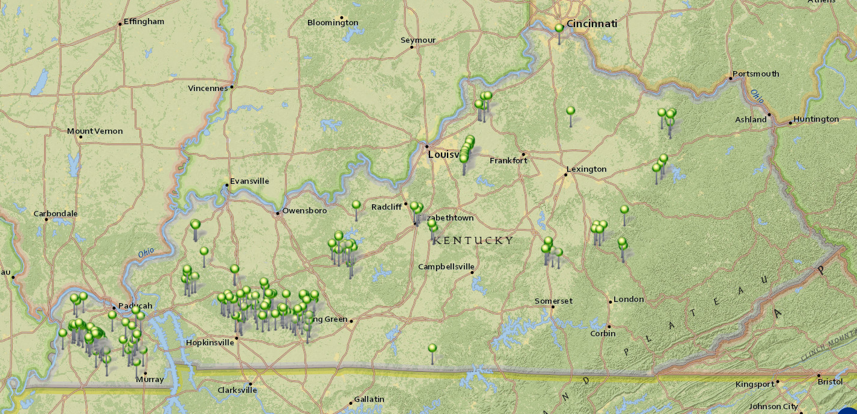
Transition to Watershed Rehab
Kentucky Watershed Dams 200 Total

Slide 10
Watershed Rehabilitation Program (Authorized by PL-83-566 Section 14, the Watershed Protection and Flood Prevention Act)
Authorizes NRCS to provide sponsors technical & financial assistance to rehabilitate their aging watershed dams
Local Sponsor requests NRCS assistance
Dam assessment
Planning Phase
Design Phase
Construction Phase
Rehabilitation is defined as all work necessary to extend the service life of a dam and to meet applicable safety and performance standards.
KY Funded rehab projects:
1 completed – Plum Creek 18 in 2007
2 in Design Phase – Red Lick 1 and 12

Slide 11
Watershed Dam Rehabilitation Program – Eligibility
Originally constructed through a NRCS Watershed Program
PL 83-566 (182 dams in KY)
PL 78-534 (No dams in KY)
Pilot Watershed Program (17 dams in KY)
RC&D (1 dam in KY)
Priority given to high-risk dams
NRCS provides assessment, planning, design, and implementation financial assistance
65% total rehabilitation cost
Not to exceed 100% construction costs

Slide 12
What Triggers the Need for Rehabilitation?
Age of the Dam
Structural Problems
Sediment Accumulation
Damaging Flows over Auxiliary Spillway
Development Downstream of Dam Causes Hazard Classification Change
Notes:
There are several things that trigger the need for rehabilitation including the age of the dam, structural problems, sediment accumulation, damages from erosion, but the main one that the Agency focuses on is the Hazard Classification.

Slide 13
Watershed Rehab 101
Local Sponsors are the key to Watershed Rehab Project success.

Slide 14
Watershed Rehab 101
Watershed Sponsors Must:
Show evidence of commitment for funding, installing, operating, and maintaining the project (35% sponsor cost)
Have control over the watershed dam
Have authority to levy taxes
Obtain property rights and permits
Be up to date on O&M for current dam and continue to provide O&M

Slide 15
Emergency Watershed Protection
Notes:
Thank you for joining us as we present an introduction to the Emergency Watershed Protection Program.

Slide 16
Introduction to the EWP Program
EWP Program
Flooding and Erosion Protection
Floods
Fires
Windstorms
Ice storms
Hurricanes/ Typhoons
Volcanic actions
Slides
Drought
Tornadoes
Earthquakes
Natural Occurrences
Notes:
The damage to a watershed from a natural disaster can be devastating to individuals and communities. Erosion, debris, and flooding issues, if not addressed, can further threaten people and their property.
Through the Emergency Watershed Protection Program, referred to as the EWP Program, the Natural Resources Conservation Service may be able to provide assist with protection from additional flooding or soil erosion.
Natural occurrences which may lead to EWP assistance include floods, fires, windstorms, ice storms, hurricanes, typhoons, tornadoes, earthquakes, volcanic actions, slides, drought, and other similar events.
The purpose of this presentation is to introduce you to the basics EWP Program by going through requirements and overall process of the program.

Slide 17
Program Eligibility
Natural Event
Watershed Impairment
Watershed Emergency
Imminent Threat
Property EWP Program Can Be Used to Protect:
EWP Program Cannot Be Used to Protect Only:
Standing Timber
Permanent structures
Dams & Flood Control
Houses & Buildings
Orchards
Agronomic crops (other USDA programs are available for Ag Land)
Roads & Utilities
Notes:
Let’s look deeper at what is considered a watershed emergency in context of the Program.
A ‘watershed emergency’ means that: a natural occurrence has caused a watershed impairment; there are adverse impacts; and there is an imminent threat to life or property.
Again, example natural occurrences include floods, fires, storms, and similar events.
Within a watershed emergency, NRCS must identify a watershed impairment. A ‘watershed impairment’ means that the ability of a watershed to carry out its natural functions is reduced.
Next, an ‘imminent threat’ means that significant damage to property or threats to human life may occur in the near future. Another way to think of ‘imminent threat’ is by saying… if something isn’t done, it’s going to get worse soon.
Finally, property, as in the property being threatened, is defined as structures permanently affixed to the land such as, houses, buildings, roads, utilities, and other infrastructure. Standing timber, orchards, and agronomic crops are not considered property eligible for protection in the EWP Program. If the threat is only to cropland, then it is not eligible for EWP Program assistance. However, USDA has other programs to provide emergency assistance for agricultural lands such as Environmental Quality Incentive Program and the Emergency Conservation Program.

Slide 18
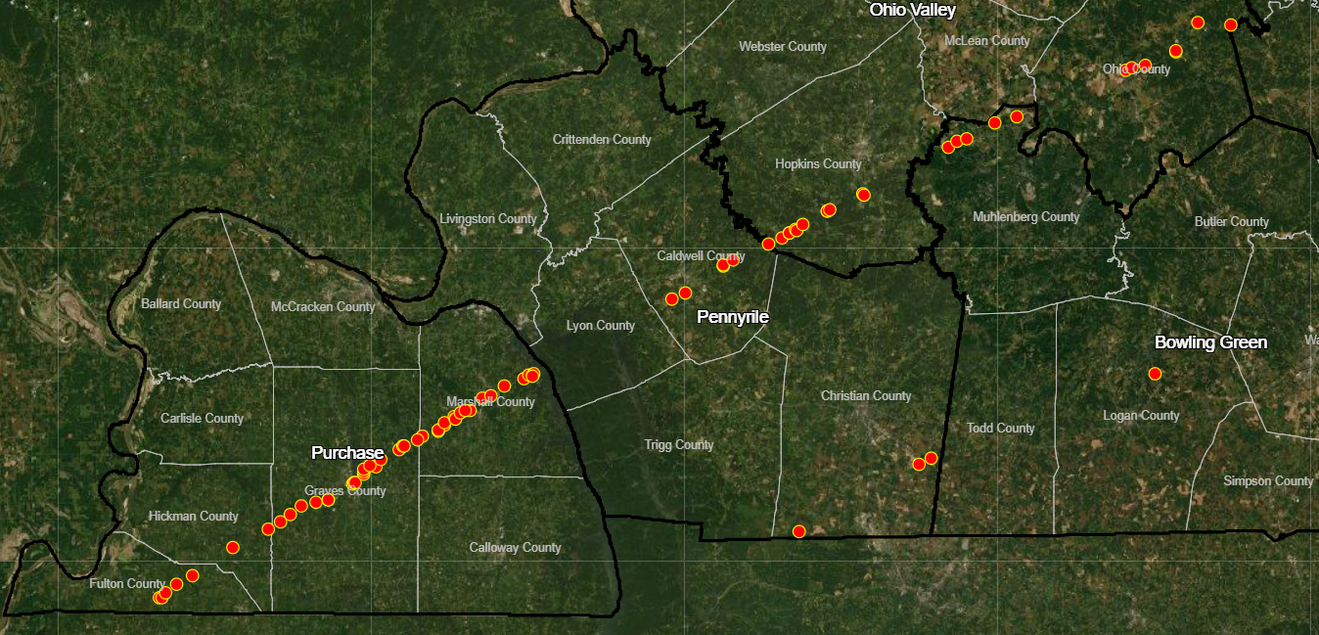
EWP Related to December Tornados
To date the NRCS has identified 77 sites that are potentially eligible for EWP Recovery assistance

Slide 19
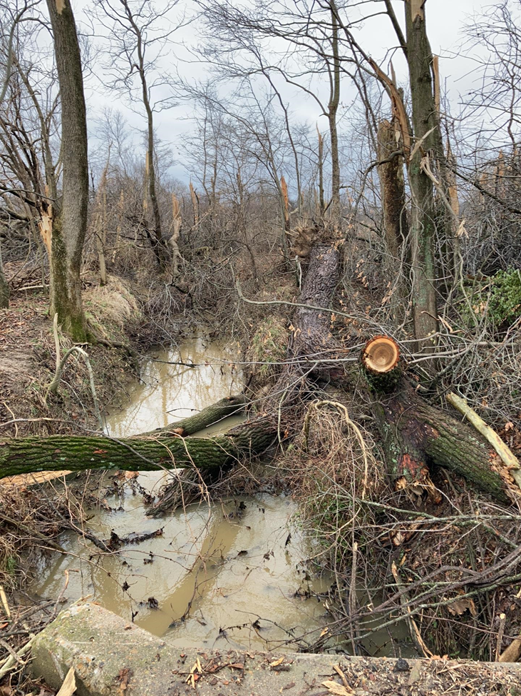
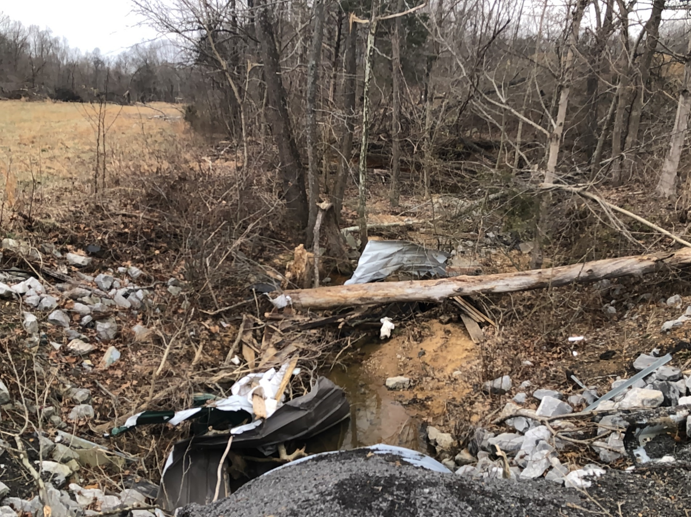
EWP Related to December Tornados

Slide 20
EWP Sponsors
EWP Assistance
Technical
Financial
Recipient
Sponsor
Landowner (if easement preferred by NRCS)
Eligible Sponsors
State
Share of project costs as determined by NRCS as cash or in-kind services
Political Subdivision of State
Qualified Indian Tribe or Tribal Organization
Unit of local government
All sponsors must have a legal interest in or responsibility for the areas threatened
Sponsor Responsibilities
Real property rights, water rights, and regulatory permits
Provide for required O&M as determined necessary by NRCS
Document they have insufficient resources to provide adequate relief
Notes:
When the NRCS State Conservationist has enough information to declare that a watershed impairment exists, NRCS may be able to provide a sponsor technical and financial assistance. Additionally, if a floodplain easement is selected by NRCS as the preferred alternative, financial assistance may be provided directly to a landowner.
Sponsors must be a State or political subdivision, a qualified Indian tribe or tribal organization, or a unit of local government. All sponsors must have a legal interest in or responsibility for the areas threatened by a watershed emergency.
The EWP Program requires that sponsors have the following responsibilities, and these responsibilities will be documented in a formal agreement between NRCS and the sponsor:
Sponsors must contribute their share of the project costs as determined by NRCS in the form of cash or in-kind services,
Sponsors must obtain real property rights, water rights, and regulatory permits; and
Sponsors must agree to provide for any required operation and maintenance of the completed emergency measures.
Also, sponsors must document they have insufficient resources to provide adequate relief from applicable hazards.

Slide 21
Construction Cost-Sharing
Sponsor
Sponsor
NRCS
NRCS
Notes:
By program regulation, the NRCS contribution for EWP construction may not exceed 75 percent. This means that if NRCS provides 75% of construction costs, then the sponsor would be responsible for 25 percent of the construction costs.
The exception for the normal cost share rate is if an area qualifies as a limited resource area. Tin this case, the NRCS contribution may not exceed 90 percent of the construction cost, and the sponsor would be responsible for 10 percent of construction costs.
Limited resource area have specific criteria in the EWP regulations. You can find a map of LRA counties on the national EWP Program webpage. All KY LRA counties are in Eastern Kentucky.
After the POTUS comments last week EWP recovery measures appear to be 100% NRCS for the first 30 days. KY NRCS will need to request waivers from NHQ for receive 100% cost sharing. More to come on this issue.

Slide 22
Natural Resources Conservation Service
In accordance with Federal civil rights law and U.S. Department of Agriculture (USDA) civil rights regulations and policies, the USDA, its Agencies, offices, and employees, and institutions participating in or administering USDA programs are prohibited from discriminating based on race, color, national origin, religion, sex, gender identity (including gender expression), sexual orientation, disability, age, marital status, family/parental status, income derived from a public assistance program, political beliefs, or reprisal or retaliation for prior civil rights activity, in any program or activity conducted or funded by USDA (not all bases apply to all programs). Remedies and complaint filing deadlines vary by program or incident.
Persons with disabilities who require alternative means of communication for program information (e.g., Braille, large print, audiotape, American Sign Language, etc.) should contact the responsible Agency or USDA's TARGET Center at (202) 720-2600 (voice and TTY) or contact USDA through the Federal Relay Service at (800) 877-8339. Additionally, program information may be made available in languages other than English.
To file a program discrimination complaint, complete the USDA Program Discrimination Complaint Form, AD-3027, found online at How to File a Program Discrimination Complaint and at any USDA office or write a letter addressed to USDA and provide in the letter all of the information requested in the form. To request a copy of the complaint form, call (866) 632-9992. Submit your completed form or letter to USDA by: (1) mail: U.S. Department of Agriculture, Office of the Assistant Secretary for Civil Rights, 1400 Independence Avenue, SW, Washington, D.C. 20250-9410; (2) fax: (202) 690-7442; or (3) email: program.intake@usda.gov.
USDA is an equal opportunity provider, employer, and lender.

