Slide 1

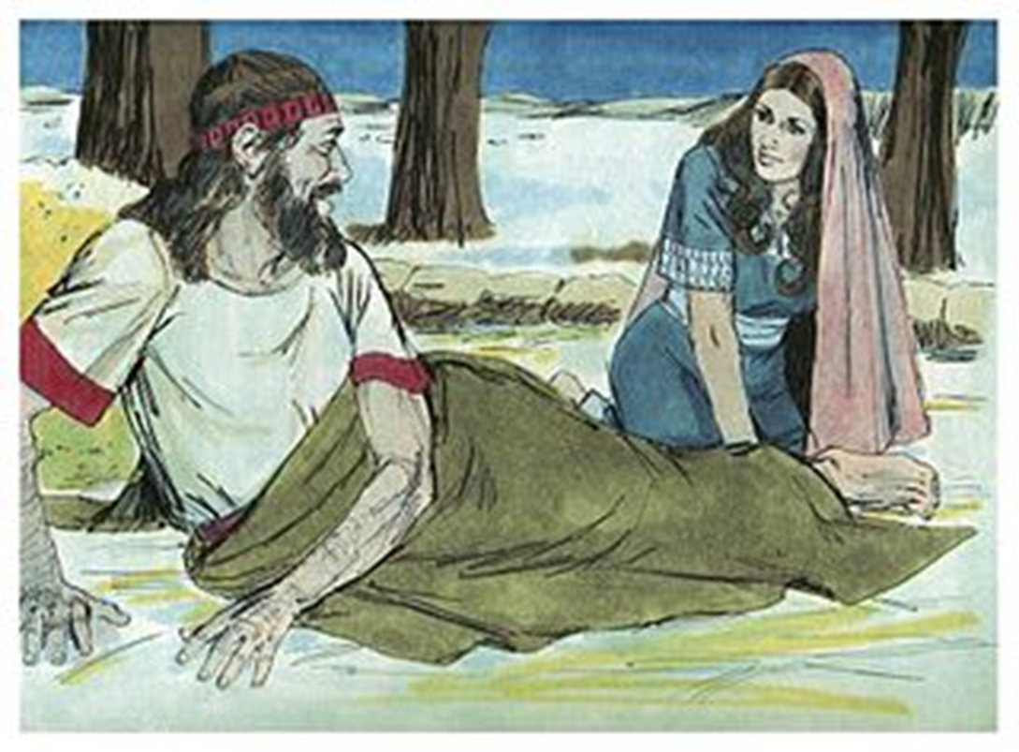
Trinity Evangelical Lutheran Church
Announcements
for
August 28, 2022

Slide 2

Body, Mind, Spirit
BODY: Just dance
MIND: Make a family picture collage
SPIRIT: Focus on the 10 commandments

Slide 3


Our Office Secretary Is Sharon Fourman
Church Office Schedule
  Tuesday – Thursday
  8:00 am – 12:00 Noon
Church Office: 937 692-5670
Email: secretary@pitsburgtlc.org

Slide 4


The Trinity Trumpet
A Monthly Newsletter
Published by Trinity Lutheran Church,
Pitsburg, OH
We’re looking for stories and pictures of Trinity people in action!
Submit to Secretary, Sharon Fourman at secretary@pitsburgtlc.org
Articles and Info due on or about the 15th of each month

Slide 5

We’re Online!
www.pitsburgtlc.org
Sermons and announcements are posted weekly
Trinity Trumpet is Posted here too!
The ‘Official’ Trinity Calendar is available for you to see!
Pictures, Videos and more!
Also, like us on FaceBook at
facebook.com/pitsburgtrinitylutheran.church

Slide 6
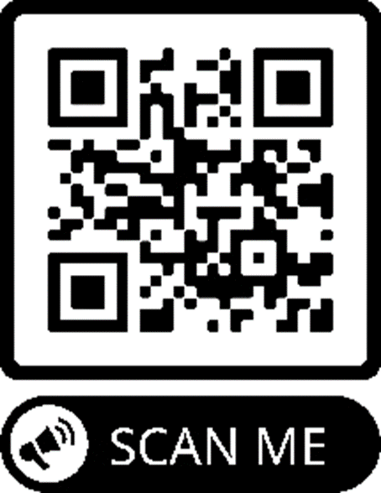
We’re Online!
www.pitsburgtlc.org
We now have our own QR Code!
Scan this code with your Smartphone and you will connect to all our Online media (Facebook, YouTube, and our own Church Website)

Slide 7
Online Giving
www.pitsburgtlc.org
Click the “Give to Trinity” Button
Stay current in your giving even when you can’t make it to Worship!
Separate Giving Categories for:
    General Treasury
    Building Fund
    Annual Christmas Auction
    Donald K. Lucas Memorial Fund

Slide 8


Church
Council
Trinity Church Council
Next Meeting:
September 21st
@ 7:00 pm

Slide 9


Trinity’s Team Meetings
Next Meeting
Wed, Sept 15th
@ 6:00 pm
On the Agenda – Preparing the proposed 2022 budget

Slide 10
Please Pass the Pew Pads
(We now track Communion on the Pads)

Slide 11

Worship Team
Next Meeting:
  TBD

Slide 12

Mutual Ministry Team
  Julie Kossler
  Joe Netzley
  Peggy Didier
  Please see one of them with your comments and suggestions
  Next Meeting - TBD

Slide 13

Rally Day!
            TODAY!!!
            This Year’s Theme –
          Trinity 4 Kindness
            Stay for Hot Dogs and Sundaes on Sunday

Slide 14
To: All Kids returning to school
If you see any of the following:
Another student struggling to make friends
Another student being bullied
A student who is shy or not with the “in” crowd
A student who eats lunch by themselves
Please be a leader!
Say Hi. Smile at them.
Ask if you can sit with them at their lunch table.
              Include them in ANY activity.
              You never know what that person might be facing inside or outside of school.
              Your kindness will make a HUGE difference in someone’s life!
Trinity4Kindness

Slide 15


Christian Education
Sunday School Teachers and Helpers Needed!!!
New, easy to use curriculum
Can you give one Sunday per month for our Children?

Slide 16

Trinity Trumpet
    Your Trinity Trumpet Newsletter for September is available!
    Please take your copy before you leave today!

Slide 17
Trinity Trumpet
    Newsletter Deadline is Tuesday, August 23rd
    Please turn in all your newsworthy items to Sharon Fourman at:
    secretary@pitsburgtlc.org

Slide 18


Choice FISH Pantry
Please join us every Friday @ 3:30 pm
400 Markwith Dr, Greenville OH
Most Needed Items
Kidney Beans
Canned Peas
Hamburger Helper
Pork & Beans
Canned Mixed Veggies
Large Cans of Soups
Applesauce
Boxed Meals
(i.e. Rice a Roni)

Slide 19

Next Meeting:
September 7, 2022
@ 11:30 am
Please note the time change!!!

Slide 20
WELCA FUNDRAISER PROJECT
Silent Auction
Make your Bids today!
Runs through the end of August Different items available each month

Slide 21
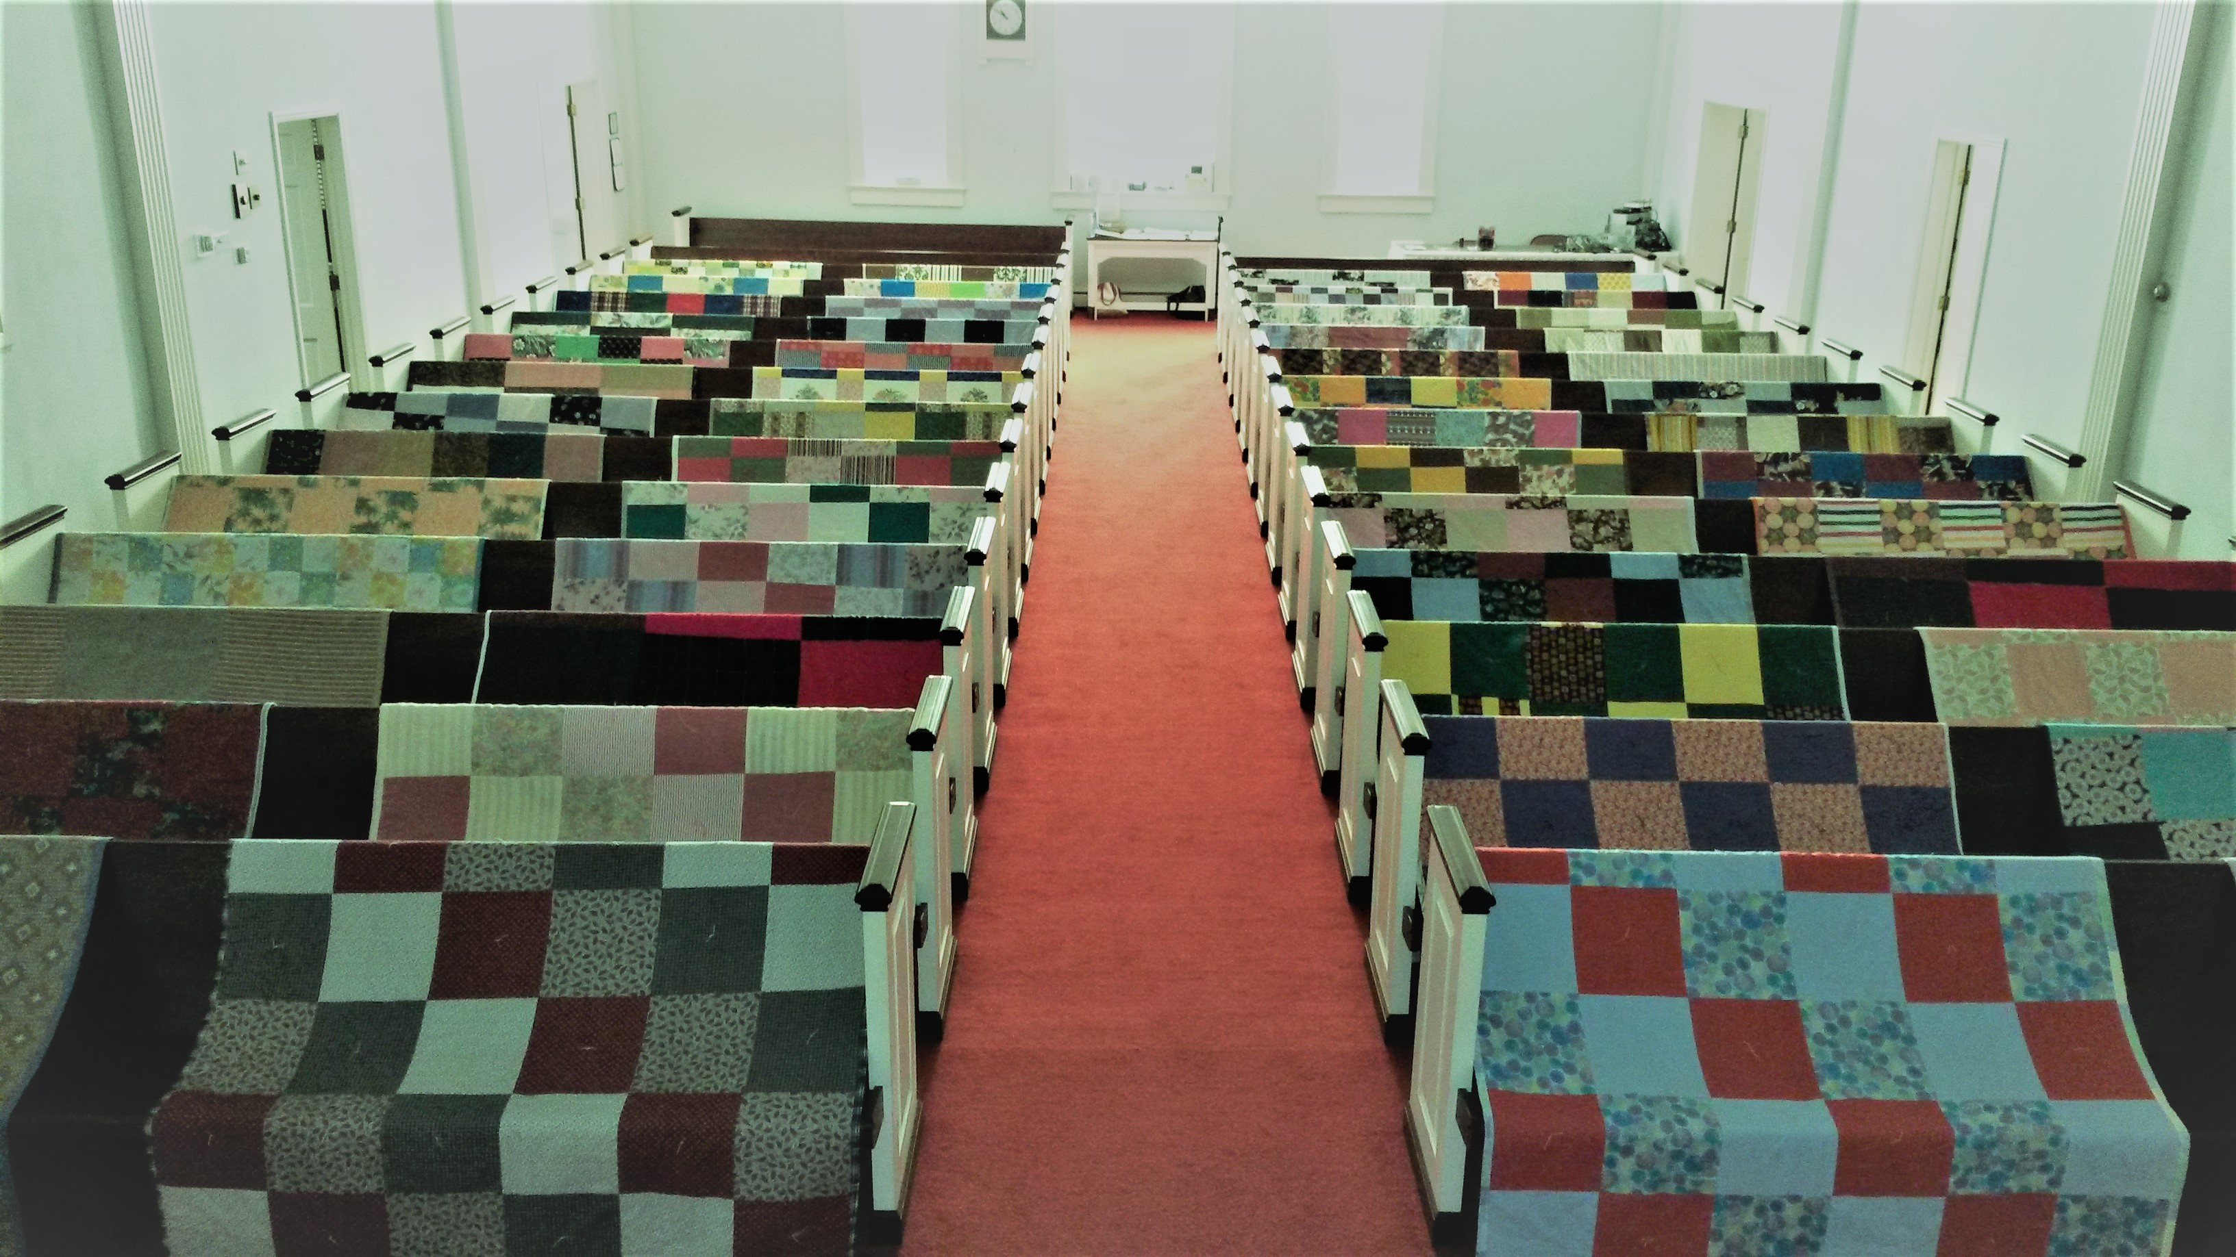
Prayers and Squares
Quilting Ministry
August 30 @ 10:00 am
September 8 @ 10:00 am

Slide 22


Ladies and Gents Luncheon
Thursday, Sept 15, 2022 @ 11:30 am
Where: Tolly's Gastropub
644 Wagner Ave, Greenville, OH For Reservations:
        See Linda Baker or call her at (937) 547-0975

Slide 23

Confirmation Classes
    All 7th and 8th Grade Students
    Parent/Student Meeting after Worship Next Sunday!

Slide 24
Confirmation Program
    Weekly Worship attendance is required (In person or via FaceBook)
    Worship Notes may be emailed to pastor@pitsburgtlc.org or placed in Pr Mel’s mailbox outside the Church Office
    Confirmands are encouraged to take turns as Acolyte

Slide 25

    Please sign up for Acolyte Duty on the chart by the Church Office!
    Confirmation Students are Highly Encouraged to perform Acolyte duty…
    Please sign up today!

Slide 26

    Commemorate special days like Anniversaries, Birthdays, Baptisms and more…
    Please sign up for Altar Flowers on the chart by the Church Office or see Shirley Rhoades

Slide 27
Trinity’s Team Meetings
Christian Education Team
Next Meeting

Slide 28

Holy Communion – Today!
Communion Elements are prepackaged by TruVine, a division of Concordia Church Supply Co.
Safe for all humans (Especially sinners)
Holy Communion Schedule will resume our Pre-Covid Schedule
    First and Third Sundays each month
    All White and Red Sundays of the Church Year

