Slide 1
Thyroid Metabolic Hormones
Prof. dr. Zoran Valić
Department of Physiology
University of Split School of Medicine

Slide 2
located below the larynx on each side of and anterior to the trachea, first endocrine gland
one of the largest glands (15-20 g)
thyroxine (T₄) and triiodothyronine (T₃)
complete lack ⇨  BM 40-50%
extreme excesses ⇨  BM 60-100%
regulation of secretion – thyreotropin (TSH)
also secretes calcitonin

Slide 3
Synthesis and Secretion of the Thyroid Metabolic Hormones
93% - thyroxine, 7% - triiodothyronine
almost all the thyroxine is eventually converted to triiodothyronine – both are functionally important
triiodothyronine is 4x as potent as thyroxine, but it is present in the blood in much smaller quantities and persists for a much shorter time than does thyroxine

Slide 4
composed of large numbers of closed follicles (100-300 μm in diameter) filled with a secretory substance called colloid and lined with cuboidal epithelial cells that secrete into the interior of the follicles

Slide 5
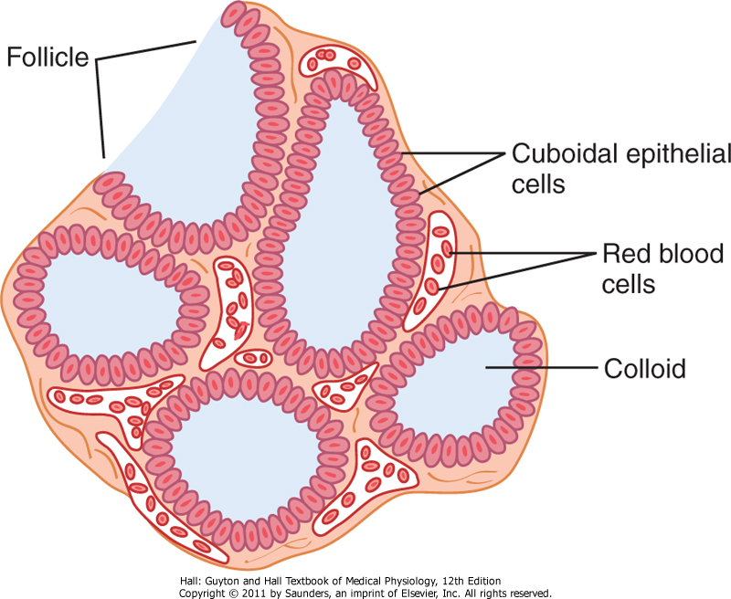

Slide 6
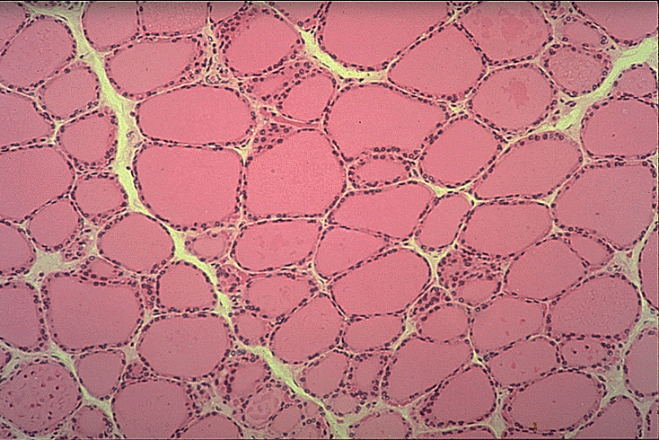

Slide 7
major constituent of colloid is the large glycoprotein thyroglobulin
it must be absorbed back through the follicular epithelium into the blood
blood flow about five times the weight of the gland each minute

Slide 8
Role of Iodine
50 mg iodine ingested each year, or about 1 mg/week – sodium iodide
table salt is iodized (1/100 000)
iodides are absorbed in about the same manner as chlorides
most of iodides are rapidly excreted by kidneys, only after 1/5 are selectively removed from circulating blood by cells of thyroid gland

Slide 9
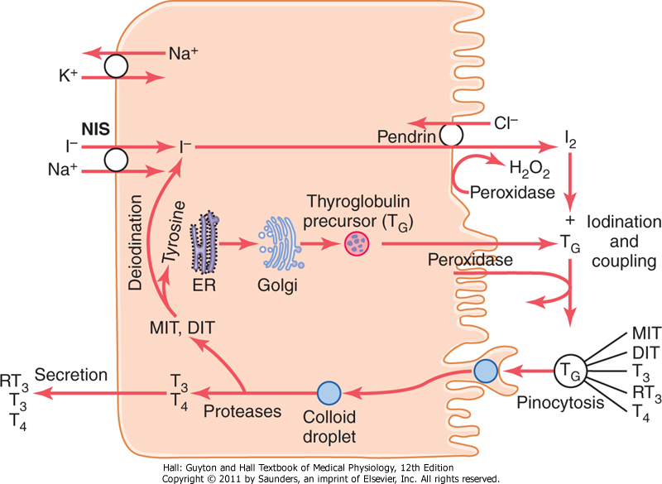

Slide 10
Iodide Pump
transport of iodides from the blood into the thyroid glandular cells and follicles
action of a sodium-iodide symporter (NIS), which co-transports one iodide ion along with two sodium ions across the basolateral (plasma) membrane into the cell – active transport

Slide 11
iodide trapping (30x – 250x)
TSH stimulates and hypophysectomy greatly diminishes the activity of the iodide pump in thyroid cells
iodide is transported across apical membrane by a chloride-iodide ion counter-transporter molecule called pendrin

Slide 13
Formation and Secretion of Thyroglobulin
typical proteinsecreting glandular cells
ER and Golgi apparatus ⇨ thyroglobulin (335 000)
thyroglobulin contains about 70 tyrosine amino acids (major substrates)
thyroid hormones form within the thyroglobulin molecule

Slide 14
Oxidation of the Iodide Ion
conversion of the iodide ions to an oxidized form of iodine (nascent iodine-I° or I₃⁻)
capable of combining directly with tyrosine
oxidation of iodine – enzyme peroxidase (apical membrane) and hydrogen peroxide
hereditarily absent – rate of formation of thyroid hormones falls to zero

Slide 15
Iodination of Tyrosine and Formation of Hormones – "Organification”
binding of iodine with the thyroglobulin molecule is called organification
peroxidase enzyme – causes the process to occur within seconds or minutes
1/6 of the tyrosine is iodinated
tyrosine ⇨ monoiodotyrosine ⇨ diiodotyrosine

Slide 16
Iodination of Tyrosine and Formation of Hormones – "Organification”
tyrosine ⇨ monoiodotyrosine ⇨ diiodotyrosine
coupling of two diiodotyrosine ⇨ thyroxine
coupling of monoiodotyrosine and diiodotyrosine ⇨ triiodothyronine

Slide 17
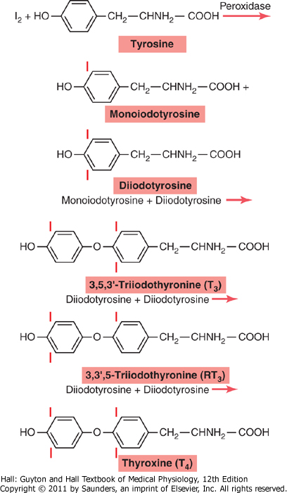

Slide 18
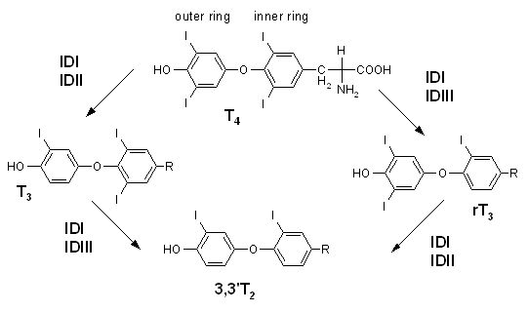

Slide 19
Storage of Thyroglobulin
ability to store large amounts of hormone – unusual
each thyroglobulin molecule contains up to 30 thyroxine molecules and a few triiodothyronine molecules
amount sufficient for 2 to 3 months (late manifestation of symptoms)

Slide 20
Release of Thyroxine and Triiodothyronine
thyroglobulin itself is not released
T₄ and T₃ must first be cleaved from the thyroglobulin
free hormones are released
pinocytic vesicles enter the apex of the thyroid cell

Slide 21
lysosomes – multiple proteases digest thyroglobulin molecules and release T₄ and T₃ in free form
diffuse through the base of the thyroid cell into the surrounding capillaries
3/4 of the iodinated tyrosine in thyroglobulin never become hormones
iodine is cleaved from them by a deiodinase enzyme

Slide 23
Transport of T₄ i T₃ to Tissues
T₄ & T₃ are combined with plasma proteins (more than 99%; synthesized by liver; thyroxine-binding globulin, prealbumin and albumin)
T₄ & T₃ released to the tissue cells slowly (high affinity; t_{1/2} T₄ = 6 days, t_{1/2} T₃ = 1 day; in the cells again bind with intracellular proteins and slowly used)
T₄ % T₃ act with long latent period (2-3 days) and longlasting (max. 10-12 days)
T₃ act 4x faster than T₄

Slide 24
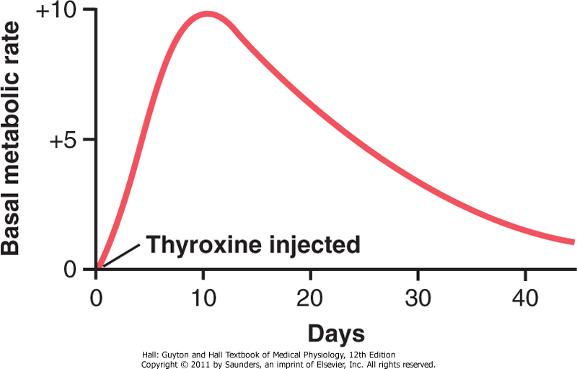

Slide 25
Physiological Functions of the Thyroid Hormones
⇧ transcription of large numbers of genes
synthesis of great numbers of protein enzymes, structural proteins and transport proteins
T₄ (10%) is converted in T₃ (90%)
T₄ & T₃ receptors are either attached to the DNA genetic strands or located in proximity to them ⇨ receptors become activated ⇨ transcription ⇨ mRNA ⇨ hundreds of proteins

Slide 26
thyroid hormone receptor usually forms a heterodimer with retinoid X receptor (RXR) at specific thyroid hormone response elements on the DNA
not all the proteins are increased by similar percentages-some only slightly, and others at least as much as sixfold
thyroid hormones also appear to have nongenomic cellular effects

Slide 27
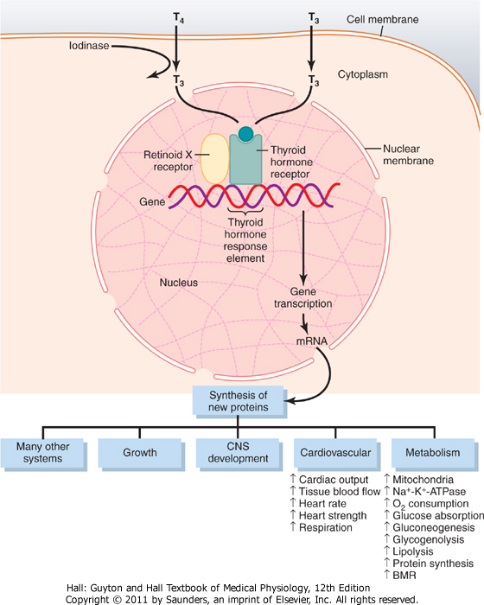

Slide 28
⇧ cellular metabolic activity
of almost all the tissues,  BM 60-100%
⇧ rate of utilization of foods for energy;  protein synthesis & catabolism;  growth rate;  mental processes;  activities of endocrine glands
⇧ size, number and activity of mitochondria; result or cause of the increase
⇧ active transport of ions through cell membranes (Na-K-ATPase; membranes of most cells to become leaky to Na⁺)

Slide 29
effect of thyroid hormone on growth
general and specific effects on growth (metamorphic change of tadpole into frog)
manifest mainly in growing children
hypothyroid –growth is greatly retarded
hyperthyroid – child taller at an earlier age, in adulthood shorten (epiphyses close)
promote growth and development of the brain (fetal life and for the first few years of postnatal life) – mental retardation

Slide 30
effects of thyroid hormone on specific bodily mechanisms
⇧ all aspects of carbohydrate metabolism (rapid uptake of glucose, enhanced glycolysis, gluconeogenesis, rate of absorption, insulin secretion – overall  in cellular enzymes)
⇧ all aspects of fat metabolism (lipids are mobilized rapidly from the fat tissue – weight loss)

Slide 31
decreases the concentrations of cholesterol (secretion in the bile), phospholipids, and triglycerides in the plasma, increases the free fatty acids; conversely in hypothyroidism
⇧ requirement for vitamins (increased quantities of enzymes, and vitamins are essential parts of enzymes)
⇧ basal metabolic rate (60-100%)
⇩ body weight (hyperthyroidism, but increase in appetite as well),  body weight in hypothyroidism

Slide 32
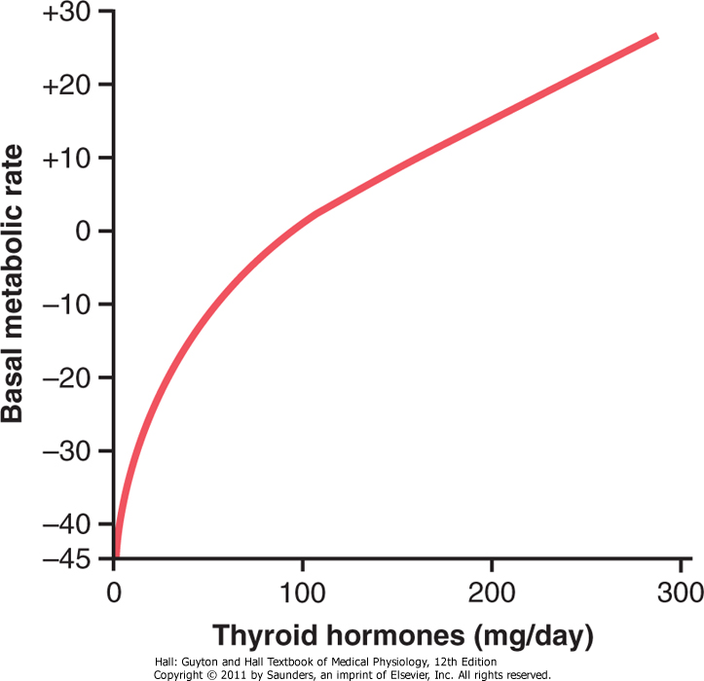
μg

Slide 33
⇧ blood flow & CO (more rapid utilization of oxygen and release of greater than normal quantities of metabolic end products – vasodilation in most tissues, especially in skin – heat elimination); C0  60%
⇧ heart rate (considerably more than due to increase in CO, direct  excitability)
⇧ heart strength (due to increased enzymatic activity; in severe hyperthyroidism, because of long-term excessive protein catabolism ⇨ myocardial failure ⇨ death)

Slide 34
mean arterial pressure remains normal, pulse pressure is often increased
increased rate and depth of respiration (increased rate of metabolism – increased utilization of O₂ and formation of CO₂)
⇧ gastrointestinal motility ( appetite and food intake,  rates of secretion of the digestive juices,  motility – diarrhea; hypothyroidism – constipation)

Slide 35
excitatory effects on the CNS (increased rapidity of cerebration, often dissociates; extreme nervousness and many psychoneurotic tendencies – anxiety, worry, paranoia)
effect on function of muscles (slight increase – makes the muscles react with vigor; excessive – weakness due to excess protein catabolism)
muscle tremor – fine muscle tremor (10 to 15 times per second) most characteristic signs ( reactivity of the neuronal synapses)

Slide 36
effect on sleep – constant tiredness due to exhausting effect on the musculature and on the CNS, difficulties to sleep; hypothyroidism – extreme somnolence (12-14 h)
effect on other endocrine glands – increases the rates of secretion of other glands, but it also increases the need for the hormones
effect on sexual function (in men – lack – loss of libido, excess – impotence; in women – lack – menorrhagia and polymenorrhea,  libido, even amenorrhea, excess – oligomenorrhea)

Slide 37
Regulation of Thyroid Hormone Secretion
thyrotropin (TSH) – anterior pituitary hormone – increases secretion T₄ & T₃
⇧ proteolysis of the thyroglobulin – the most important early effect (within 30 minutes)
⇧ activity of the iodide pump
⇧ iodination of tyrosine
⇧ size and increased secretory activity of the thyroid cells
⇧ number of thyroid cells, cuboidal ⇨ columnar cells

Slide 38
cAMP mediates most of the effects of TSH
binding of TSH with specific receptors on the basal membrane surfaces ⇨ cAMP ⇨ protein kinase ⇨ multiple phosphorylations
thyrotropin-releasing hormone (TRH)
tripeptide amide-pyroglutamyl-histidyl-proline-amide
blockade of blood portal system –  TSH, but is not reduced to zero
receptors in the pituitary cell membrane ⇨ phospholipase second messenger system ⇨ phospholipase C ⇨ Ca²⁺ & diacyl glycerol ⇨ TSH

Slide 39
exposure of an animal to cold increases TRH secretion by the hypothalamus, and therefore TSH secretion
result of excitation of the hypothalamic centers for body temperature control
⇧ secretion by 100%, and BM 50%

Slide 40
excitement and anxiety-conditions (stimulation of sympathetic nervous system) ⇨ acute  TSH
after the hypophysial stalk has been cut both effects are not longer present – role of hypothalamus

Slide 41
T₄ and T₃ decrease secretion of TSH by the anterior pituitary (rise by 1,75x – TSH rate of secretion falls essentially to zero)
direct effect on the anterior pituitary gland
concentrations of T₄ and T₃ are maintain almost constant

Slide 42
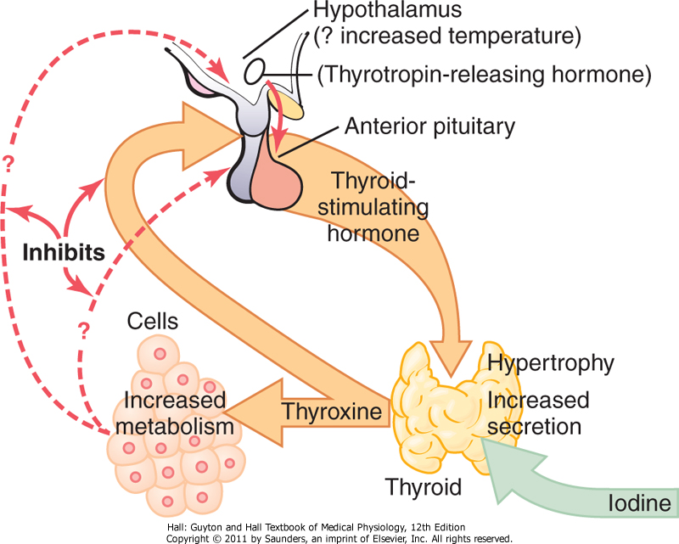
Wolff-Chaikoffljev učinak

Slide 43
Antithyroid Substances
drugs that suppress thyroid secretion
thiocyanate – decrease iodide trapping (perchlorate and nitrate ions), competitive inhibition of iodide transport – prevents thyroglobulin to become iodinated;  TSH – goiter
propylthiouracil – prevents formation of thyroid hormone from iodides and tyrosine, block the peroxidase enzyme and coupling of two iodinated tyrosines to form thyroxine or triiodothyronine;  TSH – goiter

Slide 44
inorganic iodides – in high concentrations (100x), decrease all phases of thyroid activity – slightly decrease the size of the thyroid gland (before surgical removal of the thyroid gland to decrease the necessary amount of surgery, especially to decrease the amount of bleeding)

Slide 45
Diseases of the Thyroid
hyperthyroidism (toxic goiter, thyrotoxicosis, Graves' Disease)
thyroid gland is increased 2-3x, hyperplasia
hyperplastic glands  secretion 5-15x
TSH decreased to 0
thyroid-stimulating immunoglobulins (TSI) bind with the same membrane receptors that bind TSH (lasting for as long as 12 hours)
an autoimmune disease
result from a adenoma – remainder inhibited

Slide 46
symptoms of hyperthyroidism :
a high state of excitability
intolerance to heat
increased sweating
mild to extreme weight loss (50kg)
varying degrees of diarrhea
muscle weakness
nervousness or other psychic disorders
extreme fatigue but inability to sleep
tremor of the hands

Slide 47
exophthalmos – in most people with hyperthyroidism (major degree of exophthalmos in about 1/3 – damage vision)
much more often eyes are damaged because the eyelids do not close completely – dryness, irritation, infection – ulceration of the cornea)
edematous swelling of the retro-orbital tissues and degenerative changes in the extraocular muscles (autoimmune process)

Slide 48
diagnostic tests for hyperthyroidism
direct measurement of T₄ i T₃ – radioimmunoassay
basal metabolic rate (+30-60%)
concentration of TSH
concentration of TSI
treatment in hyperthyroidism
surgical removal of most of the thyroid gland (propylthiouracil & iodides – 1/1000 of 1/25)
radioactive iodine – absorption by 80-90%, destroy most of the secretory cells

Slide 49
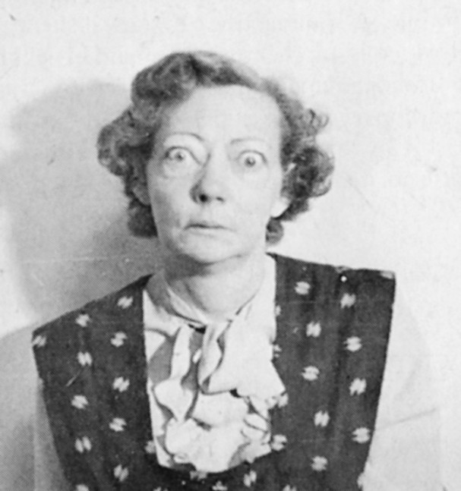

Slide 50
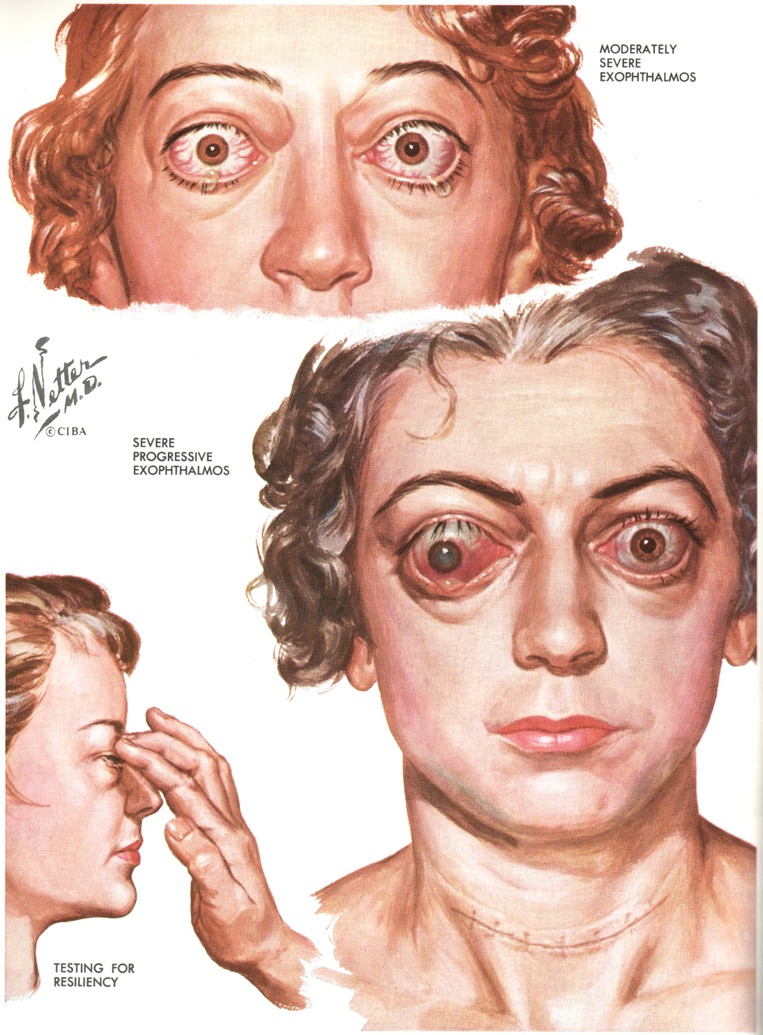

Slide 51
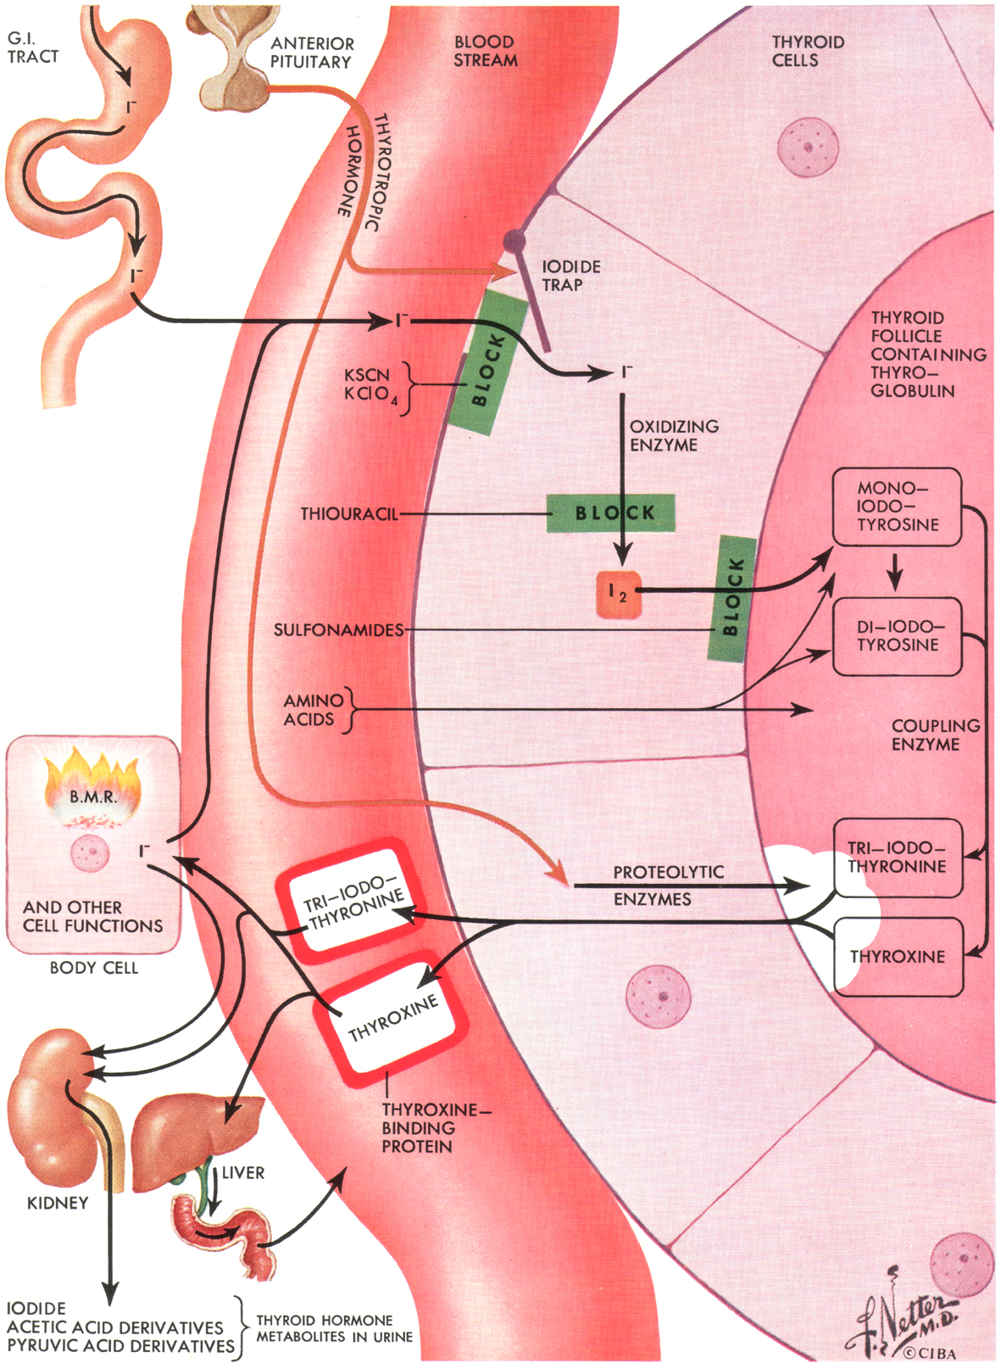

Slide 52
Diseases of the Thyroid
hypothyroidism
often initiated by autoimmunity against the thyroid gland (Hashimoto disease)
destruction of gland rather than stimulation
first autoimmune "thyroiditis" (inflammation)
fibrosis of the gland

Slide 53
endemic colloid goiter (greatly enlarged thyroid gland)
insufficient iodine in the soil for the foodstuffs
in some areas (mountains)
mechanism – activation of feedback loop
increase in size by 10-20x
iodized table salt

Slide 54
idiopathic nontoxic colloid goiter
no iodine deficiency
more frequently secretion is depressed
signs of mild thyroiditis
thyroiditis causes slight hypothyroidism –  TSH – growth of the noninflamed portions of the gland (nodular look)
abnormality of the enzyme system required for formation of the thyroid hormones
goitrogenic substances (turnips and cabbages)

Slide 55
physiological characteristics:
fatigue and extreme somnolence
extreme muscular sluggishness
slowed heart rate
decreased CO and blood volume
sometimes increased body weight
constipation
mental sluggishness
depressed growth of hair and scaliness of skin
froglike husky voice

Slide 56
myxedema – in the patient with almost total lack of thyroid hormone function
bagginess under the eyes and swelling of the face, greatly increased quantities of tissue gel – edema is the (nonpitting type)
atherosclerosis –  cholesterol (deafness, and coronary artery disease)

Slide 57
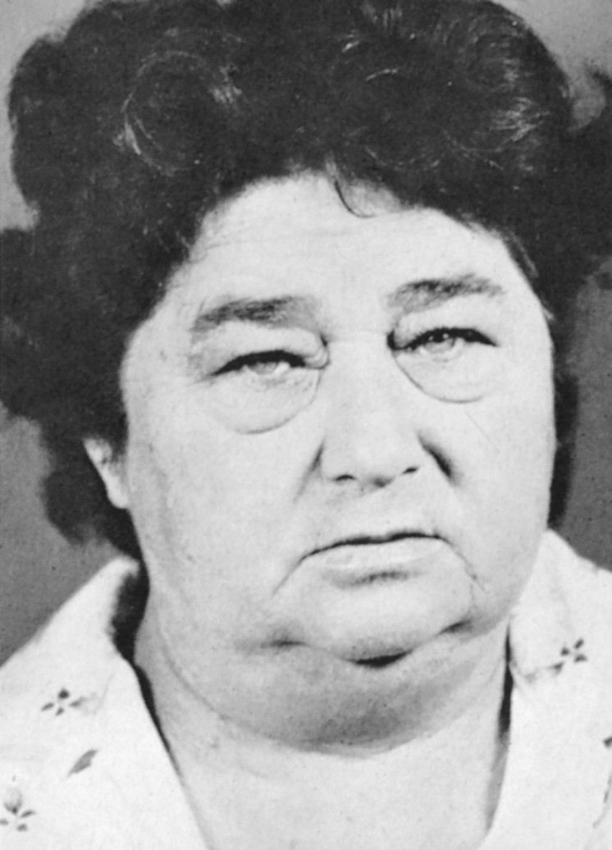

Slide 58
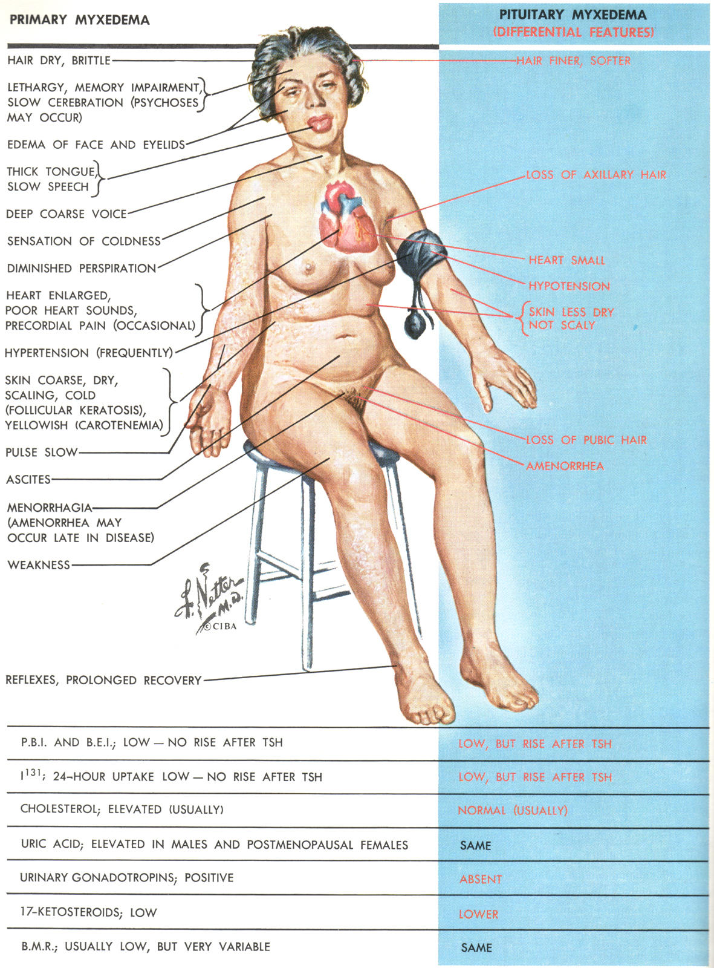

Slide 59
diagnostic tests in hypothyroidism
free T₄ in the blood is low
basal metabolic rate (-30-50%)
secretion of TSH by the anterior pituitary when a test dose of TRH is administered is usually greatly increased
treatment of hypothyroidism
oral ingestion of a tablet or more containing thyroxine
very successful
first time in 1891 – unpurified extracts

Slide 60
Diseases of the Thyroid
cretinism
extreme hypothyroidism during fetal life, infancy, or childhood
failure of body growth and by mental retardation
congenital cretinism – congenital lack of a thyroid gland
endemic cretinism – genetic defect or iodine lack in the diet
mental growth – permanent retardation

Slide 61
