Slide 1



Family Solution Finder Learning Centers
Click on speaker for audio
Hugs, Hope and Shared Family Love

Slide 2
The Not So Perfect Storm, Holidays
There is Enabling
There is Boundaries
There is Change
Enabling
Boundaries
Change

Slide 3

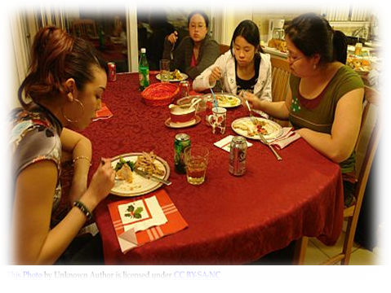
Enabling, Which One? Ten Types
Who is doing it, When are they doing it, Why are they doing it?
Which of the ten types of enabling is being used?
What is the consequence?

Slide 4
Ten Types of Enabling
Denial
Justification
Allowing Substance Use
Suppressing your Feelings
Avoiding the Problem
Protecting the Family Image
Minimizing the Situation
Playing the Blame Game
Assuming Responsibility
Controlling Behaviors

Slide 5
Boundaries
You can not Set and Forget.
Support an environment that creates success.
They see boundaries as a place to start the negotiations from.
Timing, Place and Respect.

Slide 6
Use a Worksheet
A worksheet helps you to cover the basics of setting up boundaries.
A worksheet allow you to include others, get their input, support and commitment to create a successful boundaries environment.
The worksheet summary can help the person required to meet the boundaries to have a written copy of what is the boundary.

Slide 7

Five Stages of Change
Pre-Contemplation
Contemplation
Preparation
Action
Maintenance

Slide 8
5 Stages of Change
Pre-Contemplation Limited Understand of there is a Problem
Contemplation A need to find next step options.
Preparation Steps are taken to move forward with a selected option.
Action The selected option is being implemented.
Maintenance Work is being done to continue the action.

Slide 9
Family Solution Finder Learning Series
32 Key Issues Seminars, (1.5hrs. Duration).
Family Solution Finder, Study Guidebook.
Family Solution Finder, Workbook.
Family Solution Finder, Family Member Coping Skills, The 3-D’s Workbook.
Family Solution Finder, Resource Connections Workbook.
Family Solution Finder, Monthly Learning System, (128 sessions, 2.5 years meeting content).
WWW.FAMILIESIMPACTEDBYOPIOIDS.COM

Slide 10
Conclusion
Contact Us:
Mr. Roy Poillon
440.385.7605
Families Impacted by Opioids
Email: Familiesimpactedbyopioids@gmail.com
Web: www.familiesimpactedbyopioids.com

