Slide 1
The Family Intervention
The Family Solution Finder Learning Seminars

Slide 2
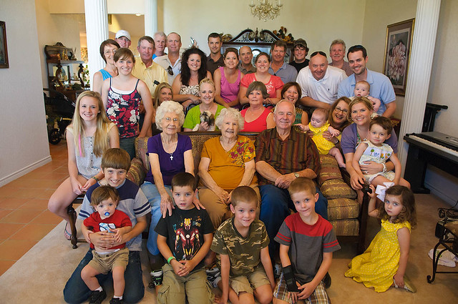
The Family Intervention
Being in Balance means Everyone contributes to support the family’s ability to function.
The family needs to understand they are not experts in “Family Intervention” to be effective, there is a great deal of experience and training required. For this reason the family needs to seek the guidance of a professional.
The family members will be the primary providers of a family intervention and they need to understand what they are trying to achieve is change. However, Change will be required by both the individual and the family members, everyone must change.
Notes:
The family Solution Finder has 32 1.5hr seminars coving all the issues a family will likely face in their journey. The family can view these in the monthly meeting or at home. Each issues require a family plan of action

Slide 3
Program Overview
Five Stages of Change
Dual Diagnosis
Suicide Risk with Co-Occurring Disorders
Practical Exercise
Supportive Family environment

Slide 5
The Family Intervention
1. 5 Stages of Change
3. Suicide Risk with Co-occurring disorders
2. Dual Diagnosis
Notes:
The SP~ARK’s Program is a self-administered faith development program that has three steps.
Self evaluation
Scoring and identify faith practices strengths and weaknesses.
Plan of Action for self directed learning.

Slide 7
How to use this information ?
By completing the worksheets a family can better understand how medical, mental health and addiction diagnosis has its own stage of progression, the family member will have a clearer understanding of what area of the loved one’s profile is impacting their behavior and how it may change over time. The family needs to know they do have a role to play especially in the area of setting up a health family environment that is supportive of the recovery goals. When setting up boundary’s having each member united to be consistent in their boundary responsibilities is very important towards a strong environment of recovery. The elements of writing down the boundary, communication between family members and working with a family therapist are all important steps.
Work with care providers in each are of the specific diagnosis the family can seek what their role can be to assure a safe and positive environment/family dynamic for their loved one.
Notes:
We will first look at the structure of the entire workbook.
The go into the purposeful driven ministry, then all three programs.

Slide 8
This Learning Sessions
What did you learn ?
How will you use it ?

Slide 9
Conclusion
Five Stages of Change
Dual Diagnosis
Suicide Risk in Co-Occurrence Diagnosis
Complete a “Responding to A Family Issue”

Slide 10
CONTACT US:
Roy Poillon Executive Director/Founder
Office: 440.385.7605 Mobile: 814.722.8946
Familiesimpactedbyopioids@gmail.com
www.Familiesimpactedbyopioids.com
LinkedIn Roy Poillon
Facebook: Familiesimpactedbyopioids public group
Instagram: Families Impacted by Opioids
ALWAYS SEEK THE ADVICE OF A PROFESSIONAL THERAPIEST BEFORE ACTING ON ANY PART OF THE INFORAMTION PROVIDED IN THESE PROGRAMS.

