Slide 1
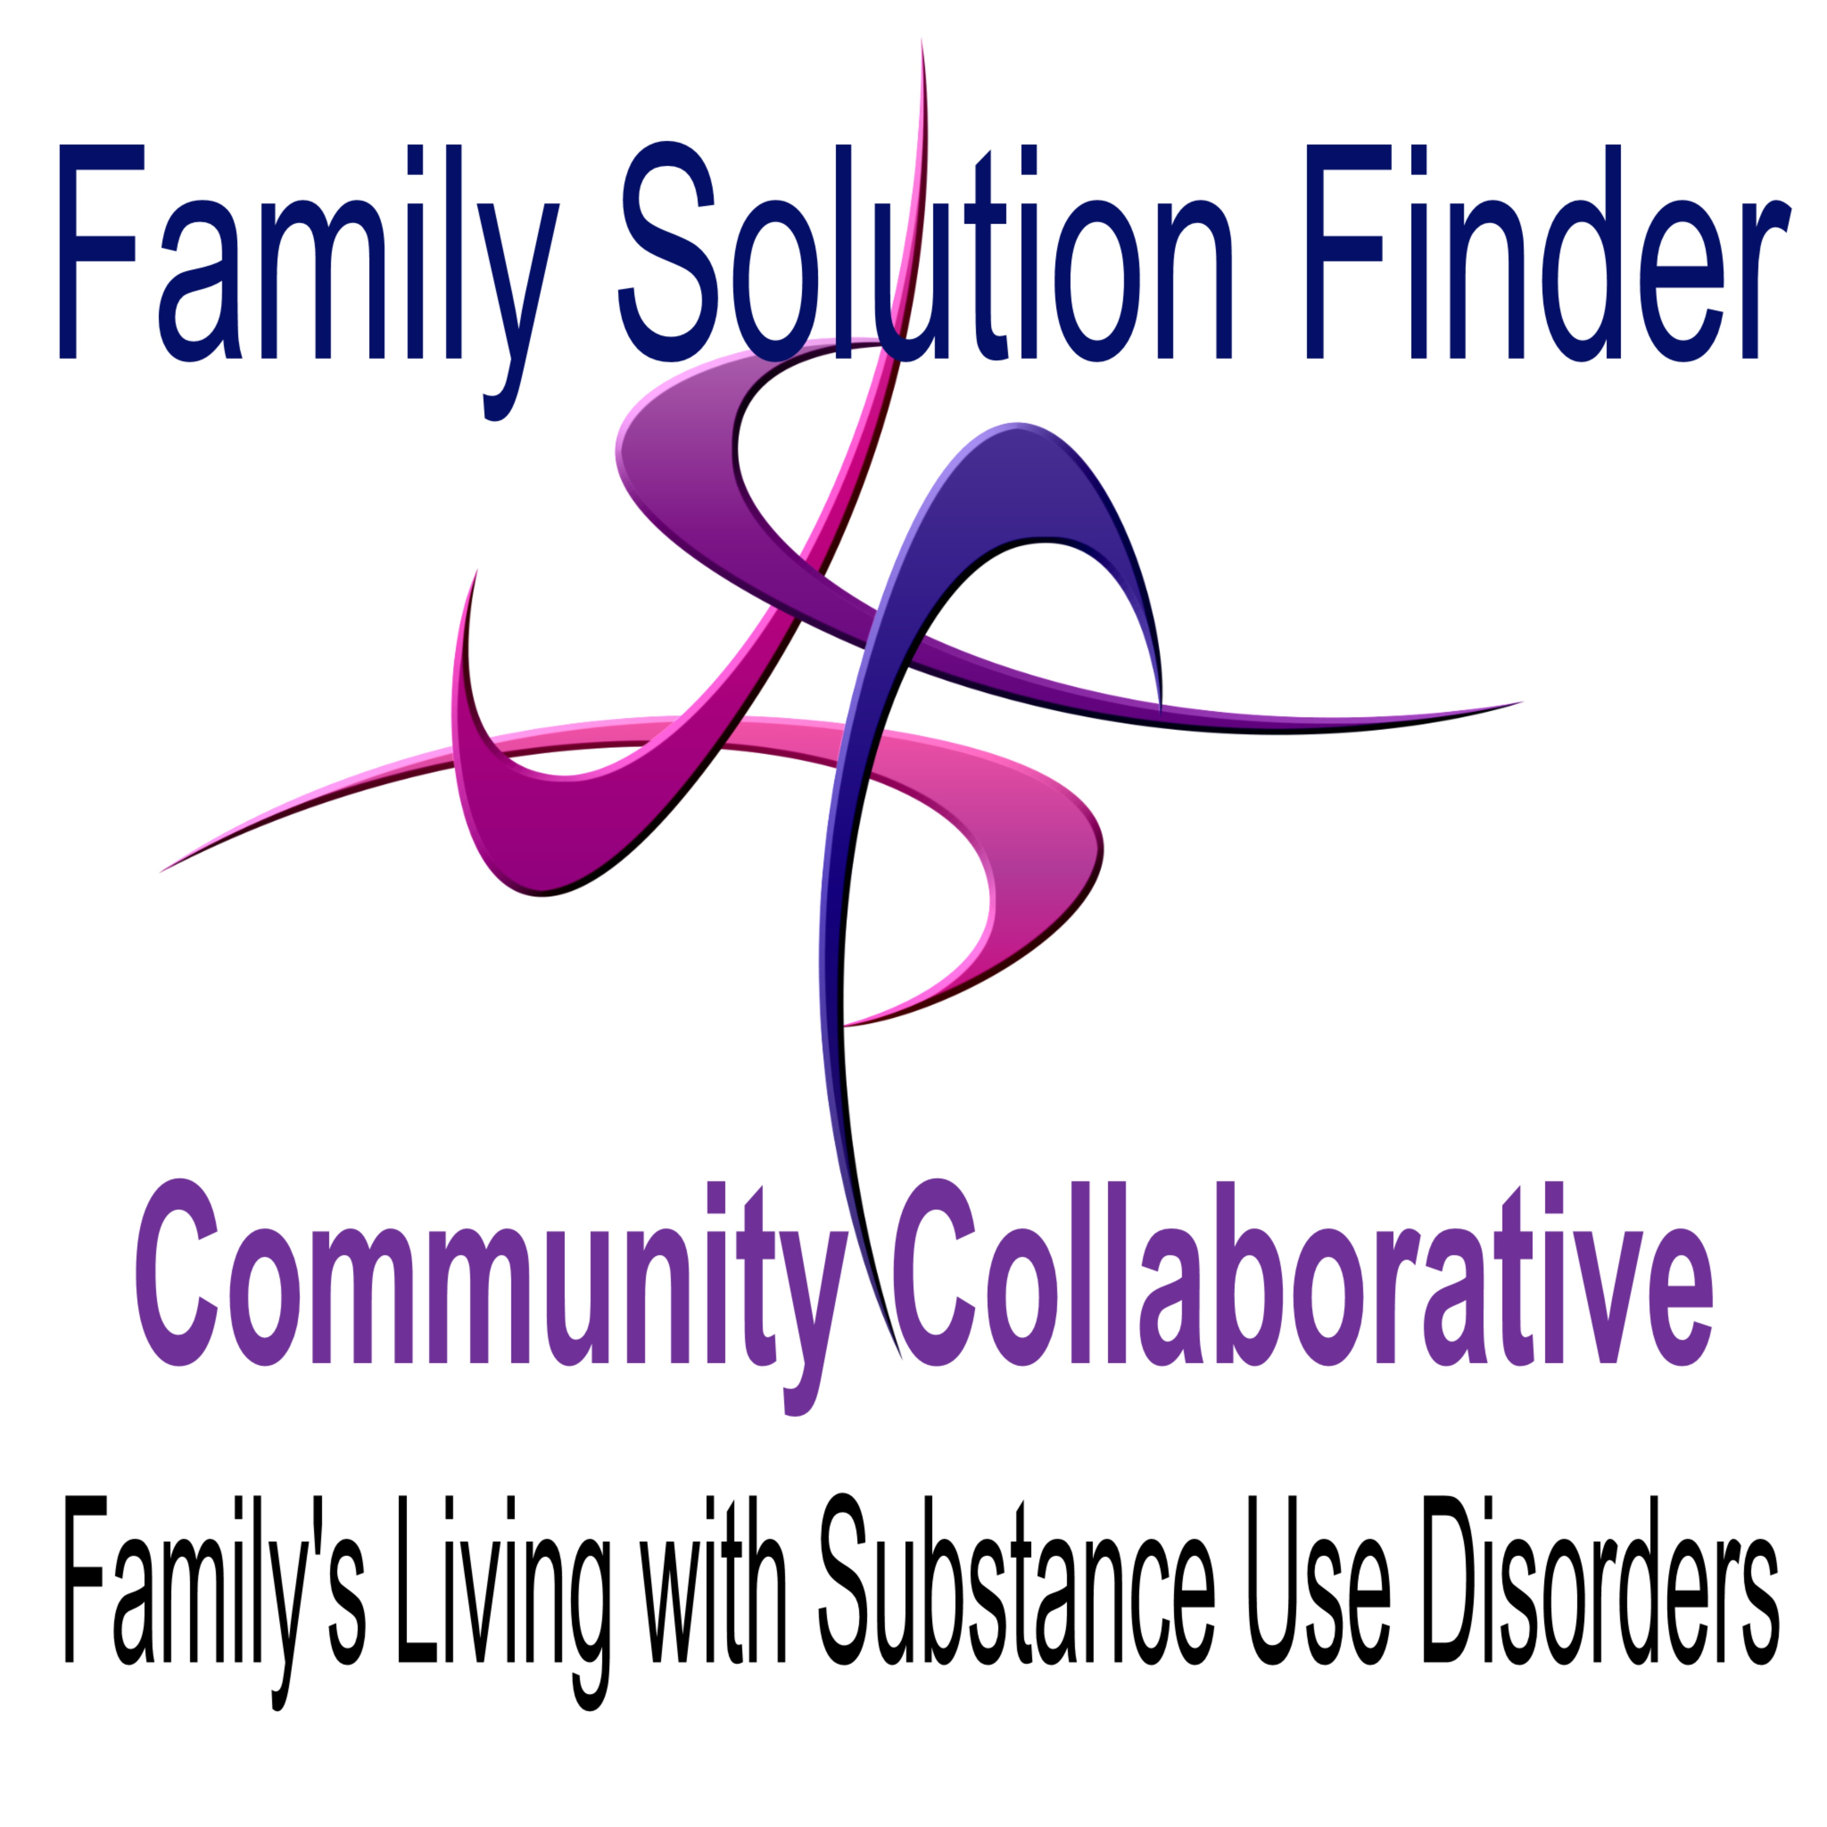
Family Members Living with Substance Use Disorders in a
Community Collaborative

Slide 2


The Family Members
Open definition of what composes a family.
Family has a system and in the system is a dynamic of the individual family members.
Family’s naturally seeks to balance themselves and support eachother as a family unit.
Substance use disorders significantly disrupt all the above.

Slide 3

The
Community
The
Family Members
Community is a collection of families
Community is a collection of industry of providers, programs, services, government agencies and faith organizations

Slide 4
The Collaborative
A common interest.
An established bridge.
A purposeful outcome.
The ability to measure for transparency.
A mutual Win-Win for all involved participants.

Slide 5
The 3 C’s in Collaboration
Community Mapping
Continuity of Care
Continuum in the Plan of Treatment

Slide 6
Community Mapping
By geography category
By industry category
By type of provider
By organization
By point of contact person
APPLY THE 32 KEY ISSUES
MATCHED TO A LOCAL PROVIDER

Slide 7
Continuity of Care
Referral
  Soft Referral
  Hard Referral
  Closed System Referral
Admissions
Services/Programs
Discharge

Slide 8
Continuum in the Plan of Treatment
Family Member Based Case Management
Community Based Case Management Support
Family Solution Finder Learning Series, Case Management education for family members. Learning Seminars for both of the above.

Slide 9
Structure, Process, Implementation
Structure in the form of a local Family Solution Finder Learning Centers
Process in the form of the Family Solution Finder Learning Series, eLearning Program, On-Demand Cirrriculum Builder Program, Specialty Courts Family Learning Program, Incarceration Family Learning Program, Pathfinder Community Seminars, Invest in the Family Ministry Model for Faith Organizations.
Implementation in the form of a Family Solution Finder Community Collaborative.

Slide 10
Anyone can start a Family Solution Finder Learning Centers
Just call us: 440.385.7605 and we will walk you through the easy start up steps. Roy Poillon Executive Director Families Impacted by Opioids, nonprofit Cleveland, Ohio
To Register as a Family Solution Finder Learning Centers (one time fee) $325.00
The content and programs are free.
A community can have several Family Solution Finder Learning Centers because the structure has four different levels (I-IV).

Slide 11
Contact Us:
Mr. Roy P. Poillon
Executive Director
Families Impacted by Opioids
440.385.7605
familiesimpactedbyopioids@gmail.com
Familiesimpactedbyopioids.com
Facebook: The Family Solution Finder Learning Centers
LlinkedIn: Roy Poillon

