Slide 1
America At The Crossroads
The Death Of A Nation
Romans 1:16-32

Slide 2
Downfall Of A Nation
Social Decay
Cultural Decay
Moral Decay

Slide 3
Observations About The Election
Preference
Personality
Principle

Slide 4
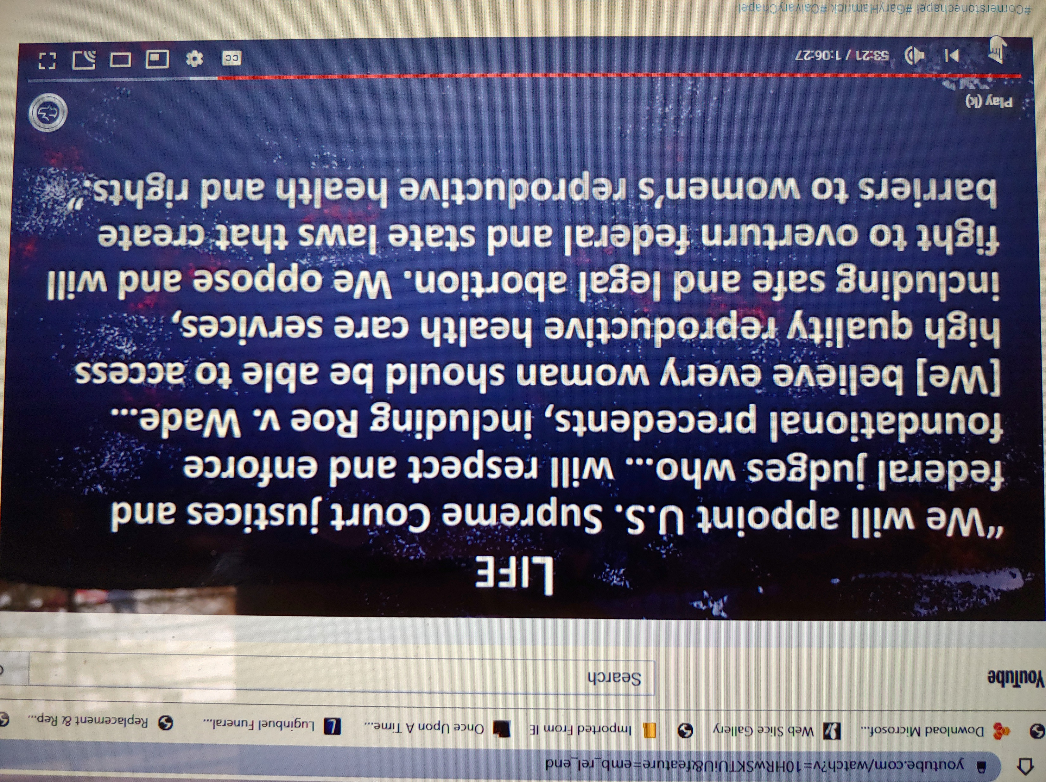

Slide 5
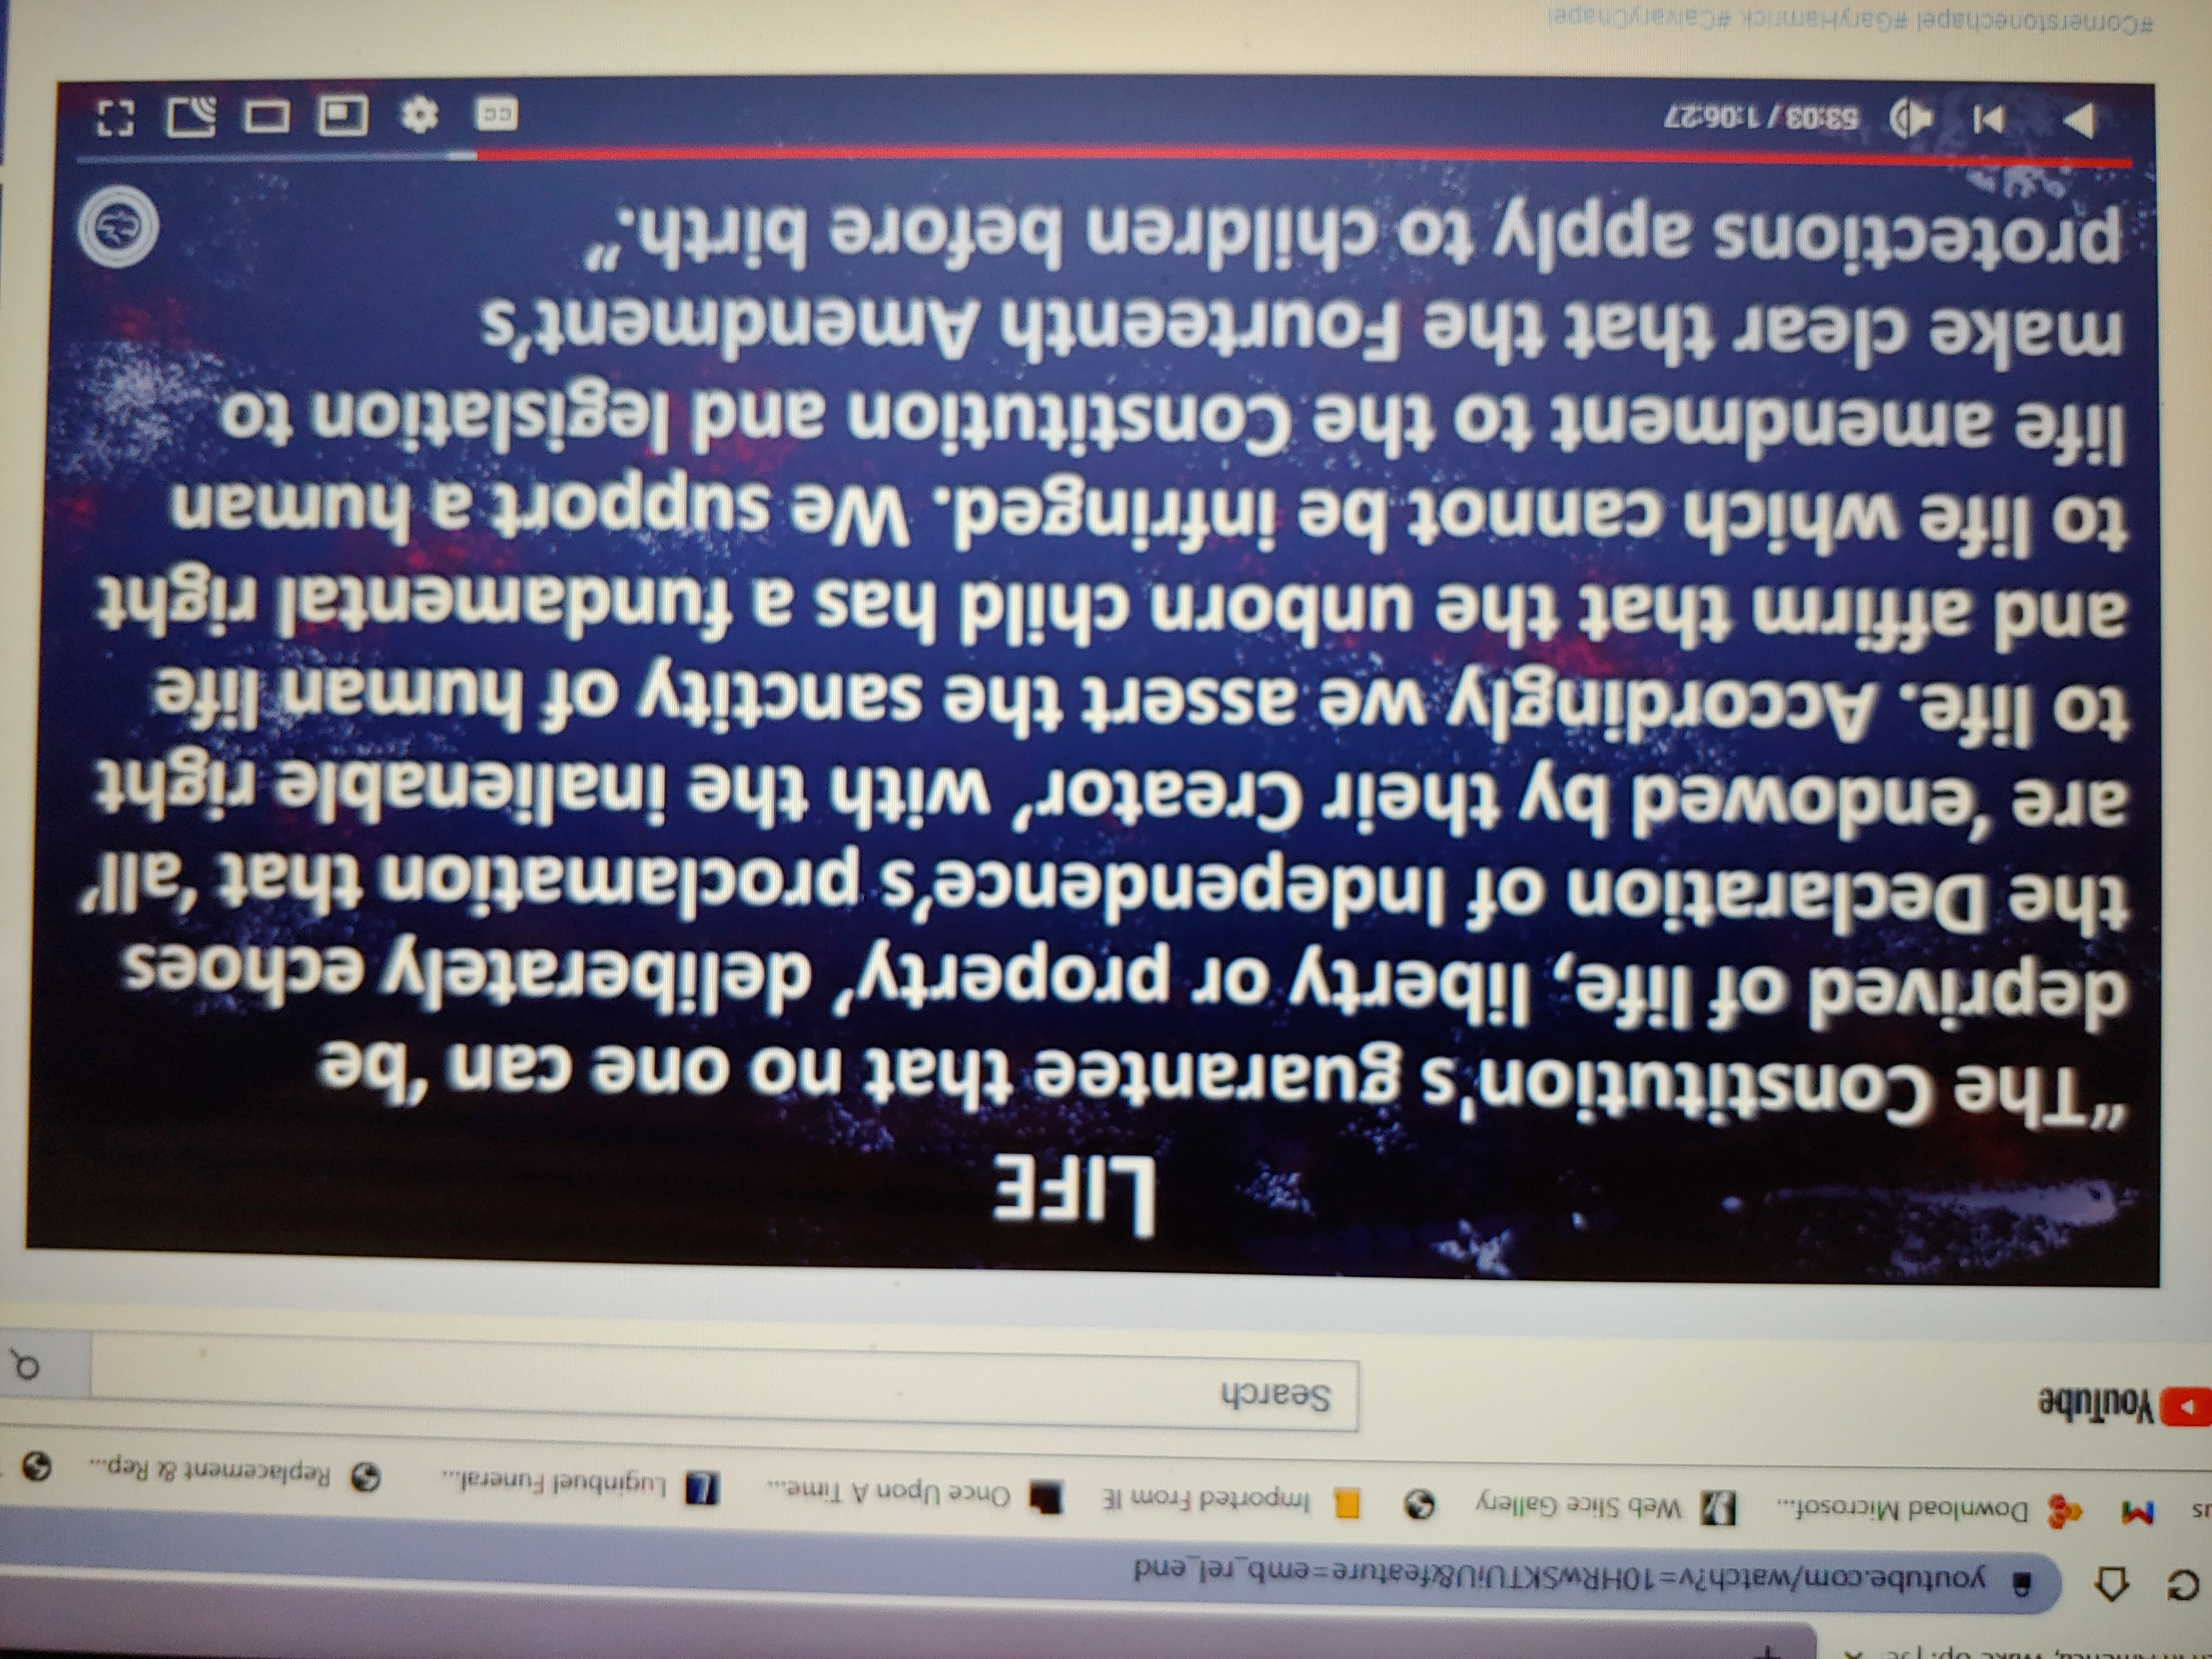

Slide 6
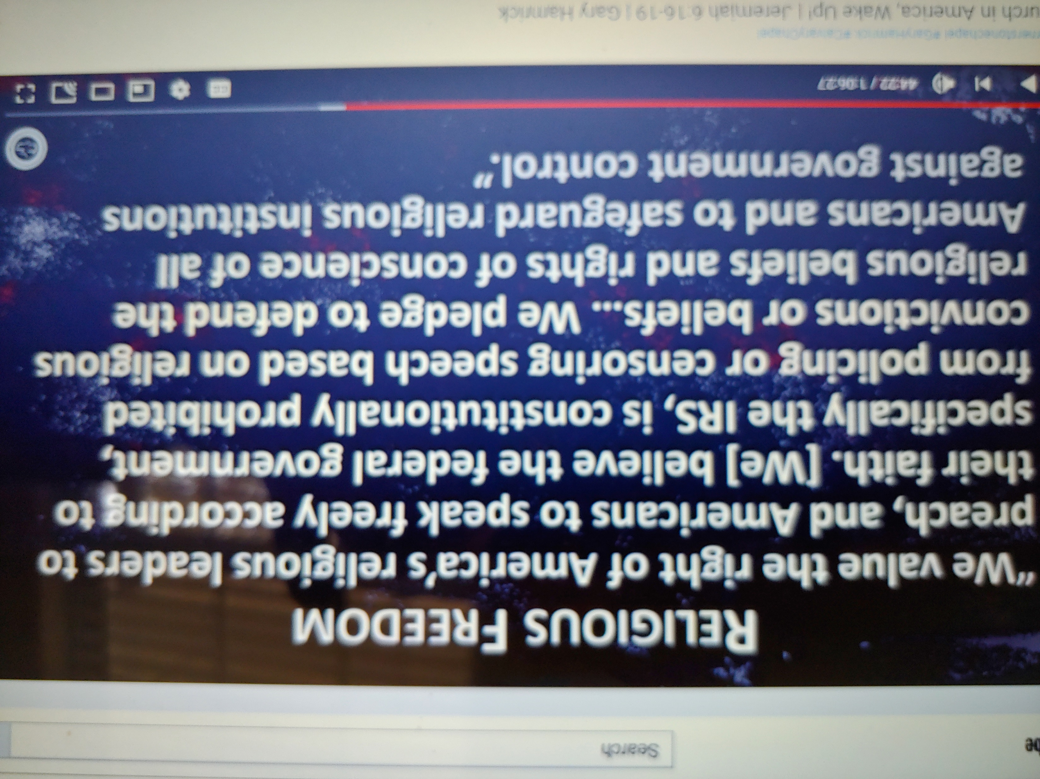

Slide 7
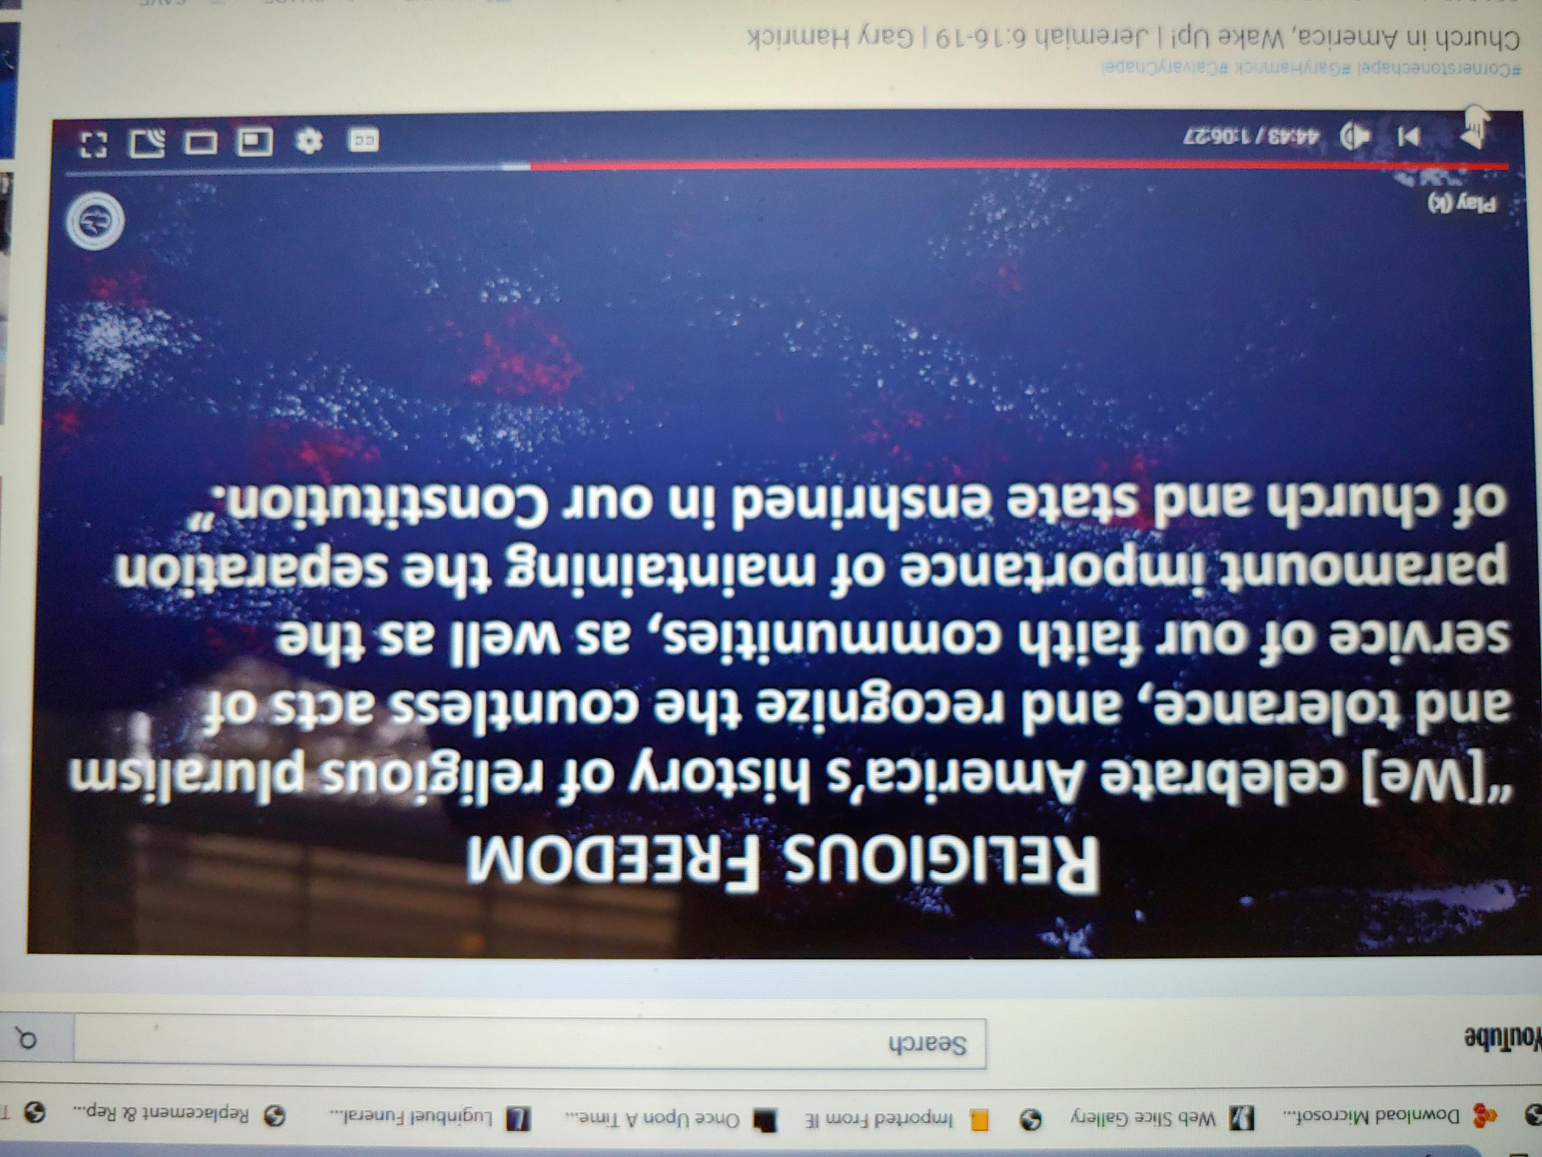

Slide 8
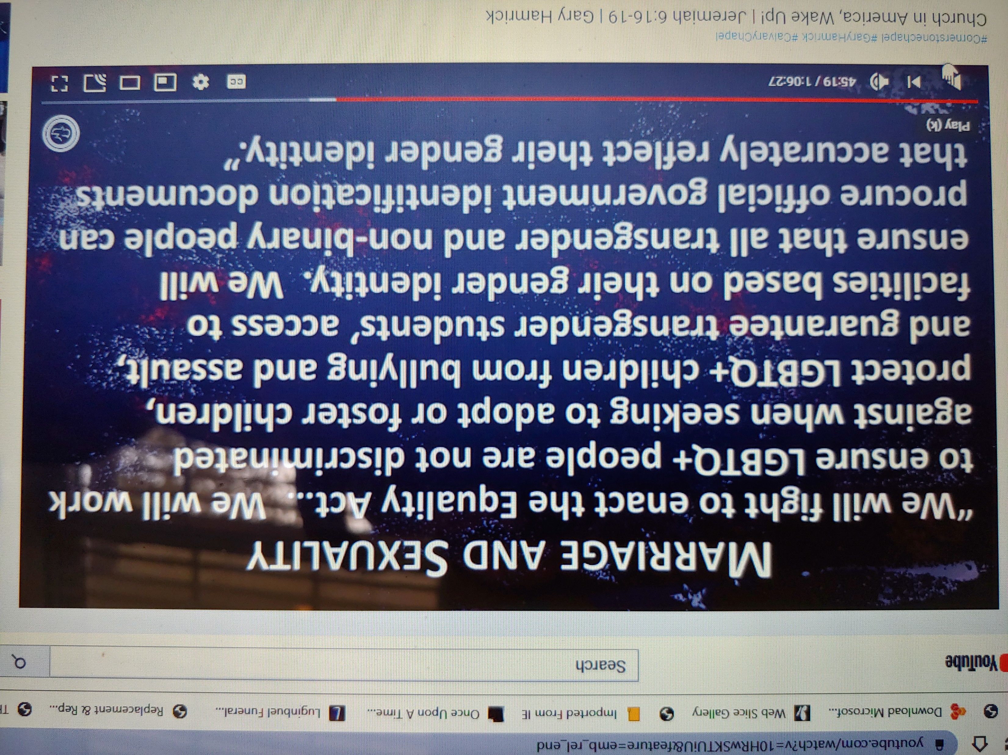

Slide 9
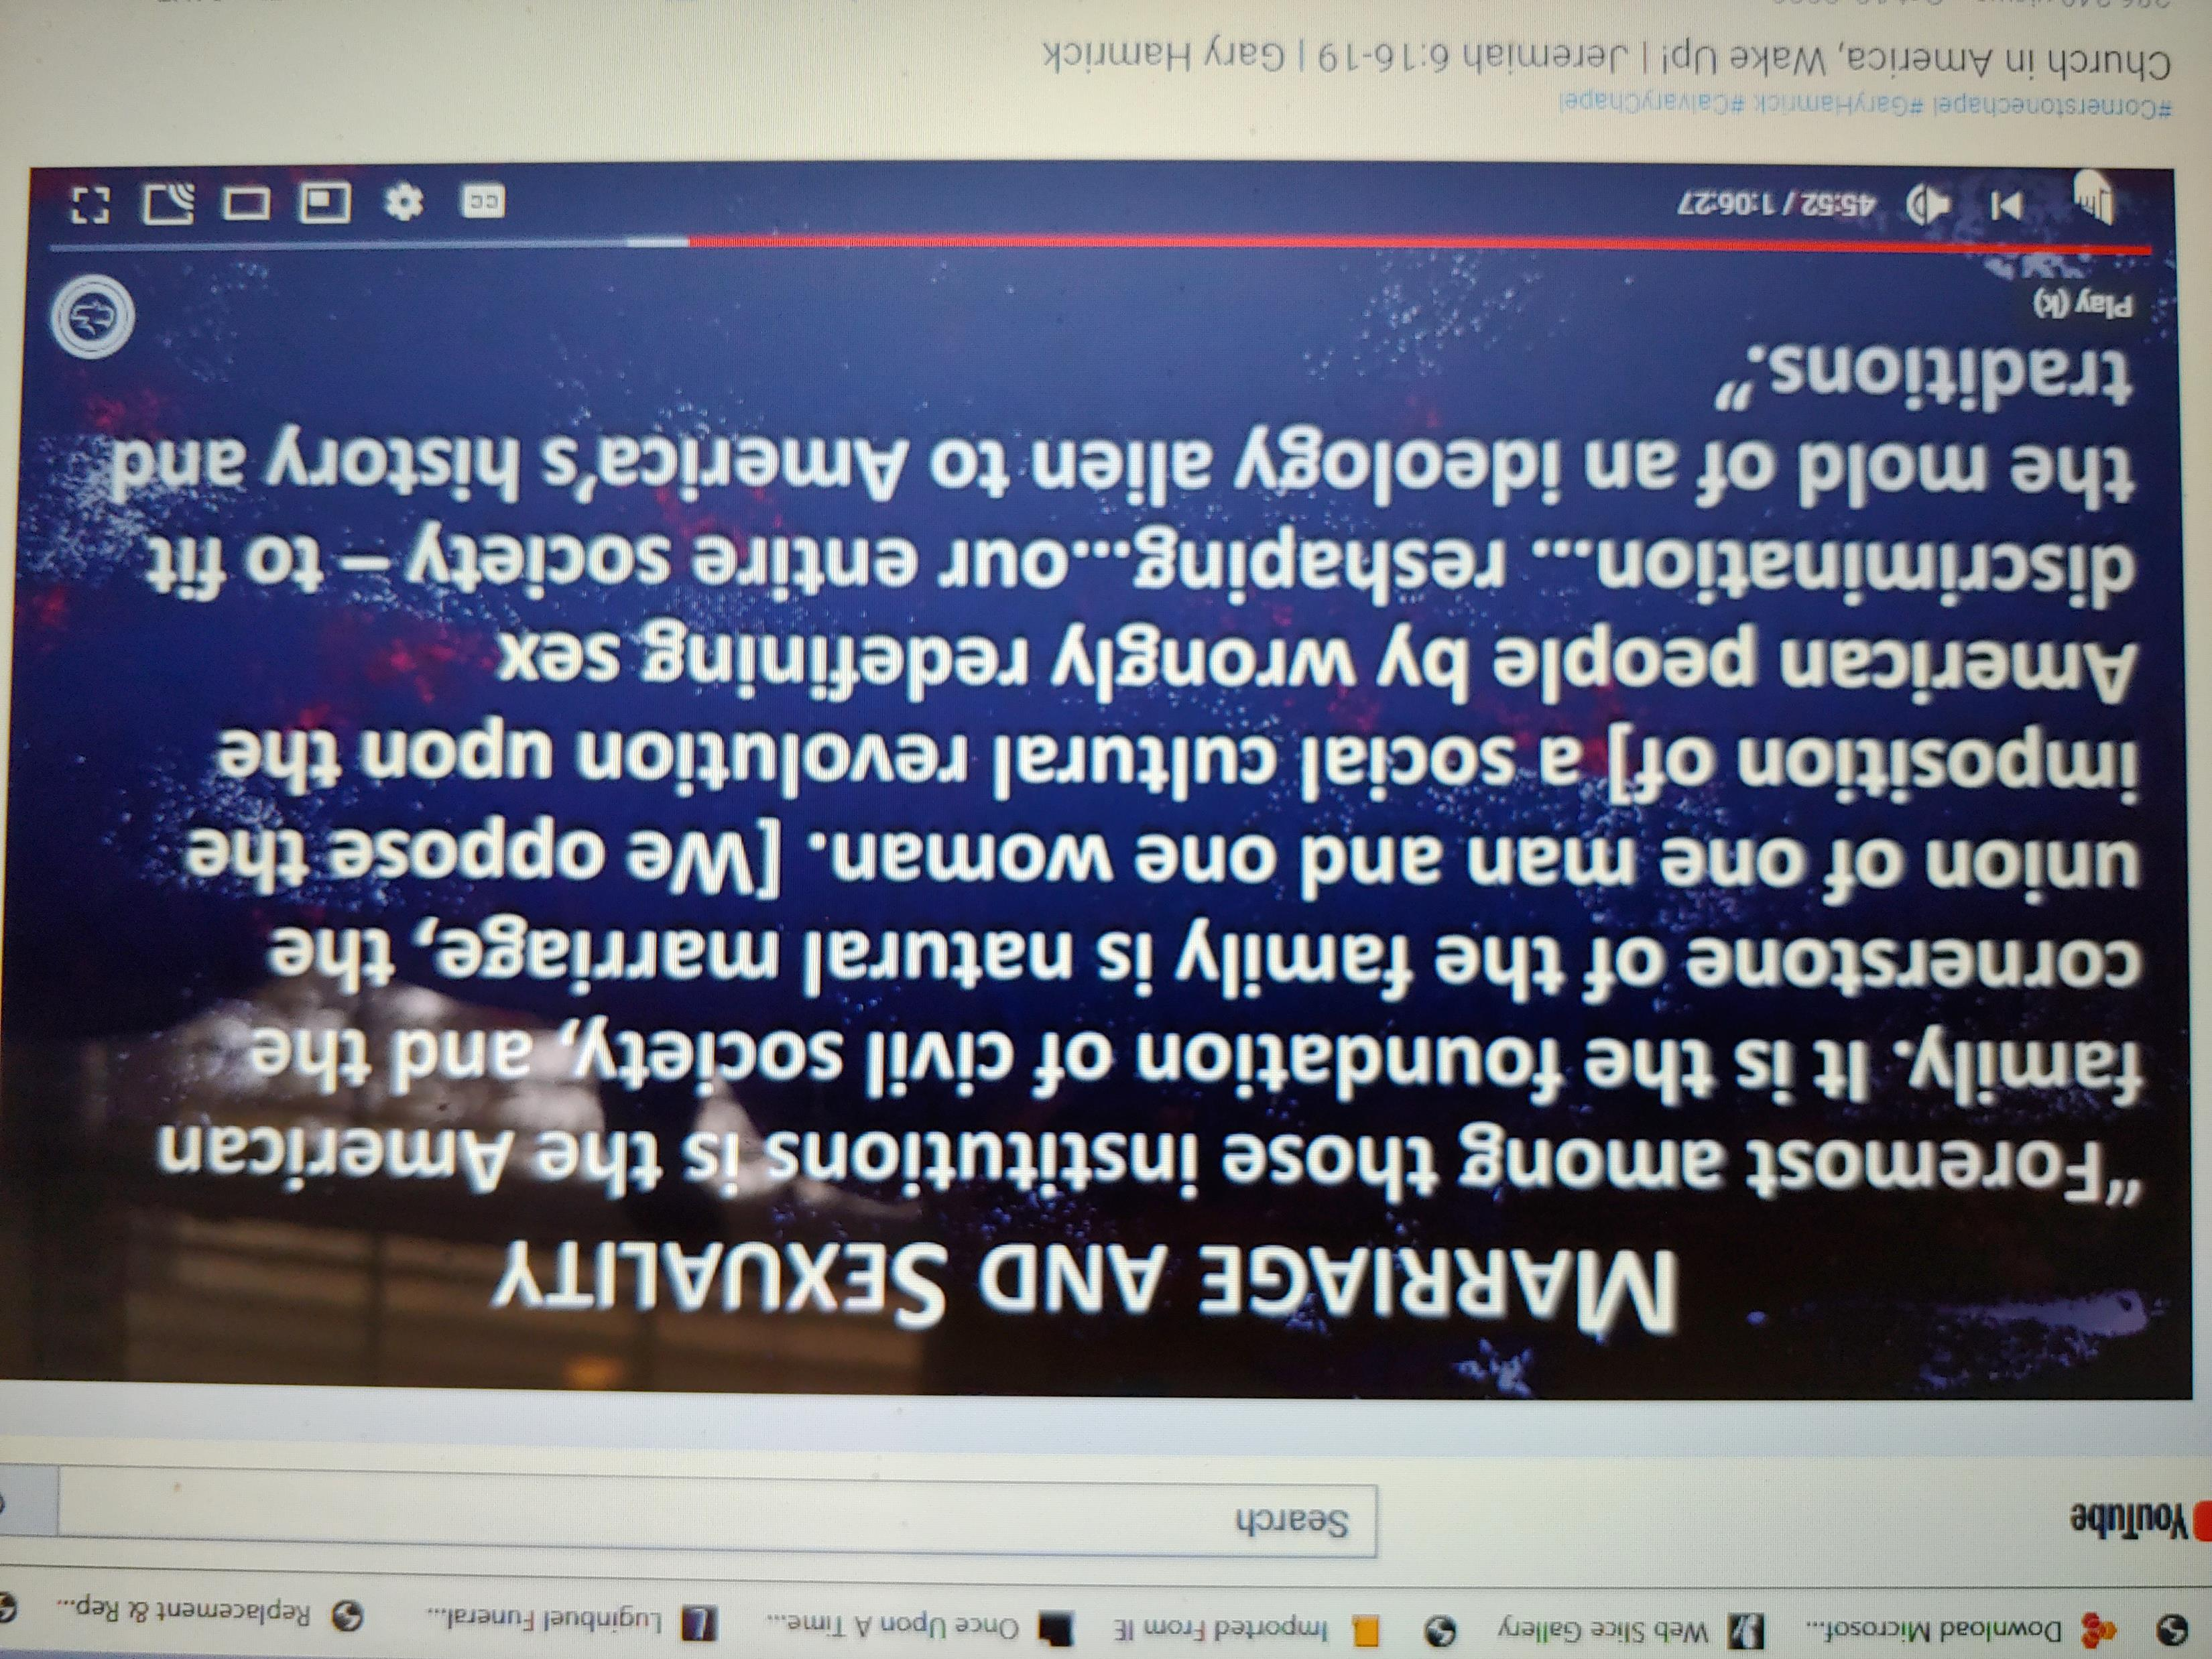

Slide 10
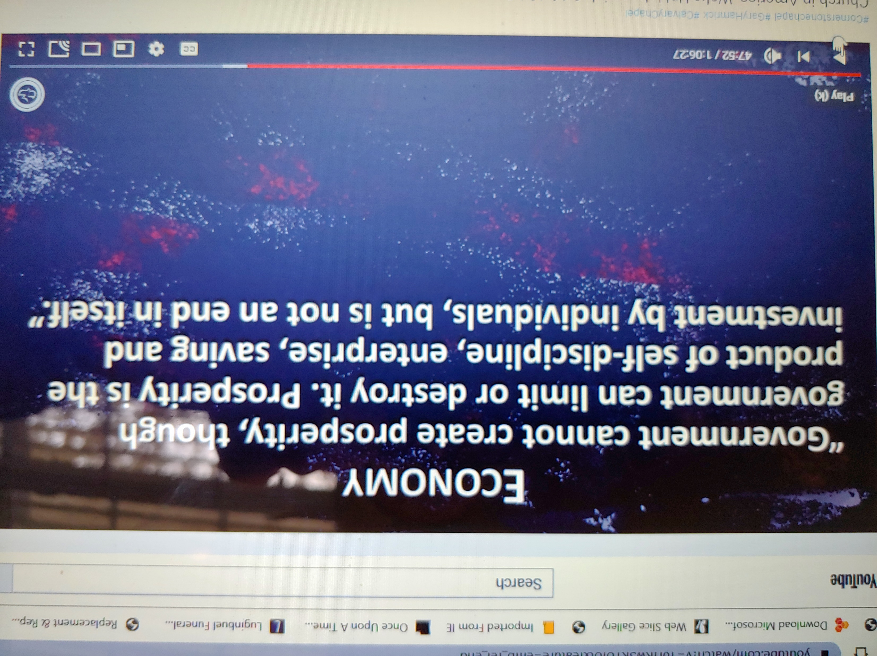

Slide 11
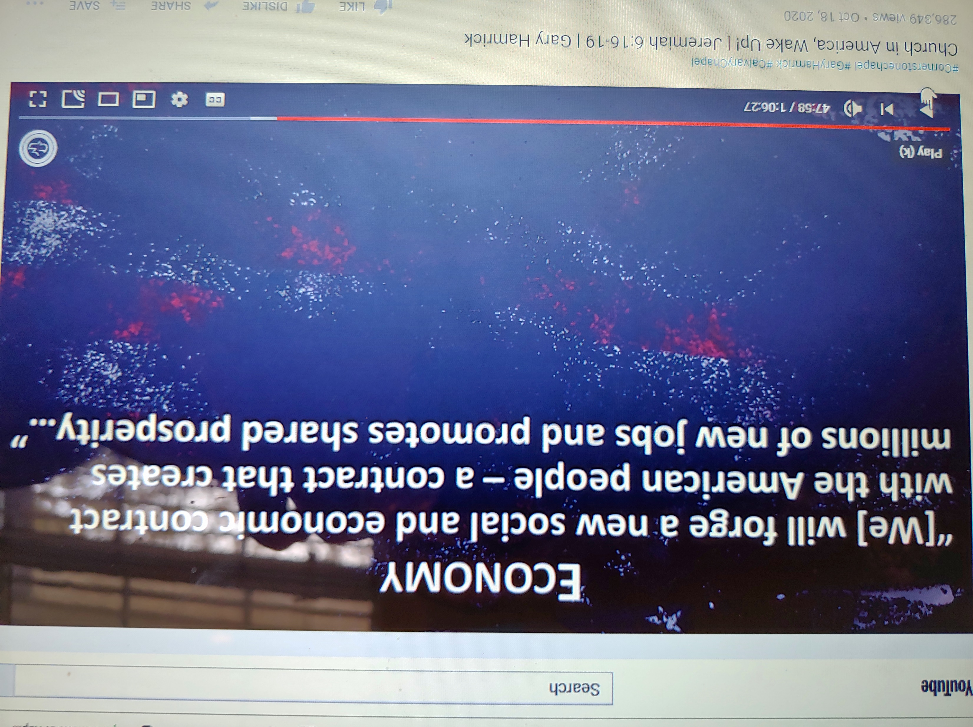

Slide 12
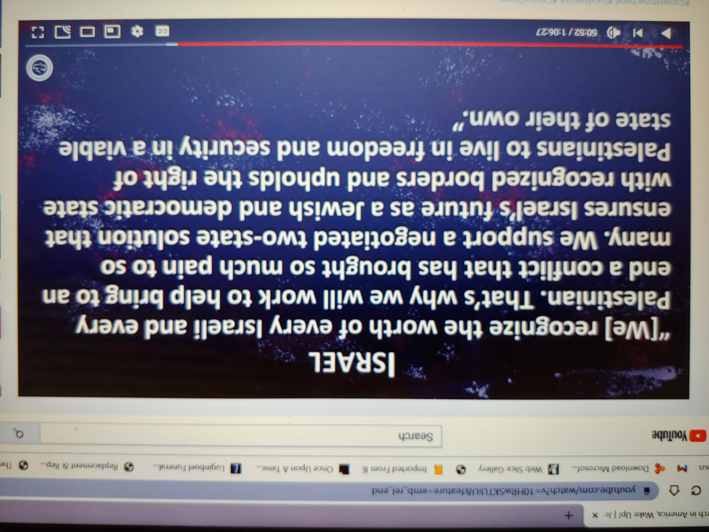

Slide 13
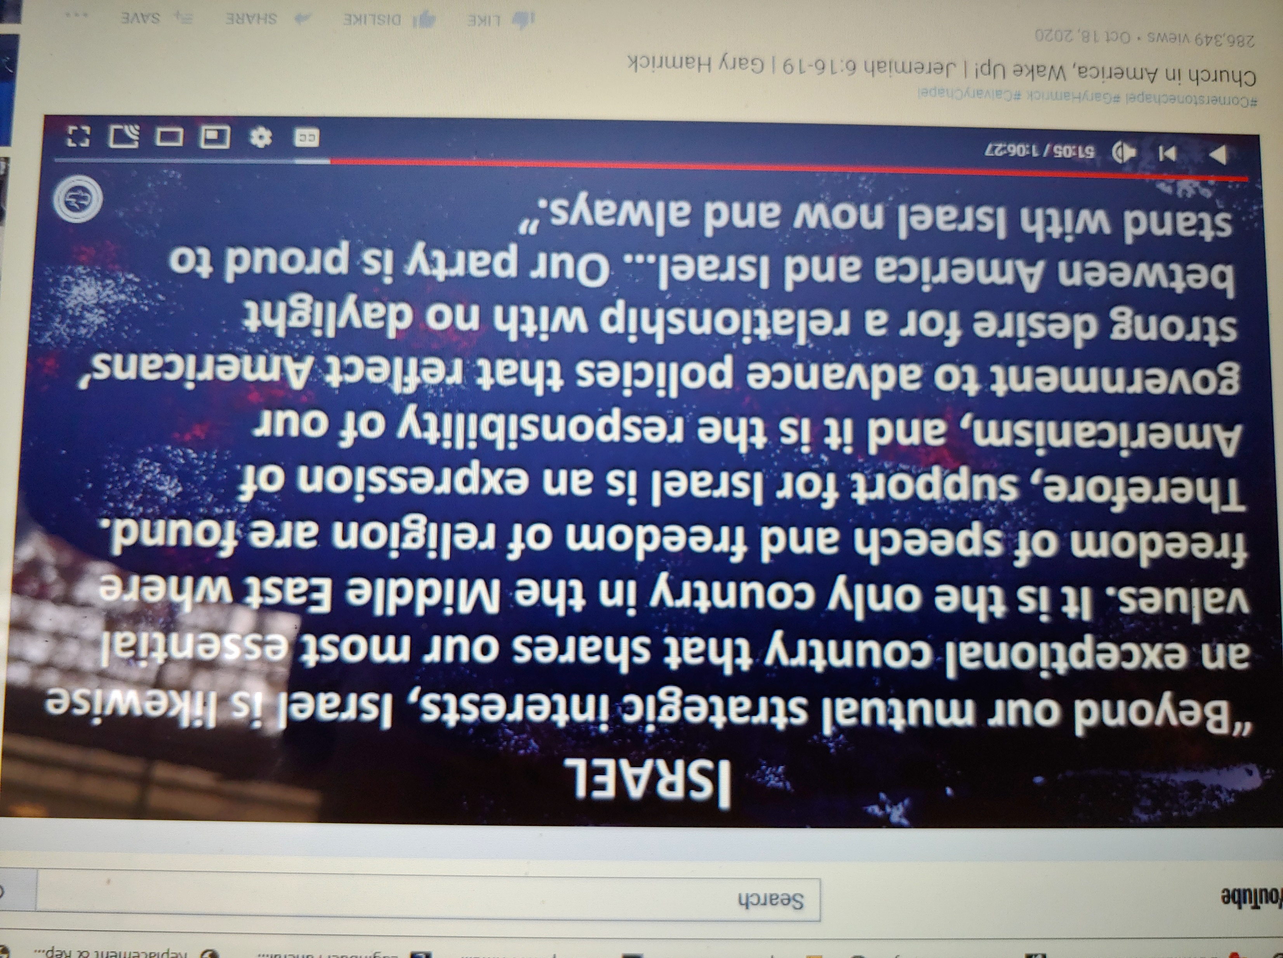

Slide 14
Romans 1:16-22

Slide 15
Reasons For God’s Wrath
Against Humanity
Spiritual Revelation vs. 19
Chosen Rejection vs. 21
Intellectual Rationalization vs. 22
Manmade Religion vs. 23

