Slide 1
Encouraging Language Revitalization through Education & Bible Translation with the Ap Ma of PNG
Jill Riepe
Pioneer Bible Translators

Slide 2
Introduction
Ap Ma
Papuan language
East Sepik Province
7,000 speakers

Slide 4
Searching for speakers
Allocated to Punyaton in 2009
Fluent speakers are grandparents
8a moribund and severely endangered

Slide 5
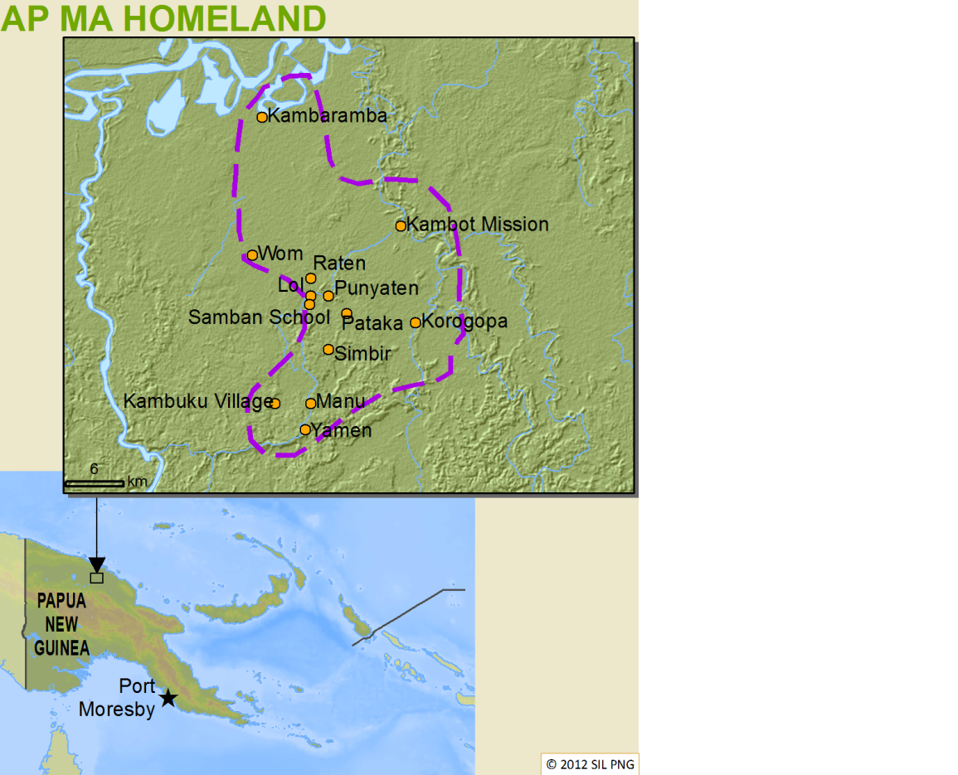

Slide 6
History of Interaction
Initial outside contact during WWII
Several missionaries interacting mainly through Tok Pisin.
Pioneer Bible Translators began translation and linguistic work in the late 1970s.

Slide 7
Pryor’s research
Domains of usage for Ap Ma in 1995
In the home & church
For trade within the language group
Domains of usage for Ap Ma in 2009
For ceremonial purposes only

Slide 8
Wade’s research
1980s
Survey of the 15 villages
Teenagers fluent in Ap Ma

Slide 9
Pryor’s research
Cause for concern
Ap Ma had very low status compared to English and Tok Pisin in 1995
Education system of 1995 strengthened Tok Pisin
Esteemed missionary children speak Tok Pisin

Slide 10
Searching for speakers
Language learning difficulties
Technological advances strengthens Tok Pisin
Advanced education strengthens Tok Pisin and English

Slide 11
Reading in Ap Ma
In homes
In church

Slide 12
Traditional & Historical Stories
Recording & transcribing
Creating small booklets made available to the community and used in the schools

Slide 13
Curriculum
Providing translating support for OIPNG to create prep – Grade 2 curriculum
Bilingual
English
Ap Ma

Slide 14
Dictionaries
Picture dictionary
poai
klaut
cloud
nii gadçma
renbo
rainbow
gçdçma
sta
star

Slide 15
Dictionaries
Trilingual dictionary
WeSay
aukop Verb. to be afraid; pret. Ñiba Wewak dama sap kal gçpai lçba ñewa motop ma, masil ñiba aukap ma. I went to Wewak and the thieves want to kill me so I'm afraid. Mi go long Wewak na ol stilman i laik kilim mi, olsem na mi pret.

Slide 16
Song book
Collecting songs and creating a book available for the community and used in the schools.

Slide 17
Translation
Translated portions of the Old Testament and New Testament to provide more opportunities to read in the vernacular.

Slide 18
Further research
Survey the remaining villages
Reevaluate the language situation in Samban and Punyaton
Analyze potential language change

Slide 19
References
Clarkson, Philip. 1992. Language and mathematics: A comparison of bilingual and monolingual students of mathematics. Educational Studies in Mathematics 23(4): 417-429.
Lewis, M. Paul (ed.). 2009. Ethnologue: Languages of the world. 16th edition. Dallas: SIL International.
Lewis, M. Paul & Simons, Gary. F. 2010. Assessing endangerment: Expanding Fishman's GIDS. Romanian Review of Linguistics 55(2): 103-120.
National Department of Education. 1992. The education reform. Port Moresby: National Department of Education.
Pryor, John. 1990. Deixis and participant tracking in Botin. Language and Linguistics in Melanesia 21:1-29.
Pryor, John & Bonita Pryor. 1995. Anthropological background study of the Ap Ma (Kambot/Botin) people. Unpublished manuscript. Madang, Papua New Guinea: Pioneer Bible Translators.
Wade, Martha. 1981. A dialect survey of the Botin language. Unpublished manuscript. Madang, Papua New Guinea: Pioneer Bible Translators.

Slide 20
Any questions?
Thank you!

