Slide 1
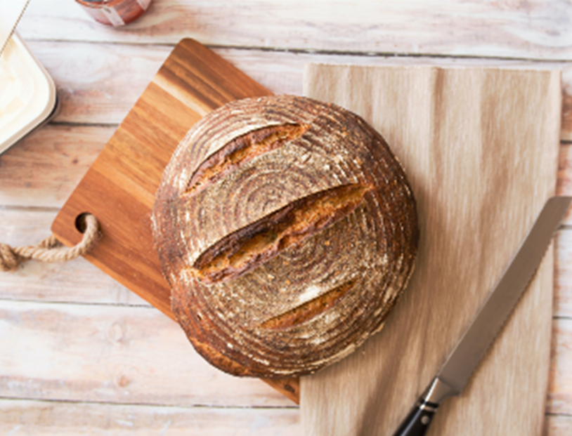
Welcome in the Name of
The Triune God
February 13, 2022
The Bread of Life
Prelude by Roxanne Groff
Office of the Acolyte
Ringing of the Bell
Scripture Focus: John 6:35-59
Notes:
Image: Preparing yeast dough. Copyright © tomasworks/iStock/Thinkstock. Used by permission.

Slide 2
CONFESSION AND FORGIVENESS
All may make the sign of the cross, the sign marked at baptism…
P: We confess our sins before God and one another.
Pause for silence and reflection.
P: Merciful God,
Notes:
Image: Five Loaves by Caroline Coolidge Brown. Copyright © Caroline Coolidge Brown. All rights reserved. Used by permission of the artist.

Slide 3
CONFESSION AND FORGIVENESS
C: Jesus shows us all the ways that we fall short. He also provides a way out of the holes we dig ourselves into. Forgive us our sins, and show us how to make better choices, be better friends, parents, kids, partners, and co-workers. Let Christ’s light shine through us, for the sake of Jesus we pray. Amen.
Notes:
Image: Five Loaves by Caroline Coolidge Brown. Copyright © Caroline Coolidge Brown. All rights reserved. Used by permission of the artist.

Slide 4
CONFESSION AND FORGIVENESS
L: Jesus does, indeed, forgive. Jesus cleanses us of our sin and recreates us in God’s image. Receive the entire forgiveness of all your sins. Go, and walk free of guilt, shame, and sin. You are made new! In Jesus’ name we pray.
C: Amen.
Notes:
Image: Five Loaves by Caroline Coolidge Brown. Copyright © Caroline Coolidge Brown. All rights reserved. Used by permission of the artist.

Slide 5
Hymn of Praise
“Just As I Am, Without One Plea”
LBW 296
Notes:
Image: Five Loaves by Caroline Coolidge Brown. Copyright © Caroline Coolidge Brown. All rights reserved. Used by permission of the artist.

Slide 6
Just As I Am LBW 296 (Verses 1, 2, 5, & 6 Only)
1 Just as I am, without one plea,
but that thy blood was shed for me,
and that thou bidd’st me come to thee,
O Lamb of God, I come, I come.
2 Just as I am, and waiting not
to rid my soul of one dark blot,
to thee, whose blood can cleanse each spot,
O Lamb of God, I come, I come.
Notes:
Image: Five Loaves by Caroline Coolidge Brown. Copyright © Caroline Coolidge Brown. All rights reserved. Used by permission of the artist.

Slide 7
Just As I Am LBW 296 (Verses 1, 2, 5, & 6 Only)
5 Just as I am, thou wilt receive,
wilt welcome, pardon, cleanse, relieve;
because thy promise I believe,
O Lamb of God, I come, I come,
6 Just as I am; thy love unknown
has broken ev’ry barrier down;
now to be thine, yea, thine alone,
O Lamb of God, I come, I come.
Notes:
Image: Five Loaves by Caroline Coolidge Brown. Copyright © Caroline Coolidge Brown. All rights reserved. Used by permission of the artist.

Slide 8
APOSTOLIC GREETING
P: The grace of our Lord Jesus Christ, the love of God, and the communion of the Holy Spirit be with you all.
C: And also with you.
Notes:
Image: Five Loaves by Caroline Coolidge Brown. Copyright © Caroline Coolidge Brown. All rights reserved. Used by permission of the artist.

Slide 9
PRAYER OF THE DAY
P: Let us pray… God of sustenance, You sent your son, Jesus, to be living bread for the world. Give us your living bread, that we may consume, and then share your everlasting life with others, for the sake of Jesus Christ, our savior and Lord.
C: Amen.
Notes:
Image: Five Loaves by Caroline Coolidge Brown. Copyright © Caroline Coolidge Brown. All rights reserved. Used by permission of the artist.

Slide 10
Notes:
Image: Preparing yeast dough. Copyright © tomasworks/iStock/Thinkstock. Used by permission.

Slide 11
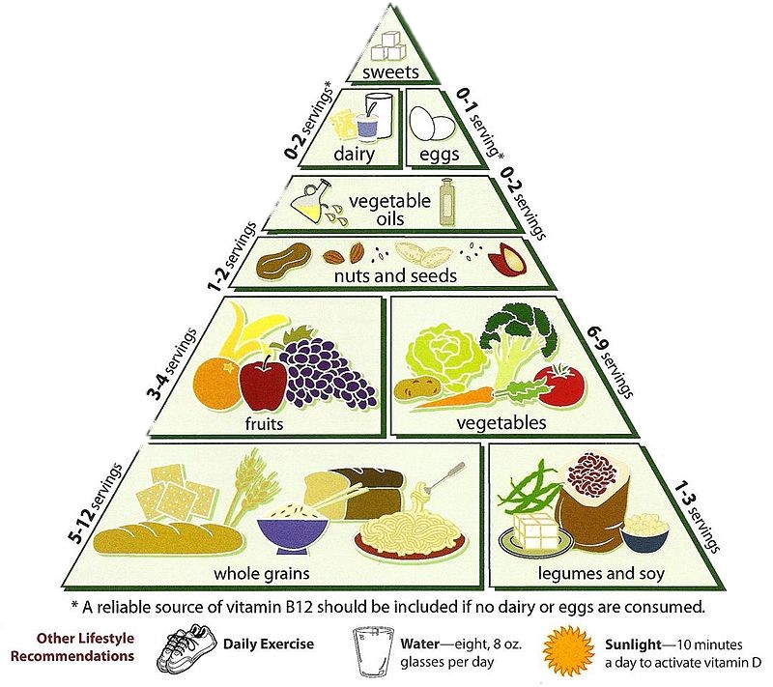
Notes:
Image: Preparing yeast dough. Copyright © tomasworks/iStock/Thinkstock. Used by permission.

Slide 12
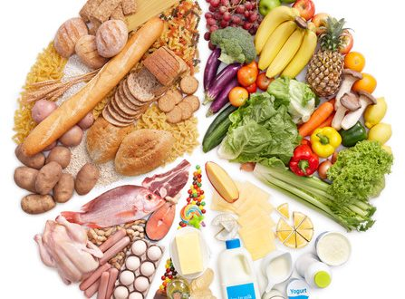
Notes:
Image: Preparing yeast dough. Copyright © tomasworks/iStock/Thinkstock. Used by permission.

Slide 13
Scripture Reading
R: The Scripture reading is from the Gospel according to Saint John, the 6th chapter.
C: Glory to you O’ Lord! (Spoken)
Notes:
Image: Five Loaves by Caroline Coolidge Brown. Copyright © Caroline Coolidge Brown. All rights reserved. Used by permission of the artist.

Slide 14
John 6:35-49
³⁵Jesus said to them, “I am the bread of life. Whoever comes to me will never be hungry, and whoever believes in me will never be thirsty. ³⁶But I said to you that you have seen me and yet do not believe. ³⁷Everything that the Father gives me will come to me, and anyone who comes to me I will never drive away; ³⁸for I have come down from heaven, not to do my own will, but the will of him who sent me. ³⁹And this is
Notes:
Image: Five Loaves by Caroline Coolidge Brown. Copyright © Caroline Coolidge Brown. All rights reserved. Used by permission of the artist.

Slide 15
John 6:35-49
the will of him who sent me, that I should lose nothing of all that he has given me, but raise it up on the last day. ⁴⁰This is indeed the will of my Father, that all who see the Son and believe in him may have eternal life; and I will raise them up on the last day.” ⁴¹Then the Jews began to complain about him because he said, “I am the bread that came down from heaven.” ⁴²They were saying, “Is not
Notes:
Image: Five Loaves by Caroline Coolidge Brown. Copyright © Caroline Coolidge Brown. All rights reserved. Used by permission of the artist.

Slide 16
John 6:35-49
this Jesus, the son of Joseph, whose father and mother we know? How can he now say, ‘I have come down from heaven’?” ⁴³Jesus answered them, “Do not complain among yourselves. ⁴⁴No one can come to me unless drawn by the Father who sent me; and I will raise that person up on the last day. ⁴⁵It is written in the prophets, ‘And they shall all be taught by God.’ Everyone who has heard and learned from the Father
Notes:
Image: Five Loaves by Caroline Coolidge Brown. Copyright © Caroline Coolidge Brown. All rights reserved. Used by permission of the artist.

Slide 17
John 6:35-49
comes to me. ⁴⁶Not that anyone has seen the Father except the one who is from God; he has seen the Father. ⁴⁷Very truly, I tell you, whoever believes has eternal life. ⁴⁸I am the bread of life. ⁴⁹Your ancestors ate the manna in the wilderness, and they died. ⁵⁰This is the bread that comes down from heaven, so that one may eat of it and not die. ⁵¹I am the living bread that came down from heaven. Whoever
Notes:
Image: Five Loaves by Caroline Coolidge Brown. Copyright © Caroline Coolidge Brown. All rights reserved. Used by permission of the artist.

Slide 18
John 6:35-49
eats of this bread will live forever; and the bread that I will give for the life of the world is my flesh.” ⁵²The Jews then disputed among themselves, saying, “How can this man give us his flesh to eat?” ⁵³So Jesus said to them, “Very truly, I tell you, unless you eat the flesh of the Son of Man and drink his blood, you have no life in you. ⁵⁴Those who eat my flesh and drink my blood have eternal life, and I will raise them up on
Notes:
Image: Five Loaves by Caroline Coolidge Brown. Copyright © Caroline Coolidge Brown. All rights reserved. Used by permission of the artist.

Slide 19
John 6:35-49
the last day; ⁵⁵for my flesh is true food and my blood is true drink. ⁵⁶Those who eat my flesh and drink my blood abide in me, and I in them. ⁵⁷Just as the living Father sent me, and I live because of the Father, so whoever eats me will live because of me. ⁵⁸This is the bread that came down from heaven, not like that which your ancestors ate, and they died. But the one who eats this bread will live forever.”
Notes:
Image: Five Loaves by Caroline Coolidge Brown. Copyright © Caroline Coolidge Brown. All rights reserved. Used by permission of the artist.

Slide 20
John 6:35-49
⁵⁹He said these things while he was teaching in the synagogue at Capernaum.
P: This is the Gospel of the Lord.
C: Praise to You, O Christ (Spoken)
Notes:
Image: Five Loaves by Caroline Coolidge Brown. Copyright © Caroline Coolidge Brown. All rights reserved. Used by permission of the artist.

Slide 21
SERMON
Notes:
Image: Five Loaves by Caroline Coolidge Brown. Copyright © Caroline Coolidge Brown. All rights reserved. Used by permission of the artist.

Slide 22
APOSTLE’S CREED
C: I believe in God, the Father almighty, creator of heaven and earth.

Slide 23
APOSTLE’S CREED
C: I believe in Jesus Christ, his only Son, our Lord. He was conceived by the power of the Holy Spirit and born of the virgin Mary. He suffered under Pontius Pilate, was crucified, died, and was buried.

Slide 24
APOSTLE’S CREED
C: He descended into hell. On the third day he rose again. He ascended into heaven, and is seated at the right hand of the Father. He will come again to judge the living and the dead.

Slide 25
APOSTLE’S CREED
C: I believe in the Holy Spirit, the holy catholic Church, the communion of saints, the forgiveness of sins, the resurrection of the body, and the life everlasting. Amen.

Slide 26
NICENE CREED
C: We believe in one God, the Father, the Almighty, maker of heaven and earth, of all that is, seen and unseen.

Slide 27
NICENE CREED
C: We believe in one Lord, Jesus Christ, the only Son of God, eternally begotten of the Father, God from God, Light from Light, true God from true God, begotten, not made, of one Being with the Father.

Slide 28
NICENE CREED
C: Through him all things were made. For us and for our salvation he came down from heaven; by the power of the Holy Spirit he became incarnate from the virgin Mary, and was made man. For our sake he was crucified under Pontius Pilate;

Slide 29
NICENE CREED
C: he suffered death and was buried. On the third day he rose again in accordance with the Scriptures; he ascended into heaven and is seated at the right hand of the Father. He will come again in glory to judge the living and the dead, and his kingdom will have no end.

Slide 30
NICENE CREED
C: We believe in the Holy Spirit, the Lord, the giver of life, who proceeds from the Father and the Son. With the Father and the Son he is worshiped and glorified. He has spoken through the prophets. We believe in one holy catholic and apostolic Church.

Slide 31
NICENE CREED
C: We acknowledge one Baptism for the forgiveness of sins. We look for the resurrection of the dead, and the life of the world to come. Amen.

Slide 32
PRAYERS OF INTERCESSION
Each petition will end with the words,
A: Lord, in your mercy,
The congregation will respond with:
C: Hear our prayer.

Slide 33
PRAYERS OF INTERCESSION
The prayer concludes…
P: Grateful for your everlasting faithfulness, we lift our hearts and our prayers to you, merciful God, in the name of your son, Jesus Christ.
C: Amen.

Slide 34
SHARING OF THE Peace
The Sharing of the Peace that began when the congregation arrived is now shared with the Pastor at this time...
P: The peace of the Lord be with you always.
C: And also with you.

Slide 35
OFFERING PRAYER
Notes:
Image: Five Loaves by Caroline Coolidge Brown. Copyright © Caroline Coolidge Brown. All rights reserved. Used by permission of the artist.

Slide 36
THE LORD’S PRAYER
P: Jesus is the “tie that Binds us together”, let us pray as Jesus taught…
C: Our Father, who art in heaven, hallowed be thy name, thy kingdom come, thy will be done, on earth as it is in heaven. Give us this day our daily bread; and forgive us our trespasses,

Slide 37
THE LORD’S PRAYER
C: as we forgive those who trespass against us; and lead us not into temptation, but deliver us from evil. For thine is the kingdom, and the power, and the glory, forever and ever. Amen.

Slide 38
ANNOUNCEMENTS
Notes:
Image: Five Loaves by Caroline Coolidge Brown. Copyright © Caroline Coolidge Brown. All rights reserved. Used by permission of the artist.

Slide 39
SENDING BLESSING
P: God, who leads you in pathways of righteousness, who rejoices over you, and who calls you by name, ☩ bless your going out and your coming in, today and forever.
C: Amen.

Slide 40
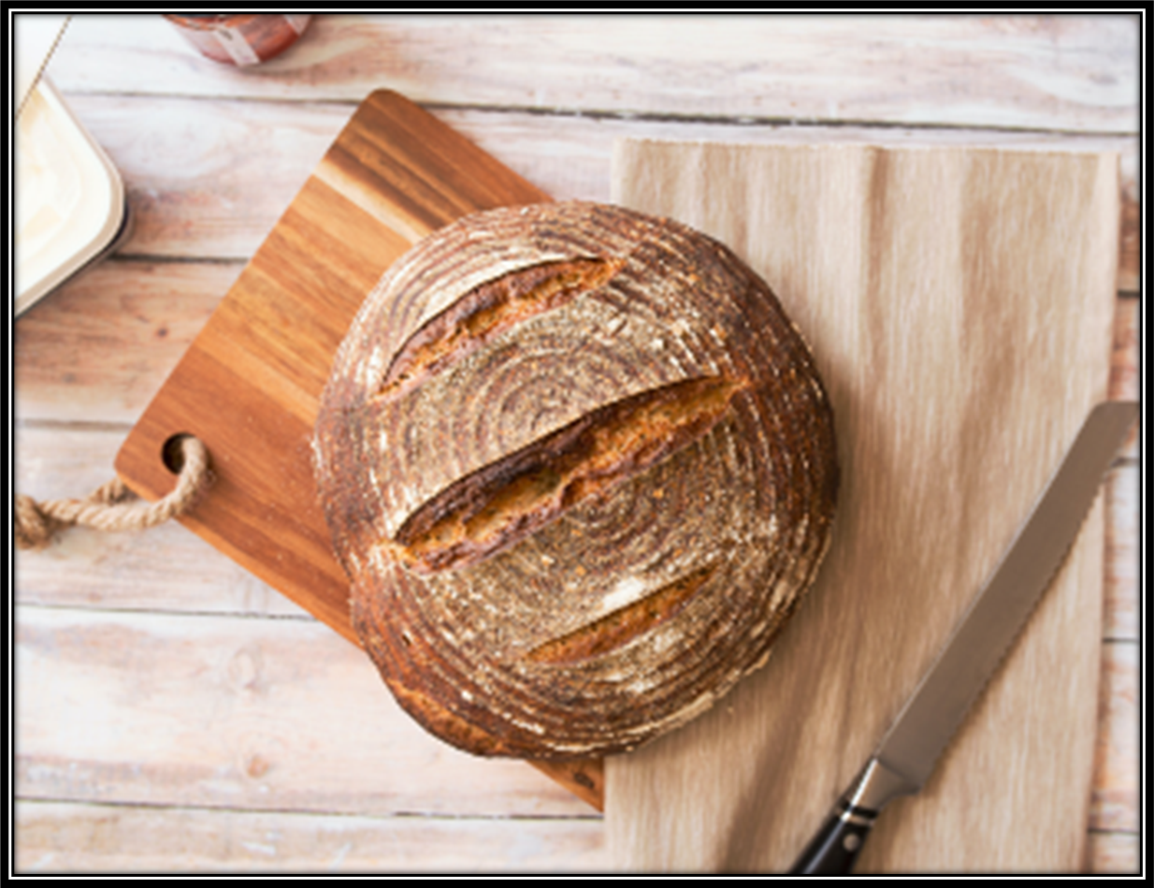
SENDING SONG
“Sent Forth by God’s Blessing”
LBW 221
Notes:
Image: Five Loaves by Caroline Coolidge Brown. Copyright © Caroline Coolidge Brown. All rights reserved. Used by permission of the artist.

Slide 41
Sent Forth By God’s Blessing ELW 547
1 Sent forth by God's blessing,
our true faith confessing,
the people of God from this dwelling take leave.
The supper is ended.
Oh, now be extended
the fruits of this service in all who believe.

Slide 42
Sent Forth By God’s Blessing ELW 547
1 The seed of Christ's teaching,
receptive souls reaching,
shall blossom in action for God and for all.
Your grace shall incite us,
your love shall unite us
to work for your kingdom and answer your call.

Slide 43
Sent Forth By God’s Blessing ELW 547
2 With praise and thanksgiving
to God ever-living,
the tasks of our ev'ryday life we will face—
our faith ever sharing,
in love ever caring,
embracing God's children, the whole human race.

Slide 44
Sent Forth By God’s Blessing ELW 547
2 With your feast you feed us,
with your light now lead us;
unite us as one in this life that we share.
Then may all the living
with praise and thanksgiving
give honor to Christ and his name that we bear.

Slide 45
DISMISSAL
P: Until we gather again as God’s people to offer our worship and praise, depart in Christ’s Love,
C: Seeking, welcoming, and serving all. Amen!
Postlude by Roxanne Groff
Copyright © 2022 Augsburg Fortress. All rights reserved. Reprinted by permission under Augsburg Fortress Liturgies Annual License #SAS023830. New Revised Standard Version Bible, Copyright © 1989, Division of Christian Education of the National Council of the Churches of Christ in the United States of America. Used by permission. All rights reserved. Revised Common Lectionary, Copyright © 1992 Consultation on Common Texts, admin Augsburg Fortress. Used by permission.

